Slide 1
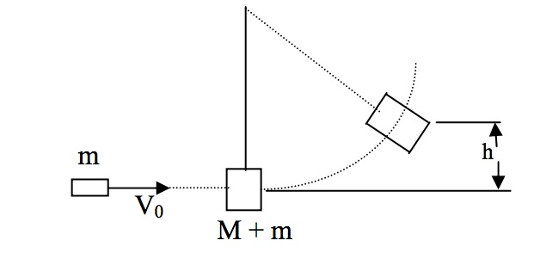
Scrolling Physics in Flutter

Slide 2
Scroll Physics
Acts a bit like a Ballistic Pendulum
Flutter has a Scroll Physics Class
Scroll Physics Class has a create Ballistic Simulation Method
Describes how the view port should react to the users initial movement

Slide 3
The Simulation Class
A generalized Simulation for an Object in one dimensional space.
Exposes the object’s position ‘x’ and velocity ‘dx’.
Has an isDone method to determine when the simulation should be finished.
Simulations can be stateless

Slide 4
Layout Builder Widget and Constraints
A builder Widget which uses the parent widget’s constraints to build a widget tree
Works like Glue in the framework
Defers the building until Layout
Constraints have both a minimum and maximum size for both width and height
When laying out widgets, the box constraints object is passed down the tree to determine the size of these widgets

