Slide 1
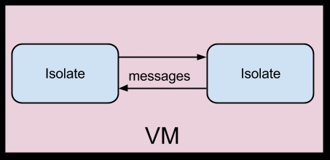
Advanced Isolates in Flutter

Slide 2
What are Isolates
Dart’s version of Threads or Actors
Based on the Erlang/Elixir Actor Model
They are Isolated Processes
Does not Share Memory
Makes use of Ports and Messages to Communicate with other Isolates

Slide 3
The Flutter Engine
The Flutter Engine is split into Four Task Runners
These task runners typically run on their own threads
These Task runners/Threads help Flutter Avoid Jank and Slowdown
Only specific Task runners can do specific things
Distributed in a way that prevents blocking

Slide 4
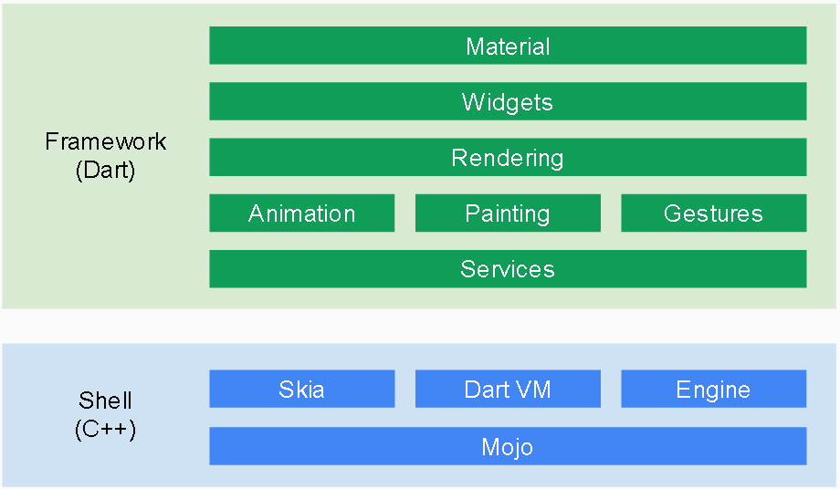
Break Down of the Platform

