Slide 1
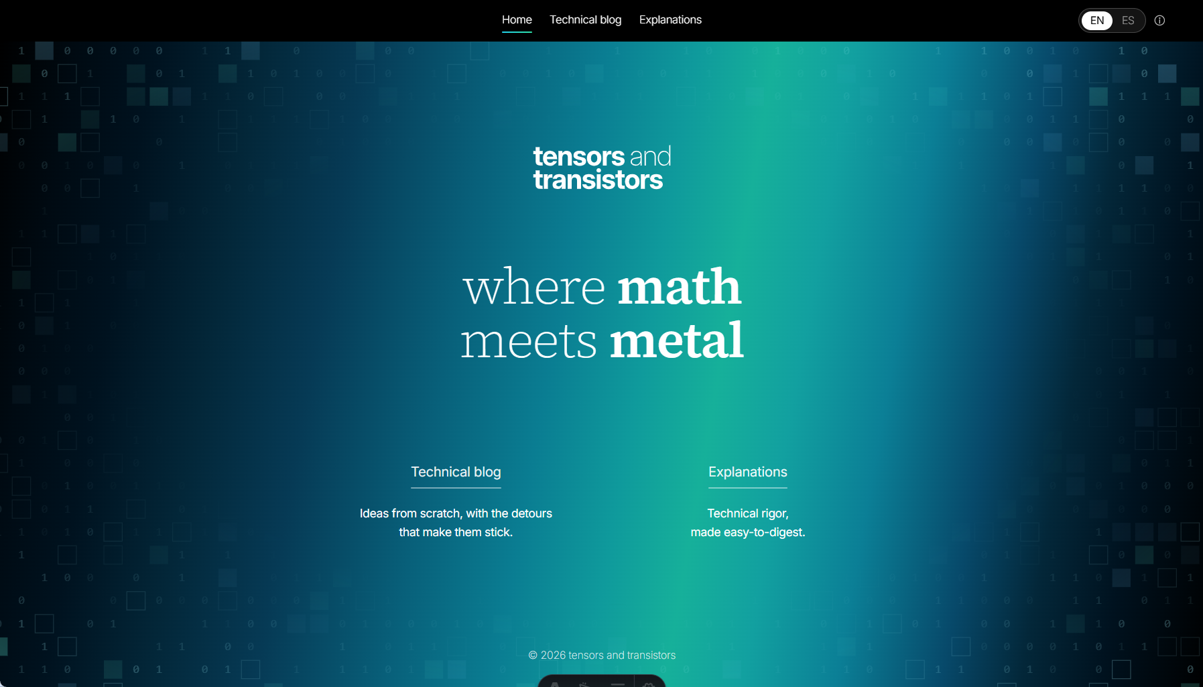


Main panel-bar should dissapear for home, when somene gets in. Only preserve the language toggle
Resize and reposition the logo. Include a soft transition
Make the square size in the background a Little bit smaller.
I need 2 cards softly rounded squares here
I need this kind on visual pixeled cards. Make native designs in pixel-style but respect the color pallete.
Technical Blog
Explanations
Description for technical blog
Description for explanations

Slide 2

