Slide 1


Team Details
  Team name:
  Team leader name:
  Problem Statement: Merchants can't yet let AI act safely on refunds, messy B2B orders and AI-shopper traffic.

Slide 2
Brief about the idea
ACS, the Autonomous Commerce Suite, is a team of AI agents that runs a merchant's back office: it answers refunds, turns plain-English policy into tested rules, converts messy purchase orders into ERP sales orders, and audits storefronts for AI shoppers. Agents propose; deterministic rules decide; humans approve anything risky.
1
2
3
4
5
ACS Orchestrator
Rule Engine
Policy Compiler
Messy-Order agent
Readiness Auditor
Google ADK agent that chats with staff and routes work to the other agents.
CEL rules give the same answer every time, with rule ids and versions.
Gemini turns policy text into CEL rules, then tests them.
Gemini reads PDFs and voice notes; SKUs are matched exactly or by vector search.
Playwright walks shopper journeys, scores the store and suggests fixes.
Live on Google Cloud: Cloud Run (scale to zero) · Firestore · Pub/Sub · Workflows · BigQuery · Gemini — all within the free tier.

Slide 3
Opportunities
How is it different?
How does it solve the problem?
USP
Most AI commerce tools let the model make the decision. ACS never does: refunds and order approval come from versioned CEL rules.
Policies are compiled and tested before deploy, so business users change behaviour without code.
One system covers both kinds of new traffic: AI shoppers (UCP, A2A) and messy B2B orders.
Refunds: instant, explainable decisions that cite the rule and version.
B2B orders: PDF or voice → extracted lines → catalog SKUs → draft order in Odoo.
Storefronts: a readiness score per journey, plus fixes ranked by severity.
Anything uncertain goes to a human review queue.
Built to be safe: tenant isolation, roles, idempotency, a safety gate before Odoo, and always-on guards.
Auditable: every decision is logged and lands in BigQuery.
Runs on the Google Cloud free tier and scales to zero.

Slide 4
List of features offered by the solution
1
Merchant Assistant
2
Deterministic refunds
3
Policy-as-Code
Chat with the orchestrator. It calls tools for audits, policies, refunds and PO status, and shows live progress for each step.
CEL rule engine decides APPROVE, DENY or ESCALATE. Idempotency keys stop double payouts; unverified high-value claims always escalate.
Plain-English policy becomes JSON-schema CEL rules. Auto-generated tests, human approval, and versioned deploys live within 30 s.
4
Messy PO intake
5
Review & ERP posting
6
Agent-readiness audits
Upload a PDF or voice note, or receive one in the Gmail inbox. Gemini extracts the lines; SKUs are matched by exact alias, then vector search.
Draft orders queue for review: correct SKUs, approve or reject. Cloud Workflows posts to Odoo behind a safety gate.
Playwright simulates AI-shopper journeys, checks UCP and schema.org, scores 0–100, and Gemini writes the fixes.

Slide 5
Process flow diagram or Use-case diagram
Purchase order → ERP (Messy-Order agent)
PO arrives
(upload, Gmail, voice)
Stored in GCS,
published to Pub/Sub
Gemini extracts
lines & terms
SKU match:
exact → vector
Rule engine:
order_terms
Auto-post or
human review
Safety gate →
Odoo quotation
Policy lifecycle (Policy-as-Code Compiler)
Admin writes
policy in English
A2A call to
compiler agent
Gemini → CEL rules
(JSON schema)
Tests run on
rule engine
Human reviews
& approves
Versioned deploy
(live in 30 s)
Refunds and shopper agents go through the same rule engine; anything not approved by a rule is escalated to a person.

Slide 6
Wireframes/Mock diagrams of the proposed solution (optional)
Pages, filtered by role
Assistant
Assistant
Page | Minimum role
Assistant | viewer+
Draft orders | viewer · review: admin
PO intake | viewer · upload: analyst
Policies | admin
Store audits | viewer · start: analyst
Refunds | analyst+
Draft orders
PO intake
Policies
Store audits
Refunds
⚙ Rule engine decision
The orchestrator enforces the same role table on the server, so hiding a page is never the only control.
user · merchant m1 · admin

Slide 7
Architecture diagram of the proposed solution
CHANNELS
FRONT DOOR
ORCHESTRATOR
AGENTS (Cloud Run)
DATA & ERP
AI shopper agents
UCP · A2A
Firebase Hosting + Auth
ID tokens with merchant & role claims
ACS Orchestrator
Google ADK on Cloud Run
sessions · tenancy · roles · idempotency · audit log
Readiness Auditor
Playwright + Gemini · A2A
BigQuery
scores · audit log
Policy Compiler
Gemini + JSON Schema · A2A
Firestore
rules · sessions · SKU vectors
Merchant Console
React on Firebase
API Gateway
JWT check, quotas, one front door
Rule Engine
CEL · deterministic
Cloud Storage
raw POs
B2B inbox
Gmail · PDF · voice
Messy-Order agent
Gemini multimodal · Pub/Sub push
Workflows → Odoo
ERP bridge + safety gate
Gemini Flash powers every LLM step; Cloud Tasks queues audits; Secret Manager holds credentials; Terraform builds all of it.

Slide 8
Technologies to be used in the solution
AI & agents
Google Cloud runtime
Data
Gemini Flash
Gemini embeddings
Cloud Run
API Gateway
Pub/Sub
Firestore
Firestore vector search
Google ADK
A2A protocol
UCP
Cloud Tasks
Cloud Workflows
BigQuery
Cloud Storage
JSON Schema output
Secret Manager
Cloud Logging
Rules & automation
Frontend
Build & ops
CEL (cel-python)
Playwright
React 19
TypeScript
Vite
Python 3 + uv
Terraform
Odoo XML-RPC
Gmail API
Firebase Hosting
Firebase Auth
Cloud Build
GitHub Actions (WIF)
pytest · vitest

Slide 9
Estimated implementation cost (optional)
Service | Always-free allowance / month | ACS use
Cloud Run | 2M requests · 180k vCPU-s | 5 services, scale to zero
Firestore | 1 GiB · 50k reads/day | rules, sessions, SKU vectors
Pub/Sub | 10 GiB | PO intake events
Cloud Storage | 5 GB | raw POs, 90-day TTL
BigQuery | 10 GB stored · 1 TB query | scores, audit log
API Gateway | 2M calls | front door
Cloud Workflows | 5,000 steps | ~15 steps per order
Cloud Build | 2,500 build-min | CI/CD
Prototype running cost
₹0 / month
Every service stays inside the Google Cloud always-free allowance.
All agents scale to zero when idle.
The first cost as volume grows is Gemini: the free tier allows about 20 requests per model per day.

Slide 10
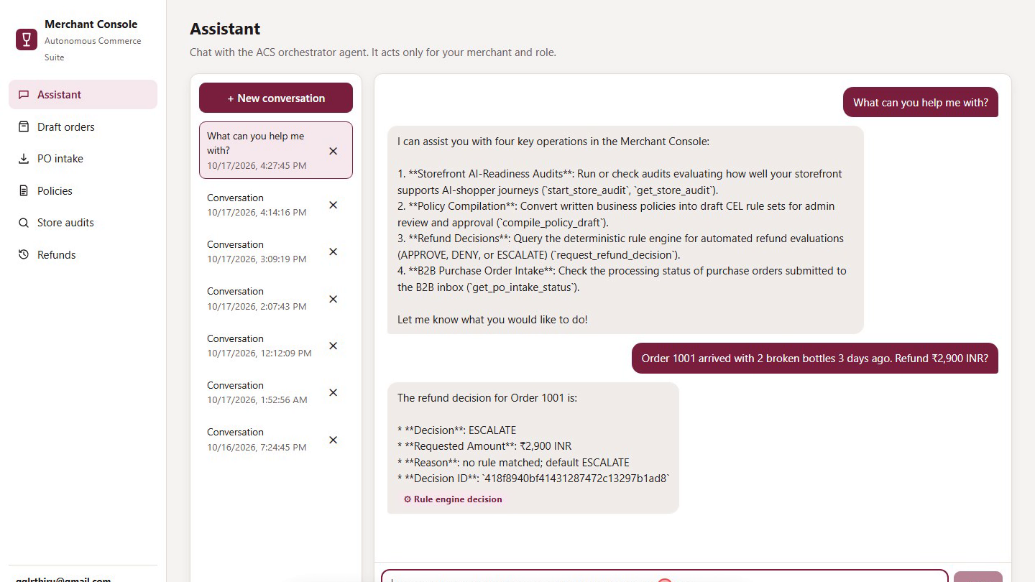
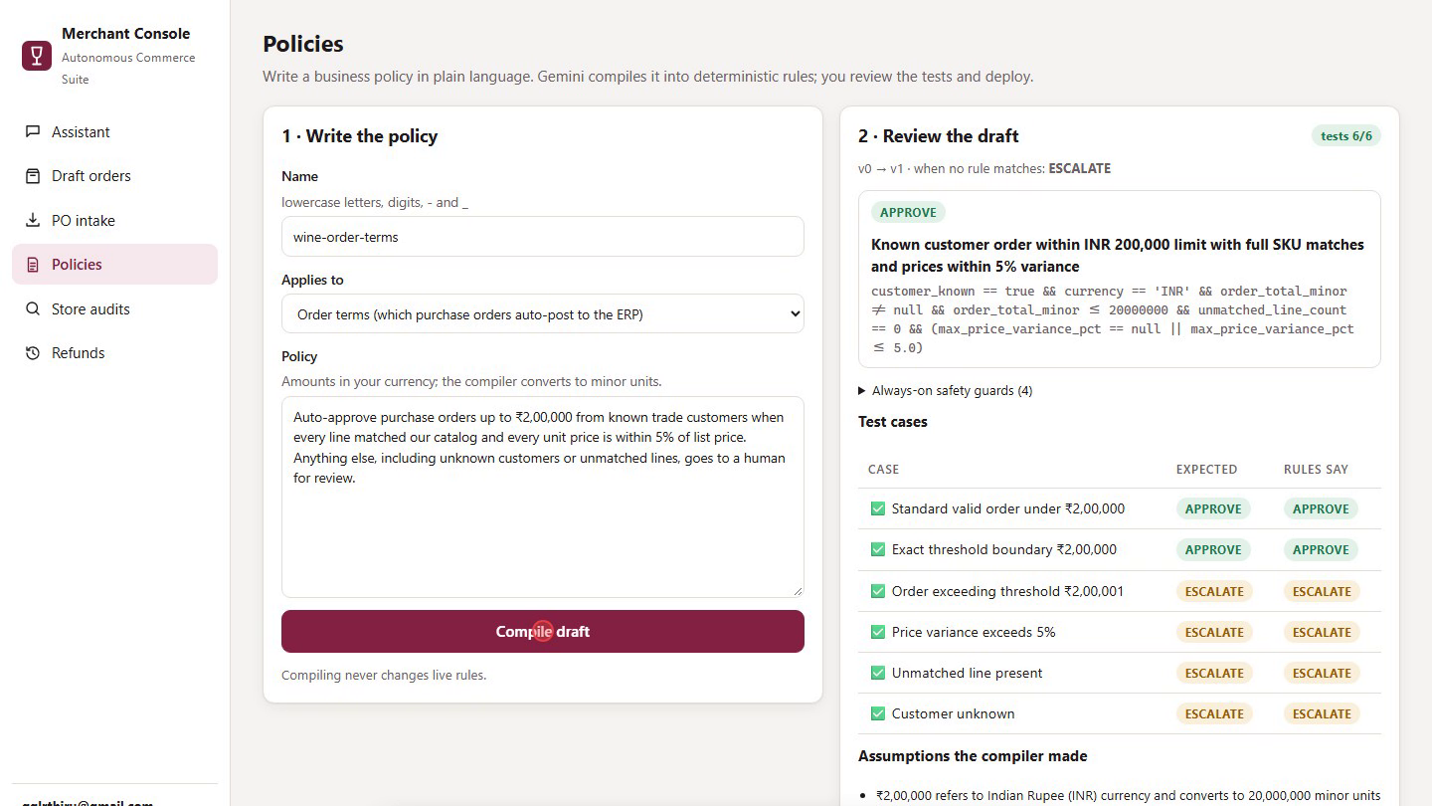
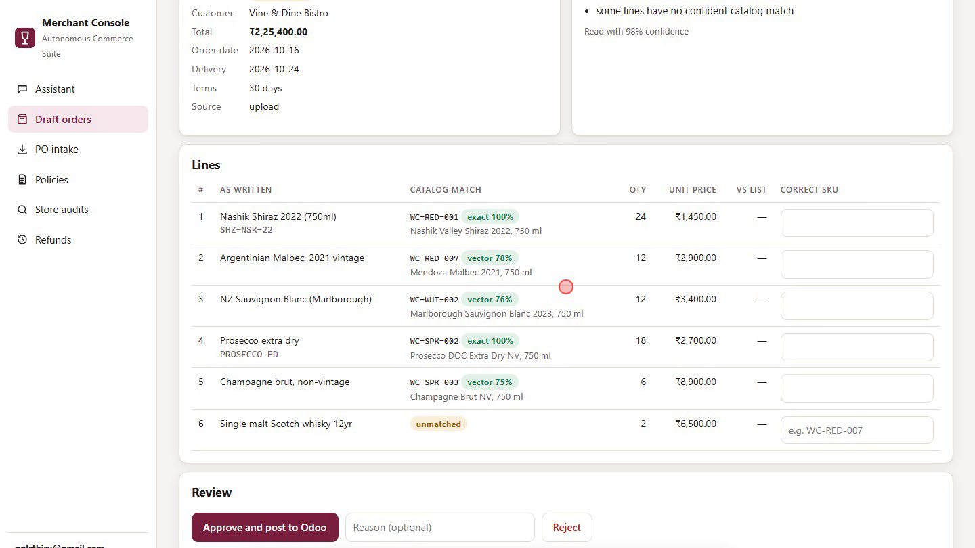
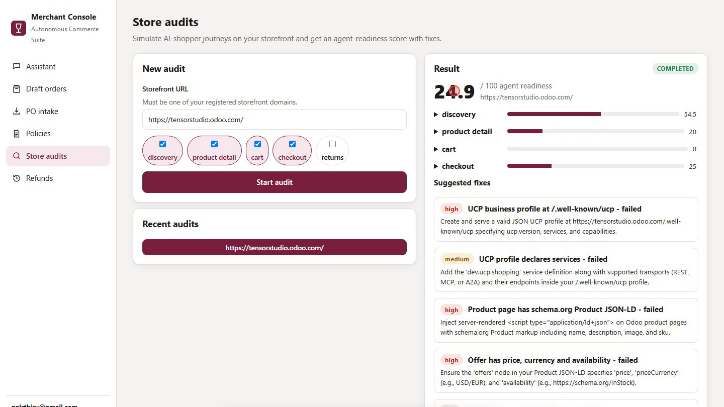
Snapshots of the prototype
Assistant: refund question answered by the rule engine
Policies: compiled CEL rule with 6/6 tests passing
Draft order: exact, vector and unmatched SKU lines
Store audit: readiness score with ranked fixes

Slide 11
Prototype Performance report/Benchmarking
177
6 / 6
98%
24.9
automated tests passing
(166 Python · 11 console)
policy test cases passed
before deploy
PO read confidence;
5 of 6 lines matched
readiness score found on
a live Odoo storefront
Measured in the recorded demo on 17 Oct 2026, on free-tier Gemini, from click to result (±1 s).
Resilient: agents switch to a Gemma fallback model when Gemini Flash is overloaded.
Deterministic: a refund decision is a rule-engine call, with no model in the loop.

Slide 12
Additional Details/Future Development (if any)
Built and live today
Next steps
5 services on Cloud Run, with Terraform, CI/CD and IAM.
Merchant Console on Firebase Hosting.
Security: tenant isolation, roles, idempotency, ERP safety gate, audit log in BigQuery.
Gemini → Gemma fallback when the model is busy.
Connect a production Odoo and turn on automatic posting.
Paid Gemini tier for production volume.
Broaden UCP support so AI shoppers can complete checkout end to end.
More rule sets (pricing, returns windows), plus a policy diff view.
Readiness-trend dashboards from BigQuery.

Slide 13
Provide links to your:
GitHub Public Repository: https://github.com/tensorthiru4/ACS
Demo Video Link (3 Minutes): [add the YouTube/Drive link after uploading acs-demo-3min.mp4]
Final Product Link: https://still-tensor-511617-t3.web.app
1
2
3
Code
Demo
Live app
Monorepo: 5 services, Terraform, console, docs
3-minute narrated walkthrough of the live system
Merchant Console on Firebase Hosting (sign-in required)

Slide 14


