Slide 1
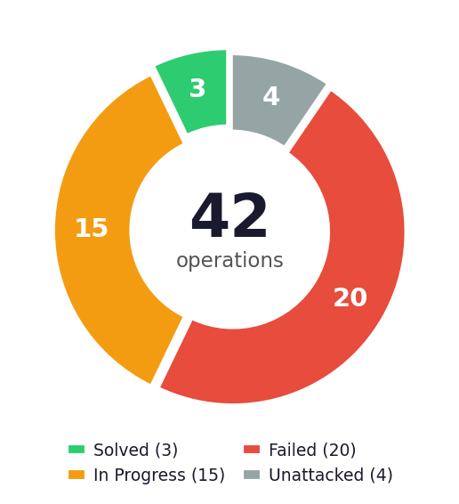
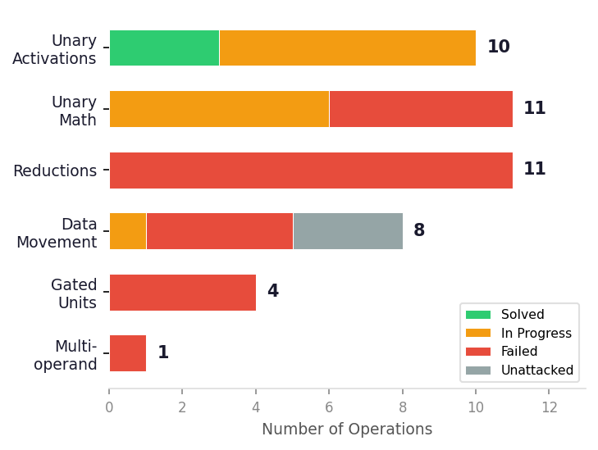
Kernel Bench: AI-Driven Kernel Generation for Tenstorrent Hardware
github.com/tenstorrent/kernel_bench | 42 Operations | 103 Submissions | 11 Contributors
Competitive benchmark platform: Measures how well AI tools generate correct TTNN kernel implementations from PyTorch op specs, evaluated on real Tenstorrent N300 hardware
Only 3 of 42 operations solved: Simple unary activations (hardsigmoid, hardswish, softsign) are solved; reductions, data movement, and multi-operand ops remain unsolved
Precision is the primary barrier: bfloat16 ULP-based accuracy metric with <2 ULP tolerance; most failures are numerical, not functional
Clear difficulty gradient emerges: Pointwise SFPU ops are tractable; cross-core coordination (reductions, matmul) is beyond current AI tool capability
Difficulty Gradient
Top Performing Operations
Easy
Unary Activations (hardsigmoid, hardswish, softsign)
Medium
Unary Math (cosh, sinh, atanh — precision issues)
Hard
Data Movement (transpose, slice, pad)
Very Hard
Reductions & Multi-op (matmul, sum, argmax)
hardsigmoid
100%
hardswish
100%
▶
▶
▶
softsign
100%
hardtanh
97.7%
cosh
68.7%
sinh
68.7%
sigmoid
62.5%
42
Benchmark Operations
3
Fully Solved
atanh
53.8%
7.1%
Overall Solve Rate
103
Total Submissions
N300
Hardware Target
Tenstorrent | kernel_bench | Analysis: April 2026
Notes:
Kernel Bench Repository Analysis — Speaker Notes
OVERVIEW:
Kernel Bench (github.com/tenstorrent/kernel_bench) is a competitive leaderboard and evaluation platform that measures how well AI-driven code generation tools can autonomously implement TT-NN kernel operations for Tenstorrent hardware. Given a PyTorch operation specification, participants must generate a correct TTNN implementation that passes rigorous numerical accuracy tests on real Tenstorrent N300 hardware.
KEY STATISTICS:
- 42 benchmark operations spanning 6 categories: unary activations (10), unary math (11), reductions (11), data movement (8), gated units (4), and multi-operand (1)
- 103 total submissions from 11 contributors
- Only 3 operations fully solved (7.1% solve rate): hardsigmoid, hardswish, softsign — all simple unary pointwise activations
- 15 operations partially working (in progress), 20 completely failed, 4 unattacked
EVALUATION METHODOLOGY:
- Tests run on Tenstorrent N300 hardware using the official tt-metalium container
- Each operation has ~150+ test cases covering multiple tensor ranks (0D-4D), dtypes (float32, bfloat16), edge cases, and shape varieties
- Accuracy uses ULP-based quantization error metric: a test passes if accuracy >= 0.99 (within ~2 ULP error for bfloat16 with 7 mantissa bits)
- Deterministic test generation with fixed seed (KERNEL_BENCH_SEED=42)
DIFFICULTY GRADIENT:
1. Easy (Solved): Unary pointwise activations — map directly to simple SFPU kernel chains
2. Medium (In Progress): Unary math ops like cosh (68.7%), sinh (68.7%), atanh (53.8%) — functionally correct but fail on precision edge cases
3. Hard (Failed): Data movement operations (transpose, slice, pad) — require complex memory access patterns
4. Very Hard (Failed): Reductions (sum, mean, argmax) and multi-operand (matmul) — require cross-core coordination and FPU matrix engine usage
MAIN BARRIERS:
- Precision is the dominant failure mode — most in-progress operations generate functionally correct code but fail the strict bfloat16 accuracy threshold
- Operations involving exp() score poorly (44-48% vs 98-100% for comparison-based ops)
- Complex communication patterns (cross-tile, cross-core) are beyond current AI tool capabilities
- Gated activation units requiring multiple tensor inputs remain completely unsolved
INFRASTRUCTURE:
- Fully automated CI/CD pipeline with parallel hardware evaluation via GitHub Actions
- Automated code generation using Claude Code CLI with structured recipe prompts
- Auto-generated leaderboard and per-operation reports
- Three submission types: bash (most common, runs shell scripts), replay (recorded sessions), manual (baseline)
TOP CONTRIBUTORS:
- nachiket-adaptive-luts: Adaptive LUT approximations (3 solved ops)
- rlesliehurd-aiworkflow: AI workflow automation (3 solved ops)
- jmalone-tt: Claude Code + documentation approach (partial success on tril)
SIGNIFICANCE:
This benchmark effectively measures AI coding assistants' ability to understand tile-based memory layouts, generate correct circular buffer management, handle reader/compute/writer kernel decomposition, and produce numerically stable implementations within hardware precision constraints. The low 7.1% solve rate highlights the significant gap between current AI capabilities and the requirements of hardware-specific kernel development.

