Slide 1
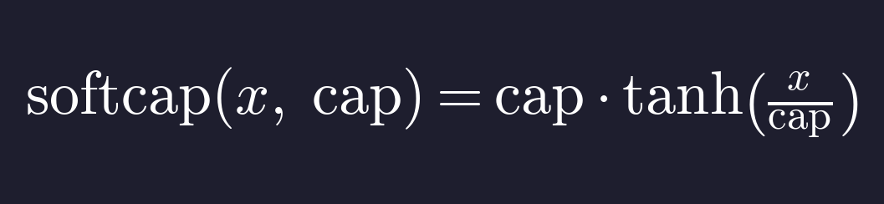
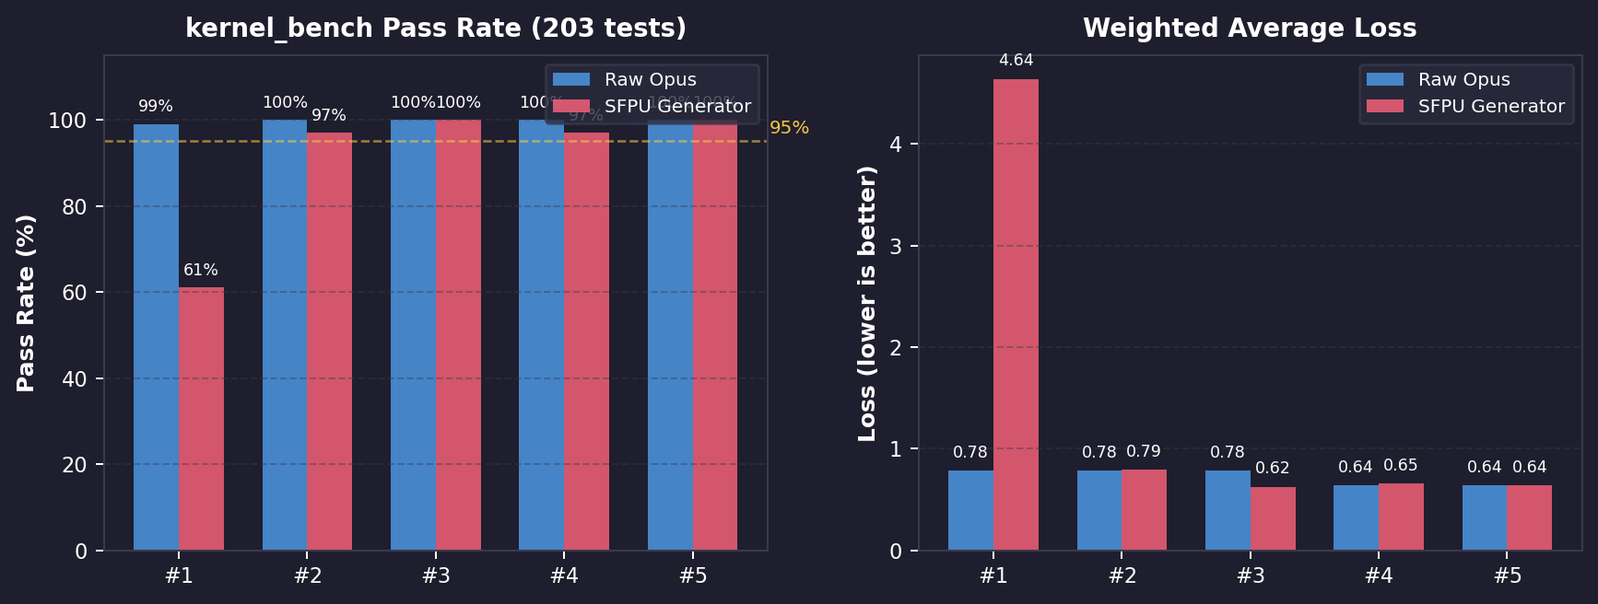
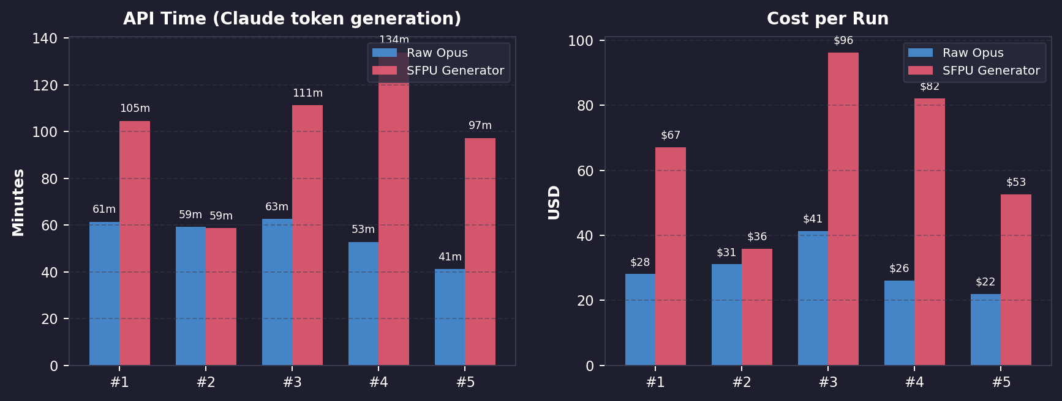
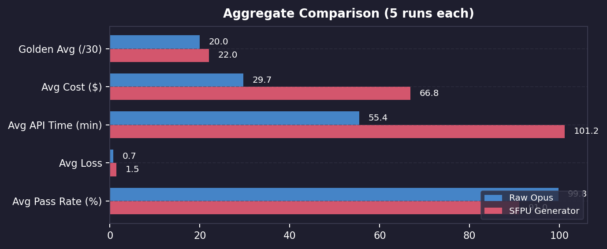
Softcap SFPU Operation — Agentic Evaluation Results
Raw Opus (5 runs) vs SFPU Generator Pipeline (5 runs) — kernel_bench evaluation (203 tests)
Why Raw Opus outperforms the SFPU Generator pipeline:
Single-session focus — raw agents spend 100% of compute on implementation and tuning, while the generator splits budget across discovery, analysis, orchestration, and implementation subagents
Lower tail risk — generator's worst run (61% pass) shows pipeline fragility when subagents miscoordinate; raw's worst (99%) stays near-perfect due to simpler execution path
Headline Results
Raw Opus: 4/5 perfect (100%), avg 99.8%, $29.71/run
SFPU Gen: 2/5 perfect (100%), avg 91.0%, $66.83/run
Best overall: sfpu_gen_3 — 100% pass, 0.625 loss, 6/6 golden
Raw advantage: 2.2x cheaper, 1.8x faster, more consistent
Gen advantage: Best precision (lowest loss), more 6/6 golden
Notes:
SPEAKER NOTES — Softcap Eval Slide
Golden Test vs kernel_bench Evaluation Differences:
- Golden test: 6 hand-written test cases with strict ULP <= 2 threshold for both bf16 and fp32. Tests specific cap values (1, 10, 50) with fixed tensor shapes. Binary pass/fail per case — measures worst-case numerical precision.
- kernel_bench: 203 auto-generated test cases across varied shapes, dtypes (bf16 + fp32), and cap values. Uses weighted accuracy-based loss metric (lower = better). More forgiving on individual precision — a run can score 97% (197/203) while failing 3/6 golden cases due to tighter ULP thresholds in the golden suite.
- Implication: Golden score measures precision ceiling (strictest cases), kernel_bench measures practical robustness (breadth of inputs). An agent can score well on kernel_bench but fail golden if its tanh approximation is slightly imprecise on fp32.
Why Raw Opus beats the SFPU Generator pipeline:
1. Single-session focus: Raw agents dedicate their entire compute budget (~55min API) to implementation and numerical tuning. The generator pipeline fragments this budget across 4-5 subagents (reference discovery, SFPU analysis, implementation, testing), leaving less compute for the core precision engineering that softcap demands.
2. Lower tail risk: The generator pipeline introduces coordination failure modes — if any subagent miscommunicates or wastes turns, the whole run degrades. sfpu_gen_1 scored only 61% due to a suboptimal tanh approximation that the pipeline's testing loop didn't catch. Raw agents have a simpler execution path with fewer failure modes.
Data sources:
- Raw r2: Wave 7 eval session 2026_04_14/2132, 5 raw prompts
- sfpu_gen r3: Wave 8 eval session 2026_04_15/0838, 5 sfpu_gen prompts (with existing-test fix)
- Both evaluated on kernel_bench branch vignjatijevic/add-rrelu-benchmark (203 test cases)

