Slide 1
Tenstorrent Robotics Intelligence Suite
Live Multi-Model Robotic Control on Blackhole AI Accelerators 4 Blackhole Chips | 2 VLA Models | Real-Time Simulation
Tenstorrent AI | Blackhole Accelerators

Slide 2
The Challenge
Autonomous robotic manipulation demands:
Vision -- understanding the scene from camera images
Language -- following human instructions ("pick up the cube")
Action -- generating precise motor commands at high frequency
Scale -- running multiple robots simultaneously
Vision-Language-Action (VLA) models solve all four,
but they need specialized hardware to run in real time.

Slide 3
What We Are Showing Today
Capability | Detail
Models | PI0 (2.3B params) + SmolVLA (450M params)
Hardware | 4x Blackhole chips in a Quiet Box
Simulation | Franka Panda 7-DOF arms in PyBullet physics
Interface | Live Streamlit dashboard with real-time video + metrics
Scenarios | 4 demonstration modes showing different capabilities

Slide 4
Two VLA Models, Two Strengths
PI0 (Physical Intelligence Zero)
2.3 billion parameters
SigLIP vision (27 layers) + Gemma 2B language + 300M action expert
Flow matching denoising (10 steps)
~330ms inference -- highest quality actions
SmolVLA (Small Vision-Language-Action)
450 million parameters
SigLIP ViT (12 layers) + VLM (16 layers) + Expert (16 layers)
Flow matching denoising (10 steps)
~229ms inference -- faster responses, compact footprint

Slide 5
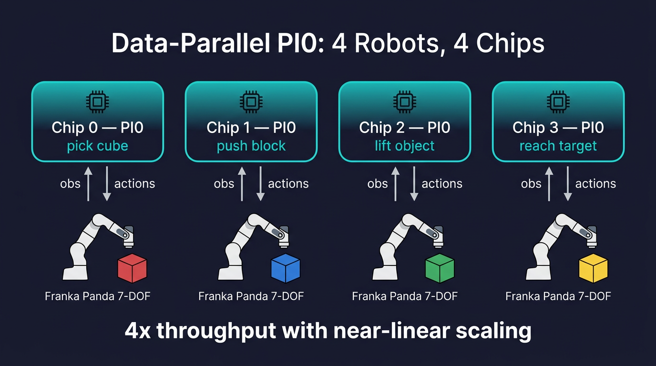
Scenario 1: Data-Parallel PI0 -- 4 Robots, 4 Chips

Slide 6
Scenario 1: Live Demo
What you will see on screen:
Quad-view video: 4 robots moving simultaneously in a 2x2 grid
Each robot working on a different colored cube
Per-chip inference latency displayed in real-time
Aggregate throughput: ~12 FPS across 4 chips
Key metric to watch:
Scaling efficiency (expect >95%)

Slide 7
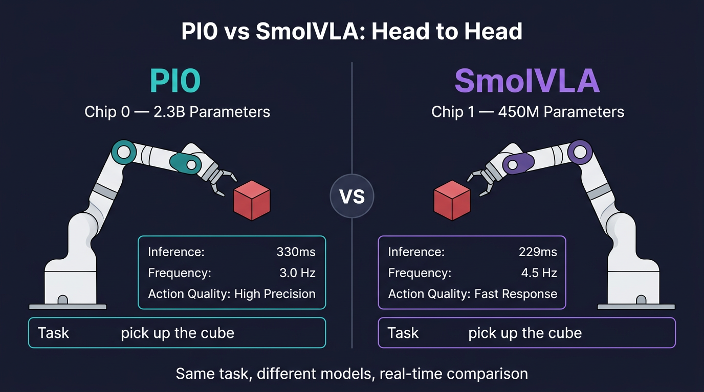
Scenario 2: PI0 vs SmolVLA -- Head to Head

Slide 8
Model Comparison Results
Metric | PI0 | SmolVLA
Parameters | 2.3B | 450M
Inference latency | ~330ms | ~229ms
Action quality | Higher precision | Good for fast tasks
Control frequency | 3.0 Hz (buffered: 12 Hz) | 4.5 Hz (buffered: 15 Hz)
Action horizon | 50 steps x 32 dims | 50 steps x 32 dims

Slide 9
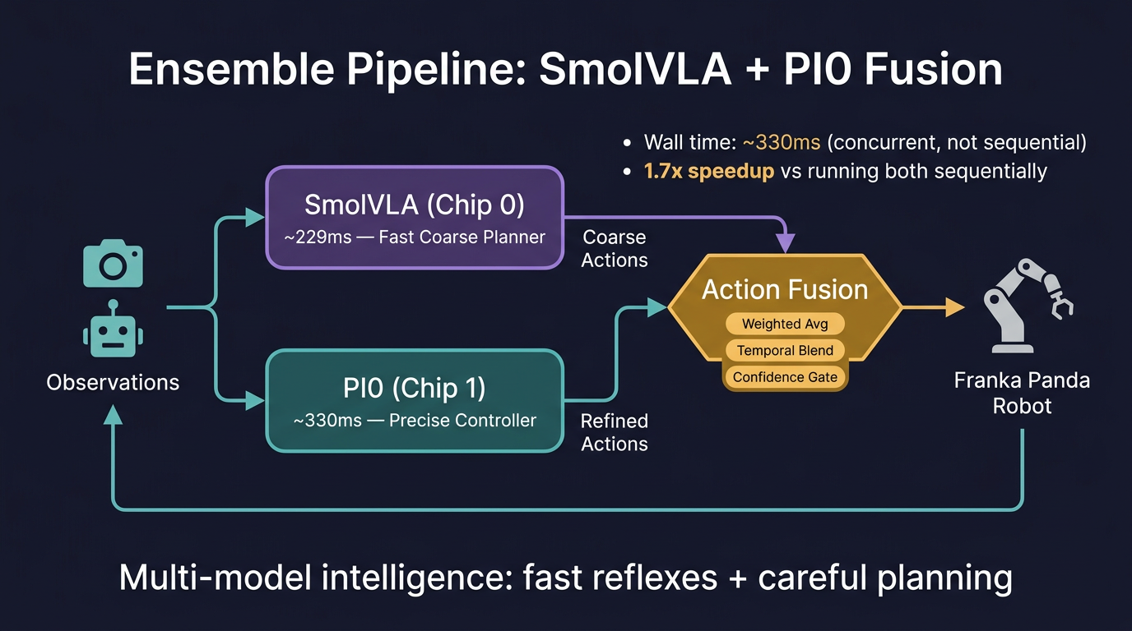
Scenario 3: Ensemble Pipeline

Slide 10
Three Fusion Strategies
1. Weighted Average
fused = 0.6 x PI0 + 0.4 x SmolVLA
Best for general-purpose blending
2. Temporal Blend
SmolVLA for immediate actions (fast reflexes)
PI0 for future actions (precise planning)
Smooth sigmoid crossover between the two
3. Confidence Gate
Per-timestep: pick the more confident model (lower action variance)
Automatic model selection, no manual tuning

Slide 11
Scenario 4: Throughput Scaling Benchmark
Measures throughput from 1 to 4 Blackhole chips:
1 chip: ~3.0 FPS
2 chips: ~5.9 FPS
3 chips: ~8.7 FPS
4 chips: ~11.5 FPS
Scaling efficiency: >95%
Generates real-time bar charts and latency waterfall diagrams.
Predictable scaling. Budget your hardware, predict your throughput.

Slide 12
Live Dashboard Features
The Streamlit interface provides:
Scenario selector -- switch between all 4 demos instantly
Configuration panel -- task prompts, re-plan interval, fusion strategy
Live video feed -- quad-view or side-by-side, updated at ~7 FPS
Real-time metrics -- per-chip latency, control frequency, distance
Metric cards -- at-a-glance performance for each Blackhole chip
Video recording -- every run saves an MP4 for offline review

Slide 13
From Simulation to Reality
Phase 1: Simulation (Today)
Full inference pipeline validated on Tenstorrent hardware
Physics-accurate robot simulation (Franka Panda in PyBullet)
All models running on real Blackhole chips -- only the robot is simulated
Phase 2: Physical Robot (Next)
Replace PyBullet with real Franka Panda arm + cameras
Same inference code, same chip allocation, same dashboard
multi_env.py abstraction: swap capture_observations() for hardware drivers
The demo you see today IS the production inference pipeline.

Slide 14
Why Tenstorrent for Robotics
Advantage | Detail
Deterministic latency | Consistent ~330ms inference, no GPU scheduling jitter
Linear scaling | Add chips, add robots -- predictable throughput
Multi-model flexibility | Run different models on different chips simultaneously
Low power | Quiet Box form factor, suitable for edge deployment
Pipeline innovation | Ensemble multi-model inference not feasible on single-GPU

Slide 15
Summary
Today we demonstrated:
1. Data parallelism: 4 robots on 4 chips with >95% scaling efficiency
2. Model comparison: PI0 vs SmolVLA running simultaneously, same hardware
3. Ensemble intelligence: two models cooperating for superior control
4. Predictable scaling: linear throughput growth from 1 to 4 chips
Next Steps:
Deploy on physical Franka Panda robot
Expand to additional VLA models (OpenVLA, RT-2)
Scale to 8+ chip configurations (Galaxy)

Slide 16
Thank You
Live demo available now -- choose any scenario from the dashboard. ./models/experimental/robotics_demo/run_demo.sh Tenstorrent Robotics Intelligence Suite v0.1
Tenstorrent AI | Blackhole Accelerators

