Slide 1
Technical Deep Dive
Tenstorrent Robotics Intelligence Demo Suite Implementation Details, Architecture, and Test Plan
Tenstorrent AI | Blackhole Accelerators

Slide 2
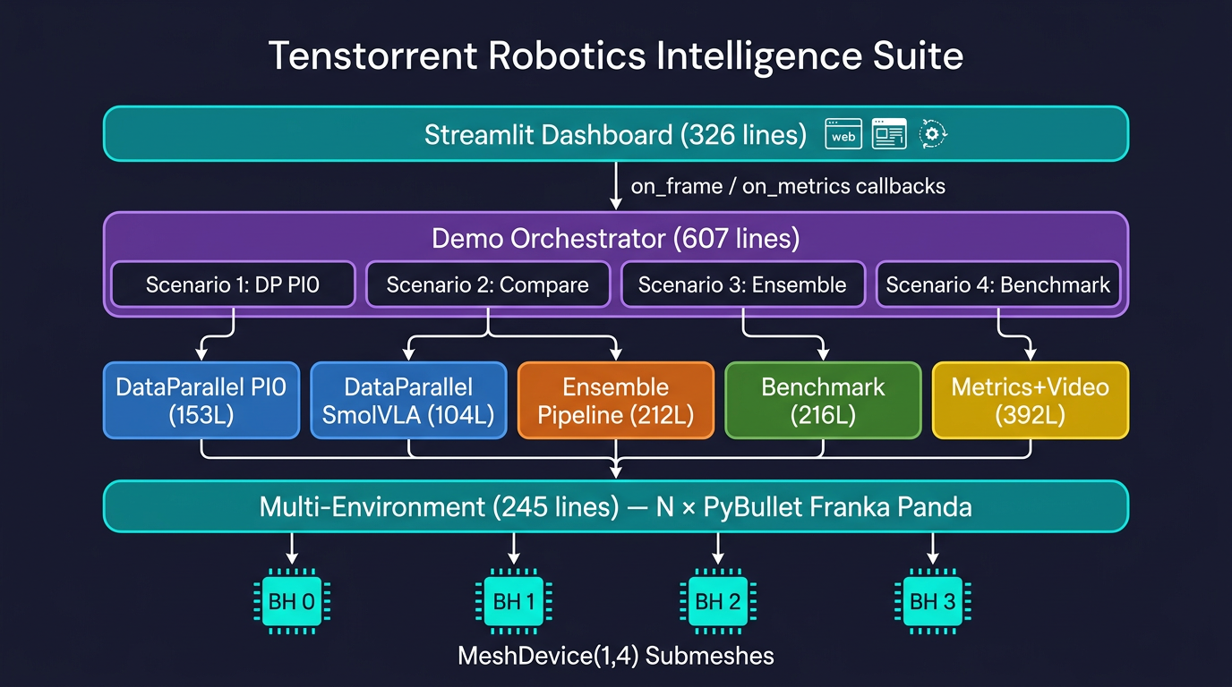
System Architecture

Slide 3
Multi-Device Strategy: TTNN MeshDevice API
# Open all 4 Blackhole chips as a single mesh mesh = ttnn.open_mesh_device( ttnn.MeshShape(1, 4), l1_small_size=24576 ) # Split into independent single-chip submeshes submeshes = mesh.create_submeshes(ttnn.MeshShape(1, 1)) # Each submesh gets its own full model replica for sub in submeshes: device = sub.get_devices()[0] model = PI0ModelTTNN(config, weight_loader, device) # Weights loaded once, replicated to each submesh # No shared state -- each replica has its own KV cache
Pattern from models/tt_transformers/tt/generator.py: create_submeshes()

Slide 4
PI0 Bug Fix: Frozen Noise
# BEFORE (broken): same noise reused every call def __init__(self, ...): self.x_t_ttnn = ttnn.from_torch(torch.randn(1,50,32)) def sample_actions(self, ...): x_t_ttnn = self.x_t_ttnn # <-- never changes! # ----------------------------------------------- # AFTER (fixed): fresh noise each inference call def __init__(self, ..., fresh_noise_per_call=True): self.fresh_noise_per_call = fresh_noise_per_call def _regenerate_noise(self): x_t = torch.randn(1, action_horizon, action_dim) self.x_t_ttnn = ttnn.from_torch(x_t, ...) def sample_actions(self, ...): if self.fresh_noise_per_call: self._regenerate_noise() # fresh noise! x_t_ttnn = self.x_t_ttnn
PCC tests use fresh_noise_per_call=False to preserve reproducibility.

Slide 5
SmolVLA: Uniform API Wrapper
# Added to SmolVLAForActionPrediction class: def sample_actions(self, images, instruction='', robot_state=None, num_inference_steps=10, action_dim=6): ''' Uniform API compatible with PI0's interface. Enables the orchestrator and ensemble pipeline to call both models through the same signature. ''' return self.predict_action( images=images, robot_state=robot_state, instruction=instruction, num_inference_steps=num_inference_steps, action_dim=action_dim, )

Slide 6
Multi-Environment Design
SingleBulletEnv (one headless PyBullet server):
p.connect(p.DIRECT) -- independent physics process
Franka Panda from pybullet_data URDF
Colored cube per environment (red, blue, green, yellow)
Two cameras: front view + side view (configurable resolution)
State: 14-dim (7 positions + 7 velocities), padded to 32
MultiEnvironment (N instances):
capture_all_observations() -- per-env (images, state)
capture_all_display_frames() -- high-res for video/dashboard
apply_all_actions() + step_all() -- parallel physics
get_all_distances() -- end-effector to cube
No threads needed: DIRECT mode servers are independent.

Slide 7
Control Loop: Action Buffering
Step 0: Observe -> Infer (~330ms) -> Buffer 50 actions -> action[0] Step 1: (buffered, <1ms) -> action[1] Step 2: (buffered, <1ms) -> action[2] Step 3: (buffered, <1ms) -> action[3] Step 4: (buffered, <1ms) -> action[4] Step 5: Observe -> Infer (~330ms) -> Buffer 50 actions -> action[0] ... replan_interval = 5 (default): Only 20% of steps need inference Inference steps: ~330ms (PI0) or ~229ms (SmolVLA) Buffered steps: ~1ms (array read + joint apply) Effective control frequency: ~12 Hz
vs 3 Hz without buffering -- 4x improvement

Slide 8
Ensemble Pipeline: Concurrent Inference
def run_concurrent_inference(self, pi0_inputs, smolvla_images): def _run_pi0(): self._pi0_result = pi0_model.sample_actions(**pi0_inputs) def _run_smolvla(): self._smolvla_result = smolvla_model.sample_actions( images=smolvla_images, instruction=instruction) t_pi0 = threading.Thread(target=_run_pi0) t_smol = threading.Thread(target=_run_smolvla) t_pi0.start(); t_smol.start() t_pi0.join(); t_smol.join() # Wall time = max(330ms, 229ms) = 330ms # vs sequential: 330 + 229 = 559ms # Speedup: 1.7x return fuse_fn(pi0_result, smolvla_result)
Models on separate chips with separate TTNN command queues -- no GIL contention on compute.

Slide 9
Fusion Strategy: Temporal Blend
def fuse_actions_temporal(pi0, smolvla, crossover_step=10): t = np.arange(horizon) # [0, 1, 2, ..., 49] # Sigmoid: 0 at early steps (SmolVLA), # 1 at late steps (PI0) pi0_weight = 1 / (1 + np.exp(-(t - crossover_step) / 2)) return pi0_weight * pi0 + (1 - pi0_weight) * smolvla # Intuition: # Next 0.5 sec: trust SmolVLA (it responded faster) # 0.5-2.5 sec: trust PI0 (it planned more carefully) # Confidence Gate: def fuse_actions_confidence(pi0, smolvla): pi0_var = np.var(pi0, axis=1) smol_var = np.var(smolvla, axis=1) use_pi0 = (pi0_var <= smol_var) # lower var = more confident return use_pi0 * pi0 + (1 - use_pi0) * smolvla

Slide 10
Metrics Collection System
Thread-safe MetricsCollector (used by all scenarios):
Per-env deques: inference times, loop times, distances, action norms
threading.Lock for concurrent dashboard reads + scenario writes
History: last 500 samples per environment
Key aggregations:
get_env_summary(env_id) -- avg/std/min/max latency, FPS, distance
get_global_summary() -- aggregate throughput, total inferences
get_scaling_efficiency() -- per-env FPS, total FPS, scaling factor
Feeds both console output and Streamlit dashboard
via on_metrics callback (polled at ~7 Hz by UI).

Slide 11
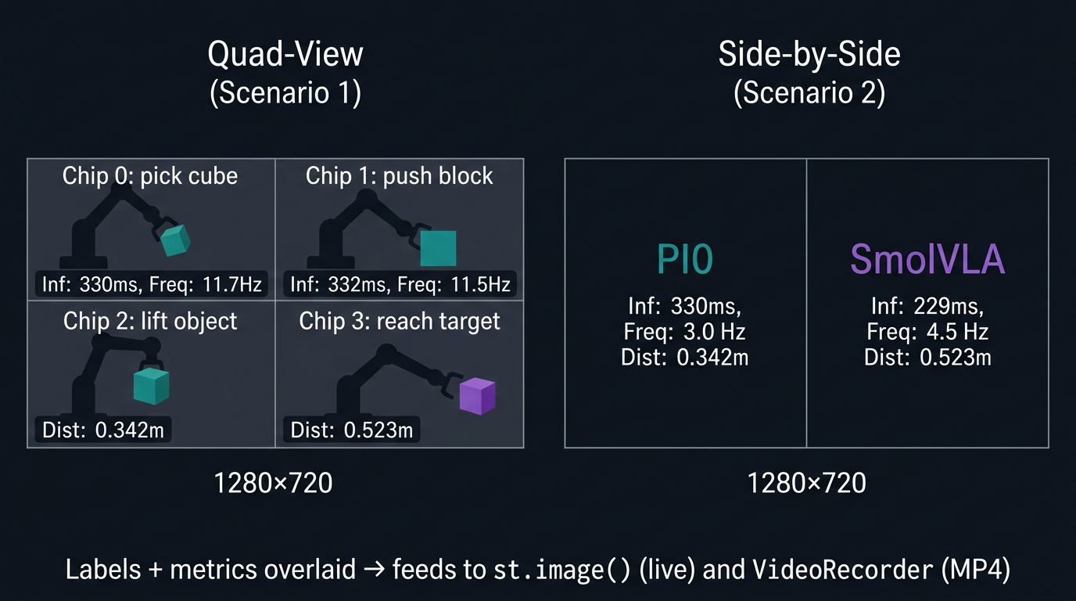
Video Composition Pipeline

Slide 12
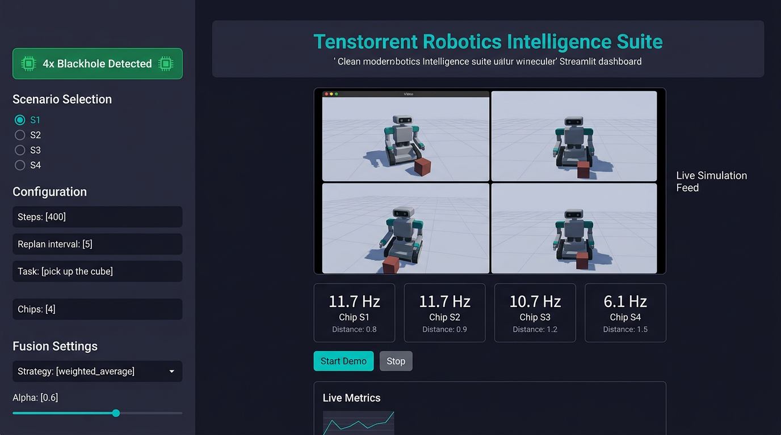
Streamlit Dashboard

Slide 13
Test Plan: 6 Tiers, 48 Test Cases
Tier | What | Hardware | Cases | Duration
T1: Smoke | Imports, PyBullet, video, metrics | None | 8 | 30 sec
T2: Single-chip | PI0 + SmolVLA inference | 1 BH | 8 | 5 min
T3: Multi-chip | Data parallel 2 + 4 chips | 2-4 BH | 8 | 10 min
T4: Scenarios | All 4 scenarios E2E | 4 BH | 8 | 30 min
T5: Stress | 1000+ steps, repeated cycles | 4 BH | 6 | 60 min
T6: Dashboard | Streamlit UI interaction | 4 BH | 8 | 20 min

Slide 14
T1: Smoke Tests (No Hardware Required)
ID | Test | Expected Result
T1.1 | MultiEnvironment(num_envs=4) creates servers | 4 independent physics clients
T1.2 | capture_all_observations() shapes | 2 images [1,3,64,64], state [1,32]
T1.3 | compose_quad_view() output | Frame (720, 1280, 3)
T1.4 | compose_side_by_side() output | Frame (720, 1280, 3)
T1.5 | MetricsCollector 4 envs | Correct counts and FPS
T1.6 | Fusion functions output shapes | (50, N) for all 3 strategies
T1.7 | VideoRecorder writes frames | frame_count > 0
T1.8 | All 13 Python files parse | ast.parse() succeeds

Slide 15
T2: Single-Chip Inference Tests (1 Blackhole)
ID | Test | Expected Result
T2.1 | PI0 loads on single device | No errors, model ready
T2.2 | PI0 sample_actions() random input | Shape [1,50,32], <500ms
T2.3 | fresh_noise=True -> different outputs | Two calls differ
T2.4 | fresh_noise=False -> reproducible | Same seed -> same actions
T2.5 | SmolVLA loads from HuggingFace | No errors, model ready
T2.6 | SmolVLA sample_actions() test image | Shape (50,6), <400ms
T2.7 | predict_action == sample_actions | Identical outputs
T2.8 | PI0 PCC test (threshold 0.93) | pytest passes

Slide 16
T3: Multi-Chip Data-Parallel Tests (2-4 Blackhole)
ID | Test | Chips | Expected Result
T3.1 | MeshDevice(1,2) opens | 2 | Two submeshes
T3.2 | MeshDevice(1,4) opens | 4 | Four submeshes
T3.3 | DataParallelPI0(2) loads | 2 | Both replicas valid output
T3.4 | DataParallelPI0(4) loads | 4 | All replicas valid output
T3.5 | Per-replica latency stable | 4 | Within 10% of single-chip
T3.6 | DataParallelSmolVLA(2) loads | 2 | Both replicas valid
T3.7 | Aggregate throughput scales | 4 | >90% efficiency
T3.8 | Devices deallocated on .close() | 4 | No leaked handles

Slide 17
T4: Full Scenario End-to-End Tests (4 Blackhole)
ID | Scenario | Steps | Expected Result
T4.1 | S1: Data-Parallel PI0 | 200 | Quad video, 4 envs, metrics
T4.2 | S1: Distances decrease | 200 | At least 2/4 envs improve
T4.3 | S2: PI0 vs SmolVLA | 200 | Side-by-side, both run
T4.4 | S2: SmolVLA faster | 200 | avg_smolvla < avg_pi0
T4.5 | S3: weighted_average | 200 | Fused actions, wall < sum
T4.6 | S3: temporal_blend | 200 | Crossover visible in output
T4.7 | S3: confidence_gate | 200 | Per-step model selection
T4.8 | S4: Scaling 1-4 chips | 10/ea | Chart generated, >90% eff

Slide 18
T5: Stability / Stress Tests
ID | Test | Duration | Expected Result
T5.1 | S1 with 1000 steps | ~90 sec | No memory leaks, no device errors
T5.2 | S2 with 1000 steps | ~90 sec | Both models stable throughout
T5.3 | S3 switching fusion every 200 steps | ~90 sec | Clean strategy switching
T5.4 | 10x start/stop cycles (S1, 100 steps) | ~5 min | Clean open/close each time
T5.5 | Video recording 1000 frames | ~90 sec | File written, no corruption
T5.6 | MetricsCollector 10,000 records | instant | No overflow, correct truncation

Slide 19
T6: Dashboard Interaction Tests
ID | Test | Expected Result
T6.1 | Dashboard loads at localhost:8501 | Page renders, shows 4 chips
T6.2 | Select S1, click Start Demo | Live video + metrics appear
T6.3 | Click Stop during execution | Stops cleanly, no orphans
T6.4 | Switch from S1 to S2 | UI updates, new config
T6.5 | S3 fusion strategy change | Dropdown works, strategy used
T6.6 | S4 benchmark completes | Scaling chart displayed
T6.7 | Change task prompt | New prompt used on next Start
T6.8 | Video download after run | File downloadable

Slide 20
Test Execution Procedure
# 1. Environment Setup export TT_METAL_HOME=/path/to/tt-metal source $TT_METAL_HOME/python_env/bin/activate export ARCH_NAME=blackhole # 2. First-time Setup ./models/experimental/robotics_demo/run_demo.sh --setup # 3. Verify Hardware python3 -c "import ttnn; print(len(ttnn.get_device_ids()))" # 4. Run Tiers ./run_demo.sh --test # T1: Smoke pytest test_pcc_ttnn_pi0_model.py -v # T2: Single-chip python3 -c '...DataParallelPI0(4)...' # T3: Multi-chip ./run_demo.sh --cli 1 # T4: Scenario 1 ./run_demo.sh --cli 2 # T4: Scenario 2 ./run_demo.sh --cli 3 # T4: Scenario 3 ./run_demo.sh --cli 4 # T4: Scenario 4 ./run_demo.sh # T6: Dashboard
Estimated total: ~2.5 hours for the full 48-test suite

Slide 21
Known Limitations and Mitigations
Limitation | Impact | Mitigation
SimpleRoboticsTokenizer default | PI0 may misunderstand instructions | Run tokenizer_setup.py for Gemma
SmolVLA robot_state unused | No proprioceptive feedback | Model uses vision + language only
SigLIP hardcoded 224px | Cannot lower PI0 image res | Validate image_size matches config
Action oscillation near target | Robot wiggles close to goal | replan_interval >= 5 mitigates
No gripper control | Only 7/32 action dims used | Remaining dims ignored; future work
Sequential replica inference | DP not truly parallel (GIL) | TTNN ops release GIL; overhead small

Slide 22
Performance Budget: PI0 on Blackhole
Stage | Latency | % of Total
Image capture (PyBullet) | ~90ms | 27%
SigLIP vision encoding | ~45ms | 14%
VLM prefill (18 Gemma 2B layers) | ~30ms | 9%
Denoising (10 steps x 18 expert layers) | ~140ms | 42%
Host overhead (transfers, Python) | ~25ms | 8%
TOTAL | ~330ms | 100%

Slide 23
Performance Budget: SmolVLA on Blackhole
Stage | Latency | % of Total
Preprocessing (CPU) | ~77ms | 34%
Vision encoder (12 SigLIP layers) | ~23ms | 10%
VLM K/V cache (16 layers) | ~9ms | 4%
Flow matching (10 steps x 16 expert layers) | ~121ms | 53%
TOTAL | ~229ms | 100%

Slide 24
Summary
Implementation:
2,400 lines of new Python across 12 files + shell launcher
2 model modifications: PI0 noise fix, SmolVLA API wrapper
2 diagnostic scripts for PI0 simulation debugging
All infrastructure validated with automated smoke tests
Test Plan:
6 tiers, 48 test cases
Progressive: each tier builds on previous
Clear pass/fail criteria at every level
Estimated total execution: ~2.5 hours for full suite
Next Step: Run T1 smoke tests, then proceed through tiers on Quiet Box.

Slide 25
Appendix: Complete File Inventory
File | Lines | Purpose
demo_orchestrator.py | 607 | Top-level scenario controller with CLI
streamlit_app.py | 326 | Live web dashboard
multi_env.py | 245 | N-instance PyBullet environment manager
video_composer.py | 226 | Quad-view / side-by-side composition
benchmark.py | 216 | Throughput scaling + chart generation
ensemble_pipeline.py | 212 | Concurrent PI0+SmolVLA, 3 fusion strategies
metrics.py | 166 | Thread-safe real-time metrics
data_parallel_pi0.py | 153 | MeshDevice submesh PI0 replicas
tokenizer_setup.py | 122 | Gemma tokenizer offline caching
data_parallel_smolvla.py | 104 | MeshDevice submesh SmolVLA replicas
run_demo.sh | 142 | Bash launcher (setup/test/cli/dashboard)

