Slide 1
Single-Chip Robotics Demo
PI0 or SmolVLA on One Tenstorrent Chip Real-Time Robot Control in PyBullet Simulation
Tenstorrent AI | Blackhole / Wormhole

Slide 2
What This Demo Shows
A single Tenstorrent chip runs a full VLA model in real time
The user picks which model to run:
PI0 -- 2.3B parameters, highest action quality, ~330ms
SmolVLA -- 450M parameters, faster response, ~229ms
A Franka Panda 7-DOF robot arm in PyBullet simulation
follows the model's predicted actions in a closed loop
Natural language task instruction: "pick up the cube"
Video recording with live metrics overlay

Slide 3
Two Models, One Command
 | PI0 | SmolVLA
Parameters | 2.3 billion | 450 million
Architecture | SigLIP 27L + Gemma 2B + 300M Expert | SigLIP 12L + VLM 16L + Expert 16L
Action generation | Flow matching, 10 Euler steps | Flow matching, 10 Euler steps
Inference latency | ~330ms per call | ~229ms per call
With buffering (replan=5) | ~12 Hz control | ~15 Hz control
Output shape | 50 steps x 32 dims | 50 steps x 32 dims
Strengths | Precision, complex tasks | Speed, low footprint

Slide 4
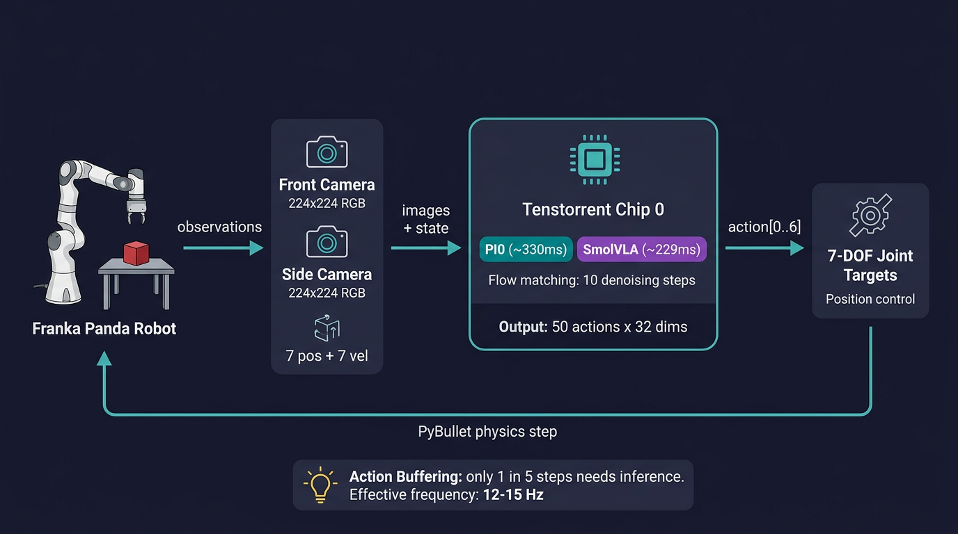
How It Works: Control Loop

Slide 5
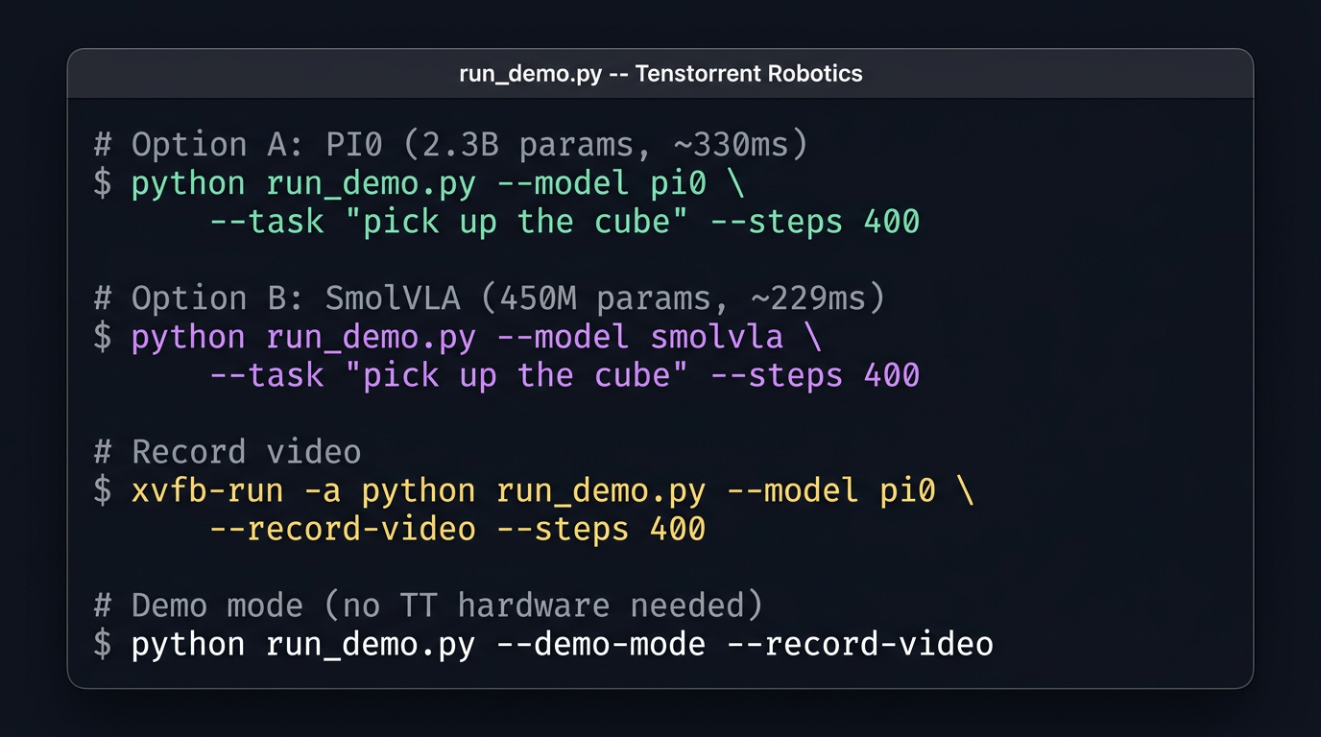
Running the Demo

Slide 6
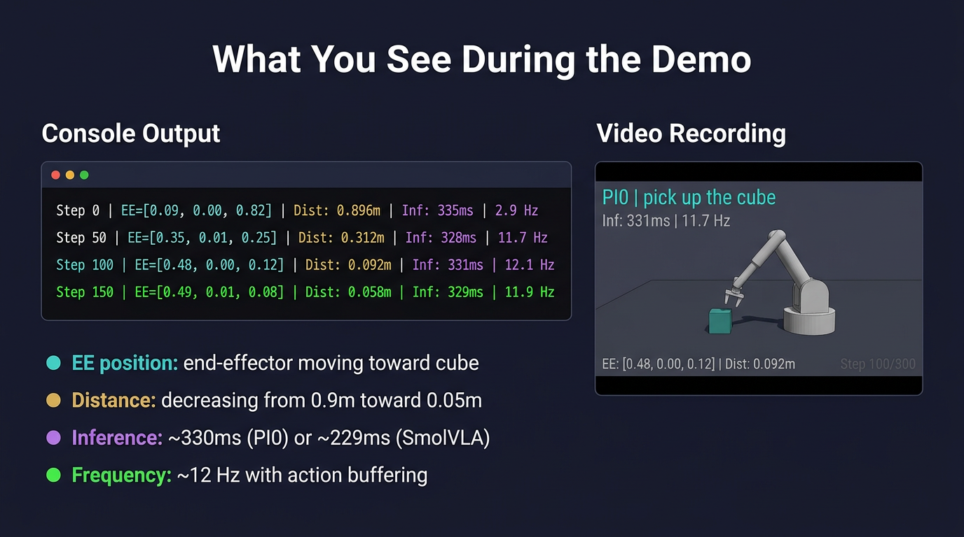
What You See During the Demo

Slide 7
Performance: PI0 vs SmolVLA on Single Chip
Metric | PI0 | SmolVLA
Inference per call | ~330ms | ~229ms
Control freq (replan=5) | ~12 Hz | ~15 Hz
Control freq (replan=1) | ~3 Hz | ~4.5 Hz
Action quality | Higher precision | Good, faster
Vision encoder | SigLIP 27 layers (~45ms) | SigLIP 12 layers (~23ms)
Denoising | 10 steps (~140ms) | 10 steps (~121ms)
Model size on chip | 2.3B params | 450M params

Slide 8
Action Buffering: Why 12 Hz, Not 3 Hz
replan_interval = 5 (default) Step 0: Observe -> Infer (330ms) -> Buffer 50 actions -> apply action[0] Step 1: (buffered, <1ms) -> apply action[1] Step 2: (buffered, <1ms) -> apply action[2] Step 3: (buffered, <1ms) -> apply action[3] Step 4: (buffered, <1ms) -> apply action[4] Step 5: Observe -> Infer (330ms) -> Buffer 50 actions -> apply action[0] ... Result: Only 20% of steps need inference (60 out of 300) 80% of steps are <1ms (just read from buffer) Average loop time: ~85ms -> 11.7 Hz Without buffering (replan_interval = 1): Every step needs 330ms inference -> 3 Hz Robot motion is jerky and may oscillate near target
4x frequency improvement. The model predicts 50 future actions -- we should use them.

Slide 9
Minimal Architecture: 695 Lines Total
run_demo.py (417 lines)
CLI argument parsing
Model loading: PI0 or SmolVLA, one function each
Control loop: observe -> infer -> apply -> step
Warmup, metrics, video recording
sim_env.py (158 lines)
FrankaCubeEnv: PyBullet Franka Panda + red cube
Two cameras (front + side) for model observations
PIL image capture for SmolVLA's HF processor
Joint control, physics stepping, IK for demo mode
tokenizer.py (39 lines)
Word-based tokenizer for PI0 task instructions
No Streamlit, no multi-device, no video compositor --
just the model, the robot, and the control loop.

Slide 10
Path Forward
Today: Single chip, single robot, simulation
Next steps:
Multi-chip: scale to 4 Blackhole chips (see robotics_demo/ suite)
Data parallel: 4 robots on 4 chips simultaneously
Model comparison: PI0 vs SmolVLA side-by-side
Ensemble: combine both models with action fusion
Real hardware: replace PyBullet with physical Franka Panda
The single-chip demo validates the full inference pipeline.
Everything above it -- multi-chip, ensemble, real robot --
builds on this exact same control loop.
This demo is the foundation for all advanced configurations.

Slide 11
Live Demo
Pick your model: PI0 or SmolVLA Pick your task: "pick up the cube" Watch the robot move. python run_demo.py --model <pi0|smolvla> --task "pick up the cube"
Tenstorrent Single-Chip Robotics Demo | 695 lines of Python

