Slide 1

Presented By: Unicornic Company

Slide 2
Work Breakdown Structure
Online Reservation with Payment System
(Administrator and Coordinator)
Data Gathering
(Project Engineer and Program Manager)
Partial System
(Project Manager and Project Assistant)
Pre-cost Estimation
(Project Specialist)
Partial Design System
(Project Engineer)
Partial Structure of Database
(Program Manager)
Reports
(Project Auditor)
Attendance
(Task Manager)
Timeline
(Project Specialist)

Slide 3
Organizational Chart
Melody Lita (Administrator)
Bonny Cardenas
(Project Coordinator)
Kim Joshua Albino
(Project Manager)
Mark Francis Maninang
(Program Manager)
Nomer Ramos
(Project Auditor)
Kim Joshua Mendoza
(Task Manager)
Exequiel Ponce
(Project Engineer)
Anthony Pacete
(Project Specialist)
Alfred Lopez
(Project Specialist)
Nikki Colleen Devera
(Project Assistant)

Slide 4
Data Gathering
History
Started at 1980 First Company Name: Daanang Tubig sa gitna ng Siyudad 1st owner: Gregorio Luna Year 2001 name changed: Unicorn Water Ways

Slide 5
Data Gathering
Customer Information Name Phone Number Address Reservation Date (From-To) Confirmation Number
Types of Customer Adult (6yrs old above) 200 Pesos Child (6yrs old below) 30% discount

Slide 6
Data Gathering
Reservation Rooms
Cottage: (2-5 persons) Morning: 500 Pesos
Night: 1000 Pesos
Swimming: Free Food: To be purchased Videoke: Not Available

Slide 7
Data Gathering
Reservation Rooms
Regular Room: (5-10 persons) Morning: 1000 Pesos
Night: 1500 Pesos
Swimming: 100 Pesos per head Food: To be purchased Videoke: Not Available

Slide 8
Data Gathering
Reservation Rooms
Grande Room: (10-15 persons) Morning: 2000 Pesos
Night: 2000 Pesos
Swimming: 100 Pesos per head Food: To be purchased Videoke: 500 Pesos

Slide 9
Data Gathering
Reservation Rooms
Supreme Room: (15-30 persons) Whole Day: 4000 Pesos
Swimming: Free Food: Free (Diner OR Lunch) Videoke: Free

Slide 10
Data Gathering
On Reservation: Half of Total Payment
During or before service end: Other Half of the Payment

Slide 11
Documentation
Introduction
A computer reservations system or central reservation system (CRS) is a computerized system used to store and retrieve information and conduct transactions related to air travel, hotels, car rental, or activities. Originally designed and operated by airlines, CRSes were later extended for the use of travel agencies. Major CRS operations that book and sell tickets for multiple airlines are known as Global Distribution System (GDS). Airlines have divested most of their direct holdings to dedicated GDS companies, who make their systems accessible to consumers through Internet gateways. Modern GDSes typically allow users to book hotel rooms, rental cars, airline tickets as well as activities and tours. They also provide access to railway reservations and bus reservations in some markets, although these are not always integrated with the main system.
The online reservation system provides service to on-line customers. Online customers can make a research about the resort, they may soon make a reservations or cancels an existing reservation on the resort’s web site and at the same time can pay already about the bill. Customers will have an easy access using this web-based online reservation where they can save time and effort going to the resort just to inquire or make a reservation.
The Unicorn Waterways was started at 1980. It was first Daanang Tubig sa gitna ng siyudad owned by Gregorio Luna. Soon year 2001 it was changed into Unicorn Waterways as of now. Customers can easily make a reservation as they go to the web, so they will not go or make a lot of effort just to make a reservation where the resort was located. In the website of the resort they can already see the resorts Customers can make a payment half of the bill as the reservation was committed then the remaining half can be followed up. But once the reservation has been paid, there will be no refunds.

Slide 12
Documentation
Statement of Objectives
General Objective
To create an Online Reservation with Payment System for Unicorn Water Ways
Specific Objectives
To create a module that will help customers to have a fast reservation.
To create a module that will help to secure records.
To create a module that will help them to lessen the difficulty in finding availability in facilities.

Slide 13
Pre cost estimation
Per Meeting: 5 Pesos
Goal Every Term: 150 Pesos
Whole Semester: 600 Pesos

Slide 14
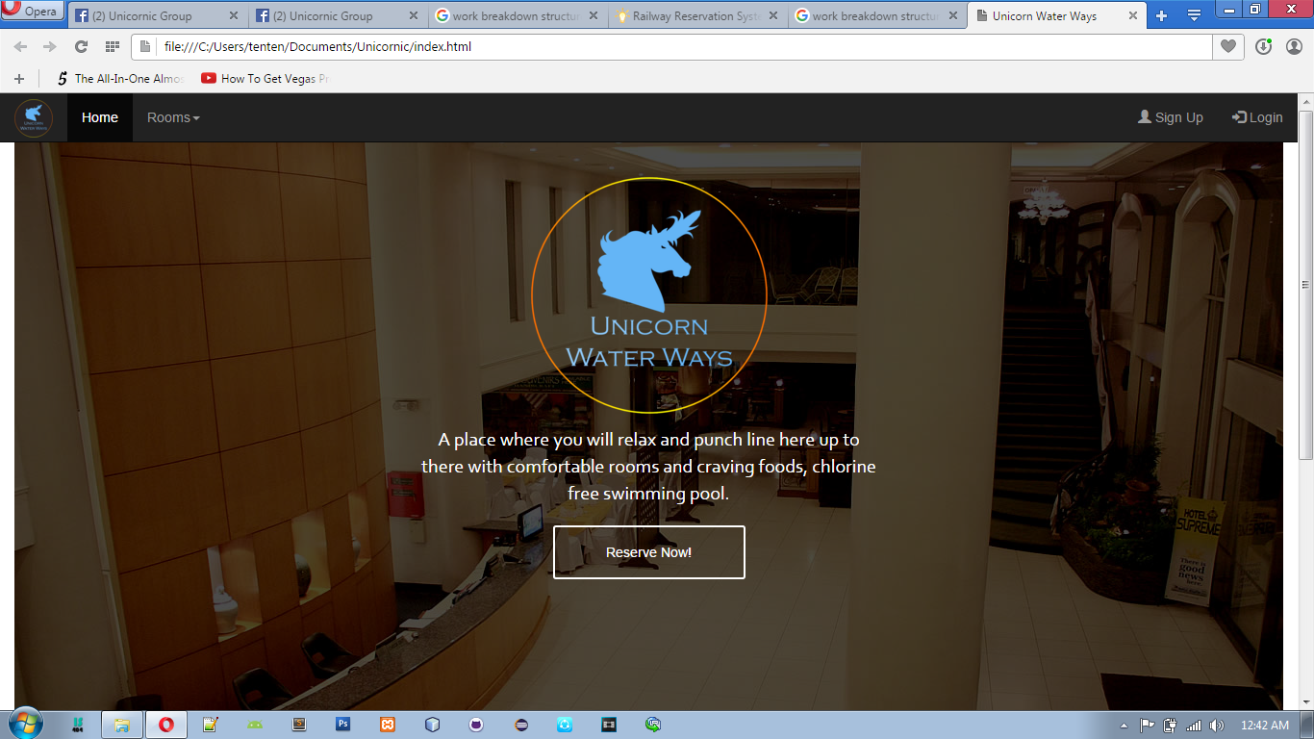

Slide 15
