Slide 1
Using RRTs to Navigate Gibson Environments
Paul McKerley

Slide 2
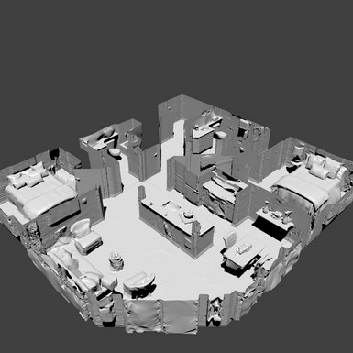
Problem
Find an efficient means of calculating paths for GibsonEnv buildings.
GibsonEnv environments are 3D maps of apartments or houses of varying complexity.
Produce roadmaps that can be queried efficiently at runtime.

Slide 3
Approach
Use Rapidly-Exploring Random Trees, based on paper by Steven LaValle
Simple algorithm:
Place random starting point in free space.
Do N times:
Pick random point s
Find nearest tree vertex t to s
Draw line of length d from t toward s, if in free space

Slide 4
Implementation
Extract 2D cross-section of 3D map using third party Python module meshcut.py (Thanks to Yimeng Li.)
Connect ends of lines to nearest line-ends to fill gaps.
Make binary image of free space. Make free areas white and use erosion to add distance to walls and fill out irregular formations.

Slide 5

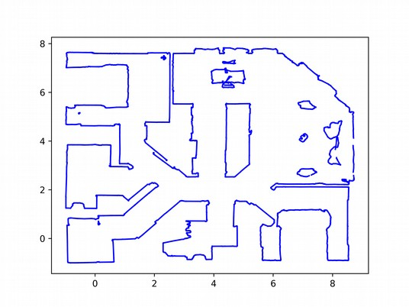
Implementation
Check RRT lines using Bresenham algorithm to ensure all points are in free space.

Slide 6
Implementation
Use A* search to find paths from a starting point to an ending point.
This leads to paths that are unnecessarily long.
Refine paths by repeatedly randomly adding edges to tree where nodes in path can be connected without obstruction.
Use A* to find better paths until convergence.
Add new paths to RRT.
Perform refining process many times with random paths to make efficient roadmap.

Slide 7
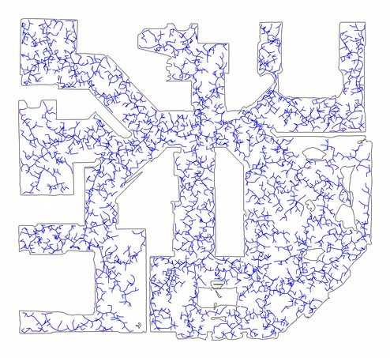
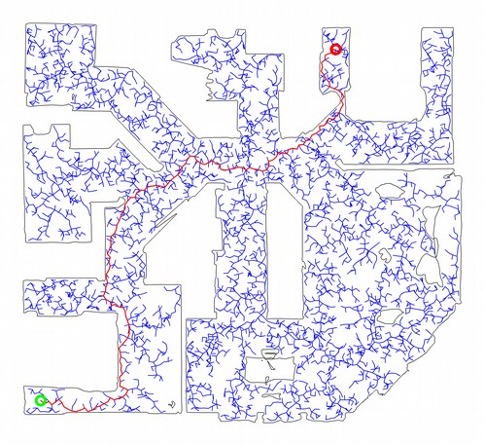
Results

Slide 8
Results
Animated example using a larger and more complex map.
Demonstrates refining of initial path.
http://mckerley.com/gmu/cs685/project/Brinnon.mp4

