Slide 1
Earthquake & ICT

Slide 2
Before Earthquake – Early warning system
Regional early warning system developed by Indian Institute of Technology, Roorkee
Sensors (total of 100) in quake sensitive areas
Mode of alert:
Sirens
Mobile apps
AM/FM Radio

Slide 3
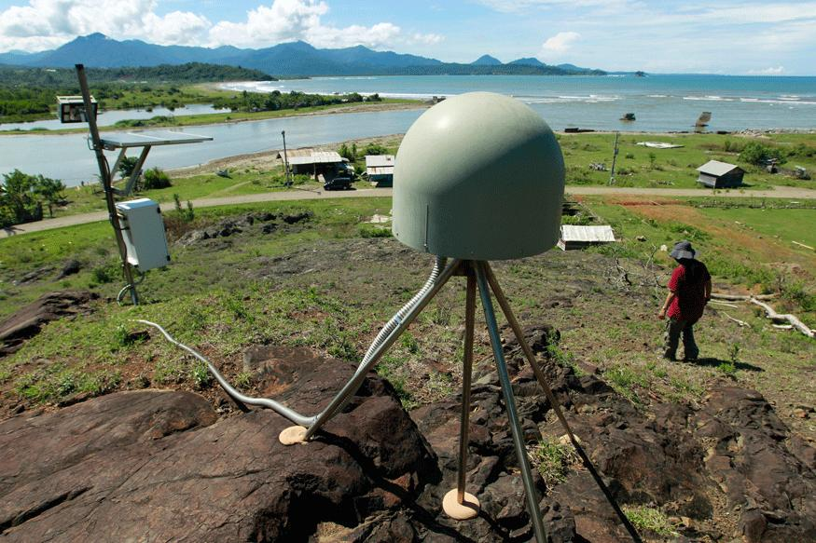
Early Warning system
Source: http://www.news18.com/news/india/earthquake-early-warning-system-developed-by-iit-r-to-alert-people-in-uttarakhand-1352954.html

Slide 4
During Earthquake

