Slide 1
Earthquake & ICT

Slide 2
Before Earthquake – Early warning system in India
Regional early warning system developed by Indian Institute of Technology, Roorkee
Sensors (total of 100) in quake sensitive areas
Mode of alert:
Sirens
Mobile apps
AM/FM Radio

Slide 3
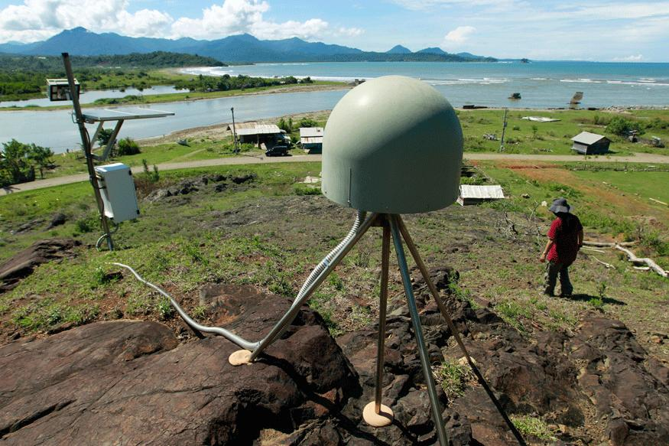
Early Warning system
Source: http://www.news18.com/news/india/earthquake-early-warning-system-developed-by-iit-r-to-alert-people-in-uttarakhand-1352954.html

Slide 4
Before Earthquake – Early warning system in Japan
https://www.technologyreview.com/s/423279/how-japans-earthquake-and-tsunami-warning-systems-work/
http://www.jma.go.jp/jma/en/Activities/eew1.html

Slide 5
Before Earthquake – Early Warning system Research
Crowdsourcing Mobile phones – making use of GPS
Source: http://www.sciencemag.org/news/2015/04/smart-phones-could-be-used-detect-earthquakes

Slide 6
During Earthquake
Measuring size of earthquake
Magnitude
Energy
Intensity
Depth
Source: https://earthquake.usgs.gov/learn/topics/measure.php

Slide 7
After Earthquake
Detection and alert for earthquake related activities
In Australia – Geoscience Australia
monitors seismic data worldwide
Analyzed automatically and reviewed within 10 minutes of origin time
Results in alerts like tsunami alerts
Earthquake database
Source: http://www.ga.gov.au/scientific-topics/hazards/earthquake/capabilties/monitoring
Source: http://www.ga.gov.au/earthquakes/searchQuake.do

