Slide 1
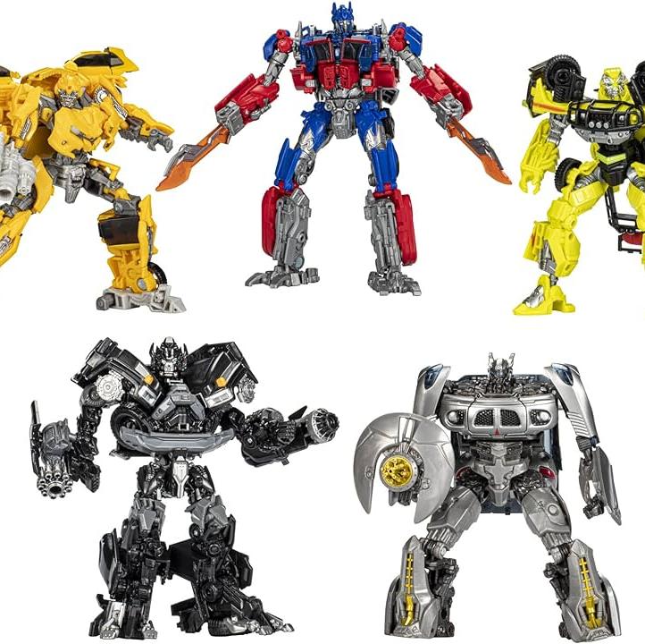
Transformers
Attention is all you need
A. Vaswami et al. 2017

Slide 2
RNN: limitations
Good at enconding history
Bad in
  Considering very long sequences
  Taking into account context
  E.g., trying to predict the last word in the following sentence:
  I grew up in France, bla bla bla ……….bla bla bla …… thus I speak ??
  The word should be French and it depends on a context that is identified by the word France, very far away in the sequence
The answer: Attention mechanism

Slide 3
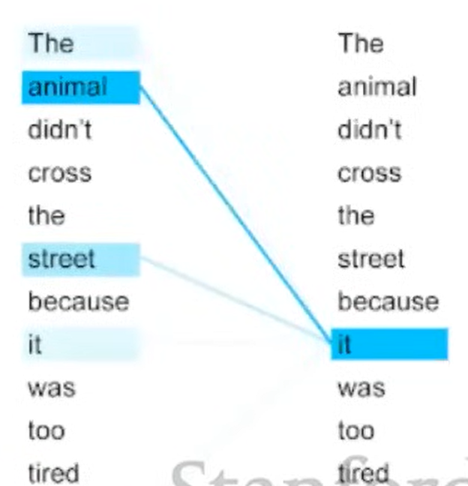
Which other word should the current word it refer to (or to take attention)?

Slide 4
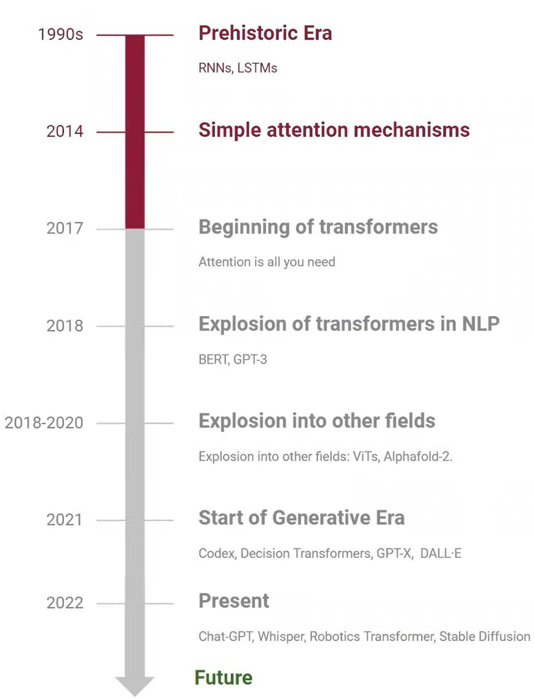
Attention timeline
2024: Sora, Vasa-1

Slide 5
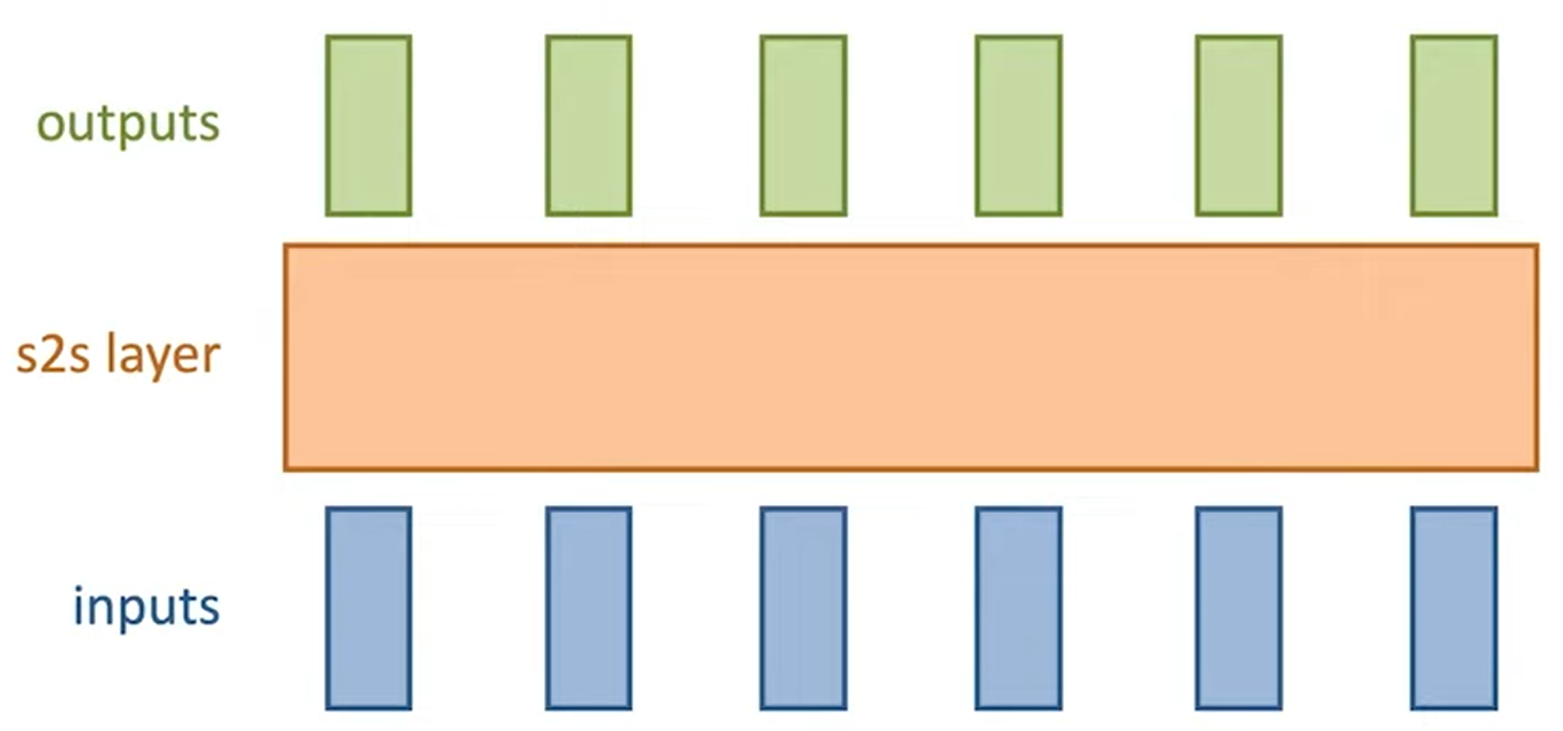
General RNN: seq2seq

Slide 6
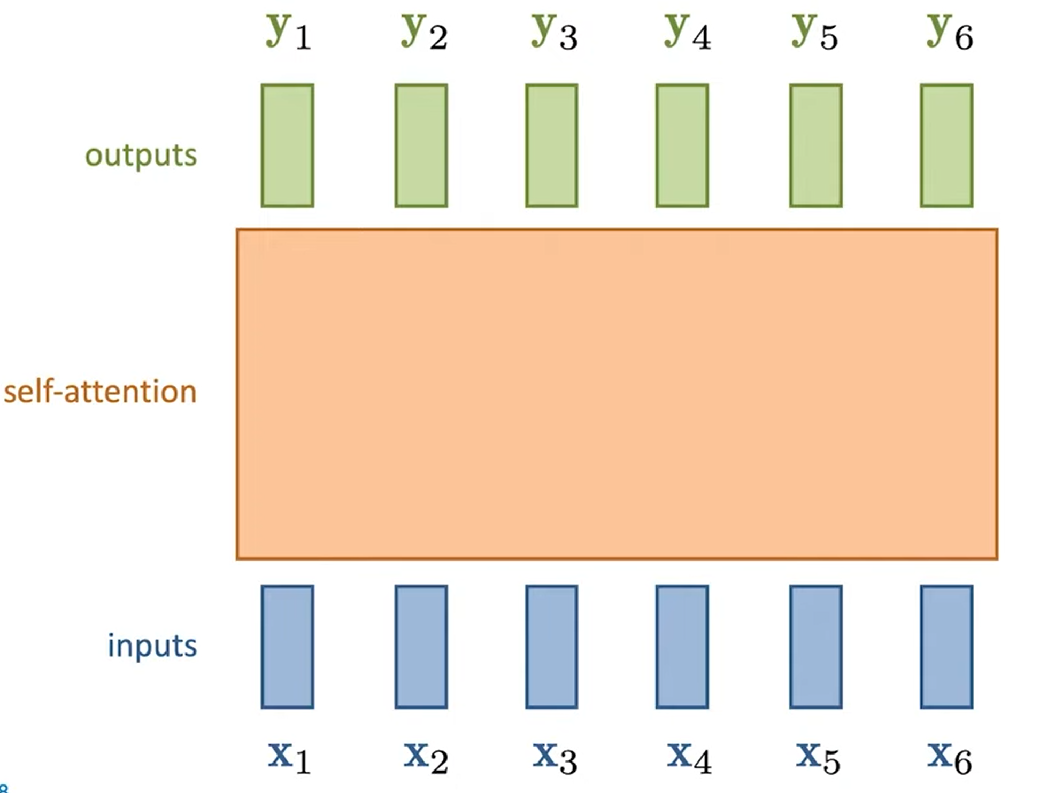


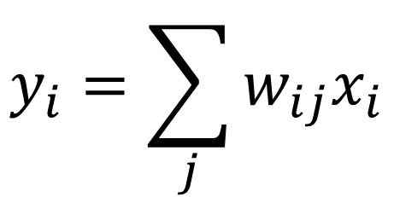
Self-attention
$$y_{i}=\sum_{j}{w_{ij}x_{i}}$$
$${w′}_{ij}={x_{i}^{T}x}_{j}$$
$$w_{ij}=\text{soft}\text{−}\text{max}⁡({x_{i}^{T}x}_{j})$$
Notes:
Come layer MLP ma con pesi non appresi ma calcolati sugli input. Softmax per normalizzare (somma a 1 e tutto positivo)

Slide 7
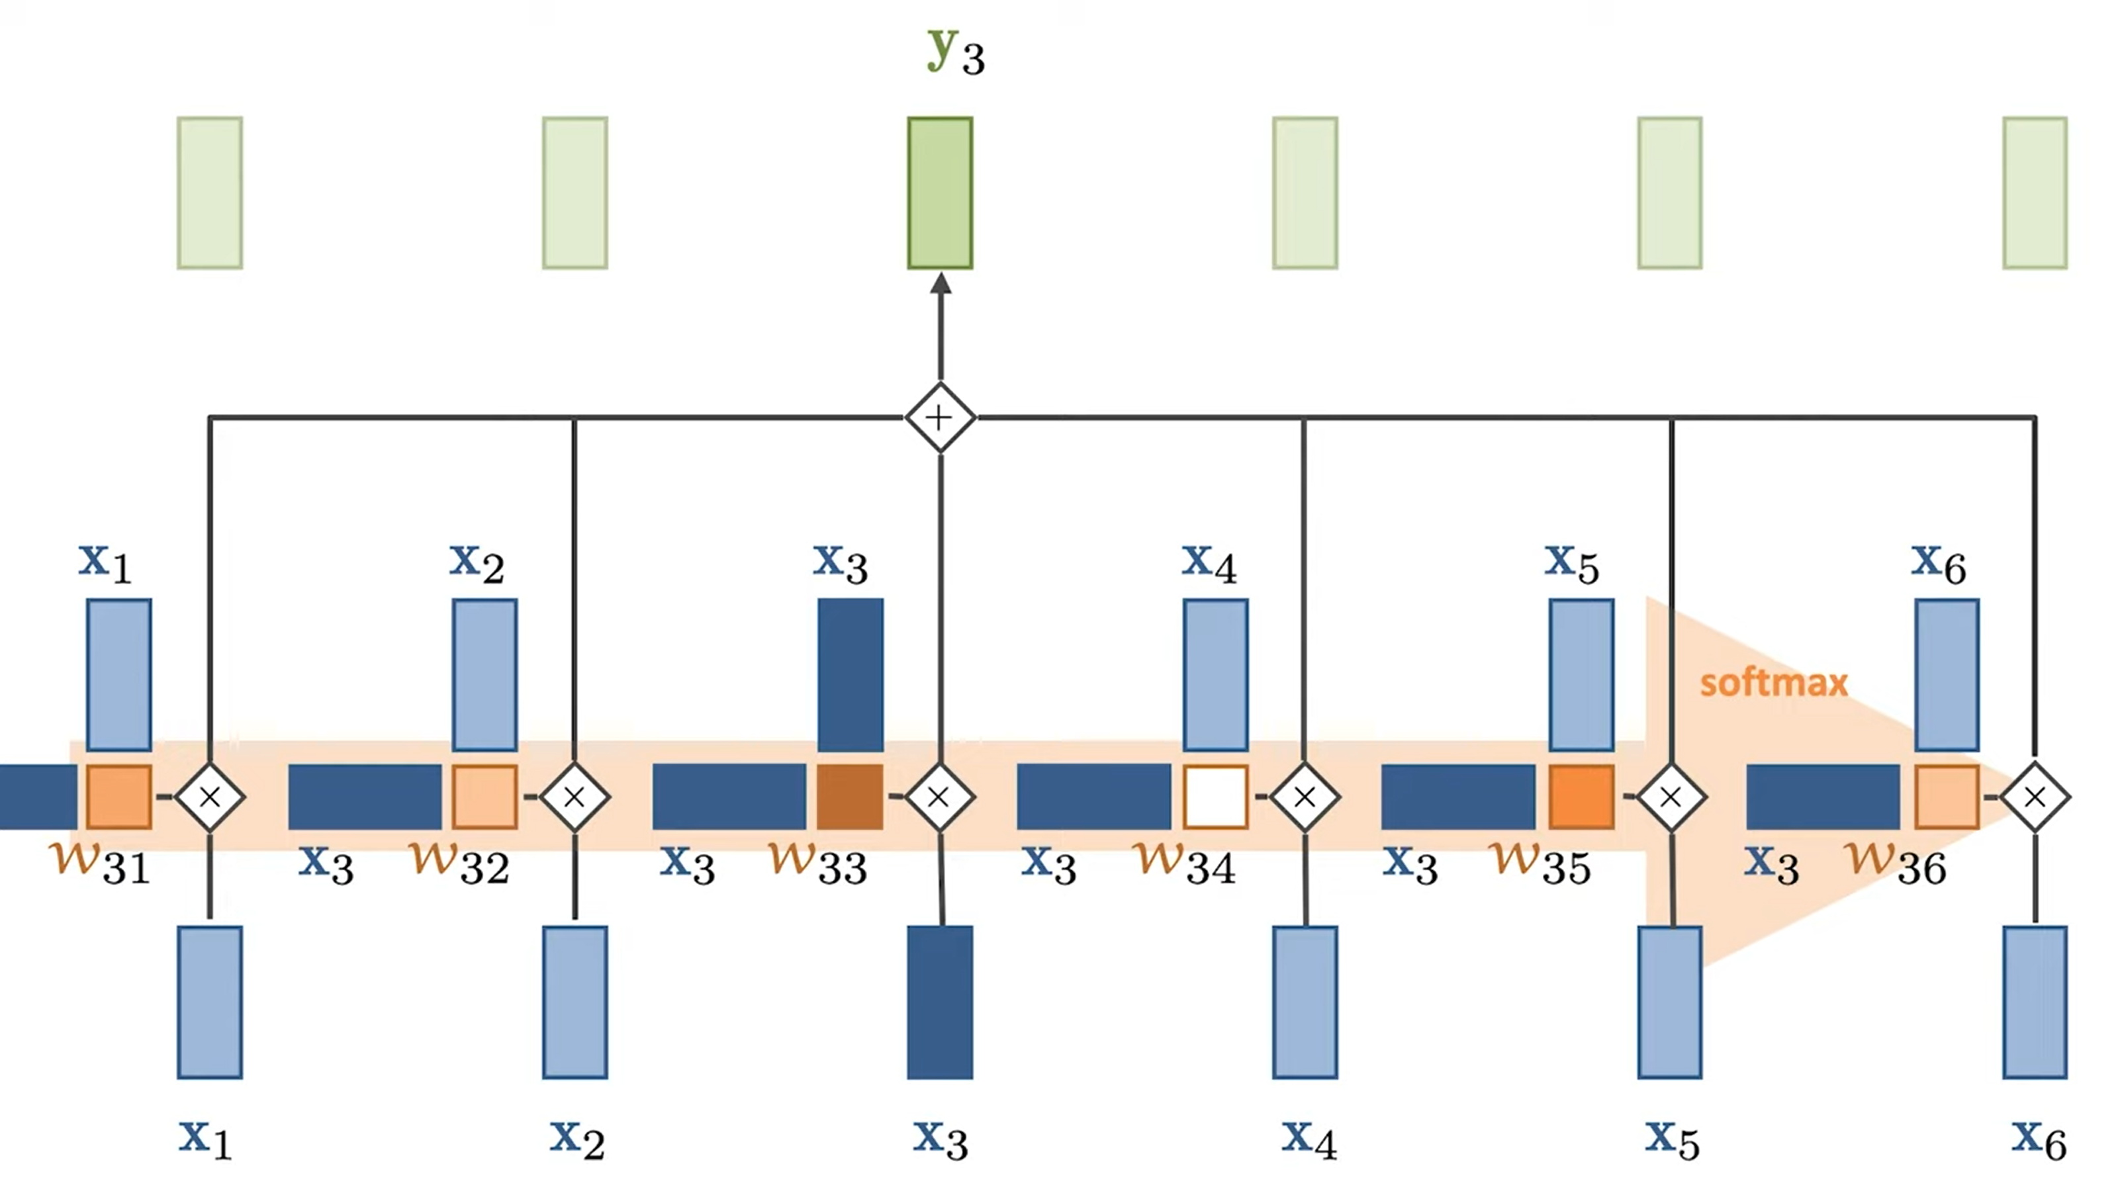

Slide 8
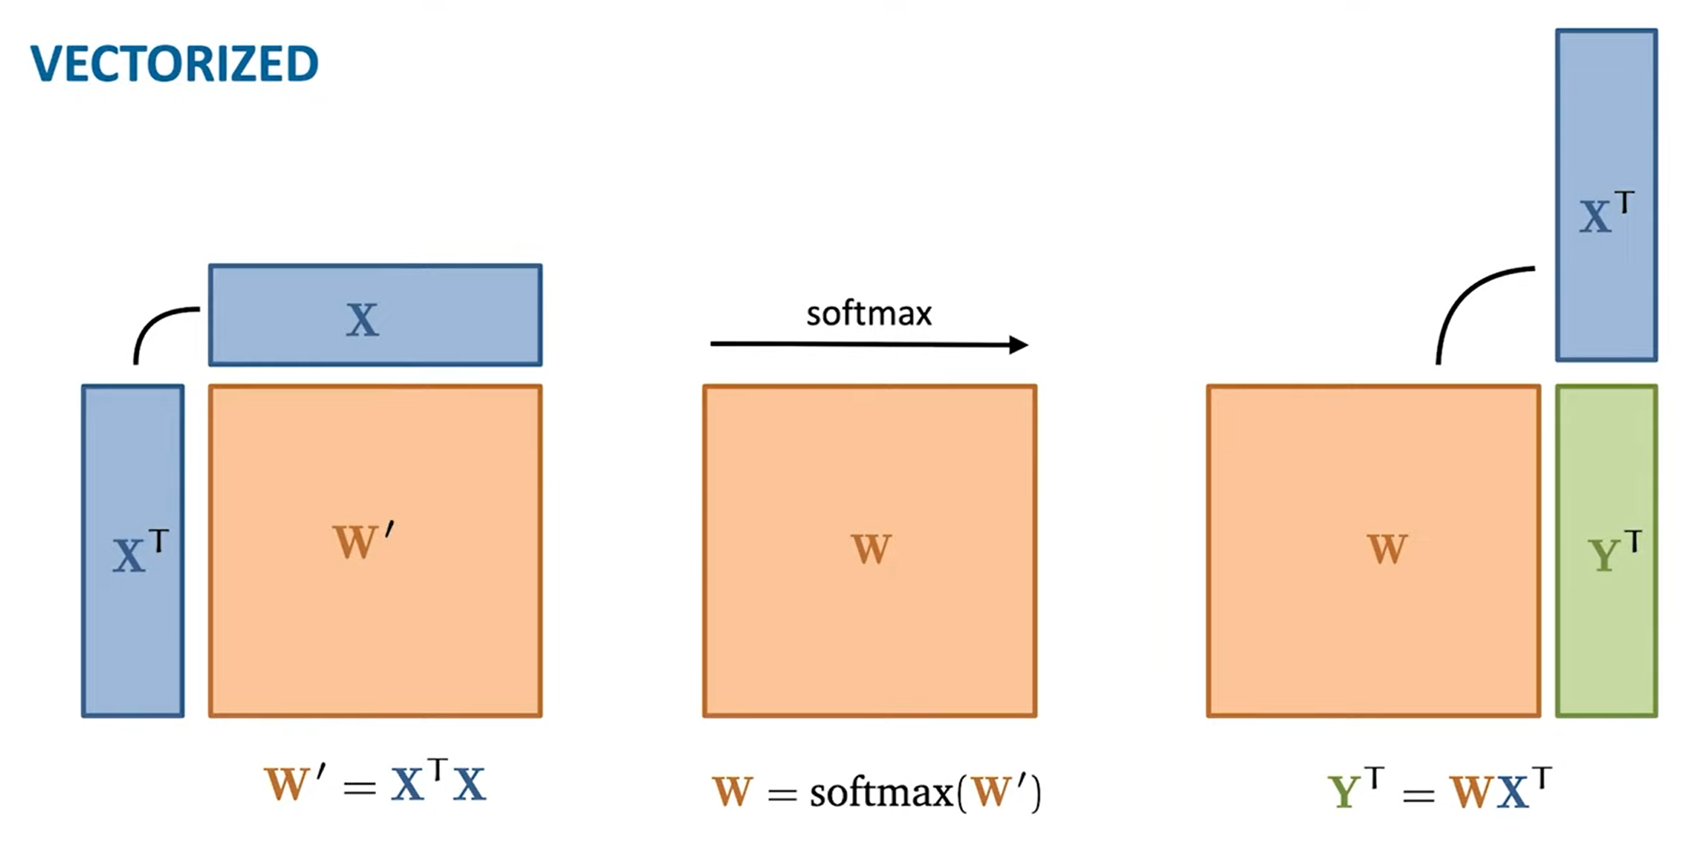

row_wise
$$w_{ii} \text{is} \text{usually} \text{the} \text{largest} \text{value}$$

Slide 9
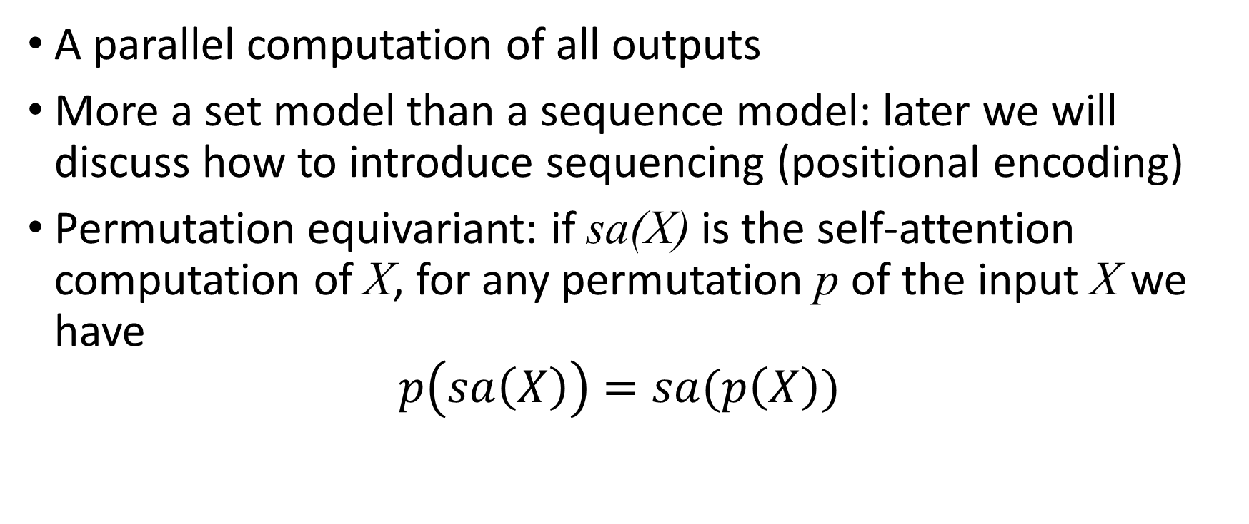
Properties
A parallel computation of all outputs
More a set model than a sequence model: later we will discuss how to introduce sequencing (positional encoding)
Permutation equivariant: if sa(X) is the self-attention computation of X, for any permutation p of the input X we have
$p\left(sa\left(X\right)\right)=sa(p\left(X\right))$

Slide 10
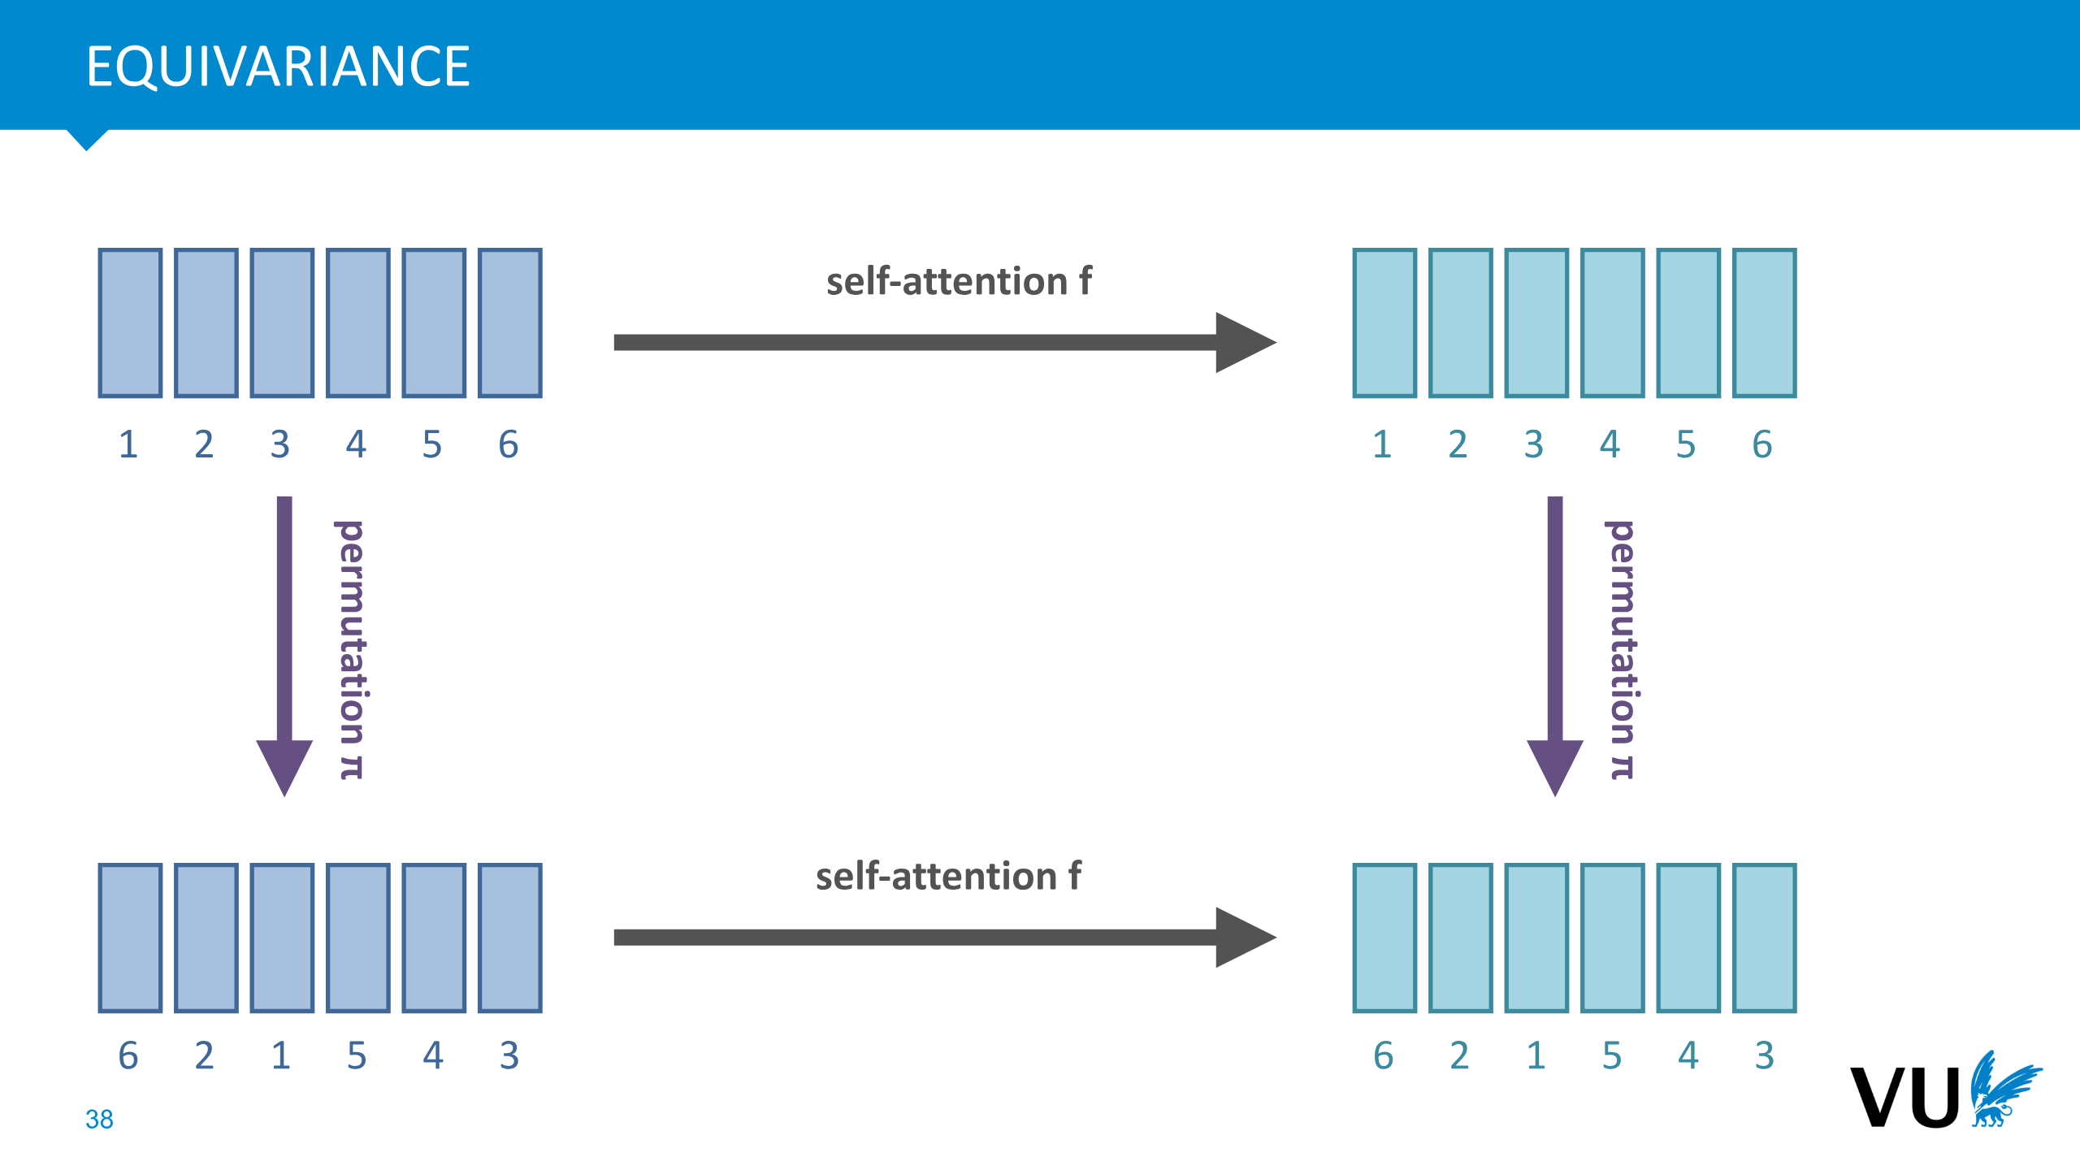

Slide 11
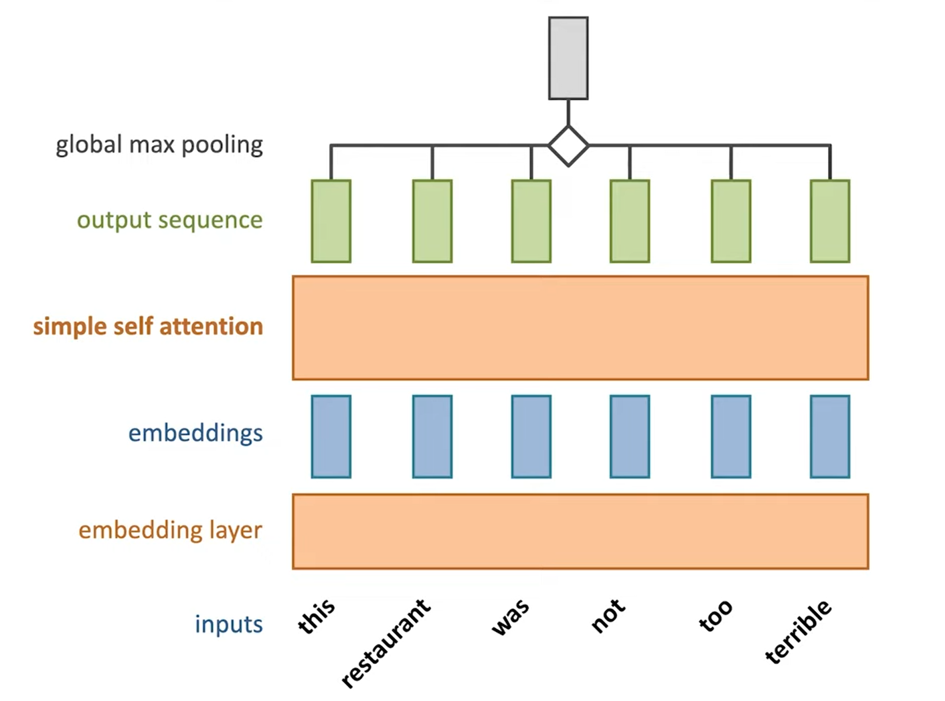
Example: sentiment classification
The model can learn that the word terrible
is actually putting attention to the word not
which reverse its meaning
(actual sentiment is positive here)

Slide 12
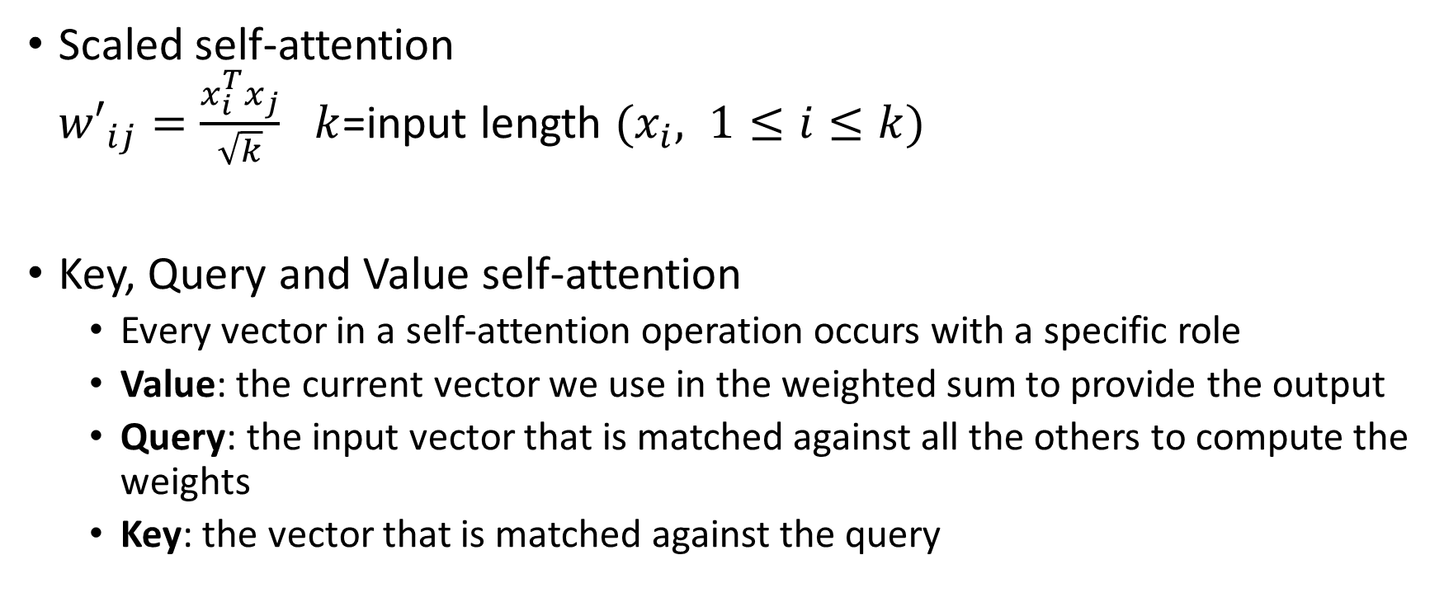
Self attention: refinements
Scaled self-attention
${w′}_{ij}=\frac{x_{i}^{T}x_{j}}{\sqrt{k}}$ $k$=input length $(x_{i}, 1≤i≤k)$
Key, Query and Value self-attention
  Every vector in a self-attention operation occurs with a specific role
  Value: the current vector we use in the weighted sum to provide the output
  Query: the input vector that is matched against all the others to compute the weights
  Key: the vector that is matched against the query

Slide 13
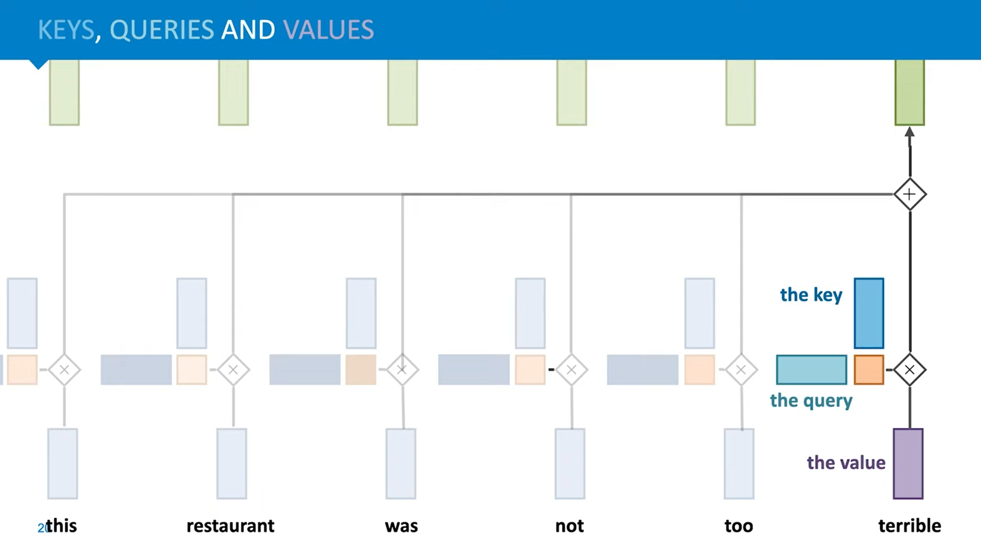

Slide 14
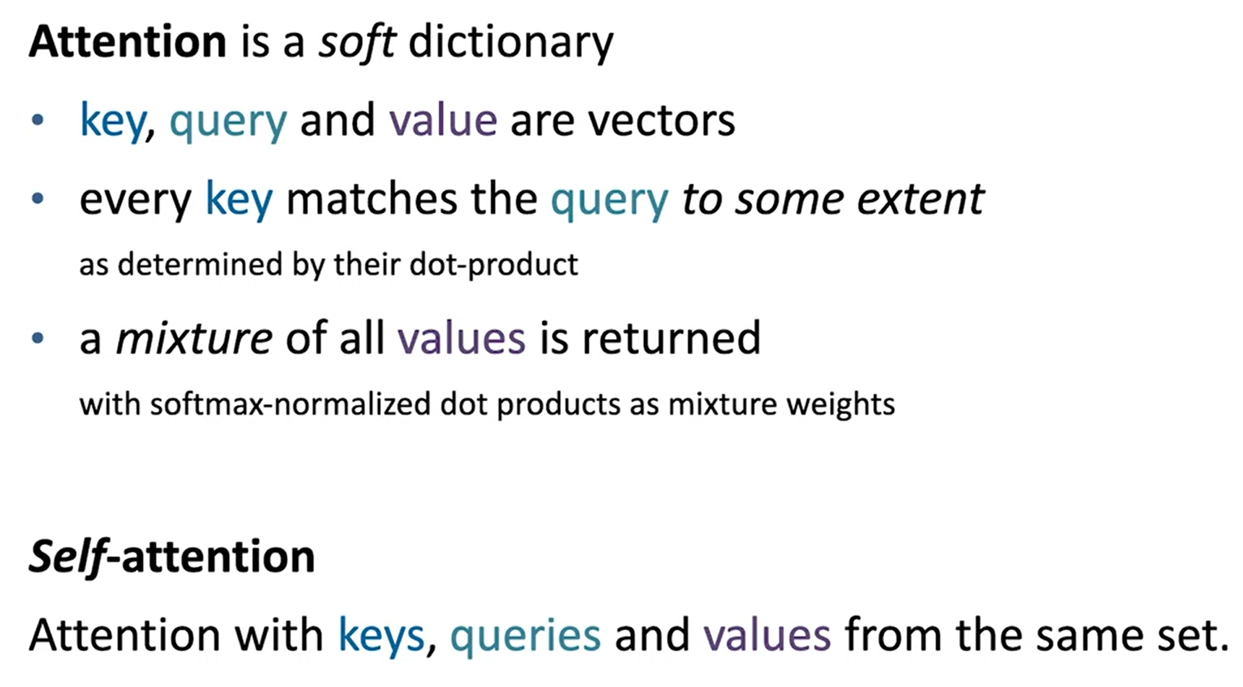
When Q is from a different set than K and V
we have Cross-attention
Example in the decoder block of a Transformer

Slide 15






Linear transformation and dimensionality reduction
$$y=Wx+b \text{(}\text{learnable} W \text{and} b)$$
Given matrix $W:\left[m ×n\right],$vector $x:[n×1]$ then $y=Wx:[m×1]$
if $m<n$ we operate a dimensionality reduction
W is a linear operator projecting the original vectors into a lower dimensionality
$$x$$
$$y$$
$$W$$
$$×$$
$$=$$

Slide 16
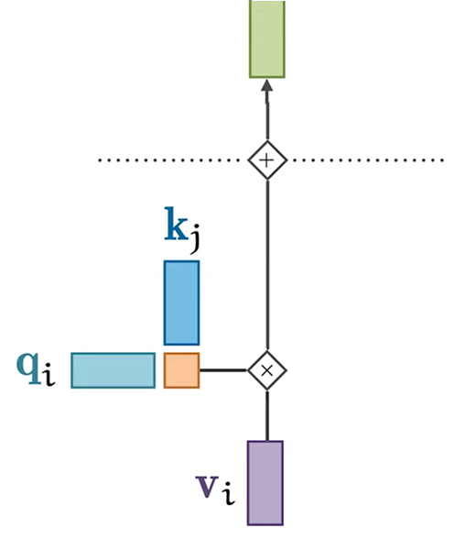
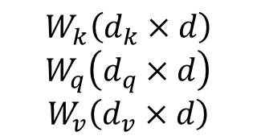
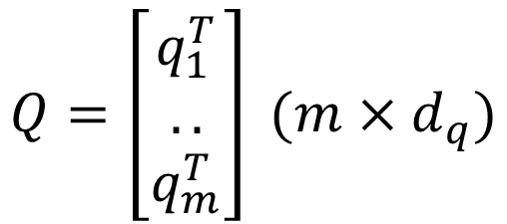

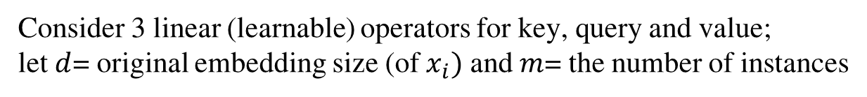
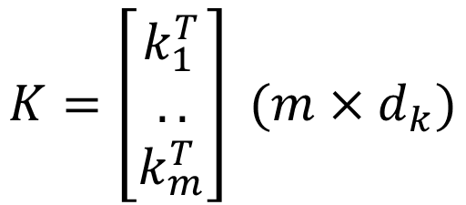


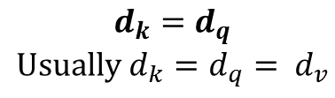

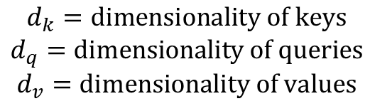
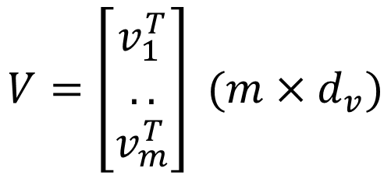
Consider 3 linear (learnable) operators for key, query and value;
let $d$= original embedding size (of $x_{i})$ and $m$= the number of instances
$$k_{j}=W_{k}x_{j}+b_{k}$$
$$W_{k}\left(d_{k}×d\right)$$
$$W_{q}\left(d_{q}×d\right)$$
$$W_{v}\left(d_{v}×d\right)$$
$$d_{k}=\text{dimensionality} \text{of} \text{keys}$$
$$d_{q}=\text{dimensionality} \text{of} \text{queries}$$
$$d_{v}=\text{dimensionality} \text{of} \text{values}$$
$$q_{i}=W_{q}x_{i}+b_{q}$$
$$v_{j}=W_{v}x_{j}+b_{v}$$
$$d_{k}=d_{q}$$
$$\text{Usually} d_{k}=d_{q}= d_{v}$$
$$\text{Let} K, Q \text{and} V \text{be} \text{the} \text{matrices} \text{with} \text{rows} k_{j},q_{i} \text{and} v_{j} \text{respectively}$$
$$j$$
$$K=\left[\begin{matrix}k_{1}^{T} \\ .. \\ k_{m}^{T}\end{matrix}\right] (m×d_{k})$$
$$Q=\left[\begin{matrix}q_{1}^{T} \\ .. \\ q_{m}^{T}\end{matrix}\right] (m×d_{q})$$
$$V=\left[\begin{matrix}v_{1}^{T} \\ .. \\ v_{m}^{T}\end{matrix}\right] (m×d_{v})$$

Slide 17
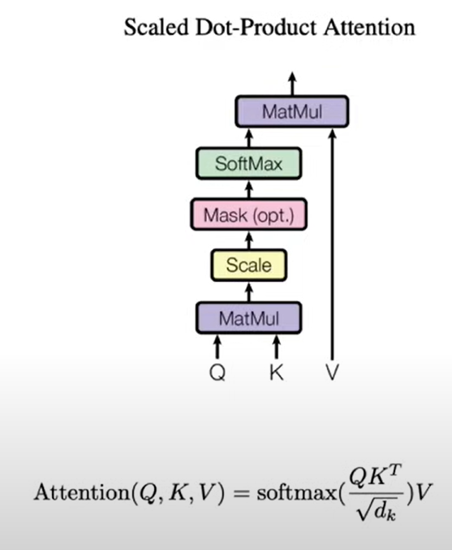
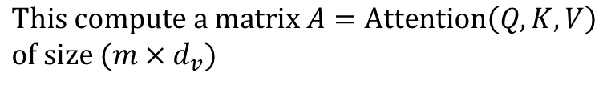
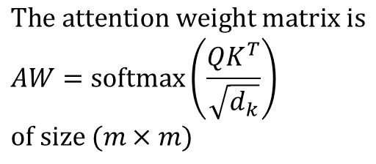
Self-attention with Query Key Value
$$\text{This} \text{compute} \text{a} \text{matrix} A=\text{Attention}\left(Q,K,V\right) \\ \text{of} \text{size} (m×d_{v})$$
$$\text{The} \text{attention} \text{weight} \text{matrix} \text{is} \\ AW=\text{softmax}\left(\frac{QK^{T}}{\sqrt{d_{k}}}\right) \\ \text{of} \text{size} (m×m)$$
$$AW\left(i,j\right)=\text{attention} \text{of} \text{query} q_{i} \text{for} \text{key} k_{j}$$

Slide 18
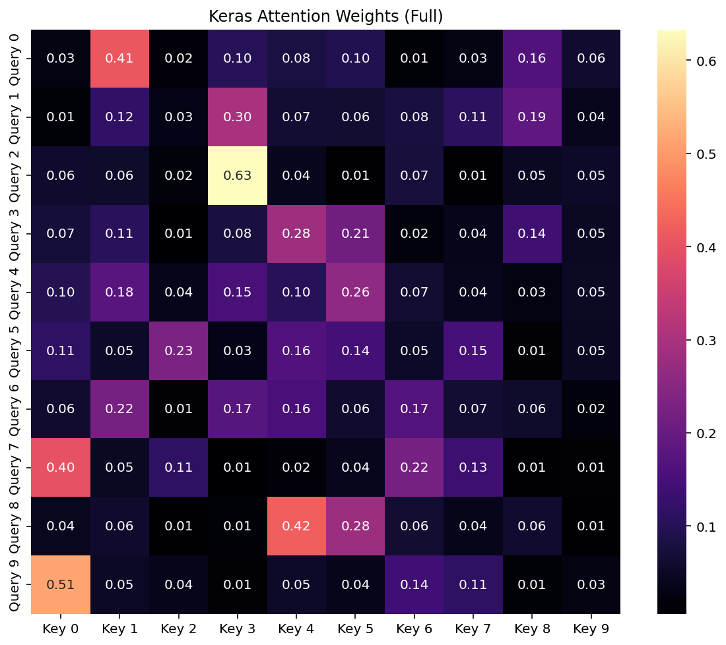
Attention
Map

Slide 19
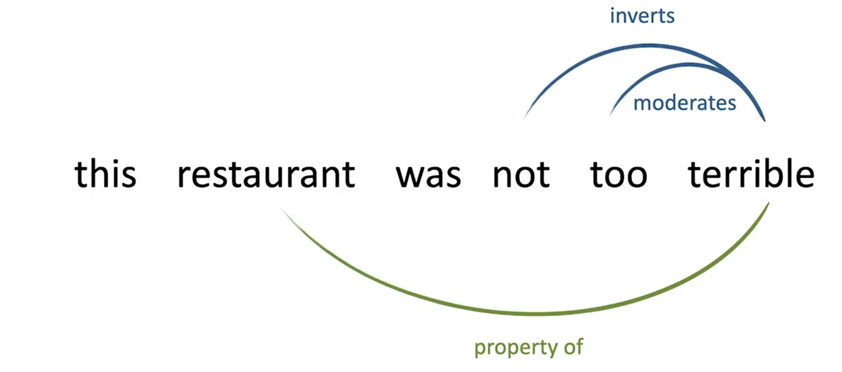
Multi-head attention
Different relationships between different words
In order to capture the different meaning of the different relationships
we split SA into heads applied in parallel

Slide 20
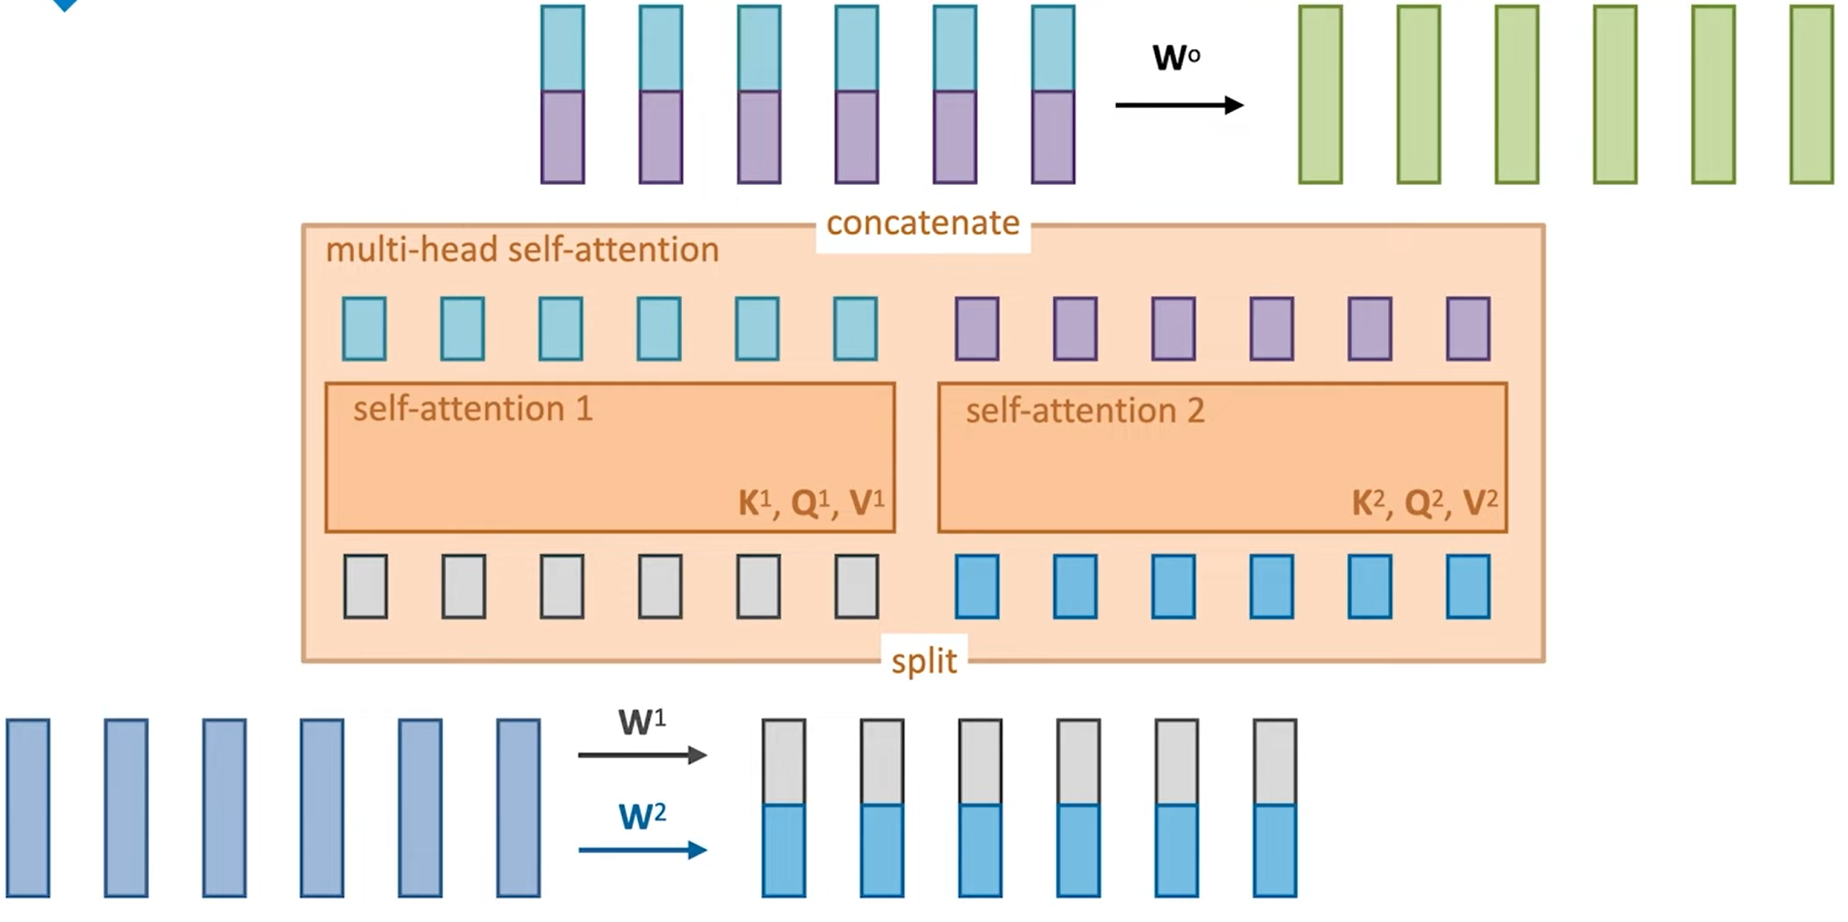
Multi-head self-attention
Linear transformations for
dimensionality reduction (embedding)

Slide 21
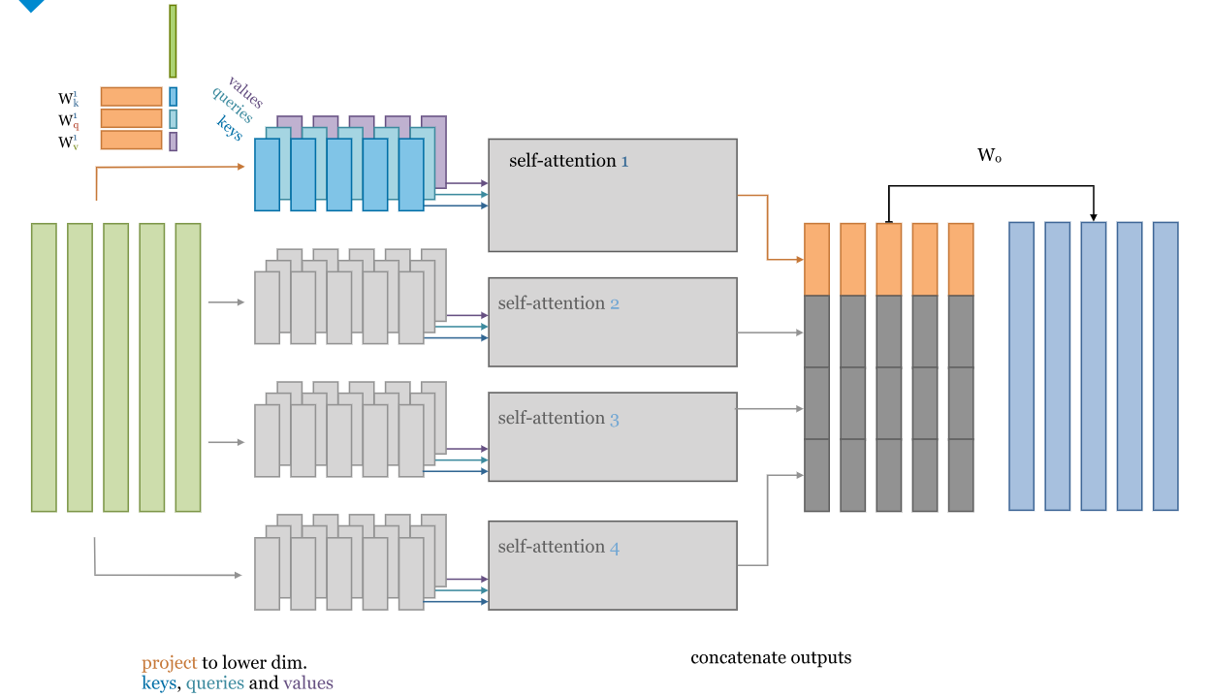
Multi-head self-attention

Slide 22
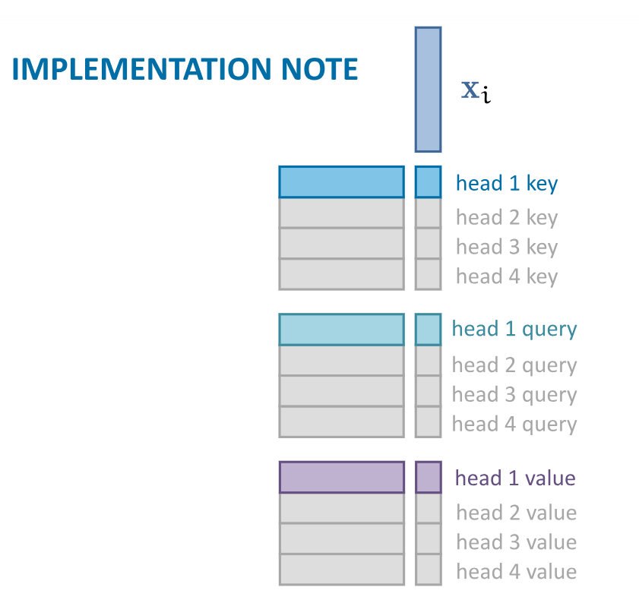
We can implement multi-head attention
by performing 3 matrix multiplications
for each vector, instead of 3 x k multiplications
(k=#heads)

Slide 23
Transformer
Any model that primarily use self-attention to propagate information between the basic units of considered instances
  Text tokens: original transformer (text transformer)
  Pixels: Vi-T: visual/vision transformer ([Dosovitskiy et al. ,"An Image is Worth 16x16 Words: Transformers for Image Recognition at Scale“, 2020]
  Graph nodes: graph transformer ([Vijai, Bresson. “A Generalization of Transformer Networks to Graphs”, 2020])

Slide 24
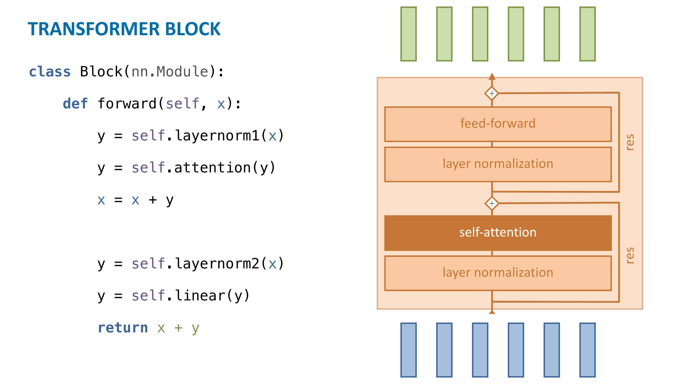

Slide 25
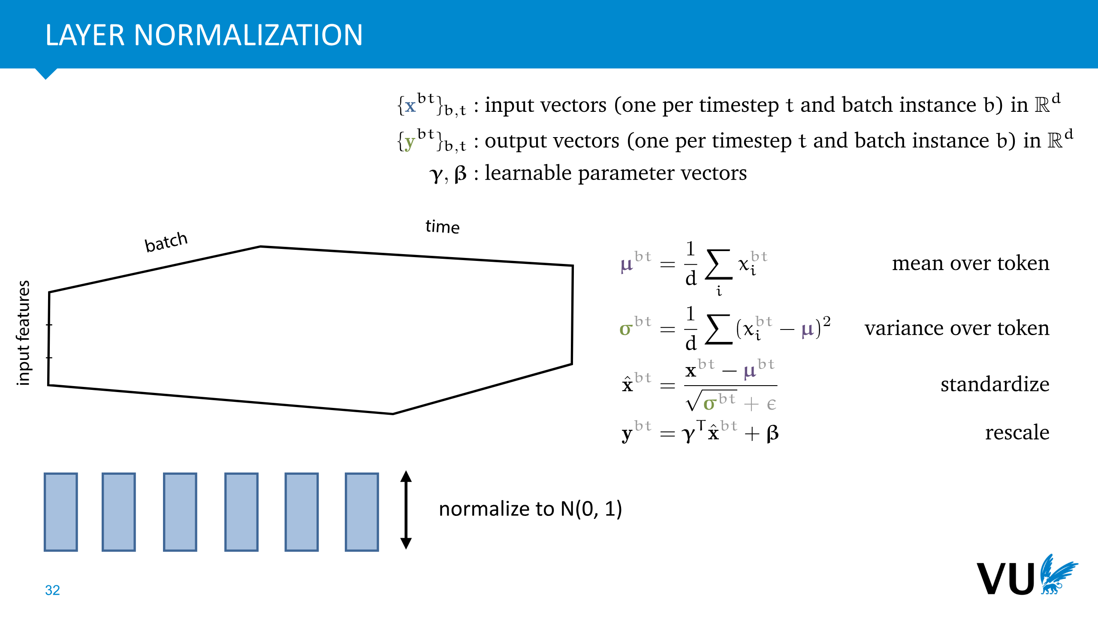
Like batch normalization but normalize on input features and not on the batch

Slide 26
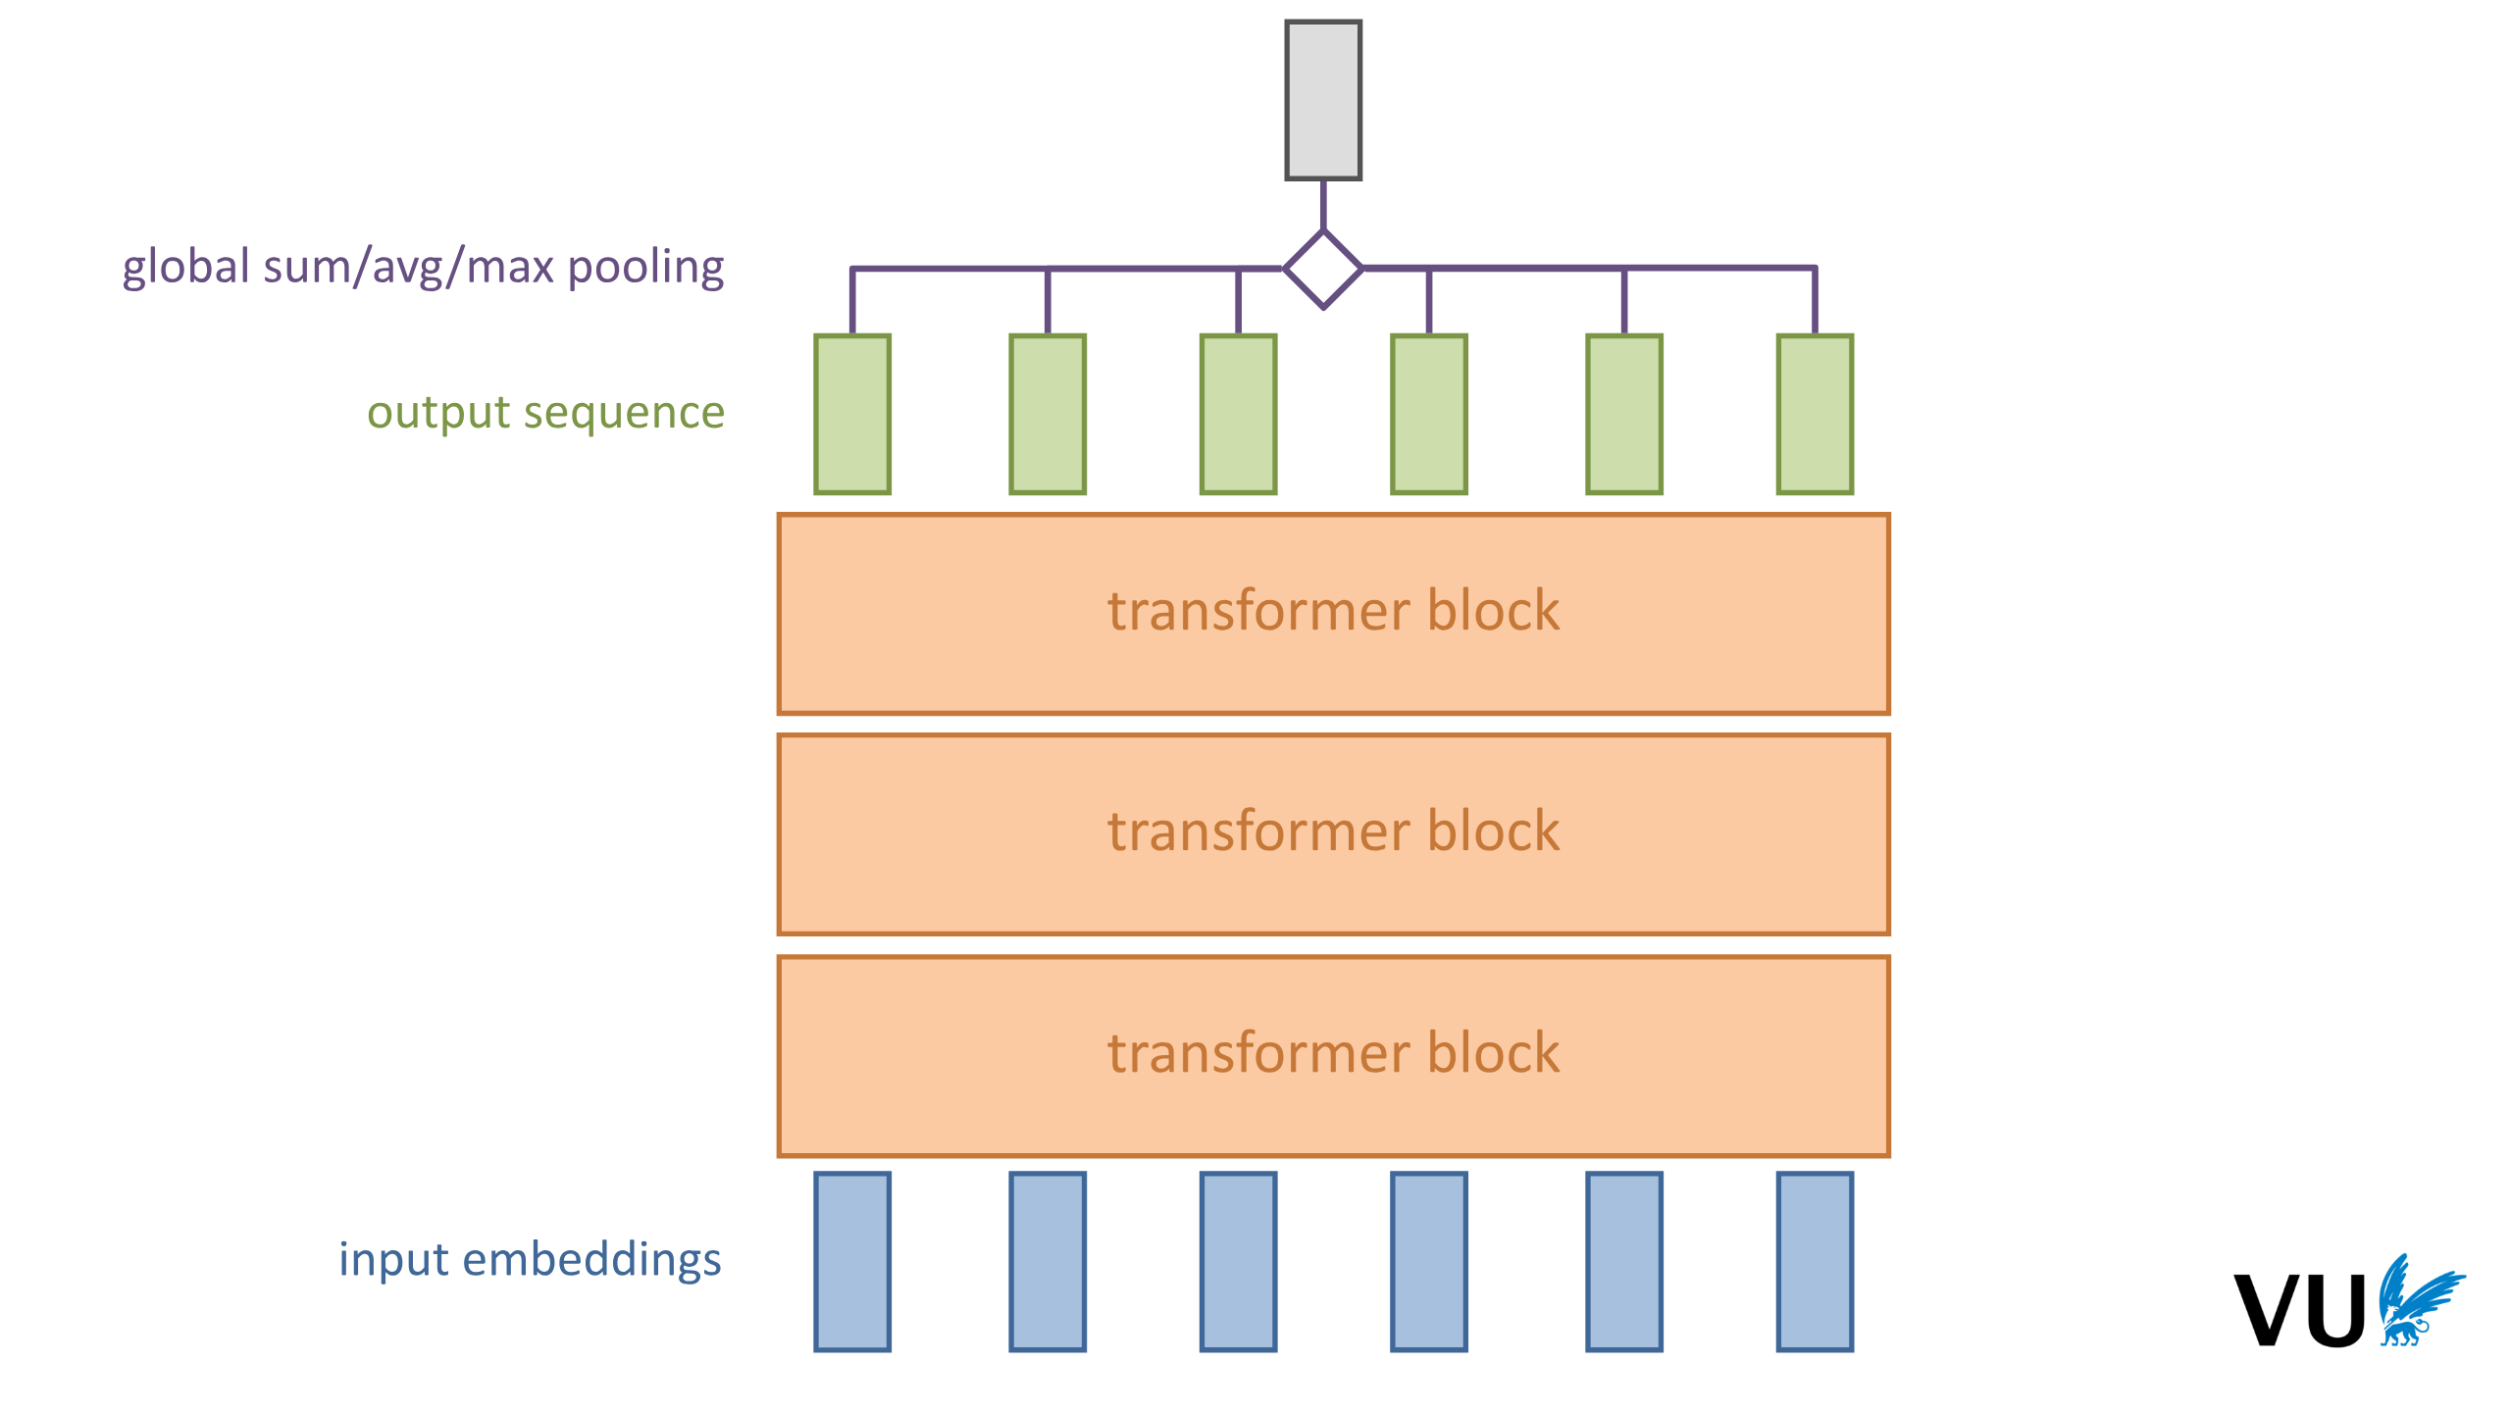

Slide 27
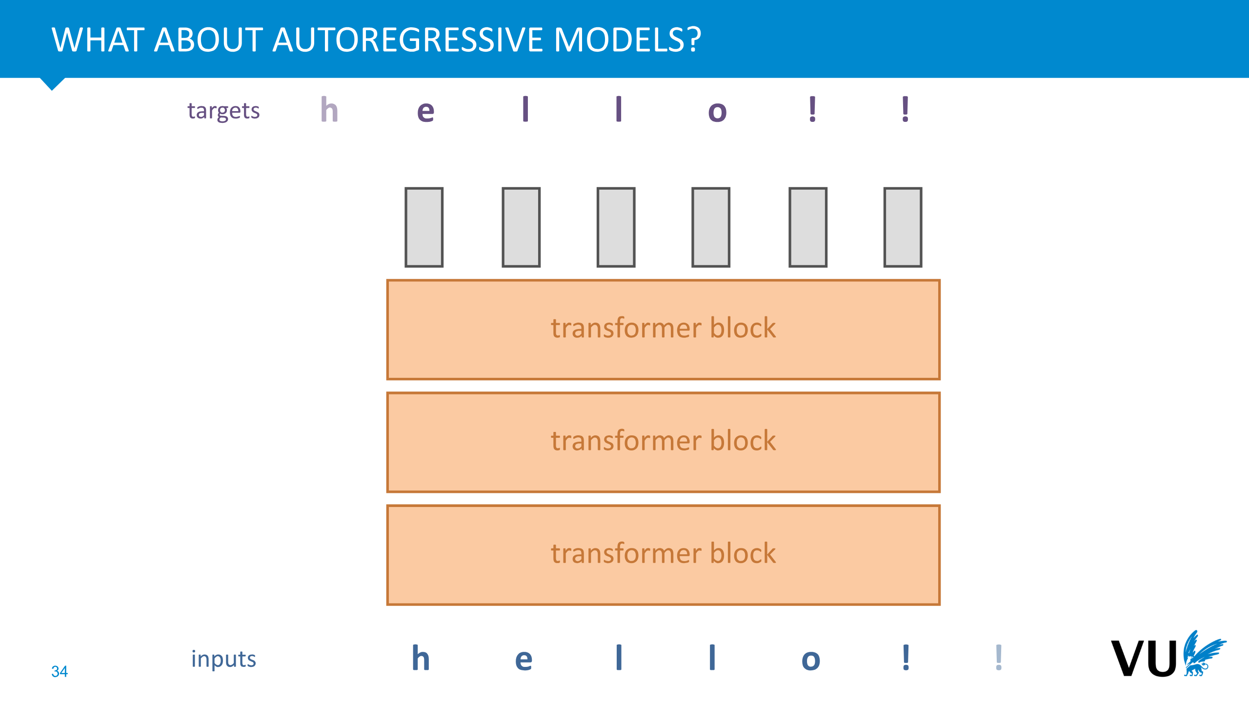
Task: predict the next token
in the sequence
The transformer has access to the
whole sequence/set, thus to predict
the next token it has to just look-up
in the sequence

Slide 28
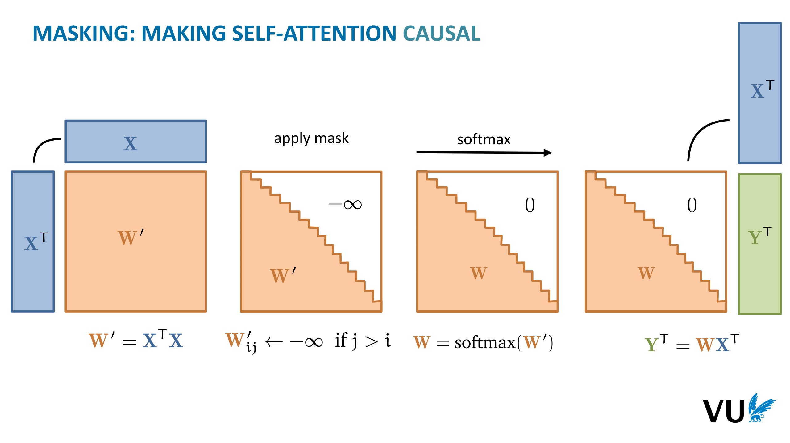

Slide 29
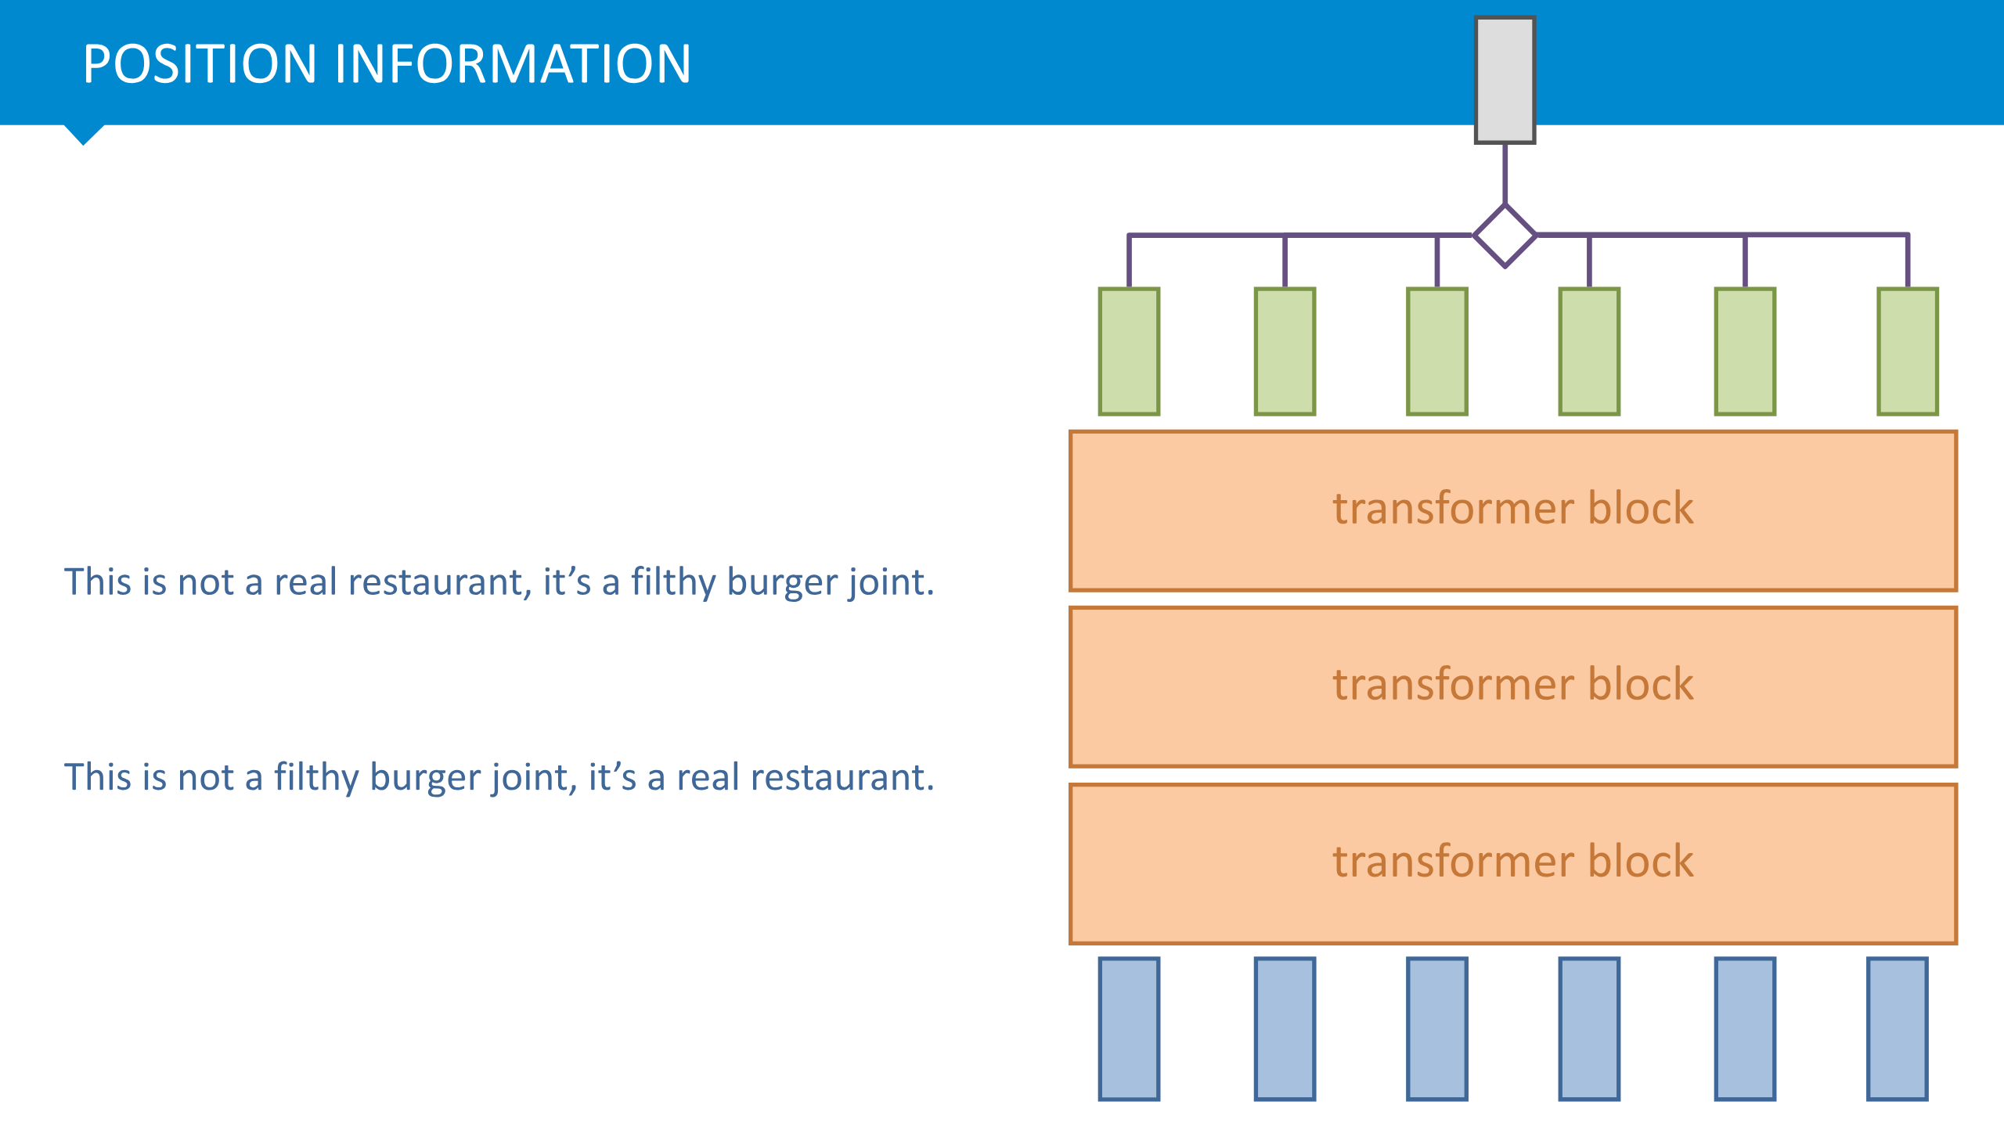

Slide 30
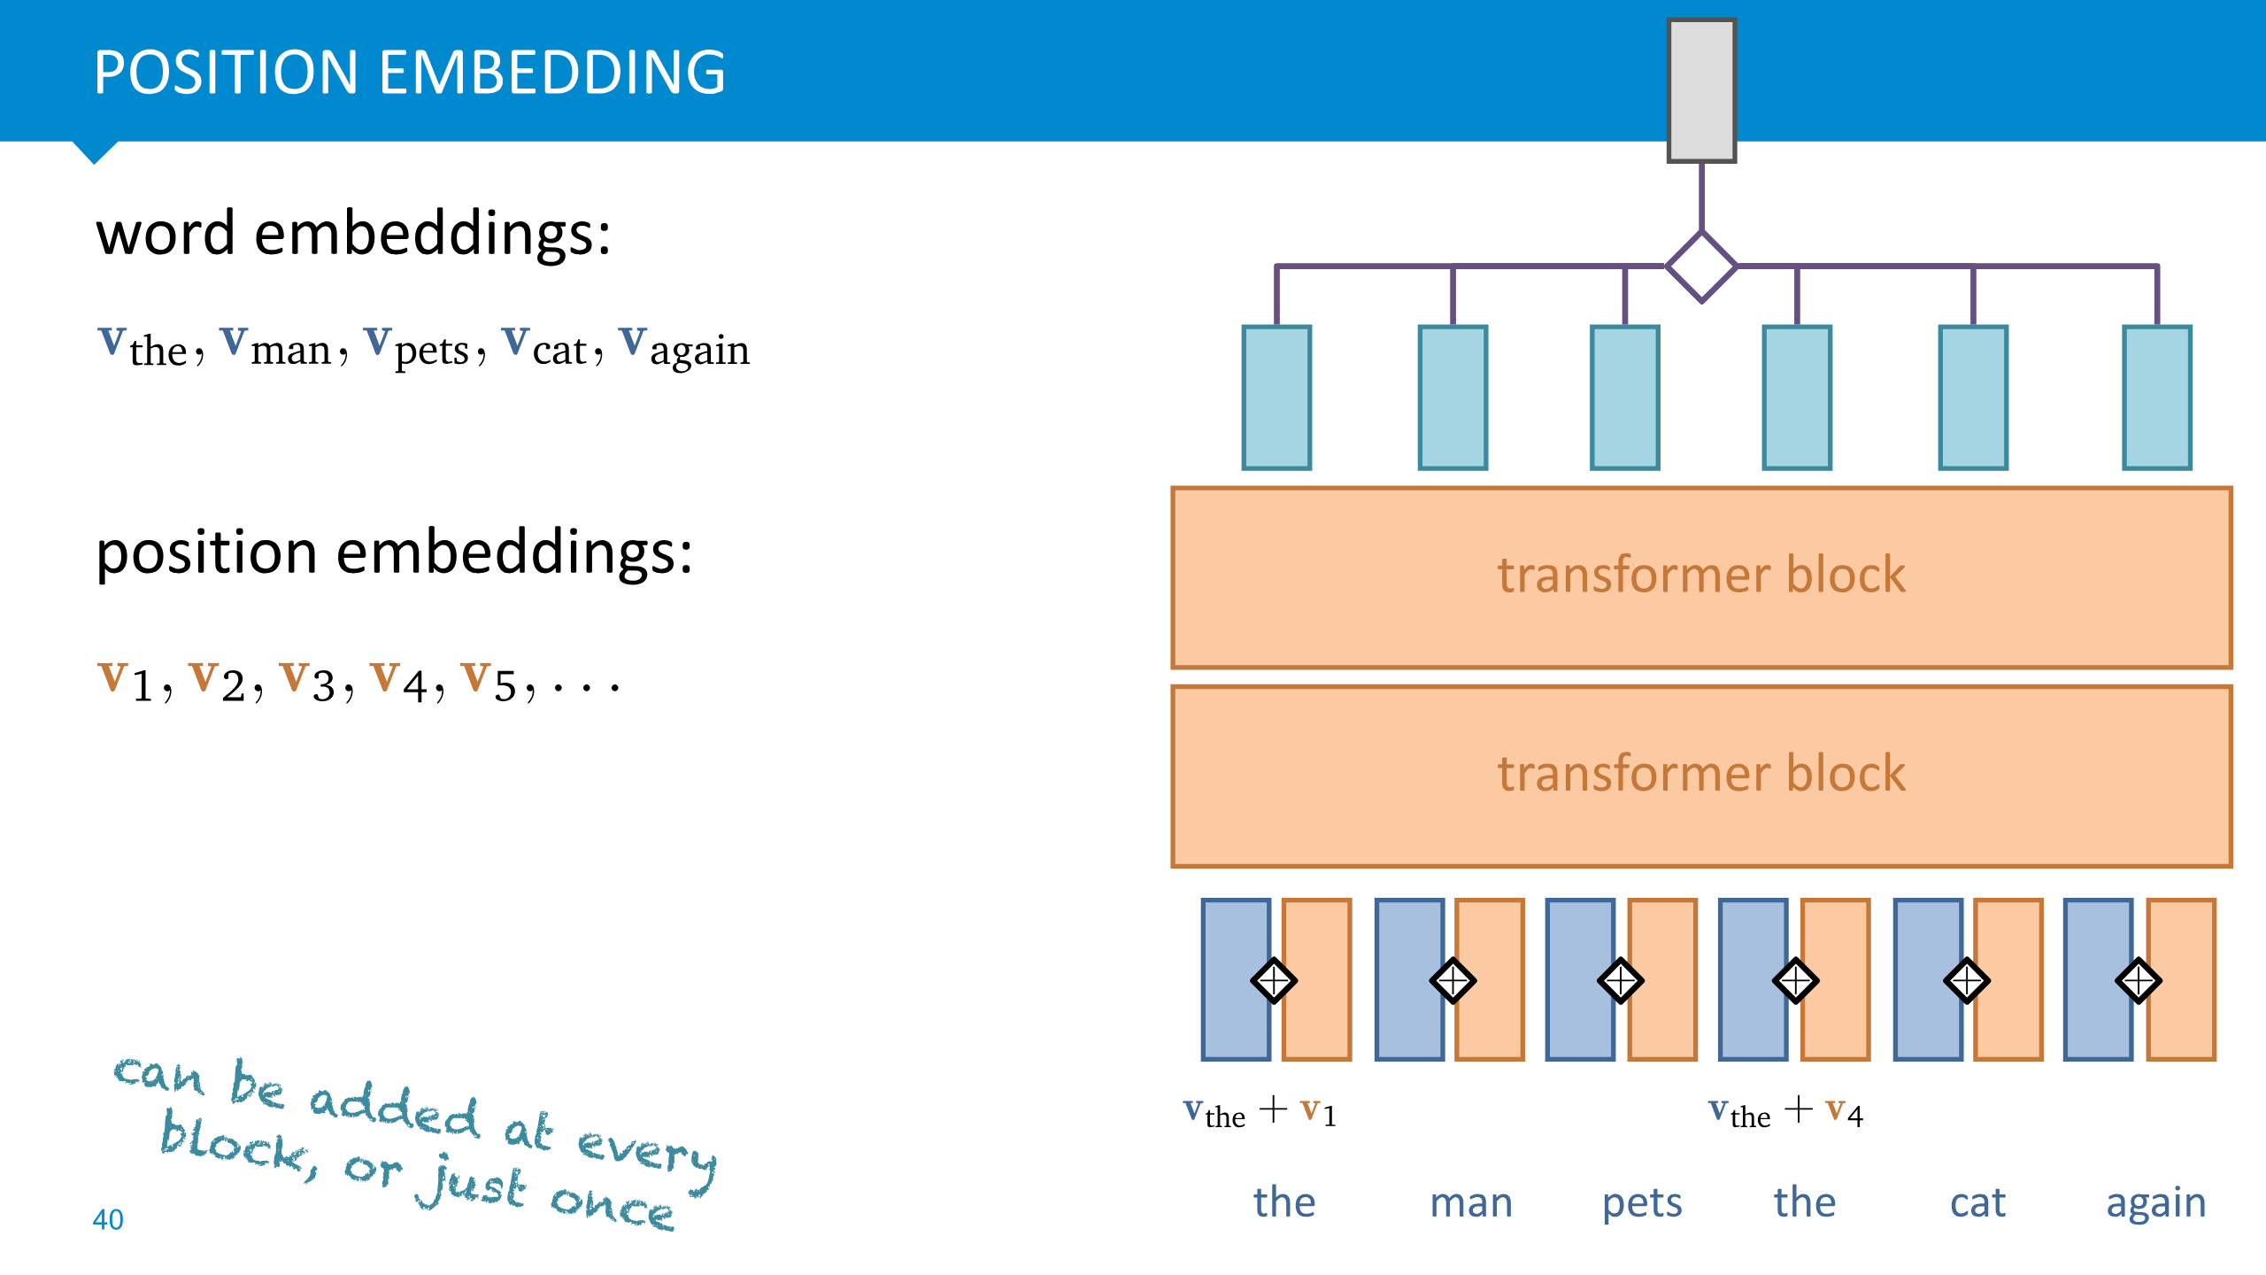
Cons: maximum length for a sequence

Slide 31
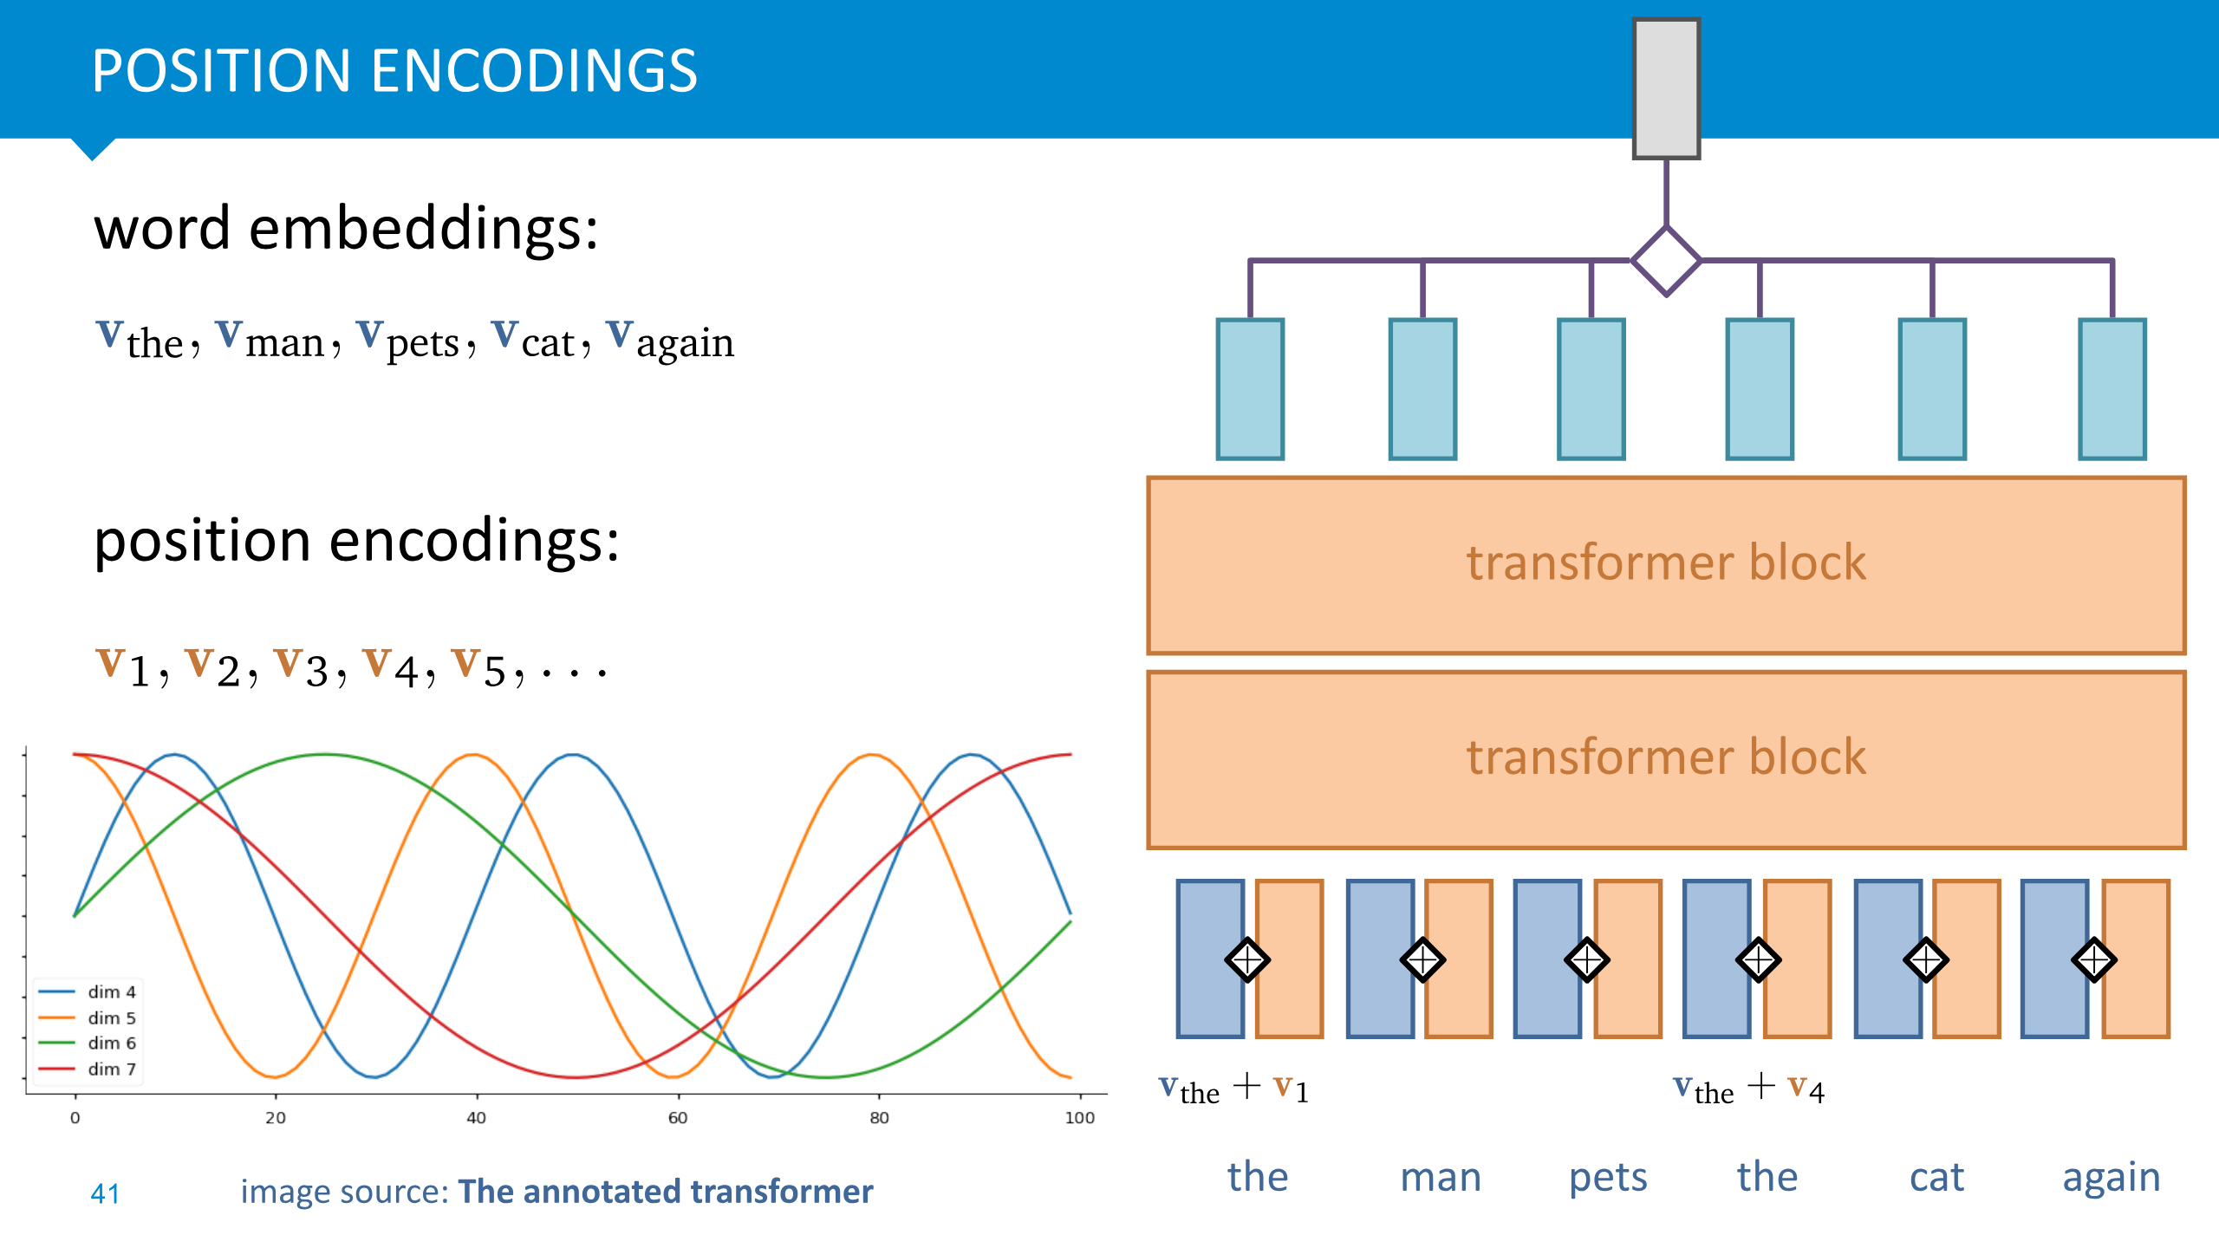

Slide 32
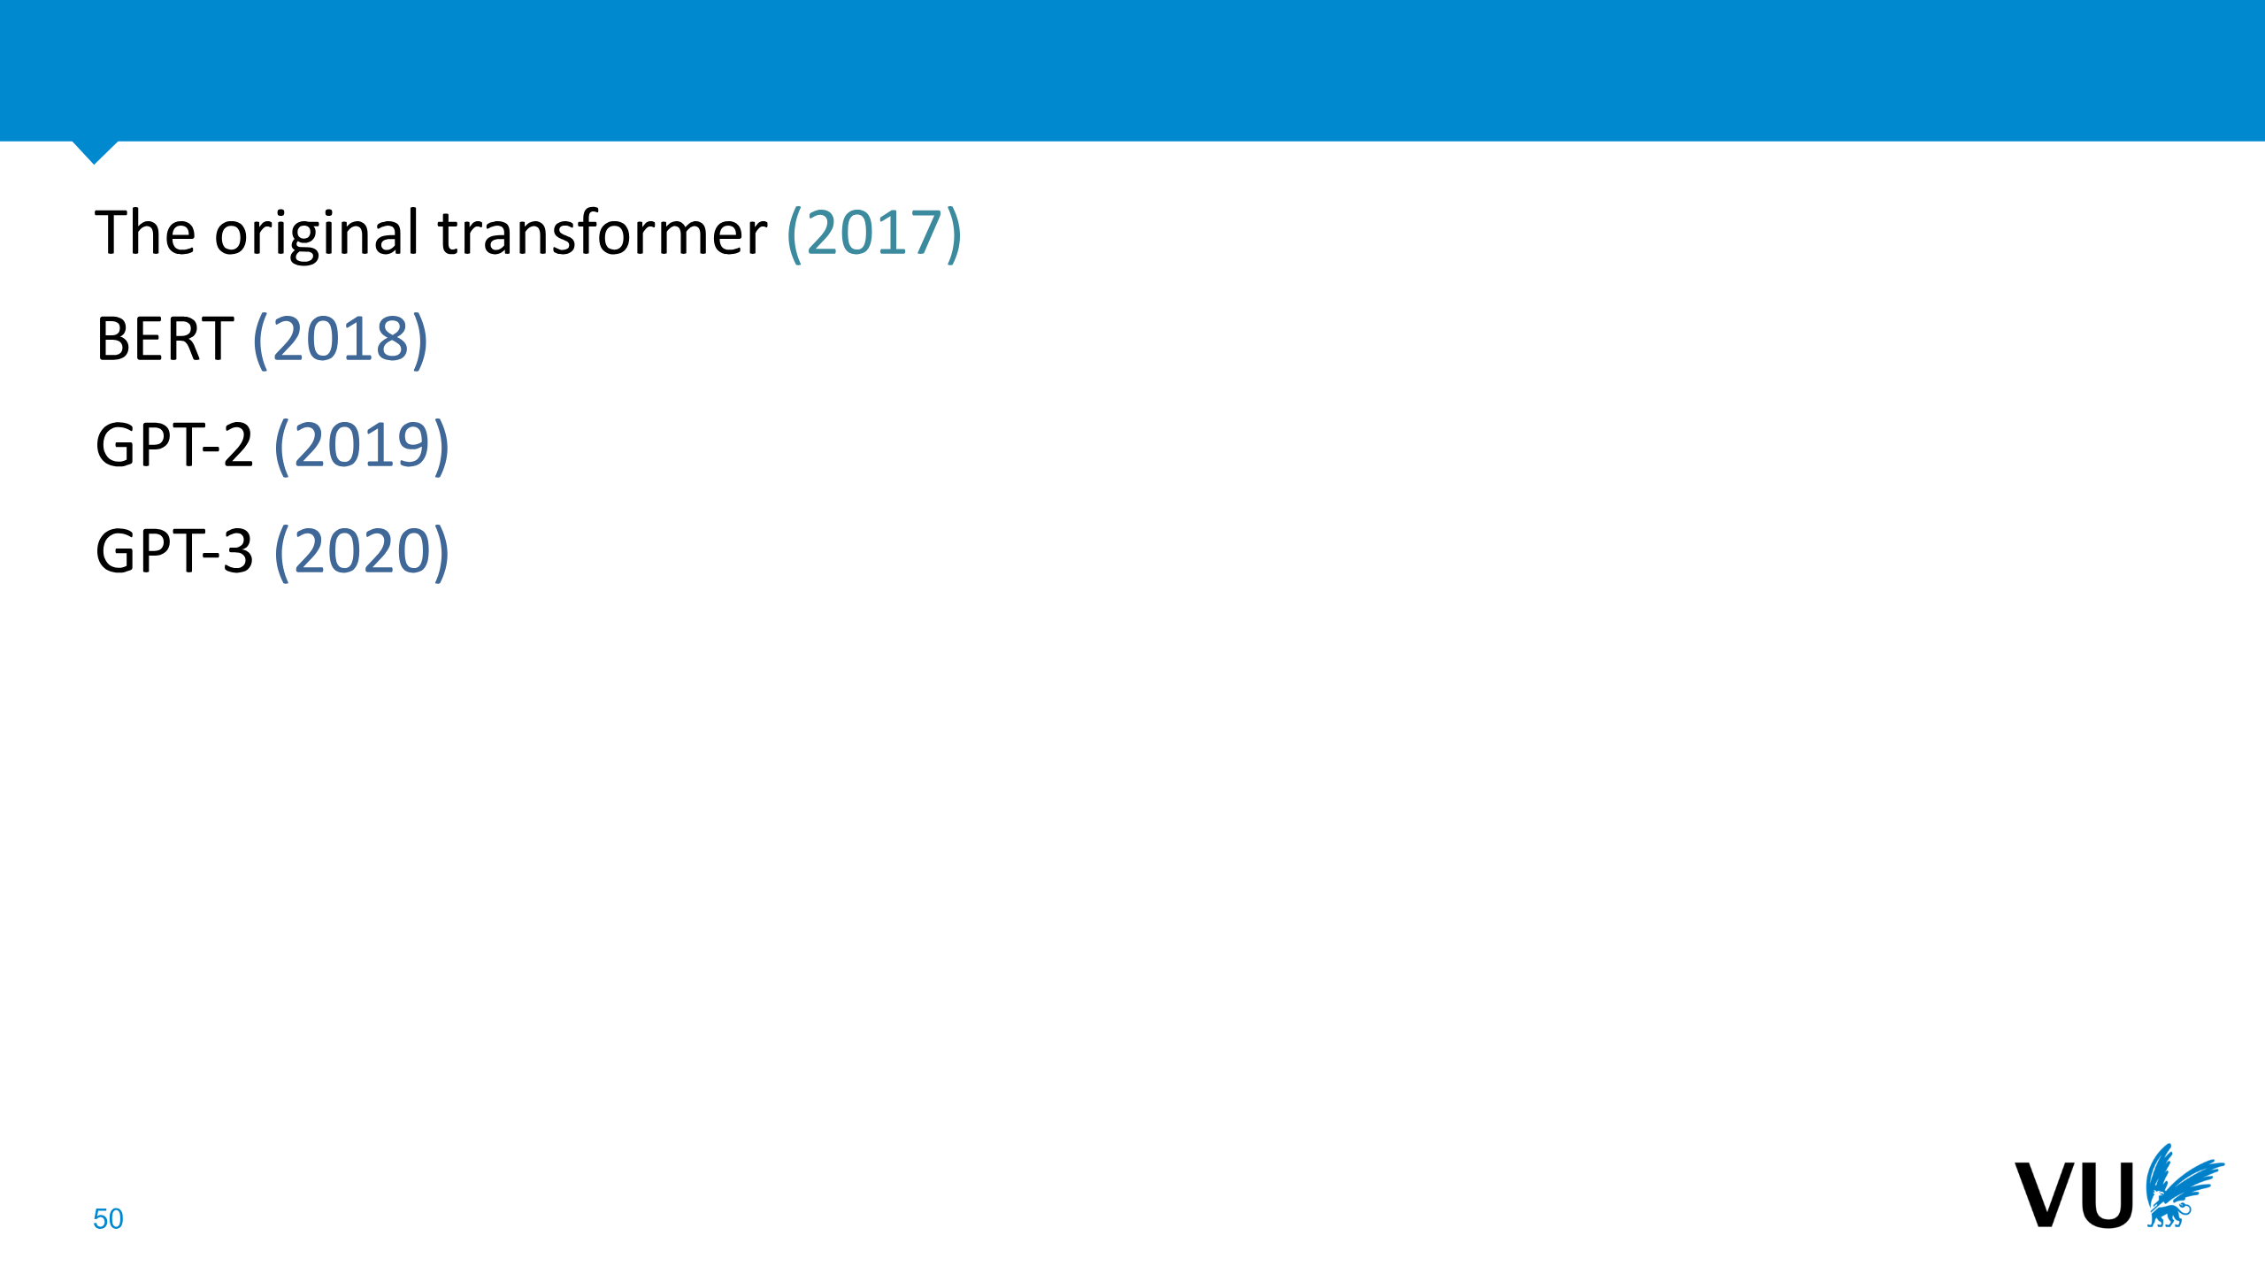

Slide 33
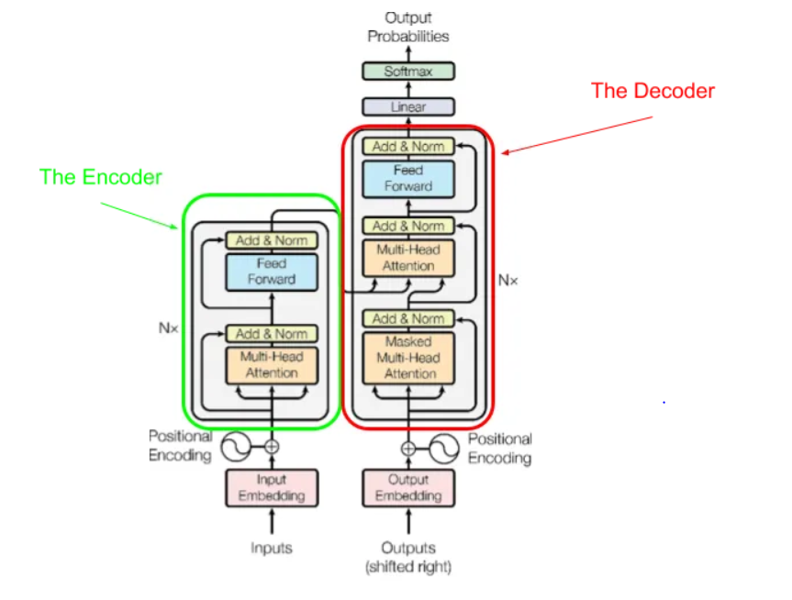

Slide 34
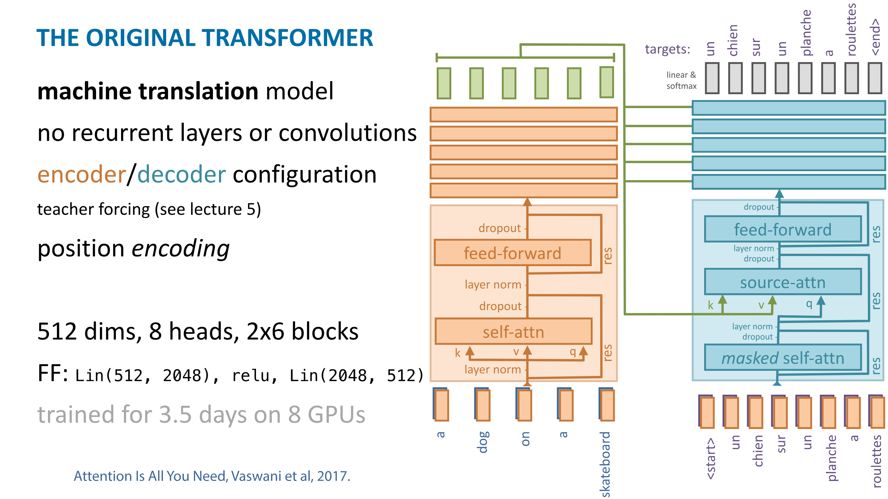

Slide 35
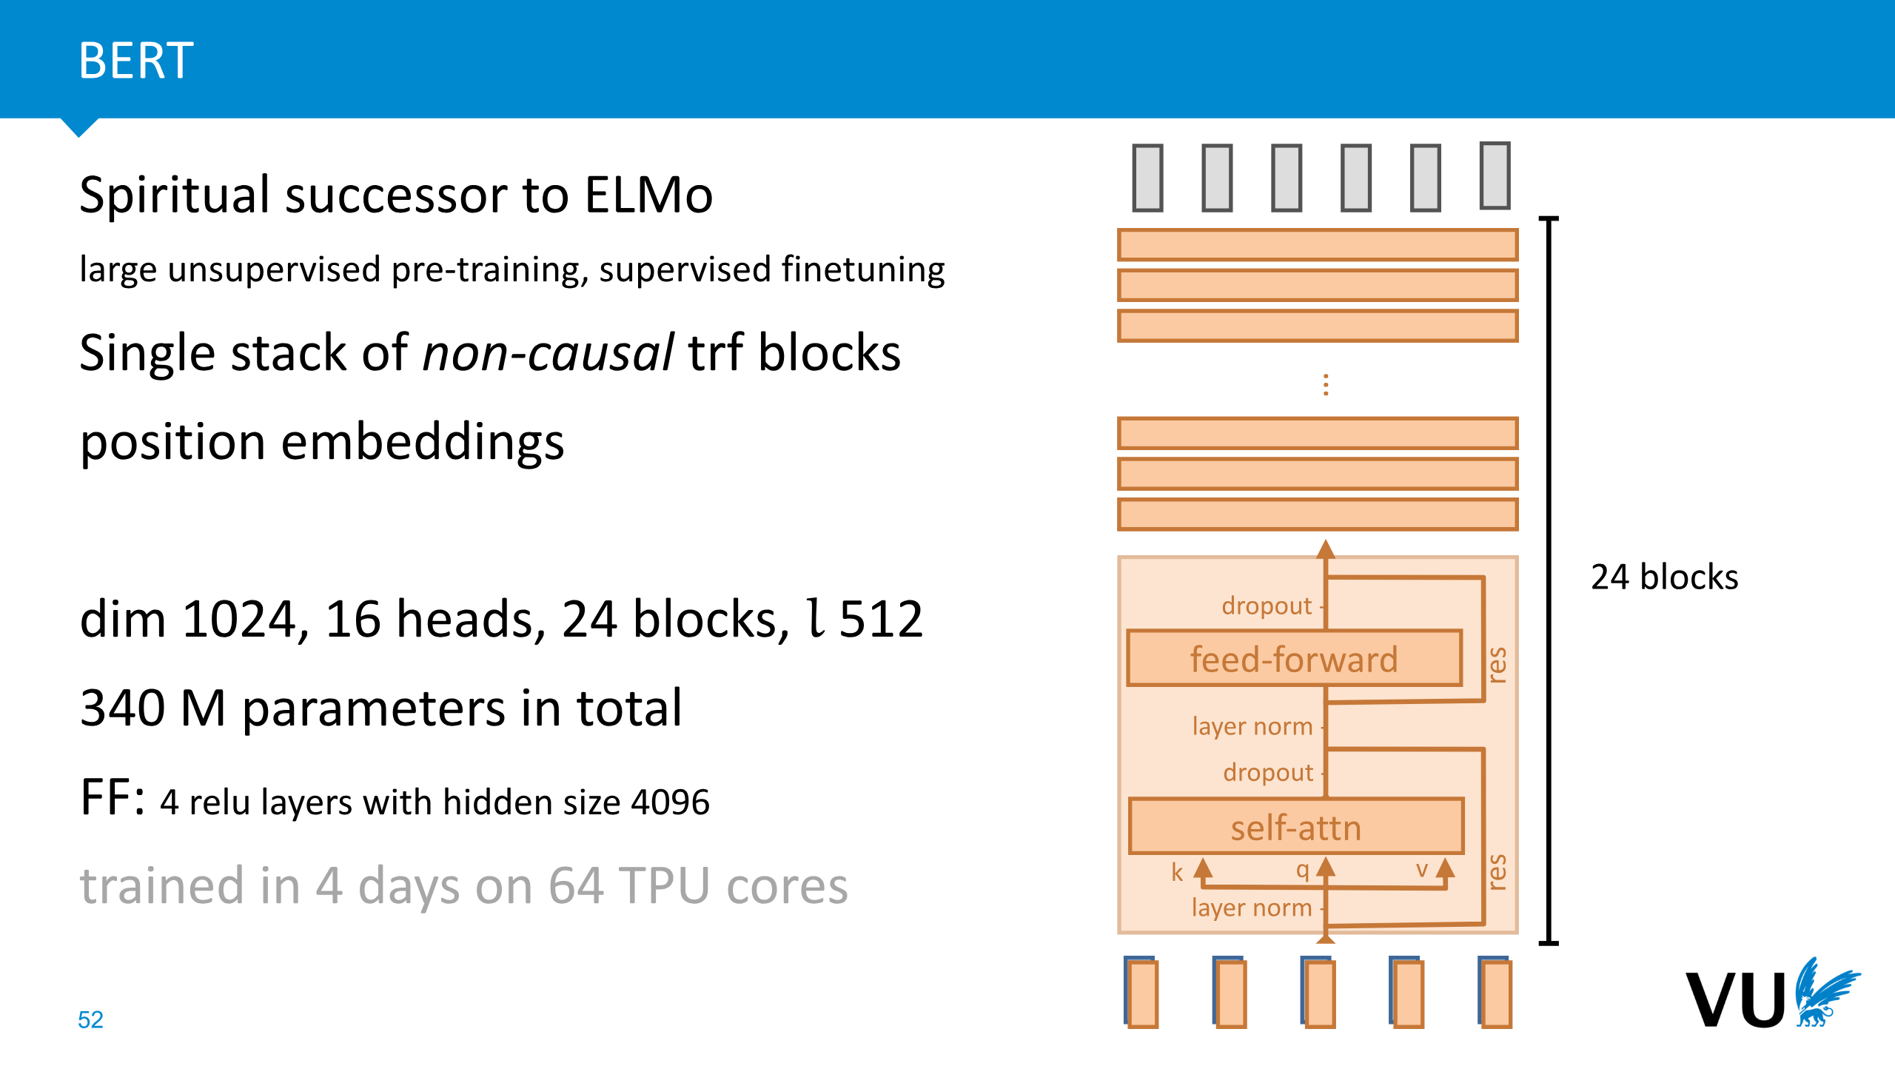
Bidirectional Encoder Representations from Transformers
Encoder-only transformer
Notes:
L’ouput sono degli embedding che catturano la semantica della frase in input. Es: genero output di una frase ed alleno un classificatore che sul quell’output clasifica il sentimento

Slide 36
BERT pre-training procedures
Task 1: masking
  Masking some input tokens and learn to predict the correct one
  Masking may be done by changing the word or by removing the word
Task 2: classification
  Input a pair of sequences from the corpus
  Learn to classify them as consecutive sequences in the corpus or not
BERT considerably advanced the state of the art on many NLP tasks

Slide 37
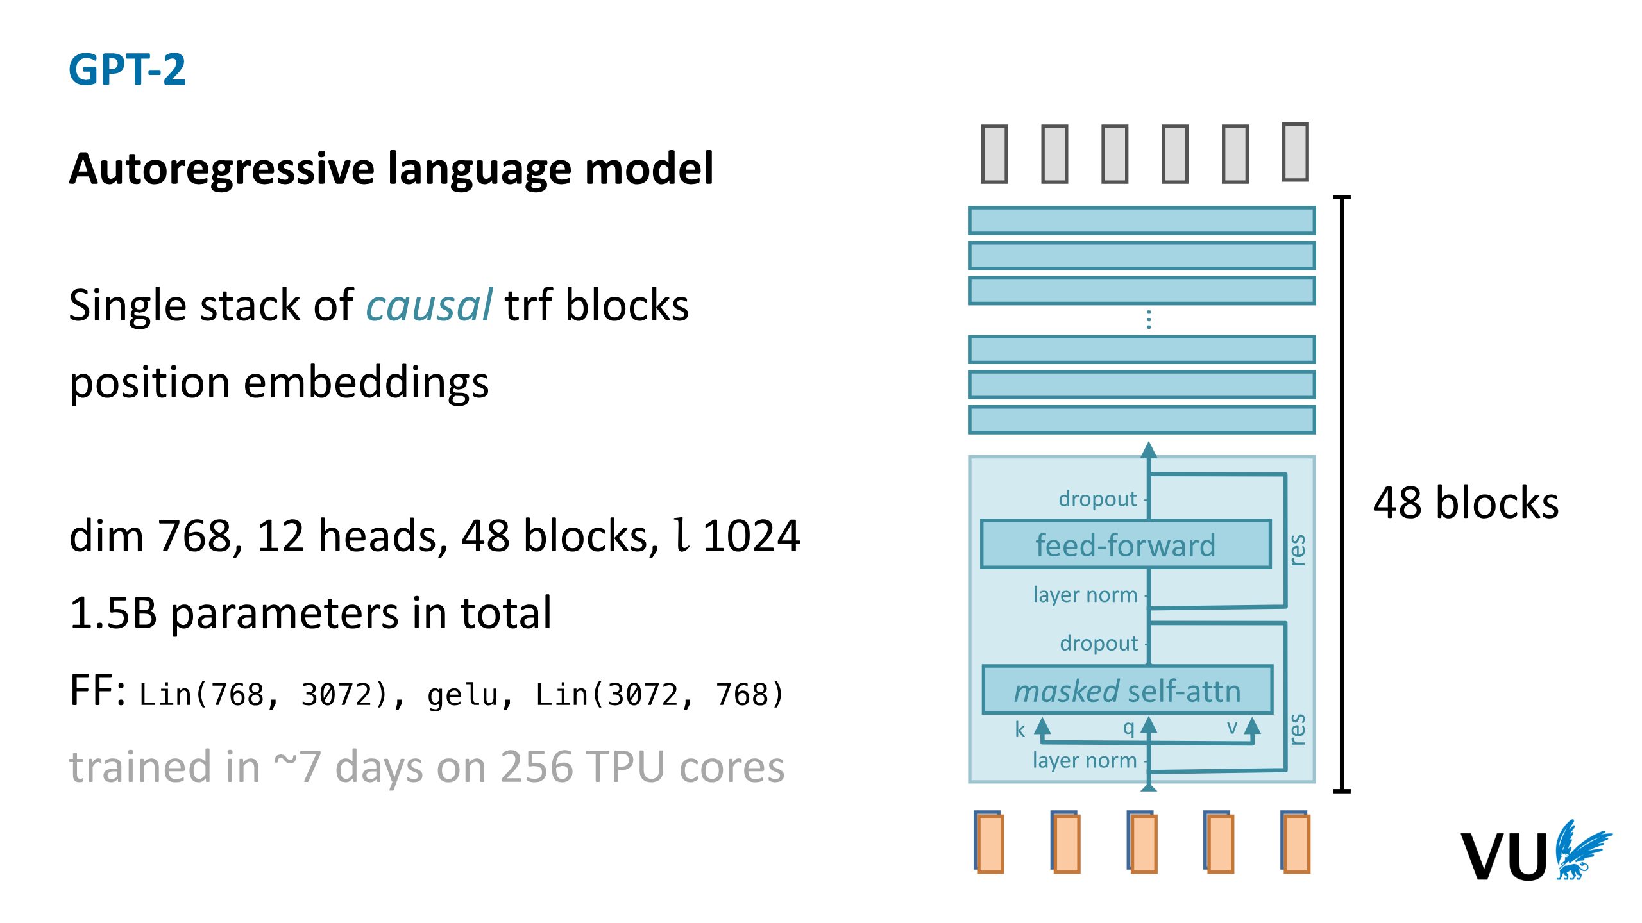
Decoder-Only Generative Model
Notes:
Predict next token on the sequence

Slide 38
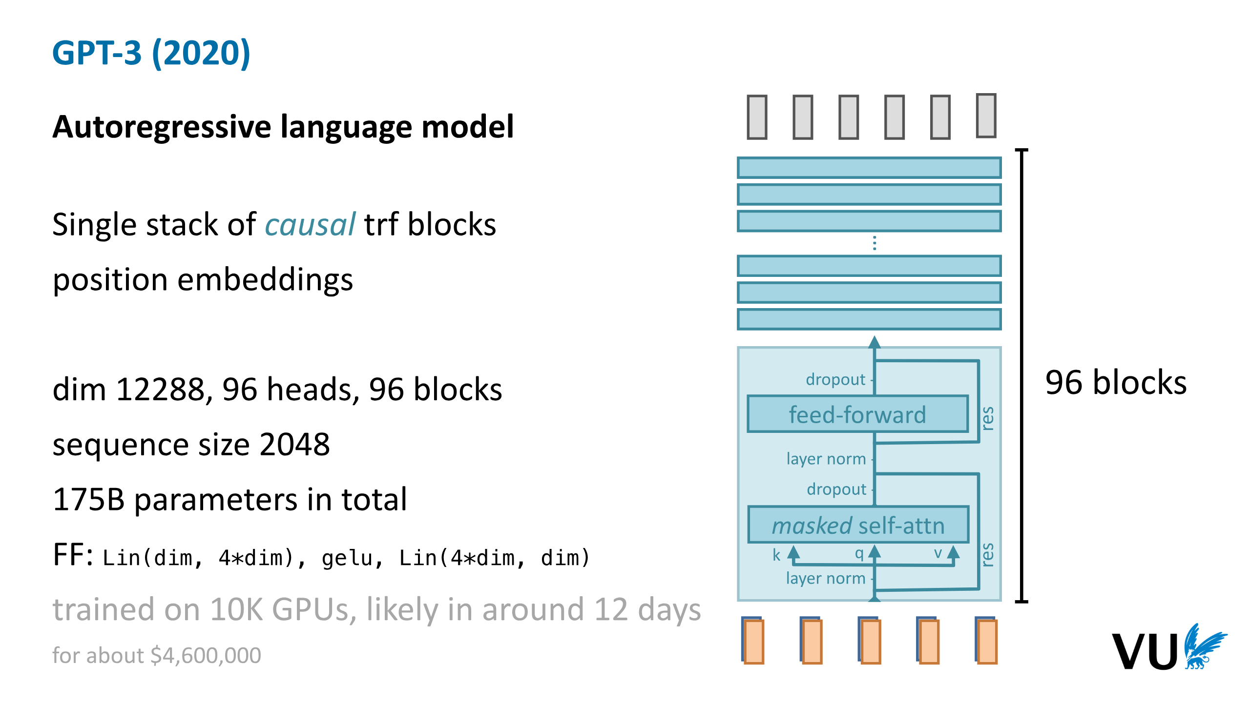

Slide 39
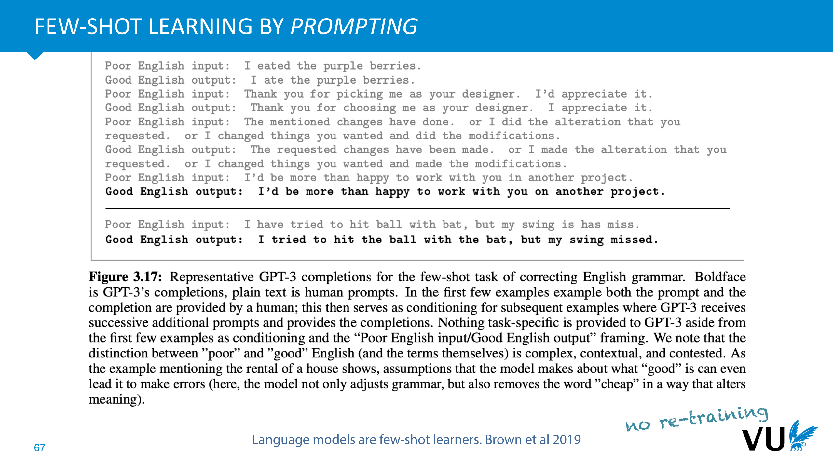

Slide 40
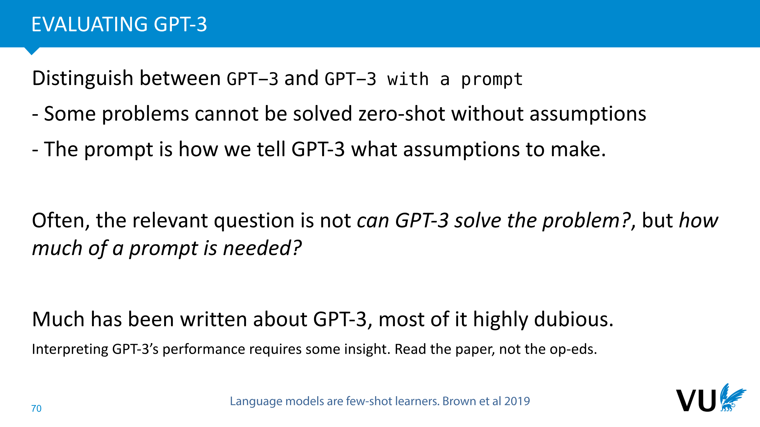

Slide 41
