Slide 1
Instance-Based Learning (Lazy Learning)
K-Nearest Neighbor & co.

Slide 2
Eager vs Lazy
Eager learning:
explicit description (model) of target function on the whole training set
once the model is built, traning set can be thrown away
prediction occurs using the model with a new example as input
Lazy learning:
learning occurs by storing all the training instances (instance-based)
prediction occurs by comparing the new instance with the stored ones
comparison is based on distance/similarity functions

Slide 3
Pros and Cons
Disadvantage of instance-based methods is that the costs of classifying new instances can be high
Nearly all computation takes place at classification time rather than learning time
Learning is just a matter of storing examples

Slide 4
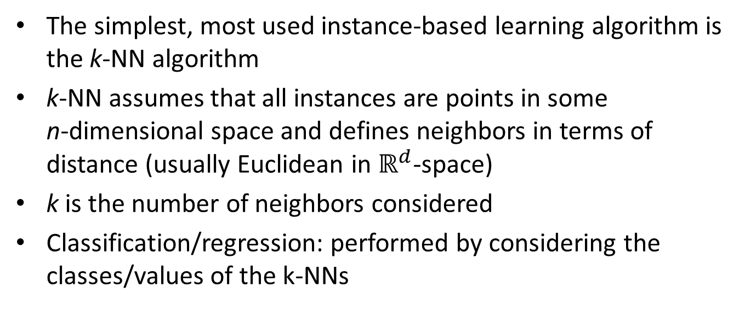
k-Nearest Neighbor
The simplest, most used instance-based learning algorithm is the k-NN algorithm
k-NN assumes that all instances are points in some n-dimensional space and defines neighbors in terms of distance (usually Euclidean in $ℝ^{d}$-space)
k is the number of neighbors considered
Classification/regression: performed by considering the classes/values of the k-NNs

Slide 5
K-NN Algorithm
Given a query instance x, retrieve the k NNs of x
Classification: assign to x the class of the majority of the neighbors (breaking ties arbitrarly)
Regression: assign to x the average value of the neighbors’ values

Slide 6
Example
q has class + if k=1 q has class – if k=5
In this example standard Euclidean distance is used
Different notion of distances can be applied

Slide 7
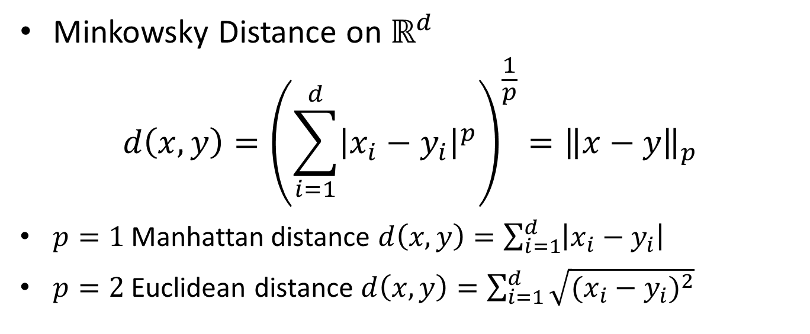
Distance
Minkowsky Distance on $ℝ^{d}$
$$d\left(x,y\right)={\left(\sum_{i=1}^{d}{{\left|x_{i}−y_{i}\right|}^{p}}\right)}^{\frac{1}{p}}={\left\|x−y\right\|}_{p}$$
$p=1$ Manhattan distance $d\left(x,y\right)=\sum_{i=1}^{d}{\left|x_{i}−y_{i}\right|}$
$p=2$ Euclidean distance $d\left(x,y\right)=\sum_{i=1}^{d}{\sqrt{{(x_{i}−y_{i})}^{2}}}$

Slide 8
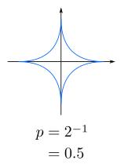
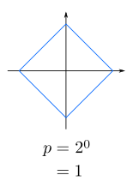
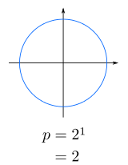
Effect of p
Euclidean
Manhattan

Slide 9
Voronoi Diagrams
Given a set of points, a Voronoi Diagrams describes the areas including points that are closer to any given point
Given a point x, each point y in the x’s area has x as nearest neighbor
y₁
y₃
x
y₂

Slide 10
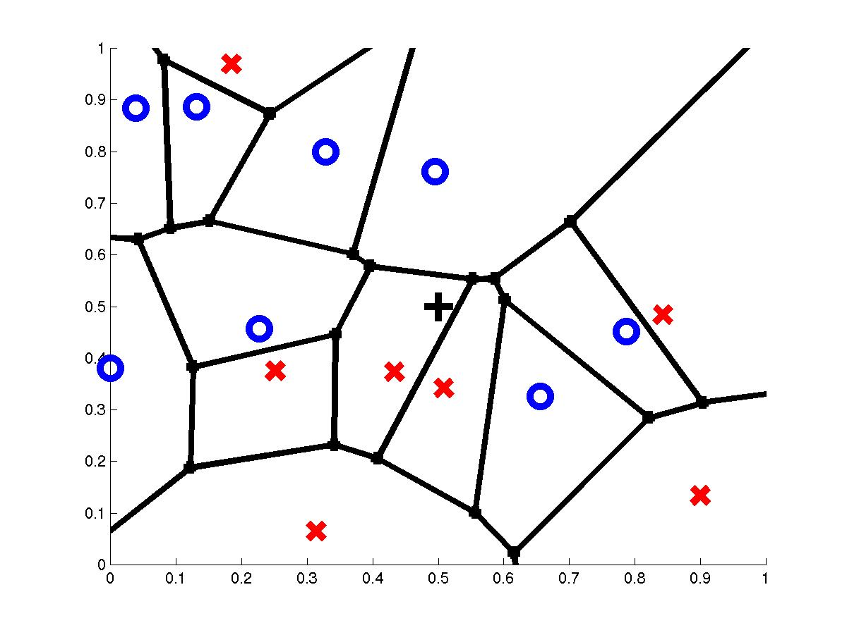
1-Nearest Neighbor
query point
nearest neighbor

Slide 11
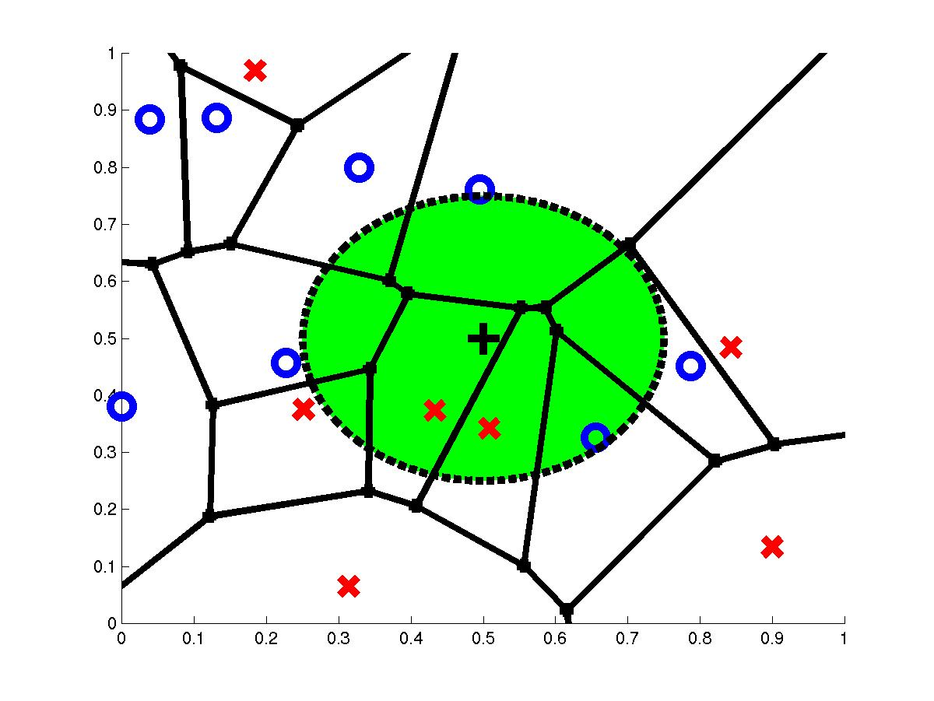
3-Nearest Neighbor
query point
3 nearest neighbors

Slide 12
Decision Boundaries

Slide 13
Effect of k
If k is too small, sensitive to noise points (overfitting)

Slide 14
Effect of k
k can be choosen by cross-validation
If k is too large, neighborhood may include points from other classes

Slide 15
Scale Effects
Different features may have different measurement scales
E.g., patient weight in kg (range [50,200]) vs. blood protein values in ng/dL (range [-3,3])
Consequences
Patient weight will have a much greater influence on the distance between samples
May bias the performance of the classifier

Slide 16
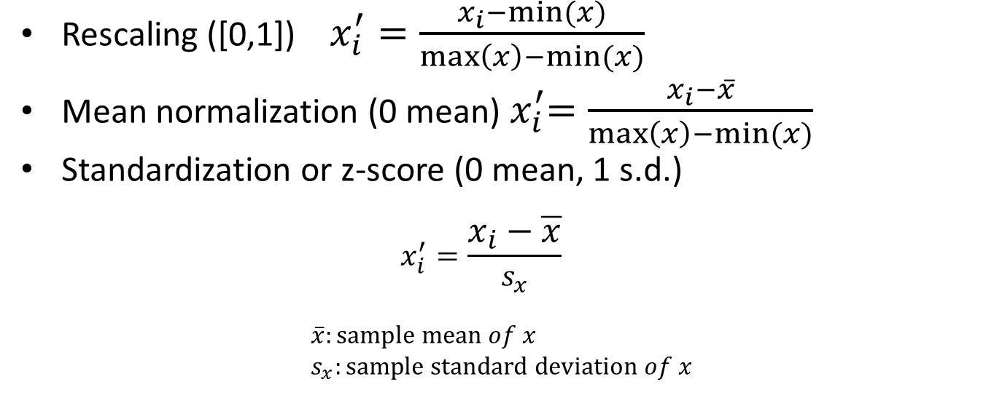
Feature scaling
Rescaling ([0,1]) $x_{i}^{′}=\frac{x_{i}−min⁡(x)}{\max\left(x\right)−min⁡(x)}$
Mean normalization (0 mean)${ x}_{i}^{′}=\frac{x_{i}−\overline{x}}{\max\left(x\right)−min⁡(x)}$
Standardization or z-score (0 mean, 1 s.d.) $x_{i}^{′}=\frac{x_{i}−\overline{x}}{s_{x}}$
$$\overline{x}:\text{sample} \text{mean} of x \\ s_{x}:\text{sample} \text{standard} \text{deviation} of x$$

Slide 17
Weighting
It makes sense to weight the contribution of each neighbour with respect to its distance to the query
Closest neighbors have larger weitghs
Classification: weigthed voting
Regression: weighted average

Slide 18
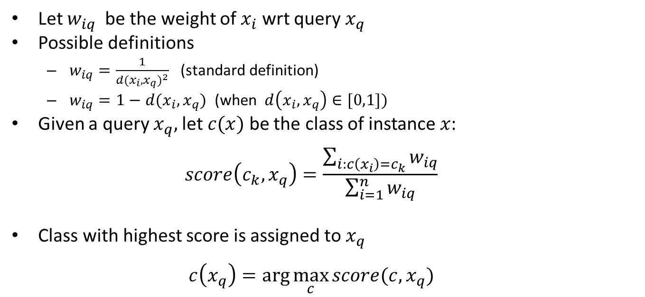
Weighted voting
Let $w_{iq}$ be the weight of $x_{i}$ wrt query $x_{q}$
Possible definitions
$w_{iq}=\frac{1}{{d(x_{i},x_{q})}^{2}}$ (standard definition)
$w_{iq}=1−d(x_{i},x_{q})$ (when$d\left(x_{i},x_{q}\right)∈[0,1])$
Given a query $x_{q},$let $c(x)$ be the class of instance $x$: $score\left(c_{k},x_{q}\right)=\frac{\sum_{i:c\left(x_{i}\right)=c_{k}}{w_{iq}}}{\sum_{i=1}^{n}{w_{iq}}}$
Class with highest score is assigned to $x_{q}$ $c\left(x_{q}\right)=\arg{\max_{c}{score(c,}}x_{q})$

Slide 19
Curse of dimensionality
k-NN breaks down in high dimensional spaces (when d is large)
Number of NN largely increase with the increase of d
Moreover irrelevant features can mislead the classifier
Solutions: feature selection, learning feature weights

Slide 20
Issues with Distance Metrics
Most distance measures were designed for linear/real-valued attributes
Two important questions in the context of machine learning:
How best to handle nominal attributes
What to do when attribute types are mixed

Slide 21
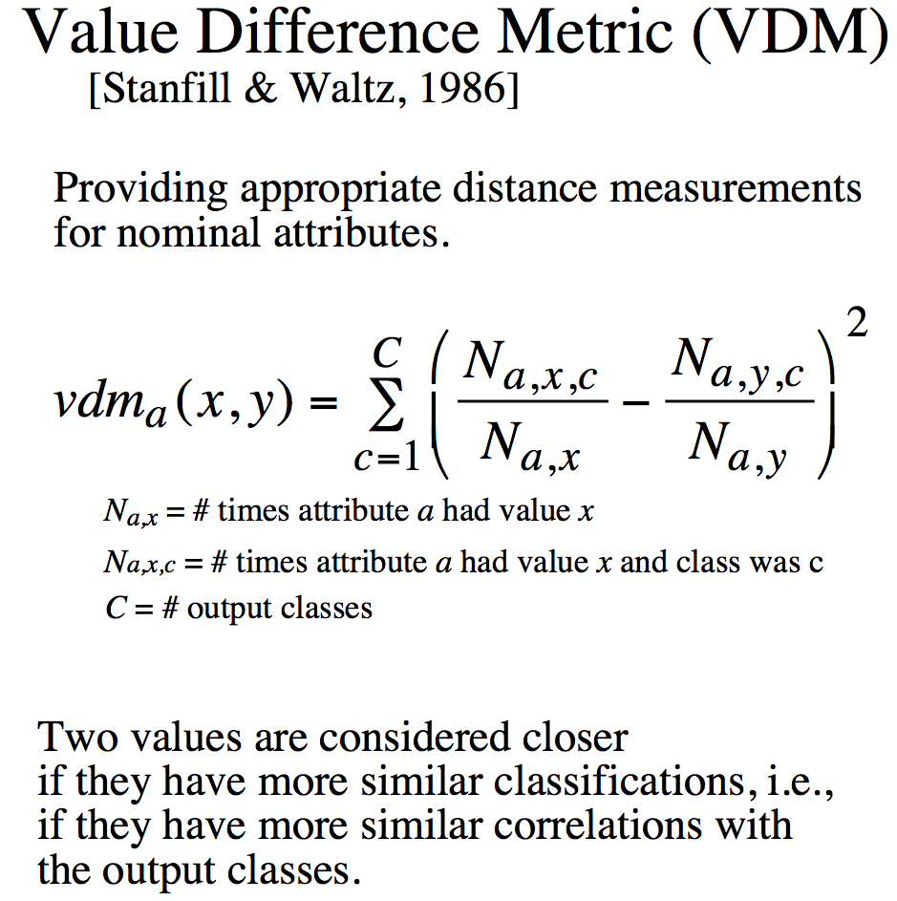
Distance for Nominal Attributes
Notes:
Do a single example here. Shape (Round, Square) 6/10 and 3/5

Slide 22
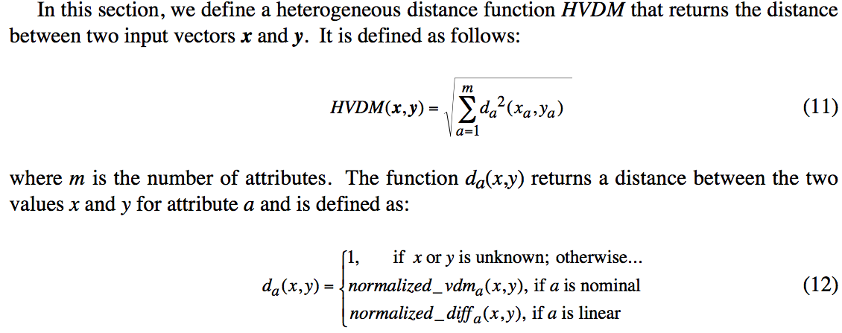
Distance for Heterogeneous Data
Wilson, D. R. and Martinez, T. R., Improved Heterogeneous Distance Functions, Journal of Artificial Intelligence Research, vol. 6, no. 1, pp. 1-34, 1997

