Slide 1
Ensemble learning
``The wisdom of the crowd’’

Slide 2
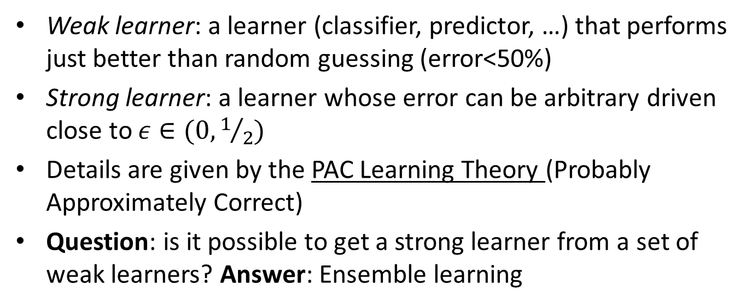
Weak and Strong Learnability
Weak learner: a learner (classifier, predictor, …) that performs just better than random guessing (error<50%)
Strong learner: a learner whose error can be arbitrary driven close to $ε∈(0,1/2)$
Details are given by the PAC Learning Theory (Probably Approximately Correct)
Question: is it possible to get a strong learner from a set of weak learners? Answer: Ensemble learning

Slide 3
Types of ensemble learning
Combining the results of different learning algorithms
Stacking (Stacked Generalization)
Voting
Combining the results of the same learning algorithm on different data
Bagging (Bootstrap Aggregating)
Boosting

Slide 4
Why?
Suppose you have 1000 binary weak classifiers with 51% accuracy and you predict the class with majority vote.
It is like having a biased coin (say 0.51 probability of H and 0.49 of T) and tossing it 1000 times.
If you do the math the prob of having a majority of H is 75%.
Thus you have increased the accuracy from 51% (weak learner) to 75%
The more you toss the coin (the more base learners you have), the larger is this probability (by the law of large numbers this process converge to 51% H with probability 1)

Slide 5
Uncorrelated predictions
Previous observation holds since coin tosses are independent (uncorrelated)
If you repeat the same algorithm on the same data, you get highly correlated predictions
Two choices to break correlation
Different algorithms
Different data

Slide 6
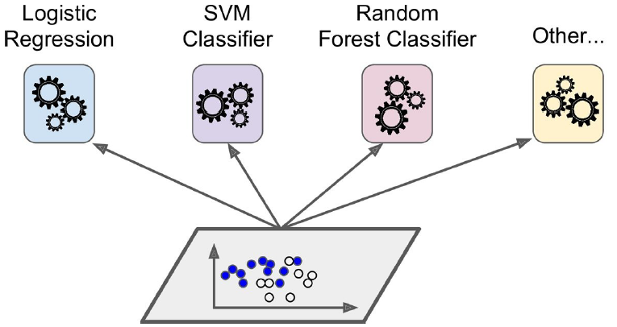
Multiple algorithms, same data
Multi Layer Perceptron

Slide 7
Voting

Slide 8
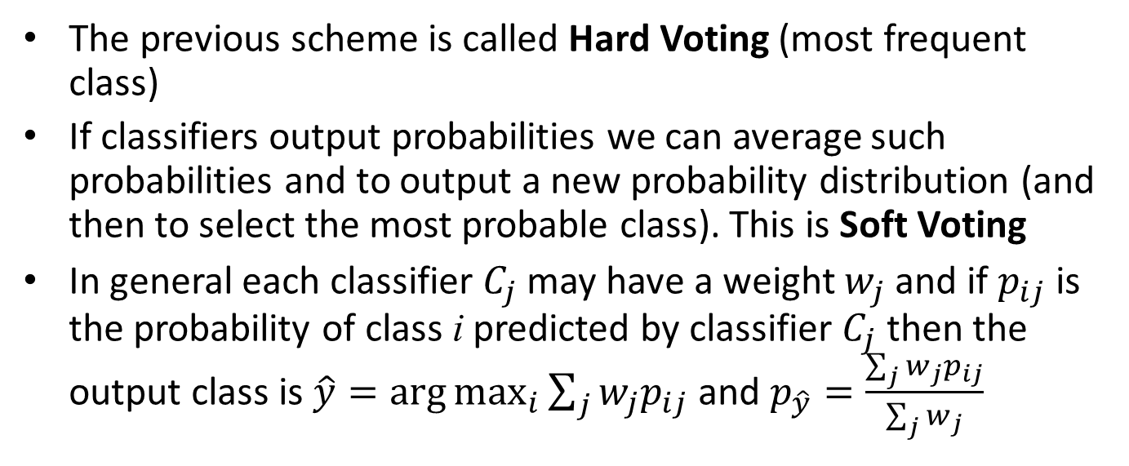
Hard vs Soft Voting
The previous scheme is called Hard Voting (most frequent class)
If classifiers output probabilities we can average such probabilities and to output a new probability distribution (and then to select the most probable class). This is Soft Voting
In general each classifier $C_{j}$may have a weight $w_{j}$ and if $p_{ij}$ is the probability of class i predicted by classifier $C_{j}$ then the output class is $\hat{y}=\arg{\max_{i}{\sum_{j}{w_{j}p_{ij}}}}$ and $p_{\hat{y}}=\frac{\sum_{j}{w_{j}p_{ij}}}{\sum_{j}{w_{j}}}$

Slide 9

The idea can be generalized to specific
aggregations: e.g., in regression we can
introduce a ``blender’’ computing the average
of input predictions
$$2.9$$
The blender can be even a new
learning algorithm leading to
Stacking

Slide 10
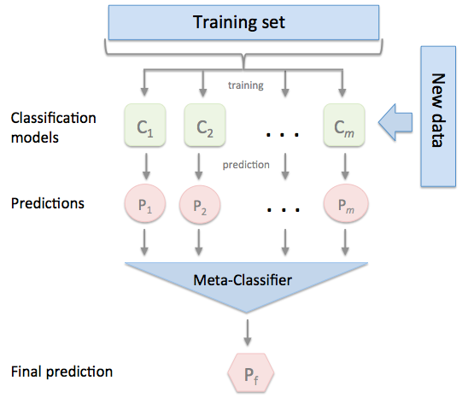
Stacking
How to train the meta classifier
How the meta training set looks like

Slide 11
Training using held-out set:
split the dataset in 2 parts
use the first part to train base learners
Use the second part to build a new training set for the meta-learner

Slide 12
or meta-learner
Meta Training set
C1 | C2 | … | Ck | Class
Pred₁₁ | Pred₂₁ | … | Pred_{k1} | Class₁
…
Pred_{1m} | Pred_{2m} | … | Pred_{km} | Class_{m}
Instance₁
Instance_{m}

Slide 13
Same algorithm, multiple data
Bags

Slide 14
Bagging
Bagging=Boostrap Aggregation
Sampling for each ``bag’’ is performed with replacement
An instance may appear several times in a ``bag’’
Some instances may not be present in a bag
Pasting
As bagging but sampling without replacement
No duplicated instances in a single bag
Once the learning algorithm has been trained several times on different bags, predictions can be aggregated for the final output
Mode (most frequent class) or average probability for classification
Average value for regression

Slide 15
Sampling with replacement: example
Dataset D | 1 | 2 | 3 | 4 | 5 | 6 | 7 | 8
D₁ | 2 | 7 | 8 | 3 | 7 | 6 | 3 | 1
D₂ | 7 | 8 | 5 | 6 | 4 | 2 | 7 | 1
D₃ | 3 | 6 | 2 | 7 | 5 | 6 | 2 | 2
D₄ | 4 | 5 | 1 | 4 | 6 | 4 | 3 | 8

Slide 16
Bagged version is more likely to generalize better!
Bagging has more bias and less variance than pasting (it is usually preferred)

Slide 17
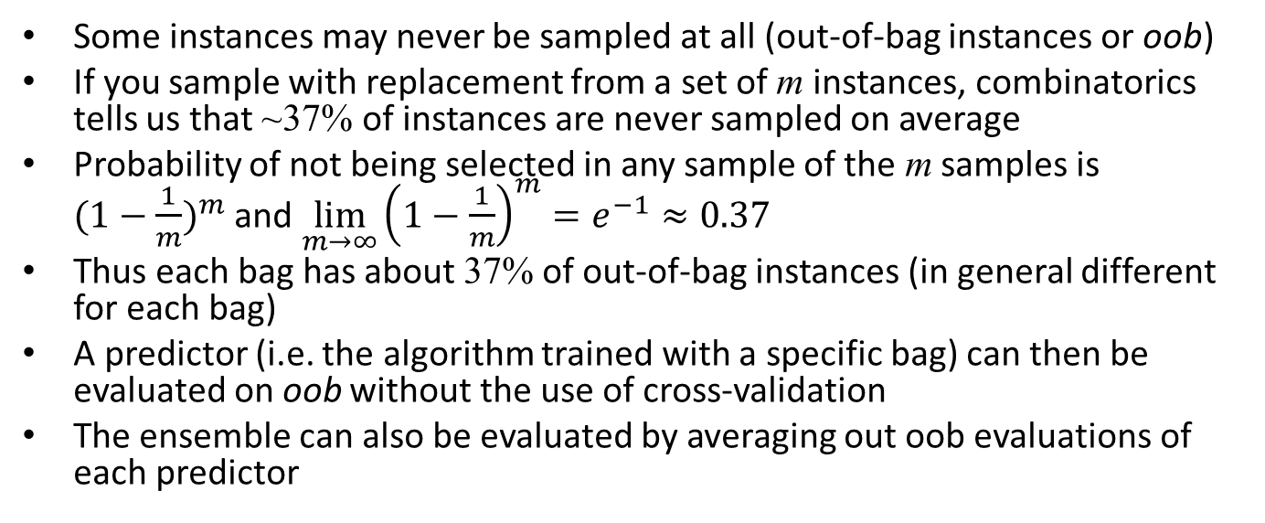
Out-of-bag evaluation
Some instances may never be sampled at all (out-of-bag instances or oob)
If you sample with replacement from a set of m instances, combinatorics tells us that ~37% of instances are never sampled on average
Probability of not being selected in any sample of the m samples is ${(1−\frac{1}{m})}^{m}$ and $\lim_{m→∞}{{\left(1−\frac{1}{m}\right)}^{m}=e^{−1}≈0.37}$
Thus each bag has about 37% of out-of-bag instances (in general different for each bag)
A predictor (i.e. the algorithm trained with a specific bag) can then be evaluated on oob without the use of cross-validation
The ensemble can also be evaluated by averaging out oob evaluations of each predictor

Slide 18
Random Forest
A special case of bagging using Decision Tree
In addition it splits the nodes by using the evaluation on a random subset of the features at each step (instead of searching for the best feature on all those available)
If you also use a random threshold for the selected feature you got an Extra-Tree (Extremely Randomized Tree)
RF is one of the most powerful supervised algorithm

Slide 19
Boosting
Idea: train the same algorithm with different data sequentially, by taking into account errors at the previous step
Most popular boosting method: AdaBoost (Adaptive Boosting)
Weights (or number of occurrences) of instances that have been misclassified at the previous step are increased at the current step

Slide 21
Weight and Predictions
Instance weights
Correspond to replicating instances (if integer value) e.g. w=3.8 → ~ 4 copies of instance
Some algorithms can take weights directly into account (e.g. Naïve Bayes, weighted k-NN)
Once all predictors are trained, the ensemble makes predictions very much like bagging or pasting, except that predictors have different weights depending on their overall accuracy on the weighted training set.

Slide 22
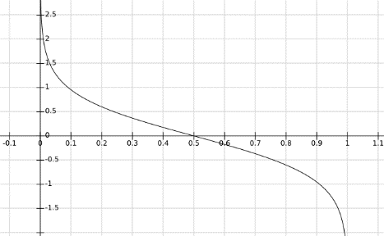
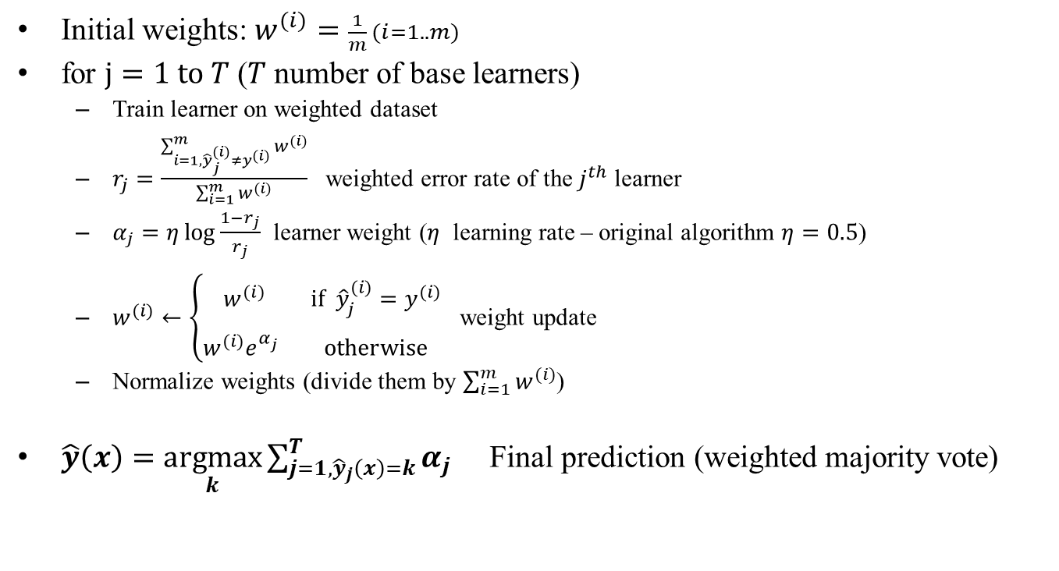

AdaBoost Algorithm
Initial weights: $w^{(i)}=\frac{1}{m} (i=1..m)$
for $j=1 \text{to} T$ ($T$ number of base learners)
Train learner on weighted dataset
$r_{j}=\frac{\sum_{i=1,{\hat{y}}_{j}^{(i)}≠y^{(i)}}^{m}{w^{(i)}}}{\sum_{i=1}^{m}{w^{(i)}}}$ weighted error rate of the $j^{th}$ learner
$α_{j}=η\log{\frac{1−r_{j}}{r_{j}}}$ learner weight ($η$ learning rate – original algorithm $η=0.5$)
$w^{(i)}←\left\{\begin{matrix}w^{(i)} & \text{if} {\hat{y}}_{j}^{(i)}=y^{(i)} \\ w^{(i)}e^{α_{j}^{}} & \text{otherwise}\end{matrix}\right.$ weight update
Normalize weights (divide them by $\sum_{i=1}^{m}{w^{(i)}}$)
$\hat{y}\left(x\right)=\underset{k}{argmax}{\sum_{j=1, {\hat{y}}_{j}\left(x\right)=k}^{T}{α_{j}}}$ Final prediction (weighted majority vote)
$$\log{\frac{1−x}{x}}$$

Slide 23

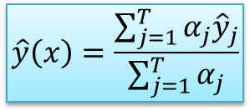
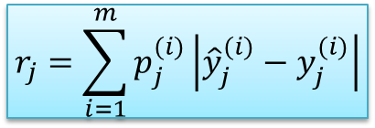
AdaBoost Regression
$$p_{j}^{(i)}=\frac{w^{(i)}}{\sum_{k=1}^{m}{w^{(k)}}}$$
Initial weights: $w^{(i)}=\frac{1}{m} (i=1..m)$
for $j=1 \text{to} T$ ($T$ number of base learners)
Train learner on weighted dataset
$r_{j}=\frac{\sum_{i=1,{\hat{y}}_{j}^{(i)}≠y^{(i)}}^{m}{w^{(i)}}}{\sum_{i=1}^{m}{w^{(i)}}}$ weighted error rate of the $j^{th}$ learner
$α_{j}=η\log{\frac{1−r_{j}}{r_{j}}}$ learner weight ($η$ learning rate – original algorithm $η=0.5$)
$w^{(i)}←\left\{\begin{matrix}w^{(i)} & \text{if} {\hat{y}}_{j}^{(i)}=y^{(i)} \\ w^{(i)}e^{α_{j}^{}} & \text{otherwise}\end{matrix}\right.$ weight update
Normalize weights (divide them by $\sum_{i=1}^{m}{w^{(i)}}$)
$\hat{y}\left(x\right)=\underset{k}{argmax}{\sum_{j=1, {\hat{y}}_{j}\left(x\right)=k}^{T}{α_{j}}}$ Final prediction (weighted majority vote)
$$r_{j}=\sum_{i=1}^{m}{p_{j}^{(i)}\left|{\hat{y}}_{j}^{(i)}−y_{j}^{(i)}\right|}$$
$$\hat{y}\left(x\right)=\frac{\sum_{j=1}^{T}{α_{j}{\hat{y}}_{j}}}{\sum_{j=1}^{T}{α_{j}}}$$

Slide 24
1
0.5

Slide 25
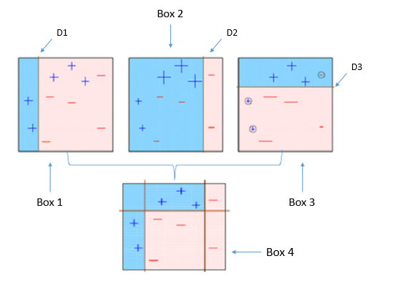




















Example: Boosting Decision Stumps (1-level DT)
D1
$$x_{1}>1$$
F
T
$$+$$
$$−$$
$$3$$
D2
$$x_{1}>4$$
$$x_{1}>1$$
F
T
$$1$$
$$4$$
F
T
$$+$$
$$−$$
$$+$$
$$x_{2}<3$$
F
T
D3
$$x_{2}$$
$$−$$
$$x_{2}<3$$
$$x_{1}>4$$
F
T
F
T
$$+$$
$$−$$
$$x_{1}$$
$$+$$
$$−$$

