Slide 1
Motivation I: Data Compression
Dimensionality Reduction

Slide 2


Data Compression
Reduce data from
2D to 1D
(inches)
If we have correlated features we can
project points into a line and to keep
only the position on that line (1D)
(cm)

Slide 3
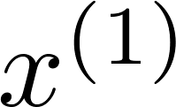
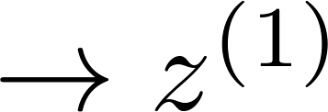
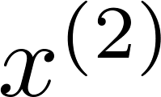
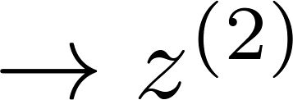
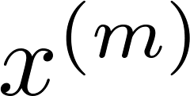
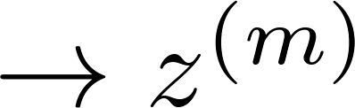







Data Compression
Reduce data from
2D to 1D
(inches)
$$εℝ^{2}$$
$$εℝ^{}$$
$$εℝ^{2}$$
$$εℝ^{}$$
(cm)
$$εℝ^{2}$$
$$εℝ^{}$$
Notes:
Add more unique colors (3-4)

Slide 4
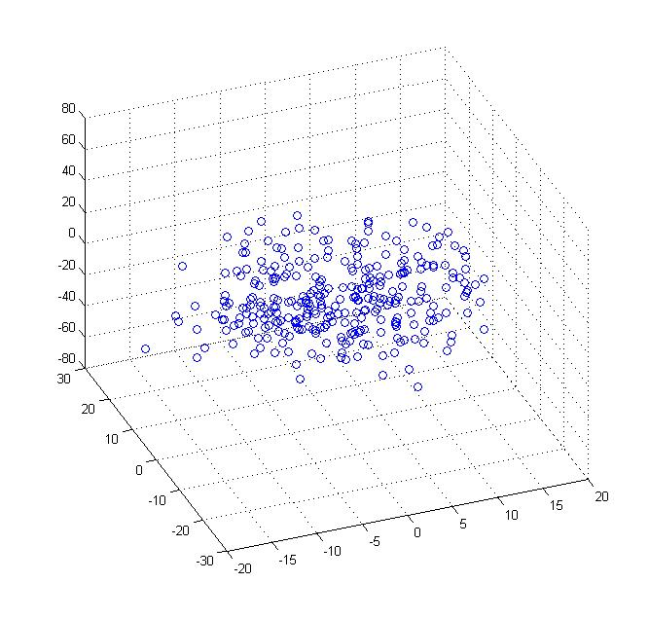
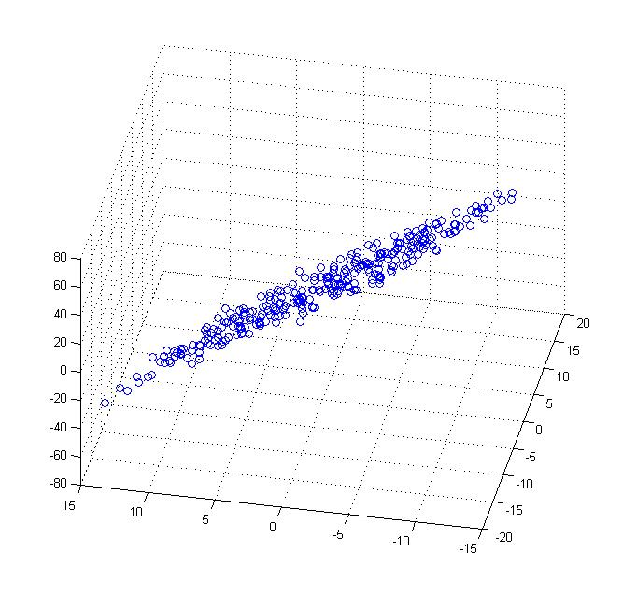
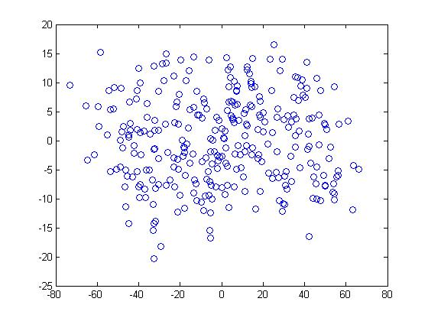


Data Compression
Reduce data from 3D to 2D (project onto a plan)
Notes:
Pca3d2d in lecture-slides/assets/pca/
Label axes

Slide 5
Motivation II: Data Visualization
Dimensionality Reduction

Slide 6
Data Visualization
Country | GDP (trillions of US$) | Per capita GDP (thousands of intl. $) | Human Develop-ment Index | Life expectancy | Poverty Index (Gini as percentage) | Mean household income (thousands of US$) | …
Canada | 1.577 | 39.17 | 0.908 | 80.7 | 32.6 | 67.293 | …
China | 5.878 | 7.54 | 0.687 | 73 | 46.9 | 10.22 | …
India | 1.632 | 3.41 | 0.547 | 64.7 | 36.8 | 0.735 | …
Russia | 1.48 | 19.84 | 0.755 | 65.5 | 39.9 | 0.72 | …
Singapore | 0.223 | 56.69 | 0.866 | 80 | 42.5 | 67.1 | …
USA | 14.527 | 46.86 | 0.91 | 78.3 | 40.8 | 84.3 | …
… | … | … | … | … | … | …
[resources from en.wikipedia.org]
Notes:
Add dots

Slide 7
Overall economic activity (Country size)
Data Visualization
Per person economic activity
Country
Canada | 1.6 | 1.2
China | 1.7 | 0.3
India | 1.6 | 0.2
Russia | 1.4 | 0.5
Singapore | 0.5 | 1.7
USA | 2 | 1.5
… | … | …

Slide 8
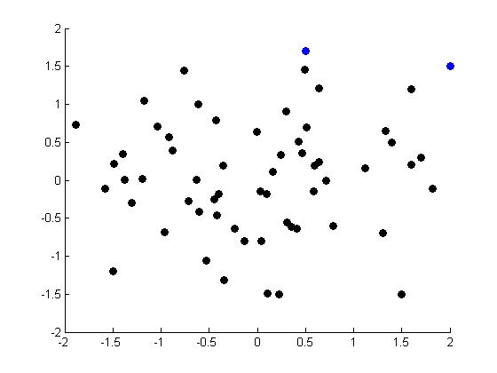
Data Visualization
Singapore
USA
Notes:
Make points look uncorrelated
US, Singapore in blue

Slide 9
Principal Component Analysis problem formulation
Dimensionality Reduction

Slide 10
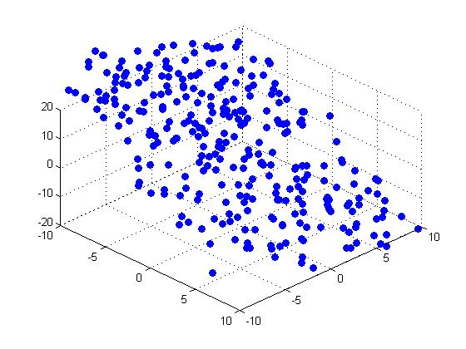


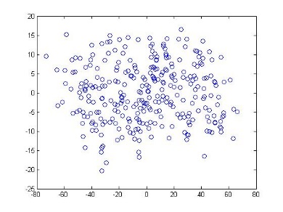
Principal Component Analysis (PCA) algorithm
Reduce data from 2D to 1D
Reduce data from 3D to 2D
X
X
X
X
X
Find a line/plane/hyperplane (set of vectors)
that minimize the sum of the projection distances
Notes:
Replace as previous; change spacing to fill page

Slide 11
The green one is better than
the red one (better keep “dispersion”
among the points)
Idea: choose directions that
maximize the spread of data,
i.e. the variance

Slide 12

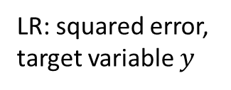
PCA vs Linear Regression
$$y$$
LR: squared error,
target variable $y$
PCA: projection distance,
no target variable

Slide 13
Principal Component Analysis algorithm
Dimensionality Reduction

Slide 14
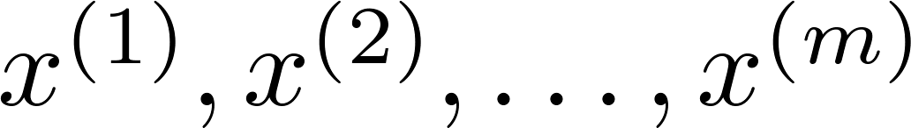
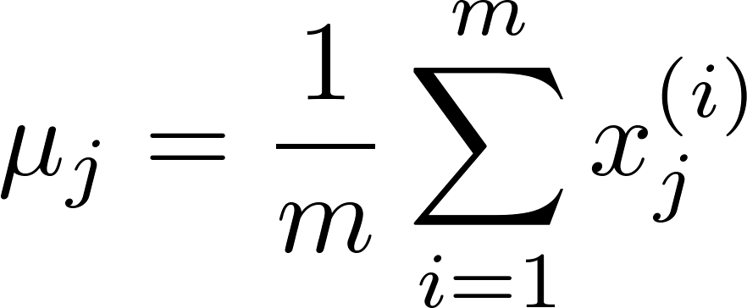
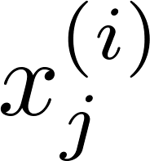



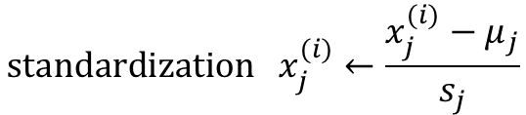
Data preprocessing
Training set:
Preprocessing (feature scaling/mean normalization):
Replace each with .
If different features on different scales (e.g., size of house,
number of bedrooms), scale features to have comparable range of values.
$${\text{standardization} x}_{j}^{(i)}←\frac{x_{j}^{(i)}−μ_{j}}{s_{j}}$$
Notes:
NB if we use standardization, we actually replace covariance with correlation, le PC cambiano! Le var con varianza maggiore vengono piu’ attenuate.

Slide 15



Principal Component Analysis (PCA) algorithm
$$u^{(1)}$$
$$u^{(1)}$$
$$u^{(2)}$$
Reduce data from 2D to 1D
Reduce data from 3D to 2D
X
X
X
X
X
Find a vectors $u^{(1)},…u^{(k)}$
that minimize the sum of the projection distances $(k<n)$ (maximize the variance)
Notes:
Replace as previous; change spacing to fill page

Slide 16
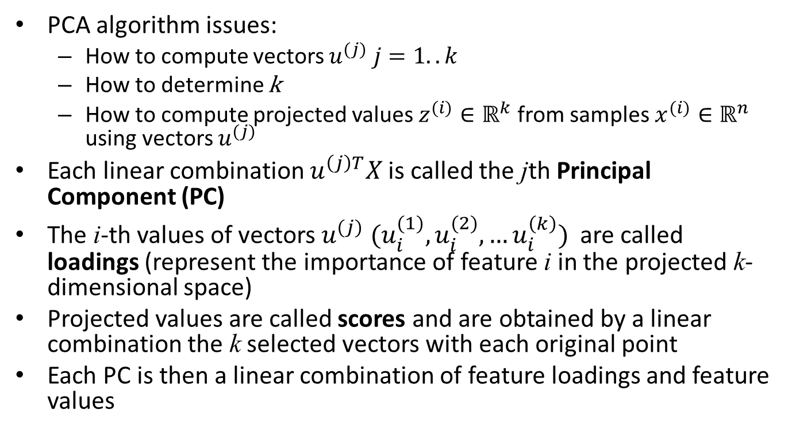
PCA
PCA algorithm issues:
How to compute vectors $u^{(j)} j=1..k$
How to determine k
How to compute projected values $z^{(i)}∈ℝ^{k}$ from samples $x^{(i)}∈ℝ^{n}$ using vectors $u^{(j)}$
Each linear combination $u^{\left(j\right)T}X$ is called the jth Principal Component (PC)
The i-th values of vectors $u^{(j)}$ ${(u}_{i}^{(1)},u_{i}^{(2)},…u_{i}^{\left(k\right)})$are called loadings (represent the importance of feature i in the projected k-dimensional space)
Projected values are called scores and are obtained by a linear combination the k selected vectors with each original point
Each PC is then a linear combination of feature loadings and feature values

Slide 17
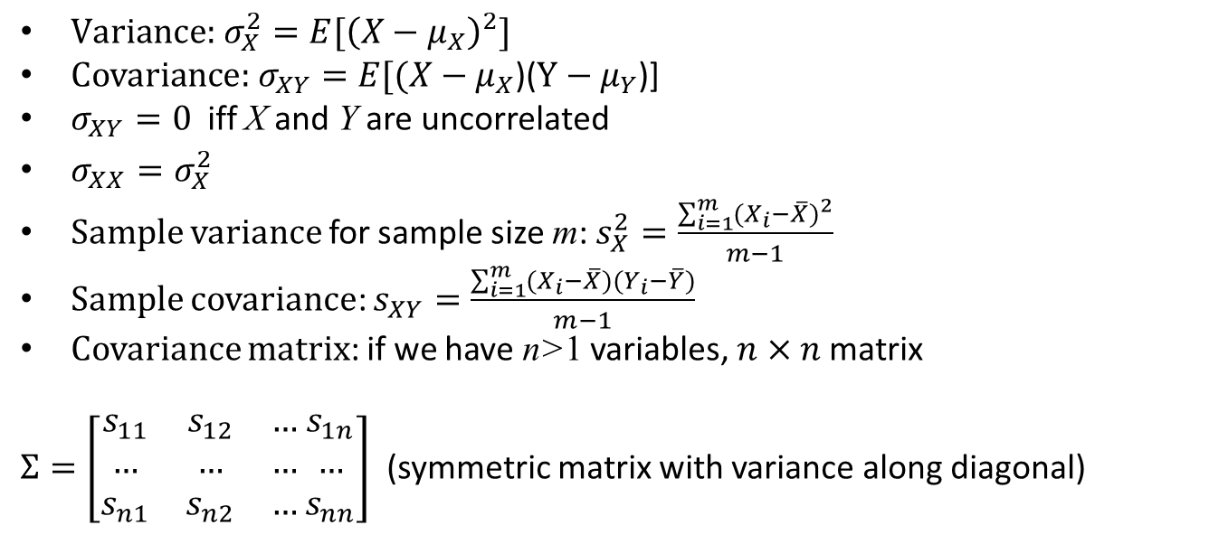
Math digression
$\text{Variance}\text{: }σ_{X}^{2}=E[{\left(X−μ_{X}\right)}^{2}]$
$\text{Covariance}\text{: }σ_{XY}=E[(X−μ_{X}$)($Y−μ_{Y}$)]
$σ_{XY}=0$ iff X and Y are uncorrelated
$σ_{XX}=σ_{X}^{2}$
Sample variance for sample size m: $s_{X}^{2}=\frac{\sum_{i=1}^{m}{{(X_{i}−\overline{X})}^{2}}}{m−1}$
Sample covariance: $s_{XY}=\frac{\sum_{i=1}^{m}{(X_{i}−\overline{X})(}Y_{i}−\overline{Y})}{m−1}$
Covariance matrix: if we have n>1 variables, $n×n$ matrix
$Σ=\left[\begin{matrix}s_{11} & s_{12} & … \\ … & … & … \\ s_{n1} & s_{n2} & …\end{matrix} \begin{matrix}s_{1n} \\ … \\ s_{nn}\end{matrix}\right]$ (symmetric matrix with variance along diagonal)

Slide 18

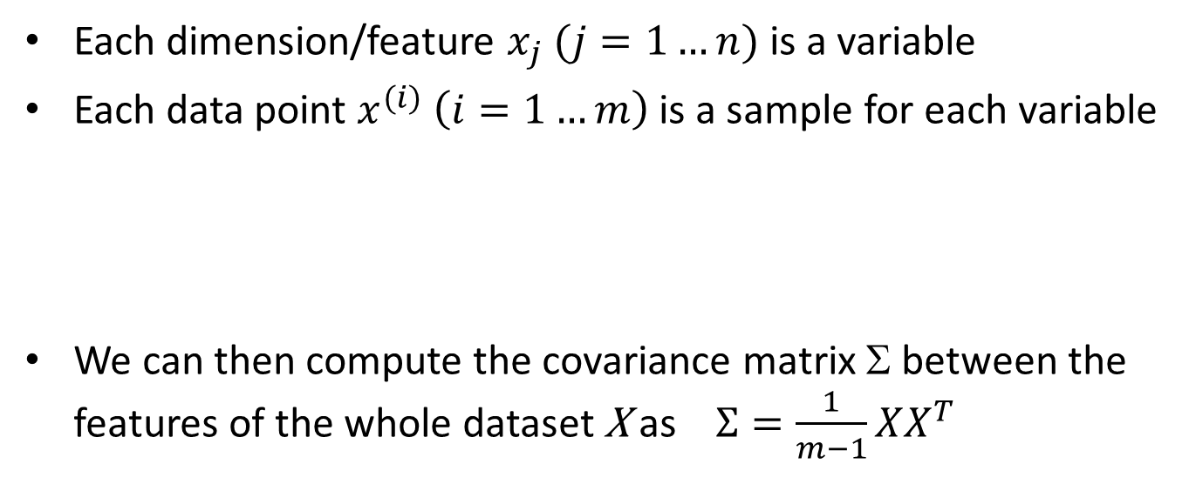
Each dimension/feature $x_{j} (j=1…n)$ is a variable
Each data point $x^{(i)} \left(i=1…m\right)$ is a sample for each variable
We can then compute the covariance matrix Σ between the features of the whole dataset X as $Σ=\frac{1}{m−1}XX^{T}$
$$x^{(i)}=\left[\begin{matrix}x_{1}^{(i)} \\ ⋮ \\ x_{n}^{(i)}\end{matrix}\right]$$

Slide 19
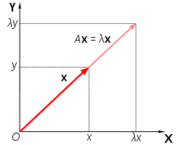
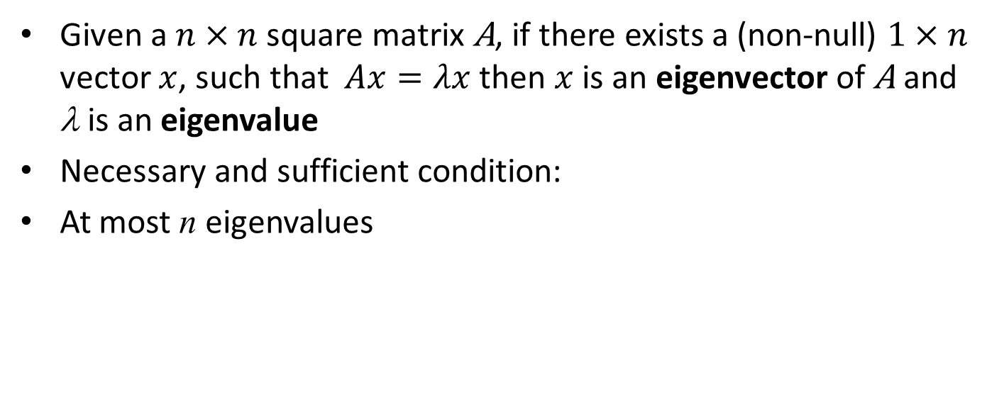


Eigenvectors and Eigenvalues
Given a $n×n$square matrix A, if there exists a (non-null) $1×n$ vector $x$, such that $Ax=λx$ then $x$ is an eigenvector of A and λ is an eigenvalue
Necessary and sufficient condition:
At most n eigenvalues
characteristic polynomial
$$\det\left(A−λI\right)=0$$
eigenvector
eigenvalue
$$\left(\begin{matrix}2 & 3 \\ 2 & 1\end{matrix}\right)×\left(\begin{matrix}3 \\ 2\end{matrix}\right)=\left(\begin{matrix}12 \\ 8\end{matrix}\right)=4\left(\begin{matrix}3 \\ 2\end{matrix}\right)$$
Matrix A acts by stretching the vector x,
not changing its direction,
so x is an eigenvector of A.

Slide 20
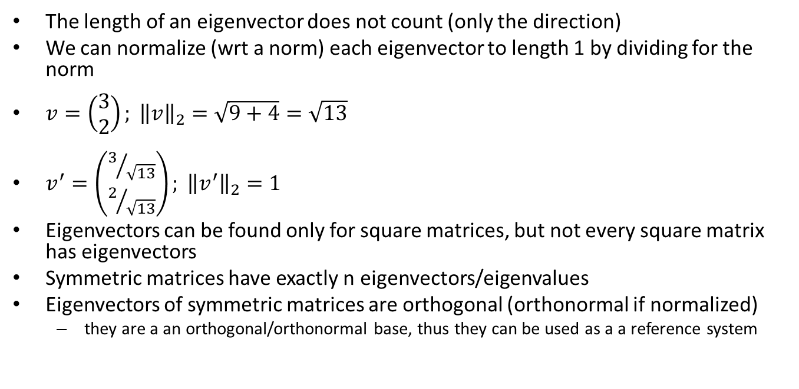
Eigenvectors and Eigenvalues
The length of an eigenvector does not count (only the direction)
We can normalize (wrt a norm) each eigenvector to length 1 by dividing for the norm
$v=\left(\begin{matrix}3 \\ 2\end{matrix}\right); {\left\|v\right\|}_{2}=\sqrt{9+4}=\sqrt{13}$
$v^{′}=\left(\begin{matrix}3/{\sqrt{13}} \\ 2/{\sqrt{13}}\end{matrix}\right); {\left\|v^{′}\right\|}_{2}=1$
Eigenvectors can be found only for square matrices, but not every square matrix has eigenvectors
Symmetric matrices have exactly n eigenvectors/eigenvalues
Eigenvectors of symmetric matrices are orthogonal (orthonormal if normalized)
they are a an orthogonal/orthonormal base, thus they can be used as a a reference system

Slide 21
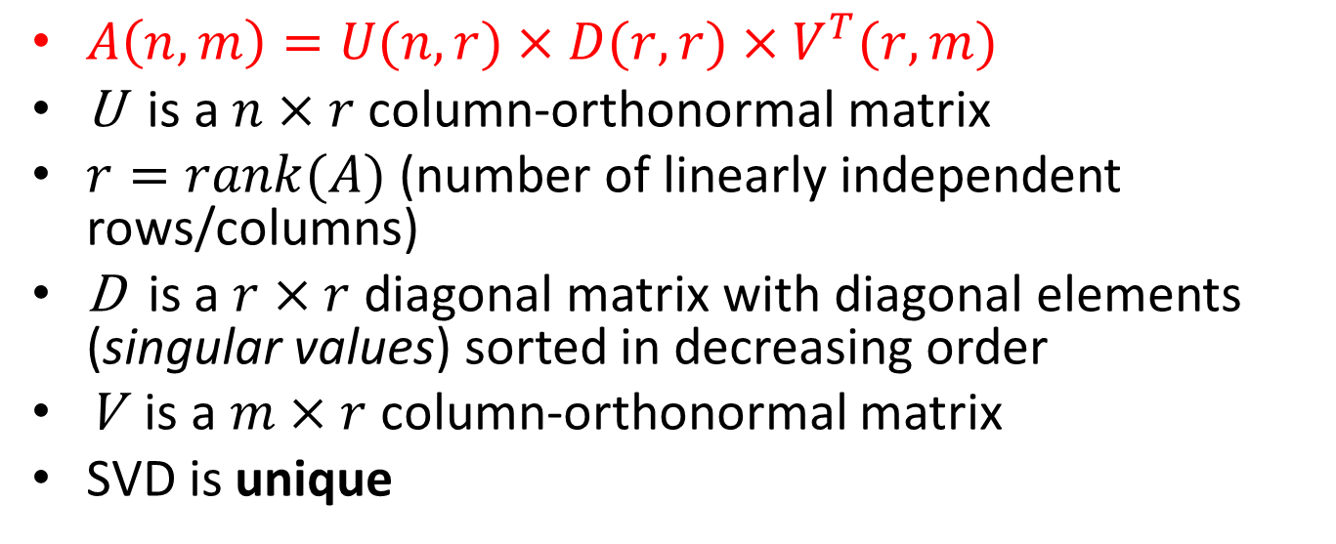
Singular Value Decomposition
$A\left(n,m\right)=U(n,r)×D(r,r)×V^{T}(r,m)$
U is a $n×r$column-orthonormal matrix
$r=rank(A)$ (number of linearly independent rows/columns)
D is a $r×r$ diagonal matrix with diagonal elements (singular values) sorted in decreasing order
V is a $m×r$column-orthonormal matrix
SVD is unique

Slide 22
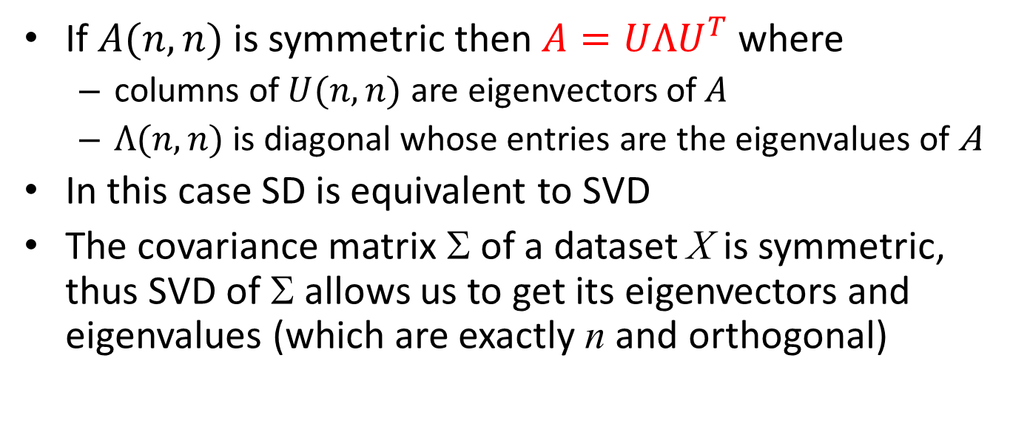
Eigendecomposition (or Spectral Decomposition)
If $A(n,n)$ is symmetric then $A=UΛU^{T}$ where
columns of $U(n,n)$ are eigenvectors of $A$
$Λ(n,n)$ is diagonal whose entries are the eigenvalues of A
In this case SD is equivalent to SVD
The covariance matrix Σ of a dataset X is symmetric, thus SVD of Σ allows us to get its eigenvectors and eigenvalues (which are exactly n and orthogonal)

Slide 23
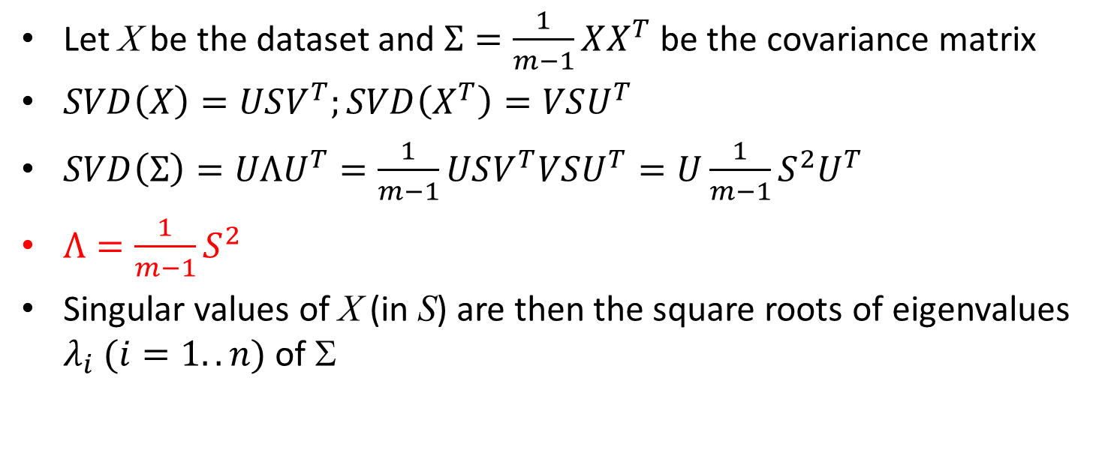
SVD of covariance matrix
Let X be the dataset and $Σ=\frac{1}{m−1}XX^{T}$ be the covariance matrix
$SVD\left(X\right)=USV^{T};SVD\left(X^{T}\right)=VSU^{T}$
$SVD\left(Σ\right)=UΛU^{T}=\frac{1}{m−1}USV^{T}VSU^{T}=U\frac{1}{m−1}S^{2}U^{T}$
$Λ=\frac{1}{m−1}S^{2}$
Singular values of X (in S) are then the square roots of eigenvalues $λ_{i} (i=1..n)$ of Σ
V has orthogonal columns
→ V^{T}V=I

Slide 24
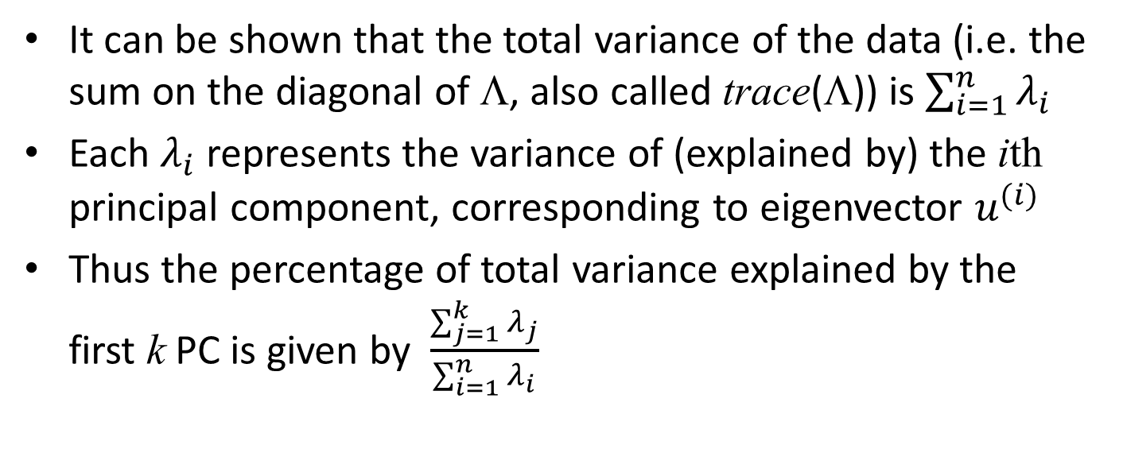
Eigenvalues and variance
It can be shown that the total variance of the data (i.e. the sum on the diagonal of Λ, also called trace(Λ)) is $\sum_{i=1}^{n}{λ_{i}}$
Each $λ_{i}$ represents the variance of (explained by) the ith principal component, corresponding to eigenvector $u^{(i)}$
Thus the percentage of total variance explained by the first k PC is given by $\frac{\sum_{j=1}^{k}{λ_{j}}}{\sum_{i=1}^{n}{λ_{i}}}$

Slide 25
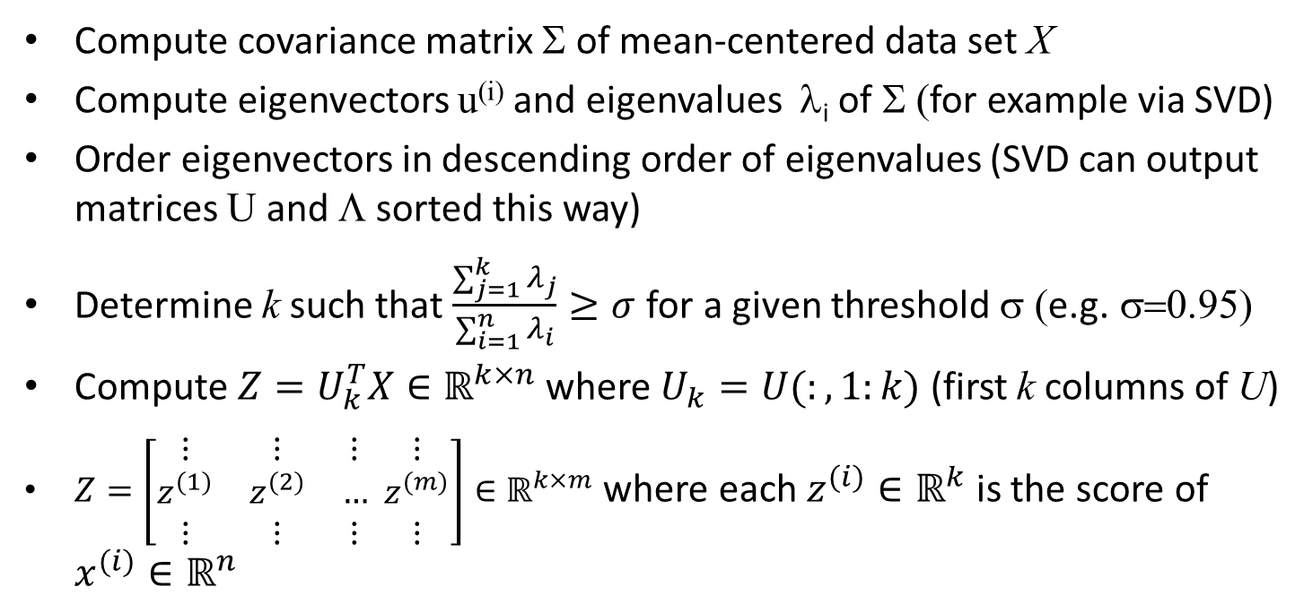
Principal Component Analysis (PCA) algorithm
Compute covariance matrix Σ of mean-centered data set X
Compute eigenvectors u^{(i)} and eigenvalues λ_{i} of Σ (for example via SVD)
Order eigenvectors in descending order of eigenvalues (SVD can output matrices U and Λ sorted this way)
Determine k such that $\frac{\sum_{j=1}^{k}{λ_{j}}}{\sum_{i=1}^{n}{λ_{i}}}≥σ$ for a given threshold σ (e.g. σ=0.95)
Compute $Z=U_{k}^{T}X∈ℝ^{k×n}$ where $U_{k}=U(:,1:k)$ (first k columns of U)
$Z=\left[\begin{matrix}⋮ & ⋮ & ⋮ \\ z^{(1)} & z^{(2)} & … \\ ⋮ & ⋮ & ⋮\end{matrix} \begin{matrix}⋮ \\ z^{(m)} \\ ⋮\end{matrix}\right]∈ℝ^{k×m}$ where each $z^{(i)}∈ℝ^{k}$ is the score of $x^{(i)}∈ℝ^{n}$

Slide 26
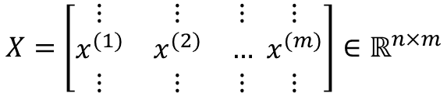
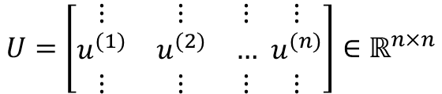

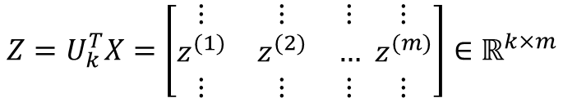
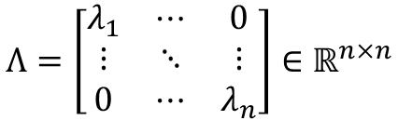
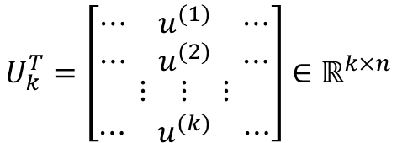
$$λ_{i}=var\left(u^{\left(i\right)T}X\right) \text{where}{ u}^{\left(i\right)T}X∈ℝ^{1×m}$$
variance of PCs
$$U=\left[\begin{matrix}⋮ & ⋮ & ⋮ \\ u^{(1)} & u^{(2)} & … \\ ⋮ & ⋮ & ⋮\end{matrix} \begin{matrix}⋮ \\ u^{(n)} \\ ⋮\end{matrix}\right]∈ℝ^{n×n}$$
$$Λ=\left[\begin{matrix}λ_{1} & ⋯ & 0 \\ ⋮ & ⋱ & ⋮ \\ 0 & ⋯ & λ_{n}\end{matrix}\right]∈ℝ^{n×n}$$
$$λ_{1}≥λ_{2}≥⋯≥λ_{n}$$
$$U_{k}=\left[\begin{matrix}⋮ & ⋮ & ⋮ \\ u^{(1)} & u^{(2)} & … \\ ⋮ & ⋮ & ⋮\end{matrix} \begin{matrix}⋮ \\ u^{(k)} \\ ⋮\end{matrix}\right]∈ℝ^{n×k} \text{where} k \text{is} \text{the} \text{first} \text{value} \text{s}\text{.}\text{t}\text{. }\frac{\sum_{j=1}^{k}{λ_{j}}}{\sum_{i=1}^{n}{λ_{i}}}≥σ$$
$$U_{k}^{T}=\left[\begin{aligned}\begin{matrix}⋯ & u^{(1)} & ⋯ \\ ⋯ & u^{(2)} & ⋯\end{matrix} \\ \begin{matrix}⋮ & ⋮ & ⋮\end{matrix} \\ \begin{matrix}⋯ & u^{(k)} & ⋯\end{matrix}\end{aligned}\right]∈ℝ^{k×n}$$
$$X=\left[\begin{matrix}⋮ & ⋮ & ⋮ \\ x^{(1)} & x^{(2)} & … \\ ⋮ & ⋮ & ⋮\end{matrix} \begin{matrix}⋮ \\ x^{(m)} \\ ⋮\end{matrix}\right]∈ℝ^{n×m}$$
score
feature loading
$$Z=U_{k}^{T}X=\left[\begin{matrix}⋮ & ⋮ & ⋮ \\ z^{(1)} & z^{(2)} & … \\ ⋮ & ⋮ & ⋮\end{matrix} \begin{matrix}⋮ \\ z^{(m)} \\ ⋮\end{matrix}\right]∈ℝ^{k×m}$$
Notes:
La PC j e’ il prodotto di u(j) riga per X ossia un vettore 1xm di elementi che sono calcolati come combinazione lineare di u(j) riga per x(i) Colonna con i=1..m (sono quindi una combinazione lineare di loading feature x valore feature)

Slide 27
PCA plots
Score plot: a scatter plot of the scores of original data points
It provides a view of how data look like in the reduced space
Loading plot: either a scatter plot or a vector representation in the reduced space of feature loadings
It provide an idea of the importance of each feature in the reduced space
These plots are of course 2D or 3D graphs
In case of more than 3 PC we can plot multiple graphs showing scores and loadings of pairs or triples of PC
Scree plot: a line/bar graph showing the variance explained by each PC (ordered)

Slide 28
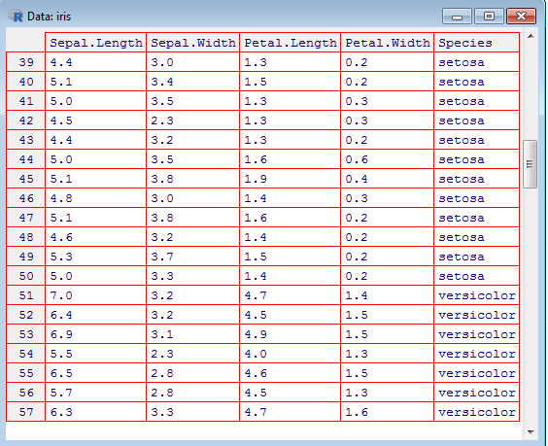
Example: IRIS dataset
4 dimensional space (4 features):
Sepal length/width Petal length/width
Three classes: setosa, versicolor, viriginica

Slide 29
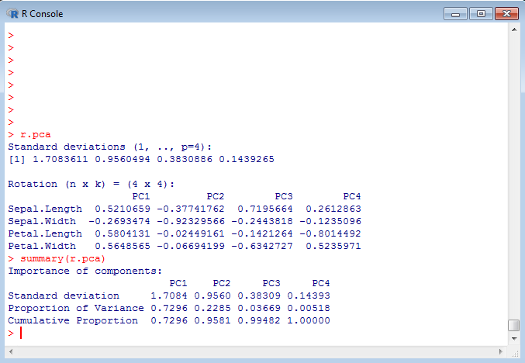
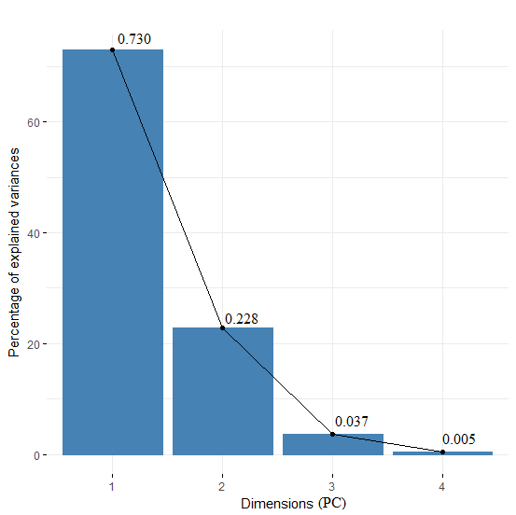
Scree Plot
Explain more than 95% of var
$$PC1=0.5210Sepal.Length−0.2693Sepal.Width+0.5804Petal.Length+0.5648Petal.Width$$

Slide 30
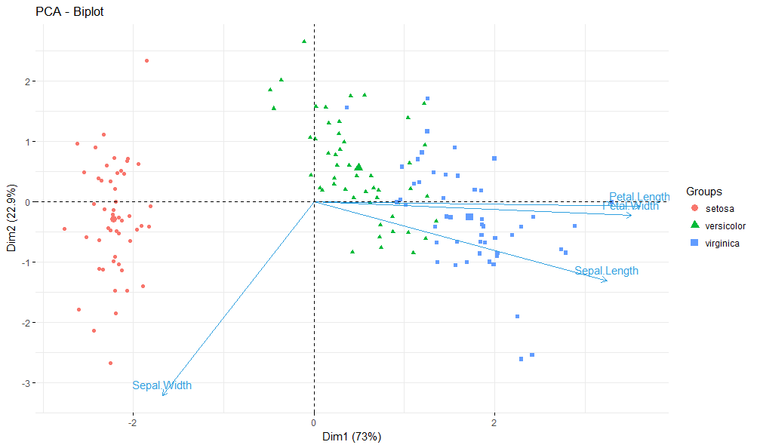
Score and loading plot
Loading interpretation: Petal length and width are very similar (highly correlated) in the reduced space; their variability is essentially
accounted for by PC1 only
While sepal width is very dissimilar (uncorrelated) to all the others
Score interpretation: in the reduced 2D space different classes are clearly separable
PC1 alone can identify setosa from the other two classes

Slide 31
Reconstruction from compressed representation
Dimensionality Reduction

Slide 32








Reconstruction from compressed representation
$$x^{(1)}$$
$$x_{approx}^{(1)}$$
$$z=U_{k}^{T}x$$
$$x_{approx}=U_{k}z$$
$$k×m$$
$$z^{(1)}$$
$$n×m$$
$$n×k$$
Notes:
Make points have 0 mean on x1 and x2

Slide 33
Advice for applying PCA
Dimensionality Reduction

Slide 34

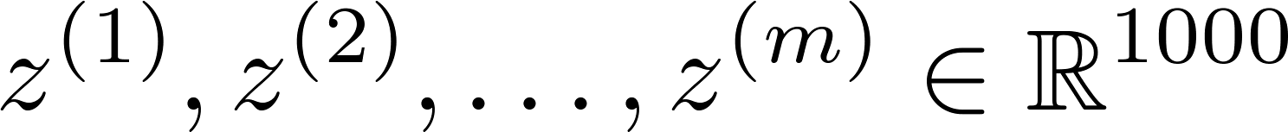
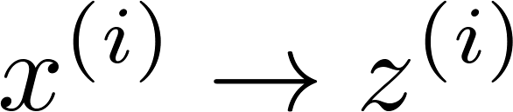
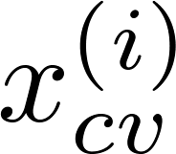
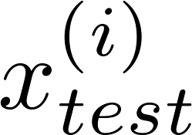
Supervised learning speedup
Extract inputs:
Unlabeled dataset:
New training set:
Note: Mapping should be defined by running PCA only on the training set. This mapping can be applied as well to the examples and in the cross validation and test sets.

Slide 35
Application of PCA
Compression
Reduce memory/disk needed to store data
Speed up learning algorithm
Visualization
Choose k by using variance explained
Choose k =2 or k =3

Slide 36
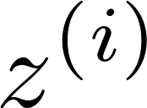
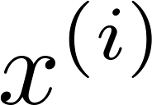

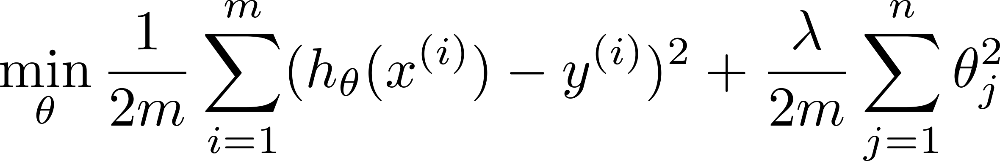
Bad use of PCA: To prevent overfitting
Use instead of to reduce the number of features to
Thus, fewer features, less likely to overfit.
This might work OK, but isn’t a good way to address overfitting. Use regularization instead.

Slide 37





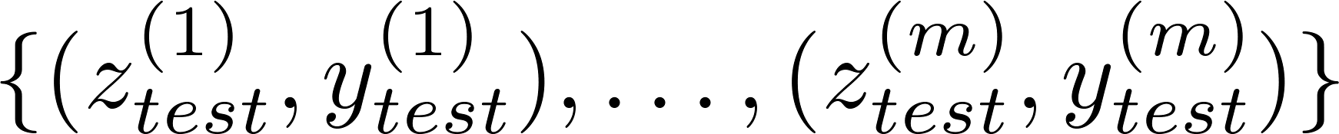
PCA is sometimes used where it shouldn’t be
Design of ML system:
Get training set
Run PCA to reduce in dimension to get
Train logistic regression on
Test on test set: Map to . Run on
How about doing the whole thing without using PCA?
Before implementing PCA, first try running whatever you want to do with the original/raw data . Only if that doesn’t do what you want, then implement PCA and consider using .

