Slide 1
Model
Univariate Linear Regression

Slide 2
Housing Prices
(Portland, OR)
Price
(in 1000s of dollars)
Size (feet²)
Supervised Learning
Correct answer for each training example
Regression Problem
Prediction of continuous values

Slide 3
Training set of
housing prices
(Portland, OR)
Size in feet² (x) | Price ($) in 1000's (y)
2104 | 460
1416 | 232
1534 | 315
852 | 178
… | …
Notation:
m = Number of training examples
x’s = “input” variable / features
y = “output” variable / “target” variable
Univariate analysis: 1 input variable
x⁽¹⁾ =2104
x⁽²⁾ =1416
y⁽²⁾ =232
(x,y) a single training example
(x^{(i)},y^{(i)}) i-th training example

Slide 4

How do we represent
hypothesis h ?
Training Set
$$h_{θ}(x)=θ_{0}+θ_{1}x$$
Learning Algorithm
Size of house
h
Estimated price
Linear regression with one variable.
Univariate linear regression.

Slide 5
Cost function
Linear regression with one variable

Slide 6
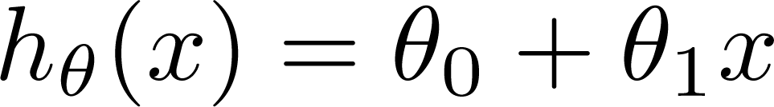

Training Set
Size in feet² (x) | Price ($) in 1000's (y)
2104 | 460
1416 | 232
1534 | 315
852 | 178
… | …
Hypothesis:
‘s: Parameters
How to choose ‘s ?

Slide 7
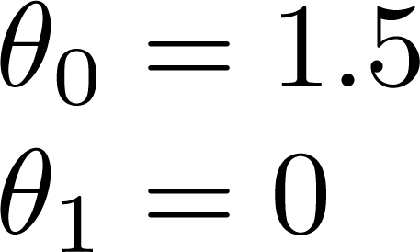
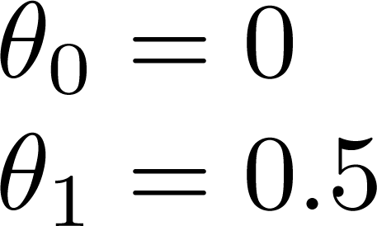
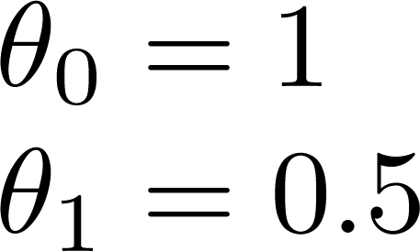

Slide 8
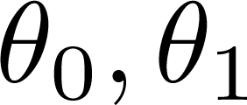


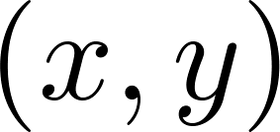
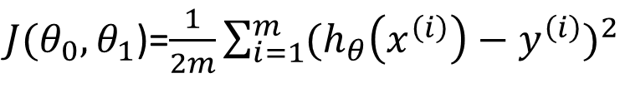
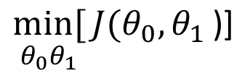
COST FUNCTION
$J(θ_{0}{,θ}_{1}$)=$\frac{1}{2m}\sum_{i=1}^{m}{{(h_{θ}\left(x^{\left(i\right)}\right)−y^{\left(i\right)})}^{2}}$
y
x
$$\underset{θ_{0}θ_{1}}{min[}{J(θ_{0}{,θ}_{1}\text{)}\text{]}}$$
Idea: Choose so that is close to for our training examples
Minimize squared errors!

Slide 9
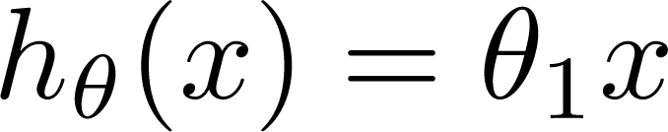

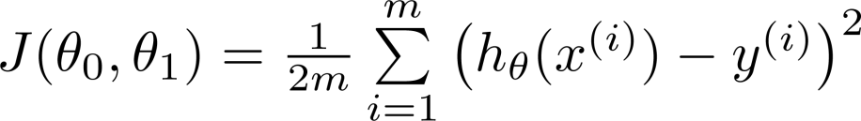
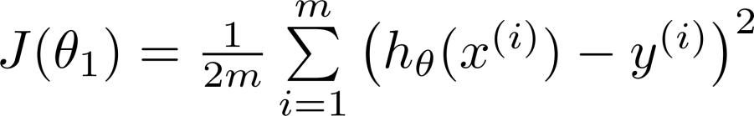
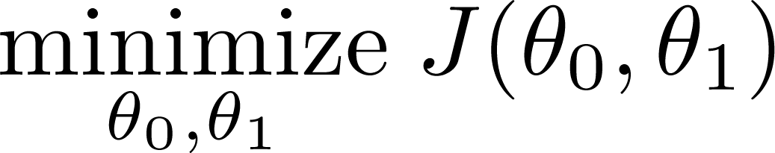
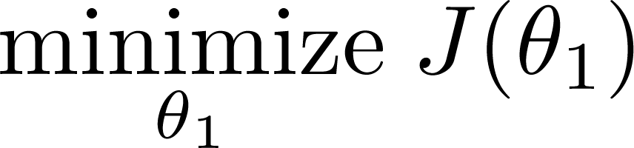
Simplified
Hypothesis:
Parameters:
Cost Function:
Goal:

Slide 10







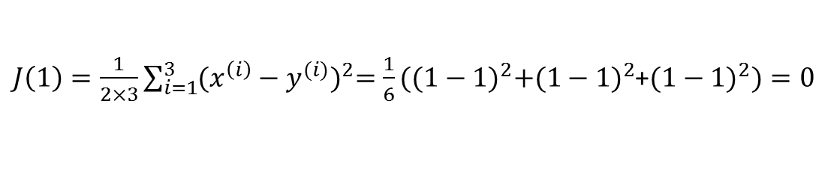
(for fixed , this is a function of x)
(function of the parameter )
y
$$m=3$$
X
x
$J\left(1\right)=\frac{1}{2×3}\sum_{i=1}^{3}{{(x^{\left(i\right)}−y^{(i)})}^{2}=\frac{1}{6}}{((1−1)}^{2}+{(1−1)}^{2}$+${(1−1)}^{2})=0$

Slide 11

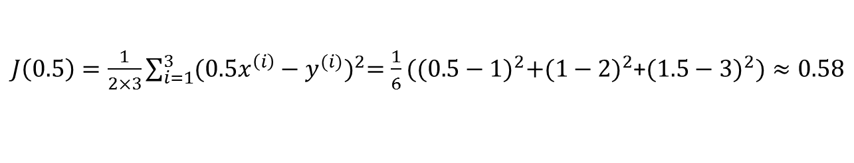
(for fixed , this is a function of x)
(function of the parameter )
y
X
X
x
$J\left(0.5\right)=\frac{1}{2×3}\sum_{i=1}^{3}{{({0.5x}^{\left(i\right)}−y^{(i)})}^{2}=\frac{1}{6}}{((0.5−1)}^{2}+{(1−2)}^{2}$+${(1.5−3)}^{2})≈0.58$

Slide 12

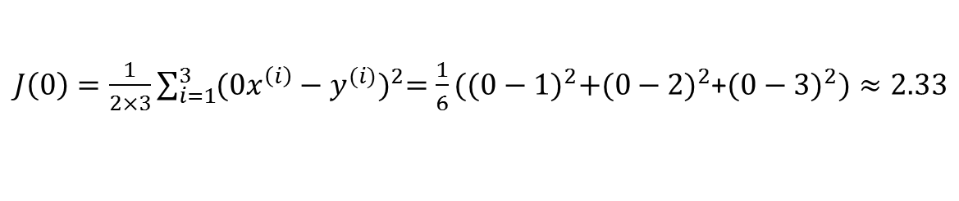
(for fixed , this is a function of x)
(function of the parameter )
X
y
X
X
x
$J\left(0\right)=\frac{1}{2×3}\sum_{i=1}^{3}{{({0x}^{\left(i\right)}−y^{(i)})}^{2}=\frac{1}{6}}{((0−1)}^{2}+{(0−2)}^{2}$+${(0−3)}^{2})≈2.33$

Slide 13

X
X
X
X
X
X
X
$$θ_{1}=1$$

Slide 14
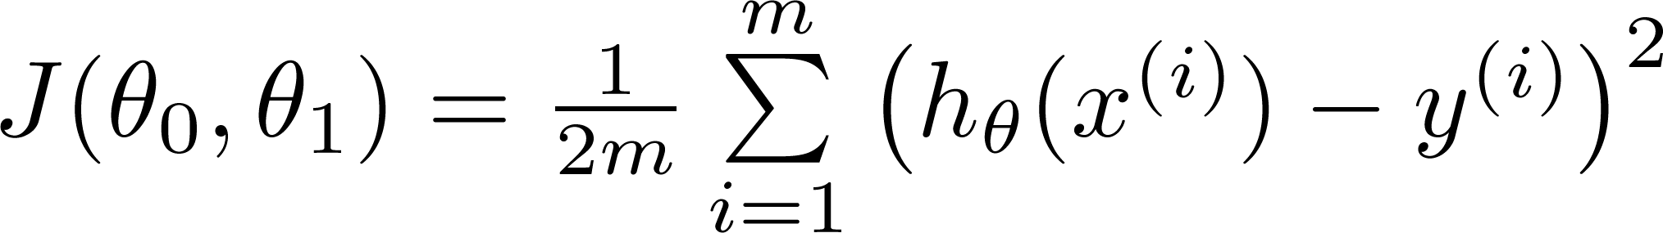
Hypothesis:
Parameters:
Cost Function:
Goal:

Slide 15
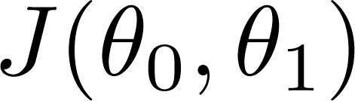


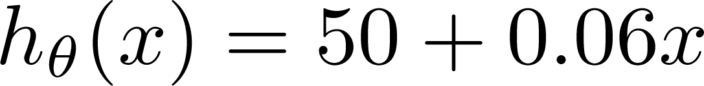

(for fixed , this is a function of x)
(function of the parameters )
Price ($)
in 1000’s
$$θ_{0}=50; θ_{1}=0.06$$
Size in feet² (x)

Slide 16
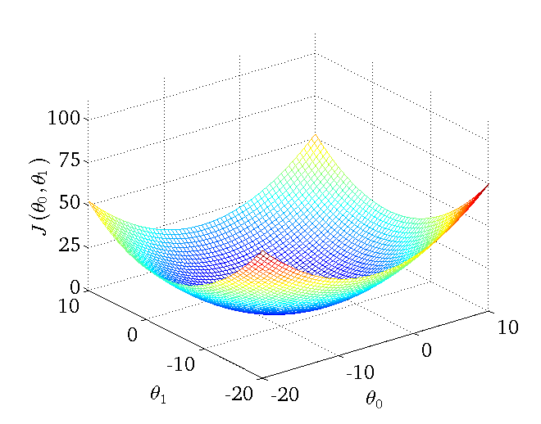

Slide 17
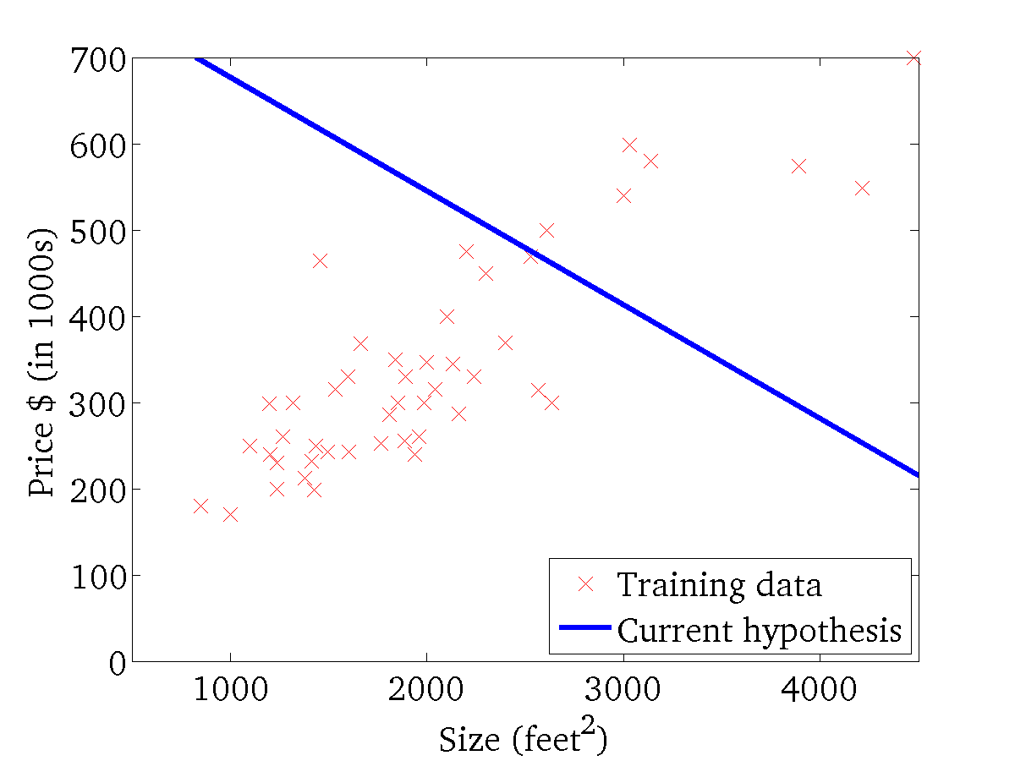
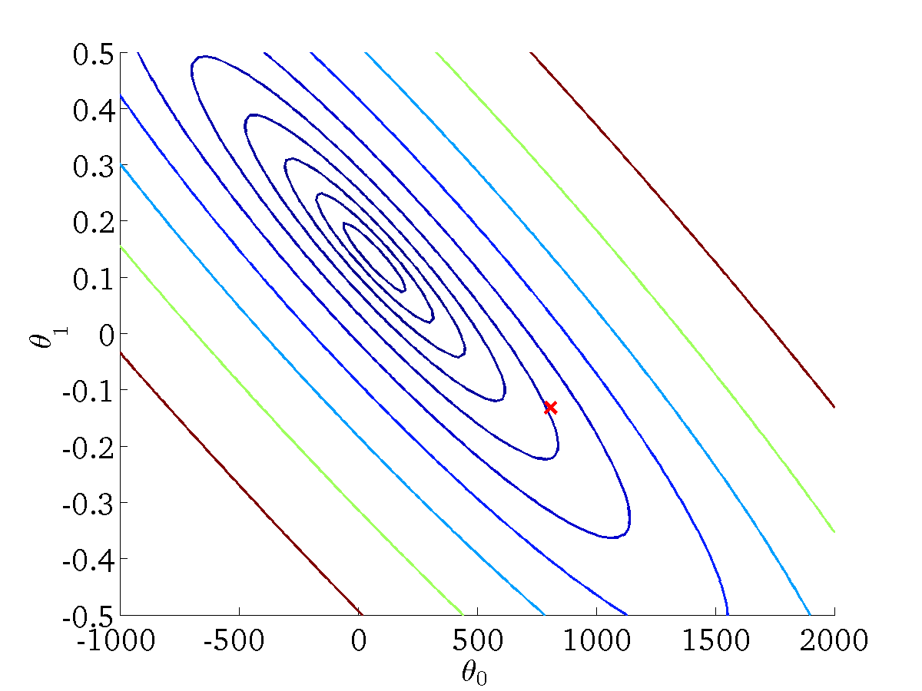

(for fixed , this is a function of x)
(function of the parameters )
Contour Plots: all points on the same line have the same value of J(θ₀,θ₁)
$$θ_{0}=800, θ_{1}=−1.5$$

Slide 18
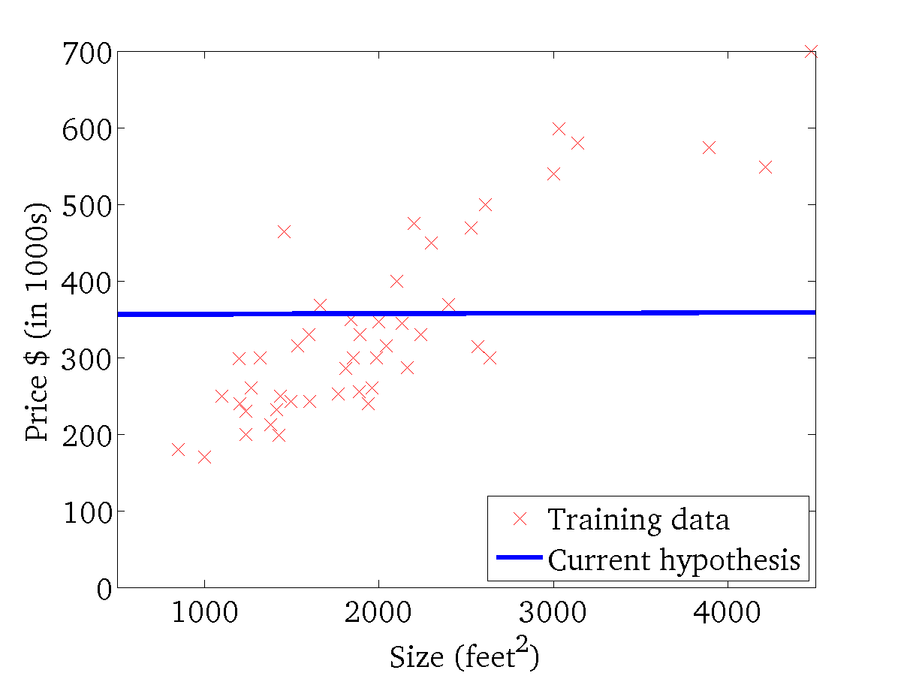
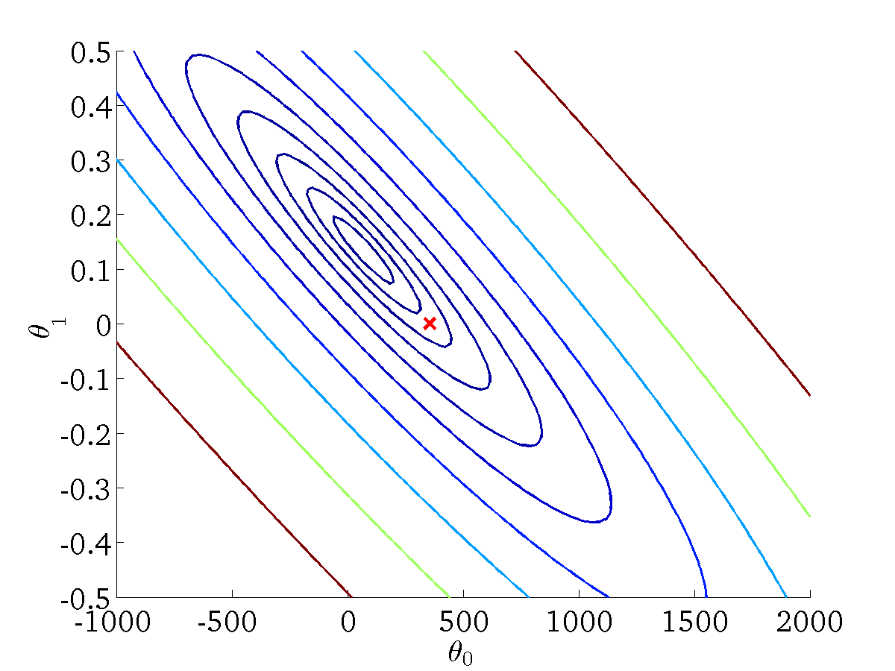

(for fixed , this is a function of x)
(function of the parameters )
$$θ_{0}=360, θ_{1}=0$$

Slide 19
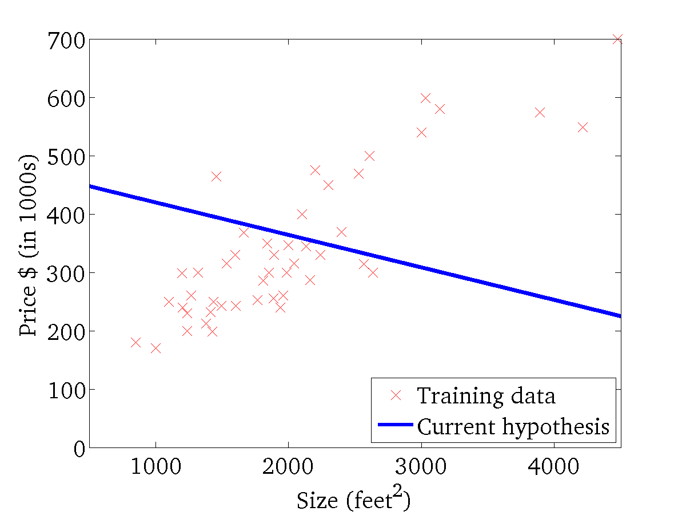

(for fixed , this is a function of x)
(function of the parameters )

Slide 20
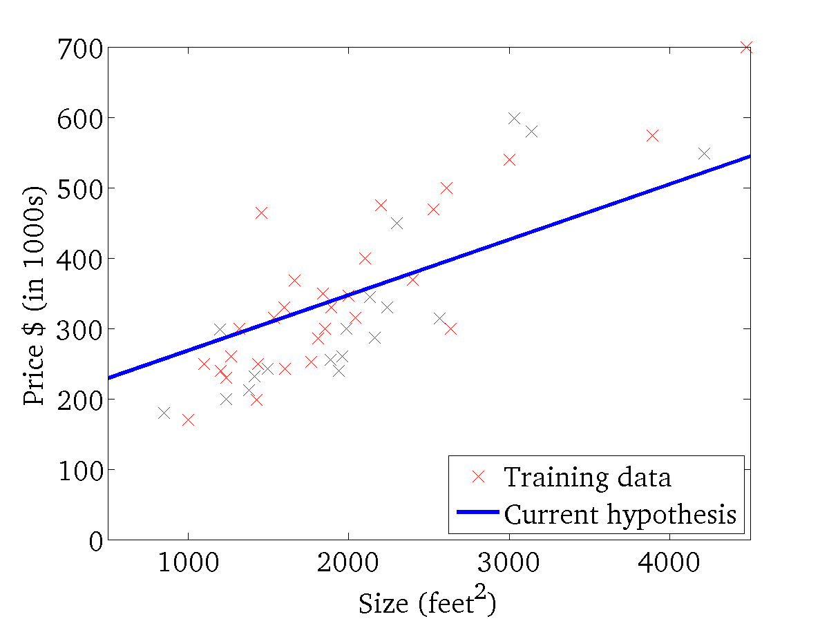
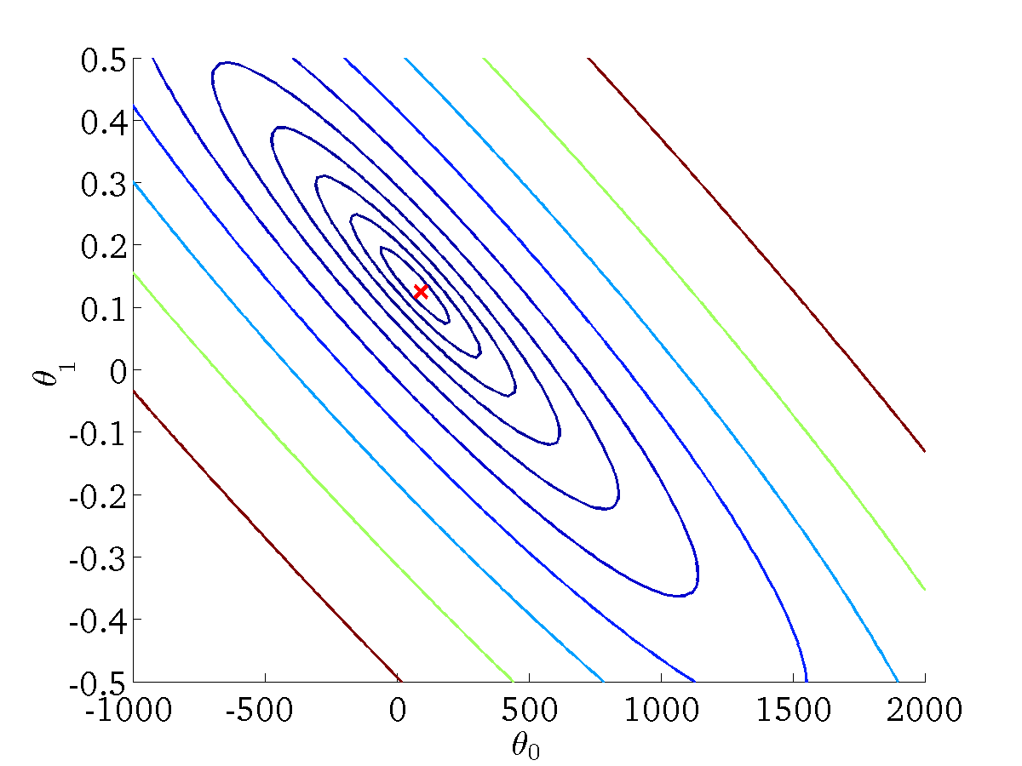
(for fixed , this is a function of x)
(function of the parameters )
Very close to the minimum

Slide 21
Gradient descent
Linear regression with one variable

Slide 22
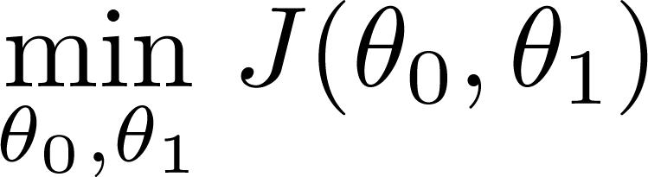
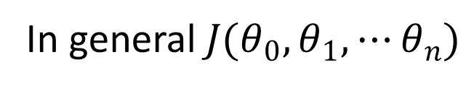
Have some function
Want
In general$J(θ_{0},θ_{1},⋯θ_{n})$
Outline:
Start with some
Keep changing to reduce until we hopefully end up at a minimum

Slide 23
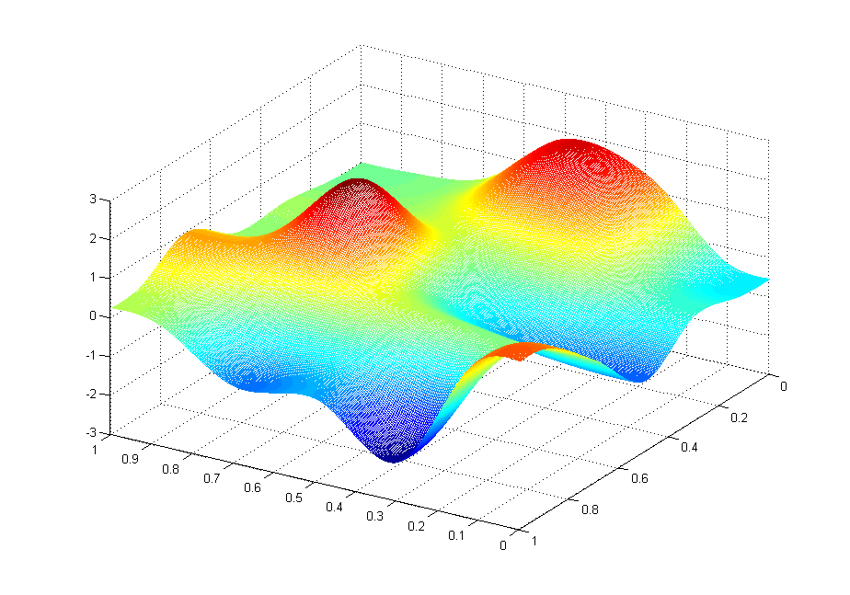
J(θ₀,θ₁)
θ₁
θ₀

Slide 24
J(θ₀,θ₁)
θ₁
θ₀

Slide 25
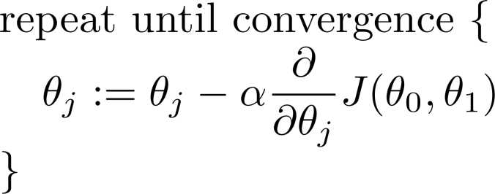
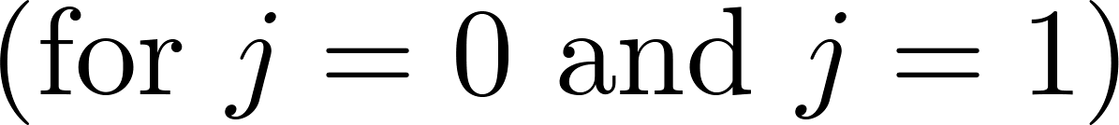
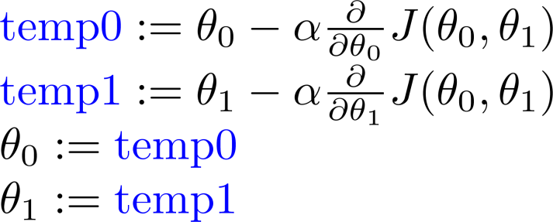
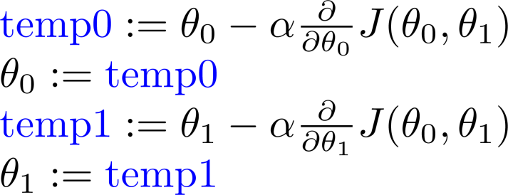
Gradient descent algorithm
Correct: Simultaneous update
Incorrect:

Slide 26
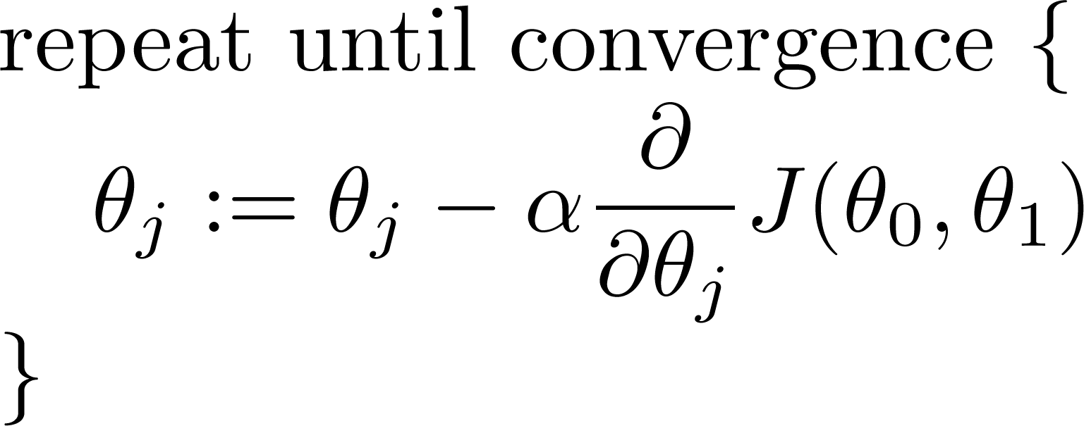
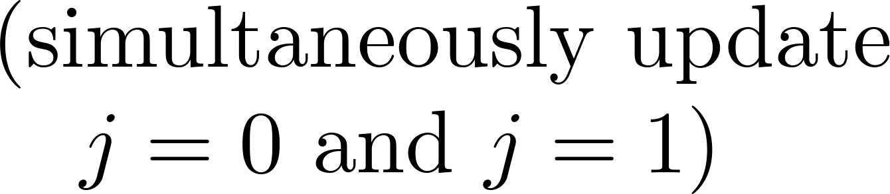

Gradient descent algorithm
$$α:\text{learning} \text{rate}$$
Define the “size” of the step

Slide 27


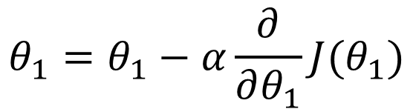

$$J(θ_{1})$$
$$θ_{1}=θ_{1}−α\frac{∂}{∂θ_{1}}J(θ_{1})$$
positive
slope
x
If the derivative is positive, parameter moves on the left
If the derivative is negative, parameter moves on the right
It goes towards a (local) minimum
$$θ_{1}$$
negative
slope
x
$$θ_{1}$$

Slide 28
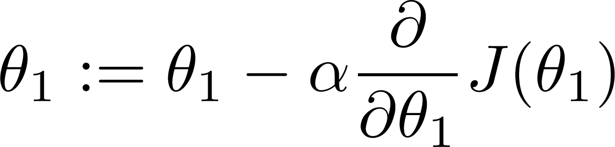

$$J(θ_{1})$$
If α is too small, gradient descent can be slow.
If α is too large, gradient descent can overshoot the minimum. It may fail to converge, or even diverge.

Slide 29

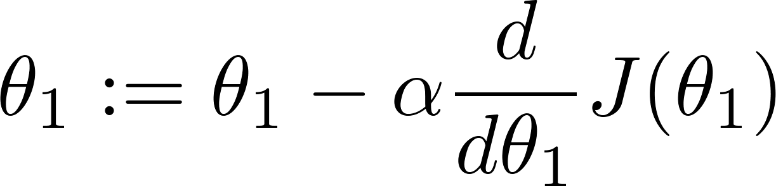
at local optima
Current value of

Slide 30
Gradient descent can converge to a local minimum, even with the learning rate α fixed.
As we approach a local minimum, gradient descent will automatically take smaller steps. So, no need to decrease α over time.

Slide 31
Gradient descent for linear regression
Linear regression with one variable

Slide 32
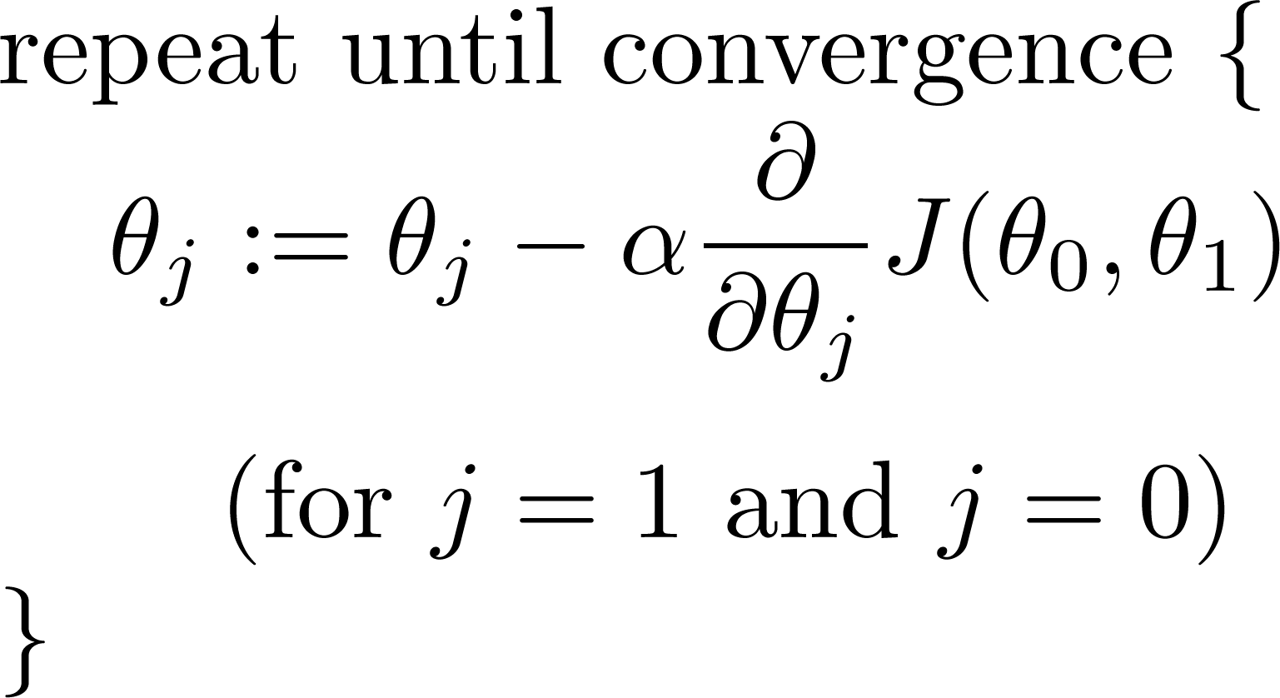
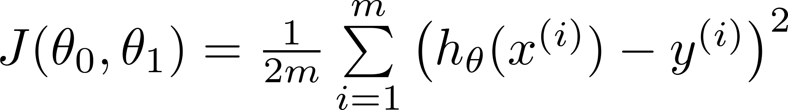
Gradient descent algorithm
Linear Regression Model

Slide 33
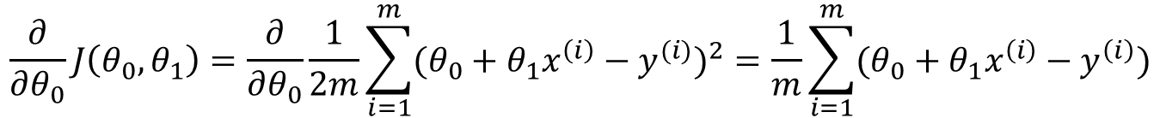
$$\frac{∂}{∂θ_{0}}J\left({θ_{0},θ}_{1}\right)=\frac{∂}{∂θ_{0}}\frac{1}{2m}\sum_{i=1}^{m}{{(θ_{0}+θ_{1}x^{\left(i\right)}−y^{(i)})}^{2}}=\frac{1}{m}\sum_{i=1}^{m}{(θ_{0}+θ_{1}x^{\left(i\right)}−y^{\left(i\right)})}$$
$$\frac{∂}{∂θ_{1}}J\left({θ_{0},θ}_{1}\right)=\frac{∂}{∂θ_{1}}\frac{1}{2m}\sum_{i=1}^{m}{{(θ_{0}+θ_{1}x^{\left(i\right)}−y^{(i)})}^{2}}=\frac{1}{m}\sum_{i=1}^{m}{(θ_{0}+θ_{1}x^{\left(i\right)}−y^{\left(i\right)})x^{(i)}}$$

Slide 34
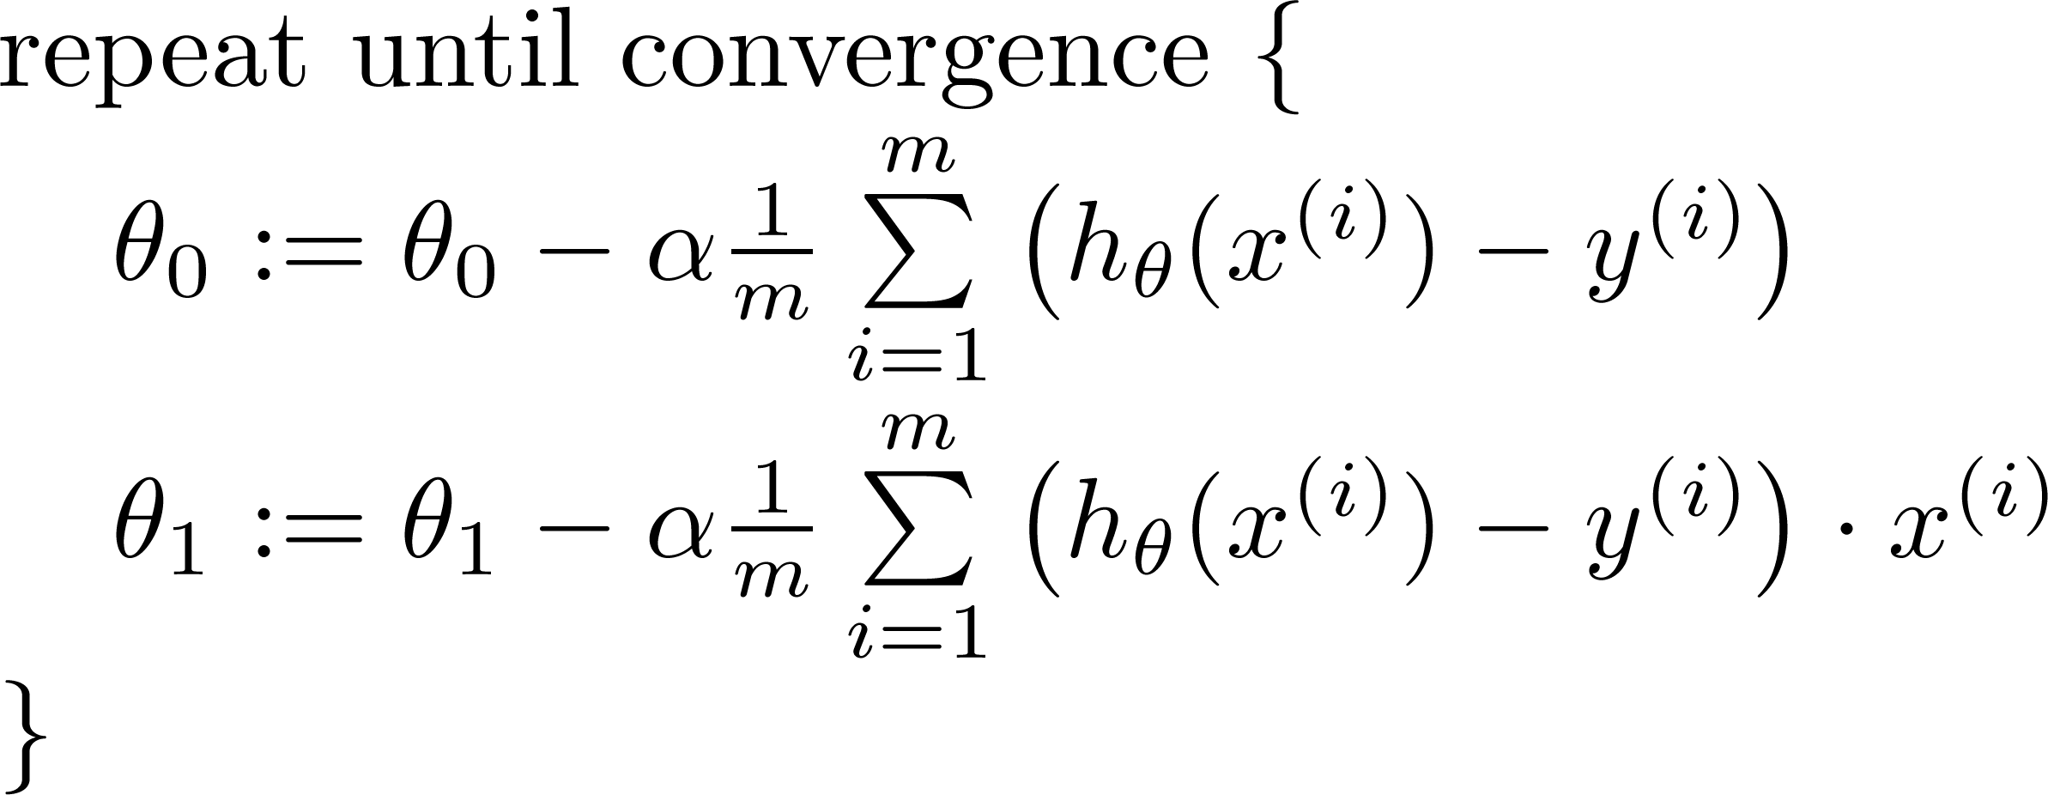

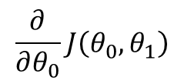
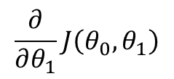
Gradient descent algorithm
$$\frac{∂}{∂θ_{0}}J\left({θ_{0},θ}_{1}\right)$$
update
and
simultaneously
$$\frac{∂}{∂θ_{1}}J\left({θ_{0},θ}_{1}\right)$$

Slide 35
J(θ₀,θ₁)
θ₁
θ₀

Slide 36
J(θ₀,θ₁)
θ₁
θ₀

Slide 37
Convex Function

Slide 38
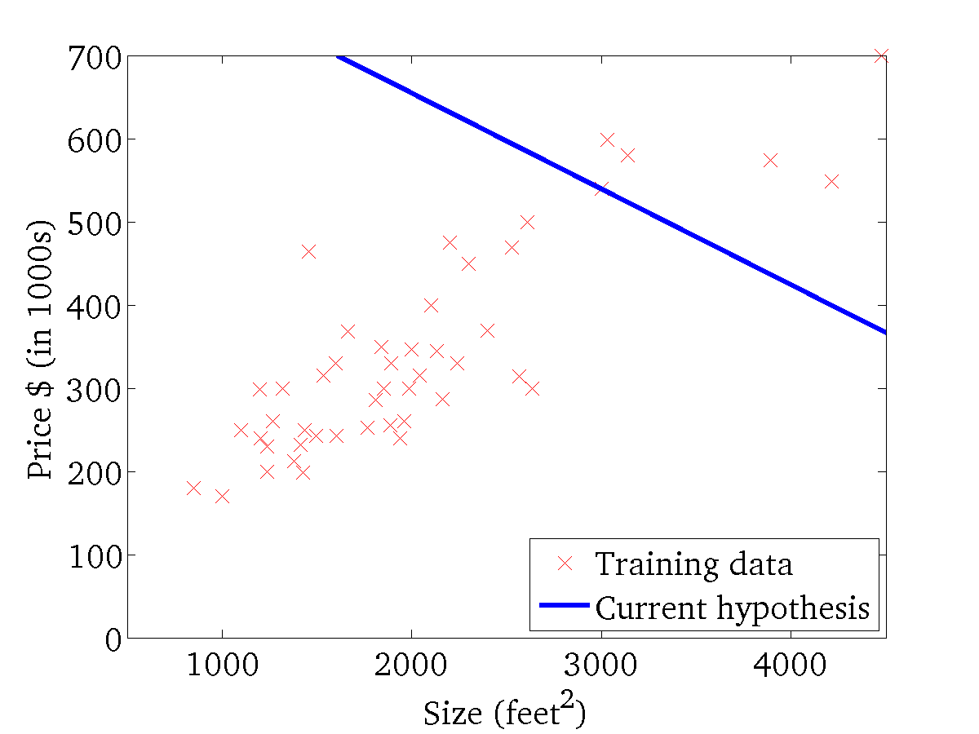
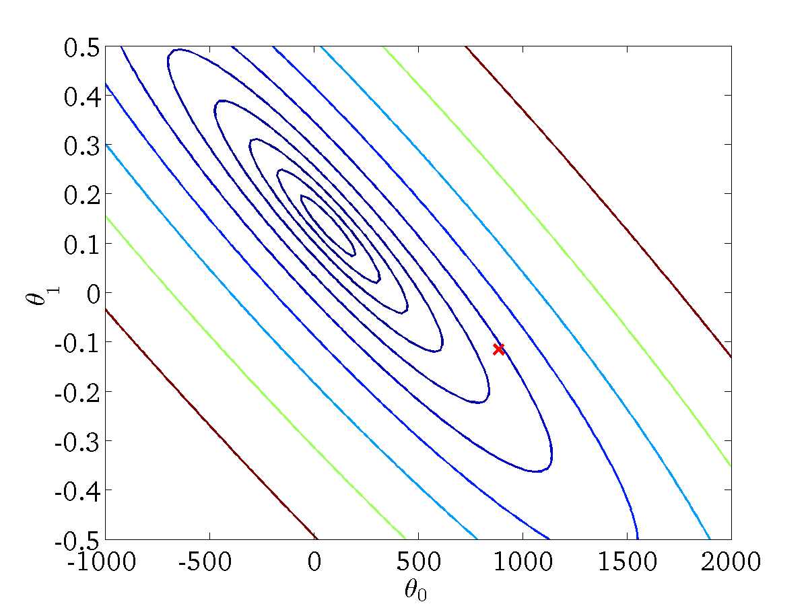
(for fixed , this is a function of x)
(function of the parameters )

Slide 39

(for fixed , this is a function of x)
(function of the parameters )

Slide 40
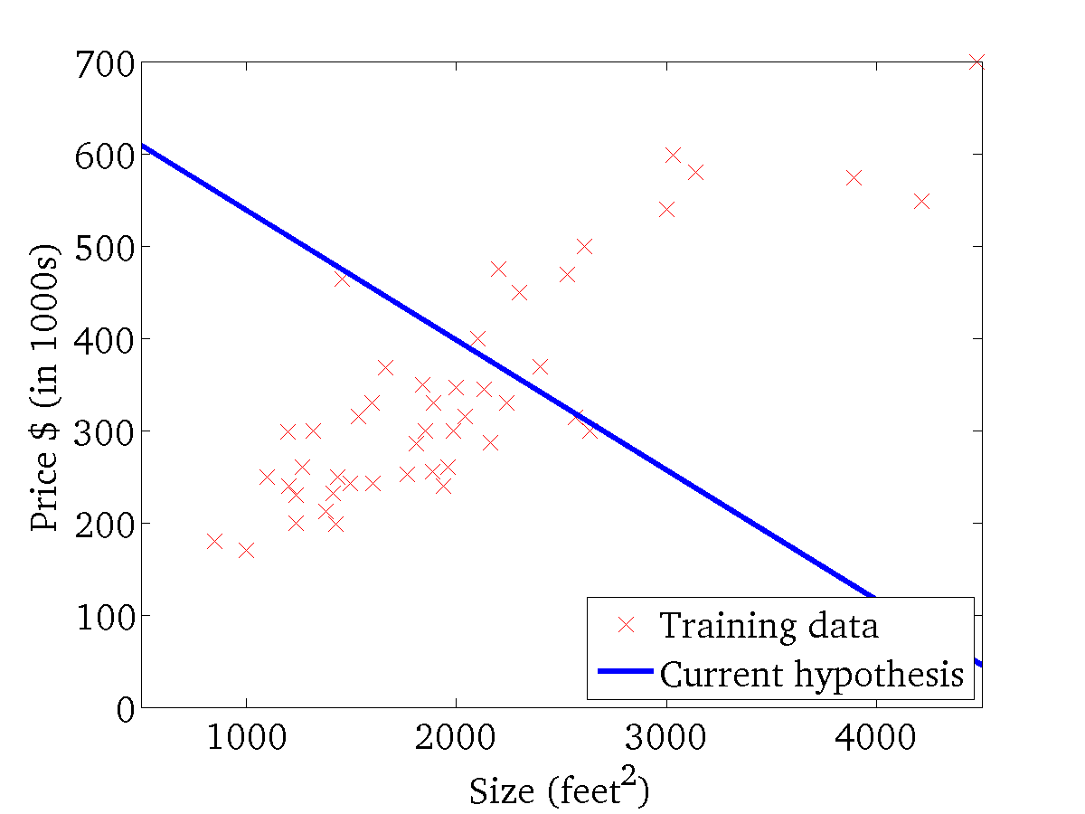
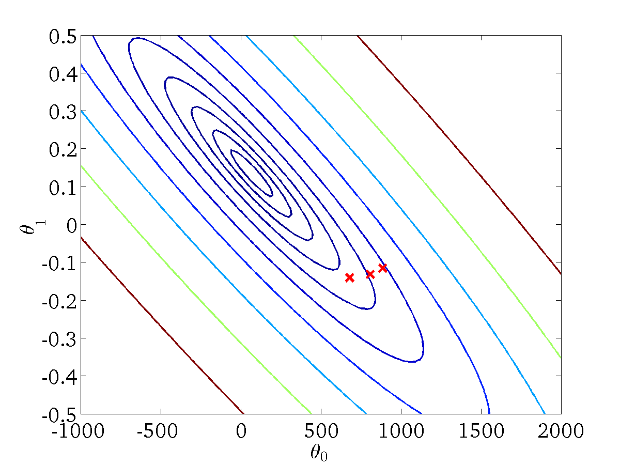
(for fixed , this is a function of x)
(function of the parameters )

Slide 41
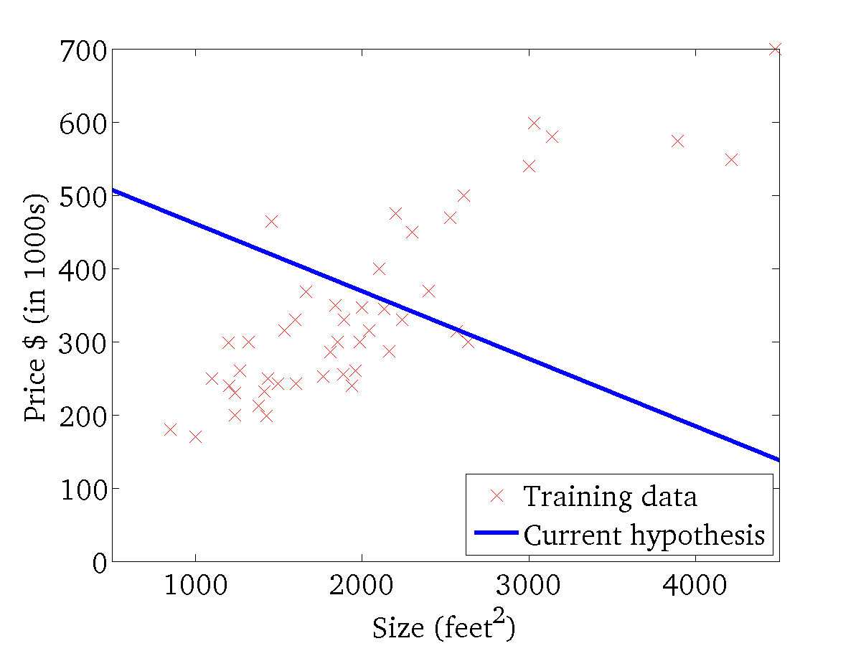

(for fixed , this is a function of x)
(function of the parameters )

Slide 42

(for fixed , this is a function of x)
(function of the parameters )

Slide 43

(for fixed , this is a function of x)
(function of the parameters )

Slide 44


(for fixed , this is a function of x)
(function of the parameters )

Slide 45

(for fixed , this is a function of x)
(function of the parameters )

Slide 46


(for fixed , this is a function of x)
(function of the parameters )

Slide 47


“Batch” Gradient Descent
“Batch”: Each step of gradient descent uses all the m training examples.
$$\sum_{i=1}^{m}{(θ_{0}+θ_{1}x^{\left(i\right)}−y^{\left(i\right)})}$$
$$\sum_{i=1}^{m}{(θ_{0}+θ_{1}x^{\left(i\right)}−y^{\left(i\right)})x^{(i)}}$$

Slide 48
Matrix Formulation
Univariate Linear Regression

Slide 49




House sizes:
predictions=data matrix x parameters
$$h_{θ}(2104)$$
$$\left[\begin{aligned}\begin{matrix}1 & 2104 \\ 1 & 1416 \\ 1 & 1534\end{matrix} \\ \begin{matrix}1 & 852\end{matrix}\end{aligned}\right]×\left[\begin{matrix}−40 \\ 0.25\end{matrix}\right]=\left[\begin{aligned}\begin{matrix}−40+2104 ×0.25 \\ −40+1416 ×0.25\end{matrix} \\ −40+1534× 0.25 \\ −40+852 ×0.25\end{aligned}\right]=\left[\begin{aligned}\begin{matrix}486 \\ 314\end{matrix} \\ 343.5 \\ 173\end{aligned}\right]$$

Slide 50





House sizes:
Have 3 competing hypotheses:
1.
2.
3.
Matrix
Matrix
Predictions of 1.
Predictions of 2.
Predictions of 3.

