Slide 1
Multiple features
Linear Regression with multiple variables

Slide 2


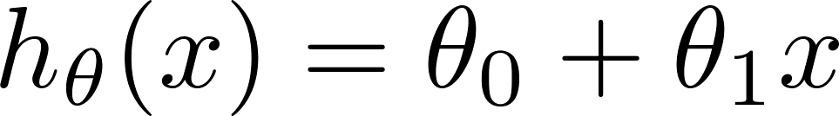
Single feature (variable)
Size (feet²) | Price ($1000)
2104 | 460
1416 | 232
1534 | 315
852 | 178
… | …

Slide 3
Multiple features (variables)
Size (feet²) | Number of bedrooms | Number of floors | Age of home (years) | Price ($1000)
2104 | 5 | 1 | 45 | 460
1416 | 3 | 2 | 40 | 232
1534 | 3 | 2 | 30 | 315
852 | 2 | 1 | 36 | 178
… | … | … | … | …

Slide 4










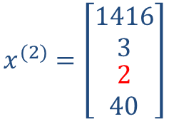

Multiple features (variables).
Size (feet²) | Number of bedrooms | Number of floors | Age of home (years) | Price ($1000)
2104 | 5 | 1 | 45 | 460
1416 | 3 | 2 | 40 | 232
1534 | 3 | 2 | 30 | 315
852 | 2 | 1 | 36 | 178
… | … | … | … | …
$$x_{1}$$
$$x_{2}$$
$$x_{3}$$
$$x_{4}$$
$$y$$
$$m$$
Notation:
= number of features
= input (features) of training example.
= value of feature in training example.
$$x^{(2)}=\left[\begin{matrix}\begin{matrix}1416 \\ 3\end{matrix} \\ \begin{matrix}2 \\ 40\end{matrix}\end{matrix}\right]$$
$$n=4$$
$$x_{3}^{(2)}=2$$
Notes:
Pop-up Quiz

Slide 5
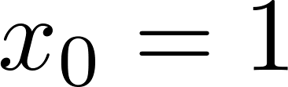

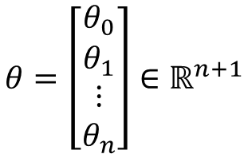
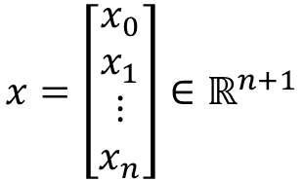

Hypothesis:
Previously:
Now:
$$∀i x_{0}^{\left(i\right)}=1$$
For convenience of notation, define .
$$x=\left[\begin{matrix}x_{0} \\ x_{1} \\ \begin{matrix}⋮ \\ x_{n}\end{matrix}\end{matrix}\right]∈ℝ^{n+1}$$
$$θ=\left[\begin{matrix}θ_{0} \\ θ_{1} \\ \begin{matrix}⋮ \\ θ_{n}\end{matrix}\end{matrix}\right]∈ℝ^{n+1}$$
$$h_{θ}\left(x\right)=θ^{T}x$$
Multivariate linear regression.

Slide 6
Gradient descent for multiple variables
Linear Regression with multiple variables

Slide 7
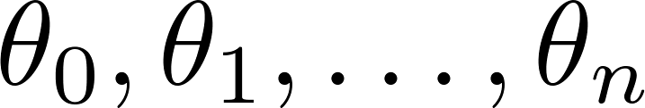
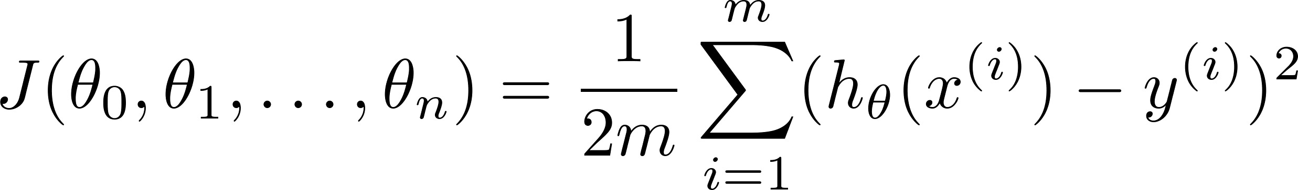

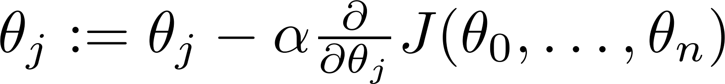

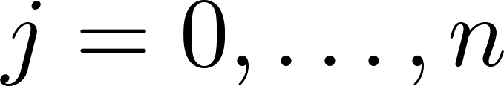


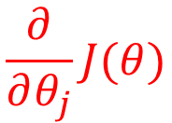
Hypothesis:
Parameters:
$$θ$$
Cost function:
$$J(θ)$$
Gradient descent:
Repeat
$$\frac{∂}{∂θ_{j}}J(θ)$$
(simultaneously update for every )

Slide 8

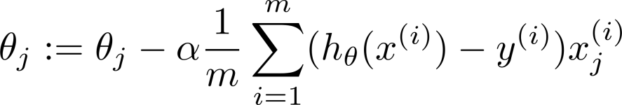
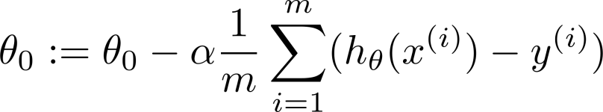



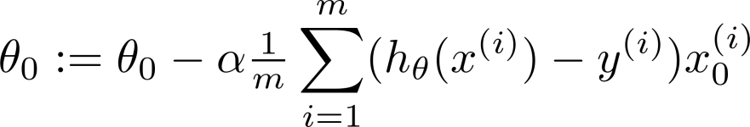
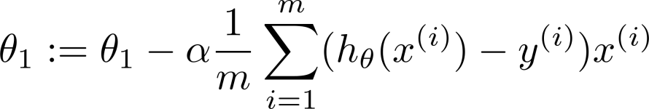
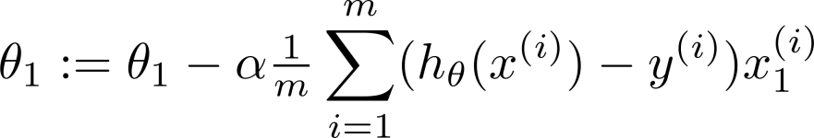

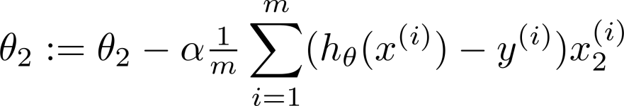

New algorithm :
Gradient Descent
Repeat
$$\frac{∂}{∂θ_{j}}J(θ)$$
Previously (n=1):
Repeat
(simultaneously update for
)
(simultaneously update )

Slide 9
Gradient descent in practice I: Feature Scaling
Linear Regression with multiple variables

Slide 10
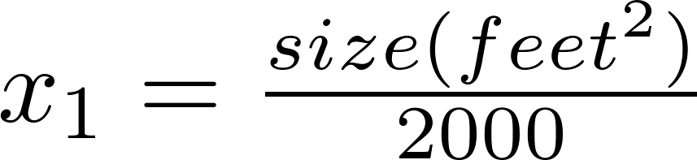


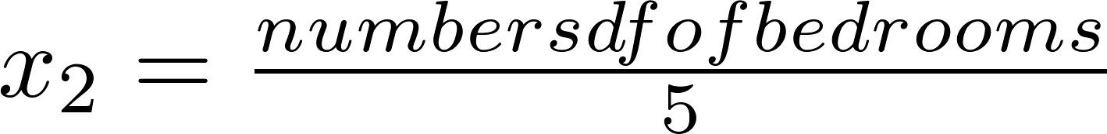



Feature Scaling (for faster convergence)
Idea: Make sure features are on a similar scale.
E.g. = size (0-2000 feet²)
= number of bedrooms (1-5)
size (feet²)
number of bedrooms
slow
fast

Slide 11



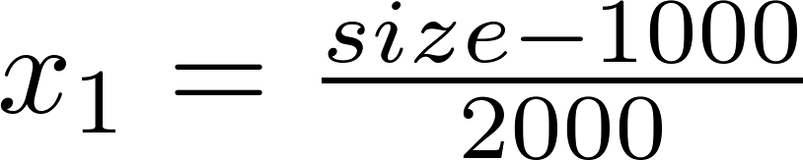
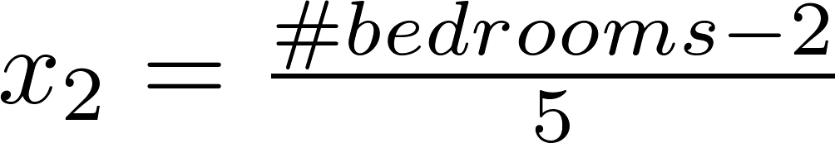

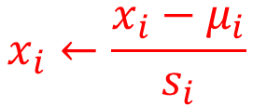
Mean normalization
Replace with to make features have approximately zero mean (Do not apply to ).
E.g.
$$4$$
$$x_{i}←\frac{x_{i}−μ_{i}}{s_{i}}$$
standardization
$$μ_{i}\text{is} \text{the} \text{average} \text{value} \text{of} x_{i}$$
$$s_{i} \text{is} \text{the} \text{average} \text{range} \text{or} \text{st}\text{. }\text{dev}\text{. }\text{of} x_{i}$$

Slide 12
Gradient descent in practice II: Learning rate
Linear Regression with multiple variables

Slide 13
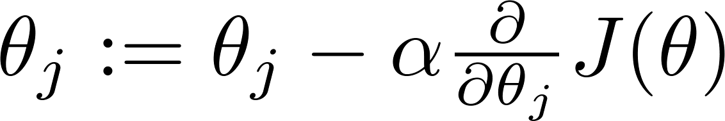

Gradient descent
“Debugging”: How to make sure gradient descent is working correctly.
How to choose learning rate .

Slide 14
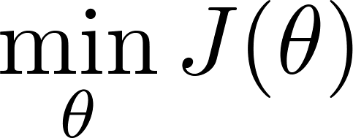
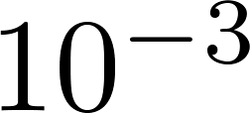
Making sure gradient descent is working correctly.
J(θ) should decrease after each iteration!
Example automatic convergence test:
Declare convergence if decreases by less than in one iteration.
No. of iterations

Slide 15

Making sure gradient descent is working correctly.
Gradient descent not working.
Use smaller .
No. of iterations
No. of iterations
θ
For sufficiently small , should decrease on every iteration.
But if is too small, gradient descent can be slow to converge.

Slide 16
Summary:
If is too small: slow convergence.
If is too large: may not decrease on every iteration; may not converge.
To choose , try
…X 10…
…X 10…
…X 10…
In general choose an increase rate (even smaller than 10) and check a set of values for α

Slide 17
Features and polynomial regression
Linear Regression with multiple variables

Slide 18
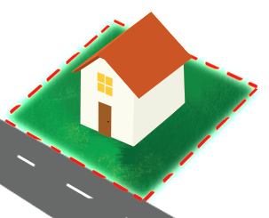


Housing prices prediction
depth
To reduce to 1 feature:
frontage
$$Area=frontage ×depth$$
$$h_{θ}\left(x\right)=θ_{0}+θ_{1}×Area$$
You can choose or invent new features!

Slide 19
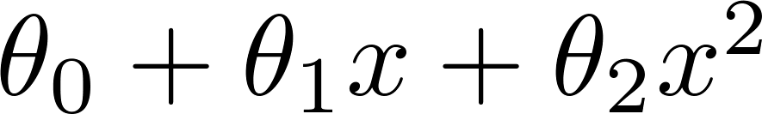
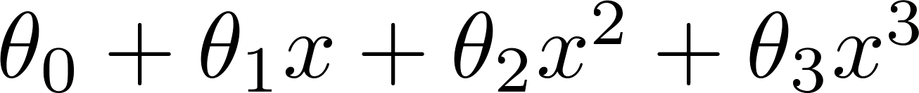
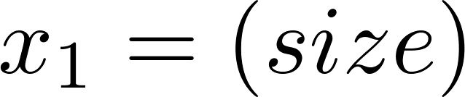
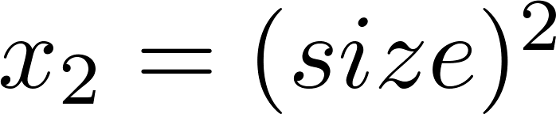
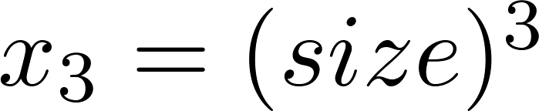
Polynomial regression
Price
(y)
Size (x)
Warning: feature scaling almost always necessary in this case (range values of x_{i} may greatly differ)

Slide 20
Choice of features
Price
(y)
Size (x)

Slide 21
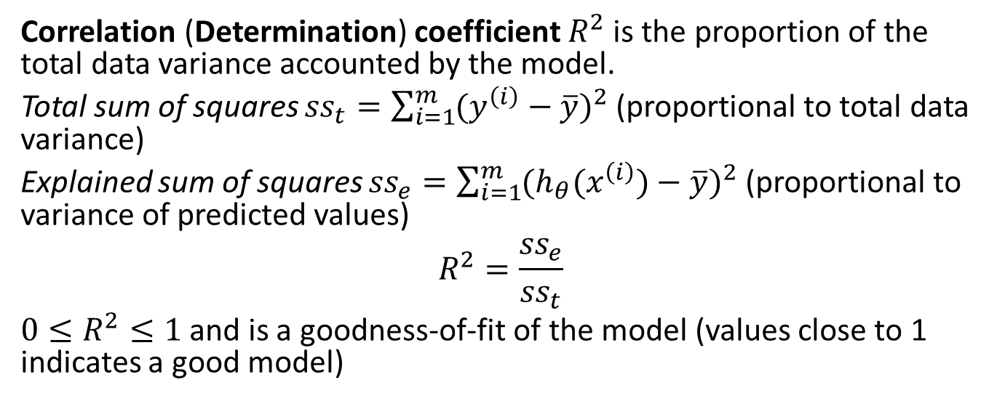
Evaluation of LR
Correlation (Determination) coefficient $R^{2}$ is the proportion of the total data variance accounted by the model.
Total sum of squares ${ss}_{t}=\sum_{i=1}^{m}{{(y^{\left(i\right)}−\overline{y})}^{2}}$ (proportional to total data variance)
Explained sum of squares ${ss}_{e}=\sum_{i=1}^{m}{{(h_{θ}(x^{\left(i\right)})−\overline{y})}^{2}}$ (proportional to variance of predicted values)
$$R^{2}=\frac{{ss}_{e}}{{ss}_{t}}$$
$0≤R^{2}≤1$ and is a goodness-of-fit of the model (values close to 1 indicates a good model)

Slide 22
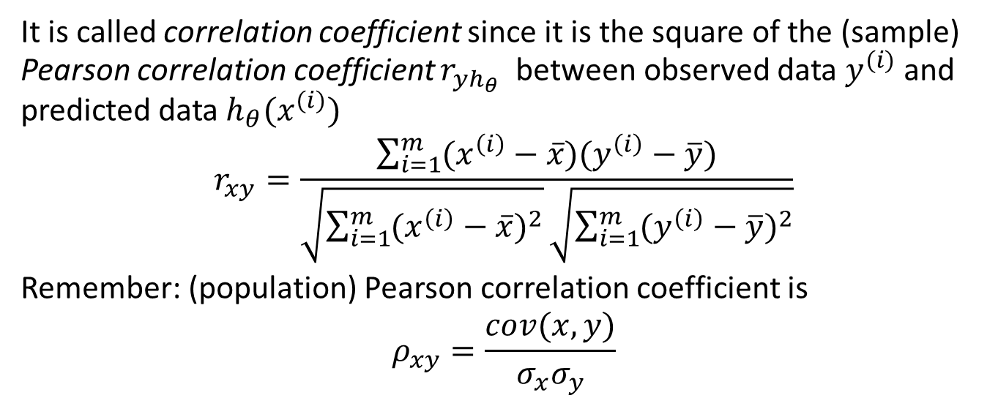
It is called correlation coefficient since it is the square of the (sample) Pearson correlation coefficient $r_{yh_{θ}}$ between observed data $y^{(i)}$ and predicted data $h_{θ}(x^{(i)})$
$$r_{xy}=\frac{\sum_{i=1}^{m}{(x^{\left(i\right)}−\overline{x})(y^{\left(i\right)}−\overline{y})}}{\sqrt{\sum_{i=1}^{m}{{(x^{\left(i\right)}−\overline{x})}^{2}}}\sqrt{\sum_{i=1}^{m}{{(y^{\left(i\right)}−\overline{y})}^{2}}}}$$
Remember: (population) Pearson correlation coefficient is
$$ρ_{xy}=\frac{cov(x,y)}{σ_{x}σ_{y}}$$

