Slide 1
Classification
Logistic
Regression

Slide 2
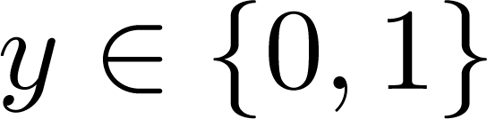
Classification
Email: Spam / Not Spam?
Online Transactions: Fraudulent (Yes / No)?
Tumor: Malignant / Benign ?
0: “Negative Class” (e.g., benign tumor)
1: “Positive Class” (e.g., malignant tumor)

Slide 3

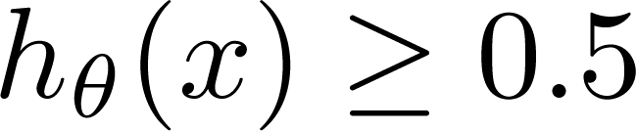
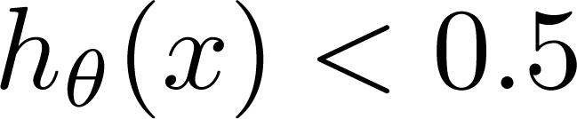

(Yes) 1
Malignant ?
$$h_{θ}(x)$$
0.5
(No) 0
Tumor Size
Tumor Size
Threshold classifier output at 0.5:
If , predict “y = 1”
If , predict “y = 0”

Slide 4
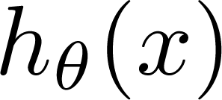
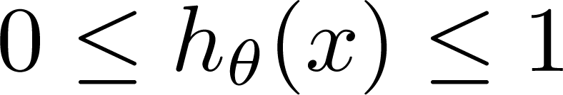
Classification: y = 0 or 1
can be > 1 or < 0
Logistic Regression:

Slide 5
Hypothesis Representation
Logistic
Regression

Slide 6
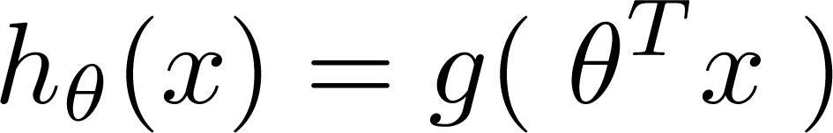
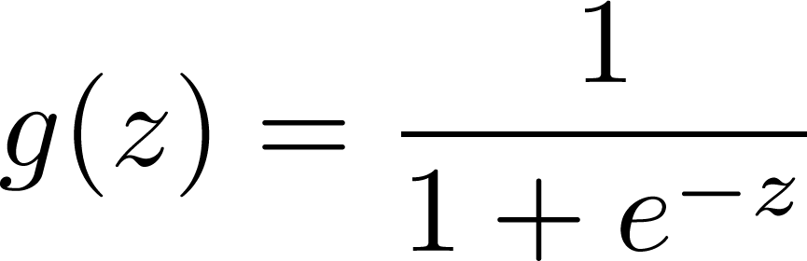
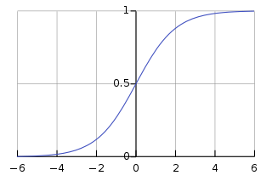
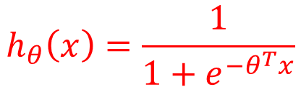
Logistic Regression Model
Want
Sigmoid function
Logistic function
$$h_{θ}\left(x\right)=\frac{1}{1+e^{−θ^{T}x}}$$

Slide 7
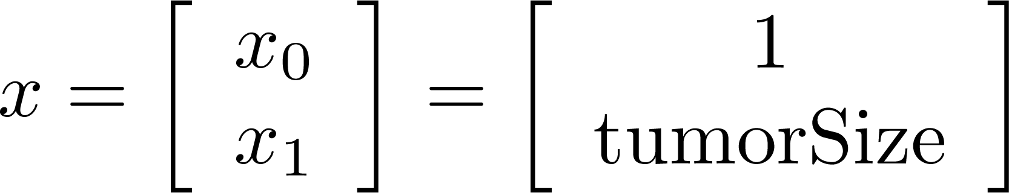
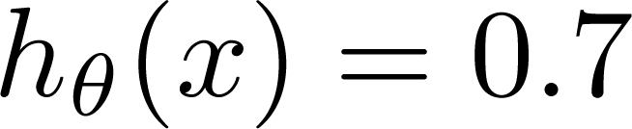
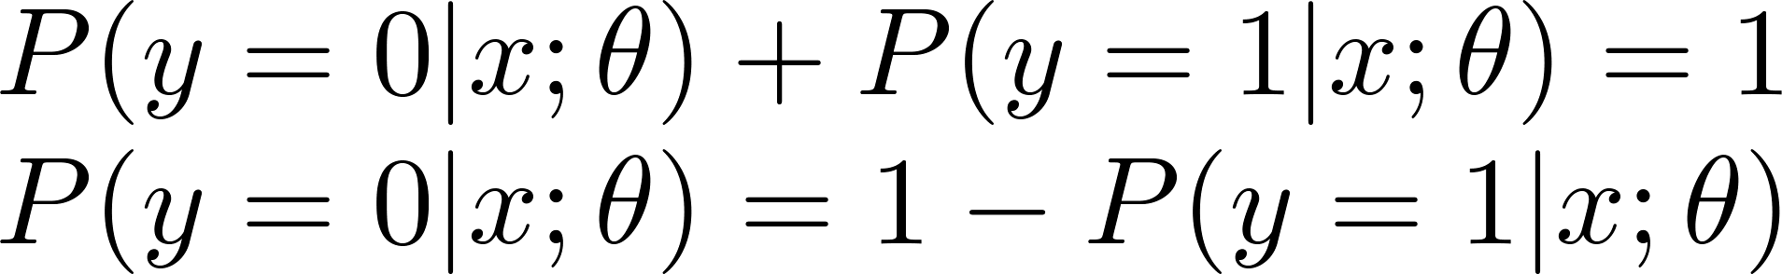

Interpretation of Hypothesis Output
= estimated probability that y = 1 on input x
Example: If
Tell patient that 70% chance of tumor being malignant
“probability that y = 1, given x,
parameterized by ”
$$h_{θ}\left(x\right)=P(y=1|x;θ)$$

Slide 8
Decision boundary
Logistic
Regression

Slide 9
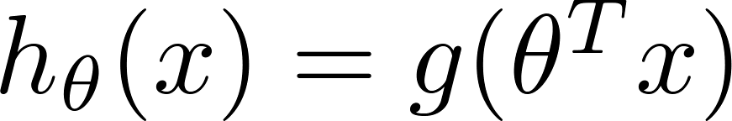
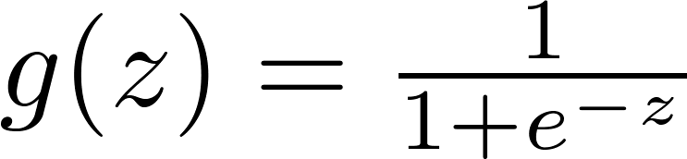

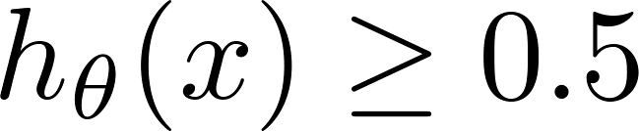

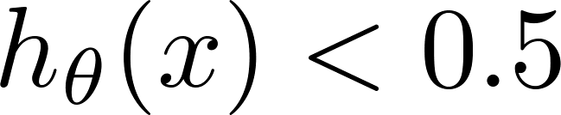



Logistic regression
$$=P(y=1|x,θ)$$
Suppose predict “ “ if
i.e. it is more likely that y=1 than y=0
$$θ^{T}x≥0$$
predict “ “ if
$$θ^{T}x≤0$$

Slide 10
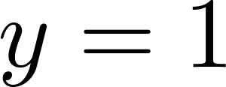
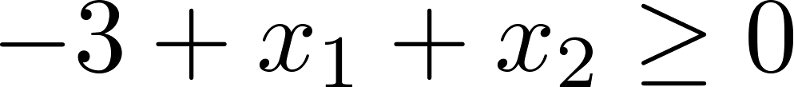


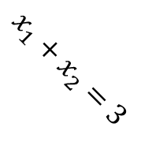


Decision Boundary
x₂
3
2
$$x_{1}+x_{2}=3$$
1
$${\text{suppose} θ}_{0}=−3;θ_{1}=1;θ_{2}=1$$
$$θ^{T}x=−3+x_{1}+x_{2}$$
1
2
3
x₁
Predict “ “ if
$${\text{Positive} \text{region}\text{ (}\text{x}\text{): }x}_{1}+x_{2}≥3$$
$${\text{Negative} \text{region}\text{ (}\text{o}\text{): }x}_{1}+x_{2}<3$$
NB decision boundaries are property of the hypothesis and not of the training set

Slide 11
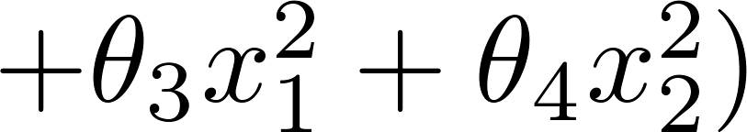
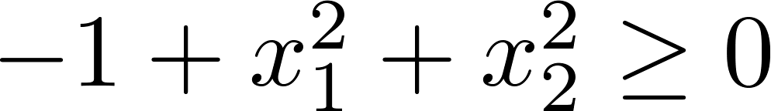
Non-linear decision boundaries
x₂
1
$${\text{suppose} θ}_{0}=−1;θ_{1}=0;θ_{2}=0;θ_{3}=1;θ_{4}=1$$
x₁
-1
1
-1
Predict “ “ if
x₂
y=1
y=0
x₁

Slide 12
Cost function
Logistic
Regression

Slide 13
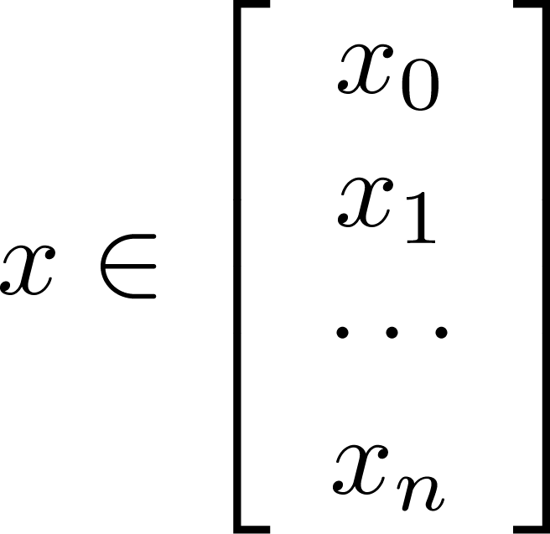
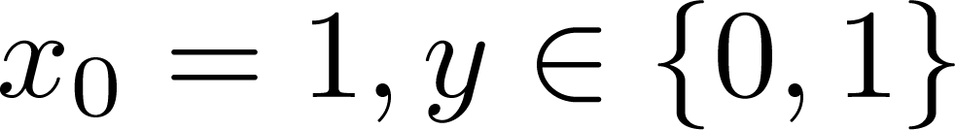
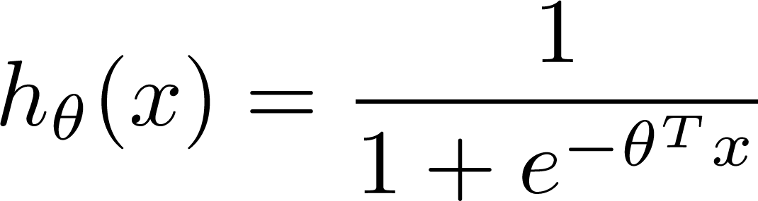

Training set:
m examples
How to choose (learn) parameters ?

Slide 14
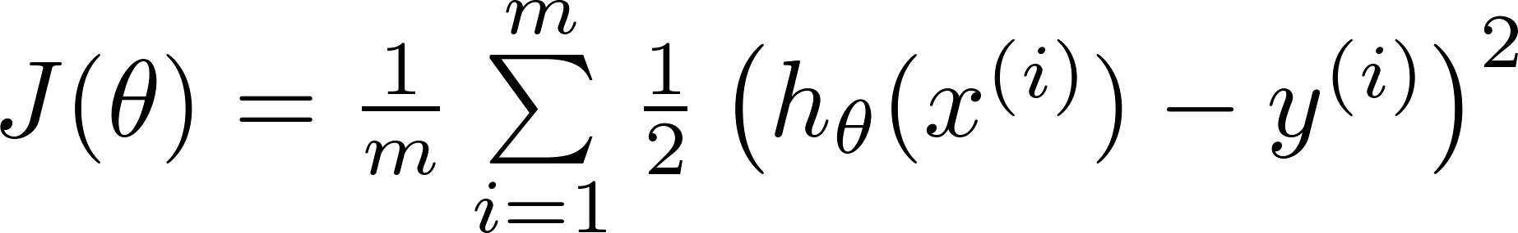


Cost function
Linear regression:
$$\text{Cost}\text{(}h_{θ}\left(x\right),y)=\frac{1}{2}{(h_{θ}\left(x\right)−y) }^{2}$$
Non convex function (because of non-linearity of h_{θ}(x))
“non-convex”
“convex”

Slide 15
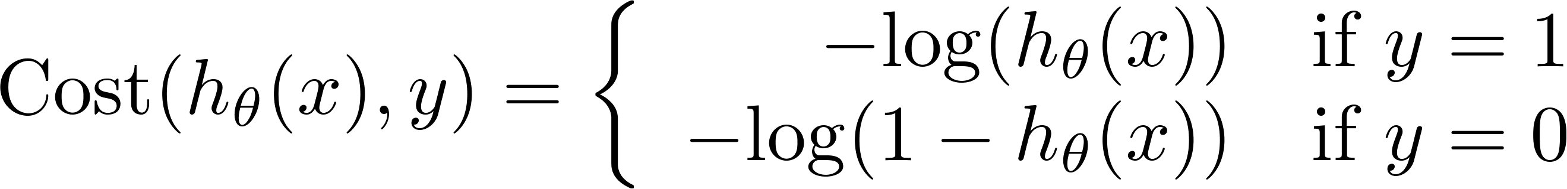
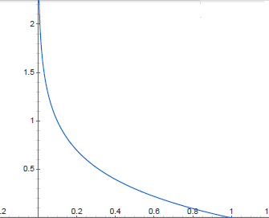
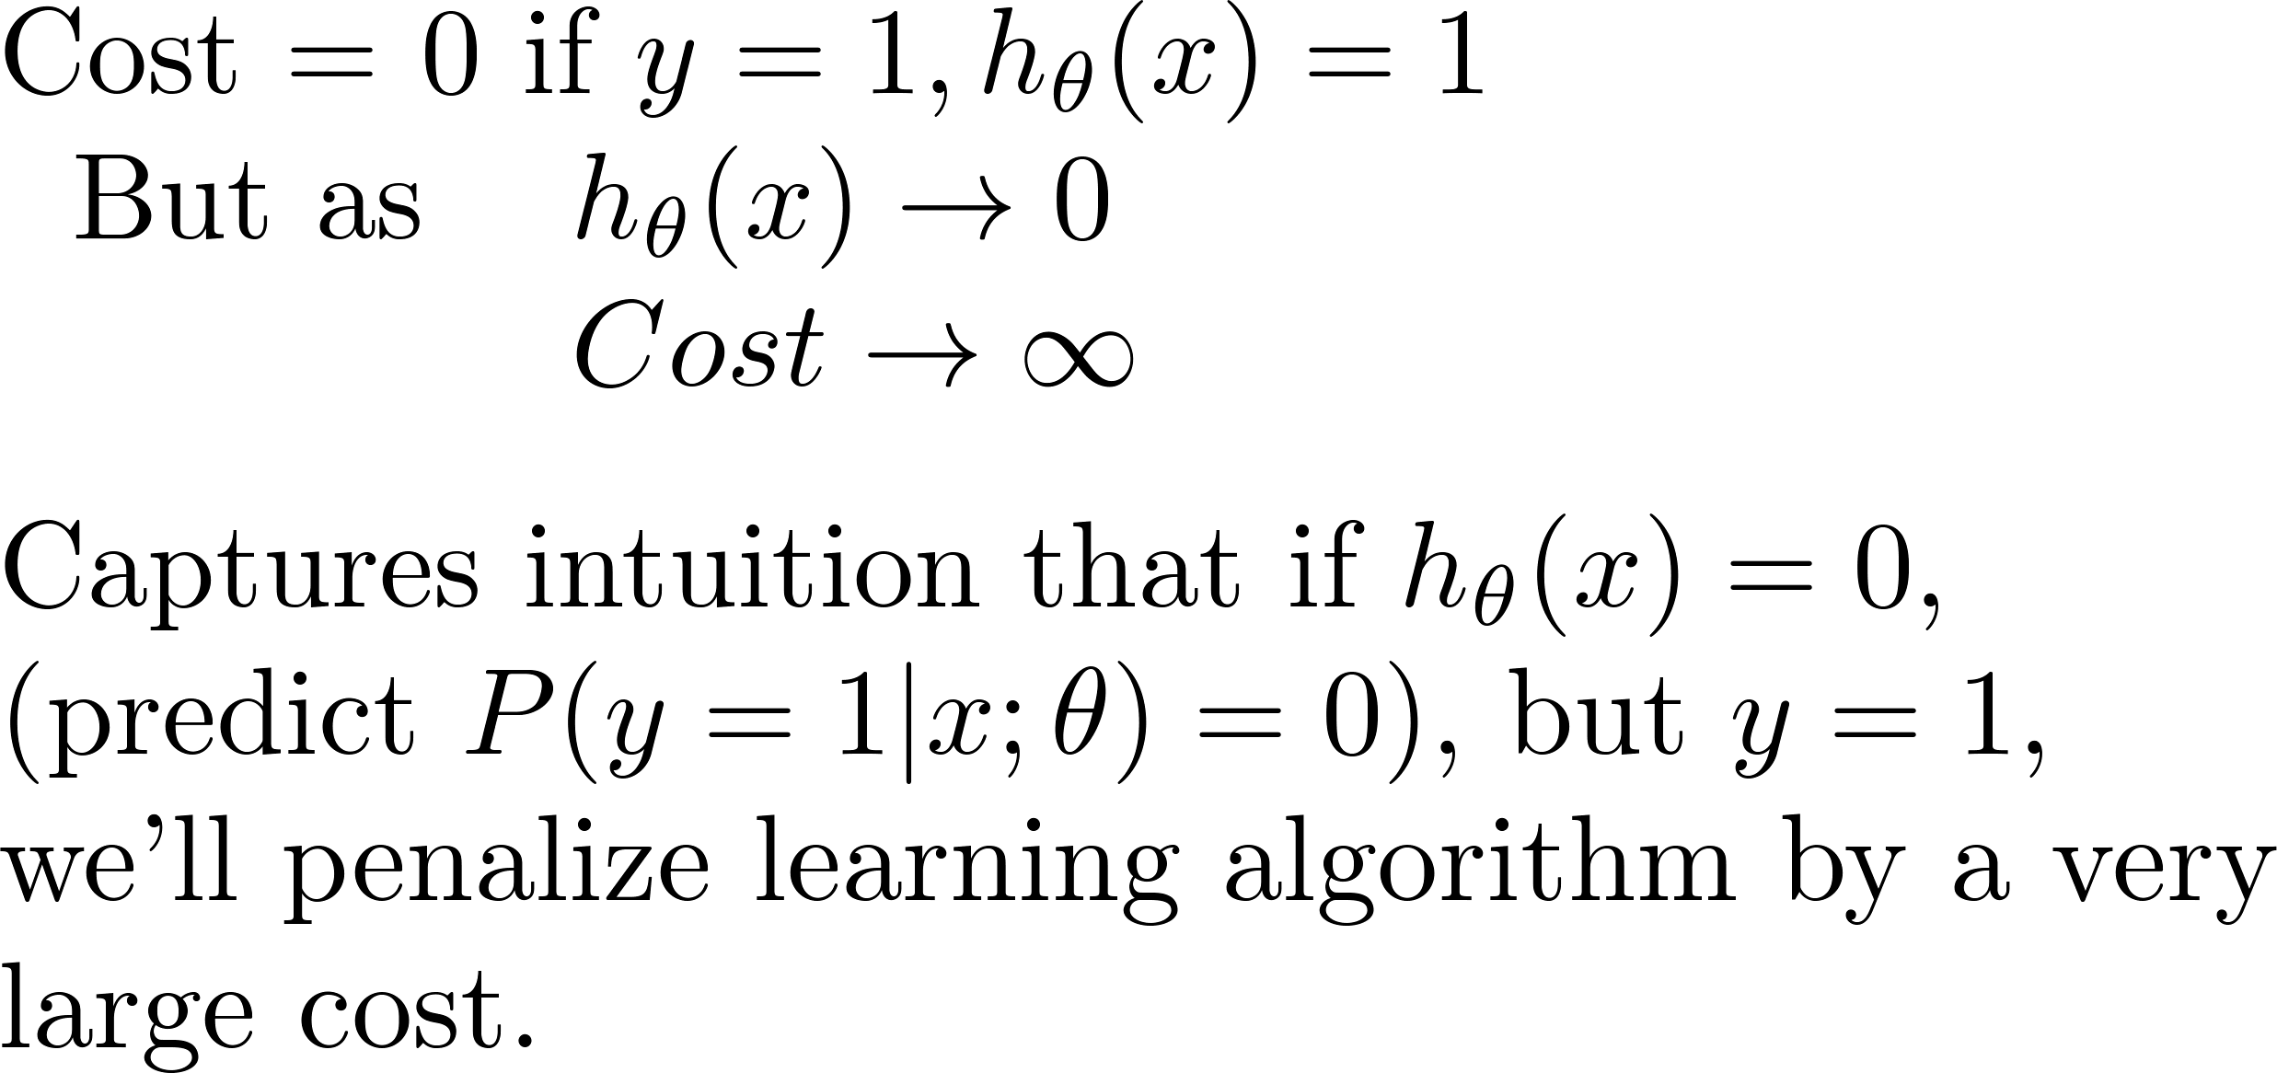
Logistic regression cost function
If y = 1

Slide 16
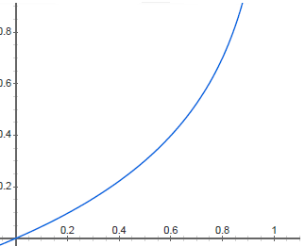


Logistic regression cost function
If y = 0
$$\text{Cost}\text{=0 }\text{if} h_{θ}\left(x\right)=0$$
$$\text{Cost}→∞ \text{if} h_{θ}\left(x\right)→1$$
It may be proved that using this cost function we get a convex optimization problem

Slide 17
Simplified cost function and gradient descent
Logistic
Regression

Slide 18
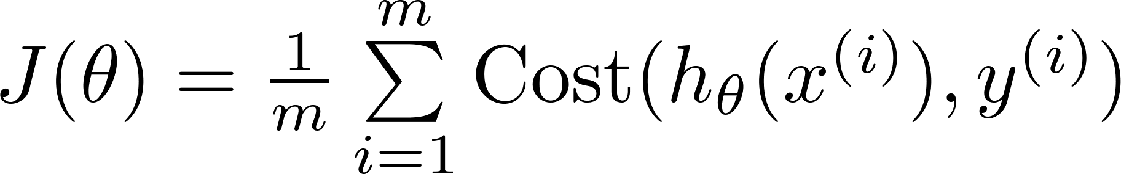
Logistic regression cost function
Thus we can rewrite as:
$$\text{Cost}\left(h_{θ}\left(x\right),y\right)=−y\log{{(h}_{θ}(x))−(1−y)log⁡(1−h_{θ}\left(x\right))}$$
Cross-entropy loss

Slide 19

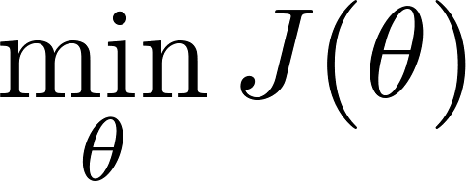

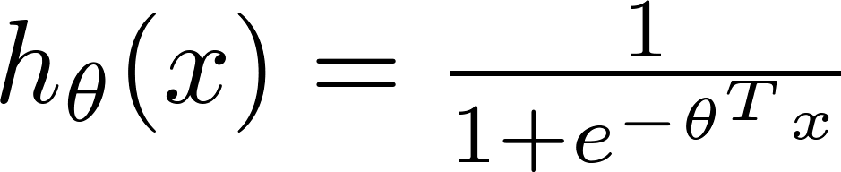
Logistic regression cost function
To fit parameters :
To make a prediction given new :
Output

Slide 20


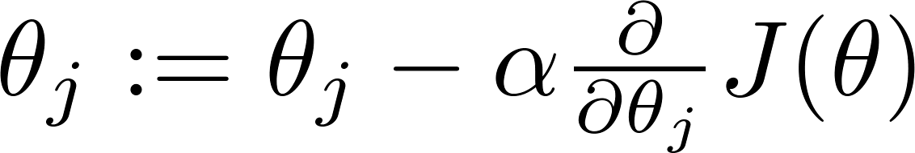


Gradient Descent
Want :
Repeat
(simultaneously update all )

Slide 21
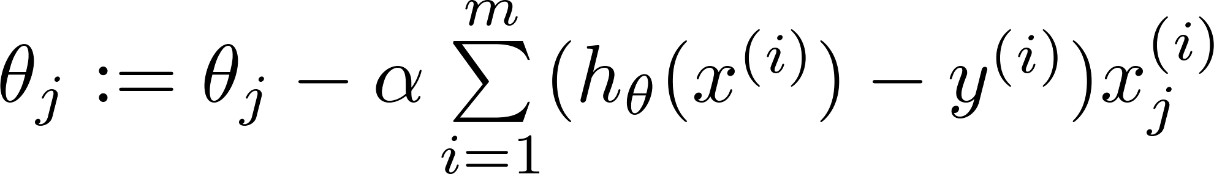


Gradient Descent
Want :
$$h_{θ}\left(x\right)=θ^{T}x$$
Linear regression
Repeat
(simultaneously update all )
$$h_{θ}\left(x\right)=\frac{1}{1+e^{−θ^{T}x}}$$
Logistic regression
Algorithm looks identical to linear regression!

Slide 22
Advanced optimization
Logistic
Regression

Slide 23

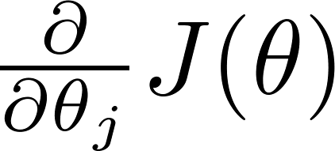
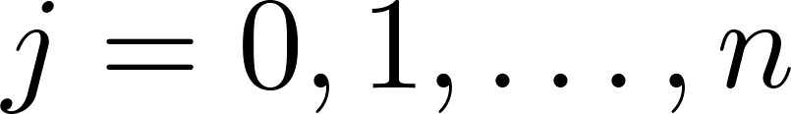
Optimization algorithm
Cost function . Want .
Given , we have code that can compute
(for )
Gradient descent:
Repeat

Slide 24

Optimization algorithm
Given , we have code that can compute
(for )
Optimization algorithms:
Gradient descent
Advantages:
No need to manually pick
Often faster than gradient descent.
Disadvantages:
More complex
Conjugate gradient
BFGS (Broyden–Fletcher–Goldfarb–Shanno)
L-BFGS (Limited memory BFGS)

Slide 25
Multi-class classification: One-vs-all
Logistic
Regression

Slide 26
Multiclass classification
Email foldering/tagging: Work, Friends, Family, Hobby
We can map classes on natural numbers
y=1, y=2, y=3, etc…
Medical diagrams: Not ill, Cold, Flu
Weather: Sunny, Cloudy, Rain, Snow

Slide 27
Binary classification:
Multi-class classification:
x₂
x₂
x₁
x₁

Slide 28
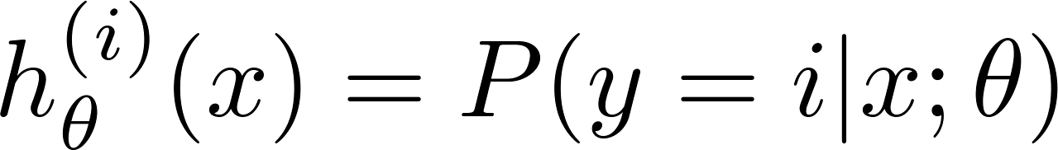

x₂
OvA: One-vs-All (one-vs-rest):
x₁
x₂
x₂
x₁
x₁
Class 1:
Class 2:
Class 3:
x₂
x₁

Slide 29
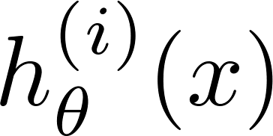

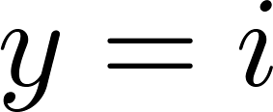
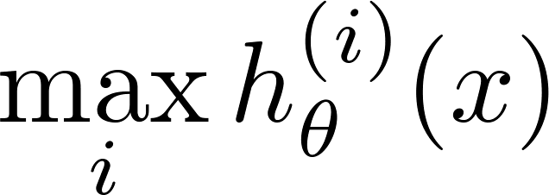
One-vs-all
Train a logistic regression classifier for each class to predict the probability that .
On a new input , to make a prediction, pick the class that maximizes

Slide 30
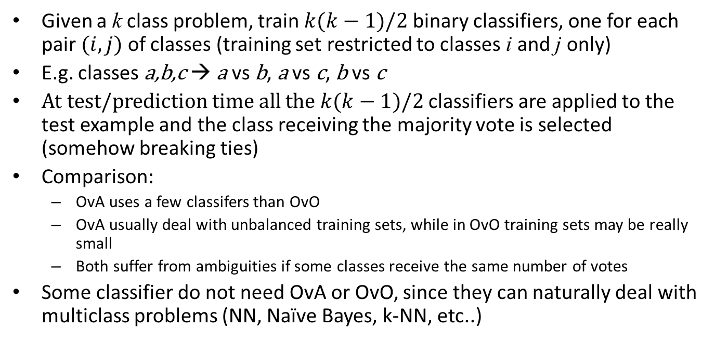
OvO: One-vs-One
Given a k class problem, train $k(k−1)/2$ binary classifiers, one for each pair $(i,j)$ of classes (training set restricted to classes i and j only)
E.g. classes a,b,c → a vs b, a vs c, b vs c
At test/prediction time all the $k(k−1)/2$ classifiers are applied to the test example and the class receiving the majority vote is selected (somehow breaking ties)
Comparison:
OvA uses a few classifers than OvO
OvA usually deal with unbalanced training sets, while in OvO training sets may be really small
Both suffer from ambiguities if some classes receive the same number of votes
Some classifier do not need OvA or OvO, since they can naturally deal with multiclass problems (NN, Naïve Bayes, k-NN, etc..)

