Slide 1
The problem of overfitting
Regularization

Slide 2
Bias and Variance
Model Bias: a set of erroneous assumptions in the learning algorithm. High bias can cause an algorithm to miss the relevant relations between features and output class (underfitting).
Model Variance: the sensitivity to small fluctuations in the training set. High variance can cause an algorithm to model the random noise in the training data, rather than the intended outputs (overfitting).

Slide 3
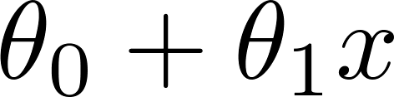
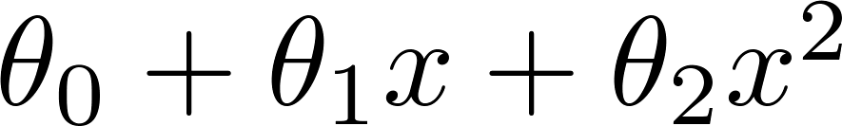
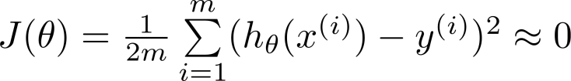
Example: Linear regression (housing prices)
Price
Price
Price
Size
Size
Size
underfit →high bias
just right
overfit →high variance
Overfitting: If we have too many features, the learned hypothesis may fit the training set very well ( ), but fail to generalize to new examples (predict prices on new examples).

Slide 4
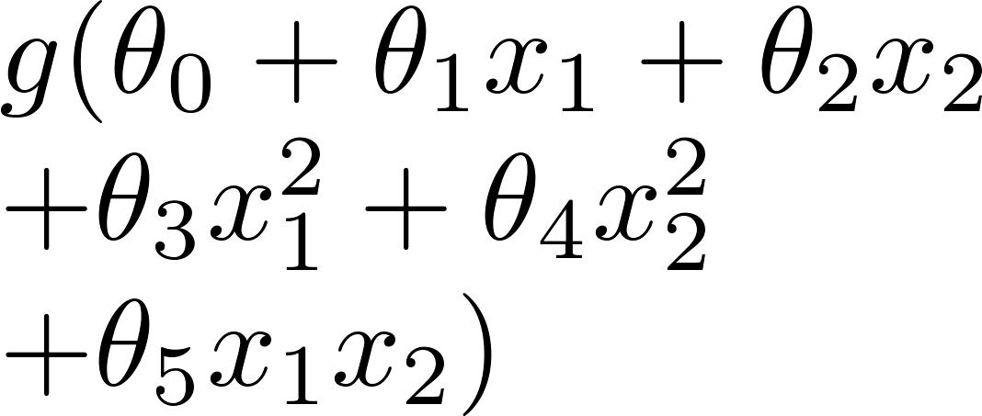
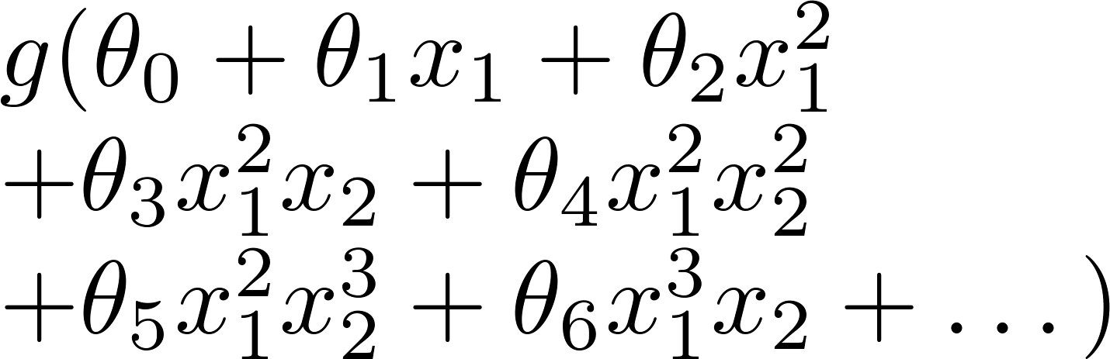
Example: Logistic regression
x₂
x₂
x₂
x₁
x₁
x₁
( = sigmoid function)
underfit →high bias
overfit →high variance

Slide 5






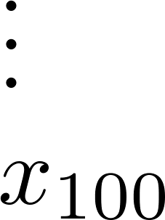
Addressing overfitting:
size of house
no. of bedrooms
Price
no. of floors
age of house
average income in neighborhood
Size
kitchen size

Slide 6


Addressing overfitting:
Options:
Reduce number of features.
Manually select which features to keep.
Model selection algorithm (later in course).
Regularization.
Keep all the features, but reduce magnitude/values of parameters .
Works well when we have a lot of features, each of which contributes a bit to predicting .

Slide 8
Cost function
Regularization

Slide 9


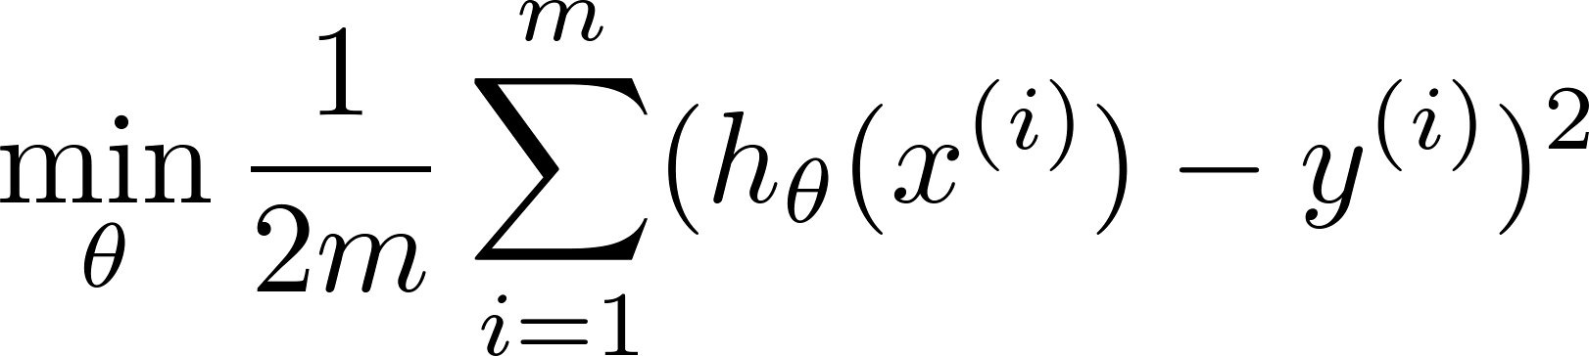

Intuition
Price
Price
Size of house
Size of house
Suppose we penalize and make , really small.
$$+ αθ_{3}+βθ_{4}$$
If α,β are large values, to minimize the function we need $θ_{3}≈0, θ_{4}≈0$

Slide 10
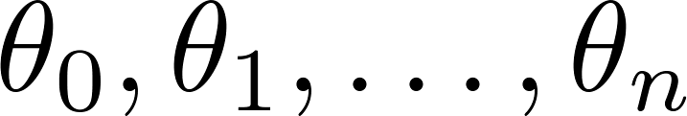
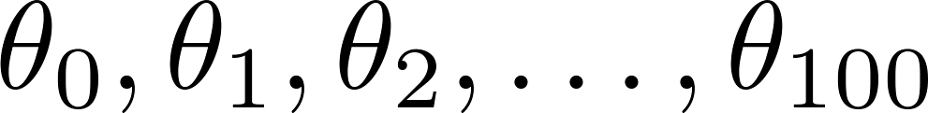
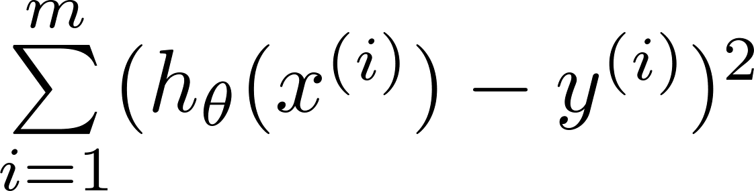
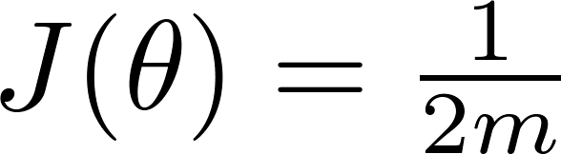
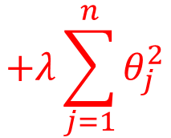
Regularization.
Small values for parameters
“Simpler” hypothesis
Less prone to overfitting
NB: by convention we do not regularize θ₀
Housing:
Features:
Parameters:
$$+λ\sum_{j=1}^{n}{θ_{j}^{2}}$$
Regularization Parameter

Slide 11
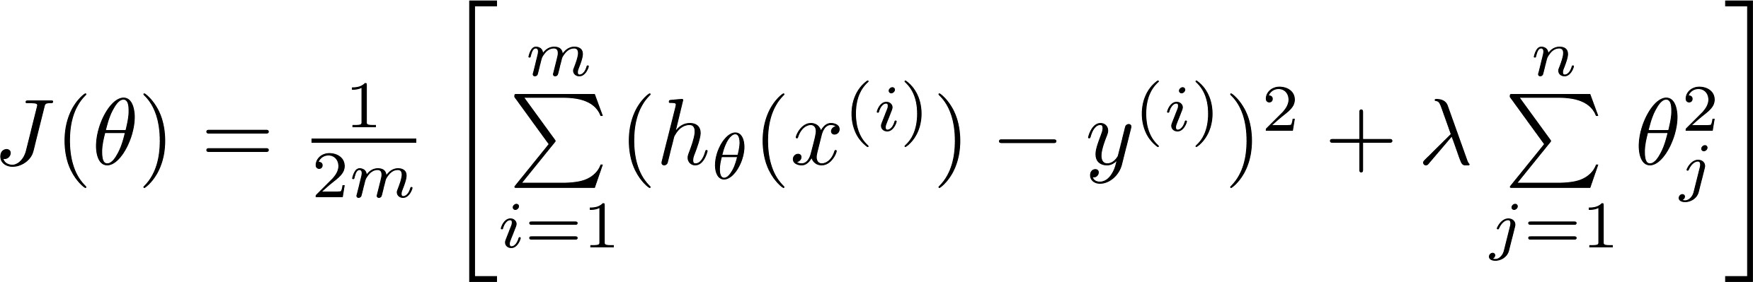
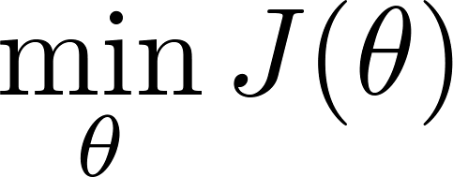
Regularization.
Regularization term can change a higher-order polynomial to a lower-order one
Price
Size of house

Slide 12
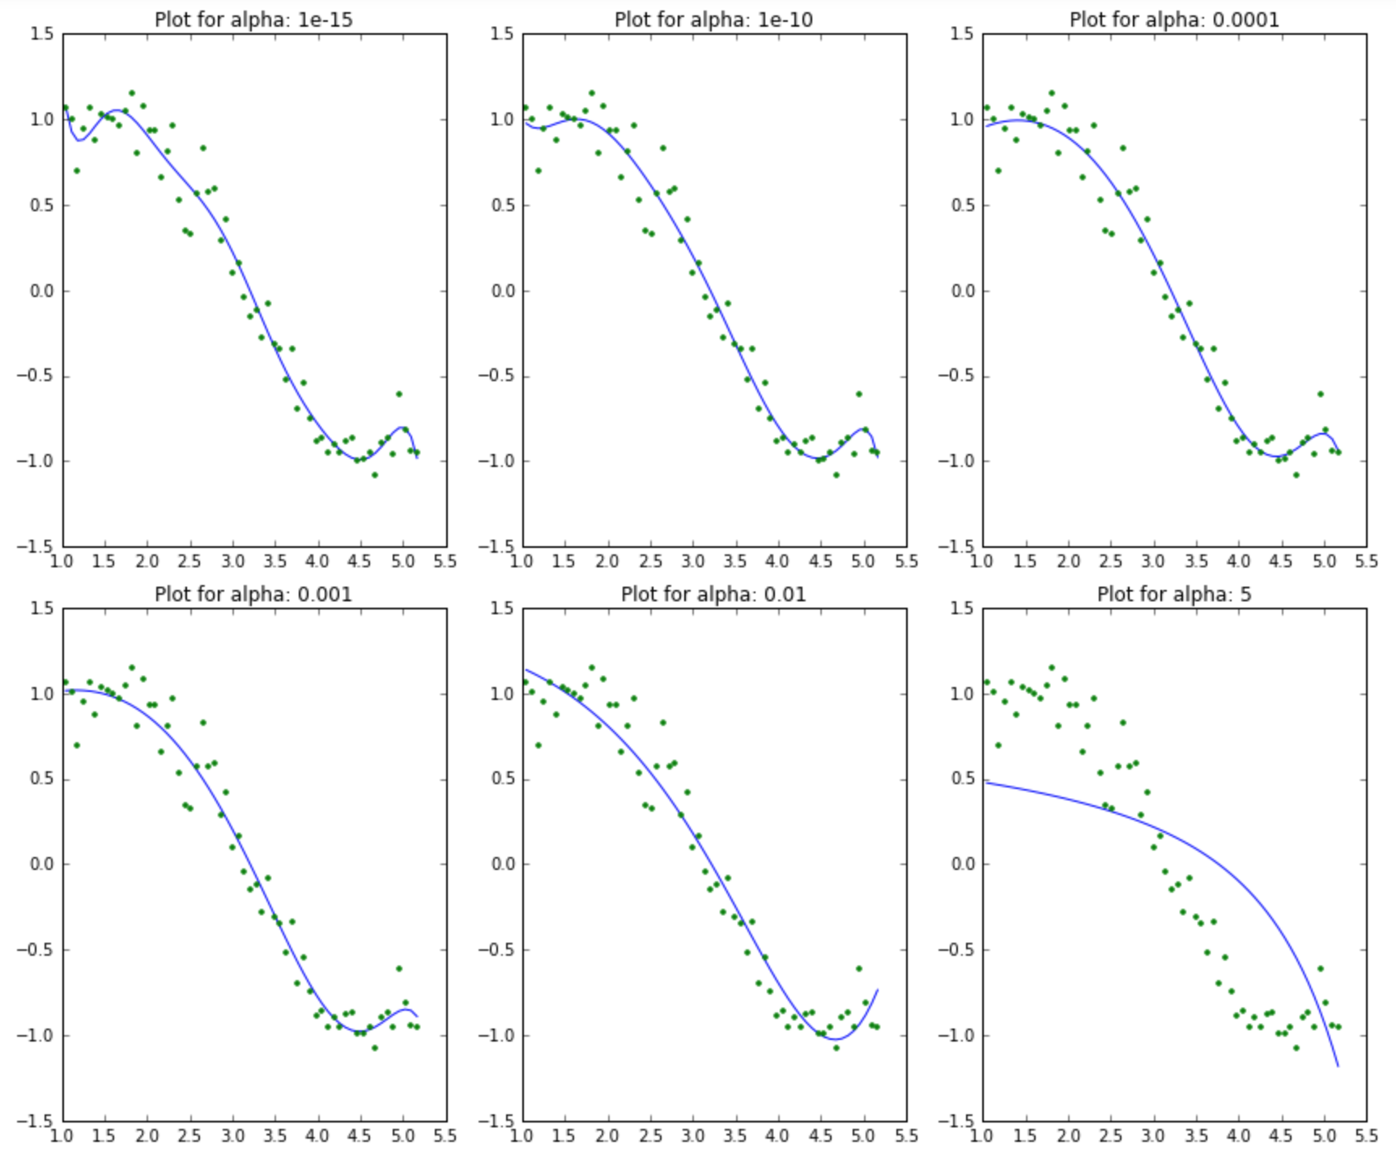
Linear regression with a 15th power polynomial
(α is the regularization or ridge parameter)

Slide 13
Why penalize large coefficients?
What does a large coefficient signify? It means that we’re putting a lot of emphasis on that feature, i.e. the particular feature is a good predictor for the outcome. When it becomes too large, the algorithm starts modelling intricate relations to estimate the output and ends up overfitting to the particular training data.
As λ increase, the model complexity decrease
Regularization with the sum of squares → ridge regression

Slide 14


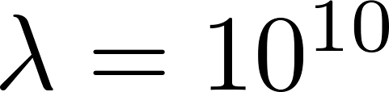
In regularized linear regression, we choose to minimize
What if is set to an extremely large value (perhaps for too large for our problem, say )?
Algorithm works fine; setting to be very large can’t hurt it
Algorithm fails to eliminate overfitting.
✓Algorithm results in underfitting. (Fails to fit even training data well).
Gradient descent will fail to converge.

Slide 15


In regularized linear regression, we choose to minimize
What if is set to an extremely large value (perhaps for too large for our problem, say )?
$$θ_{0}$$
$$∀1≤j≤n { θ}_{j}≈0$$
Price
UNDERFIT
Size of house
X
X
X
X

Slide 16
Regularized linear regression
Regularization

Slide 17
Regularized linear regression
$$\text{it} \text{is} \text{the} \text{square} \text{of} \text{the} \text{L}\text{−2 }\text{norm} \text{of} \text{vector} θ\text{ (} {\left\|θ\right\|}_{2})$$
This kind of regularization is called ridge regression or Tichonov regularization

Slide 18

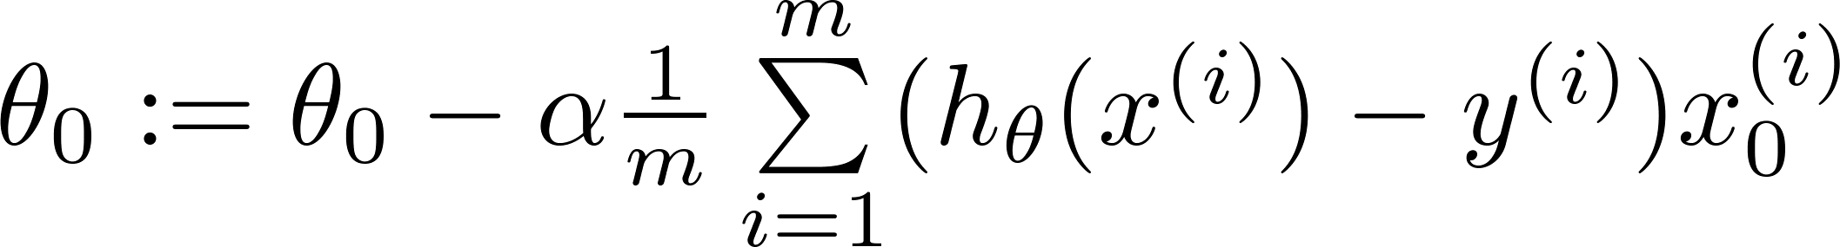
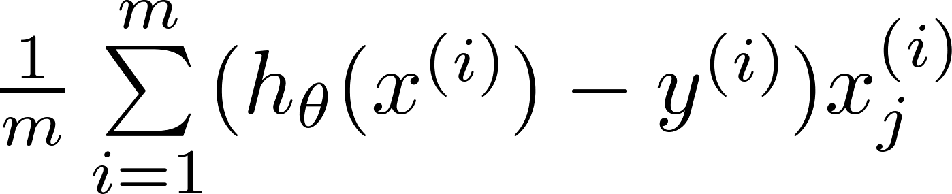
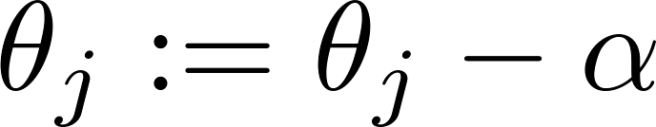


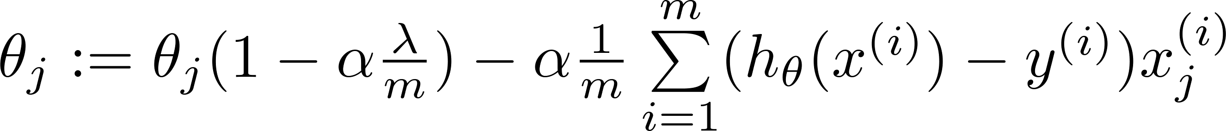



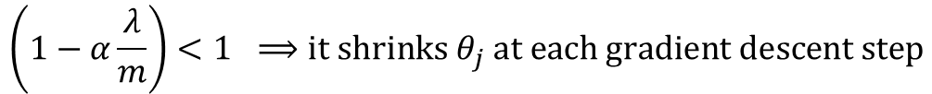
Gradient descent
Repeat
$$\frac{∂}{∂θ_{0}}J(θ)$$
$$−\frac{λ}{m}θ_{j}$$
$$\frac{∂}{∂θ_{j}}J(θ)$$
$$\left(1−α\frac{λ}{m}\right)<1 ⟹\text{it} \text{shrinks} θ_{j} \text{at} \text{each} \text{gradient} \text{descent} \text{step}$$

Slide 19
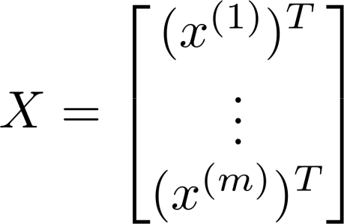
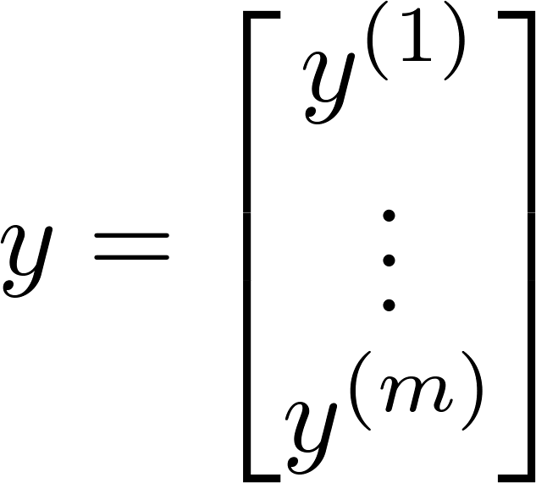
Normal equation

Slide 20
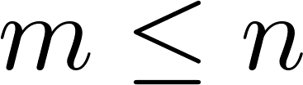
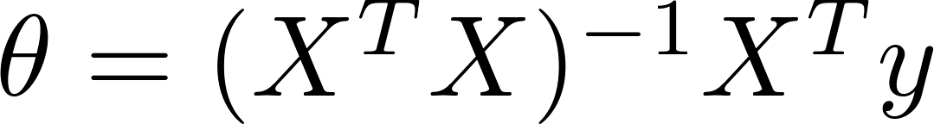

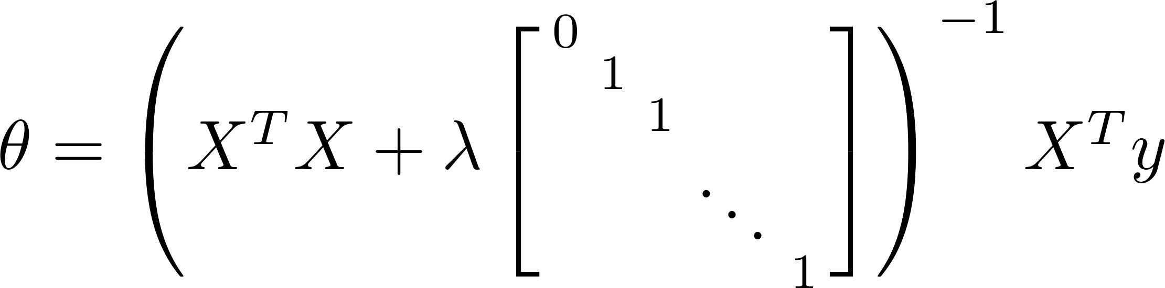
Non-invertibility (optional/advanced).
Suppose ,
(#examples) (#features)
If ,

Slide 21
Regularized logistic regression
Regularization

Slide 22
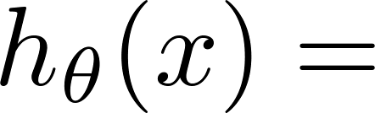
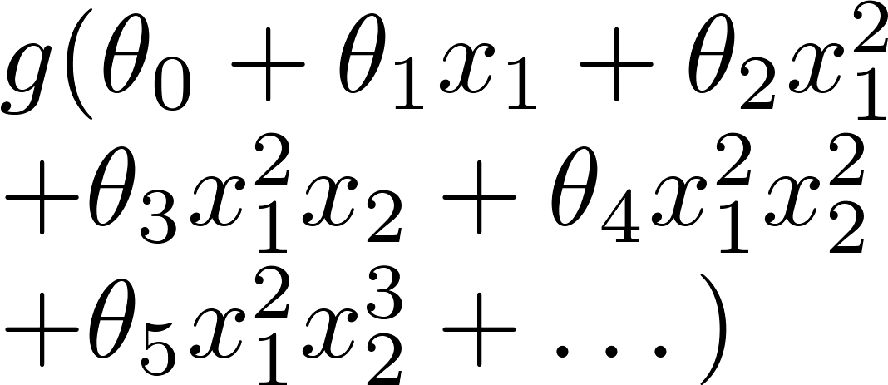
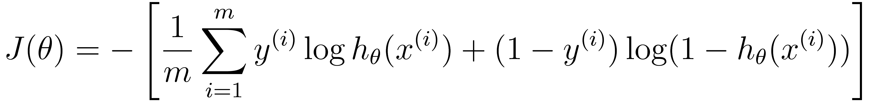
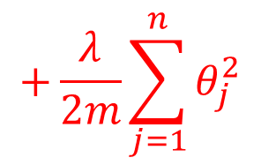
Regularized logistic regression.
Potential overfitting!
x₂
x₁
Cost function:
$$+\frac{λ}{2m}\sum_{j=1}^{n}{θ_{j}^{2}}$$

Slide 23
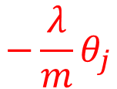
Gradient descent
Repeat
$$−\frac{λ}{m}θ_{j}$$
Logistic ridge regression:
Same form as linear ridge regression but with different h_{θ}(x)

Slide 24


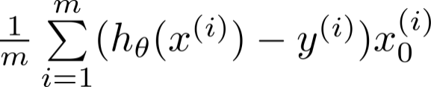

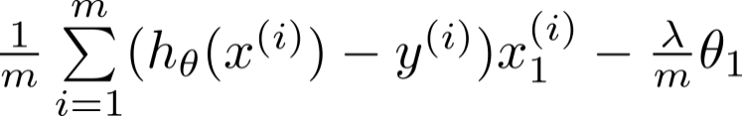

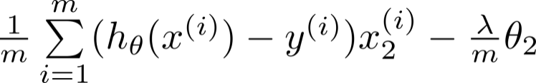

Advanced optimization
function [jVal, gradient] = costFunction(theta)
code to compute
jVal = [ ];
code to compute
gradient(1) = [ ];
code to compute
gradient(2) = [ ];
code to compute
gradient(3) = [ ];
code to compute
gradient(n+1) = [ ];

