Slide 1
Cost function
Neural Networks: Learning

Slide 2







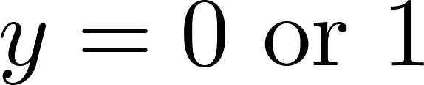




Neural Network (Classification)
total no. of layers in network
no. of units (not counting bias unit) in layer
Layer 1
Layer 2
Layer 3
Layer 4
Binary classification
1 output unit
Multi-class classification (K classes)
K output units
E.g. , , ,
pedestrian car motorcycle truck
$$h_{Θ}(x)∈ℝ$$
$$s_{L}=1;K=1$$
$$h_{Θ}(x)∈ℝ^{K}$$
$$s_{L}=K;K≥3$$

Slide 3
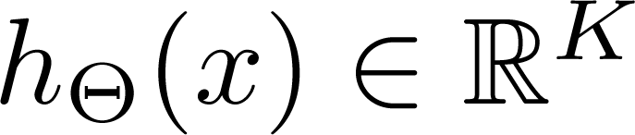
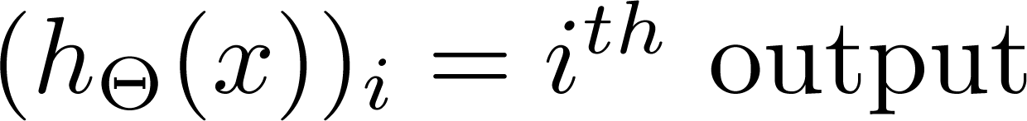
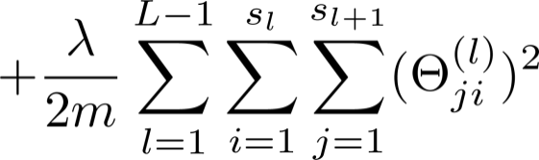
Cost function
Logistic regression (or NN with 1 output unit):
Neural network (with K output units):

Slide 4
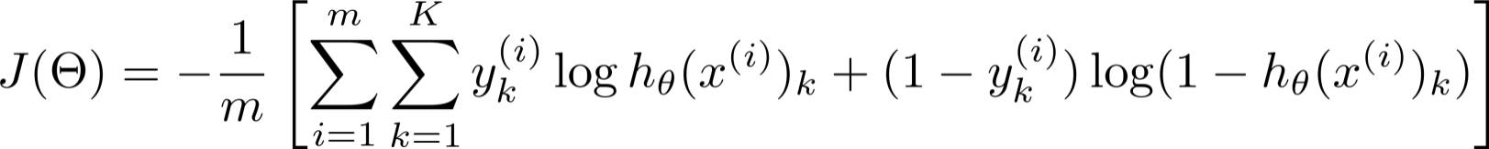
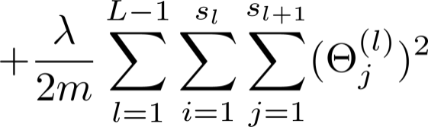


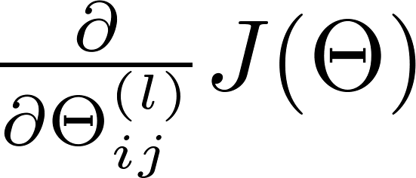
Learning the parameters: gradient descent
Need code to compute:
Efficient implementation: backpropagation algorithm
[Rumelhart, Hinton, Williams 86]

Slide 5








Numerical estimation of gradients
$$J(θ+ε)$$
$$2ε$$
$$J(θ−ε)$$
$$θ−ε$$
$$θ$$
$$θ+ε$$
$$\frac{dJ(Θ)}{dΘ}≈\frac{J\left(θ+ε\right)−J(θ−ε)}{2ε}$$
Smaller is ε, more precise is the approximation
Very inefficient approach!

Slide 6
Backpropagation algorithm
Neural Networks: Learning

Slide 7


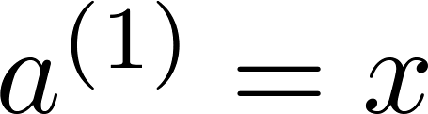
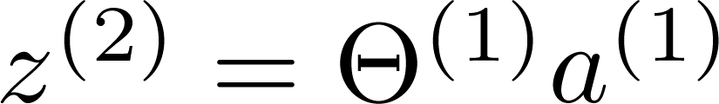
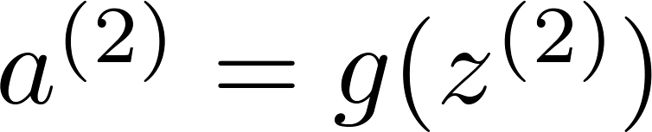
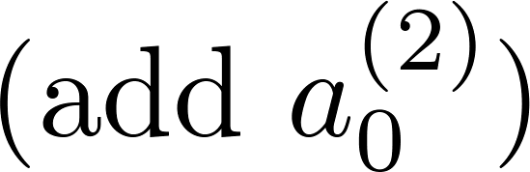
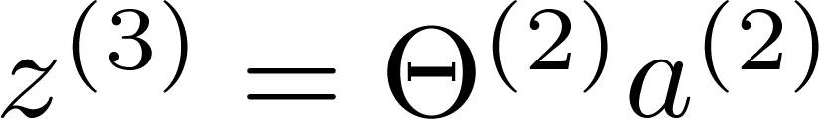
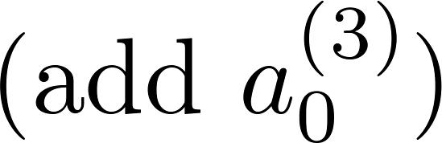
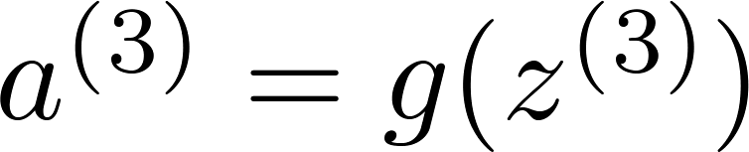
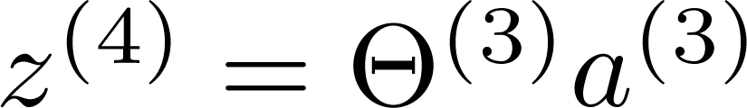
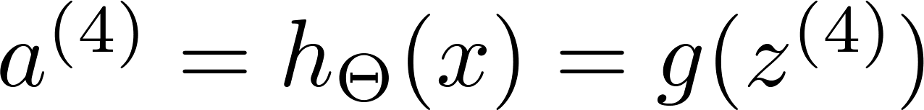




Gradient computation: Backpropagation algorithm
Given one training example ( , ):
$$a^{(1)}$$
$$a^{(2)}$$
$$a^{(3)}$$
$$a^{(4)}$$
Forward propagation:
Layer 1
Layer 2
Layer 3
Layer 4

Slide 8


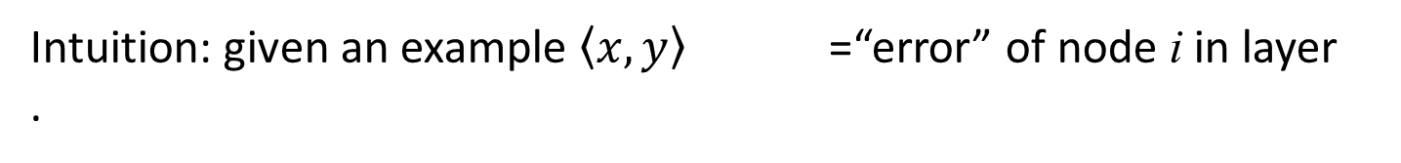

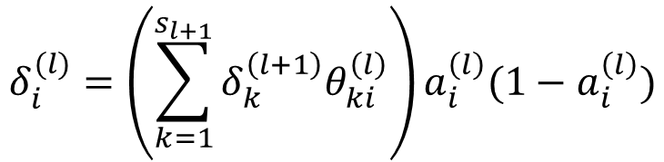




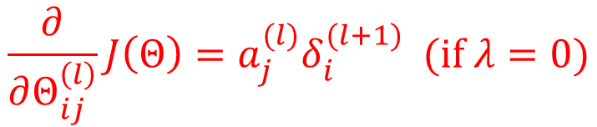
Gradient computation: Backpropagation algorithm
$$δ_{i}^{(l)}$$
Intuition: given an example $\left\langle x,y\right\rangle$ =“error” of node i in layer .
For each output unit (layer L = 4)
$$δ^{(2)}$$
$$δ^{(3)}$$
$$δ^{(4)}$$
$$δ_{i}^{(L)}=a_{i}^{(L)}−y_{i}$$
$${⟶δ}^{(L)}=a^{(L)}−y$$
For each $l<L$
$$δ_{i}^{(l)}=\left(\sum_{k=1}^{s_{l+1}}{δ_{k}^{\left(l+1\right)}θ_{ki}^{\left(l\right)}}\right)a_{i}^{\left(l\right)}(1−a_{i}^{\left(l\right)})$$
Layer 1
Layer 2
Layer 3
Layer 4
$$\frac{∂}{∂Θ_{ij}^{\left(l\right)}}J\left(Θ\right)=a_{j}^{(l)}δ_{i}^{(l+1)}\text{ (}\text{if} λ=0)$$

Slide 9

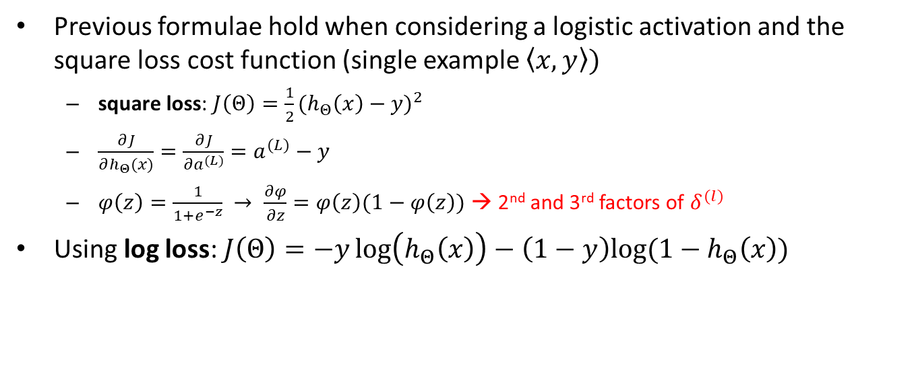


Cost and activation functions in backpropagation
Previous formulae hold when considering a logistic activation and the square loss cost function (single example $\left\langle x,y\right\rangle )$
square loss: $J\left(Θ\right)=\frac{1}{2}{(h_{Θ}\left(x\right)−y)}^{2}$
$\frac{∂J}{∂h_{Θ}(x)}=\frac{∂J}{{∂a}^{(L)}}=a^{(L)}−y$
$φ\left(z\right)=\frac{1}{1+e^{−z}} → \frac{∂φ}{∂z}=φ\left(z\right)(1−φ\left(z\right))$ → 2nd and 3rd factors of $δ^{(l)}$
Using log loss: $J\left(Θ\right)=−y\log\left(h_{Θ}\left(x\right)\right)−\left(1−y\right)log⁡(1−h_{Θ}\left(x\right))$
$${→δ}^{\left(L\right)}$$
$$δ_{i}^{(L)}=\frac{∂J}{{∂a}^{(L)}}=\frac{1−y_{i}}{1−a_{i}^{(L)}}−\frac{y}{a_{i}^{(L)}}$$
$$⟶ δ^{\left(L\right)}=\frac{1−y}{1−a^{(L)}}−\frac{y}{a^{(L)}}$$
We can change the activation function $φ(z)$ with any derivable function (the computation of $δ^{(l)}$ will change accordingly)

Slide 10




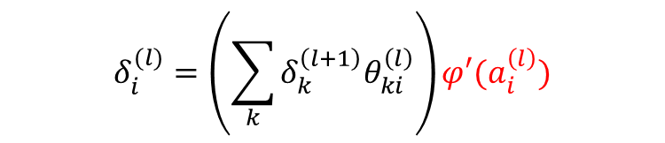

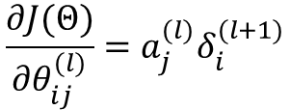

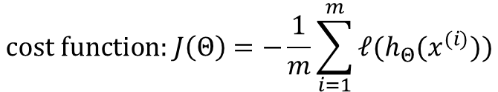





NN Recap: backpropagation
$$a^{(1)}$$
$$a^{(2)}$$
$$a^{(3)}$$
$$a^{(4)}$$
$$δ^{(2)}$$
$$δ^{(3)}$$
$$δ^{(4)}$$
Layer 1
Layer 2
Layer 3
Layer 4
Layer 1
Layer 2
Layer 3
Layer 4
$$\text{cost} \text{function}\text{: }J\left(Θ\right)=−\frac{1}{m}\sum_{i=1}^{m}{ℓ(h_{Θ}(x^{(i)}))}$$
$$δ_{i}^{(l)}=\left(\sum_{k}{δ_{k}^{\left(l+1\right)}θ_{ki}^{\left(l\right)}}\right){φ′(a}_{i}^{\left(l\right)})$$
$$\frac{∂J(Θ)}{∂θ_{ij}^{(l)}}=a_{j}^{(l)}δ_{i}^{(l+1)}$$
$δ_{i}^{(L)}=$ $ℓ′(h_{Θ}(x^{(i)}$))
$$a_{j}^{(l)}$$
$$θ_{ij}^{(l)}$$
When computing the δ entry for a hidden unit we use the derivative of the activation function of such a unit
$$a_{i}^{(l+1)}$$

Slide 11
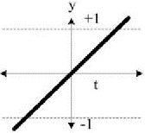
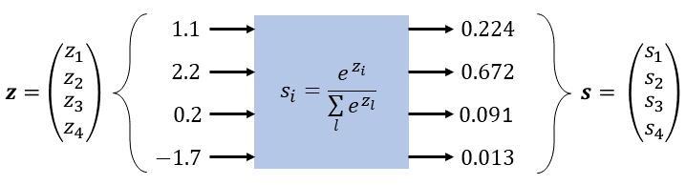






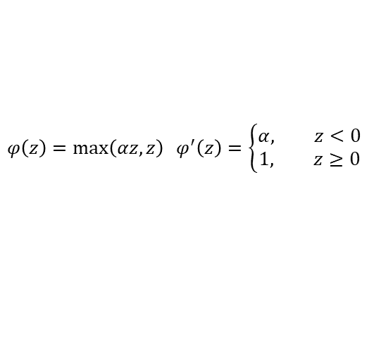
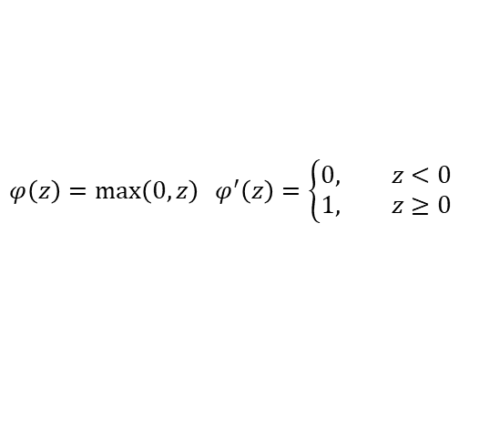




NN Recap
Activation Functions
Loss functions
Linear/Identity
$$y: \text{expected} \text{value}\text{; }z: \text{predicted} \text{value}$$
$$φ\left(z\right)=z φ^{′}\left(z\right)=1$$
$$y,z∈ℝ\text{ (}\text{regression}\text{)}$$
$$square loss: ℓ\left(z,y\right)=\frac{1}{2}{\left(z−y\right)}^{2}$$
$$ℓ^{′}\left(z\right)=z−y$$
$$φ\left(z\right)=\frac{1}{1+e^{−z}} { φ}^{′}\left(z\right)=φ(z)(1−φ\left(z\right))$$
$$y∈\text{\{0,1}\}^{C}\text{ , }\text{z}∈ℝ^{C}\text{(}\text{class}\text{.)}$$
$$ℓ\left(z,y\right)=−\sum_{i=1}^{C}{y_{i}\log{s_{i}}}$$
log (cross entropy) loss:
$$s_{i}=\frac{e^{z_{i}^{}}}{\sum_{j=1}^{C}{e^{z_{j}}}}$$
$$φ\left(z\right)=\frac{e^{z}−e^{−z}}{e^{z}+e^{−z}} φ^{′}\left(z\right)=1−{φ(z)}^{2}$$
$$ℓ^{′}\left(z_{i}\right)=s_{i}−y_{i}$$
$$φ\left(z\right)=\max\left(0,z\right) φ^{′}\left(z\right)=\left\{\begin{aligned}0, z<0 \\ &1, z≥0\end{aligned}\right.$$
$$φ\left(z\right)=\max\left(αz,z\right) φ^{′}\left(z\right)=\left\{\begin{aligned}α, z<0 \\ &1, z≥0\end{aligned}\right.$$

Slide 12
Derivation of formulae for backpropagation
See notes

Slide 13
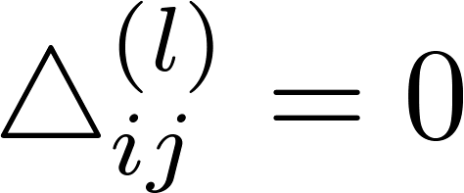


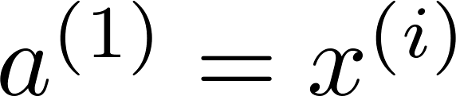

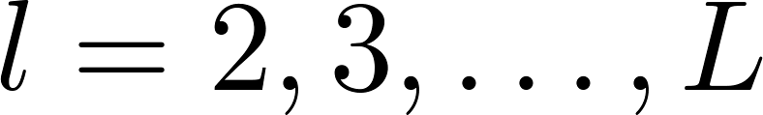

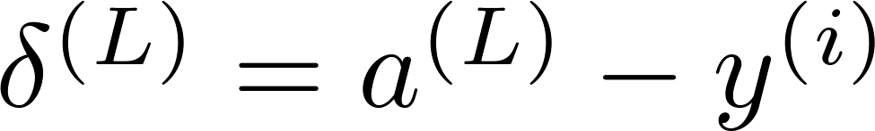
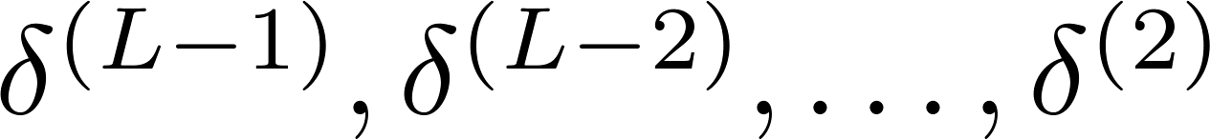
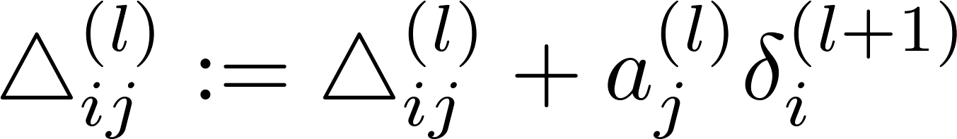
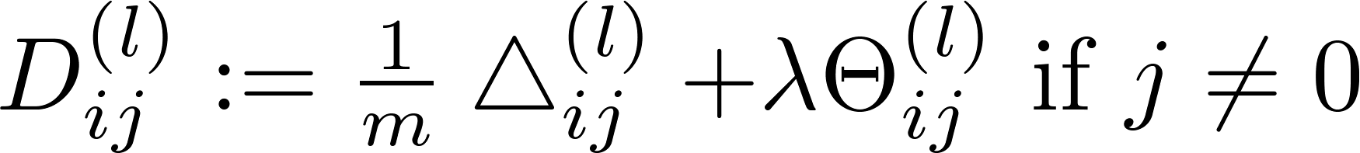
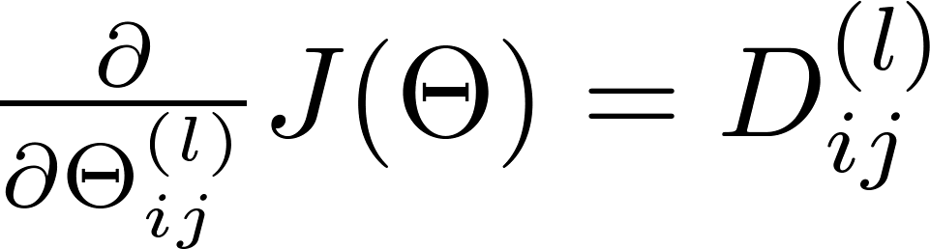
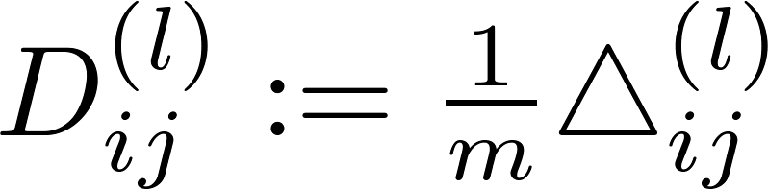


Backpropagation algorithm
Training set
Set (for all ).
For
Set
Perform forward propagation to compute for
Using , compute
Compute
$$Δ^{(l)}≔Δ^{\left(l\right)}+δ^{\left(l+1\right)} {(a^{(l)})}^{T}$$

Slide 14
Random initialization
Neural Networks: Learning

Slide 15

Initial value of
For gradient descent and advanced optimization method, need initial value for .
Consider gradient descent
Set ?
Bad Idea: it works for logistic regression, but it does not work for NN where hidden units have the same activation function
initialTheta = zeros(n,1)

Slide 16
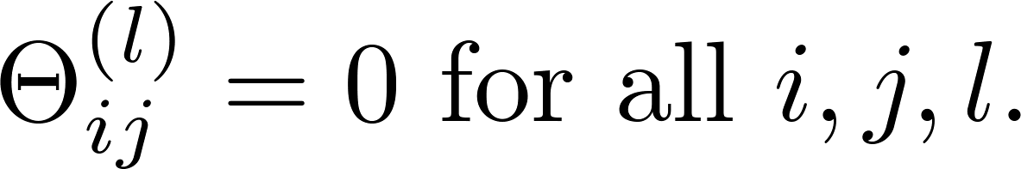




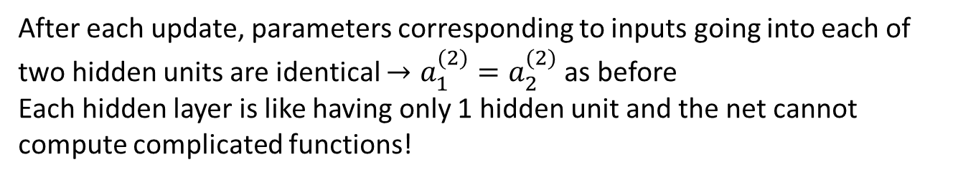
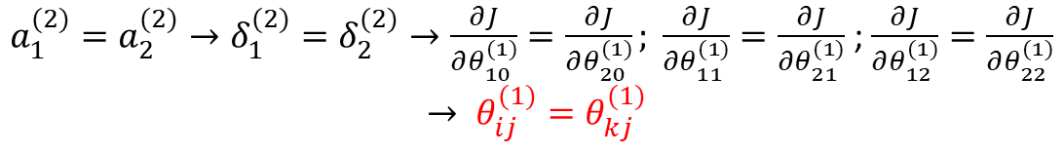
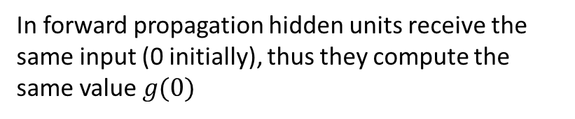
Zero initialization
In forward propagation hidden units receive the same input (0 initially), thus they compute the same value $g(0)$
$a_{1}^{(2)}=a_{2}^{(2)}→δ_{1}^{(2)}=δ_{2}^{(2)}→\frac{∂J}{∂θ_{10}^{(1)}}=\frac{∂J}{∂θ_{20}^{(1)}}; \frac{∂J}{∂θ_{11}^{(1)}}=\frac{∂J}{∂θ_{21}^{(1)}}$ ; $\frac{∂J}{∂θ_{12}^{(1)}}=\frac{∂J}{∂θ_{22}^{(1)}}$ $$→ θ_{ij}^{(1)}=θ_{kj}^{(1)}$$
After each update, parameters corresponding to inputs going into each of two hidden units are identical $→a_{1}^{(2)}=a_{2}^{(2)}$ as before
Each hidden layer is like having only 1 hidden unit and the net cannot compute complicated functions!

Slide 17
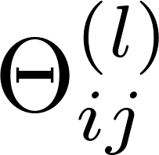
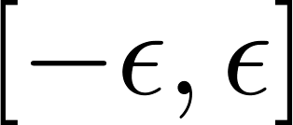
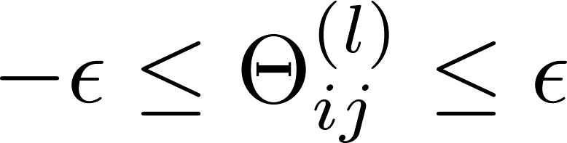

Random initialization: Symmetry breaking
Initialize each to a random value in
(i.e. )
We need to ensure that parameters entering a unit are not the same.
$$θ={\text{rand}}_{01}()∗2ε−ε$$

Slide 18
Putting it together
Neural Networks: Learning

Slide 19

Training a neural network
Pick a network architecture (connectivity pattern between neurons)
No. of input units: Dimension of features
No. output units: Number of classes
Reasonable default: 1 hidden layer, or if >1 hidden layer, have same no. of hidden units in every layer (usually the more the better)
Heuristic for number of hidden units:
(#feature+#classes)/2
#classes
#attributes
etc…

Slide 20
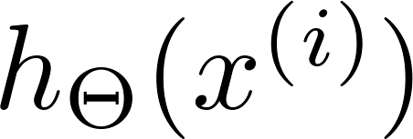

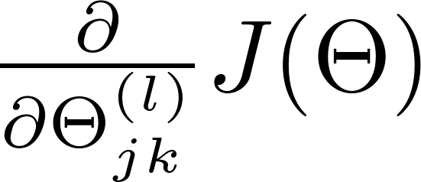
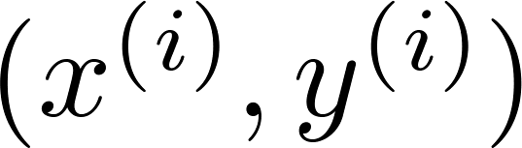

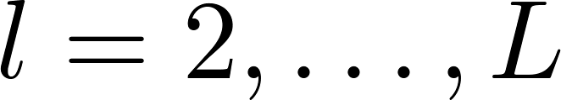
Training a neural network
Randomly initialize weights
Implement forward propagation to get for any
Implement code to compute cost function
Implement backprop to compute partial derivatives
for i = 1:m
Perform forward propagation and backpropagation using example
(Get activations and delta terms for ).

Slide 21

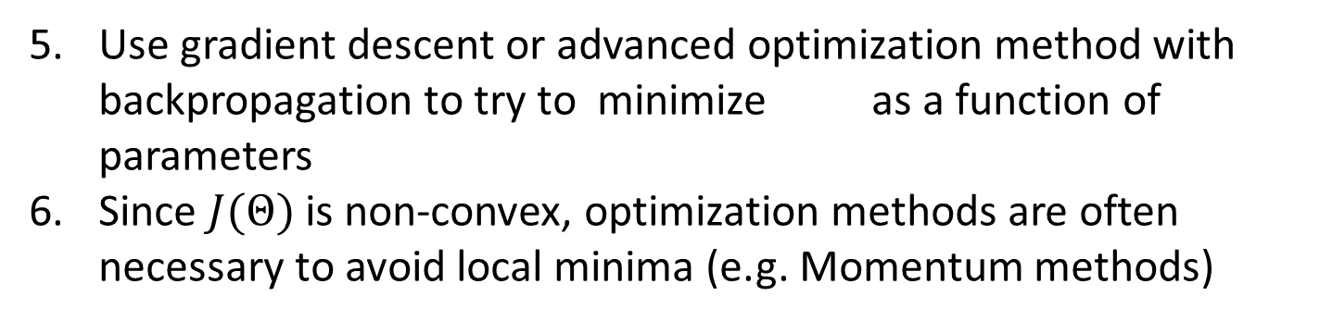
Training a neural network
Use gradient descent or advanced optimization method with backpropagation to try to minimize as a function of parameters
Since $J(Θ)$ is non-convex, optimization methods are often necessary to avoid local minima (e.g. Momentum methods)

Slide 22
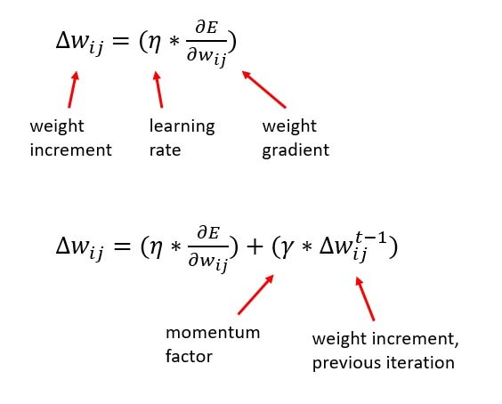


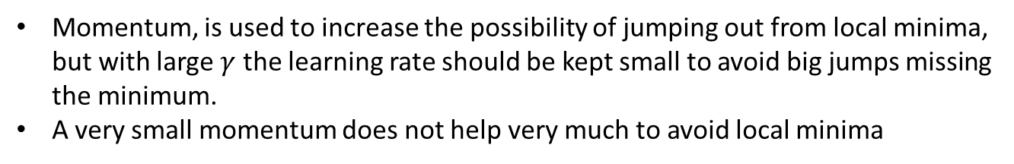
(Think of $w_{ij}$ as $θ_{ij}$ and E as J)
$$0≤γ≤1$$
Momentum, is used to increase the possibility of jumping out from local minima, but with large $γ$ the learning rate should be kept small to avoid big jumps missing the minimum.
A very small momentum does not help very much to avoid local minima

Slide 23
Categorical Variables
Ordinal variables: they have an order, thus can be mapped on natural numbers (e.g. low, medium, high, very high,…)
One node for each feature, with integers to encode values (0, 1, 2, …)
Nominal/categorical variables: no order among values (e.g. Roma, Firenze, Milano, ….)
OHE (One-Hot Encoding): create a set of binary nodes for each feature, one for every value, then treat them as a vector with 1 for the value to be set, and 0 elsewhere
It adds dimensionality to the problem, since the number of “features” (nodes of the NN) increases (curse of dimensionality problem)

Slide 24
Categorical Variables
Target encoding
Classification:
Estimate the posterior probability of each class given the categorical value; use this as numerical value for the category
Needs (k-1)-sized vector if k classes
Regression
Compute the mean value of the target variable for each category; use this as numerical value for the category

