Slide 1
Diagnostic and Evaluation
Practical machine learning

Slide 2
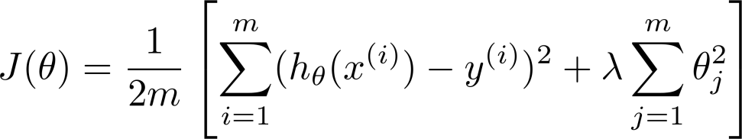
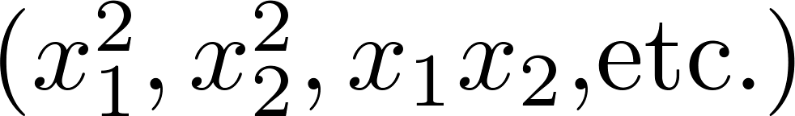
Debugging a learning algorithm:
Suppose you have implemented regularized linear regression to predict housing prices.
However, when you test your hypothesis on a new set of houses, you find that it makes unacceptably large errors in its predictions. What should you try next?
Get more training examples
Try smaller sets of features
Try getting additional features
Try adding polynomial features
Try decreasing
Try increasing

Slide 3
Machine learning diagnostic:
Diagnostic: A test that you can run to gain insight what is/isn’t working with a learning algorithm, and gain guidance as to how best to improve its performance.
Diagnostics can take time to implement, but doing so can be a very good use of your time.

Slide 4




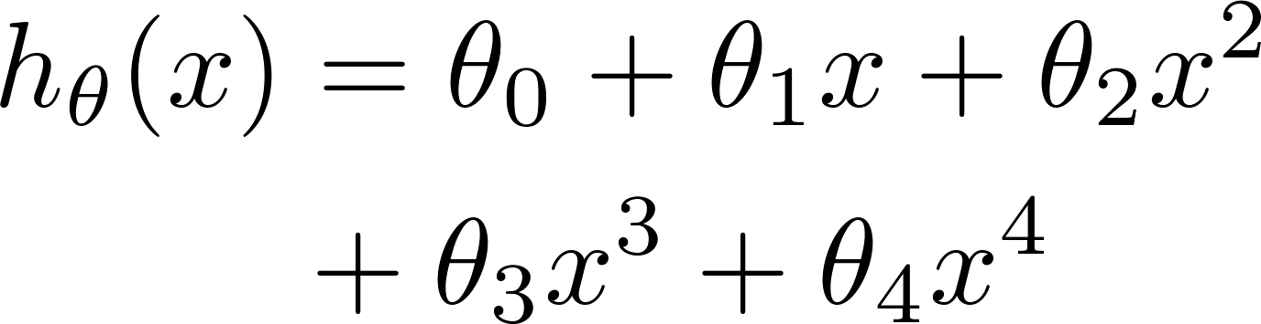


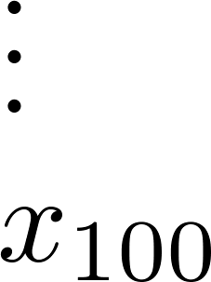
Evaluating your hypothesis
Fails to generalize to new examples not in training set.
price
size of house
no. of bedrooms
no. of floors
size
age of house
average income in neighborhood
kitchen size
Difficult to plot to see overfitting

Slide 5






Evaluating your hypothesis
Dataset:
Size | Price
2104 | 400
1600 | 330
2400 | 369
1416 | 232
3000 | 540
1985 | 300
1534 | 315
1427 | 199
1380 | 212
1494 | 243
Training set
Typical split: 70%; 30%
Test set

Slide 6

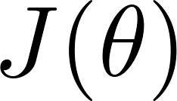
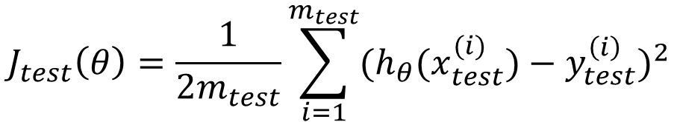
Training/testing procedure for linear regression
Learn parameter from training data (minimizing training error )
Compute test set error:
$$J_{test}\left(θ\right)=\frac{1}{2m_{test}}\sum_{i=1}^{m_{test}}{{(h_{θ}(x_{test}^{(i)})−y_{test}^{\left(i\right)})}^{2}}$$

Slide 7
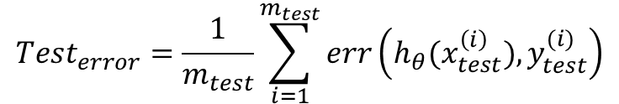
Training/testing procedure for logistic regression
Learn parameter from training data
Compute test set error:
Alternatively: Misclassification error (0/1 misclassification error):
$$err\left(h_{θ}\left(x\right),y\right)=\left\{\begin{matrix}1 & \text{if}\text{ (}h_{θ}\left(x\right)≥0.5,y=0)⋁(h_{θ}\left(x\right)<0.5,y=1) \\ 0 & \text{otherwise}\end{matrix}\right.$$
$${Test}_{error}=\frac{1}{m_{test}}\sum_{i=1}^{m_{test}}{err\left(h_{θ}(x_{test}^{\left(i\right)}),y_{test}^{(i)}\right)}$$

Slide 8
Model selection and training/validation/test sets
Practical machine learning

Slide 9
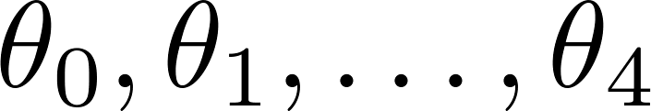
Overfitting example
Once parameters
were fit to some set of data (training set), the error of the parameters as measured on that data (the training error xxxxx) is likely to be lower than the actual generalization error.
price
size

Slide 10
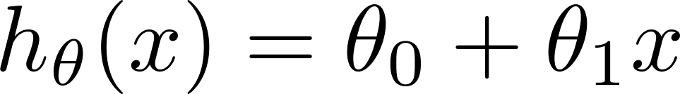
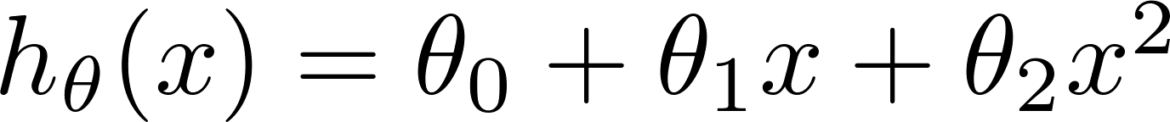
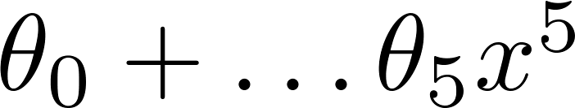
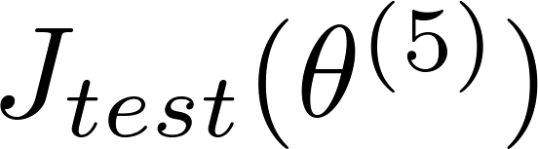





Model selection
$$θ^{(1)}→J_{test}(θ^{(1)})$$
1.
2.
3.
10.
Different degrees of polynomial d
$$θ^{(2)}→J_{test}(θ^{(2)})$$
$$θ^{(3)}→J_{test}(θ^{(3)})$$
$$θ^{(10)}→J_{test}(θ^{(10)})$$
Choose
How well does the model generalize? Report test set error .
Problem: is likely to be an optimistic estimate of generalization error. I.e. our extra parameter ( = degree of polynomial) is fit to test set.

Slide 11





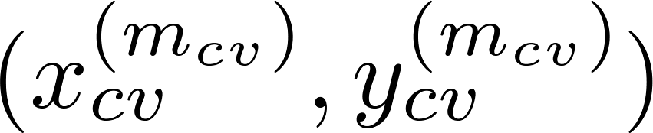
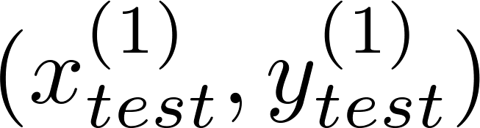
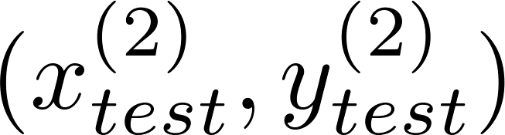
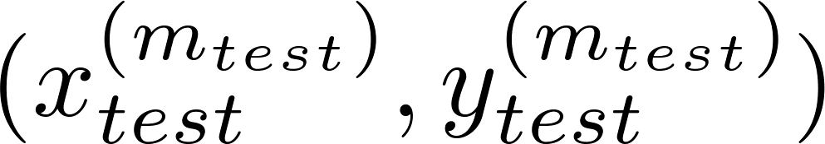
Evaluating your hypothesis
Dataset:
Size | Price
2104 | 400
1600 | 330
2400 | 369
1416 | 232
3000 | 540
1985 | 300
1534 | 315
1427 | 199
1380 | 212
1494 | 243
Training set
Validation (Cross Validation) set
CV
set
Test set

Slide 12
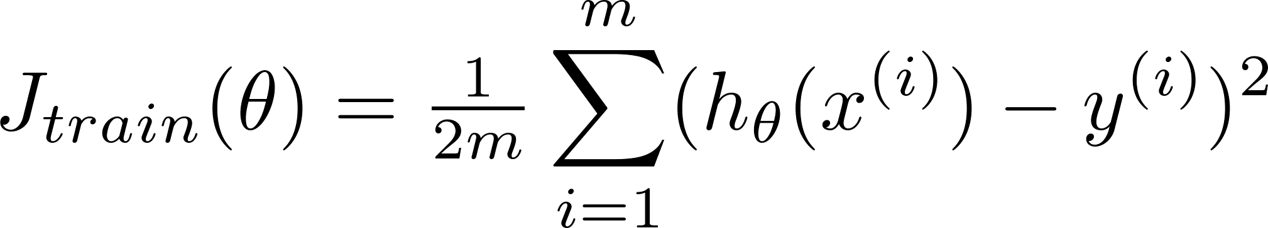
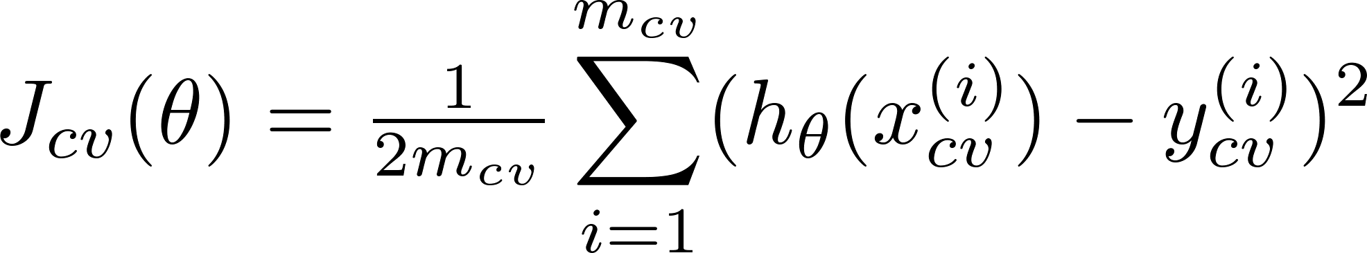
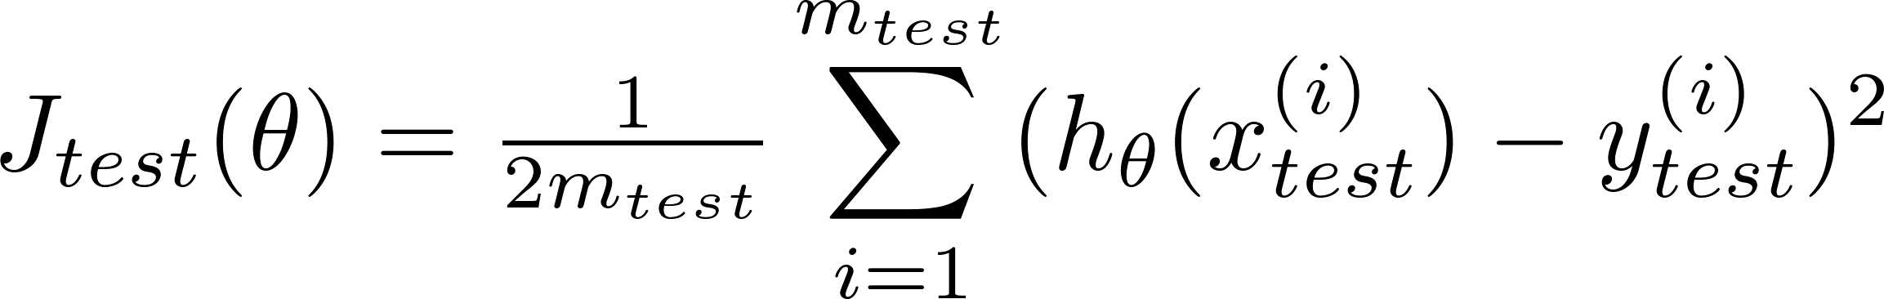
Train/validation/test error
Training error:
Cross Validation error:
Test error:

Slide 13
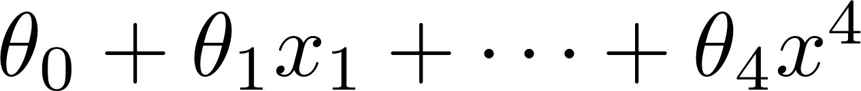
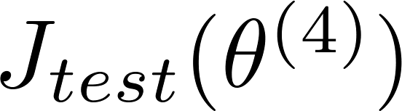





Model selection
1.
2.
3.
10.
$$θ^{(1)}→J_{cv}(θ^{(1)})$$
$$θ^{(2)}→J_{cv}(θ^{(2)})$$
$$θ^{(3)}→J_{cv}(θ^{(3)})$$
$$θ^{(10)}→J_{cv}(θ^{(10)})$$
Suppose $\min_{θ}{J(θ)}=θ^{(4)}$
Pick
Estimate generalization error for test set

Slide 14
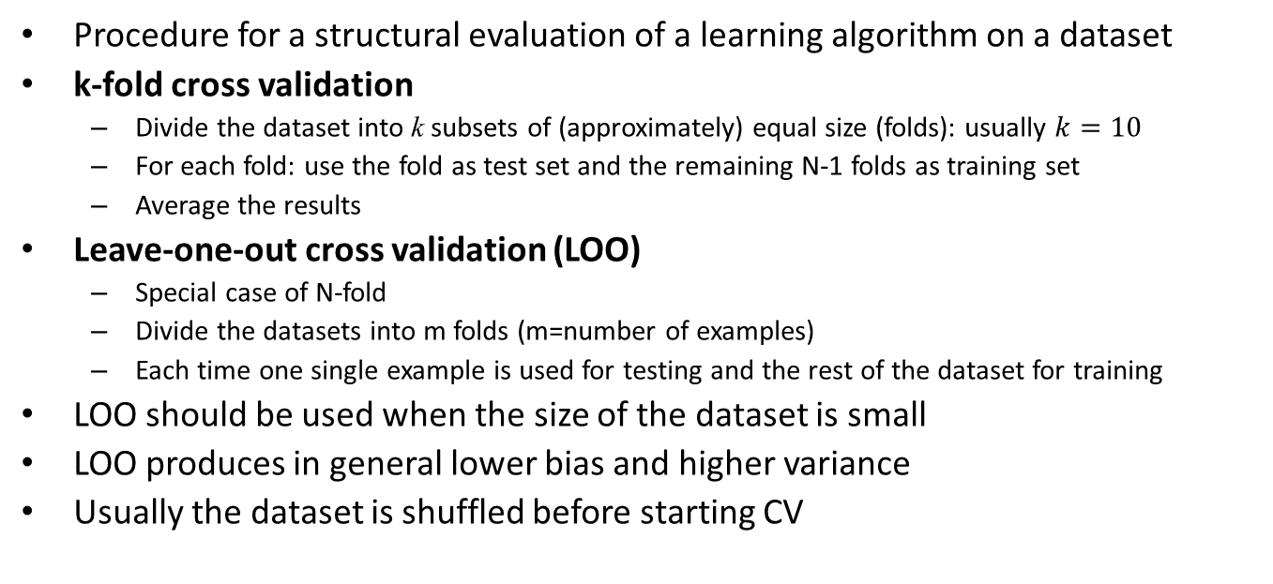
Cross validation
Procedure for a structural evaluation of a learning algorithm on a dataset
k-fold cross validation
Divide the dataset into k subsets of (approximately) equal size (folds): usually $k=10$
For each fold: use the fold as test set and the remaining N-1 folds as training set
Average the results
Leave-one-out cross validation (LOO)
Special case of N-fold
Divide the datasets into m folds (m=number of examples)
Each time one single example is used for testing and the rest of the dataset for training
LOO should be used when the size of the dataset is small
LOO produces in general lower bias and higher variance
Usually the dataset is shuffled before starting CV

Slide 15
Diagnosing bias vs. variance
Prectical machine learning

Slide 16
Remember: Bias and Variance
Model Bias: a set of erroneous assumptions in the learning algorithm. High bias can cause an algorithm to miss the relevant relations between features and output class (underfitting).
Model Variance: the sensitivity to small fluctuations in the training set. High variance can cause an algorithm to model the random noise in the training data, rather than the intended outputs (overfitting).

Slide 17
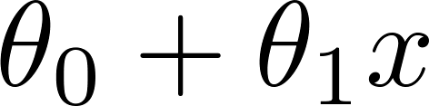
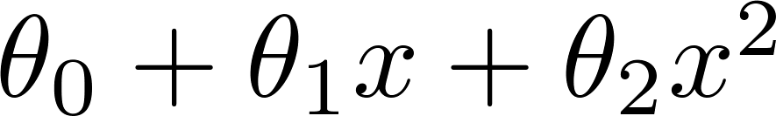
Bias/variance
Price
Price
Price
Size
Size
Size
High bias
(underfit)
“Just right”
High variance
(overfit)

Slide 18
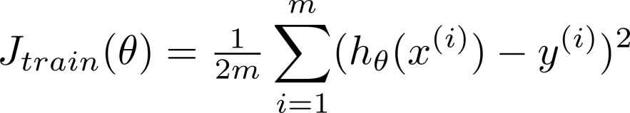
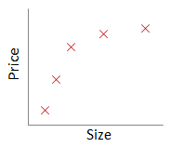




Bias/variance
Training error:
Cross validation error:
$${\text{or} J}_{test}(θ)$$
error
$$J_{cv}(θ)/J_{test}(θ)$$
$$J_{train}(θ)$$
$$d=4$$
degree of polynomial d

Slide 19
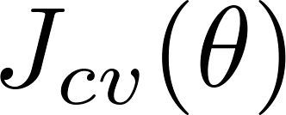
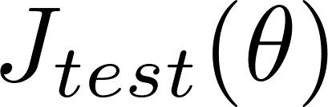




Diagnosing bias vs. variance
Suppose your learning algorithm is performing less well than you were hoping. ( or is high.) Is it a bias problem or a variance problem?
Bias (underfit):
High bias
(cross validation
error)
$$J_{train}≈J_{cv} \text{and} J_{train} \text{large}$$
error
High variance
Variance (overfit):
(training error)
$$J_{train}≪J_{cv} \text{and} J_{train} \text{low}$$
degree of polynomial d

Slide 20
Regularization and bias/variance
Practical machine learning

Slide 21
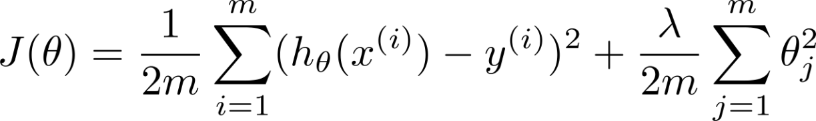



Linear regression with regularization
Model:
Price
Price
Price
Size
Size
Size
Large xx
High bias (underfit)
Intermediate xx
“Just right”
Small xx
High variance (overfit)
$$λ→0$$

Slide 22
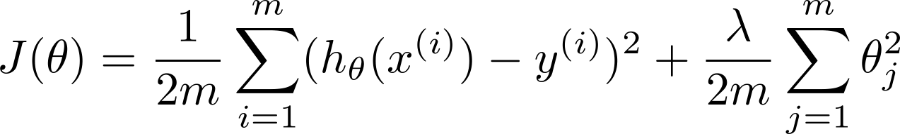
Choosing the regularization parameter
Use CV to select the parameter and evaluate on test

Slide 23
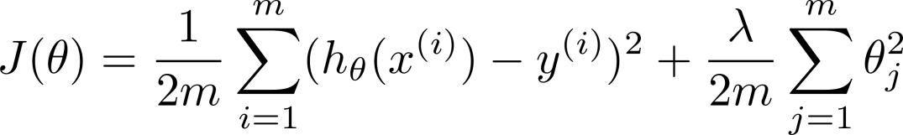













Choosing the regularization parameter
Model:
Try
Try
Try
Try
Try
Try
$$→\min_{θ}{J(θ)→θ^{\left(1\right)}→J_{cv}(θ^{(1)})}$$
$$→\min_{θ}{J(θ)→θ^{\left(2\right)}→J_{cv}(θ^{(2)})}$$
$$→\min_{θ}{J(θ)→θ^{\left(3\right)}→J_{cv}(θ^{(3)})}$$
$$→\min_{θ}{J(θ)→θ^{\left(4\right)}→J_{cv}(θ^{(4)})}$$
$$→\min_{θ}{J(θ)→θ^{\left(5\right)}→J_{cv}(θ^{(5)})\text{ (}\text{minimum} J_{cv})}$$
$$→\min_{θ}{J(θ)→θ^{\left(12\right)}→J_{cv}(θ^{(12)})}$$
Pick . Test error:
$$J_{test}(θ^{(5)})$$

Slide 24



Bias/variance as a function of the regularization parameter
error
$$J_{cv}(θ)$$
Just right
$$J_{train}(θ)$$
$$λ^{∗}$$

Slide 25
Learning curves
Prectical machine learning

Slide 26








Learning curves
$$m=1$$
$$m=2$$
$m=$3
$$m=4$$
error
$$J_{cv}(θ)$$
$m=$5
$$m=6$$
$$J_{train}(θ)$$
(training set size)

Slide 27



High bias
error
price
$$J_{cv}(θ)$$
$$J_{train}(θ)$$
Large
error
size
(training set size)
price
If a learning algorithm is suffering from high bias, getting more training data will not (by itself) help much.
size

Slide 28


High variance
(and small )
error
price
$$J_{cv}(θ)$$
$$J_{train}(θ)$$
size
(training set size)
price
If a learning algorithm is suffering from high variance, getting more training data is likely to help.
size

Slide 29
Deciding what to try next (revisited)
Prectical machine learning

Slide 30
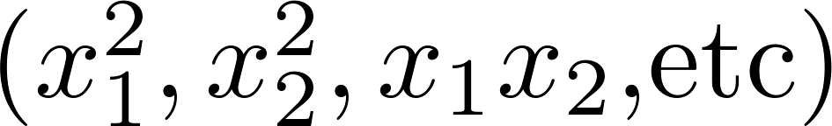
Debugging a learning algorithm:
Suppose you have implemented regularized linear regression to predict housing prices. However, when you test your hypothesis in a new set of houses, you find that it makes unacceptably large errors in its prediction. What should you try next?
Get more training examples
Try smaller sets of features
Try getting additional features
Try adding polynomial features
Try decreasing
Try increasing
→ fixes high variance
→ fixes high variance
→ fixes high bias
→ fixes high bias
→ fixes high bias
→ fixes high variance

Slide 31
Neural networks and overfitting
“Small” neural network
(fewer parameters; more prone to underfitting)
“Large” neural network
(more parameters; more prone to overfitting)
Computationally cheaper
Computationally more expensive.
Use regularization ( ) to address overfitting.

Slide 32




Performance measures
Confusion Matrix
classes
+
-
← classified as
+
TP (true positive) | FN (false negative)
FP (false positive) | TN (true negative)
-
$$m=TP+FN+FP+TN=\text{total} \text{number} \text{of} \text{examples}$$
$$tpr=\frac{TP}{TP+FN}(\text{Recall} \text{or} \text{Sensitivity})$$
$$tnr=\frac{TN}{FP+TN}\text{ (}\text{Specifity}\text{)}$$
$$fpr=\frac{FP}{FP+TN}\text{ (}\text{Fallout}\text{)}$$
$$fnr=\frac{FN}{TP+FN}$$

Slide 33

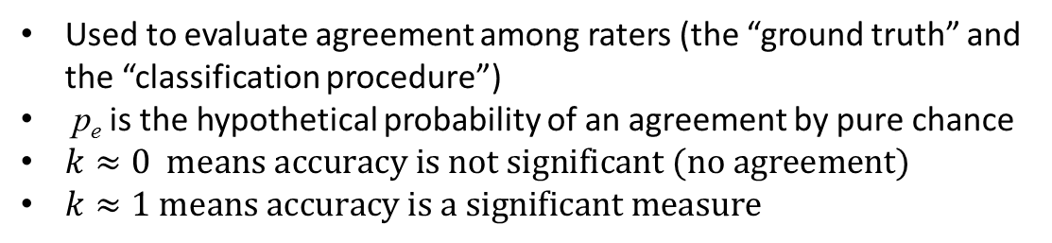



Performance measures II
$$\text{Accuracy}: a=\frac{TP+TN}{m} \text{ \% }\text{of} \text{correct} \text{classifications}$$
Cohen’s Kappa Coefficient
$$k=\frac{a−p_{e}}{1−p_{e}}$$
% predicted positive
% predicted negative
% actual positive
$$p_{+}=\frac{TP+FN}{m}×\frac{TP+FP}{m}$$
$$p_{−}=\frac{TN+FP}{m}×\frac{TN+FN}{m}$$
$$p_{e}=p_{+}+p_{−}$$
% actual negative
Used to evaluate agreement among raters (the “ground truth” and the “classification procedure”)
p_{e} is the hypothetical probability of an agreement by pure chance
$k≈0 \text{means} \text{accuracy} \text{is} \text{not} \text{significant}\text{ (}\text{no} \text{agreement}\text{)}$
$k≈1 \text{means} \text{accuracy} \text{is} \text{a} \text{significant} \text{measure}$

Slide 34





Example
 | + | -
+ | 98 | 0
- | 2 | 0
 | + | -
+ | 49 | 1
- | 1 | 49
$$a=0.98$$
$$p_{e}=\frac{98}{100}\frac{100}{100}+\frac{2}{100}\frac{0}{100}=0.98$$
$$p_{e}=\frac{50}{100}\frac{50}{100}+\frac{50}{100}\frac{50}{100}=0.5$$
$$k=\frac{0.98−0.98}{1−0.98}=0$$
$$k=\frac{0.98−0.5}{1−0.5}=0.96$$

Slide 35
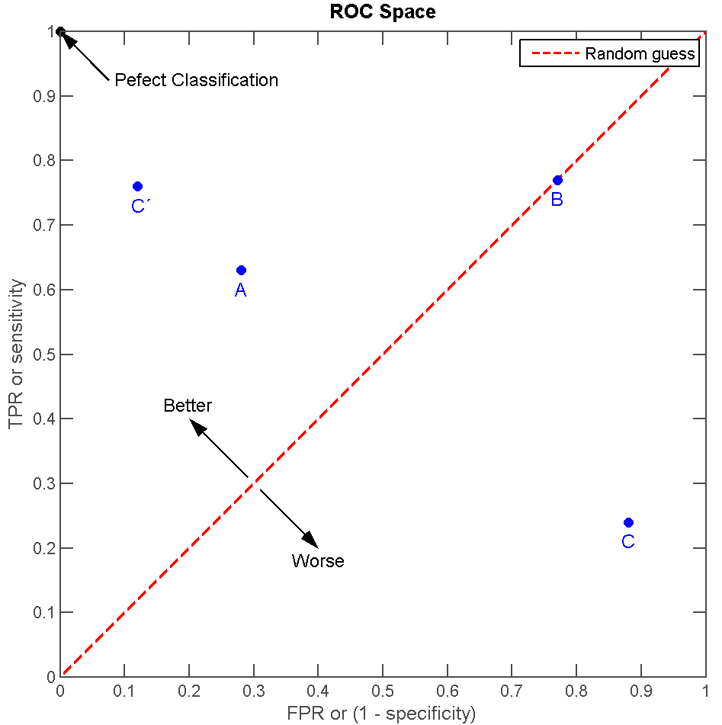
ROC Curve
Receiver Operating Characteristic
FPR vs TPR
Each point is a classifier
Random guess: point (p,p) as flipping a coin with P(+)=p
(0,1) perfect classification
(0,0) always class –
(1,1) always class +
(1,0) + classified as – and viceversa

Slide 36
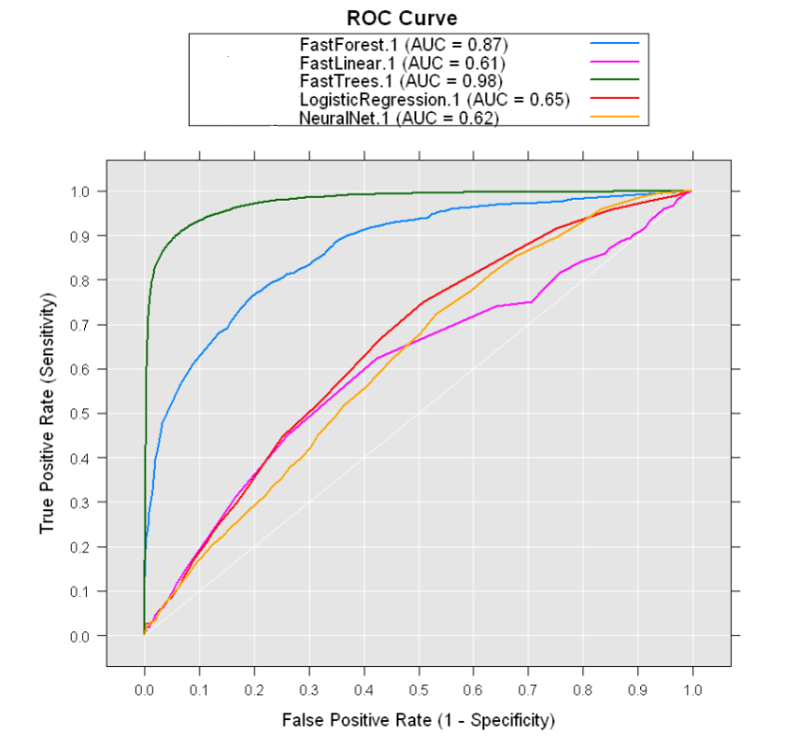
ROC Curve: comparing classifiers
Given a classifier, produce a ROC curve by changing some parameter (es: prob. threshold for + classification)
Each point in the curve is a different instance of the classifier
Comparing different classifiers by plotting their ROC curves
AUC=Area Under the (ROC) Curve
Prefer classifiers with larger AUC
AUC close to 1 means a robust classifier

Slide 37
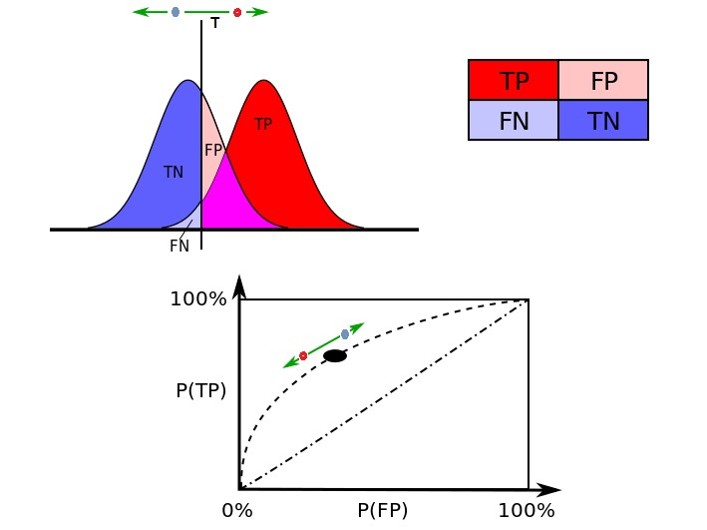
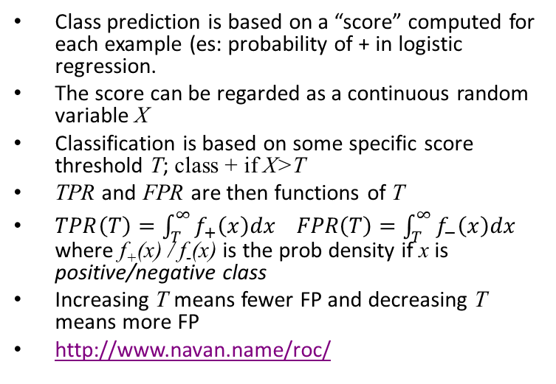
ROC: math digression
Class prediction is based on a “score” computed for each example (es: probability of + in logistic regression.
The score can be regarded as a continuous random variable X
Classification is based on some specific score threshold T; class + if X>T
TPR and FPR are then functions of T
$TPR\left(T\right)=\int_{T}^{∞}{f_{+}\left(x\right)dx FPR\left(T\right)=\int_{T}^{∞}{f_{−}\left(x\right)dx}}$ where f₊(x) / f₋(x) is the prob density if x is positive/negative class
Increasing T means fewer FP and decreasing T means more FP
http://www.navan.name/roc/
score

Slide 38
Error metrics for skewed classes
Practical Machine learning

Slide 39



Cancer classification example
Train logistic regression model . ( if cancer, otherwise) Find that you got 1% error on test set.
(99% correct diagnoses)
Only 0.50% of patients have cancer.
→ skewed/unbalanced classes
function y = predictCancer(x)
y = 0; %ignore x!
return
$$99.5\% \text{accuracy}$$
$$0.5\% \text{classification} \text{error}$$

Slide 41


Precision/Recall
In case of unbalanced problems two measures can be more suitably considered instead of accuracy
$$prec=\frac{TP}{TP+FP}$$
Precision: % of cases correctly classified over all classified positive
$$rec=\frac{TP}{TP+FN}$$
Recall: % of cases classified correctly classified over all positive case (true positive rate)
Precision
Of all patients we predicted having cancer, what fraction actually has cancer?
Recall
Of all patients that actually have cancer, what fraction did we correctly detect as having cancer?

Slide 42
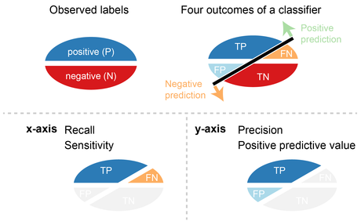

Slide 43
Trading off precision and recall
Practical Machine learning

Slide 44
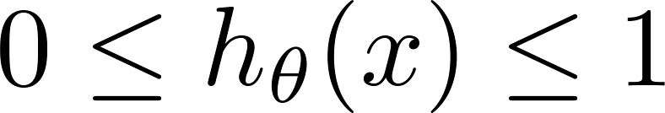



Trading off precision and recall
precision =
true positives
no. of predicted positive
Logistic regression:
Predict 1 if
Predict 0 if
recall =
true positives
no. of actual positive
Suppose we want to predict (cancer)
only if very confident.
large threshold
1
higher prec, lower rec → increase threshold (0.7, 0.9, …)
Precision
0.5
Suppose we want to avoid missing too many cases of cancer (avoid false negatives).
low threshold
lower prec, higher rec → decrease threshold (0.3, 0.2, …)
0.5
1
Recall
More generally: Predict 1 if threshold.

Slide 45

Completing PR curves
1
Precision
0.5
$$\frac{P}{m}$$
P=# positive cases
0.5
1
Recall

Slide 46
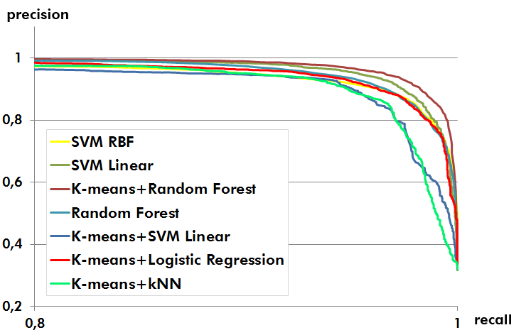
Comparison of classifiers via PR Curve
AUPR: Area Under PR curve
Prefer classifier with larger AUPR
AUPR more robust measure than AUC in unbalanced datasets

Slide 47
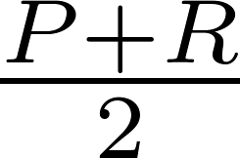
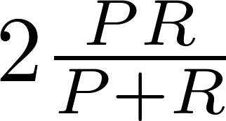


F₁ Score (F score)
How to compare precision/recall numbers?
 | Precision(P) | Recall (R) | Average | F₁ Score
Algorithm 1 | 0.5 | 0.4 | 0.45 | 0.444
Algorithm 2 | 0.7 | 0.1 | 0.4 | 0.175
Algorithm 3 | 0.02 | 1.0 | 0.51 | 0.0392
Average:
predict y=1 (+) all the time
best balance prec/rec
F₁ Score:
$$F_{1}=0↔(prec=0)∨(rec=0)$$
$$F_{1}=1↔(prec=1)∧(rec=1)$$

Slide 48
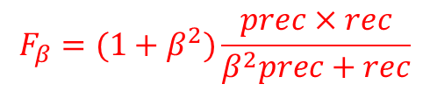
F_{β} Score
F₁ score is the harmonic mean of prec and rec
F₁ is a special case of a F_{β} score with β=1
$$F_{β}=(1+β^{2})\frac{prec×rec}{β^{2}prec+rec}$$
β is a weight of the relative importance of rec vs prec
β >1 more importance to rec; β <1 more importance to prec
Usual values β=1, β=0.5, β=2
F score is between 0 and 1, with 1 best value

Slide 49

Data for machine learning
Machine learning system design
Machine Learning

Slide 50
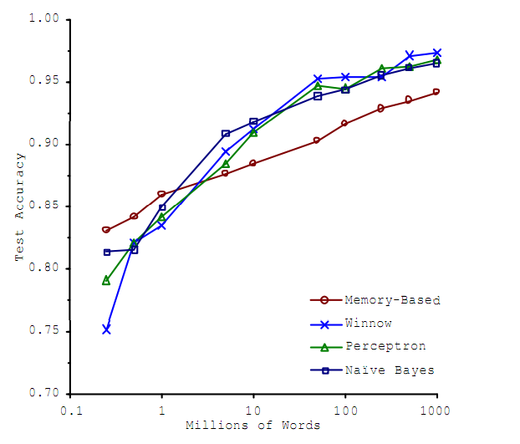
Designing a high accuracy learning system
E.g. Classify between confusable words.
{to, two, too}, {then, than}
For breakfast I ate _____ eggs.
Algorithms
Perceptron (Logistic regression)
Winnow
Memory-based
Naïve Bayes
Accuracy
Training set size (millions)
“It’s not who has the best algorithm that wins.
It’s who has the most data.”
_{[Banko and Brill, 2001]}

Slide 51
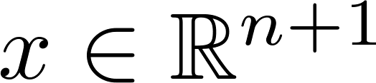


Large data rationale
Assume feature has sufficient information to predict accurately.
Example: For breakfast I ate _____ eggs.
Counterexample: Predict housing price from only size (feet²) and no other features.
Useful test: Given the input , can a human expert confidently predict ?

Slide 52
Large data rationale
Use a learning algorithm with many parameters (e.g. logistic regression/linear regression with many features; neural network with many hidden units).
Use a very large training set (unlikely to overfit)

