Slide 1


Faculty of Engineering in
Foreign Languages
Group 1211EF
Dragomirescu Alexandru
Pencea Vlad-Alexandru
Coord teacher
sl. dr. ing. Mitrea Dan Alexandru

Slide 2
Faculty of Engineering in
Foreign Languages
Group 1211EF
Dragomirescu Alexandru
Pencea Vlad-Alexandru
Coord teacher
sl. dr. ing. Mitrea Dan Alexandru

Slide 3

Contents
Faculty of Engineering in
Foreign Languages
Group 1211EF
Dragomirescu Alexandru
Pencea Vlad-Alexandru
Coord teacher
sl. dr. ing. Mitrea Dan Alexandru

Slide 4
Contents
Objectives
Technologies Used
Features
Comparison with
Other Platforms
Unique Elements
Conclusion

Slide 5







Firebase
Typescript
Programming languages used to implement the application
Tailwind
ReactJS
HTML
CSS
JavaScript

Slide 6
Programming languages used to implement the application
Firebase
Typescript
HTML
CSS
Tailwind
ReactJS
JavaScript

Slide 7
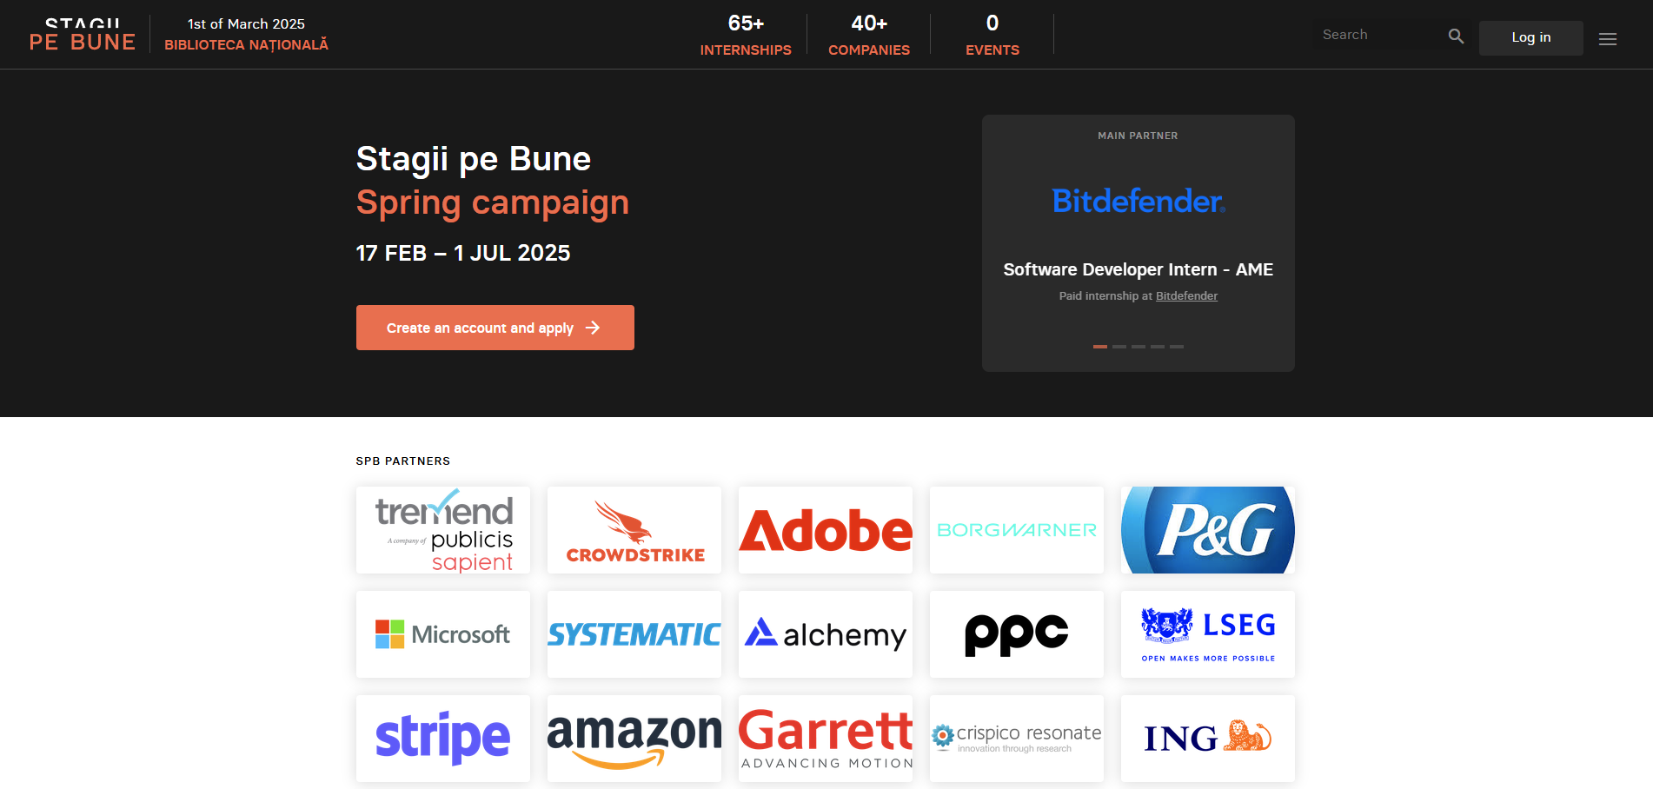
Comparison with other similar applications
stagiipebune.ro
The website "Stagii pe Bune" serves as an internship platform designed to bridge the gap between academic requirements and the professional world, offering significant benefits to students. It provides a dedicated space for students to explore and apply for internship opportunities.

Slide 8
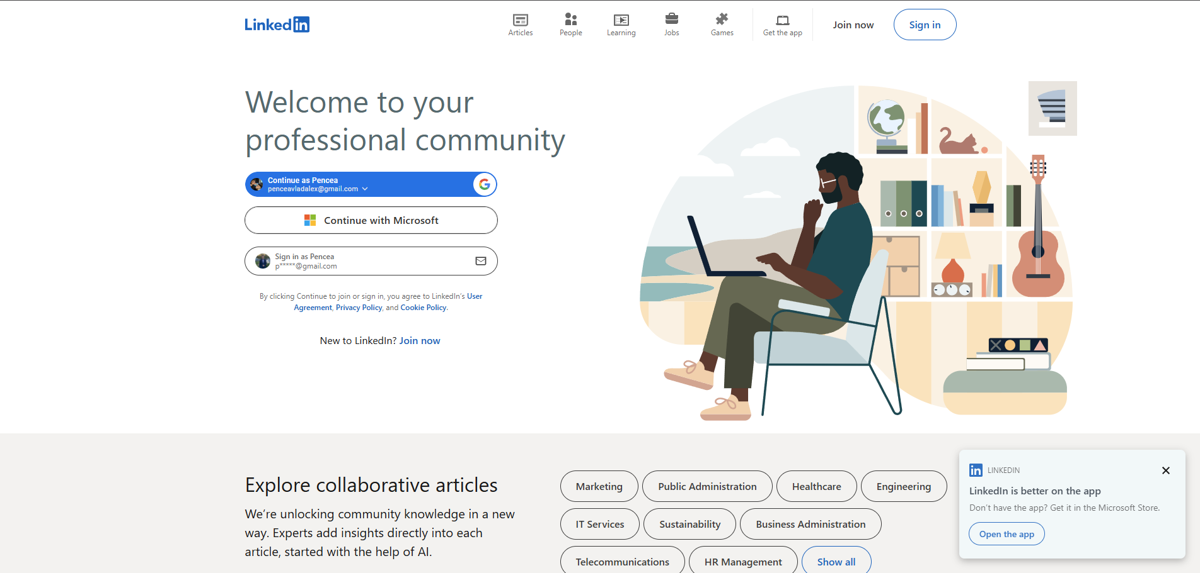
Comparison with other similar applications
stagiipebune.ro
linkedin.com
The website "Stagii pe Bune" serves as an internship platform designed to bridge the gap between academic requirements and the professional world, offering significant benefits to students. It provides a dedicated space for students to explore and apply for internship opportunities.
LinkedIn is a professional networking platform designed primarily for career and business-oriented individuals. It allows users to create professional profiles, connect with colleagues, employers, and industry peers, and expand their professional network.

Slide 9
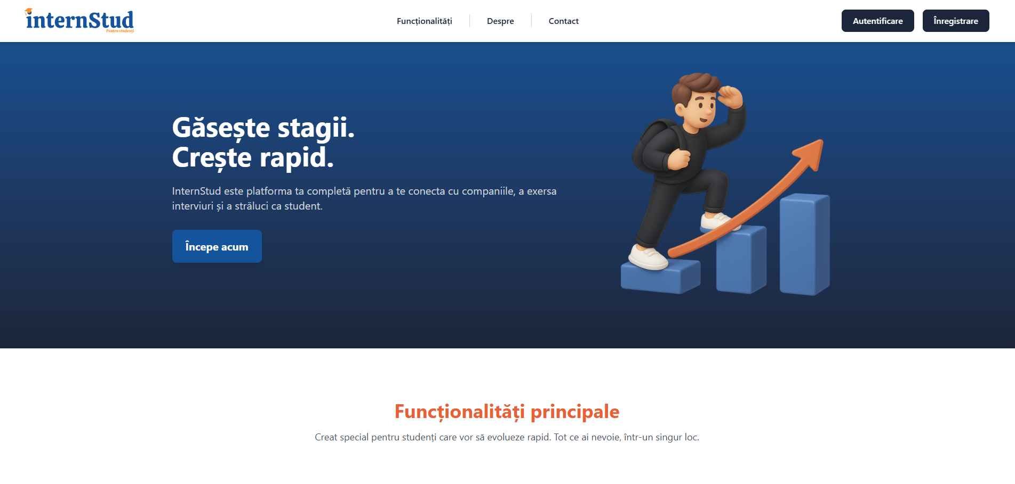
Comparison with other similar applications
insternstud.ro
linkedin.com
stagiipebune.ro
InternStud is a similar application with the same goal as job platforms, but the differences lie in functionalities tailored for students and companies. It has unique features compared to a basic job board, including an integrated Interview Simulator for practice and a community section for sharing company reviews after completing an experience.
The website "Stagii pe Bune" serves as an internship platform designed to bridge the gap between academic requirements and the professional world, offering significant benefits to students. It provides a dedicated space for students to explore and apply for internship opportunities.
LinkedIn is a professional networking platform designed primarily for career and business-oriented individuals. It allows users to create professional profiles, connect with colleagues, employers, and industry peers, and expand their professional network.

Slide 10
Comparison with other similar applications
insternstud.ro
linkedin.com
InternStud is a similar application with the same goal as job platforms, but the differences lie in functionalities tailored for students and companies. It has unique features compared to a basic job board, including an integrated Interview Simulator for practice and a community section for sharing company reviews after completing an experience.
LinkedIn is a professional networking platform designed primarily for career and business-oriented individuals. It allows users to create professional profiles, connect with colleagues, employers, and industry peers, and expand their professional network.

Slide 11

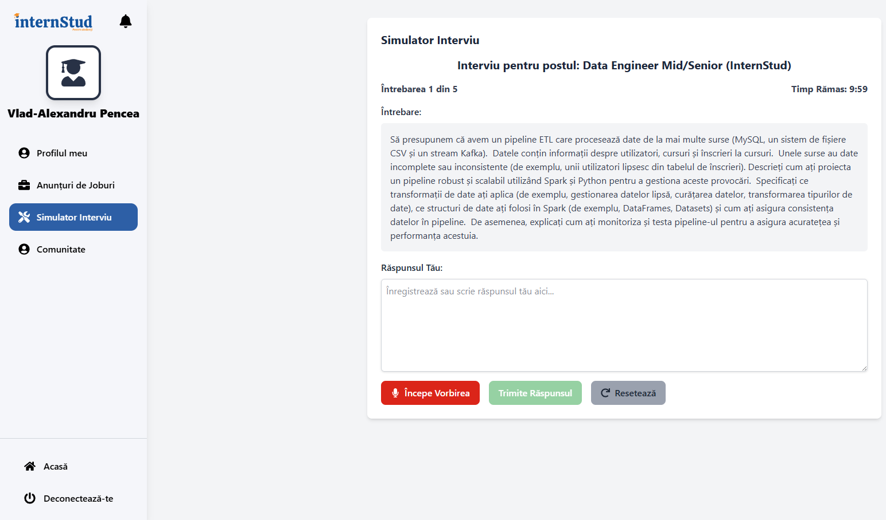
Uniqueness
What sets InternStud apart from others
InternStud sets itself apart with an integrated Interview Simulator that helps remove interview anxiety by preparing you for the interview, and a Community Review section for sharing company experiences.

Slide 12




Objectives
Career Advancement: Facilitate student career development and preparation for opportunities through integrated tools.
Software: Ensure an intuitive and user-friendly interface for seamless navigation and interaction.
Development: Implement a scalable architecture to handle a large number of users, job postings, and applications.
Data analytics: Create a system for monitoring application statuses, user activity, and other relevant data.

Slide 13





Features
In-Browser Interview Simulator
Community to bring students together
Students can practice interviews directly on the platform with AI-driven feedback.
Connect, share experiences, and discuss topics with other students.
Exclusive Platform for Students
Challenges and Testing
A secure space with controlled access dedicated to student development (institutional email verification is a planned access control method).
Companies will be able to create custom tests and challenges for objective student evaluation.

Slide 14




ADVANTAGES
ADVANTAGES
DISADVANTAGES
DISADVANTAGES
Key features still planned.
AI feedback has limits.
Requires active student participation.
Currently limited feature scope.
Key features still planned.
AI feedback has limits.
Requires active student participation.
Currently limited feature scope.
Easy interview practice in browser.
Get instant AI feedback.
Connect with student community.
Secure, student-exclusive platform.
Easy interview practice in browser.
Get instant AI feedback.
Connect with student community.
Secure, student-exclusive platform.

Slide 15
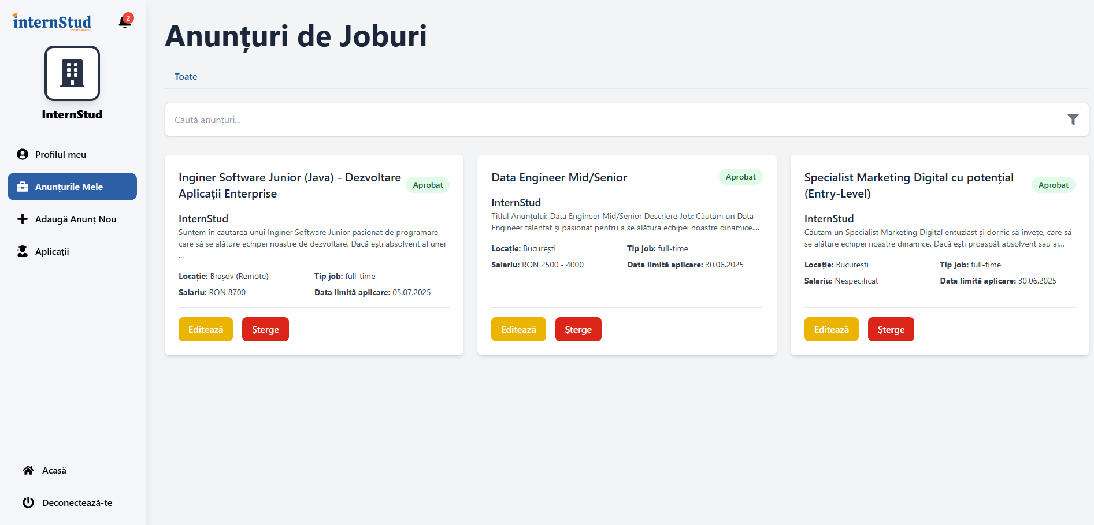

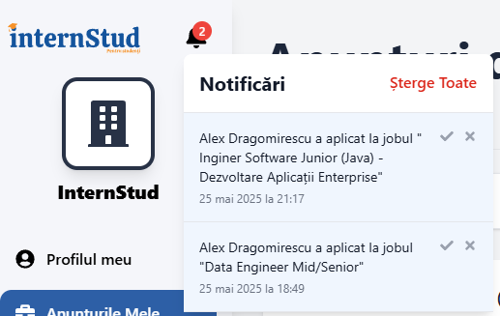

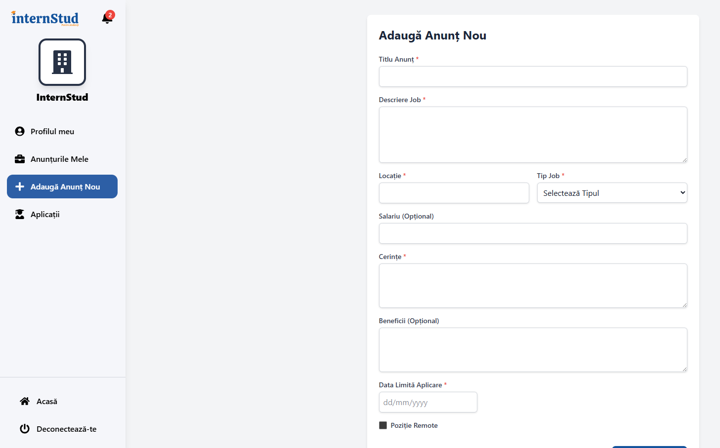

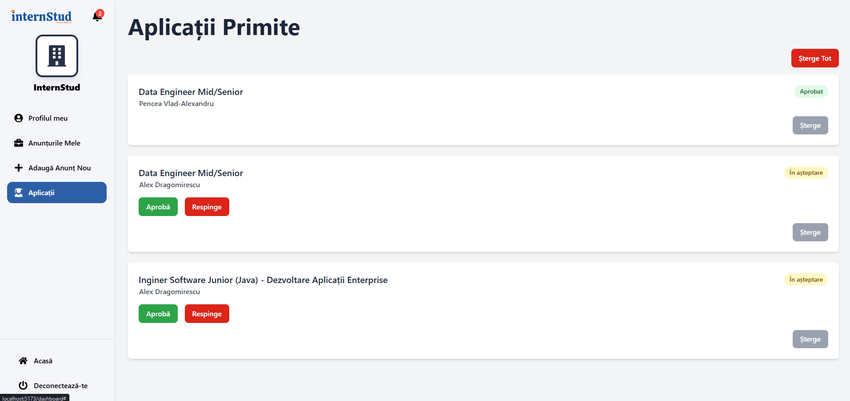
Company Dashboard
App Overview
Notification system
Homepage
New Job listing
SignUp
Candidate list and option to refuse/accept

Slide 16
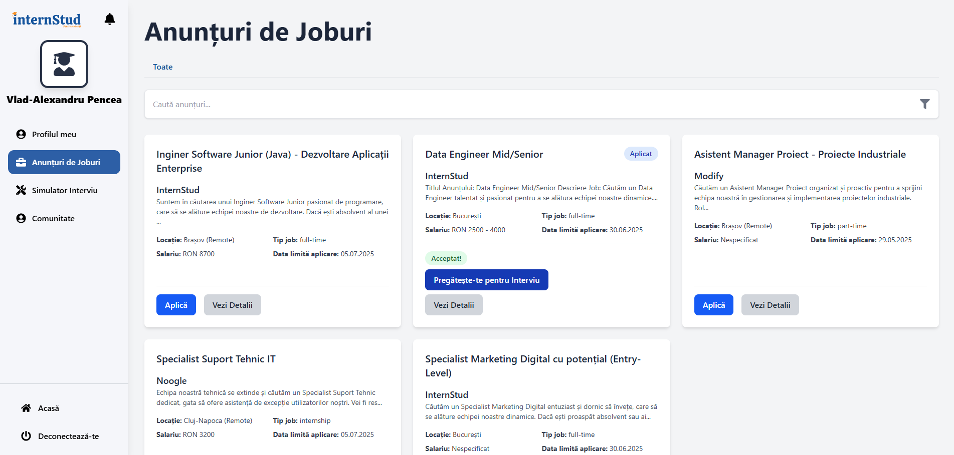
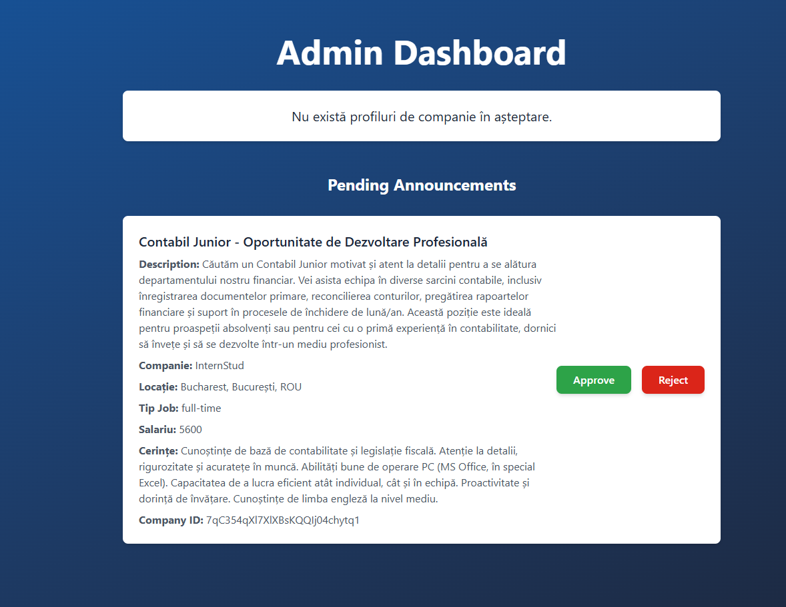
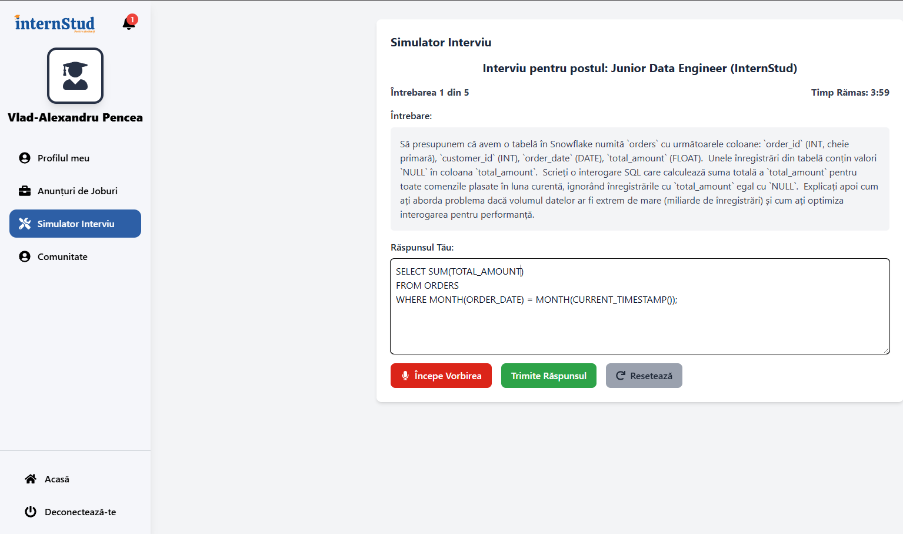
Student Dashboard
App Overview
Notification system
Homepage
Company Dashboard
Admin Dashboard
New Job listing
AI-Generated Interview based on Job description
Candidate list and option to refuse/accept
SignUp

Slide 17
App Overview
Student Dashboard
Company Dashboard
Admin Dashboard
New Job listing
AI-Generated Interview based on Job description
Candidate list and option to refuse/accept

Slide 18
InternStud stands out by offering tools tailored to students' needs, such as AI-powered interview practice and company reviews.
It bridges the gap between academic life and career opportunities, helping students prepare effectively for the job market.
CONCLUSION

Slide 19
InternStud stands out by offering tools tailored to students' needs, such as AI-powered interview practice and company reviews.
It bridges the gap between academic life and career opportunities, helping students prepare effectively for the job market.
CONCLUSION

Slide 20
InternStud stands out by offering tools tailored to students' needs, such as AI-powered interview practice and company reviews.
It bridges the gap between academic life and career opportunities, helping students prepare effectively for the job market.
THANK YOU FOR WATCHING!

