Slide 1
Paper Topic Recognition System Final Project
Matteo De Angelis

Slide 2
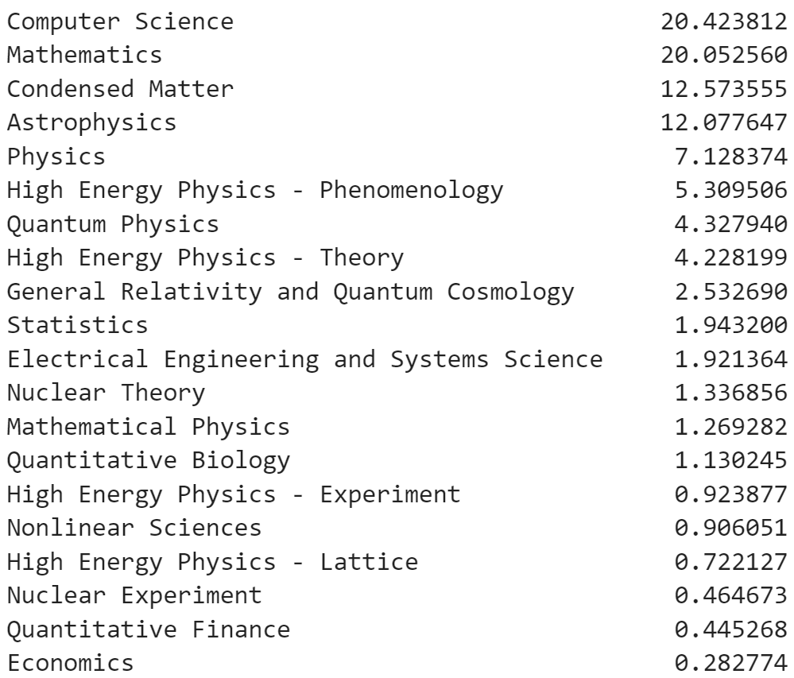
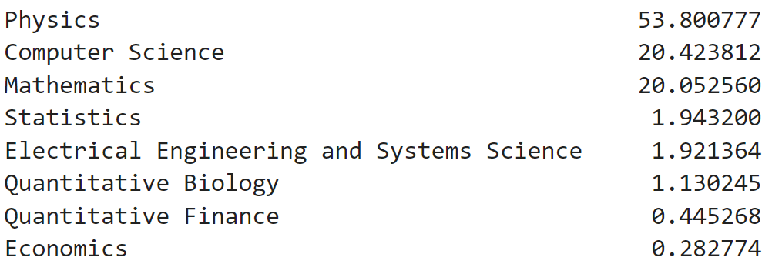
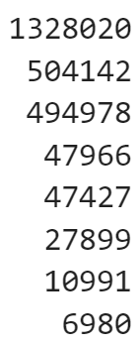
Data
arXiv Dataset Version 177
2,468,403 STEM papers
155 categories
8 main categories
20 categories expanding physics
55840 papers (6980 x 8)

Slide 3
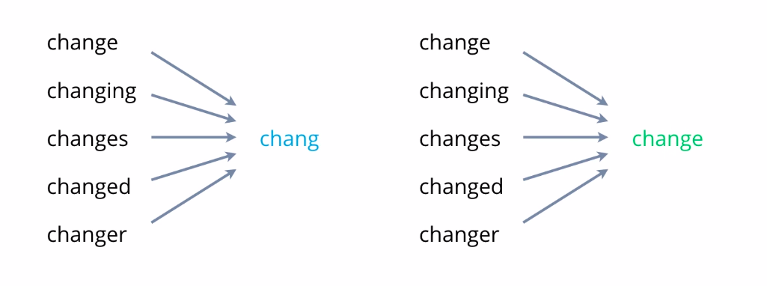
Preprocessing
{'under', "don't", 've', 'for', 'y', 'while', 'yourself', 'below', 'should', 'herself', "haven't", 'after', 'we', 'from', 'was', 'have', 'or', 'a', 'before', 'mightn', 'on', 'against', 'she', 'nor', 'where', 'hadn', 'more', 'these', 'by', 'if', 'you', 'until', 'so', 'theirs', "doesn't", 'it', 'there', 'its', "wouldn't", 'them', 't', 'doesn', 'only', "shan't", "hasn't", 'once', 'did', 'isn', 'didn', 'ma', "it's", 'been', 'hasn', 'which', 'but', "hadn't", 'myself', 'he', 'of', 'no', 'all', "shouldn't", 'that', 'what', 'how', 'wouldn', 'aren', "should've", "she's", 'in', 'can', 'same', 'down', 's', 'me', "needn't", 'over', 'don', 'off', 'the', 'into', 'any', 'd', 're', 'not', 'very', 'is', 'had', 'why', 'who', 'i', 'each', 'themselves', 'at', 'doing', 'other', 'needn', 'just', 'has', "you'll", 'his', 'through', 'as', 'shouldn', 'out', "weren't", 'between', 'our', 'does', 'shan', "wasn't", 'am', 'weren', 'm', 'do', 'ours', "you've", 'are', 'such', 'won', "you're", 'further', 'wasn', 'with', 'than', "didn't", 'those', 'most', 'couldn', 'ourselves', "mightn't", 'my', 'whom', 'haven', 'be', "won't", 'up', 'yours', "you'd", 'an', 'own', 'her', 'being', 'mustn', "mustn't", 'hers', "couldn't", 'about', "aren't", 'this', 'few', "isn't", 'him', 'o', 'both', 'again', 'yourselves', 'will', 'having', 'some', 'during', 'above', 'were', 'when', 'll', "that'll", 'too', 'they', 'because', 'now', 'your', 'to', 'here', 'himself', 'and', 'itself', 'then', 'ain', 'their’} (179)
using abstracts
removing non-alphanumeric characters
removing stopwords
Stemming and Lemmatization

Slide 4
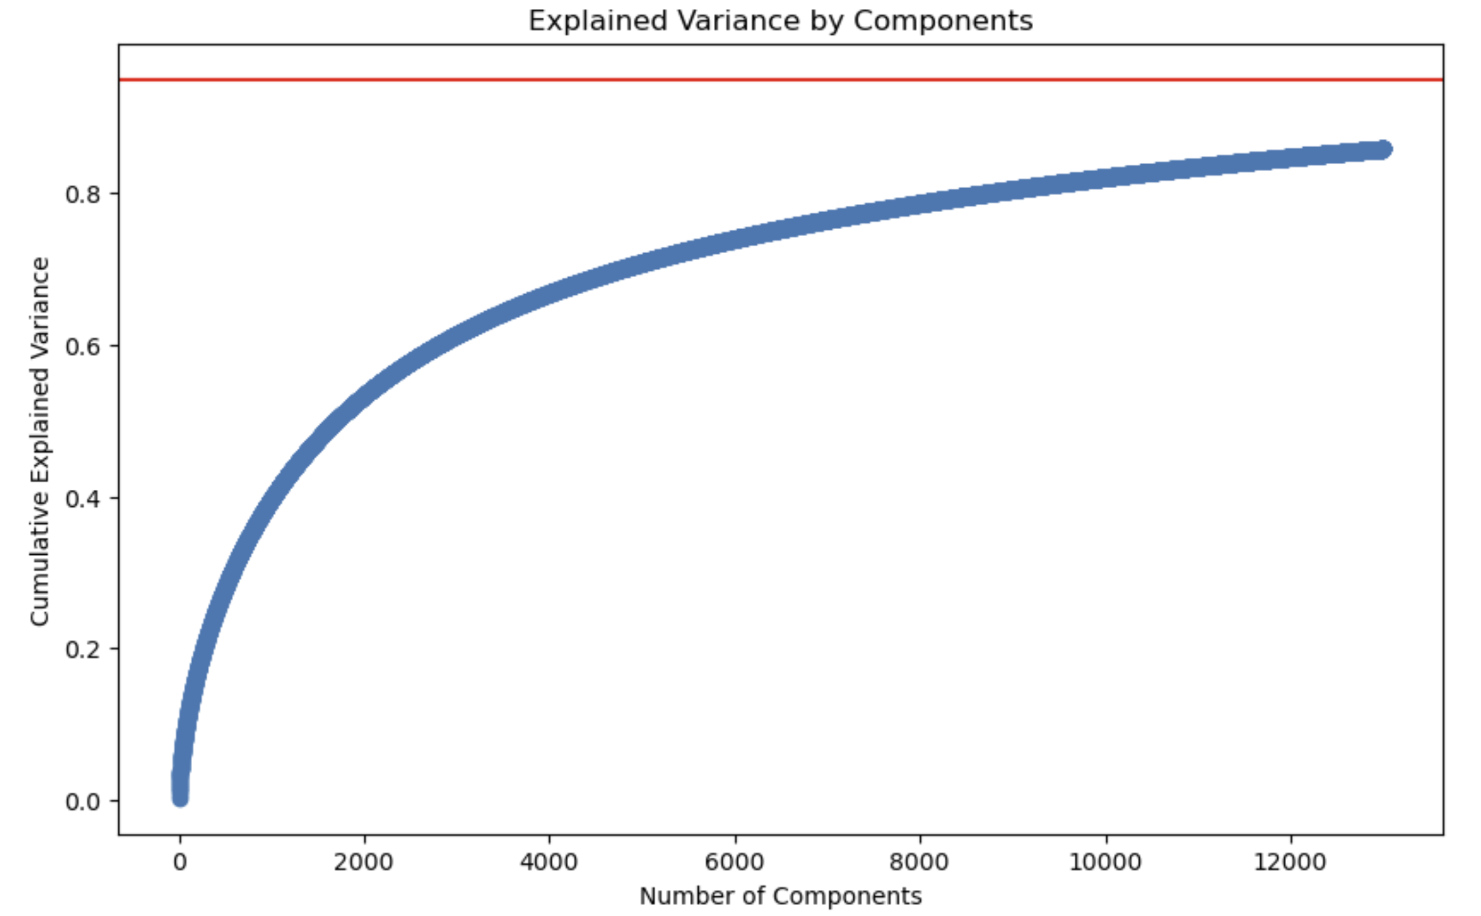
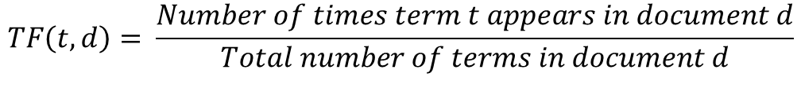

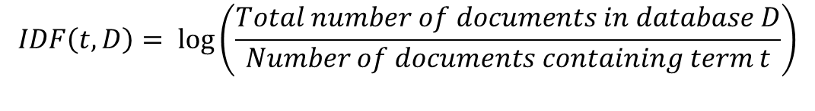
Feature Extraction
$$TF\left(t,d\right)= \frac{Number of times term t appears in document d}{Total number of terms in document d}$$
TF-IDF algorithm
Latent Semantic Analysis
$$IDF\left(t,D\right)= log\left(\frac{Total number of documents in database D}{Number of documents containing term t}\right)$$
$$TF\text{−}IDF(t,d,D)=TF(t,d)×IDF(t,D)$$

Slide 5
Model Implementation
Training Set (70%), Testing Set (30%)
5-fold cross-validation
Multinomial Naïve Bayes
K-Nearest Neighbors
Support Vector Machines

Slide 6
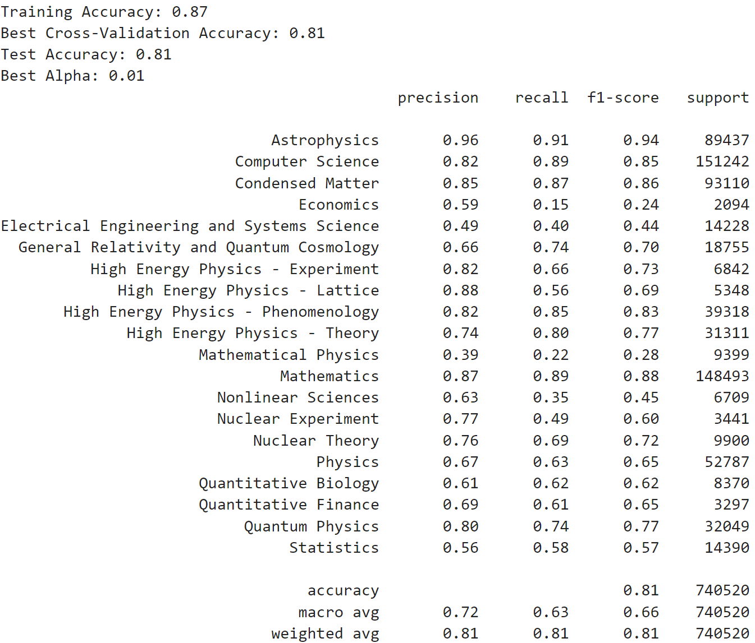
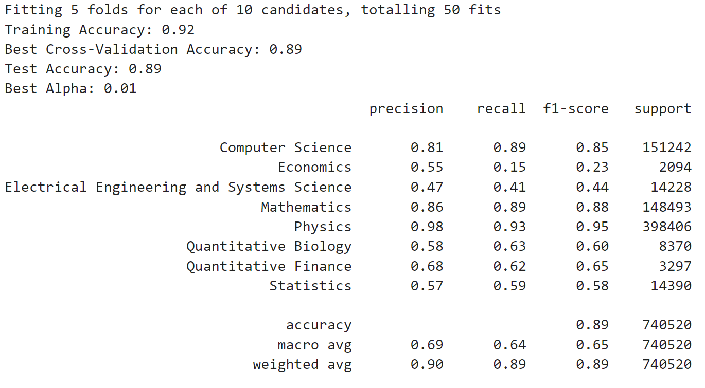
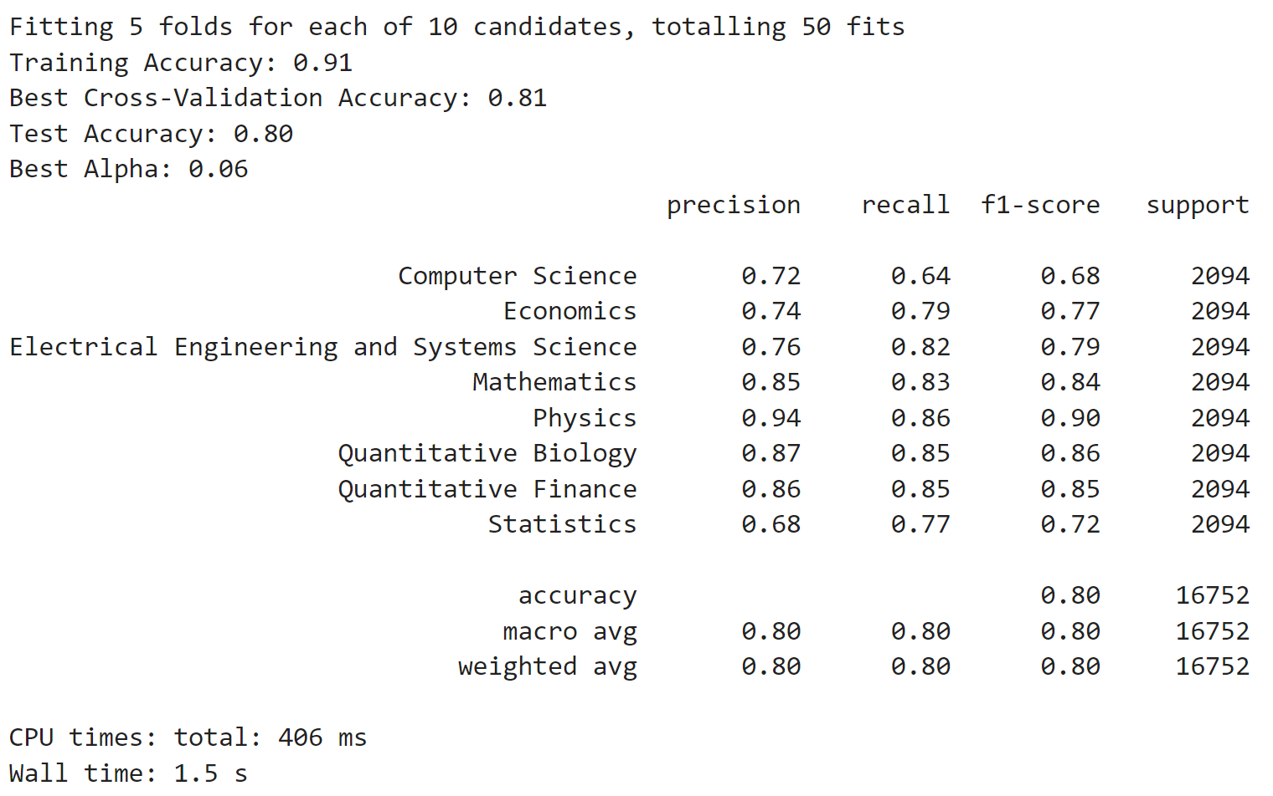
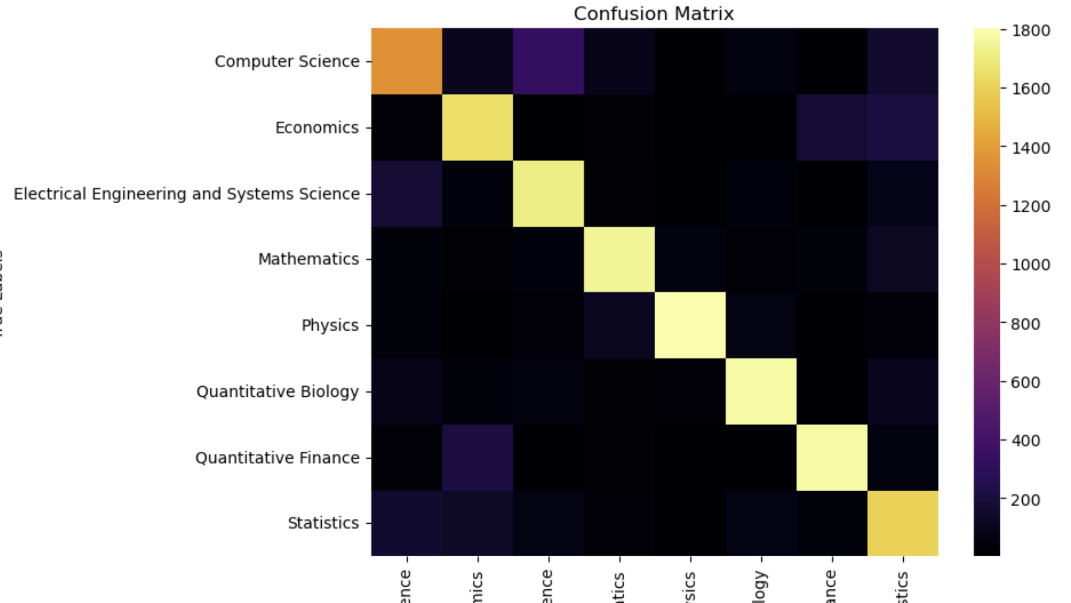
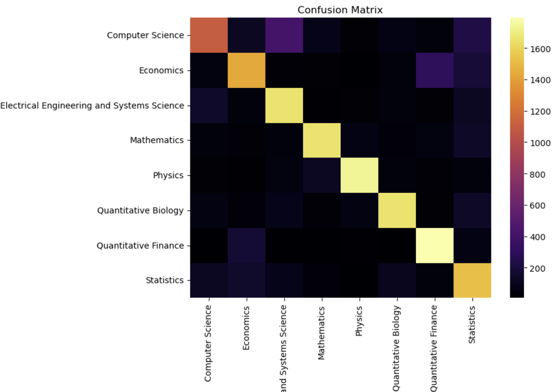
Multinomial Naïve Bayes
alpha

Slide 7
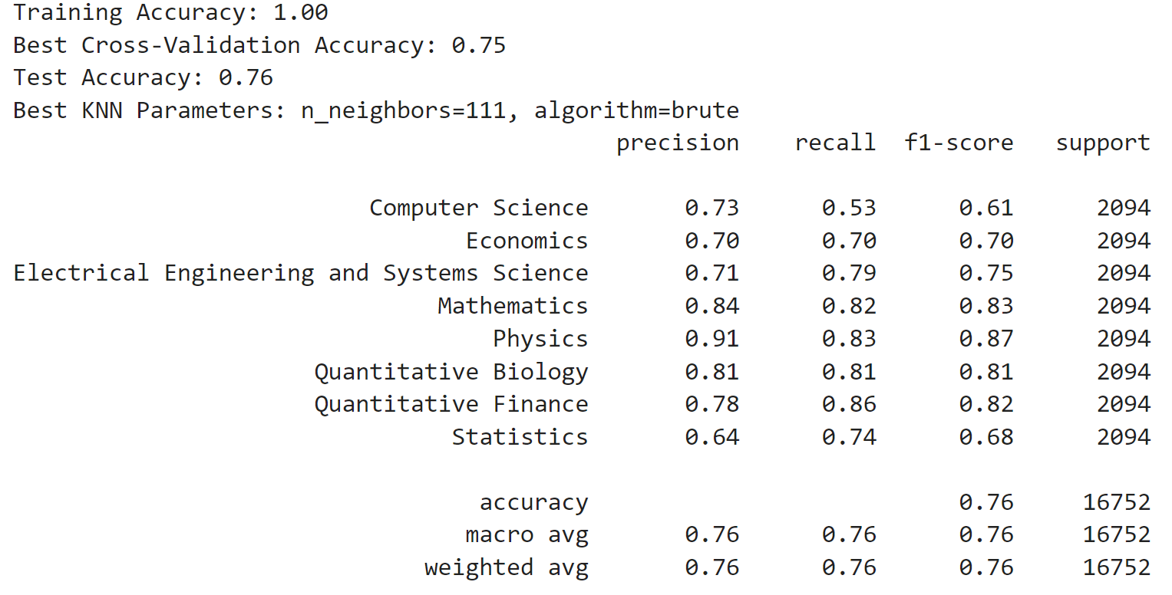
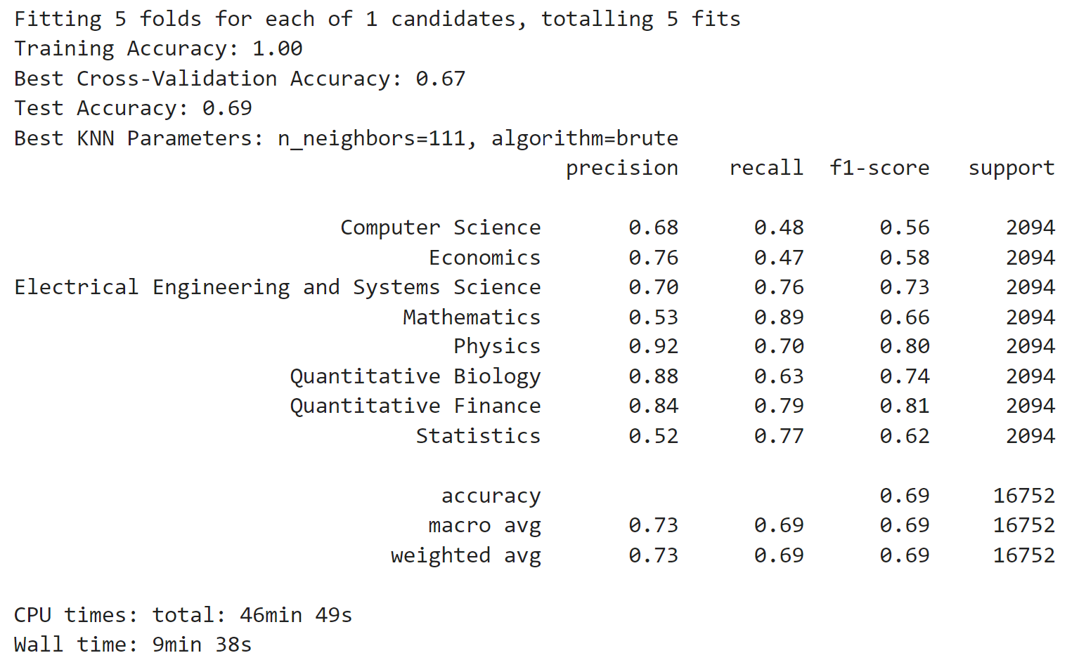
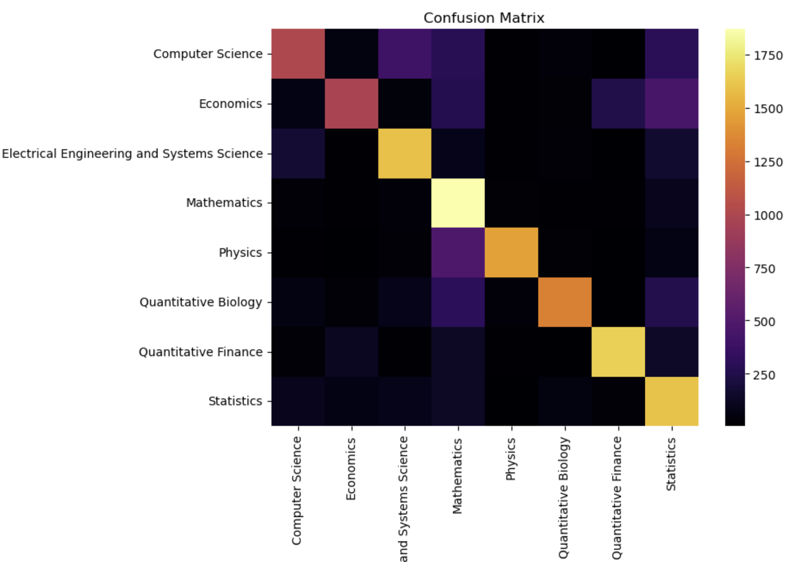
K-Nearest Neighbors
k neighbors

Slide 8
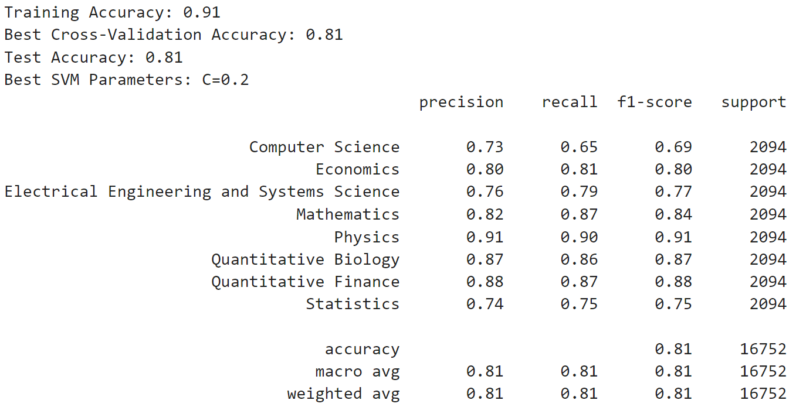
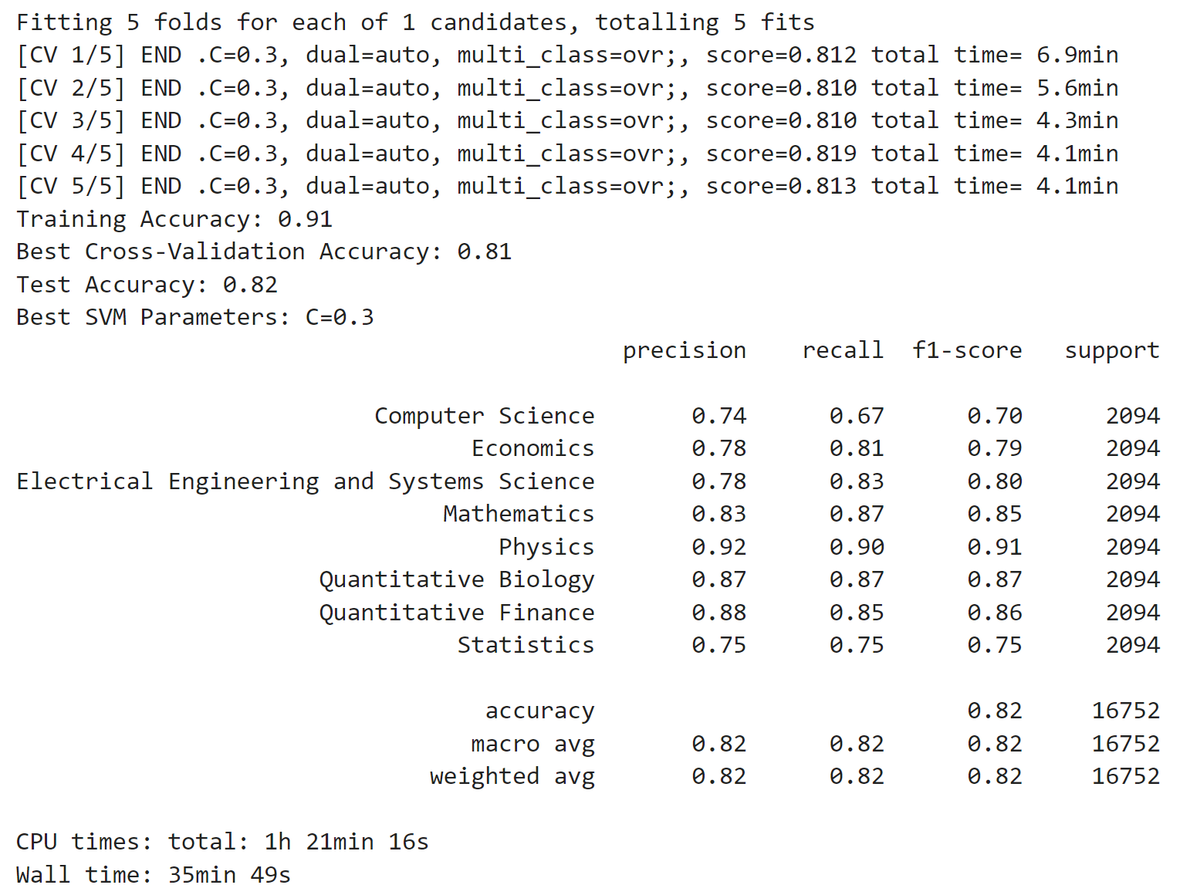
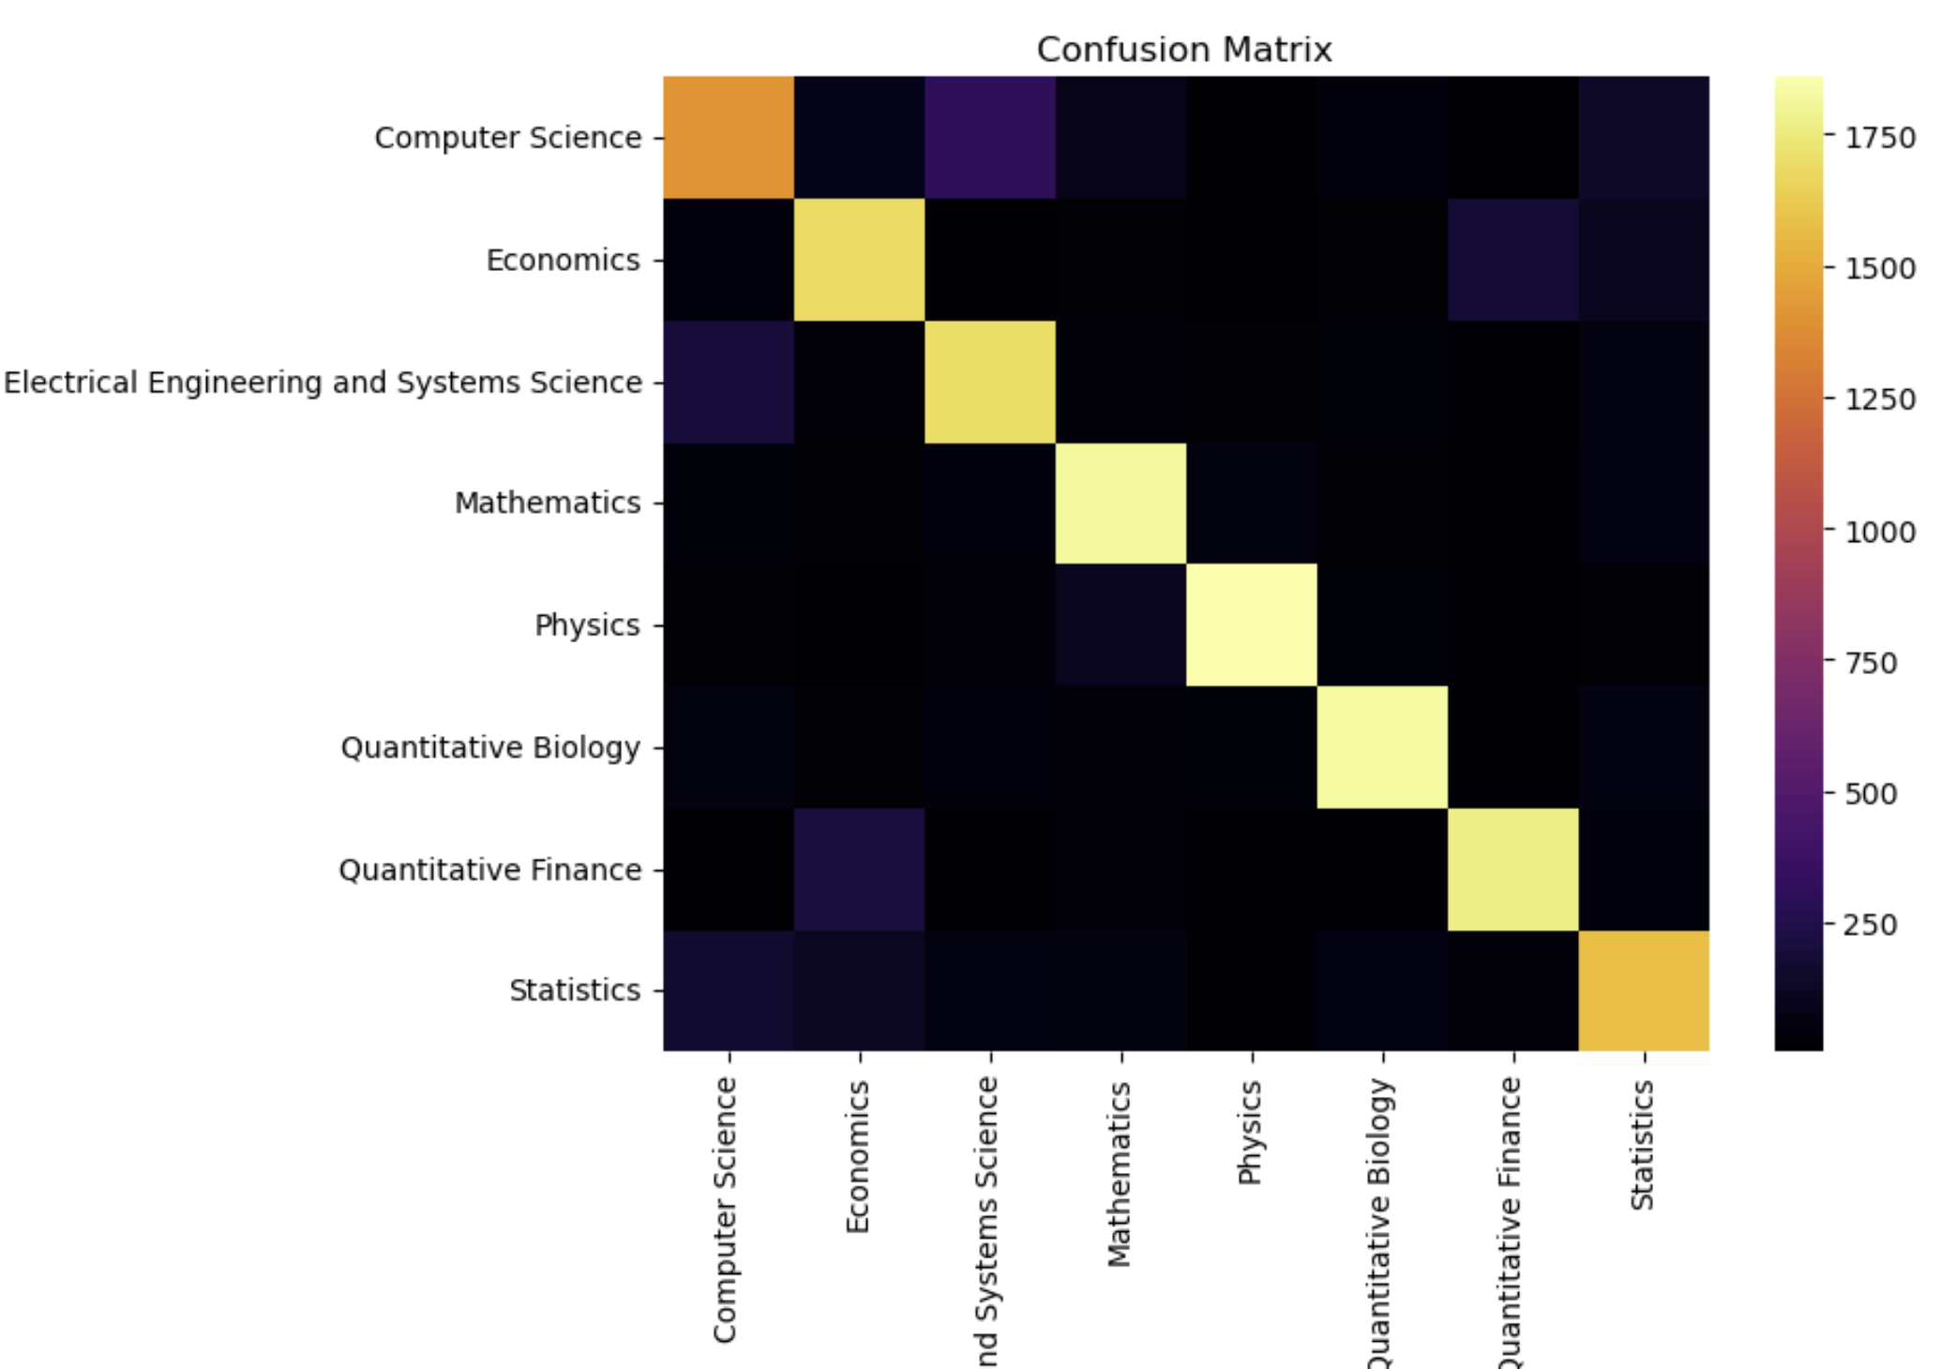
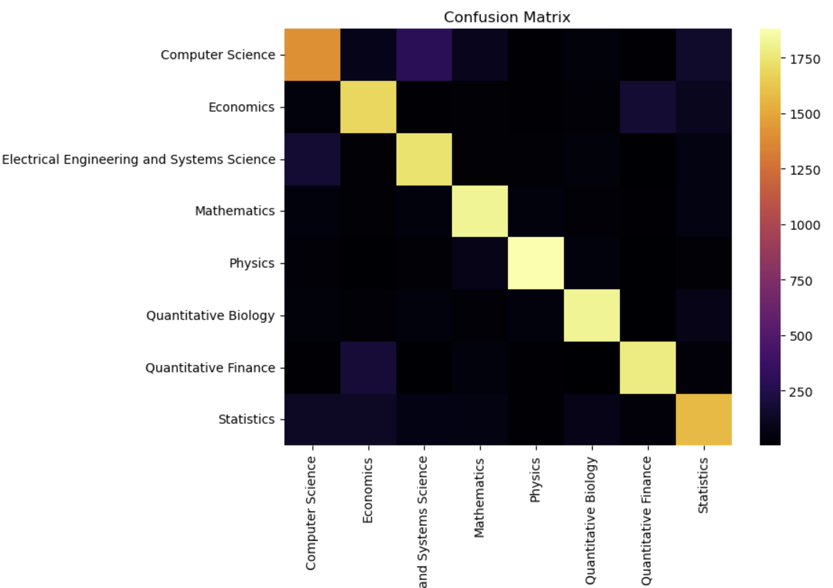
Support Vector Machines
C

Slide 9
Singular Value Decomposition

Slide 10
Conclusion
space complexity
time complexity
traditional techniques

