Slide 1

Domain Adaptation for Person Re-identification on New Unlabeled Data
Overview Objective Related Work Proposed Method Experimental Results Conclusions
Tiago de C. G. Pereira and Teo de Campos
Universidade de Brasília
February 28, 2020
The authors would like to thanks:
FAPDF (fap.df.gov.br)
CNPq grant PQ 314154/2018-3 (cnpq.br)
Domain Adaptation for Person Re-identification on New Unlabeled Data

Slide 2
Schedule
Overview Objective Related Work Proposed Method Experimental Results Conclusions
Overview
Objective
Related Work
Proposed Method
Direct Transfer
CycleGAN
Pseudo labels
Experimental Results
CycleGAN
Pseudo labels
Conclusions and Future Works
Tiago Pereira and Teofilo de Campos UnB February 28, 2020
Domain Adaptation for Person Re-identification on New Unlabeled Data
2 / 16

Slide 3






Overview
Overview Objective Related Work Proposed Method Experimental Results Conclusions
The purpose of person re-identification is to match images of persons in non-overlapping cameras views.
In person re-identification, each dataset or network of cameras is a domain.
Figure 1: Example from Market 1501 [1] dataset
Tiago Pereira and Teofilo de Campos UnB February 28, 2020
Domain Adaptation for Person Re-identification on New Unlabeled Data
3 / 16

Slide 4
Objective
Overview Objective Related Work Proposed Method Experimental Results Conclusions
Our objective is to improve person re-identification performance on new datasets without the need of labeling it.
Tiago Pereira and Teofilo de Campos UnB February 28, 2020
Domain Adaptation for Person Re-identification on New Unlabeled Data
4 / 16

Slide 5
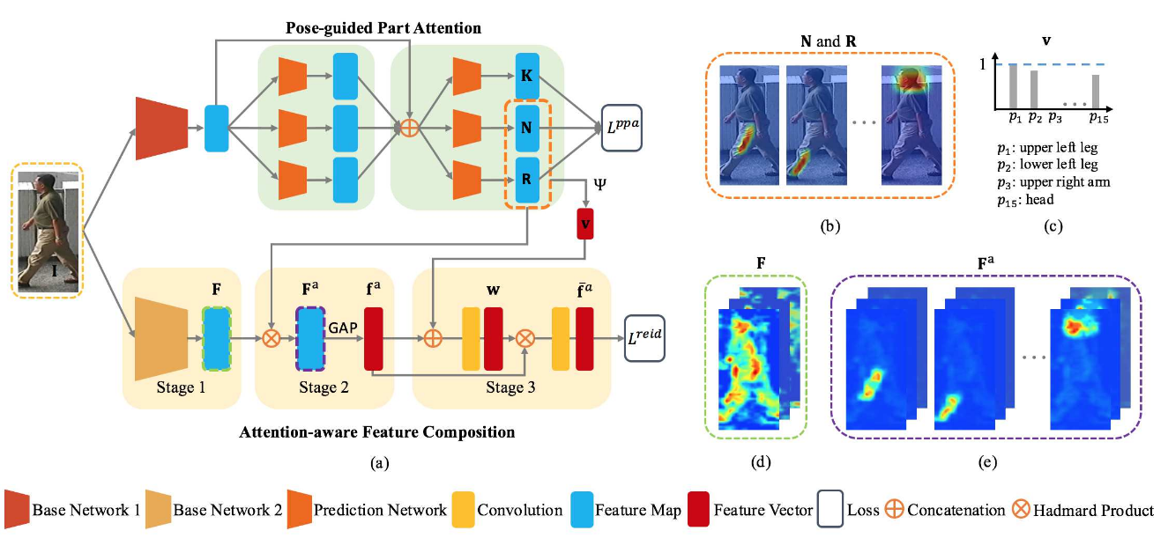
Related Work
Overview Objective Related Work Proposed Method Experimental Results Conclusions
The state-of-art on person re-identification uses either:
Attention-based neural networks [2]
Factorization neural networks [3]
Body parts detection [4]
Tiago Pereira and Teofilo de Campos UnB February 28, 2020
Domain Adaptation for Person Re-identification on New Unlabeled Data
5 / 16
Notes:
The common point in these works is trying to disregard the background information.
As our focus is on the exploitation of domain adaptation for this application, we use a relatively simple end-to-end system based on the ResNet-50 [5], so we can design more controlled experiments.

Slide 6
Related Work
Overview Objective Related Work Proposed Method Experimental Results Conclusions
The person re-identification challenge can be approached as:
metric learning task [4][5]
classification task [2][3]
Tiago Pereira and Teofilo de Campos UnB February 28, 2020
Domain Adaptation for Person Re-identification on New Unlabeled Data
6 / 16
Notes:
Our target application is public spaces, then it is not possible to restrict the set of labels. Therefore we approach this as a metric learning challenge.
Further to being applicable to public spaces, the task of comparing samples is the same across different domains. This enables the application of unsupervised domain adaptation methods to adapt the marginal distribution of the data.

Slide 7
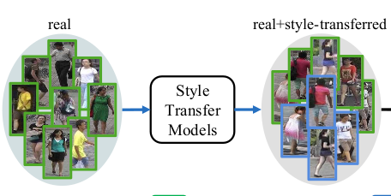
Related Work
Overview Objective Related Work Proposed Method Experimental Results Conclusions
Domain adaptation techniques for person re-identification:
Direct transfer [4]
Camera style adaptation [6]
Domain guided dropout [7]
Tiago Pereira and Teofilo de Campos UnB February 28, 2020
Domain Adaptation for Person Re-identification on New Unlabeled Data
7 / 16
Notes:
Xiao et al. [7] trained their CNN with a super dataset created concatenating multiple datasets.
In this work, we consider that the target domains have no labeled data, then we cannot use the approaches of Zhong et al. [7] or Xiao et al. [8].
The approach of Zhao et al. [6] can be called direct transfer, because it just evaluates a CNN on a target domain. We shall demonstrate that our method outperforms direct transfer.

Slide 8
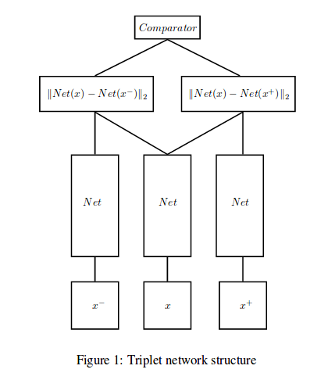
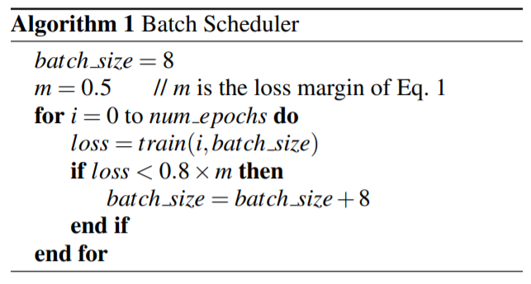
Proposed Method – Direct Transfer [4]
Overview Objective Related Work Proposed Method Experimental Results Conclusions
Our baseline method had the following configurations:
ResNet-50
Pre-trained on ImageNet
Triplet loss with batch hard [8]
Adam optimizer
Batch scheduler
Tiago Pereira and Teofilo de Campos UnB February 28, 2020
Domain Adaptation for Person Re-identification on New Unlabeled Data
8 / 16

Slide 9
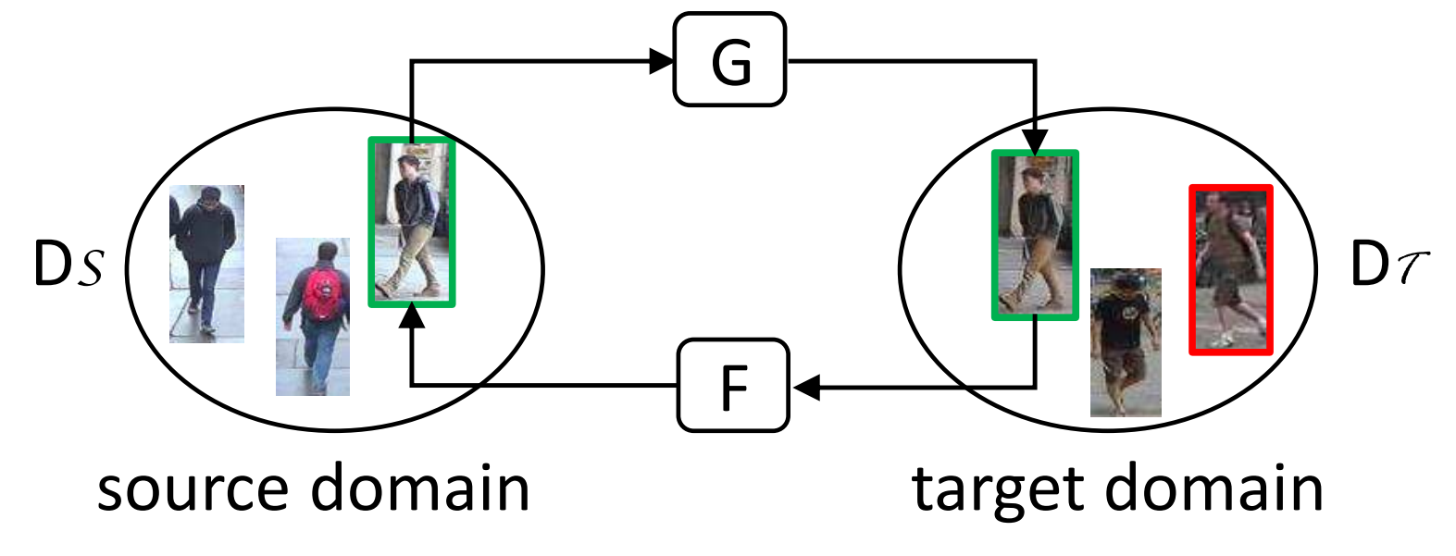
Proposed Method – CycleGAN [5]
Overview Objective Related Work Proposed Method Experimental Results Conclusions
Train CycleGAN [9] with images from source and target domain
Fine Tune the CNN using the intermediate dataset
Generate Intermediate Dataset
Tiago Pereira and Teofilo de Campos UnB February 28, 2020
Domain Adaptation for Person Re-identification on New Unlabeled Data
9 / 16

Slide 10
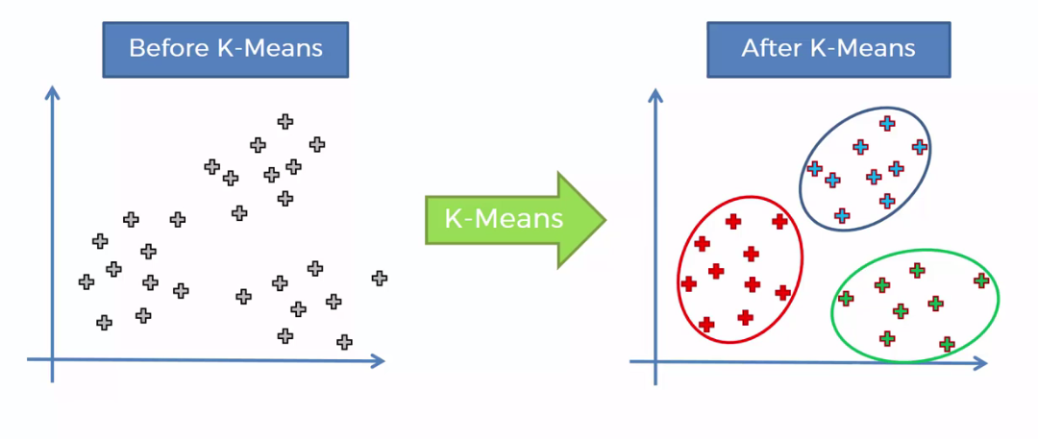
Proposed Method – Pseudo label
Overview Objective Related Work Proposed Method Experimental Results Conclusions
Extract Features from target domain images
Generate a pseudo labelled dataset with the grouped features
Group these features using k-means [10]
Fine Tune the CNN using the pseudo labelled dataset
Tiago Pereira and Teofilo de Campos UnB February 28, 2020
Domain Adaptation for Person Re-identification on New Unlabeled Data
10 / 16

Slide 11
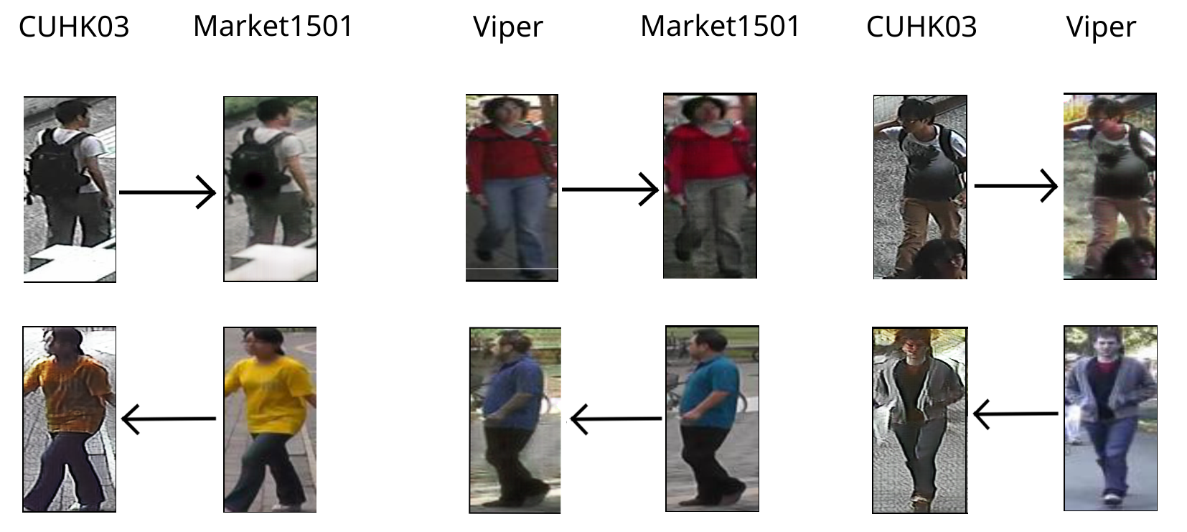
Experimental Results - CycleGAN
Overview Objective Related Work Proposed Method Experimental Results Conclusions
Tiago Pereira and Teofilo de Campos UnB February 28, 2020
Domain Adaptation for Person Re-identification on New Unlabeled Data
11 / 16

Slide 12
Experimental Results - CycleGAN
Overview Objective Related Work Proposed Method Experimental Results Conclusions
 |  |  | Accuracy (CMC scores)
Target Domain | Source Domain | Method | Rank – 1 | Rank - 5 | Rank - 10
Market 1501 | Viper | Direct Transfer | 5.7% | 15.5% | 22.2%
 |  | CycleGAN | 6.7% | 17.0% | 23.7%
 | CUHK 03 | Direct Transfer | 26.8% | 45.9% | 55.1%
 |  | CycleGAN | 35.8% | 56.5% | 65.7%
CUHK 03 | Viper | Direct Transfer | 5.9% | 18.1% | 29.0%
 |  | CycleGAN | 31.9% | 64.4% | 77.5%
 | Market 1501 | Direct Transfer | 19.9% | 49.4% | 63.2%
 |  | CycleGAN | 34.8% | 66.7% | 79.1%
Viper | CUHK 03 | Direct Transfer | 10.1% | 22.5% | 29.0%
 |  | CycleGAN | 11.6% | 25.5% | 34.7%
 | Market 1501 | Direct Transfer | 12.5% | 25.0% | 33.1%
 |  | CycleGAN | 9.8% | 26.9% | 36.4%
Tiago Pereira and Teofilo de Campos UnB February 28, 2020
Domain Adaptation for Person Re-identification on New Unlabeled Data
12 / 16

Slide 13
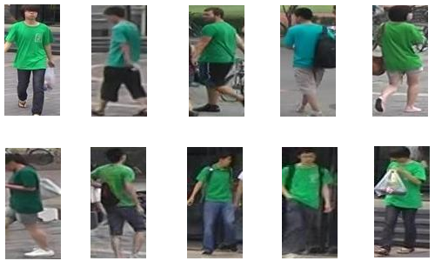
Experimental Results - Pseudo labels
Overview Objective Related Work Proposed Method Experimental Results Conclusions
Tiago Pereira and Teofilo de Campos UnB February 28, 2020
Domain Adaptation for Person Re-identification on New Unlabeled Data
13 / 16

Slide 14
Experimental Results - Pseudo labels
Overview Objective Related Work Proposed Method Experimental Results Conclusions
 |  |  | Accuracy (CMC scores)
Target Domain | Source Domain | Method | Rank – 1 | Rank - 5 | Rank - 10
Market 1501 | Viper | Direct Transfer | 5.7% | 15.5% | 22.2%
 |  | CycleGAN | 6.7% | 17.0% | 23.7%
 |  | Ours | 8.6% | 20.5% | 28.4%
 | CUHK 03 | Direct Transfer | 26.8% | 45.9% | 55.1%
 |  | CycleGAN | 35.8% | 56.5% | 65.7%
 |  | Ours | 37.3% | 60.4% | 70.4%
CUHK 03 | Viper | Direct Transfer | 5.9% | 18.1% | 29.0%
 |  | CycleGAN | 31.9% | 64.4% | 77.5%
 |  | Ours | 36.1% | 69.2% | 81.3%
 | Market 1501 | Direct Transfer | 19.9% | 49.4% | 63.2%
 |  | CycleGAN | 34.8% | 66.7% | 79.1%
 |  | Ours | 38.2% | 69.7% | 81.6%
Viper | CUHK 03 | Direct Transfer | 10.1% | 22.5% | 29.0%
 |  | CycleGAN | 11.6% | 25.5% | 34.7%
 |  | Ours | 13.6% | 33.9% | 46.0%
 | Market 1501 | Direct Transfer | 12.5% | 25.0% | 33.1%
 |  | CycleGAN | 9.8% | 26.9% | 36.4%
 |  | Ours | 13.9% | 29.0% | 40.7%
Tiago Pereira and Teofilo de Campos UnB February 28, 2020
Domain Adaptation for Person Re-identification on New Unlabeled Data
14 / 16

Slide 15
Conclusions and Future Works
Overview Objective Related Work Proposed Method Experimental Results Conclusions
Conclusions:
Pseudo-labels lead to a significant boost in the performance
Batch scheduler plays a crucial role in triplet loss training in noisy datasets
The presented domain adaptation workflow is a great jump start for the deployment of person re-ID software in real applications
Future works:
Re-apply the pseudo-labels method in an iterative manner
Experiment other clustering algorithms to generate pseudo-labels
Tiago Pereira and Teofilo de Campos UnB February 28, 2020
Domain Adaptation for Person Re-identification on New Unlabeled Data
15 / 16
Notes:
This opens doors for the deployment of person re-ID software to real applications, as it completely removes the burden of annotating new data.

Slide 16
Overview Objective Related Work Proposed Method Experimental Results Conclusions
Thank You!
Tiago Pereira and Teofilo de Campos UnB February 28, 2020
Domain Adaptation for Person Re-identification on New Unlabeled Data

