Slide 1

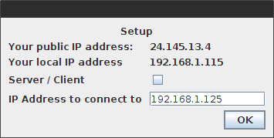
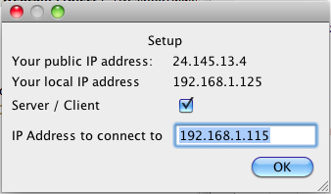
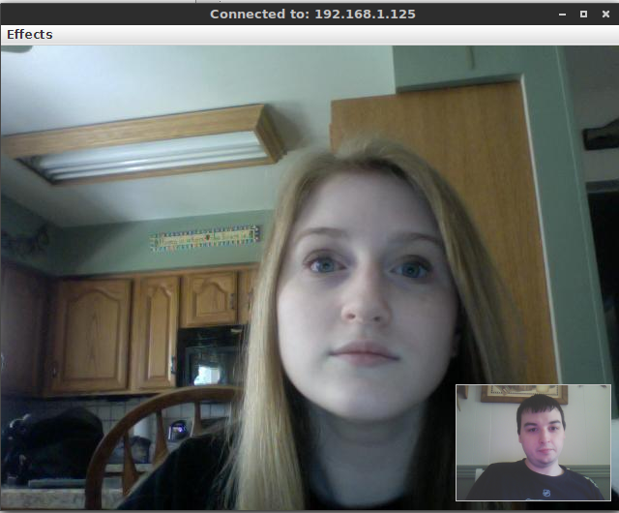
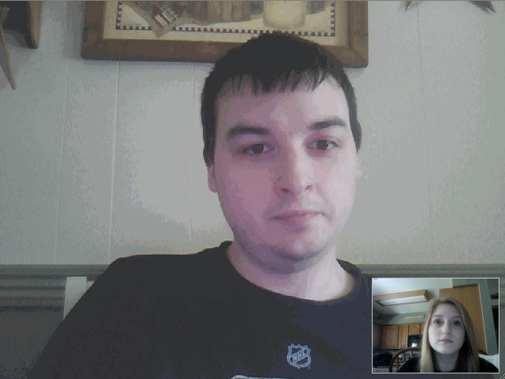
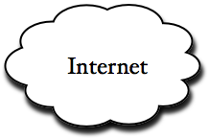
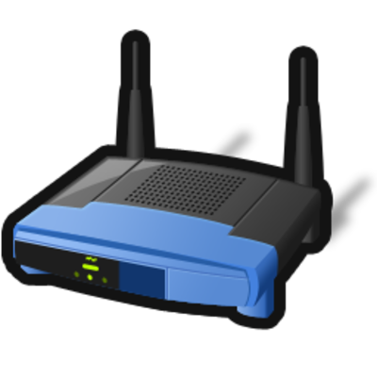
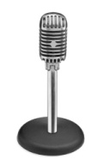

Yet Another Webcam Application
A small and lightweight point-to-point video conferencing streamer made with Java
Developed by Travis O’Donnell
Dr. Xunyu Pan
Department of Computer Science and Information Technologies, Frostburg State University, Frostburg, MD 21532
There is no doubt we live in a technology driven world today. We are capable of being a long distance away from another party, but yet able to communicate with them as if they were with you. Companies such as Google and Skype do a great job at video conferencing, but run off of an older Client/Server network model. The proposed software, "Yet Another Webcam Application," is to create a minimal, cross platform, service for on the go point-to-point webcam application. Unlike Google and Skype's Client/Server model where your webcam and audio stream goes through their server before being sent to another user, the point-to-point model directly connects two nodes over the network. The goal is to create a simplistic and possibly quicker way for people to be able to video chat with each other across the Internet. The software is to be able to run cross platform as long as Java Runtime Environment version >= 1.6 and OpenCV version >= 2.4.0 is installed on the clients computer.
Method
Results
Abstract
Structure
The project is ran by a data structure called Main Interface. The data structure is initialized by running a separate class called Setup. The setup class is a separate graphical user interface that notifies the user of their local/public IP addresses, as well as two input forms that tell the program if the user is to be the server/client and the IP address to connect to. To obtain the users local IP address, an external application is called based on the operating system that is being used such as “ipconfig”, “ifconfig” or “ip.” A data structure found in the “java.net” package, called URL, is used to fetch text off of a website containing the public IP address. Depending on whether the user selected to be the server or client, one of two classes are then called to help connect everything together. The two classes, Server and Client, are structured exactly the same except for how the UDP and TCP connections are dealt with. Inside these data structures are 4 separate threads that get executed to allow internal classes to be executed simultaneously.
The application was tested on the following environments:
Arch Linux (x86-64)
Intel Core i7-2630QM @ 2.00 GHz
4 GB memory
OpenJDK version 1.7.0_51
Microsoft Windows 7 (Virtual Box)
Intel Core i7-2630QM @ 2.00 GHz
1.5 GB memory
Oracle Java 1.7
Apple Mac 10.5
Intel Core Duo @ 2.00 GHz
2 GB memory
Oracle Java 1.6.0_1
Microsoft Windows Vista
Intel Quad Core @ 2.3 GHz
4 GB memory
Oracle Java 1.7
While testing the application, we were looking to see how the application help up after extensive usage of time and if everything was working as it should within each environment. One major bug that we found and could not fix was while the Apple Mac 10.5 was being tested with any of the other environments, the sound coming from the speakers was complete static. This may or may not be a bug within this application rather than just the way the Java Virtual Machine gets ran on OS X 10.5. Each testing session lasted approximately 45 minutes by using a local area network.
During each session frame stabilization, sound synchronization and overall performance was noted. Frames were captured from the machine at a rate of 30 frames per second and sent out via the UDP protocol, however frame playback was not an even 30 frames per second, rather than play once received. Nonetheless, it was not to noticeable besides some minor stalling every now and again. Because of this, the sound was never actually synchronized with the video fully, but it was never implemented to be so.
Webcam
The Webcam class uses a data structure found in OpenCV called openCVFrameGrabber. This structure captures frames from the user’s webcam of 640x480 pixels at a rate of 15 frames per second. Depending on if the user specified an “Effect” to the frame, it can be converted to a gray scale image or rotated 90, 180, or 270 degrees. After this process is done, the frame is converted from an OpenCV IplImage data structure to send out via a UDP datagram packet.
FrameReceiver
Each frame that is received from a peer is handled by the UDP protocol. The class is made
up of many different data structures such as DatagramPacket, ByteArrayInputStream, and
BufferedImage. A buffer is used to store bytes of incoming UDP packets. Each received packet
ran through the ByteArrayInputStream data structure, allowing the bytes to be converted back
into the Image class. A boolean value is set to to let our Client/Server class know a frame is
ready to be displayed.
Microphone
Unlike using the UDP protocol for the Webcam and FrameRecevier classes, the microphone class used the TCP protocol. The TCP protocol makes sure that each packet is delivered in order and delivered with no corruption to the packets. Audio is captured from the users microphone at a sample rate of 44,100Hz, using the DataLine class found within the javax.sound package. After the sound is digitalized, it is sent to the internet by using a data structure in java called BufferedOutputStream.
AudioReceiver
The final class uses the TCP protocol to retrieve incoming packets containing data for the audio. Data structures used within the AudioReceiver class are DataLine and SourceDataLine, both of which are found within the sound package of Javax.
Introduction
To accomplish this project, “Yet Another Webcam Application” uses JavaCV, which provides wrappers to libraries used in the field of computer vision. Such wrappers include OpenCV and Ffmpeg. The application uses both the User Datagram Protocol (UDP) and the Transmission Control Protocol (TCP) to send and receive packets between clients. Image frames captured from a client’s webcam are sent through the UDP protocol. Since UDP does not ensure packets delivered in order, each packet contains a timestamp for the receiver to keep track and remove old packets that were supposed to be received at a previous time. Audio segments captured from a client’s microphone are sent out through TCP in order to ensure that no packets gets lost or corrupted. The application runs cross platform as long as Java Runtime Environment >= 1.6 and OpenCV >= 2.4.0 is installed on the client’s computer.
Background
In “Yet Another Webcam Application,” we take advantage of the JavaCV libraries. The creator of JavaCV, Samuel Audet, has ported libraries found in OpenCV into libraries to use with Java[4]. The software uses JavaCV to easily gather data from the users webcam and hold it into a buffer until needed for transmission.
The software captures and sends frames captured from the webcam at a rate of 30 frames per seconds. Each frame is a resolution of 640x480 pixels and compressed into a JPeG image type by using the ImageIO data structure. Sending frames at a rate of 15 frames per seconds, it isn’t noticeable to the human eye if one of the frames doesn’t show up to the receiver correctly or shows up out of order. UDP also allows for fast transmissions over TCP due to its continuous packet stream[1].
Because the TCP protocol ensures each packet is delivered in order and without any corruption to the packets, I decided it is probably best to use it to send and receive packets containing audio data. Audio will be captured at 44,100 HZ, which should have no troubles being transmitted with todays internet download/upload speeds.
The graphical user interface for “Yet Another Webcam Application” is to semi-replicate other popular webcam streaming services such as Skype and Apple’s Face Time. The screen is 640x480 pixels, which is the size of the frame the webcam captures. On the bottom right corner of the window is a preview frame that shows a scaled down version of what is being captured from your own webcam.
Conclusion
The application has met the minimal specifications that was laid out in February. In the future, we would like change a lot of things with the application that we did not have time to do before the due date. First of all, we would like to port the application to the programming language C++. Porting the application to C++ would require more testing and the use of OpenCV rather than JavaCV. One of the main reasons behind the wanting to switch is due to the sluggishness behind Java. When a program starts in Java, it does not run directly off of the operating system; instead, it runs off of a virtual machine called the Java Virtual Machine. Since it has to run a virtual machine just to execute the program, it uses extra resources that other programming languages do not. Another direction we would like to take “Yet Another Webcam Application” is to use JavaCV and develop an Android application capable of doing the same thing the current program does. In the original project proposal we had indented on being able to complete the Android application by the end of this project, but time had ran short.
“Yet Another Webcam Application” has the potential to grow in multiple directions. One way would hope to take the application is to not only be able to stream images captured from a client’s webcam, but to be able to stream images of the client’s desktop. With the backbone of transmitting packets containing image data, a VNC remote accessible desktop would be highly possible.
It is our intention to keep on developing code for this application after the semester is over. Given more time with “Yet Another Webcam Application”, we can fix bugs and expand with more content.
Setup dialogs
References
References
[1] J. Kurose, K. Ross , Computer Networking A Top-Down Approach, : Addison-Wesley, 2012
[2] Z. Li, M. Drew , Fundamentals of Multimedia, : Pearson, 2004
[3] A. Silberschatz, P. Galvin, G. Gagne , Operating System Concepts Essentials, : Wiley, 2011
[4]Java interface to OpenCV and more. “JavaCV.”, [Feb-Apr 2014].
Internet: https://code.google.com/p/javacv/, [2014]
TCP connection
Port 38107
Audio Data
UDP Connection
Incoming Port 18107
Outgoing Port 28107
Image Frames
TCP connection
Port 38107
Audio Data
Software Developer:
Travis O’Donnell
Software Testers:
Travis O’Donnell
Kiersten O’Donnell
Documentation:
Travis O’Donnell (Writer)
Kiersten O’Donnell (Editor)
Dr. Xunyu Pan (Editor)
Special thanks to Dr. Xunyu Pan for allowing me this opportunity
UDP Connection
Incoming Port 28107
Outgoing Port 18107
Image Frames
User interface during chat session

