Slide 1
Image Captioning
Authors :Teodor-Mihai Cotet
Theodor Stoican

Slide 2
Problem definition
describing an image with a sentence
at the intersection of NLP and CV
it concerns what we understand about perception with respect to machines
very similar to machine translation (a different description of the subject of encoding)

Slide 3
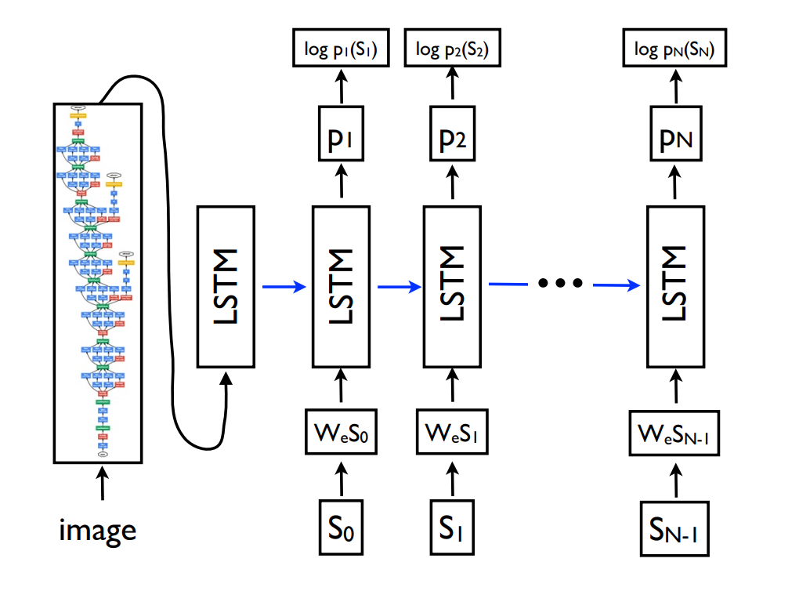
Architecture
We had as support a standard reference in captioning (a paper from Google):
[1] Vinyals, Oriol, et al. "Show and tell: A neural image caption generator." Proceedings of the IEEE conference on computer vision and pattern recognition. 2015.
VGG16 as encoder
LSTM-based decoder
char embeddigs vs word embeddings
(syntax vs morphology of language)

Slide 4
Implementation
Keras with TF backend
trained in Google Cloud
Dataset: Flickr8k
Encoder:
pretrained VGG16 weights on ImageNet
an additional Dense layer to generate an emedding for the image (300-element feature vector)

Slide 5
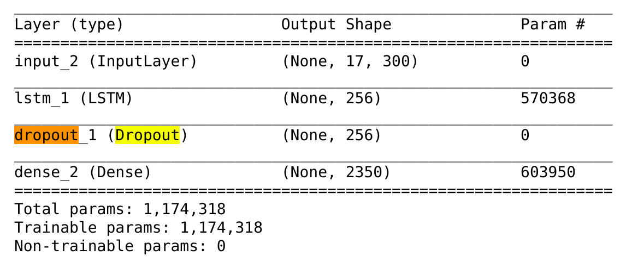
Implementation(cont.)
Decoder:
Vocabulary size:2350
LSTM cell:256 units

Slide 6
Metrics
difficult to measure text generation -> similar to machine translation
ranking descriptions for the same image
BLEU-n metric (aprox. human scoring)
human scoring (costly)

Slide 7
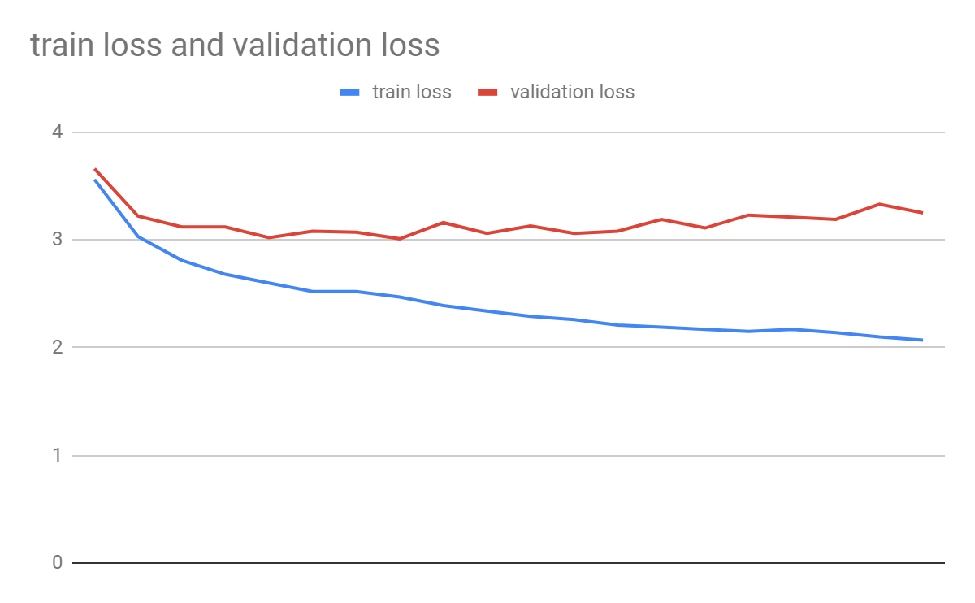
Results (20 epochs train)

Slide 8
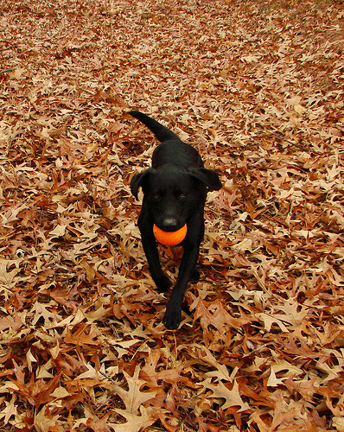
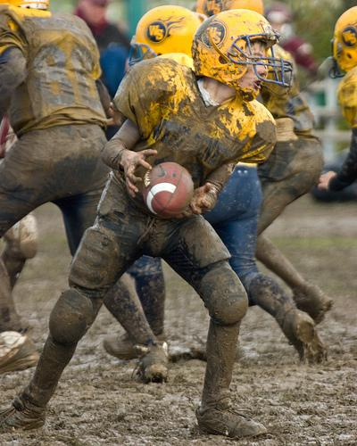
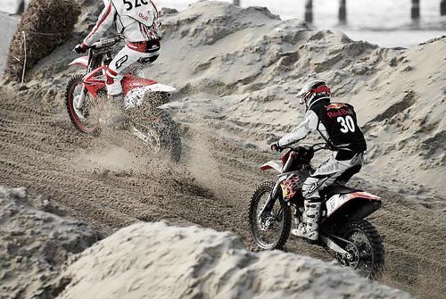
Results - 1st epoch
<start> boy in a red shirt be run on a <end>
<start>boy in a red shirt be run on a beach <end>
<start> child be play in a pool <end>

Slide 9
Results - 7th epoch
<start> man and a woman be play a game <end>
<start> man in a red shirt and a black and white dog be stand in the grass <end>
<start> person be ride a bike in the snow <end>

Slide 10
Results - 12th epoch
<start> football player in red be tackle a player in red and white <end>
<start> dog be play in the grass <end>
<start> person wear a red helmet be ride a bike down a snowy hill <end>

Slide 11
References
[1] Vinyals, Oriol, et al. "Show and tell: A neural image caption generator." Proceedings of the IEEE conference on computer vision and pattern recognition. 2015.
[2] You, Quanzeng, et al. "Image captioning with semantic attention." Proceedings of the IEEE conference on computer vision and pattern recognition. 2016.

