Slide 1


Trilaterales Transferprojekt DFG - Fraunhofer

Slide 2

Allocation and Pricing in Electricity Markets

Slide 3
Deliverables
Simulator that allows running simulations with different pricing rules, different relaxations of the ACOPF, and different data sets on realistic problem sizes.
Which optimization models best approximate the underlying AC optimal power-flow problem and allow for the computation of realistic problem sizes?
Which pricing rules best achieve design desiderata, such as low side-payments, adequate congestions signals, and low lost opportunity costs?

Slide 4
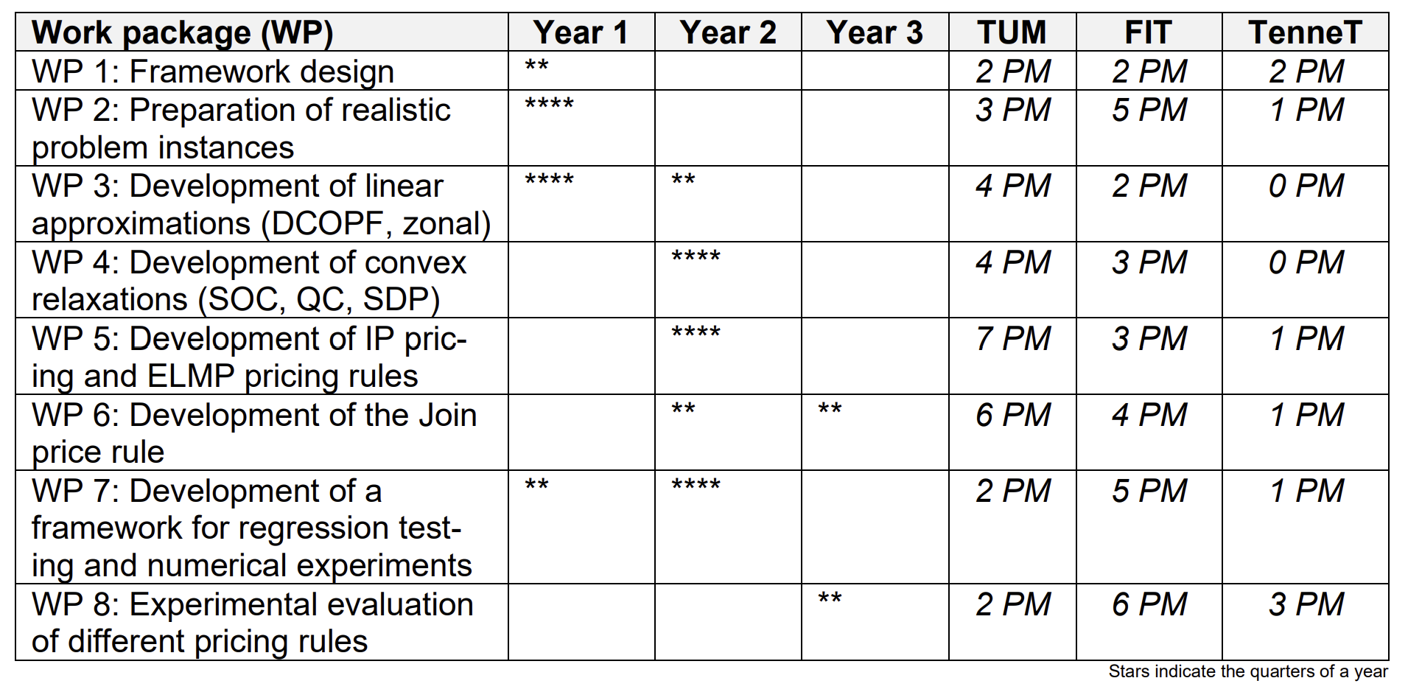
Collaboration Between TUM, FIT and Tennet

Slide 5
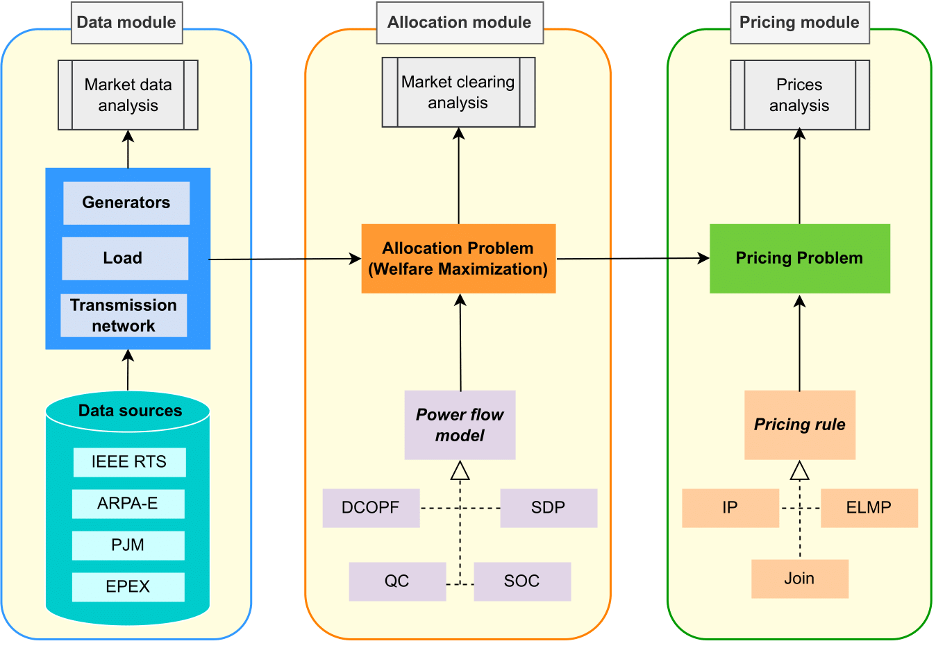
Framework Design

Slide 6
Other Topics
Programming language
Python
PyJulia
Open-source license
MIT
BSD (like PowerModels.jl)
GNU General Public License

Slide 7
Other slides

Slide 8
Programming Language & Software Design
PyJulia is the Python package to access Julia from Python – integrate functionalities provided in the PowerModels.jl package.
OOP design
Strategy design pattern:
strategies for computing power flow approximations
strategies for solving the pricing problem

Slide 9
MIT License
Users can use the software without any restrictions.
Users can modify the source code (e.g., adding new features, fixing bugs, etc.).
Users can distribute the software and their modifications under the same MIT license terms. That is, the modified versions can be distributed freely, there is no requirement to distribute the source code without the modifications.
Users cannot hold the original authors or contributors liable for any damages/issues arising from the use of the software (no warranty).
It requires that the original copyright notice and the disclaimer must be included in all copies or substantial proportions of the software.
“Permission is hereby granted, free of charge, to any person obtaining a copy of this software and associated documentation files (the "Software"), to deal in the Software without restriction, including without limitation the rights to use, copy, modify, merge, publish, distribute, sublicense, and/or sell copies of the Software, and to permit persons to whom the Software is furnished to do so, subject to the following conditions:
The above copyright notice and this permission notice shall be included in all copies or substantial portions of the Software.”

Slide 10
BSD License - Variants
0-Clause BSD:
“Permission to use, copy, modify, and/or distribute this software for any purpose with or without fee is hereby granted.”
2-Clause BSD (similar to MIT license):
“Redistribution and use in source and binary forms, with or without modification, are permitted provided that the following conditions are met:
1. Redistributions of source code must retain the above copyright notice, this list of conditions and the following disclaimer.
2. Redistributions in binary form must reproduce the above copyright notice, this list of conditions and the following disclaimer in the documentation and/or other materials provided with the distribution.”
3-Clause BSD (used by PowerModels.jl): adds the following clause:
“3. Neither the name of the [organization] nor the names of its contributors may be used to endorse or promote products derived from this software without specific prior written permission.”
4-Clause BSD: adds the following clause:
“4. All advertising materials mentioning features or use of this software must display the following acknowledgement: This product includes software developed by the [organization].”

Slide 11
GNU General Public License
Used to prevent software from becoming proprietary.
Any changes made to the code must be released under the GPL, and any software that uses the code must also be released under the same GPL license (Copyleft).
If a user distributes the software, they must also provide the source code and any changes made to it.
Not compatible with e.g., 3-Clause BSD: if we combine GPL-licensed code with code licensed under an incompatible license, we cannot distribute the resulting combination unless we remove the GPL-licensed code or obtain permission to re-license it.

Slide 12
Open-Source Licenses - Examples
Example MIT license: https://www.mit.edu/~amini/LICENSE.md
Example BSD license: https://github.com/lanl-ansi/PowerModels.jl/blob/master/LICENSE.md
Example GNU General Public License: https://github.com/collective/example.p4p5/blob/master/LICENSE.GPL
Useful links:
https://opensource.stackexchange.com/questions/217/what-are-the-essential-differences-between-the-bsd-and-mit-licences#:~:text=MIT%20applies%20to%20the%20documentation,%22%2C%20no%20mention%20of%20documentation
https://www.quora.com/What-is-the-difference-between-BSD-3-Clause-license-and-GPL-2-0+-license

