Slide 1
APEM Monthly Meeting
12.06.2024

Slide 2
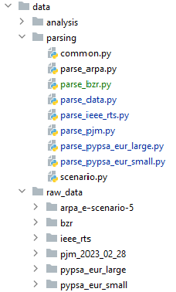
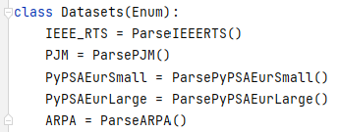
Data module
Notes:
IEEE RTS: done
PJM: data for a specific day (28.02.2023) is parsed – TODO: parse PJM data agnostically; allow user to download the data for a specific day and use the framework to work with it
PyPSAEurSmall: 40-node network & market data for 01.03.2013
PyPSAEurLarge: 328-node network & market data for 01.03.2013
TODO: consider different days
ARPA: one scenario works, TODO: parse scenarios agnostically; allow user to a specific scenario and use the framework to work with it
BZR: TODO

Slide 3
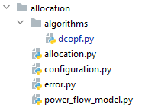

Allocation module
Notes:
DCOPF works for the current data sources

Slide 4
Next steps
Finalize the data module with the current sources
Create documentation for the data module
Automatically using, e.g., Sphinx

