Slide 1
APEM Monthly Meeting
12.09.2024

Slide 2
Agenda
Project updates
Redispatch 3.0, Local flexibility markets, Network tariffs

Slide 3
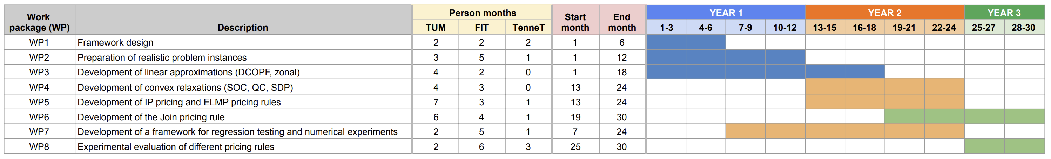
Timeline
We are here

Slide 4
Project updates
EUPHEMIA – openDAM
Pricing rules implementation

Slide 5
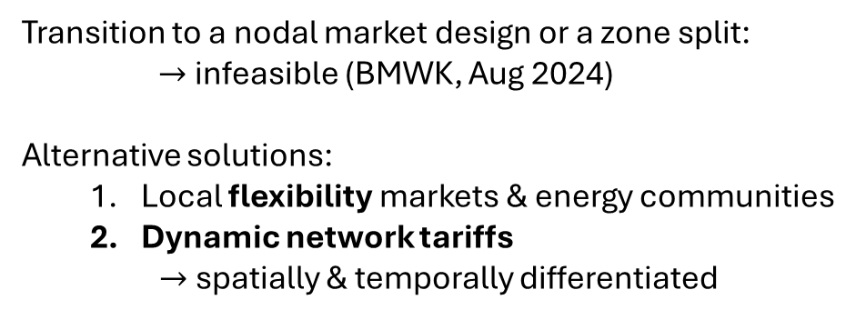
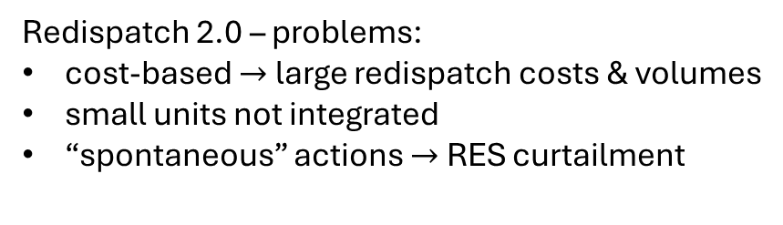
Congestion management
Local incentives
Redispatch 2.0 – problems:
cost-based $→$ large redispatch costs & volumes
small units not integrated
“spontaneous” actions $→$ RES curtailment
Transition to a nodal market design or a zone split:
$→$infeasible (BMWK, Aug 2024)
Alternative solutions:
Local flexibility markets & energy communities
Dynamic network tariffs
$→$spatially & temporally differentiated
Redispatch 3.0:
forecast-based congestion avoidance
market-based
integration of small units
flexibility platforms: GOPACS, enera, etc.
methodology in progress

Slide 6
Redispatch 3.0
Optimization problem
Objective: curtailment minimization? redispatch volume/cost minimization? others?
Initial solution: output from EUPHEMIA?
Scale: national level? TSO control area? smaller area?
Constraints: demand & supply side, network?
Time resolution: solve whenever a congestion event is forecasted?
Small flexible units: integration?
Reward scheme
Marginal costs – RES costs??
Contracts?
Relationship to (local) flexibility markets

Slide 7
Local flexibility markets
Objectives
Participants
Flexibility products
Time frame
Allocation method
Optimization problem?
Auction design?
Reward scheme
Challenges & Solutions
Regulation
Inc-Dec gaming
Implementation
Best design?

Slide 8
Dynamic network tariffs
Current GCD in Germany – low cost-reflectivity
base charge (indep. of the amount of energy used, EUR/year) +
fixed volumetric tariff (dep. on kWh energy used, EUR ct / kWh)
Volumetric tariff - options:
Fixed price for a predefined amount of energy (flat)
Fixed price per unit of energy (fixed)
Price per amount of energy that dep. on ToU
Even-driven price (e.g., Critical Peak Pricing: higher prices in times of load peaks/grid congestion)
Dynamic price
Capacity-based tariff (EUR/kW) - options:
Fixed price for a fixed capacity (flat)
Different price levels for different capacity levels (variable)
Price that dep. on ToU
Europe: shift towards capacity-based tariffs
Notes:
https://publica-rest.fraunhofer.de/server/api/core/bitstreams/98e2ef12-25e9-4778-b087-d0eddfd6b4ba/content

Slide 9
Backup slides

Slide 10
CM: Questions
Congestion event (CE)
Definition: What information is available?
Prediction: Based on what data? Output from EUPHEMIA?
Action time: available time to decide on a congestion management (CM) strategy? Any options or fixed procedure?
Current CM strategy
Cost-based redispatch – concrete definition? Input/initial solution? Time granularity? Fixed optimization problem or dynamic formulation?
What generators can change their “position” (profile, location in the grid, ”distance” to CE)? Fixed set? Agreement with TSO? Any priority or just cost-based optimization?
Demand redispatch?
Reward scheme: Marginal costs? Other?
TSO Coordination
Optimization over the whole market area? TSO control area? Smaller area?

Slide 11
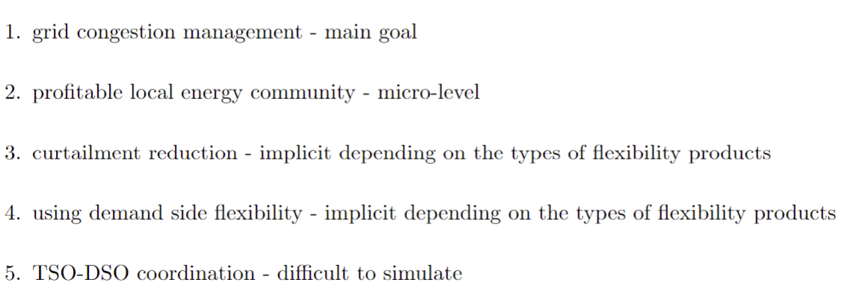
Local flexibility markets
Objectives
Participants
Flexibility products
Time frame
Allocation method
Optimization problem?
Auction design?
Reward scheme
Challenges & Solutions
Regulation
Inc-Dec gaming
Implementation

Slide 12
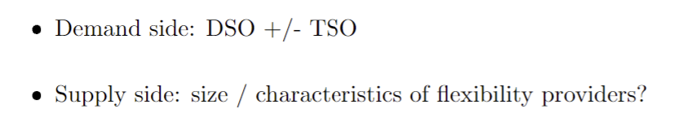
Local flexibility markets
Objectives
Participants
Flexibility products
Time frame
Allocation method
Optimization problem?
Auction design?
Reward scheme
Challenges & Solutions
Regulation
Inc-Dec gaming
Implementation

Slide 13
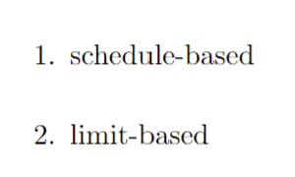
Local flexibility markets
Objectives
Participants
Flexibility products
Time frame
Allocation method
Optimization problem?
Auction design?
Reward scheme
Challenges & Solutions
Regulation
Inc-Dec gaming
Implementation

Slide 14
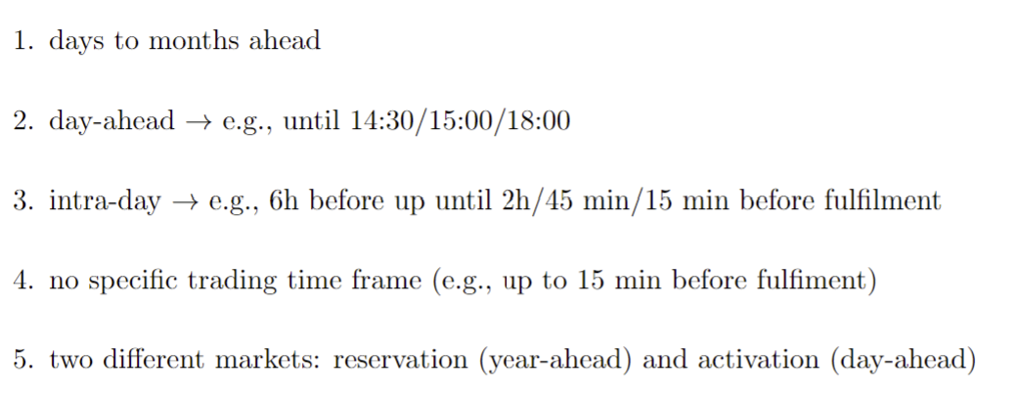
Local flexibility markets
Objectives
Participants
Flexibility products
Time frame
Allocation method
Optimization problem?
Auction design?
Reward scheme
Challenges & Solutions
Regulation
Inc-Dec gaming
Implementation

Slide 15
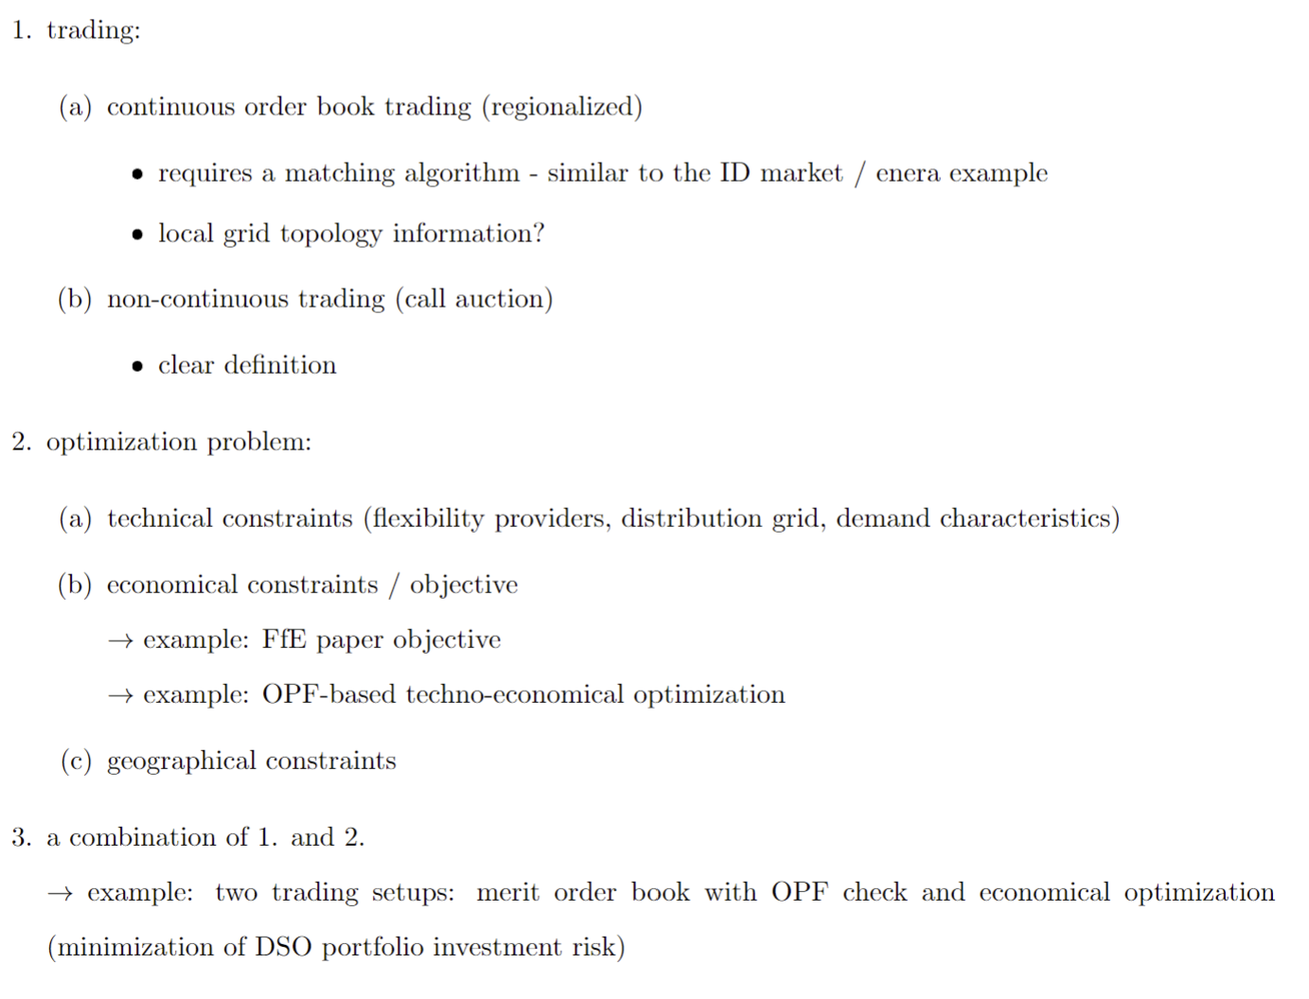
Local flexibility markets
Objectives
Participants
Flexibility products
Time frame
Allocation method
Optimization problem?
Auction design?
Reward scheme
Challenges & Solutions
Regulation
Inc-Dec gaming
Implementation

Slide 16
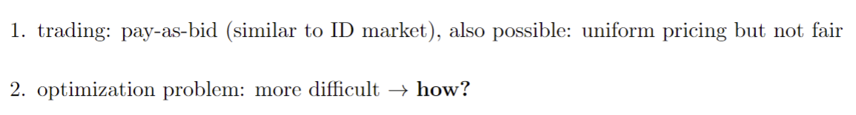
Local flexibility markets
Objectives
Participants
Flexibility products
Time frame
Allocation method
Optimization problem?
Auction design?
Reward scheme
Challenges & Solutions
Regulation
Inc-Dec gaming
Implementation

