Slide 1
APEM Monthly Meeting
15.10.2024

Slide 2
Agenda
Project updates
Network tariffs

Slide 3
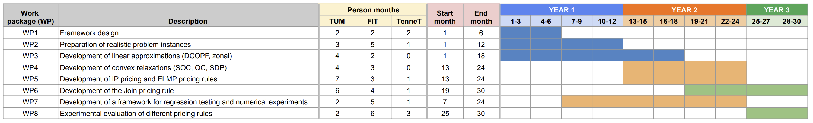
Timeline
We are here

Slide 4
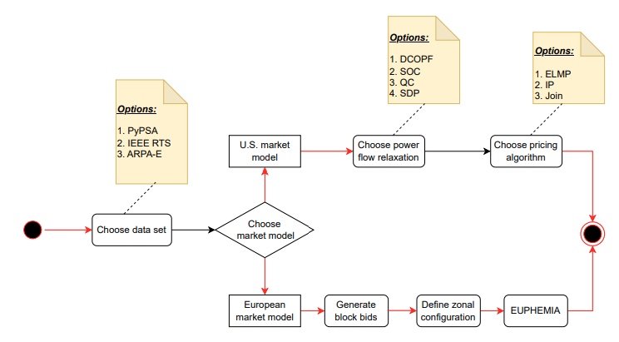

Project updates
Completed
Modeling:
data conversion US $→$ European bidding language
Implementation:
Allocation: DCOPF, NTC
Pricing: IP, ELMP, Join
Initial testing
In progress
Implementation data conversion
EUPHEMIA
Mathematical model based on the public description & openDAM
Basic implementation by the end of the year
Order book
NTC
We are here

Slide 5

Project updates
Completed
Modeling:
data conversion US $→$ European bidding language
Implementation:
Allocation: DCOPF, NTC
Pricing: IP, ELMP, Join
Initial testing
In progress
Implementation data conversion
EUPHEMIA
Mathematical model based on the public description & openDAM
Basic implementation by the end of the year
Order book
NTC
WP7
We are here

Slide 6
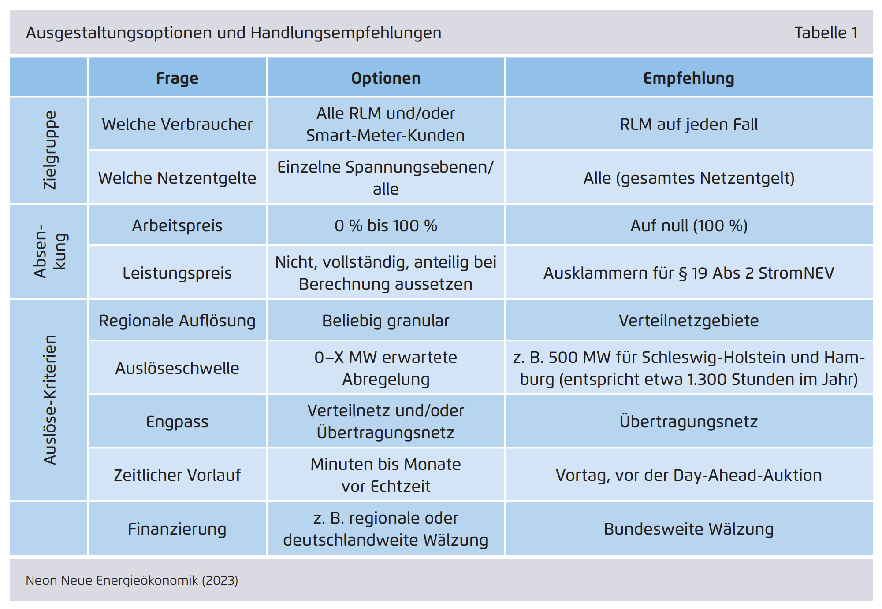
Network tariffs
Current situation
Local & temporal differentiation?
Source: “Windstrom nutzen statt abregeln”, https://neon.energy/Neon-Regionale-Netzentgelte.pdf

