Slide 1
APEM Monthly Meeting
29.11.2024

Slide 2
Agenda
Project updates

Slide 3
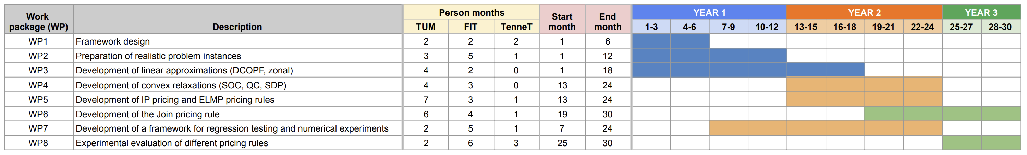
Timeline
We are here

Slide 4
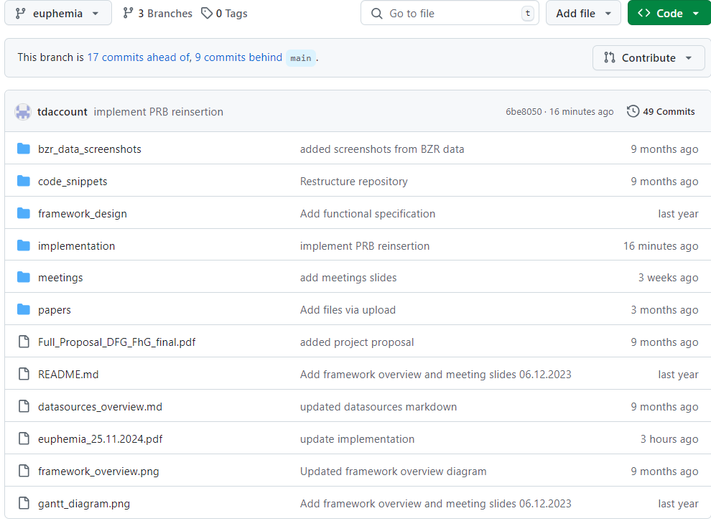
Project updates - EUPHEMIA
Initial implementation
Data generation
Implementation details

Slide 5
Orders
Aggregated periodic orders
Stepwise
Linear piecewise (interpolated)
Hybrid
Complex orders
MIC / MP condition
Load gradient condition
Combination of MIC / MP & load gradient conditions
Scalable complex orders
Block orders
Linked
Exclusive groups
Flexible
Merit orders and PUN orders
Not implemented
MTUs of 15’ and 30’ (only 60’)
Scheduled stop in (scalable) complex orders
Order tie breaking rules
Rules 2-4 for the acceptance of linked block orders

Slide 6
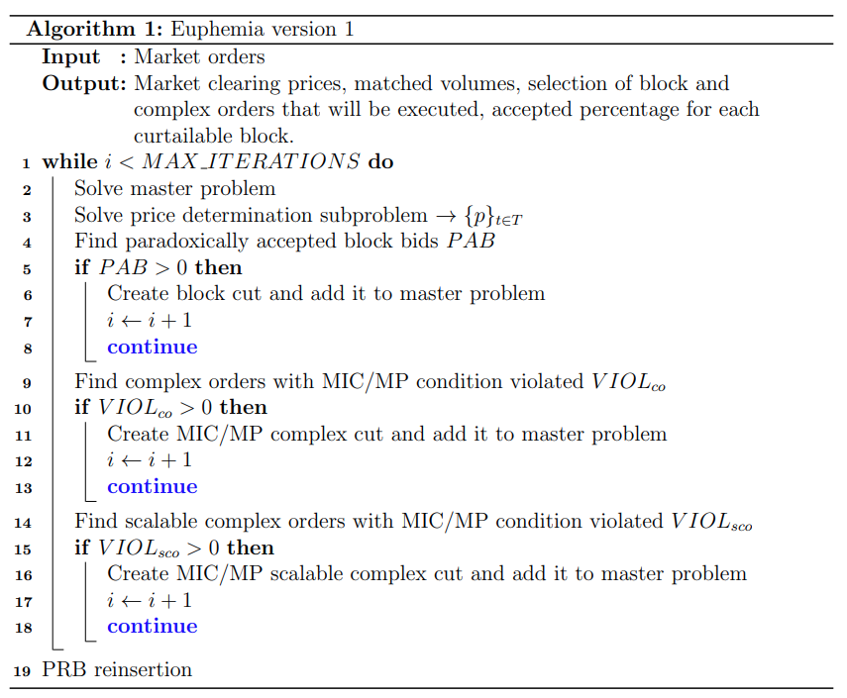

Slide 7
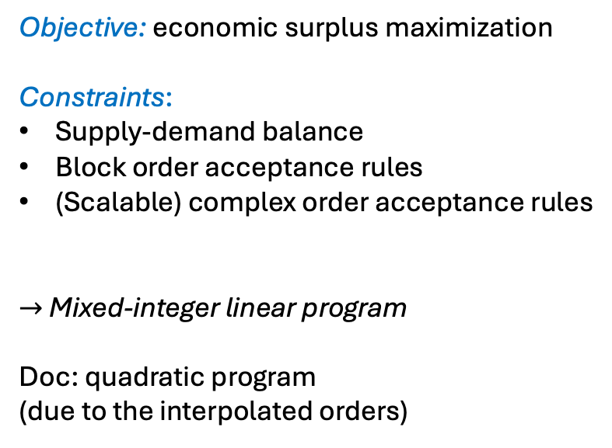
Objective: economic surplus maximization
Constraints:
Supply-demand balance
Block order acceptance rules
(Scalable) complex order acceptance rules
$→$ Mixed-integer linear program
Doc: quadratic program
(due to the interpolated orders)

Slide 8
IP prices for the current master solution
No upper bounds
Doc:

Slide 9
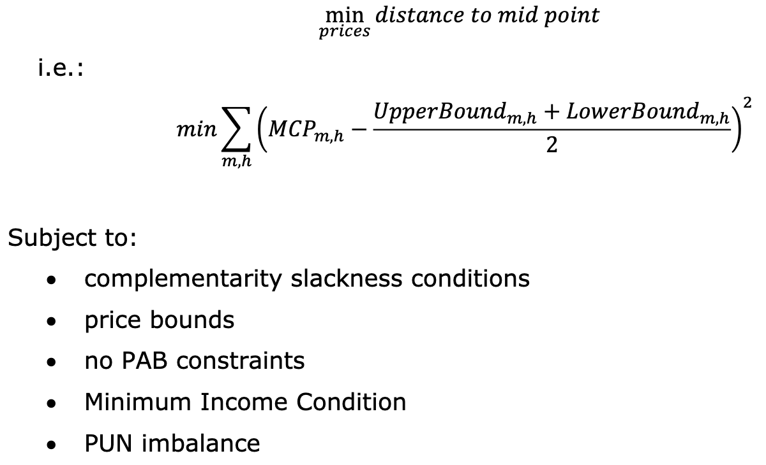
IP prices for the current master solution
No upper bounds
Doc:
TODO

Slide 10
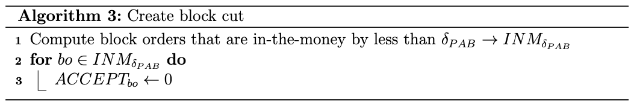
*
*Heuristic as described in Annex B

Slide 11
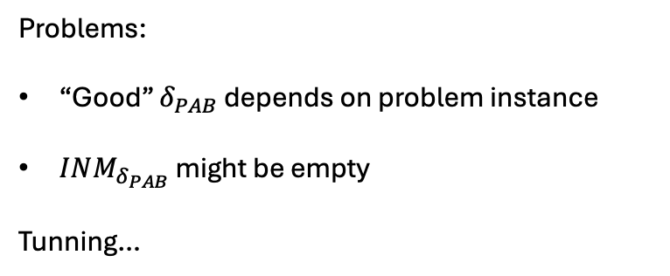
TODO
more cut approaches
*
Problems:
“Good” $δ_{PAB}$ depends on problem instance
$INM_{δ_{PAB}}$ might be empty
Tunning…
*Heuristic as described in Annex B

Slide 12
Similar cut approaches

Slide 13
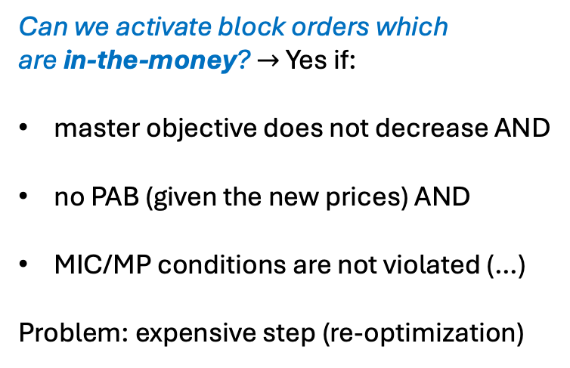
Can we activate block orders which
are in-the-money? $→$ Yes if:
master objective does not decrease AND
no PAB (given the new prices) AND
MIC/MP conditions are not violated (…)
Problem: expensive step (re-optimization)

Slide 14
Next steps
Price determination subproblem – version 2 (QP)
Integrate upper & lower price bounds
Optimizations (cut creation)
Data generation
Testing

