Slide 1
APEM Monthly Meeting
07.08.2024

Slide 2
Agenda
Project updates
Data set: US & European models
EUPHEMIA implementation
Flow-based market coupling

Slide 3
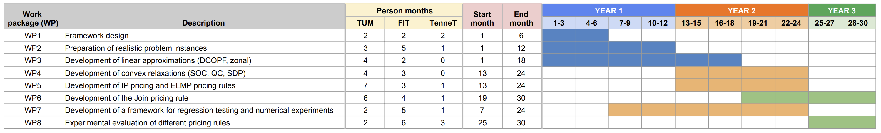
Timeline
We are here

Slide 4
Project updates
Committed data module & DCOPF implementation
Initial EUPHEMIA model
Working on:
Framework for regression testing & numerical experiments
Data conversion (details will follow)
Pricing algorithms

Slide 5
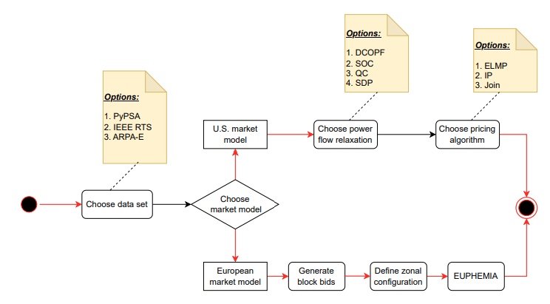
Scenario configuration

Slide 6
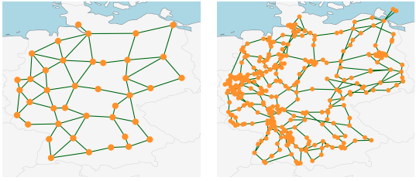
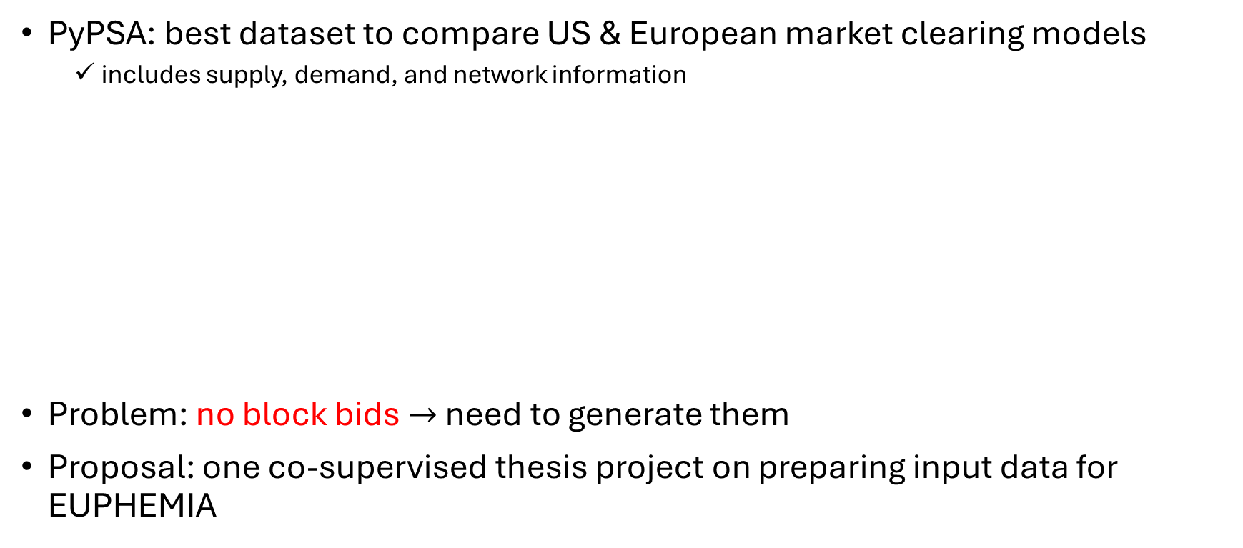
Data set
PyPSA: best dataset to compare US & European market clearing models
includes supply, demand, and network information
Problem: no block bids $→$ need to generate them
Proposal: one co-supervised thesis project on preparing input data for EUPHEMIA

Slide 7
Existing EUPHEMIA implementation
https://github.com/bcornelusse/openDAM?tab=BSD-2-Clause-1-ov-file#readme
Can we use it?

Slide 8
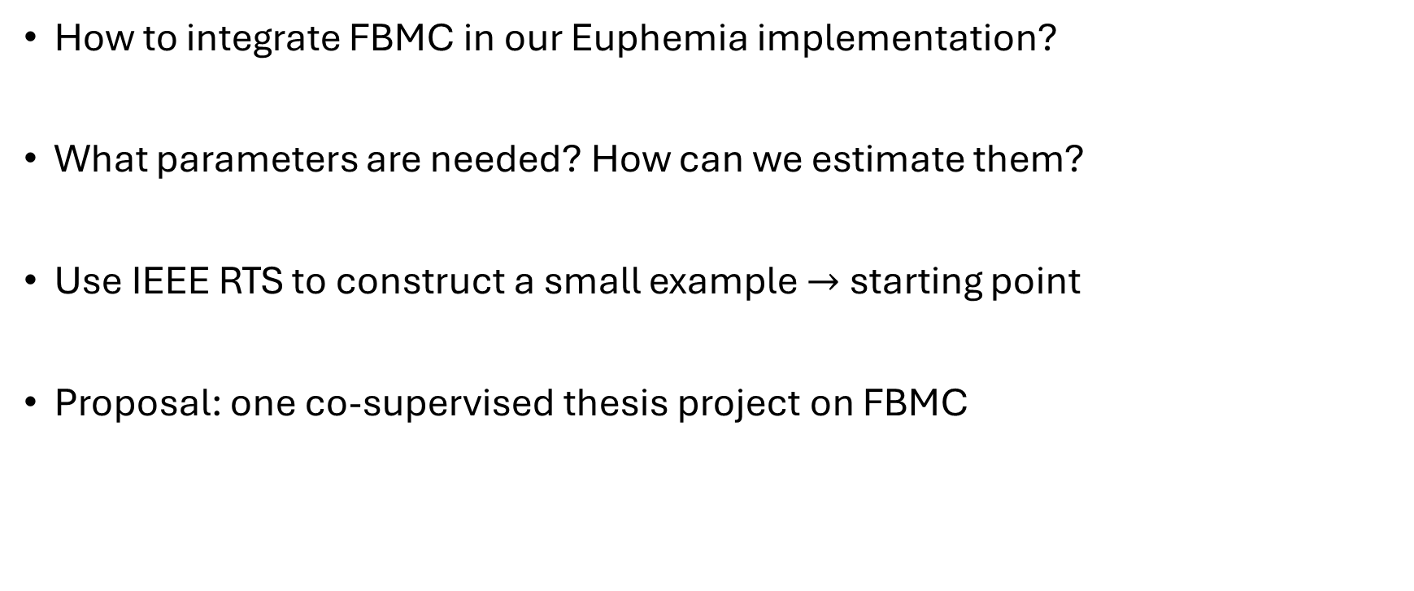
Flow-based market coupling (FBMC)
How to integrate FBMC in our Euphemia implementation?
What parameters are needed? How can we estimate them?
Use IEEE RTS to construct a small example $→$ starting point
Proposal: one co-supervised thesis project on FBMC

