Slide 1

Solving Large-Scale Electricity Market Pricing Problems in Polynomial Time
Mete Ahunbay, Martin Bichler, Teodora Dobos, Johannes Knörr
TUM School of Computation, Information and Technology
Chair of Decision Sciences & Systems
OR 2024
September 2024

Slide 2


Pricing in non-convex markets
Electricity markets are non-convex markets:
non-convex preferences: minimum production levels, startup-costs, etc.
Day-ahead markets: compute an allocation and prices for the next day
Two challenges:
I. Identifying an optimal allocation is NP-hard.
Yes, with the markup mechanism!
II. Walrasian equilibria (market-clearing prices)
may not exist.
Scalability issues
Desirable properties
Can we efficiently find a near-optimal allocation and prices
that satisfy budget balance?

Slide 3
Outline
Electricity market model
Welfare maximization & pricing problems
Markup mechanism
Evaluation
Conclusions

Slide 4
Electricity market model
Transmission network
Periods (24 hours)
Goods: electricity at each node for every period

Slide 5


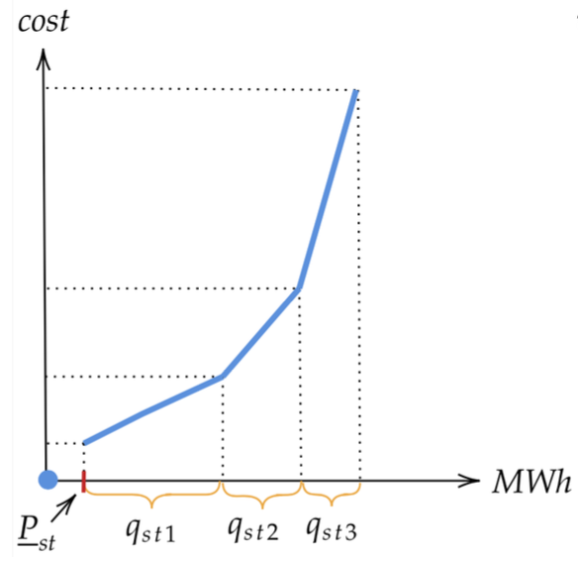

Electricity market model
Transmission network
Periods (24 hours)
Set of sellers $S$
production constraints (min-uptime, no-load cost, etc.)
supply bids $→$ cost function
Goods: electricity at each node for every period

Slide 6

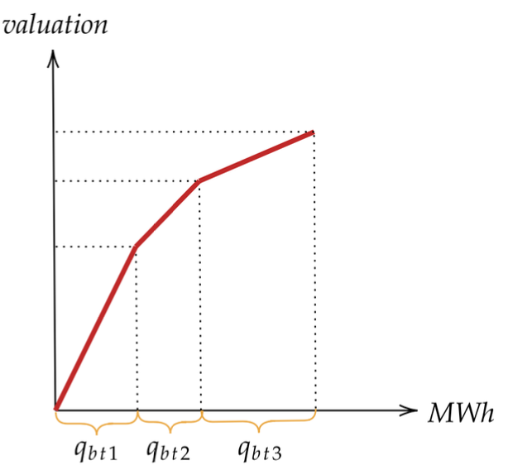


Electricity market model
Transmission network
Periods (24 hours)
Set of sellers $S$
Set of buyers $B$
price-inelastic demand
price-elastic demand bids $→$ valuation function
Goods: electricity at each node for every period

Slide 7




Electricity market model
Transmission network
Periods (24 hours)
Set of sellers $S$
Set of buyers $B$
DCOPF power flow approximation (Molzahn & Hiskens, 2019)
linear approximation
Goods: electricity at each node for every period
$$w$$
$$v$$
$$f_{vwt}$$

Slide 8
Outline
Electricity market model
Welfare maximization & pricing problems
Markup mechanism
Evaluation
Conclusions

Slide 9
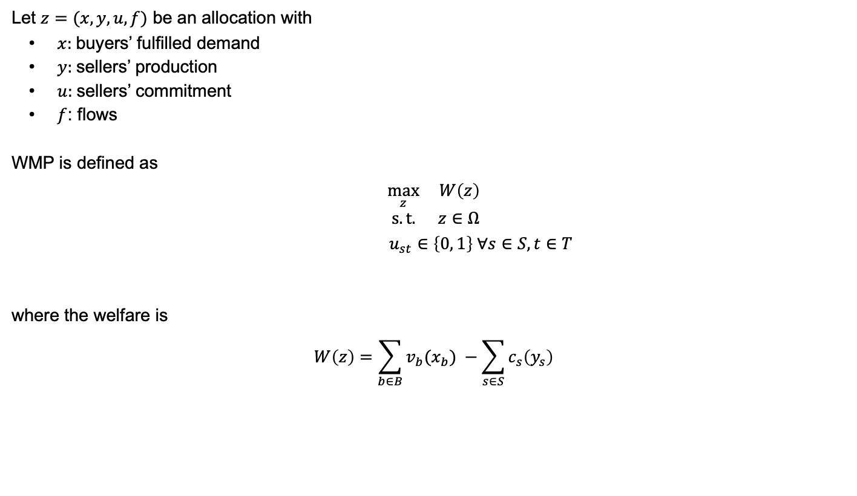
Welfare maximization problem (WMP)
Let $z=(x, y, u, f)$ be an allocation with
$x$: buyers’ fulfilled demand
$y$: sellers’ production
$u$: sellers’ commitment
$f$: flows
WMP is defined as
$$\max_{z} W\left(z\right)$$
$$s.t. z∈Ω$$
$$u_{st}∈\left\{0, 1\right\} ∀s∈S, t∈T$$
where the welfare is
$$W\left(z\right)=\sum_{b∈B}{v_{b}(x_{b})} −\sum_{s∈S}{c_{s}\left(y_{s}\right)}$$
Node-balance constraints
Price-inelastic demand fulfillment
Production constraints, etc.

Slide 10






Pricing problem
For a convex market, the Welfare Theorems (Arrow & Debreu 1954) hold.
A primal solution $z^{∗}$ and a dual solution $p^{∗}$ form a Walrasian equilibrium.
Such a pair $\left(z^{∗}, p^{∗}\right)$ satisfies certain desirable properties:
Efficiency
Supply-demand balance
Envy-freeness
Budget balance

Slide 11



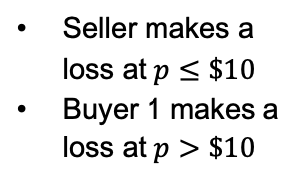
Walrasian equilibria in electricity markets?
With non-convexities present, a Walrasian equilibrium might not exist.
Clearing the market
Buyer 1
Indivisible
1 Unit
$10
Seller
?
Indivisible
2 Units
$30
Buyer 2
Indivisible
1 Unit
$28
Seller makes a loss at $p≤\$10$
Buyer 1 makes a loss at $p>\$10$

Slide 12

Individual rationality in electricity markets
No guarantee that prices satisfy individual rationality market participants make no loss
Make-whole payments (MWPs): compensations for the negative utility of a market participant $ℓ$, given prices $p$ and allocation $z_{ℓ}^{∗}$:
$$MWP_{ℓ}\left(p | z_{ℓ}^{∗}\right)=max \{{−u}_{ℓ}\left(z_{ℓ}^{∗} | p\right), 0\}$$

Slide 13
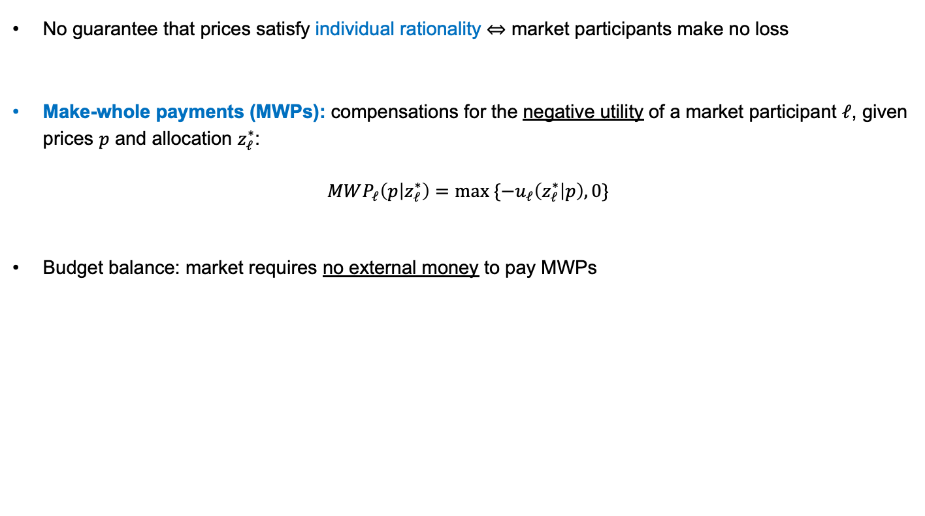
Individual rationality in electricity markets
No guarantee that prices satisfy individual rationality market participants make no loss
Make-whole payments (MWPs): compensations for the negative utility of a market participant $ℓ$, given prices $p$ and allocation $z_{ℓ}^{∗}$:
$$MWP_{ℓ}\left(p | z_{ℓ}^{∗}\right)=max \{{−u}_{ℓ}\left(z_{ℓ}^{∗} | p\right), 0\}$$
Budget balance: market requires no external money to pay MWPs

Slide 14
How to compute prices?
Integer Programming (IP) Pricing (O’Neill et al., 2005)
standard approach used in the US
“marginal pricing“ for non-convex markets
good congestion signals, but large MWPs

Slide 15
Outline
Electricity market model
Welfare maximization & pricing problems
Markup mechanism
Evaluation
Conclusions

Slide 16
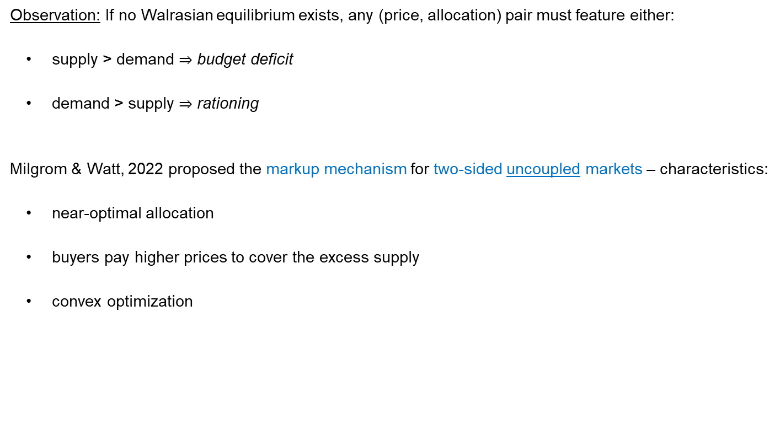
Markup mechanism
Observation: If no Walrasian equilibrium exists, any (price, allocation) pair must feature either:
supply > demand $⇒$ budget deficit
demand > supply $⇒$ rationing
Milgrom & Watt, 2022 proposed the markup mechanism for two-sided uncoupled markets – characteristics:
near-optimal allocation
buyers pay higher prices to cover the excess supply
convex optimization

Slide 17

Markup mechanism for electricity markets
Phase 1: Valuations scaling & convexifying WMP
$$\max_{z} W\left(z, α\right)$$
$$s.t. z∈Ω$$
$$0≤u_{s}≤1 ∀s∈S$$
$$W\left(z, α\right)=\sum_{b∈B}{\frac{v_{b}(x_{b})}{1+α}} −\sum_{s∈S}{c_{s}\left(y_{s}\right)}$$
Phase 2: Rounding & Residual Clearing
Option 1: Rounding with a threshold $δ∈(0, 1]$
Option 2: Rounding by solving a small MILP

Slide 18


Markup mechanism for electricity markets
Phase 1: Valuations scaling & convexifying WMP
$$\max_{z} W\left(z, α\right)$$
$$s.t. z∈Ω$$
$$0≤u_{s}≤1 ∀s∈S$$
$→$ obtain ${\left({u′}_{s}\right)}_{s∈S}$
Phase 2: Rounding & Residual Clearing – Option 1: Rounding with a threshold $δ∈(0, 1]$
$$\max_{z} W\left(z\right)$$
$$s.t. z∈Ω$$
$$u_{s}=u_{s}^{α} ∀s∈S$$
$$u_{s}^{α}=1 if {u′}_{s}>δ, else u_{s}^{α}=0$$

Slide 19


Markup mechanism for electricity markets
Phase 1: Valuations scaling & convexifying WMP
$$\max_{z} W\left(z, α\right)$$
$$s.t. z∈Ω$$
$$0≤u_{s}≤1 ∀s∈S$$
$→$ obtain ${\left({u′}_{s}\right)}_{s∈S}$
Phase 2: Rounding & Residual Clearing – Option 2: Rounding by solving a small MILP
$$\max_{z} W\left(z\right)$$
$$s.t. z∈Ω$$
$$u_{s}=u_{s}^{α} ∀s∈S^{α}$$
$$u_{s}∈\left\{0, 1\right\} ∀s∈S \backslash S^{α}$$
$S^{α}=\{s∈S |{ u}_{s}^{′}∈\{0, 1\}$}

Slide 20

What about the prices?
Prices are obtained from the dual problem of the convexified WMP.
$$\max_{z} W\left(z, α\right)$$
$$s.t. z∈Ω$$
$$0≤u_{s}≤1 ∀s∈S$$
Sellers‘ prices are $p$ and buyers’ prices are $(1+α)p$.
Role of $α$: ensure that the market has no budget deficit:
$$p^{T}\left(\sum_{b}{x_{b}\left(1+α\right) −\sum_{y}{y_{s}}}\right)−MWPs≥0$$
$→$ No guarantee that such $α$ exists!

Slide 21
Outline
Electricity market model
Welfare maximization & pricing problems
Markup mechanism
Evaluation
Conclusions

Slide 22
Data sets
6 scenarios from the ARPA-E Challenge 2 extended to 24 hours
Scenario | Nodes | Lines | Sellers | Buyers | Demand (GWh) | Supply (GWh)
1. | 617 | 841 | 94 | 404 | 506 | 830
2. | 2,020 | 2,709 | 194 | 1,392 | 622 | 1,041
3. | 8,718 | 26,084 | 321 | 5,819 | 988 | 1,088
4. | 10,480 | 16,253 | 750 | 6,871 | 2,033 | 2,289
5. | 12,209 | 30,500 | 2,009 | 6,987 | 2,391 | 3,328
6. | 18,889 | 57,630 | 898 | 12,273 | 2,686 | 2,916

Slide 23
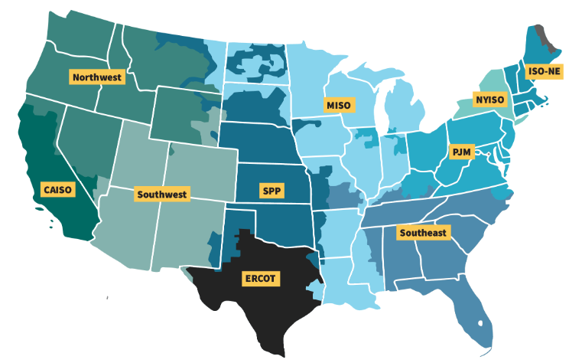
Data sets
6 scenarios from the ARPA-E Challenge 2 extended to 24 hours
Scenario | Nodes | Lines | Sellers | Buyers | Demand (GWh) | Supply (GWh)
1. | 617 | 841 | 94 | 404 | 506 | 830
2. | 2,020 | 2,709 | 194 | 1,392 | 622 | 1,041
3. | 8,718 | 26,084 | 321 | 5,819 | 988 | 1,088
4. | 10,480 | 16,253 | 750 | 6,871 | 2,033 | 2,289
5. | 12,209 | 30,500 | 2,009 | 6,987 | 2,391 | 3,328
6. | 18,889 | 57,630 | 898 | 12,273 | 2,686 | 2,916
ISO-NE | 1,216 | - | 98 | 139 | 380 | 2,151
PJM | 13,431 | - | 1,217 | 366 | 2,204 | 4,907

Slide 24
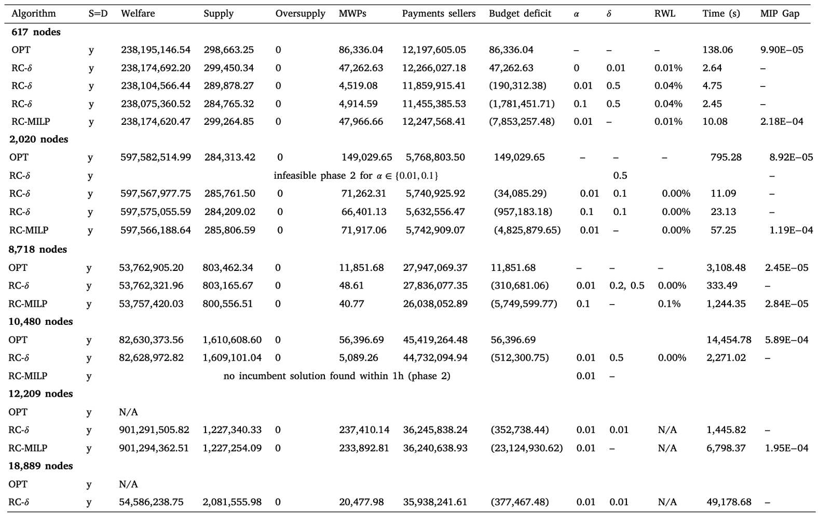
Experiments overview
Notes:
Applied IP on OPT

Slide 25
Result 1: Close approximation of OPT
Relative welfare loss

Slide 26
Result 2: Fast method

Slide 27
Result 3: No budget deficit
*A quantity in paratheses indicates budget surplus

Slide 28
Outline
Electricity market model
Welfare maximization & pricing problems
Markup mechanism
Evaluation
Conclusions

Slide 29
Conclusions
Electricity markets need to solve very large non-convex problems and determine prices.
Runtime limits are a concern.
The markup mechanism computes a near-optimal allocation in polynomial time.
The markup mechanism relies on two hyperparameters.
Buyers pay slightly higher prices to cover the make-whole payments.
The markup mechanism is a practical recommendation for large electricity markets.
Notes:
Why it works well: >>cont var but <<int vars
Downsides: alpha, hyperparams to explore –> solve larger instances
MIP gap is small, same for alpha -> practical recommendation

Slide 30

Thanks!
Our paper

Slide 31
References
Milgrom P, Watt M (2022) Walrasian mechanisms for non-convex economies and the bound-form first welfare theorem. Proceedings of the ACM Conference of Economics and Computation
Neill, Hytowitz, Whitman, Mead, Dautel, Chen, Eldridge, Siskind, Kheloussi, Kolkmann, Smith, Castillo, Mays: Essays on average incremental cost pricing for independent system operators. 2019
Ahunbay, Bichler, Knoerr: Pricing optimal outcomes in coupled and non-convex markets: Theory and applications to electricity markets, Operations Research 2024, https://doi.org/10.1287/opre.2023.0401
Molzahn, D.K., Hiskens, I.A., 2019. A survey of relaxations and approximations of the power flow equations. Found. Trends® Electr. Energy Syst. 4 (1–2), 1–221. http://dx.doi.org/10.1561/3100000012.
Liberopoulos, Andrianesis: Critical review of pricing schemes in markets with non-convex costs. 2016. Operations Research 64(1):17–31
Starr RM, Quasi-equilibria in markets with non-convex preferences. Econometrica 37(1):25, ISSN 00129682, URL http://dx.doi.org/10.2307/1909201.
O’Neill RP, Sotkiewicz PM, Hobbs BF, Rothkopf MH, Stewart WR (2005) Efficient market-clearing prices in markets with nonconvexities. European Journal of Operational Research 1(164):269–285, URL https://doi.org/10.1016/j.ejor.2003.12.011

