Slide 1
INTERNET OF THINGS
Albu Victor
Cojocaru Teodora
Ilie Ana
Autori:

Slide 2
Face Detection with ESP32 CAM

Slide 3
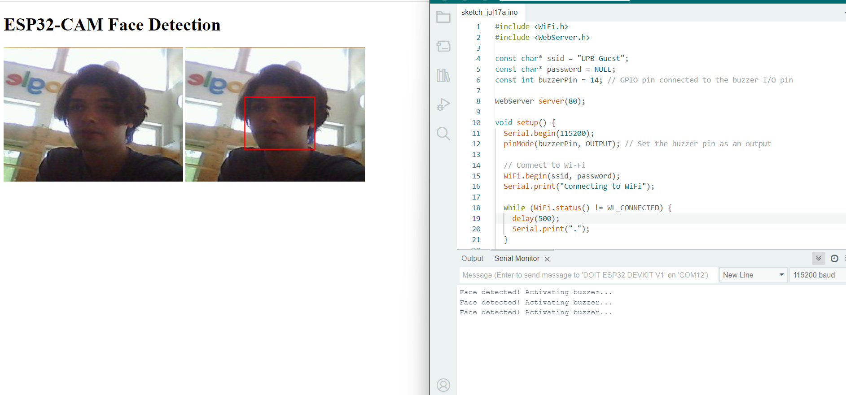

Slide 4
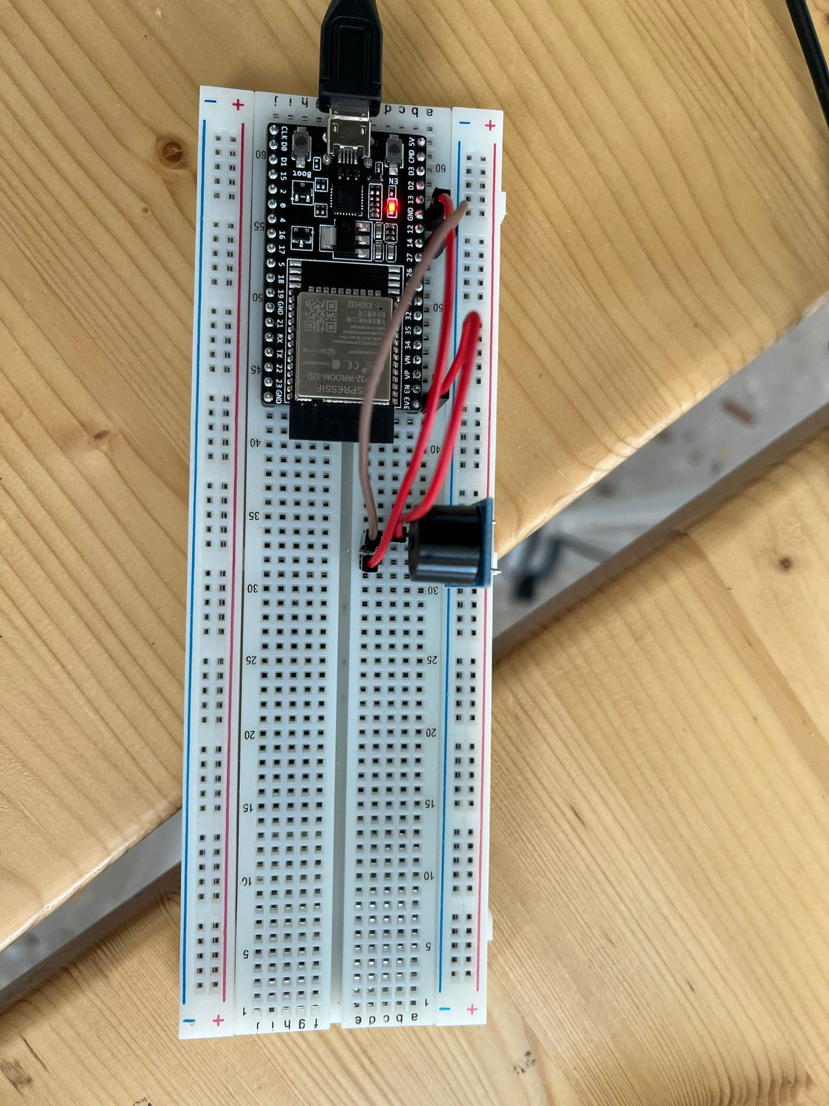
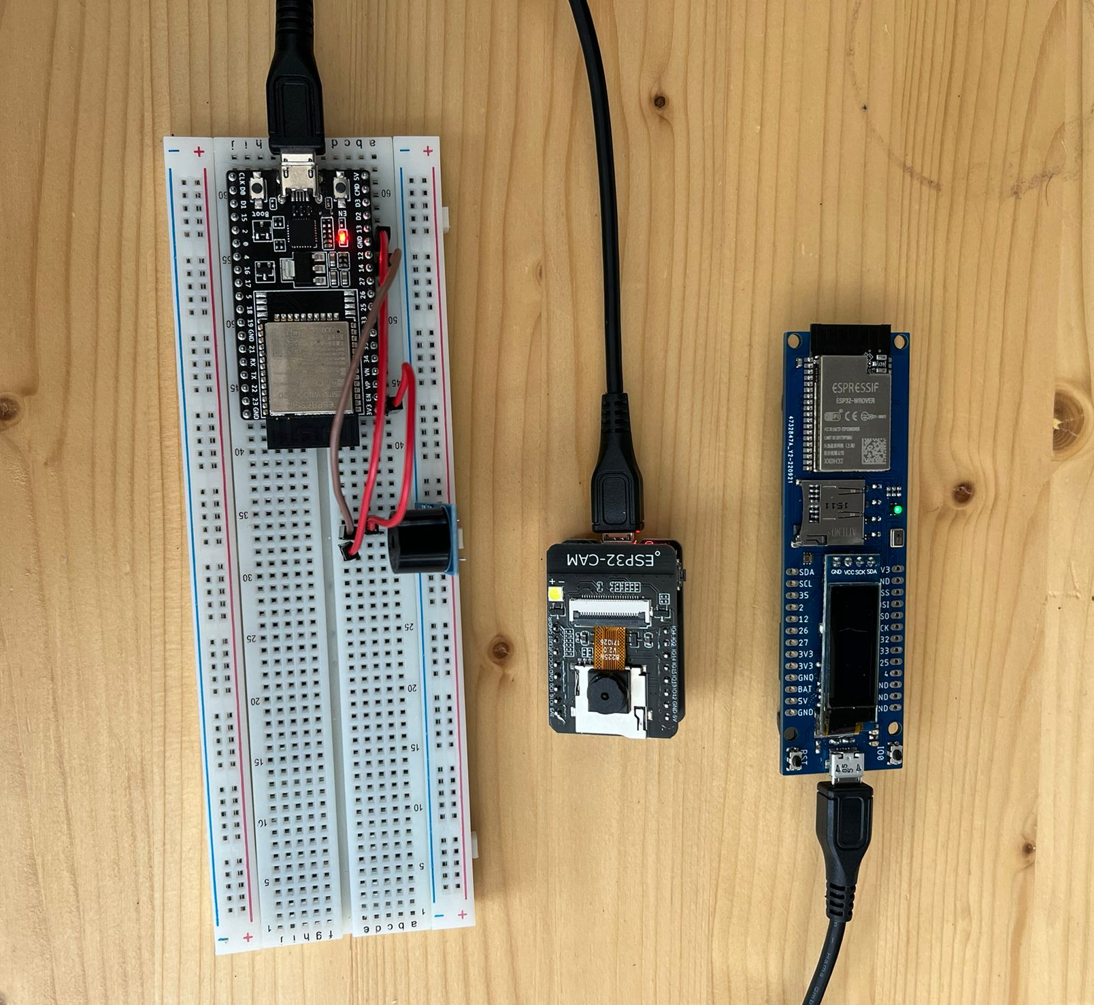
Components

Slide 5
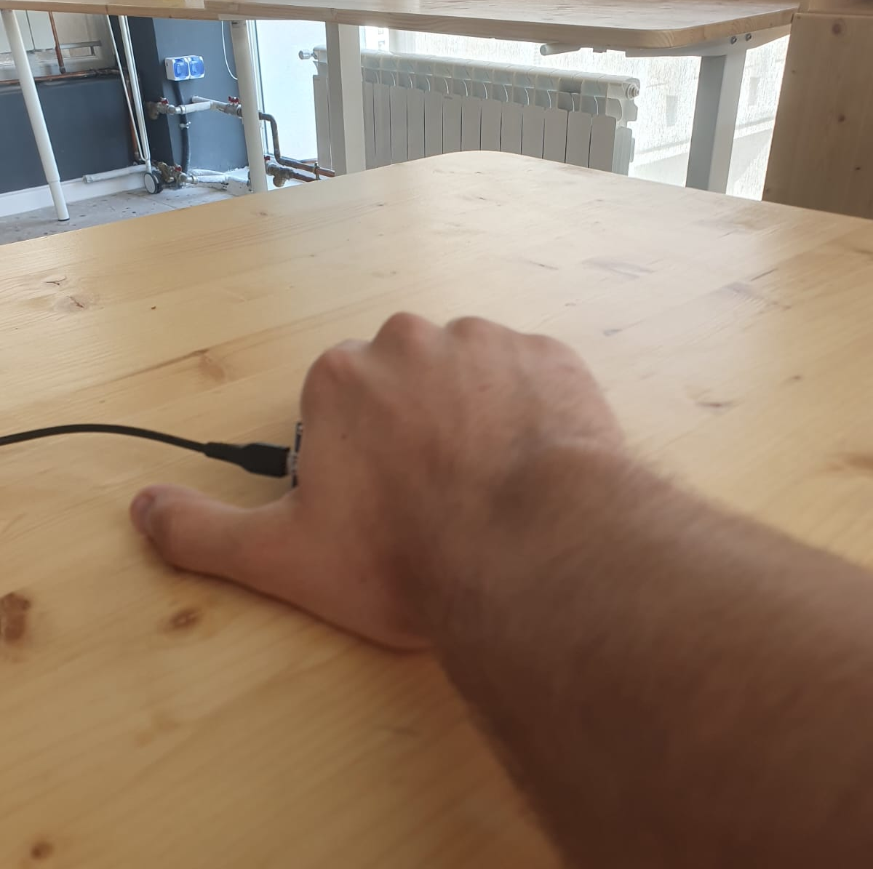
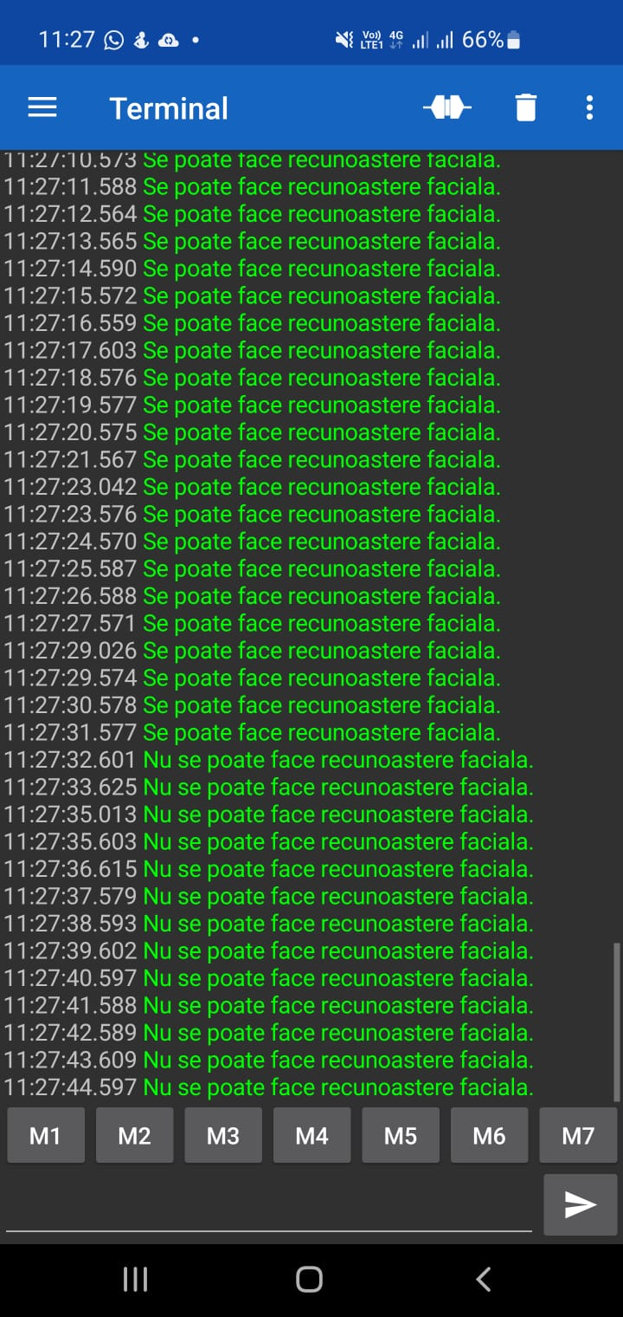
How does the light sensor work?

Slide 6
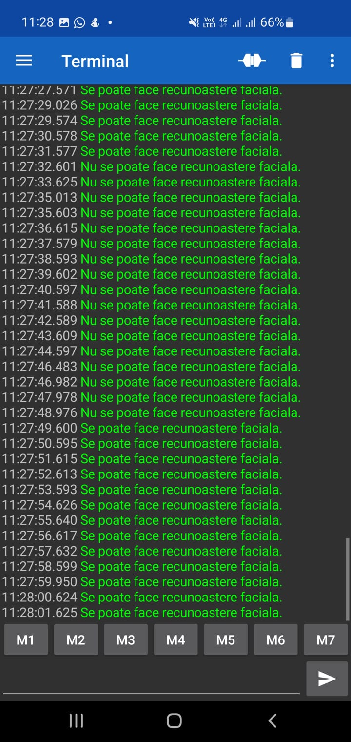
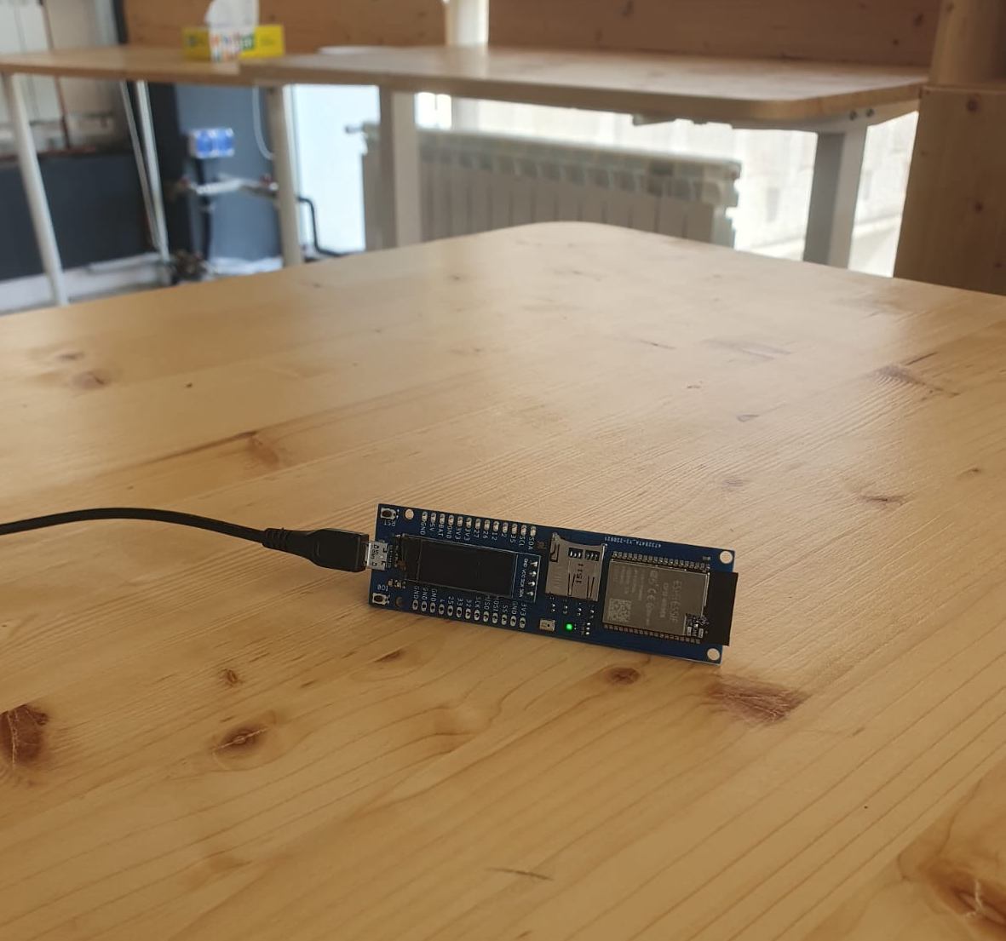
How does the light sensor work?

Slide 7
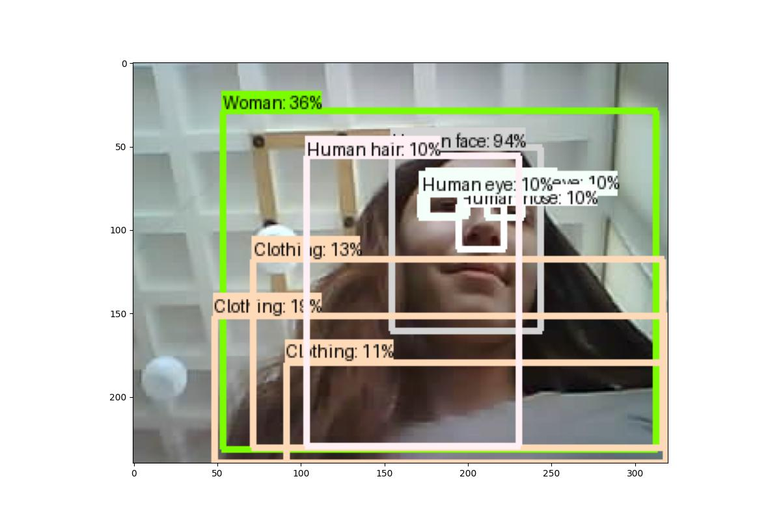
How does the camera work?

Slide 8
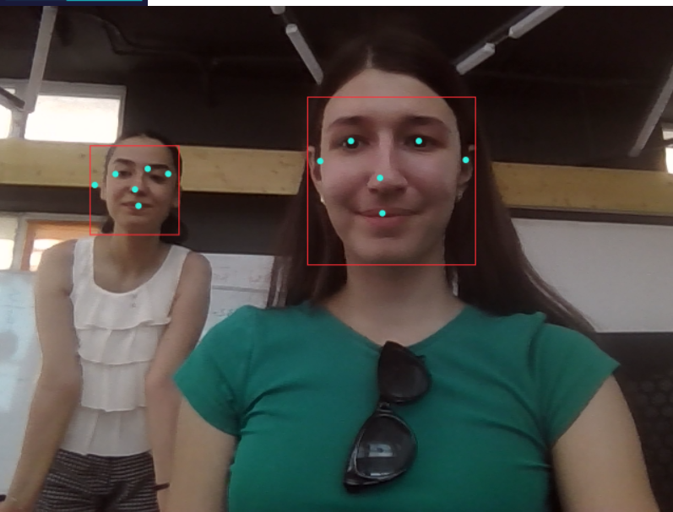
How does the camera work?

Slide 9
FACILITIES
01
02
Security and Surveillance
Financial Services
Law Enforcement - Helps in identifying and tracking suspects, finding missing persons
Border Control - Used at airports and border crossings to verify the identity of travelers and enhance security
Banking Security – Enhances security for online banking and ATM transactions by verifying the user's identity.
Fraud Prevention - Helps in detecting and preventing fraudulent transactions

Slide 10
IMPROVEMENTS
01
Smart Automobiles and Transportation
02
Shopping Experiences
Augmented Reality and Gaming
03
Facial recognition for driver authentication and vehicle setting personalization, such as seat position and entertainment preferences
Technology can allow customers to enter a store, take the desired products, and leave, with payment being automatically processed via facial recognition
Facial recognition can create realistic 3D avatars of players, customizing games and virtual interactions.

Slide 11
THE END

