Slide 1
Proiect Programare Web
User Stories
Arhitectura de domeniu
Arhitectura de sistem
Wireframes
Adrian Dragomir 342C5
Teodora Rumanu 341C5

Slide 2
User Stories
As an administrator, I would like to be able to
access the platform.
setup a profile, consisting of email, phone number, name and address.
view all the news posts in the dashboard, as well as the votes for each post.
create a speacial news post, by providing a title, image and a description. For each post, I want to assign some keywords that describe the post. The same keyword can be used for more than 1 post.
modify any news post.
delete any news post, if it is signaled as fake or misleading information.
check status of a news post, by seeing its name and number of votes (thumbs up and thumbs down).
create a shelter post, by providing a name, an image, capacity, location, location details and status.
modify a shelter post.
delete any shelter post.

Slide 3
User Stories
As a user, I would like to be able to
access the platform.
setup a profile, consisting of email, phone number, name and address.
view all the news posts in the dashboard, as well as the votes for each post.
vote (thumbs Up/Down).
view all the shelters posts in the dashboard,.
see details about donations.

Slide 4
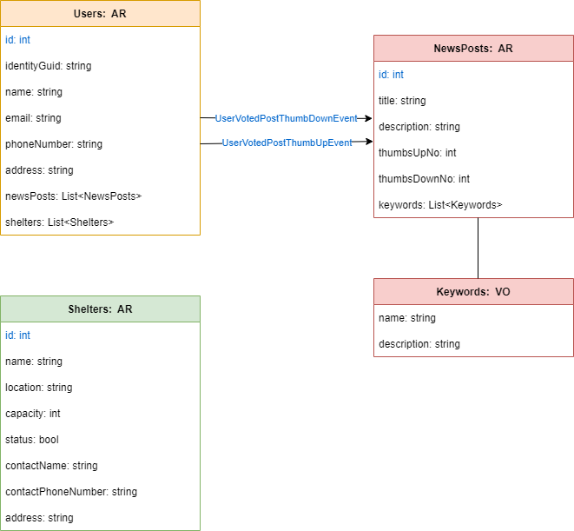
Arhitectura de domeniu

Slide 5
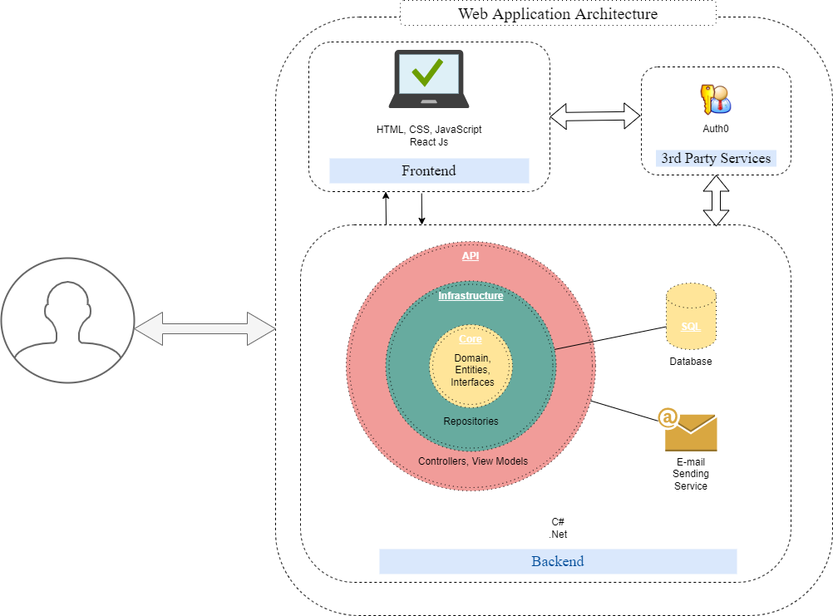
Arhitectura de sistem

Slide 6
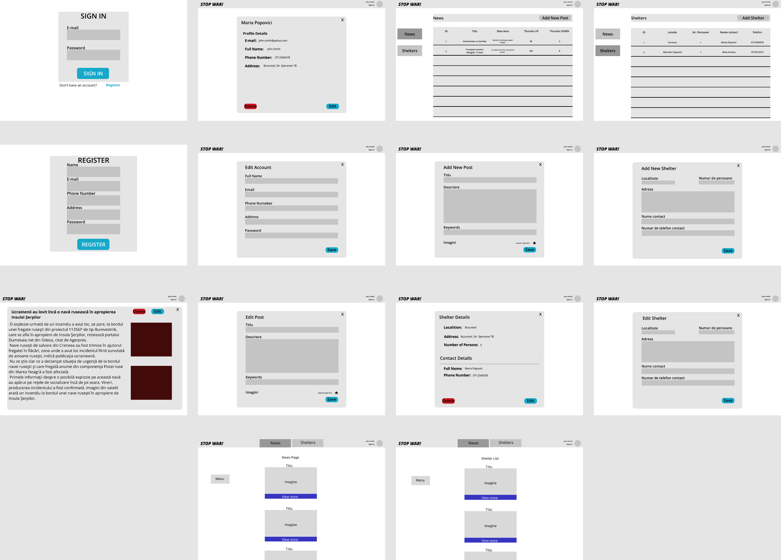
Wireframes
Notes:
https://www.figma.com/file/BdDo0XYzXXamU1N9ueeTkQ/Proiect_PW?node-id=13%3A4

