Slide 1
Football data transformer
Nikolay Shivarov
Stoyan Nikolov
Teodor Grozdanov

Slide 2
introduction
As a football enthusiasts we were interested into finding and transforming football data. The goal was to accomplish the given task and extract some interesting statistics.

Slide 3
Raw Data sources
Finding the data
We considered several data sources but most of them proved to be hard to extract at once or too small. The best data was found in a Kaggle dataset collected from the trasfermakrt.com
Data format and size
The dataset comprised of 9 csv files containing
60,000+ games from many seasons on all major competitions
400+ clubs from those competitions
30,000+ players from those clubs
400,000+ player market valuations historical records
1,200,000+ player appearance records from all games

Slide 4
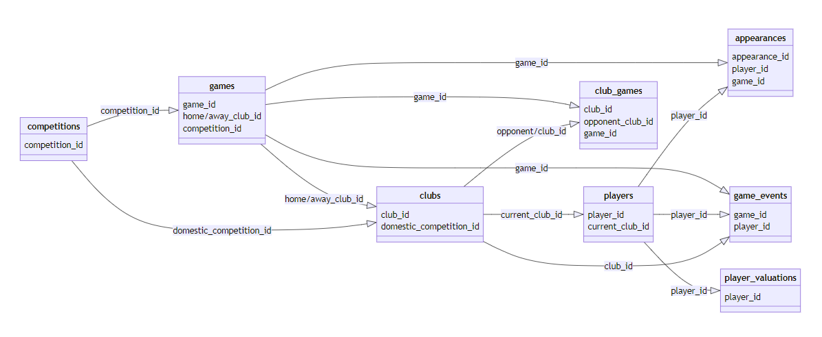
Data scheme

Slide 5



Data Format migration
Formats
The retrieved raw data had to be migrated into different formats in a meaningful and data preserving way.
CSV
The original raw data format was used for the game events.
JSON
File containing football games data was transformed into JSON.
MongoDB
Integrated CSV documents containing players data and valuations into a MongoDB database.
MongoDB was chosen for its flexibility and scalability, allowing efficient storage and retrieval of large volumes of data.
The integration process included defining the database schema, creating collections, and importing the preprocessed data into classes.

Slide 6
Data Cleaning
Dropped columns that we don't need
Fixed the data for retired players or no longer tracked players to be precise

Slide 7
Spark queries were crafted that focused on extracting interesting statistics

Slide 8



Max market value player in 2023. If there are many with the same max value take them all
EERLING HAALAND
180,000,000€
KYLIAN MBAPÉ
180,000,000€
JUDE BELLINGHAM
180,000,000€

Slide 9
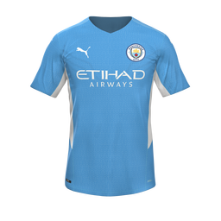

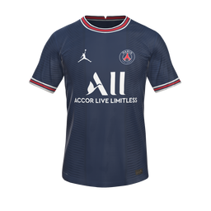
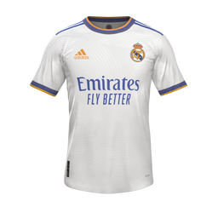
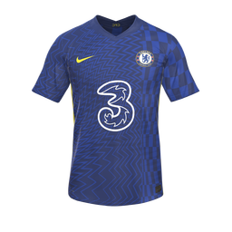
Top clubs by market value
Manchester city FC
1,323,700,000€
Arsenal FC
1,166,000,000€
Paris Saint-Germain FC
1,138,800,000€
Real Madrid CF
1,105,000,000€
Chelsea FC
1,099,300,000€

Slide 10

English Premier league bookings Outputted in Parquet Format
Joined Games and Game Events on game id. Now every row has an event and the attributes of the game of the event.
Player Valuations is joined on player id adding the attributes of the player in the event.
Filter where the match is in the premier league and the event is a red/yellow card.
Order it by date - the earliest cards are shown first.
Select the most important attributes to show in the printed table.

Slide 11





The goals scored by each player, since the data is being collected
Robert Lewandowski
450
Lionel Messi
443
Cristiano Ronaldo 433
Harry Kane
297
Luis Suárez
283

Slide 12
SUMMARY
We have gathered the needed data. Migrated it to multiple formats. Parsed them into data frames that were queried via Spark. The query results were outputted into parquet format for efficient data storage and retrieval.

Slide 13
THANK YOU

