Slide 1
Cybersecurity using CNN
Thodoris Goulas

Slide 2
Inroduction
1

Slide 3
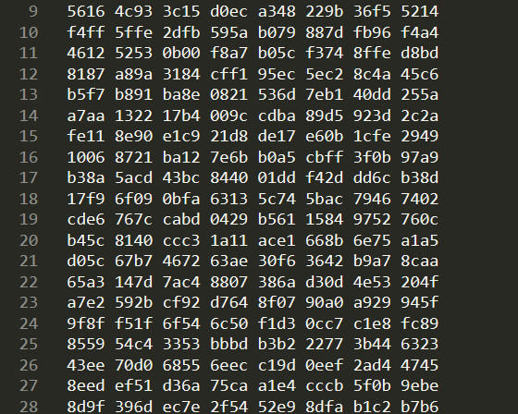
PCAP
API
captures live network packet data
data is stored to .pcapfile files
file analysis and network traffic monitoring

Slide 4
Related Work
2

Slide 5
Hwang et al. paper
LSTM-based DL model
detection at packet level
focusing on minimizing detection time
Maimó et al. paper
cyberthreats in 5G mobile networks
manage traffic fluctuation
anomaly detection
Wang et al. paper
CNN DL model
PCAP files -> MNIST

Slide 6
Dataset
3

Slide 7
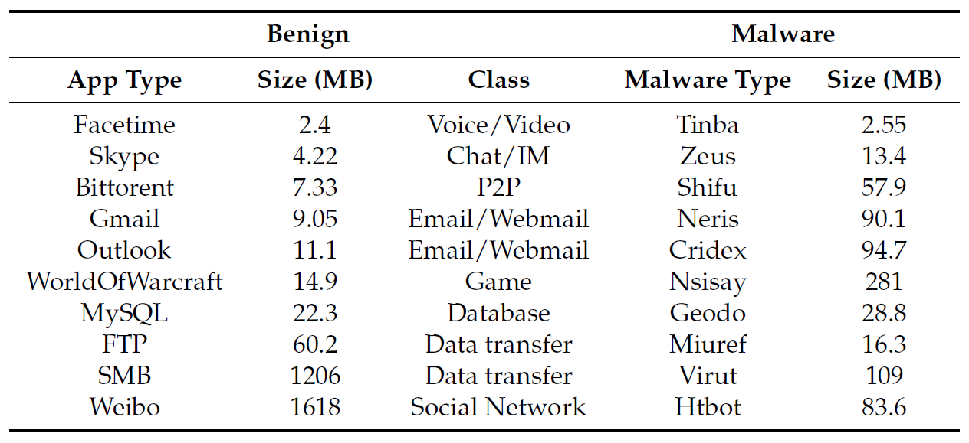
USTC-TK2016 Dataset
set of pcap files
Network traffic from 10 benign & 10 malware applications

Slide 8
Data preparation
4

Slide 9
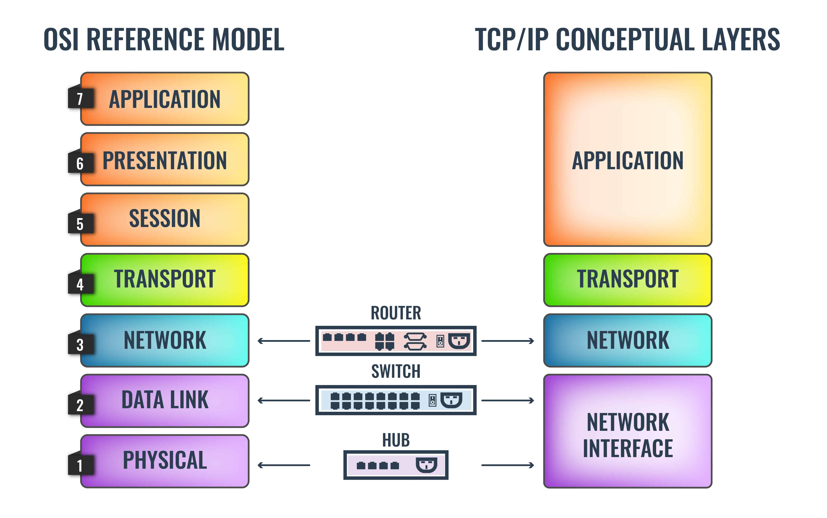
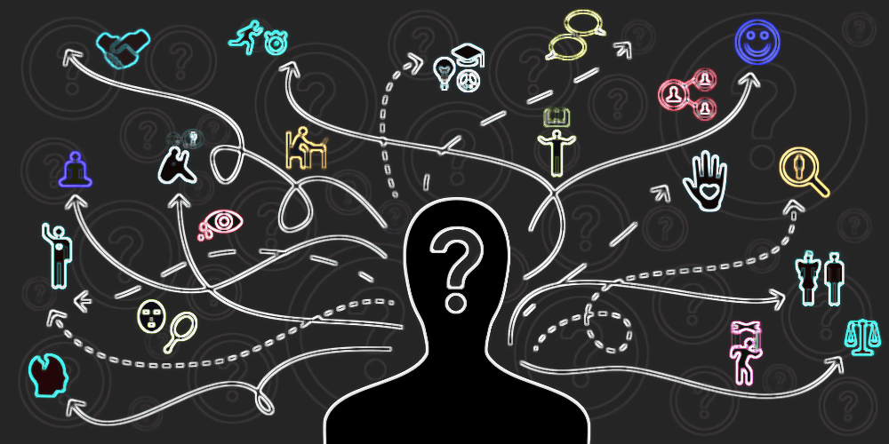
Data preprocessing steps
SplitCap program used to extract network data from the application level (layer 7)
Sessions separated
Top 60000 large pcap files selected and split to train an test datasets
PCAP files converted to 28x28 png images
Png files labeled and converted to MNIST-like files

Slide 10
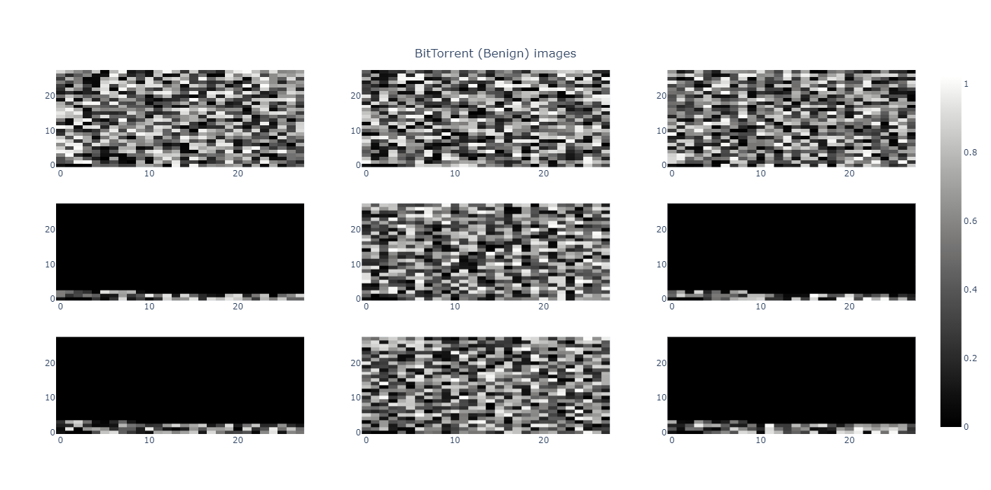
BitTorrent (Benign) images

Slide 11
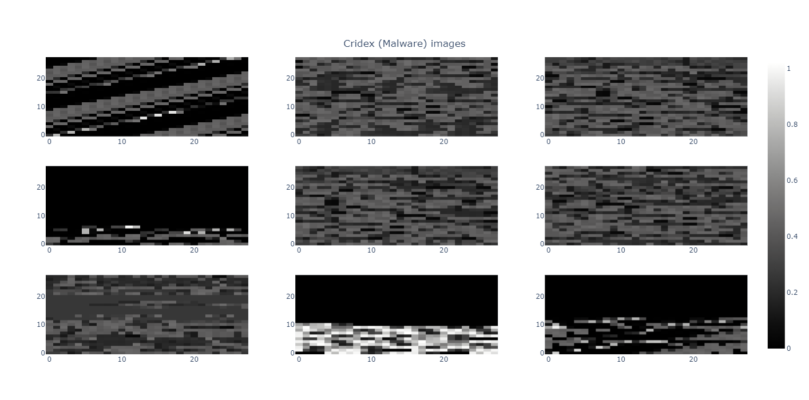
Cridex (Malware) images

Slide 12
DL Model
5

Slide 13
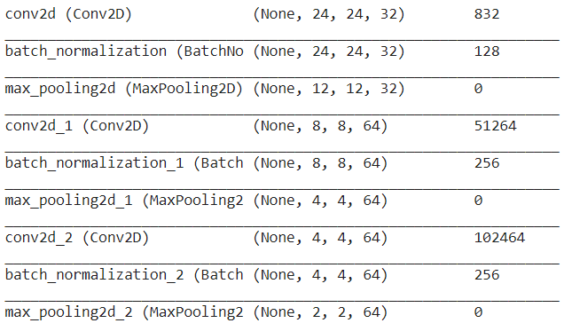
CNN model –(feature extraction)
3 hidden layers
BatchNormalization (2D) & MaxPooling per layer
relu activation function

Slide 14
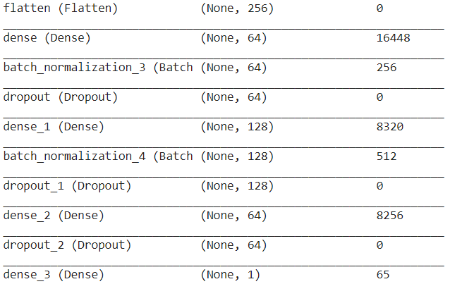
NN model - classification
3 hidden layers
BatchNormalization & Dropout per layer
relu activation function
output layer : sigmoid activation function

Slide 15
Training process
Tensorflow framework
Batch size: 64
Epochs: 10, 20, 40
Learning rate: 0.001, 0.0001

Slide 16
ML classifier –(SVM)
C: 0.1, 1, 10
gamma: 0.1, 0.01, 0.001
kernel: rbf, linear, sigmoid
5-fold cross-validation
Optimal configuration
C: 10
gamma: 0.001
kernel: rbf

Slide 17
Results
6

Slide 18
Accuracy Metrics
Accuracy
Precision
Recall
Primary goal: Avoid False Positives
Key metric: Precision

Slide 19
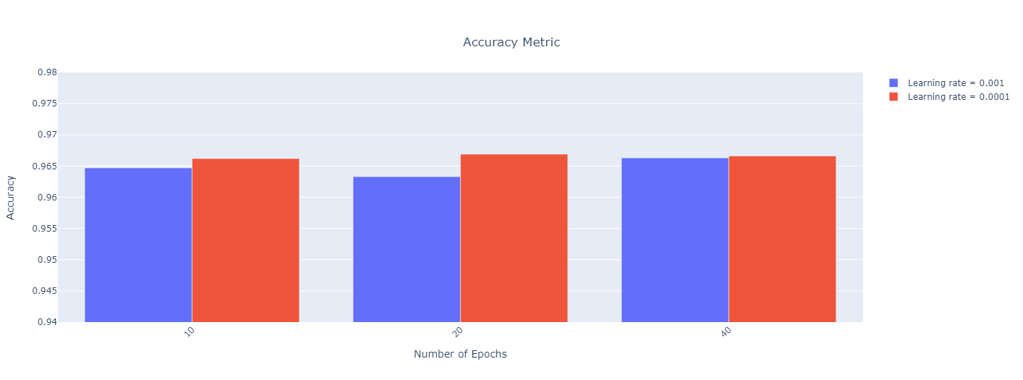
CNN classifier - Accuracy Metric

Slide 20
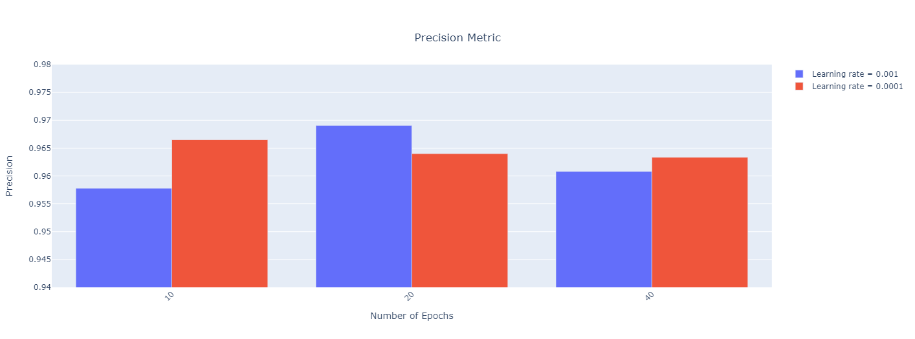
CNN classifier - Precision Metric

Slide 21
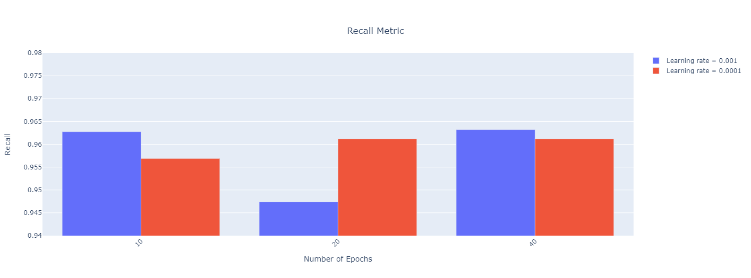
CNN classifier - Recall Metric

Slide 22
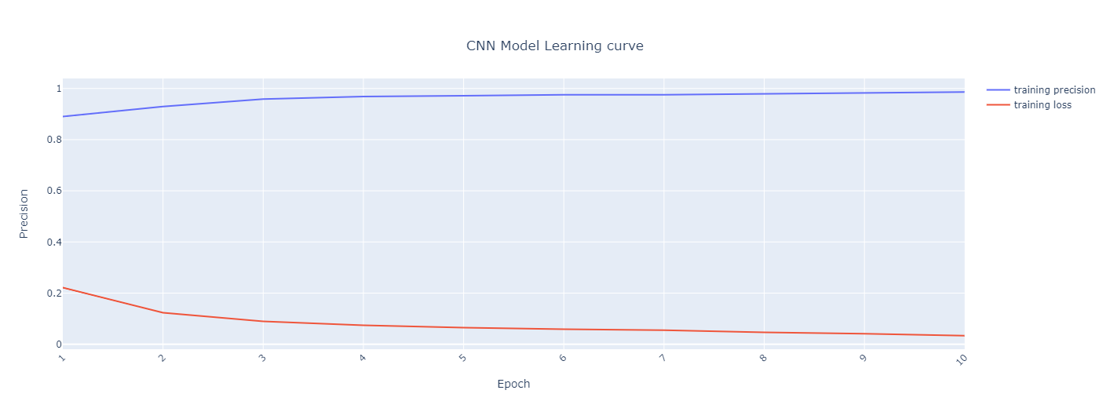
Learning Curve

Slide 23
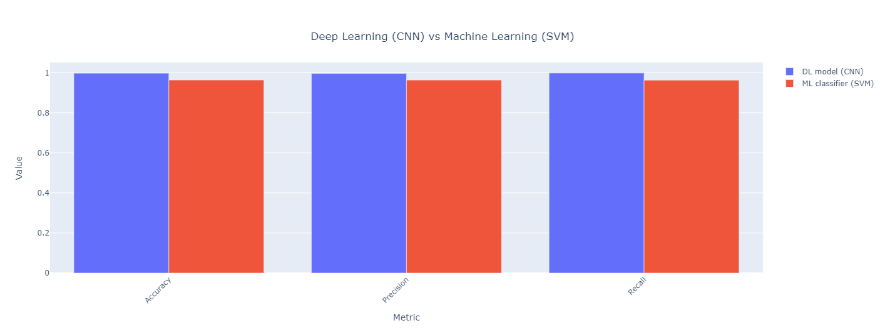
DL Model (CNN) vs ML classifier (SVM)

Slide 24
Conclusion
7

Slide 25
DL model
Optimal Precision:
Epochs: 20
Learning rate: 0.001

Slide 26
DL model vs ML model
Both models achieve decent results
DL model outperforms ML one
DL model training time efficient

Slide 27
THANKS!
Any questions?

