Slide 1
Question Answering
Summarization in Question Answering

Slide 2
Text Summarization
Goal: produce an abridged version of a text that contains information that is important or relevant to a user.
Summarization Applications
  outlines or abstracts of any document, article, etc
  summaries of email threads
  action items from a meeting
  simplifying text by compressing sentences

Slide 3
What to summarize?
Single vs. multiple documents
Single-document summarization
  Given a single document, produce
    abstract
    outline
    headline
Multiple-document summarization
  Given a group of documents, produce a gist of the content:
    a series of news stories on the same event
    a set of web pages about some topic or question

Slide 4
Query-focused Summarization
& Generic Summarization
Generic summarization:
  Summarize the content of a document
Query-focused summarization:
  summarize a document with respect to an information need expressed in a user query.
  a kind of complex question answering:
    Answer a question by summarizing a document that has the information to construct the answer

Slide 5
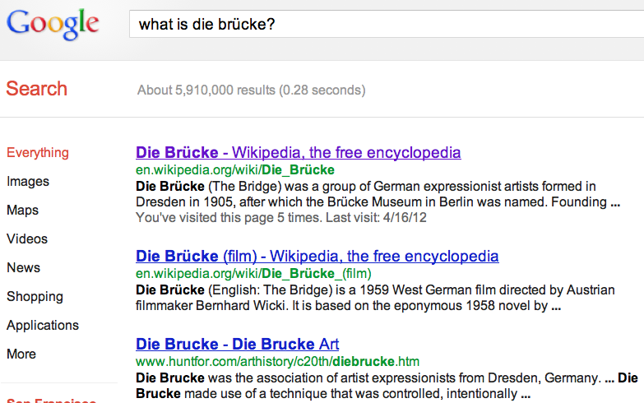
Summarization for Question Answering: Snippets
Create snippets summarizing a web page for a query
  Google: 156 characters (about 26 words) plus title and link

Slide 6
Summarization for Question Answering: Multiple documents
Create answers to complex questions summarizing multiple documents.
  Instead of giving a snippet for each document
  Create a cohesive answer that combines information from each document

Slide 7
Extractive summarization &
Abstractive summarization
Extractive summarization:
  create the summary from phrases or sentences in the source document(s)
Abstractive summarization:
  express the ideas in the source documents using (at least in part) different words

Slide 8
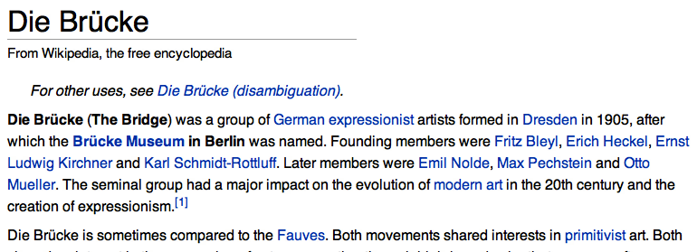
Simple baseline: take the first sentence

Slide 9
Question Answering
Summarization in Question Answering

Slide 10
Question Answering
Generating Snippets and other Single-Document Answers

Slide 11
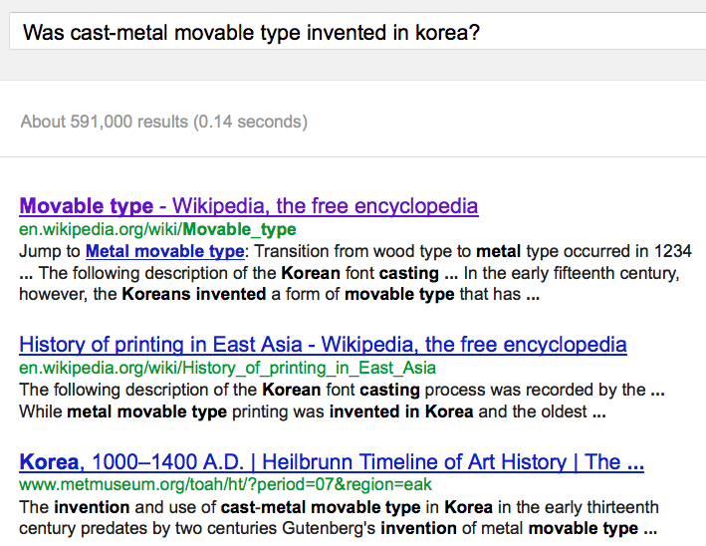
Snippets: query-focused summaries

Slide 12
Summarization: Three Stages
content selection: choose sentences to extract from the document
information ordering: choose an order to place them in the summary
sentence realization: clean up the sentences

Slide 13
Basic Summarization Algorithm
content selection: choose sentences to extract from the document
information ordering: just use document order
sentence realization: keep original sentences

Slide 14
Unsupervised content selection
H. P. Luhn. 1958. The Automatic Creation of Literature Abstracts.
IBM Journal of Research and Development. 2:2, 159-165.
Intuition dating back to Luhn (1958):
  Choose sentences that have salient or informative words
Two approaches to defining salient words
  tf-idf: weigh each word w_{i} in document j by tf-idf
  topic signature: choose a smaller set of salient words
    mutual information
    log-likelihood ratio (LLR) Dunning (1993), Lin and Hovy (2000)

Slide 15
Topic signature-based content selection with queries
Conroy, Schlesinger, and O’Leary 2006
choose words that are informative either
  by log-likelihood ratio (LLR)
  or by appearing in the query
Weigh a sentence (or window) by weight of its words:
(could learn more complex weights)

Slide 16
Supervised content selection
Given:
  a labeled training set of good summaries for each document
Align:
  the sentences in the document with sentences in the summary
Extract features
  position (first sentence?)
  length of sentence
  word informativeness, cue phrases
  cohesion
Train
Problems:
  hard to get labeled training data
  alignment difficult
  performance not better than unsupervised algorithms
So in practice:
  Unsupervised content selection is more common
    a binary classifier (put sentence in summary? yes or no)

Slide 17
Question Answering
Generating Snippets and other Single-Document Answers

Slide 18
Question Answering
Evaluating Summaries: ROUGE

Slide 19
ROUGE (Recall Oriented Understudy for Gisting Evaluation)
Lin and Hovy 2003
Intrinsic metric for automatically evaluating summaries
  Based on BLEU (a metric used for machine translation)
  Not as good as human evaluation (“Did this answer the user’s question?”)
  But much more convenient
Given a document D, and an automatic summary X:
  Have N humans produce a set of reference summaries of D
  Run system, giving automatic summary X
  What percentage of the bigrams from the reference summaries appear in X?

Slide 20
A ROUGE example:
Q: “What is water spinach?”
Human 1: Water spinach is a green leafy vegetable grown in the tropics.
Human 2: Water spinach is a semi-aquatic tropical plant grown as a vegetable.
Human 3: Water spinach is a commonly eaten leaf vegetable of Asia.
System answer: Water spinach is a leaf vegetable commonly eaten in tropical areas of Asia.
ROUGE-2 =
3 + 3 + 6
= 12/28 = .43
10 + 9 + 9

Slide 21
Question Answering
Evaluating Summaries: ROUGE

