Slide 1
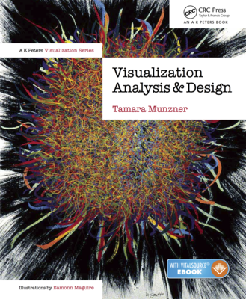
Visualization Analysis & Design
Analysis: Nested Model (Ch 4)
Tamara Munzner
Department of Computer Science
University of British Columbia
@tamaramunzner

Slide 2
Analysis framework: Four levels, three questions
domain situation
who are the target users?
domain
[A Nested Model of Visualization Design and Validation. Munzner. IEEE TVCG 15(6):921-928, 2009 (Proc. InfoVis 2009). ]

Slide 3
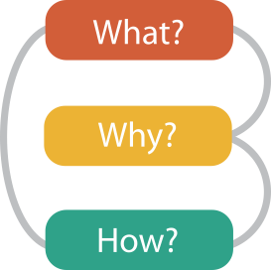
Analysis framework: Four levels, three questions
domain situation
who are the target users?
abstraction
translate from specifics of domain to vocabulary of vis
what is shown? data abstraction
why is the user looking at it? task abstraction
domain
abstraction
[A Multi-Level Typology of Abstract Visualization Tasks. Brehmer and Munzner. IEEE TVCG 19(12):2376-2385, 2013 (Proc. InfoVis 2013). ]
[A Nested Model of Visualization Design and Validation. Munzner. IEEE TVCG 15(6):921-928, 2009 (Proc. InfoVis 2009). ]

Slide 4
Analysis framework: Four levels, three questions
domain situation
who are the target users?
abstraction
translate from specifics of domain to vocabulary of vis
what is shown? data abstraction
why is the user looking at it? task abstraction
idiom
how is it shown?
visual encoding idiom: how to draw
interaction idiom: how to manipulate
domain
abstraction
idiom
[A Multi-Level Typology of Abstract Visualization Tasks. Brehmer and Munzner. IEEE TVCG 19(12):2376-2385, 2013 (Proc. InfoVis 2013). ]
[A Nested Model of Visualization Design and Validation. Munzner. IEEE TVCG 15(6):921-928, 2009 (Proc. InfoVis 2009). ]

Slide 5
Analysis framework: Four levels, three questions
domain situation
who are the target users?
abstraction
translate from specifics of domain to vocabulary of vis
what is shown? data abstraction
why is the user looking at it? task abstraction
idiom
how is it shown?
visual encoding idiom: how to draw
interaction idiom: how to manipulate
algorithm
efficient computation
domain
abstraction
idiom
algorithm
[A Multi-Level Typology of Abstract Visualization Tasks. Brehmer and Munzner. IEEE TVCG 19(12):2376-2385, 2013 (Proc. InfoVis 2013). ]
[A Nested Model of Visualization Design and Validation. Munzner. IEEE TVCG 15(6):921-928, 2009 (Proc. InfoVis 2009). ]

Slide 6
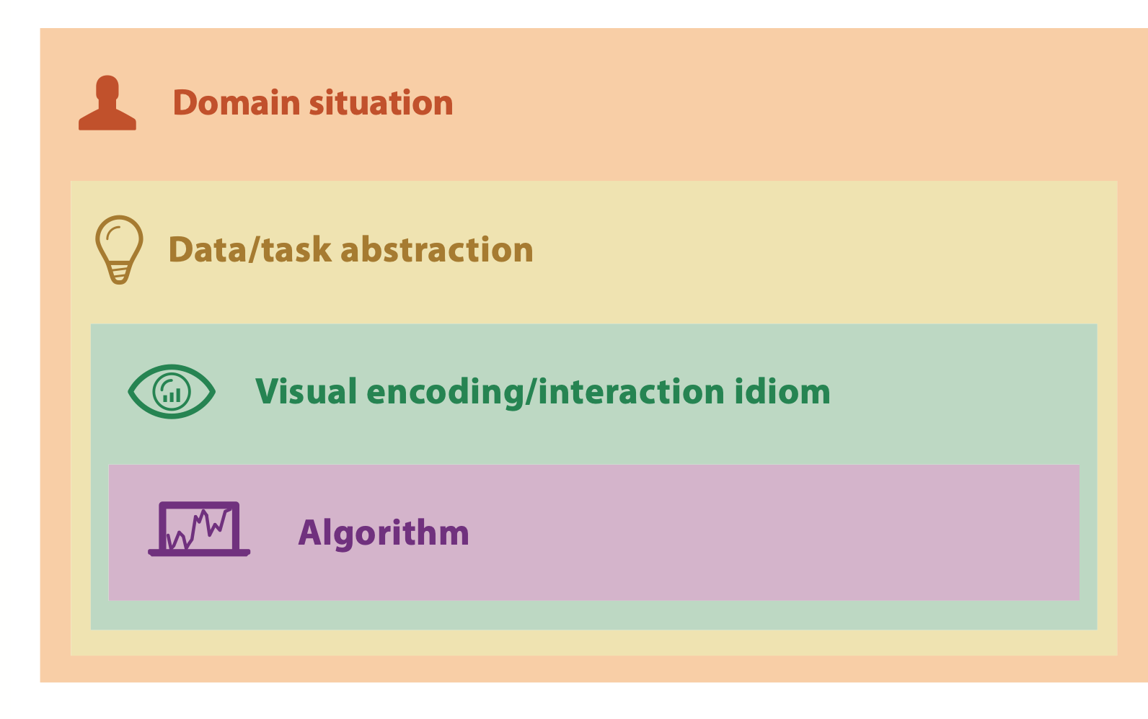

Nested model
downstream: cascading effects
[A Nested Model of Visualization Design and Validation. Munzner. IEEE TVCG 15(6):921-928, 2009 (Proc. InfoVis 2009). ]

Slide 7
Nested model
downstream: cascading effects
upstream: iterative refinement
[A Nested Model of Visualization Design and Validation. Munzner. IEEE TVCG 15(6):921-928, 2009 (Proc. InfoVis 2009). ]

Slide 8
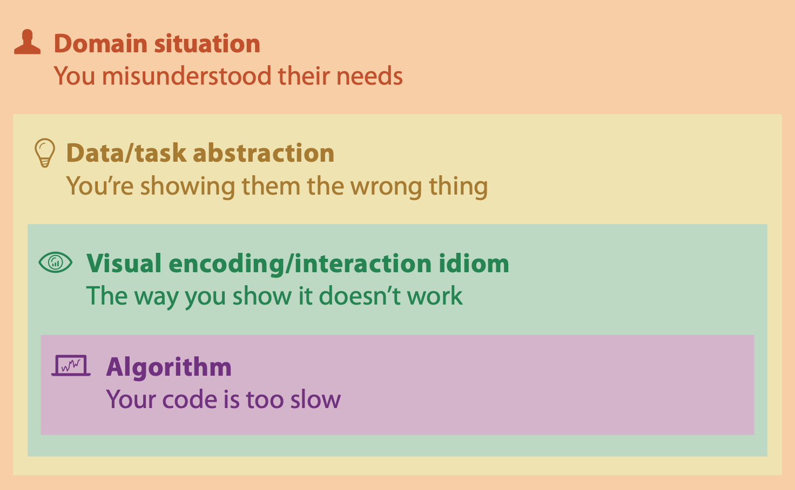
Why is validation difficult?
different ways to get it wrong at each level
[A Nested Model of Visualization Design and Validation. Munzner. IEEE TVCG 15(6):921-928, 2009 (Proc. InfoVis 2009). ]

Slide 9
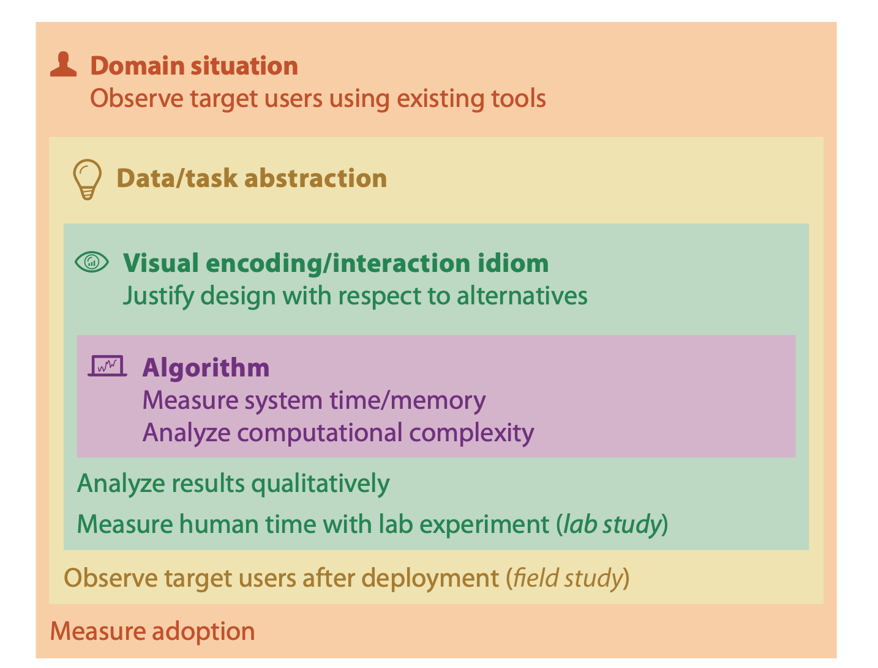
Why is validation difficult?
solution: use methods from different fields at each level
[A Nested Model of Visualization Design and Validation. Munzner. IEEE TVCG 15(6):921-928, 2009 (Proc. InfoVis 2009). ]

Slide 10
Why is validation difficult?
solution: use methods from different fields at each level
computer science
technique-driven work
[A Nested Model of Visualization Design and Validation. Munzner. IEEE TVCG 15(6):921-928, 2009 (Proc. InfoVis 2009). ]

Slide 11
Why is validation difficult?
solution: use methods from different fields at each level
design
computer science
technique-driven work
cognitive psychology
[A Nested Model of Visualization Design and Validation. Munzner. IEEE TVCG 15(6):921-928, 2009 (Proc. InfoVis 2009). ]

Slide 12
Why is validation difficult?
solution: use methods from different fields at each level
anthropology/ ethnography
design
computer science
technique-driven work
cognitive psychology
anthropology/ ethnography
[A Nested Model of Visualization Design and Validation. Munzner. IEEE TVCG 15(6):921-928, 2009 (Proc. InfoVis 2009). ]

Slide 13

Why is validation difficult?
solution: use methods from different fields at each level
problem-driven work (design study)
anthropology/ ethnography
design
computer science
technique-driven work
cognitive psychology
anthropology/ ethnography
[A Nested Model of Visualization Design and Validation. Munzner. IEEE TVCG 15(6):921-928, 2009 (Proc. InfoVis 2009). ]

Slide 14

Avoid mismatches
computational benchmarks do not confirm idiom design
[A Nested Model of Visualization Design and Validation. Munzner. IEEE TVCG 15(6):921-928, 2009 (Proc. InfoVis 2009). ]

Slide 15
Avoid mismatches
lab studies do not confirm task abstraction
computational benchmarks do not confirm idiom design
[A Nested Model of Visualization Design and Validation. Munzner. IEEE TVCG 15(6):921-928, 2009 (Proc. InfoVis 2009). ]

Slide 16
Visualization Analysis & Design
Analysis: Nested Model (Ch 4) II
Tamara Munzner
Department of Computer Science
University of British Columbia
@tamaramunzner

Slide 17
Analysis examples: Single paper includes only subset of methods

Slide 18
Analysis examples: Single paper includes only subset of methods
MatrixExplorer. Henry and Fekete. InfoVis 2006.
observe and interview target users
justify encoding/interaction design
measure system time/memory
qualitative result image analysis

Slide 19
Analysis examples: Single paper includes only subset of methods
MatrixExplorer. Henry and Fekete. InfoVis 2006.
observe and interview target users
justify encoding/interaction design
measure system time/memory
qualitative result image analysis
LiveRAC. McLachlan, Munzner, Koutsoﬁos, and North. CHI 2008.
observe and interview target users
justify encoding/interaction design
qualitative result image analysis
field study, document deployed usage

Slide 20
Analysis examples: Single paper includes only subset of methods
MatrixExplorer. Henry and Fekete. InfoVis 2006.
observe and interview target users
justify encoding/interaction design
measure system time/memory
qualitative result image analysis
LiveRAC. McLachlan, Munzner, Koutsoﬁos, and North. CHI 2008.
observe and interview target users
justify encoding/interaction design
qualitative result image analysis
field study, document deployed usage
An energy model for visual graph clustering. (LinLog) Noack. Graph Drawing 2003
qualitative/quantitative image analysis

Slide 21
Analysis examples: Single paper includes only subset of methods
MatrixExplorer. Henry and Fekete. InfoVis 2006.
Effectiveness of animation in trend visualization. Robertson et al. InfoVis 2008.
observe and interview target users
justify encoding/interaction design
lab study, measure time/errors for operation
measure system time/memory
qualitative result image analysis
LiveRAC. McLachlan, Munzner, Koutsoﬁos, and North. CHI 2008.
observe and interview target users
justify encoding/interaction design
qualitative result image analysis
field study, document deployed usage
An energy model for visual graph clustering. (LinLog) Noack. Graph Drawing 2003
qualitative/quantitative image analysis

Slide 22
Analysis examples: Single paper includes only subset of methods
MatrixExplorer. Henry and Fekete. InfoVis 2006.
Effectiveness of animation in trend visualization. Robertson et al. InfoVis 2008.
observe and interview target users
justify encoding/interaction design
lab study, measure time/errors for operation
measure system time/memory
qualitative result image analysis
Interactive visualization of genealogical graphs. McGufﬁn and Balakrishnan. InfoVis 2005.
LiveRAC. McLachlan, Munzner, Koutsoﬁos, and North. CHI 2008.
justify encoding/interaction design
qualitative result image analysis
test on target users, get utility anecdotes
observe and interview target users
justify encoding/interaction design
qualitative result image analysis
field study, document deployed usage
An energy model for visual graph clustering. (LinLog) Noack. Graph Drawing 2003
qualitative/quantitative image analysis

Slide 23
Analysis examples: Single paper includes only subset of methods
MatrixExplorer. Henry and Fekete. InfoVis 2006.
Effectiveness of animation in trend visualization. Robertson et al. InfoVis 2008.
observe and interview target users
justify encoding/interaction design
lab study, measure time/errors for operation
measure system time/memory
qualitative result image analysis
Interactive visualization of genealogical graphs. McGufﬁn and Balakrishnan. InfoVis 2005.
LiveRAC. McLachlan, Munzner, Koutsoﬁos, and North. CHI 2008.
justify encoding/interaction design
qualitative result image analysis
test on target users, get utility anecdotes
observe and interview target users
justify encoding/interaction design
qualitative result image analysis
field study, document deployed usage
Flow map layout. Phan et al. InfoVis 2005.
An energy model for visual graph clustering. (LinLog) Noack. Graph Drawing 2003
justify encoding/interaction design
computational complexity analysis
measure system time/memory
qualitative/quantitative image analysis
qualitative result image analysis

