Slide 1

Regression

Slide 2
Objective
Using one or more variable (Xs)to predict one variable (Y) via Regression
Regression is one of the most important model in machine learning
How to select the best model

Slide 3
Agenda
Intro to Regression
Linear Regression (R)
Multi-Linear Regression, Logistic Regression as classifier
Other Considerations
Exercise
Discussion
Review

Slide 4
Activities
Linear Regression – R
Prediction Exercise
Plot and Visualize - R
Non-Linear Model – R
RMSE - R
Multi-Linear Regression with logistic regression as classifier and splitting of train test set - R

Slide 5
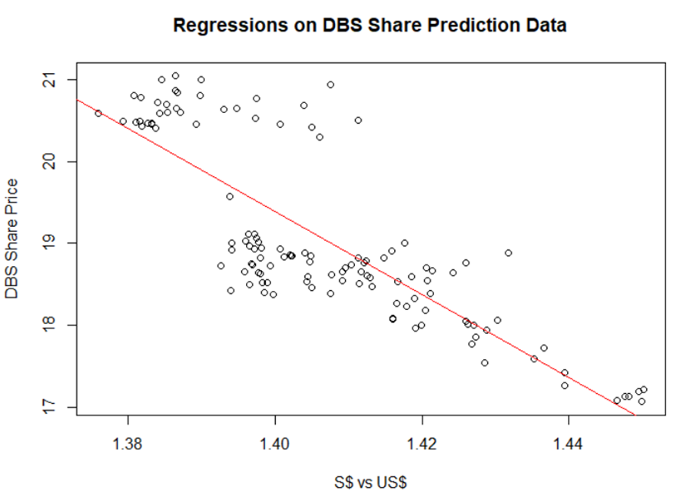
Linear Regression
Y has a linear relationship with the Xs.
Notes:
Error must be random

Slide 6

Linear Regression Model Line
$y=b_{0}+b_{1}x_{1}+b_{2}x_{2}+…+b_{m}x_{m}+e$
$\hat{y}$

Slide 7
Data Analysis: When $S Strengthen, will DBS share price up or down?
When Sing Dollar strengthen, DBS share price will be expensive for foreign investor, therefore, DBS price should go down, if everything else remain the same.
However, when Sing Dollar strengthen, DBS asset in S$ will appreciate from foreign investor perspective, hence, if DBS has more Sing Dollar Asset than Liability, DBS share price should go up.
Hence, data analytics is important.

Slide 8
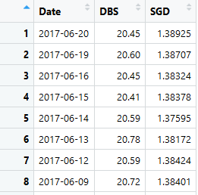
Data : Total 122 rows
R: By double click on the variable at the environment window

Slide 9
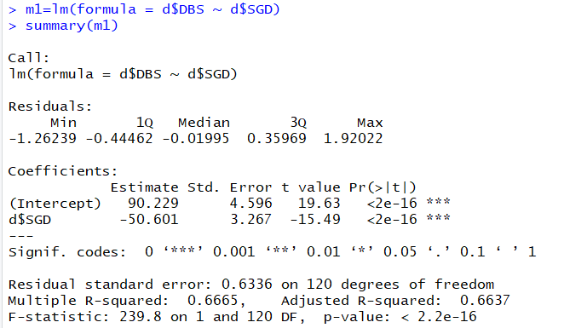

Activity 1: Run The R Code DBS vs Sing Dollar.r Line 152: Summary(m1)
P-value is very low => SGD is a significant predictor of DBS Share Price or can refer to the star
F-statistic P-value is very low => DBS = -50.601*SGD+90.229 is significant

Slide 10
Activity 2: What to Predict DBS Share Price base on the formula generated?
DBS = -50.601*SGD+90.229
Machine Learning Process:
After 112 set of data training: We have the coefficient of -50.601 and 90.229.
Testing:
When SGD = 1.38925, what is the error?
When SGD = 1.38707, what is the error?
When SGD = 1.38324, what is the error?
19.93122506 | -0.51877494
20.04153512 | -0.558464884
20.23533673 | -0.214663273

Slide 11
What does the formula means?
DBS = -50.601*SGD+90.229
When Singapore appreciate by 100 basis point, example 1.3800 to 1.3700, then DBS price appreciate by 50.601 * 0.01 = $0.5 (50cents).
By able to predict DBS share price accurately, there is chance that you can buy at lower price if you predict DBS price will appreciate.

Slide 12
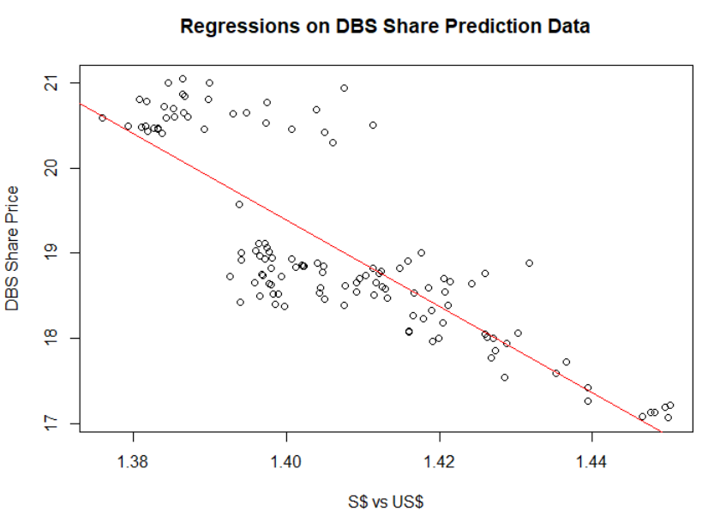
Activity 3: Run The R Code DBS vs Sing Dollar.r Line 154
> plot(d$SGD, d$DBS, main = 'Regressions on DBS Share Prediction Data', xlab = 'S$ vs US$', ylab = 'DBS Share Price')
> abline(m1, col="red")
What is your conclusion on DBS Price vs Sing$?
Sing$ Strengthen, DBS price goes up
What about the error?
Notes:
Students are expected to look at the difference between the predicted line vs the scattered plot and find other pattern

Slide 13
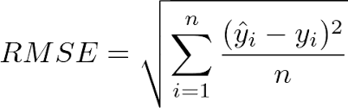
Activity 6: Error
From F-test, Polynomial is more significant than Linear
How about error? Let us take look at RMSE.
5 types of error:
Error
Square Error
Sum of Square Error
Mean Square Error
Root Mean Square Error

Slide 14
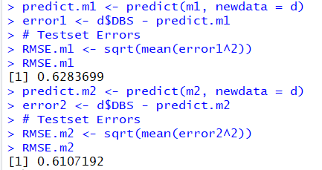
R Code: Line 163 to Line 176
Select lowest error.
Notes:
M2 is better because the RMSE is lower than M1. Significant and Error are related.

Slide 15
Activity 7: Multi-Linear Regression as classifier with train test set split Date-set: Loan Default

Slide 16
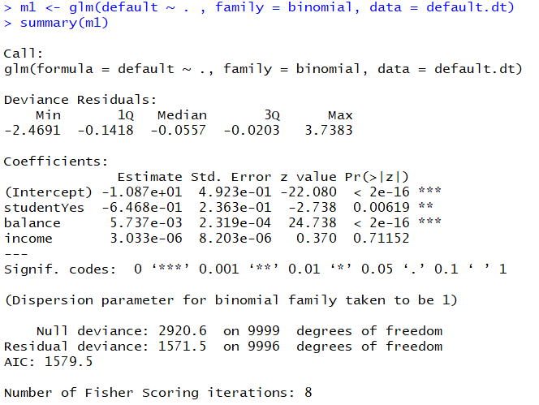
GLM for logistic regression as classifier

Slide 17
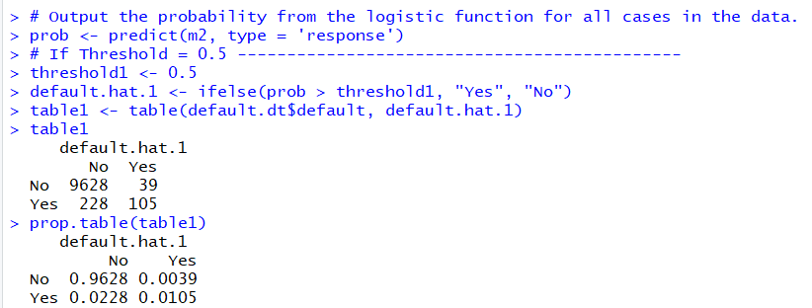
Accuracy

Slide 18
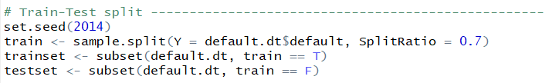

Split Train Test Set (70 train, 30 test)

Slide 19
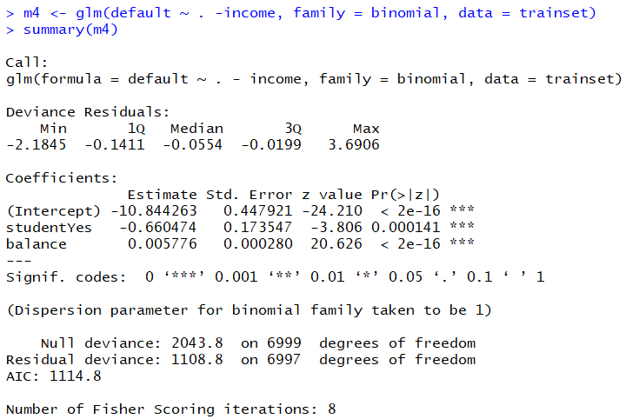
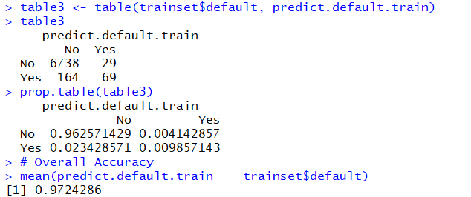
Train the coefficient

Slide 20
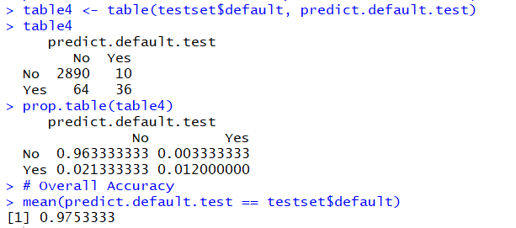
Test on the test set
Train or Test set has higher accuracy?

Slide 21
Why predict loan default & What other consideration?
By able to predict loan default, the financial institute can reduce bad debt.
Other consideration could include:
Macro economic like unemployment rate and GDP
Abnormal situation like Covid

Slide 22
Other Considerations
Residual
Not normal distribution
Correlation with X or Y
Multicollinearity – Relationship Between Variable
Time Series – Correlation between the rows
Is this dataset good enough to generalize the prediction? Split the date into Train and Test, Cross Validation, Bootstrap.
Notes:
Teach later in the class

Slide 23
Other models
Non-Linear
Polynomial
Log
Exponential
Quantile
Adaptive
https://www.dropbox.com/sh/m03zs4hd497rnk7/AABZ_o5g1MHKE7wUvvXYPWACa?dl=0
Notes:
Please let me know if you are keen in advance regression, we can discuss separately due to time constraint in class.

Slide 24
Programming Activities (B)
Passexam.csv
Rating.csv
Deliverables:
Check the significant of both the independent variable (X) from t-test and the regression formula (f-significant)
Find out the Accuracy (for classifier or categorical) or RMSE (for continuous)

Slide 25
Presentation & Discussion (1)
We analyze how debt payments may be influenced by income (measured in $1,000s) and the unemployment rate(measured in %). The sample regression equation is
(Debt) =20+10Income+0.6Unemployment
Interpret the regression coefficients.
Use the coefficients to predict debt payment if income is $80,000 and the unemployment rate is 7.5%.

Slide 26
Check Your Understanding
Regression as Prediction
Types of Regression
Other consideration

