Slide 1
New York city: Where to live for food loving tourist?
Kevin Teo

Slide 2
Motivation
Due to limited time tourists have in a city, they may not have sufficient time to try out all the different cuisines the city has to offer
What if we are able to use data analysis to determine where is the best location to stay for different cuisines?

Slide 3
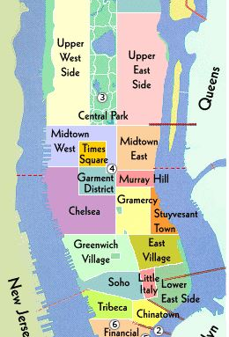
Background
Manhattan has a number of well defined districts, such as Soho, Tribeca and Harlem
Almost all ethnic cuisines are well represented in New York City, both within and outside the various ethnic neighborhoods

Slide 4
Methodology
By investigating the neighborhoods in Manhattan, we will segment and link food options to a nearby neighborhood
The food options are: pizza shops, cafés and American diners

Slide 5
Process workflow
Retrieve overall New York City data
Use geopy library to get coordinates of each neighborhood
Slice the original data frame into the five boroughs, keeping the Manhattan data frame
Using foursquare API, retrieve venues near each Manhattan neighborhood
Use k-means clustering to segment the venues
Analyze the resulting data and come to a conclusion for the end-user

Slide 6
Results

Slide 7
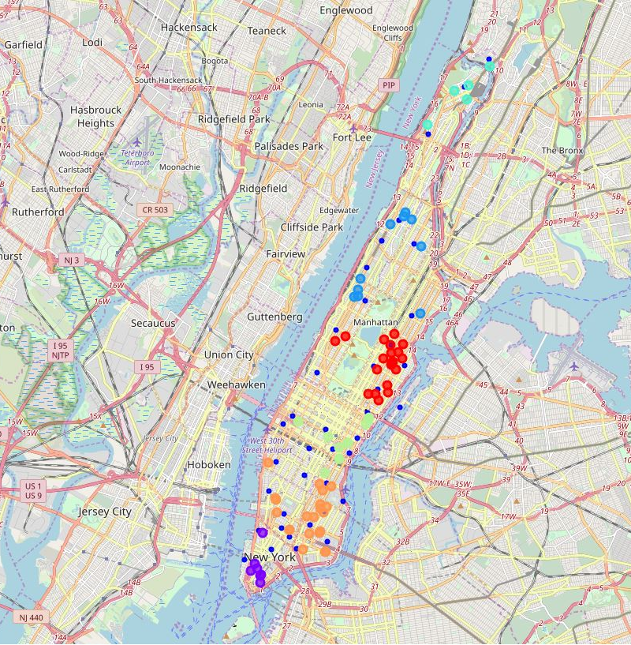
PIZZA LOVERS
For pizza lovers, the clustering suggest that the optimal places to stay are near the red and orange venues
Some of the neighborhoods in that location include Lower East Side and Carnegie Hill
Between these two clusters, they contain 55.4% of the sourced pizza locations

Slide 8
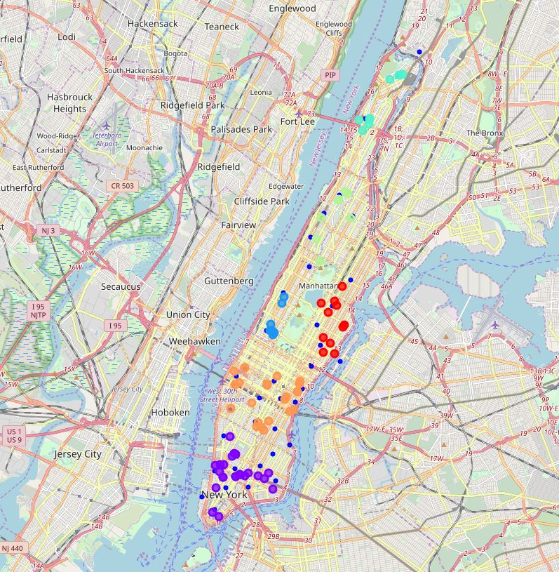
café LOVERS
For café lovers, the clustering suggest that the optimal places to stay are near the purple and orange venues
Some of the neighborhoods in that location include Tudor City and Tribeca.
Between these two clusters, they contain 57.3% of the sourced café locations

Slide 9
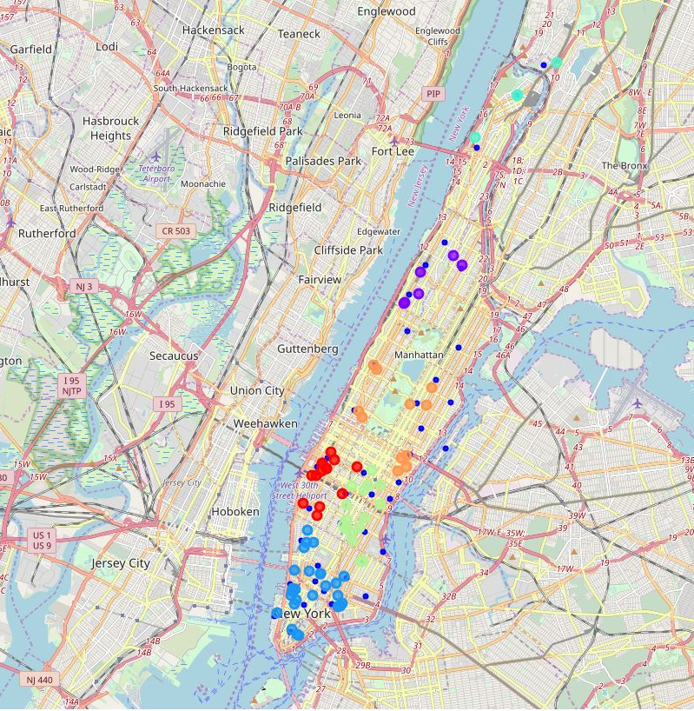
American diner LOVERS
For American diner lovers, the clustering suggest that the optimal places to stay are near the blue venues
Some of the neighborhoods in that location include Chinatown and Tribeca.
For this cluster, it contains 33.3% of the sourced diner locations.

Slide 10
conclusion
Tourist can rely on data analysis and machine learning to do the hard work for them on deciding where to stay
Other improvements to the analysis could be including other factors like Airbnb prices and crime frequency of each neighborhood to give a clearer picture to the end-user
Further expansion of this project to include more food options, or a wider radius, or a larger segmentation number are all viable options.

