Slide 1
PCA
Of 3 datasets:
SIMP 0136 SOSS
VHS1256b simulation
Luhman 16b simulation

Slide 2
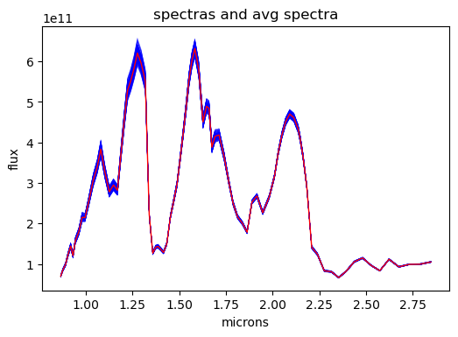
Luhman 16b simulated data

Slide 3
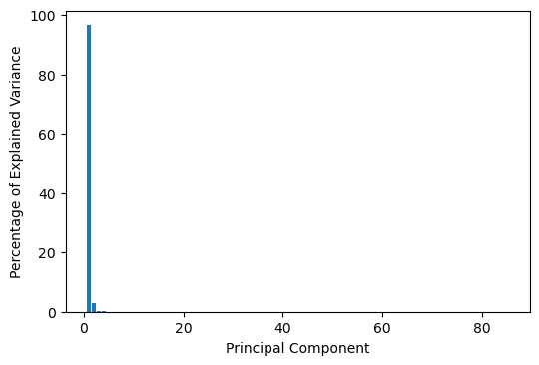
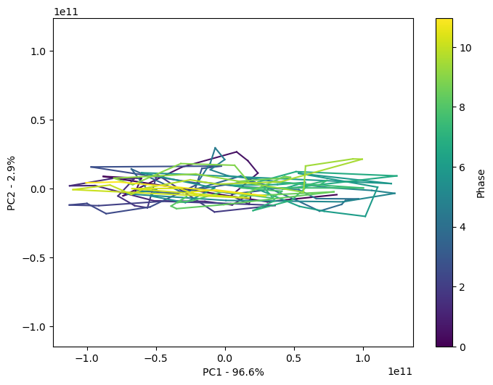
Luhman 16b

Slide 4
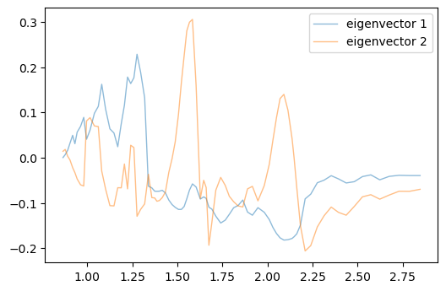
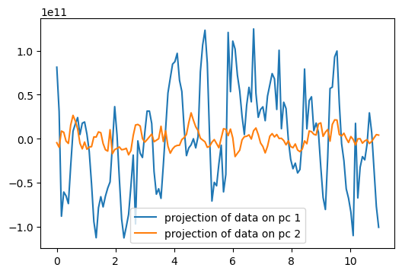
Luhman 16b eigenvectors and projections
phase

Slide 5
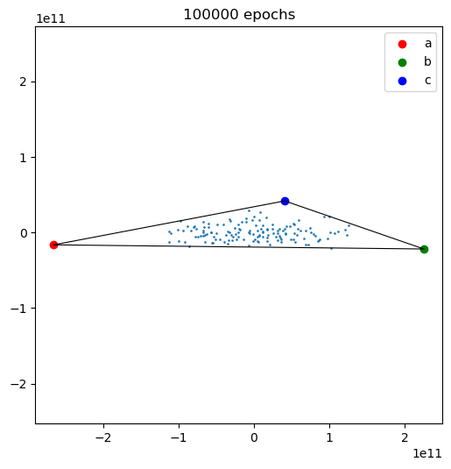
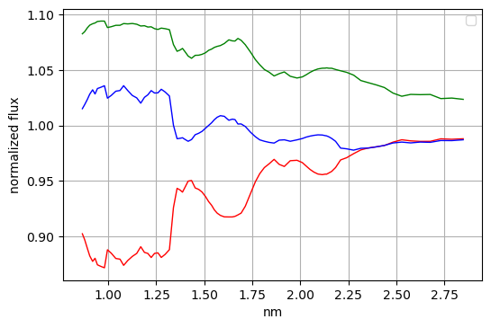
Luhman 16b PCP and simplex shrink-wrap
microns

Slide 6
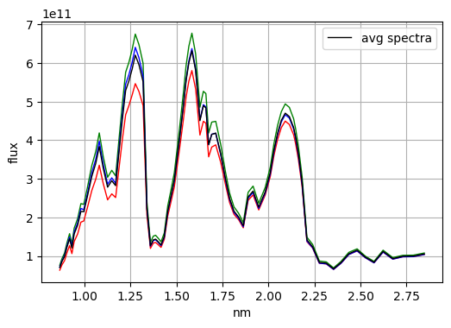
Luhman 16b simplex spectra
microns

Slide 7
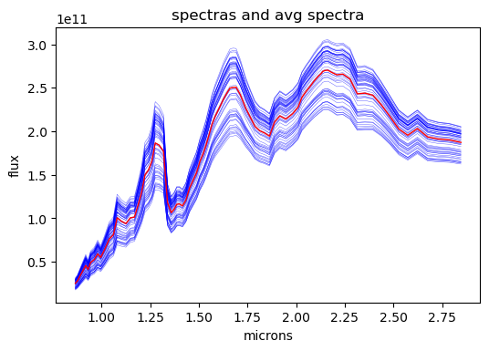
VHS 1256b simulated data

Slide 8
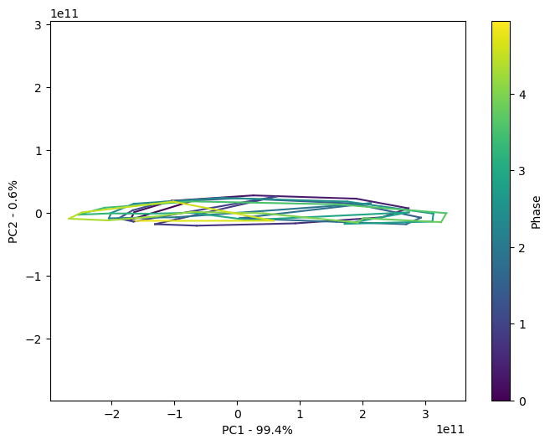
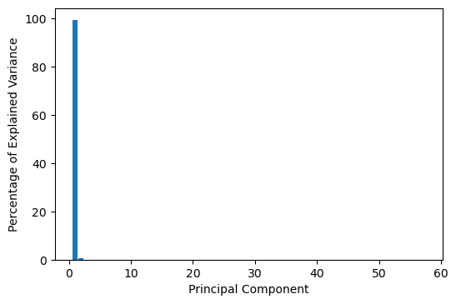
VHS 1256b

Slide 9
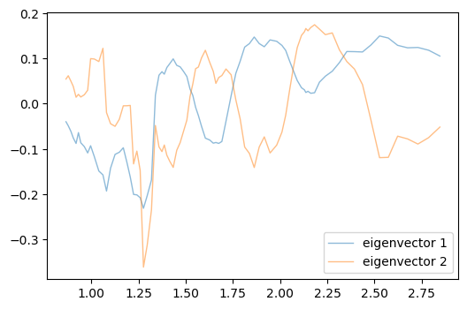
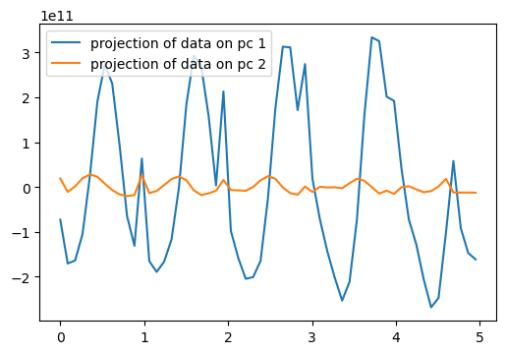
VHS 1256b eigenvectors and projections
phase

Slide 10
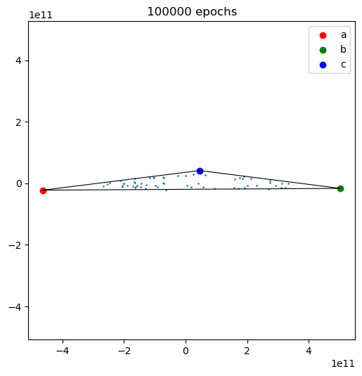
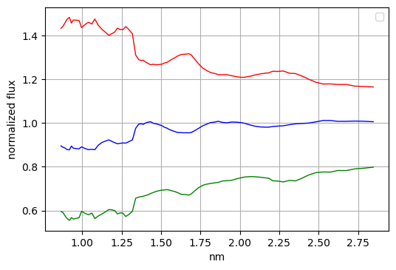
VHS 1256b PCP and simplex shrink-wrap
microns

Slide 11
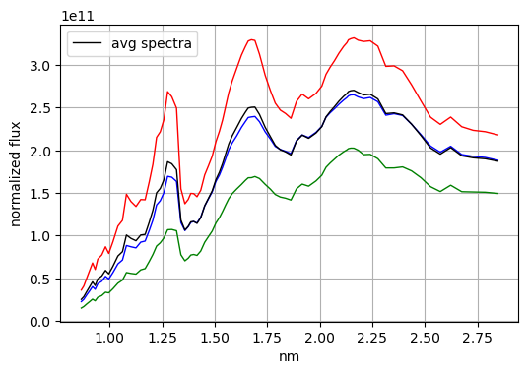
VHS 1256b spectra at simplex
microns

Slide 12
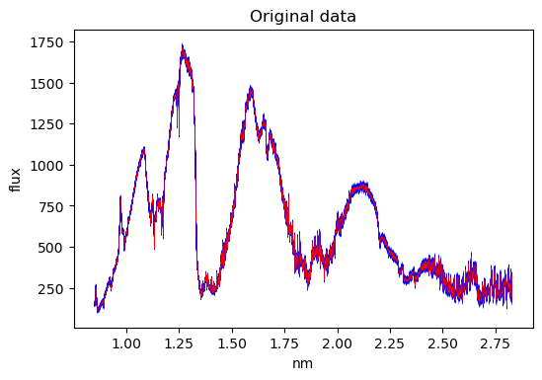
SIMP 0136 spectroscopic data
microns

Slide 13
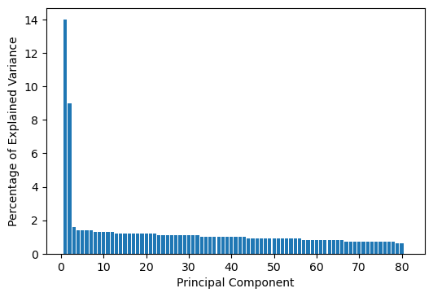
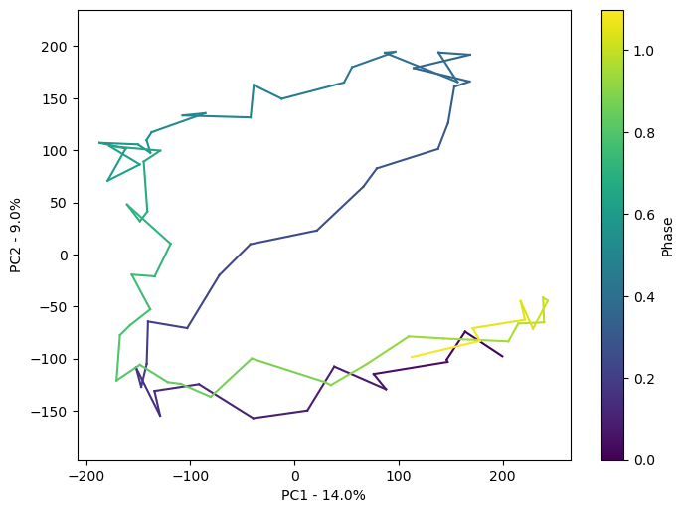
SIMP 0136

Slide 14
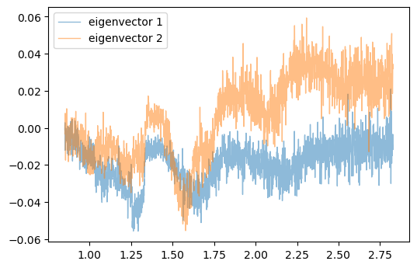
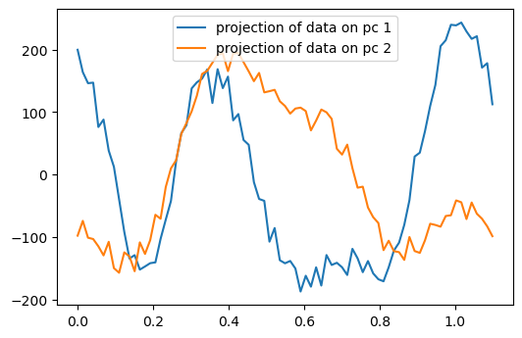
SIMP 0136 eigenvectors and projections
phase

Slide 15
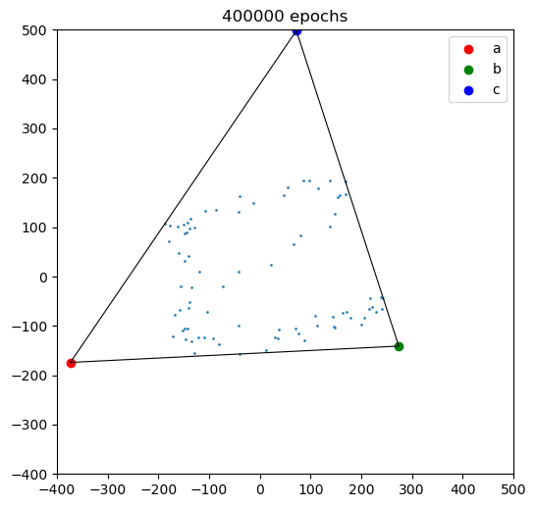
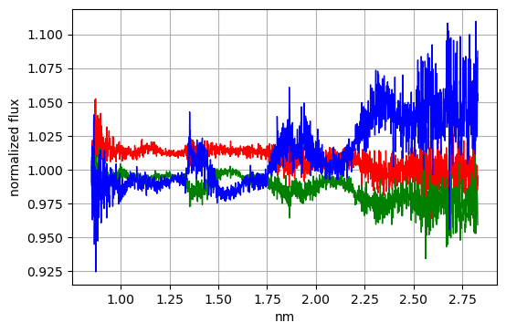
SIMP 0136 PCP and simplex shrink-wrap
microns

Slide 16
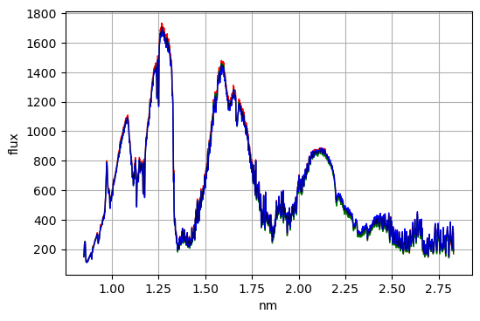
SIMP 0136 spectra at simplex
microns

Slide 17
Variance in real data is more complex
Try:
NMF
ICA
Longitudinal spectra retrieval

