Slide 2
Source identification
Timestamp
Jitter compensation
Early detection of problems

Slide 3
Source identification
Timestamp
Jitter compensation
Early detection of problems
Feature identification and classification

Slide 4
Source identification
Timestamp
Jitter compensation
Early detection of problems
Feature identification and classification
Real-time audio generation

Slide 5
Source identification
Timestamp
Jitter compensation
Early detection of problems
Feature identification and classification
Real-time audio generation
Click tracks

Slide 6
Source identification
Timestamp
Jitter compensation
Early detection of problems
Feature identification and classification
Real-time audio generation
Click tracks
Persistent storage

Slide 7
Source identification
Timestamp
Jitter compensation
Early detection of problems
Feature identification and classification
Real-time audio generation
Click tracks
Persistent storage
Time domain visualization (python/bokeh)

Slide 8
…
Source identification
Timestamp
Jitter compensation
Early detection of problems
Feature identification and classification
Real-time audio generation
Click tracks
Persistent storage
Time domain visualization (python/bokeh)

Slide 9
…
Source identification
Timestamp
Jitter compensation
Early detection of problems
Feature identification and classification
…
Join
Real-time audio generation
Click tracks
Persistent storage
Time domain visualization (python/bokeh)

Slide 10
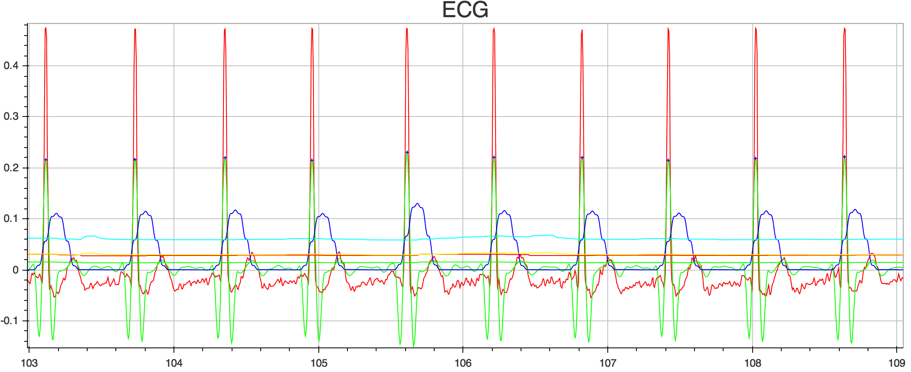
Raw ECG
Fiducial marking the peak of the R wave
MWI
Adaptive thresholds (4)
Bandpass Filtered ECG

Slide 11
