Slide 1
RESTAURANT-PLUG
By: Tolu Omotunde
10/22/2020

Slide 2
Agenda
Project Overview
Key Questions
Literature Review
Data Sources
Model Building Process
Model Metrics Evaluation
Deployment Process
Postmortem & Future Research

Slide 3
Project Overview
WHY
Currently, restaurant labels (like classy ambience, outdoor seating, etc.), are manually selected by Yelp users when they submit a review.
WHAT
Data was from Kaggle’s Yelp Restaurant Photo Classification Competition
HOW
Built a 3 Stage Classifier utilizing Frameworks like Caffe and Sckit-Learn to classify restaurant images
At Yelp, there are lots of photos and lots of users uploading photos.
Testing Set: 1,190,225 photos of 10,000 restaurants
Deployed the model to an App where users can perform real time prediction of uploaded restaurant images
Users can also get the closest restaurants for a predicted image class and weather forecast at different time points. This enables them to plan their visit accordingly
Selecting the labels is optional, leaving some restaurants un- or only partially-categorized.
I aimed to solve this problem by providing automatic classification of restaurants using Yelp’s photo dataset
Training Set: 234,842 photos of 2,000 restaurants

Slide 4
Key Questions
Does your favorite Ethiopian restaurant take reservations? Will a first date at that authentic looking bistro break your wallet? Restaurant labels help Yelp users quickly answer questions like these.
Currently (2015), restaurant labels (like classy ambience, outdoor seating, etc.), are manually selected by Yelp users when they submit a review. Rather than rely on a user who may not manually fill in all the labels at review time, can I train a model that accurately labels different restaurants?
Capturing this information can be used for recommendation systems, restaurant search filtering, ratings, etc.

Slide 5
Literature Review
Wei et al. [2] proposes a model to predict multiple labels for images using a CNN pretrained on a large-scale single-label dataset such as ImageNet, aggregating predictions using max pooling.
Razavian et al. [3] suggests the use of transfer learning on features extracted from deep learning with convolutional nets to use as image representations.
Kraus et al. [4] experimented with utilizing global pooling layers with fully connected layers in a convolutional neural network to learn relationships between classes using an adaptive Noisy-AND pooling function

Slide 6
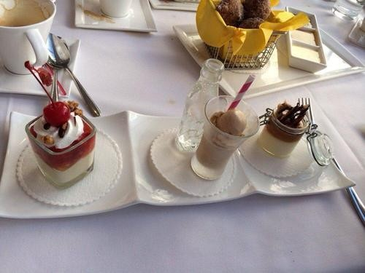
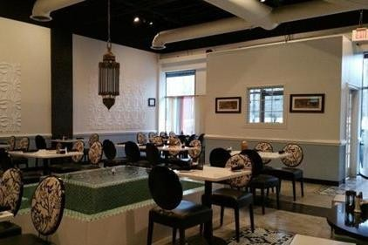
Data Sources
At Yelp, there are lots of photos and lots of users uploading photos.
Training Set: 234,842 photos of 2,000 restaurants
Testing Set: 1,190,225 photos of 10,000 restaurants
9 Different attributes in this problem
0: Good for lunch 1: Good for dinner 2: Takes reservations 3: Outdoor seating 4: Restaurant is expensive 5: Has alcohol 6: Has table service 7: Ambience is classy 8: Good for kids

Slide 7
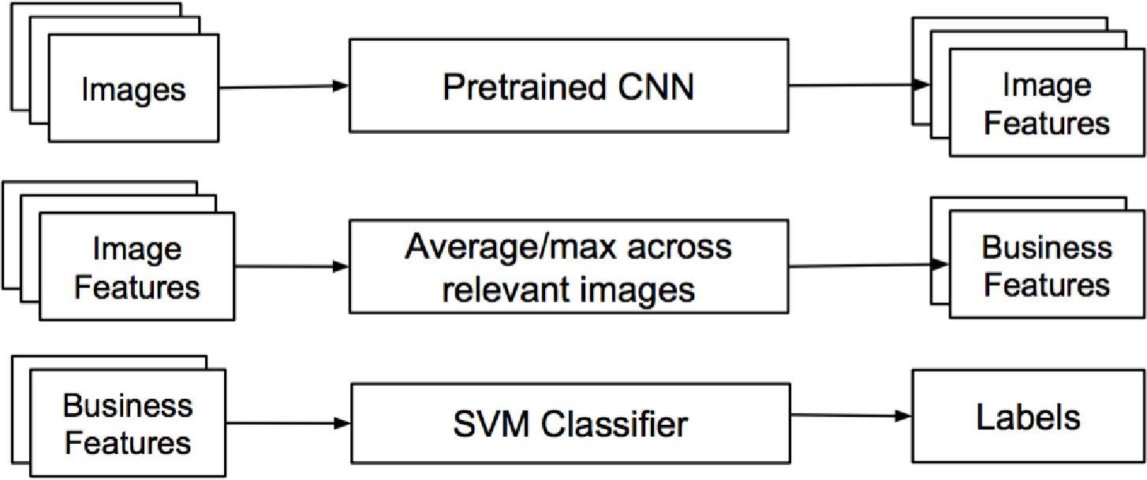
Model Building Process

Slide 8
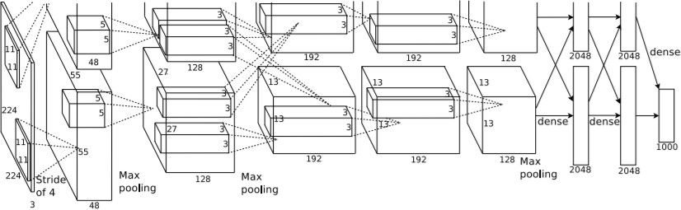
Model Building Process
Image Feature Extraction – CAFFE Model
Fig. BAIR Reference CaffeNet
Input Size: 224×224×3
Convolutional Layer 1:
Convolutional Layer 3:
Fully Connected Layer 6:
Output: 4096×1
Fully Connected Layer 7:
Output: 4096×1
Number of Kernels: 384
Size: 3 × 3 × 256
Number of Kernels: 96
Size: 11×11×3
Stride: 4 pixels
Convolutional Layer 4:
Number of Kernels: 384
Size: 3 × 3 × 192
Convolutional Layer 2:
Number of Kernels: 256
Size: 5 × 5 × 48
Convolutional Layer 5:
Number of Kernels: 256
Size: 3 × 3 × 192

Slide 9
Model Building Process
Restaurant Feature Extraction
Having obtained these features for each image from CNN, relate the images to their associated network by merging the relevant image features together.
Each restaurant is represented by its “average” image features.
e.g. For a restaurant ‘r’, there are 50 images. ‘r’ can be represented by one 4096-vector which is the average of 50
feature vectors of size 4096.
Having converted our image features into business features, it is now time to train the classifier.

Slide 10
Model Building Process
Train different classifiers to predict 9-dimensional vectors for each restaurant, where each of the nine labels receives a 1 or 0 score relating respectively to the presence or absence of a label.
This is a case of “Multilabel Learning”, in comparison to multi-class learning where we predict one class out of multiple class options.
To do this, the following models were used:
- Support Vector One-vs-All Classifier (SVC)
- Random Forest Classifier (RF)
- K-Nearest Neighbor Classifier (KNN)
- Extra-Trees Ensemble Classifier
- Stacked Classifier1 => stacking of SVC, RF, KNN and Extra-Trees Classifiers
- Stacked Classifier2 => stacking of 1 RF and 3 KNN
Classifiers

Slide 11
Model Metrics Evaluation
Used Mean F1-Score as the evaluation metric for our multi label classification. F1 provides a good comparison between Recall and Precision
𝑁
1
𝑀𝐹𝑆 = _{𝑁} ෍ 𝑓_{𝛽} (𝐶_{𝑖} )
where, 𝑁 is row's size of train set, and 𝑓_{𝛽} is a single class label. In general, 𝑓_{𝛽 =} 1.
Used a 10-fold Cross Validation strategy
 | MFS | Variance | Training Time (sec)
SVC | 0.79910 | 0.01443 | 295.4199
RF | 0.80516 | 0.01443 | 17.7761
KNN | 0.80656 | 0.01132 | 2.7335
Extra-Trees | 0.76833 | 0.03619 | 3.6577
Stacked1 | 0.79852 | 0.01412 | 197.6927
Stacked2 | 0.77767 | 0.01467 | 34.3231
The KNN and RF clearly outperformed the other models considerably. KNN
was chosen for the rest of the analysis.

Slide 12
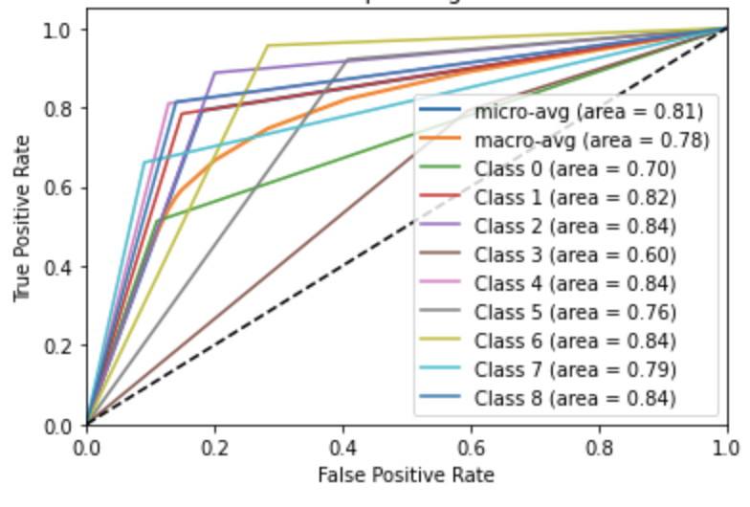
Model Metrics Evaluation
Receiver Operating Characteristic (ROC) Curve

Slide 13
Deployment Process
1
2
3
4
Step
Step
Step
Step
Location data is passed to a Flask server via a Javascript Ajax request.
The location data is used to make an API call to Open Weather API to get the coordinates (Lat & Lon) as well as Weather Forecast data
The Caffe model is used to extract the features from the image. An average of the extracted features is then passed to the trained KNN Classifier.
The result from the model is in this form below:
[(2, 3, 4, 5, 6, 7)]
The coordinates gotten from Open Weather API and the Restaurant Classes from the 3-Stage Model makes a call to Google Places API. The first 20 Restaurants ranked by dominance for each class is retrieved as well as their metadata
User uploads an image and enters location of interest (City, Country Code) as well as weather forecast units (Metric/Imperial)

Slide 14
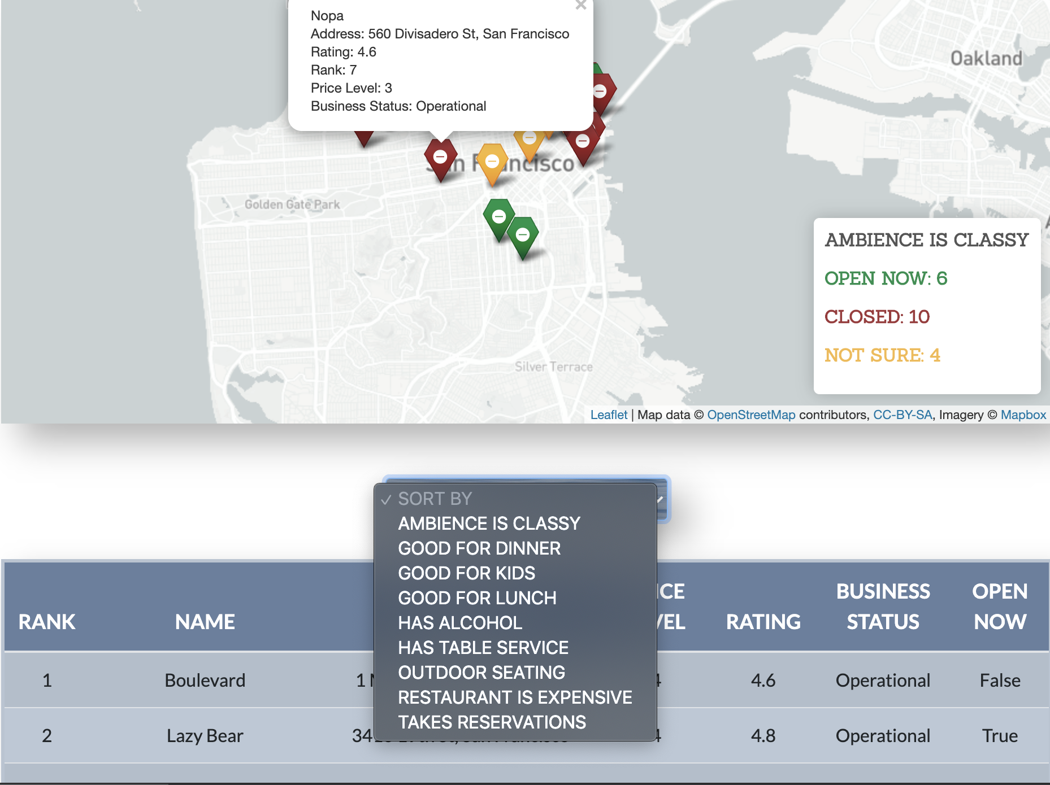
Deployment Process

Slide 15
Postmortem + Future Research
Key issues we encountered:
Ran into issues installing Caffe on my Mac so I had to train the model on Google Collab due to time constraint and compute resources
Could on only test on 395500 photos due to Google Collab runtime constraint
Future research recommendations:
Hyperparameter tuning of the model with GridSearch and RandomSearch to improve model performance
Add a feature for the users to make reservations and provide feedback after their visit to the restaurant. This feedback can help in retraining the model and better user experience.
Incorporate local traffic data from Google Map to better help users plan their visits to Restaurants
Connect with local restaurant owners on how my product can further improve their customer experience

Slide 16
References
Huang, Jade. "Multiple Instance Multi-Label Learning for Yelp Restaurant Photo Classification."
Z. Zhou, M. Zhang, S. Huang, and Y. Li. MIML: A framework for learning with ambiguous objects. CoRR, abs/0808.3231, 2008.
A. S. Razavian, H. Azizpour, J. Sullivan, and S. Carlsson. CNN features off-the-shelf: an astounding baseline for
recognition. CoRR, abs/1403.6382, 2014.
O. Z. Kraus, L. J. Ba, and B. J. Frey. Classifying and segmenting microscopy images using convolutional multiple instance learning. CoRR, abs/1511.05286, 2015.

Slide 17
Thank you! Questions?

