Slide 1
DOAA CA2
Made by: Teo Xu Jie
Admin No: 2317719

Slide 2
Contents
Gitlab and branches setup
Setup of Scrum board
Wireframe Design
APIs Testing
CI/CD
- Running Docker and Deployment to Internet
Demonstration

Slide 3
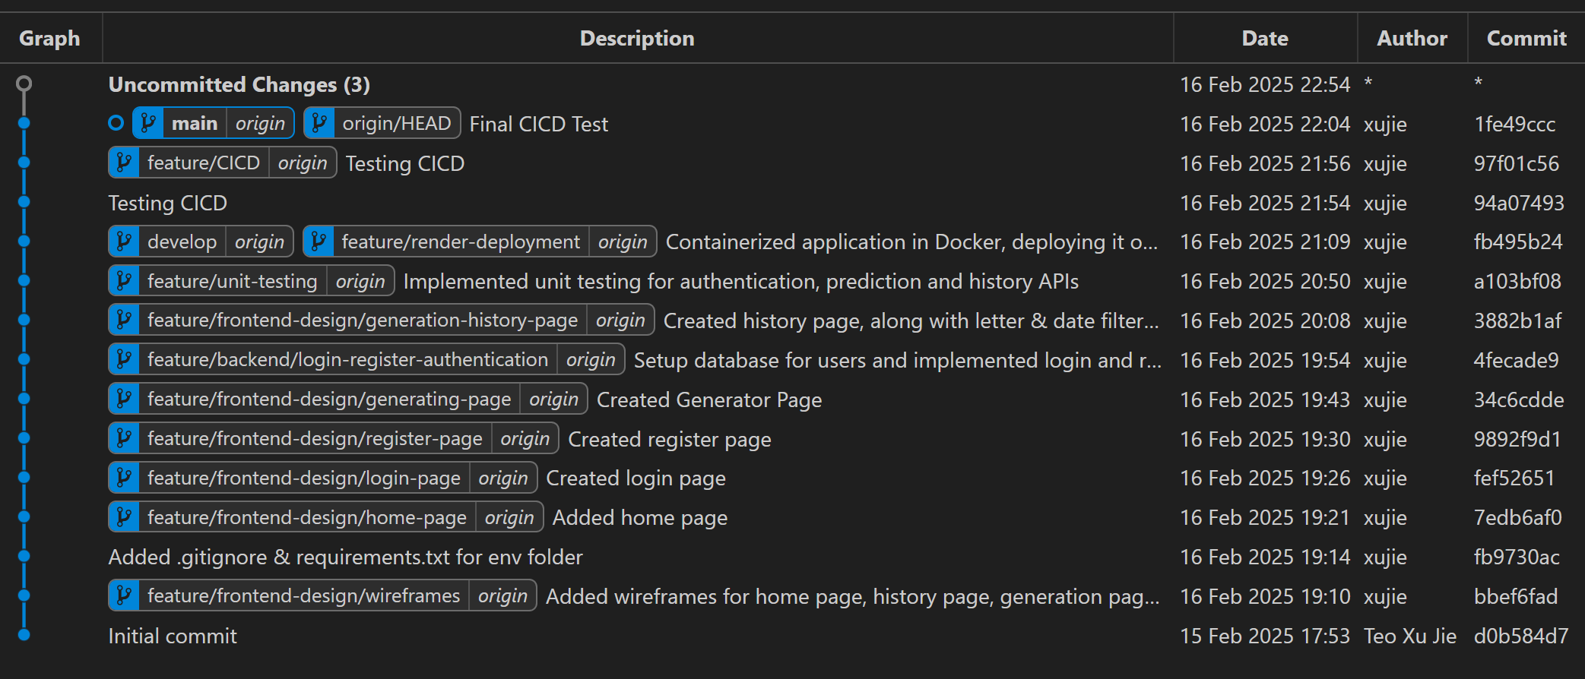
Gitlab and branches setup

Slide 4
Gitlab and branches setup
Main and Develop Branches – The main branch holds stable, production-ready code, while develop is used for integrating new features before merging into main.
Feature Branches – Each new functionality is developed in a separate feature/* branch, such as feature/CICD for pipeline setup and feature/backend/login-register-authentication for user authentication.
Testing and Merging – Feature branches are tested individually, reviewed, and merged into develop, ensuring a clean and stable integration before moving to main.
Deployment Workflow – After passing tests in develop, the code is merged into main, triggering the CI/CD pipeline for automated deployment.

Slide 5
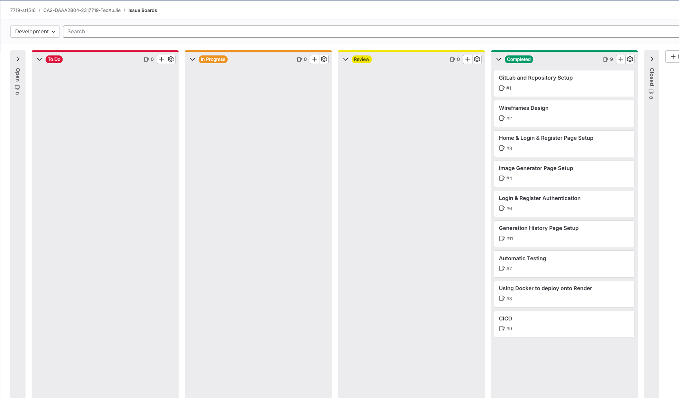
Setup of Scrum Board

Slide 6
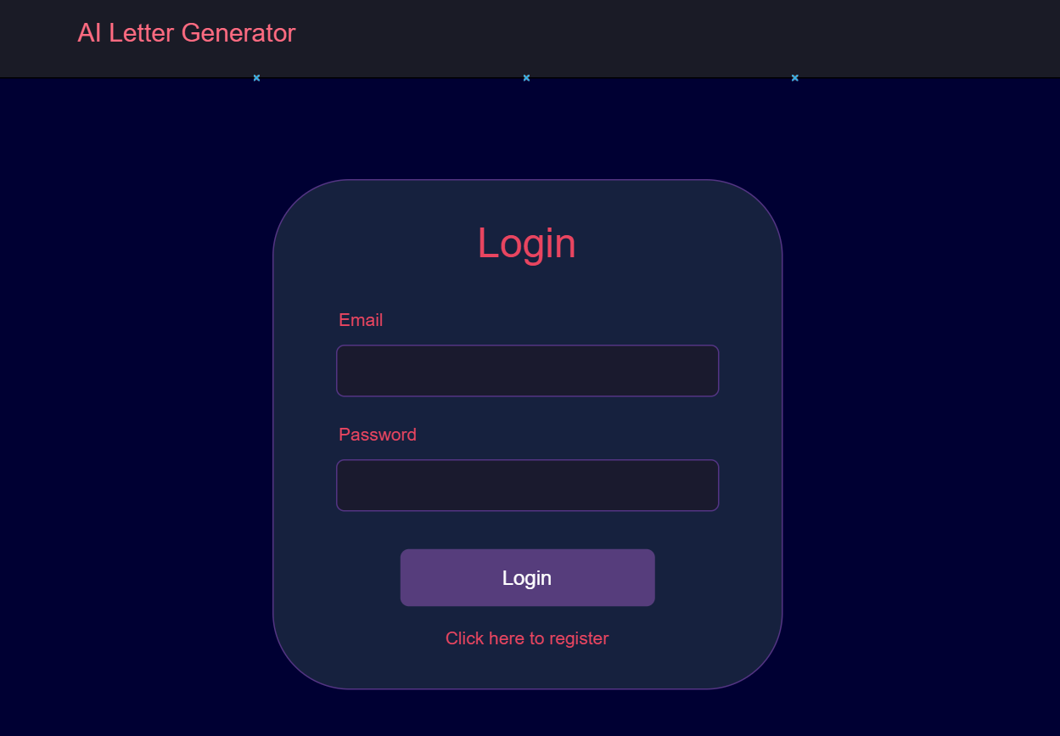
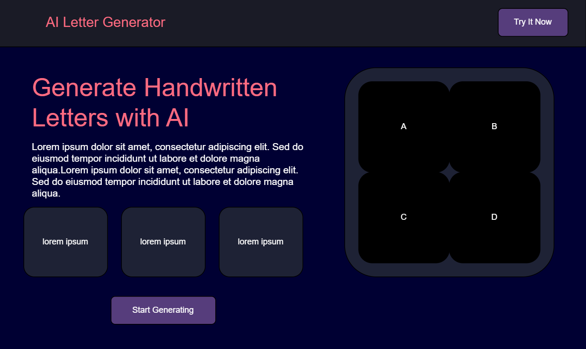
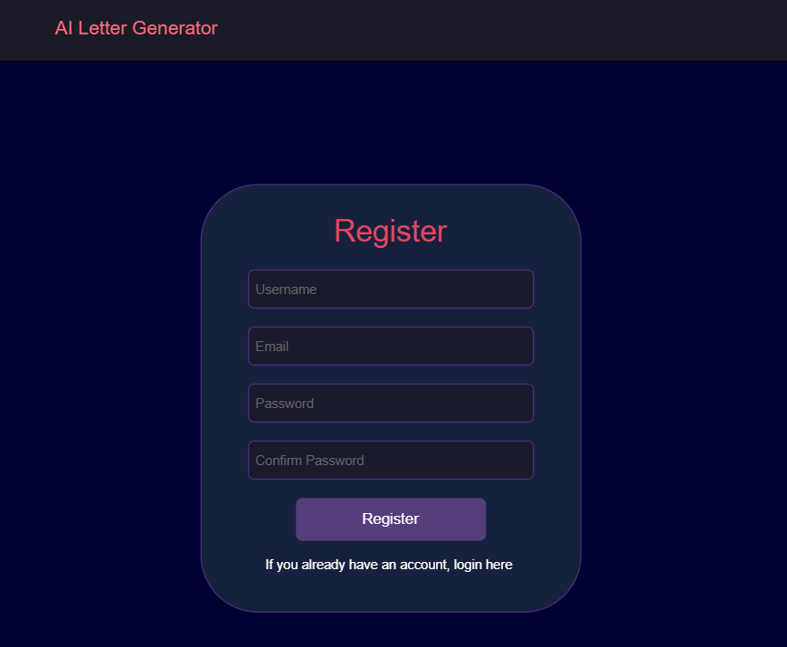
Wireframe Design

Slide 7
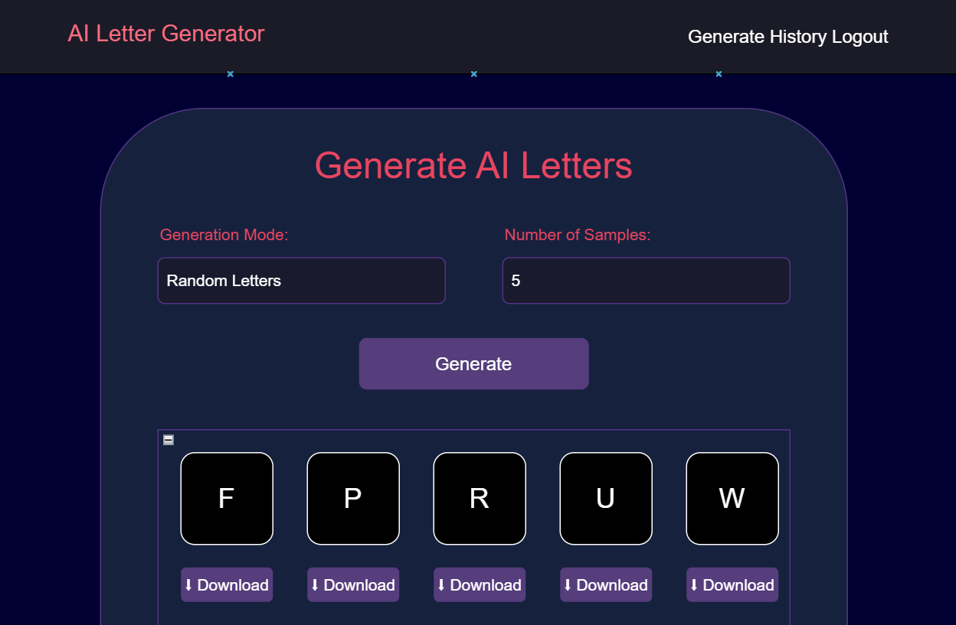
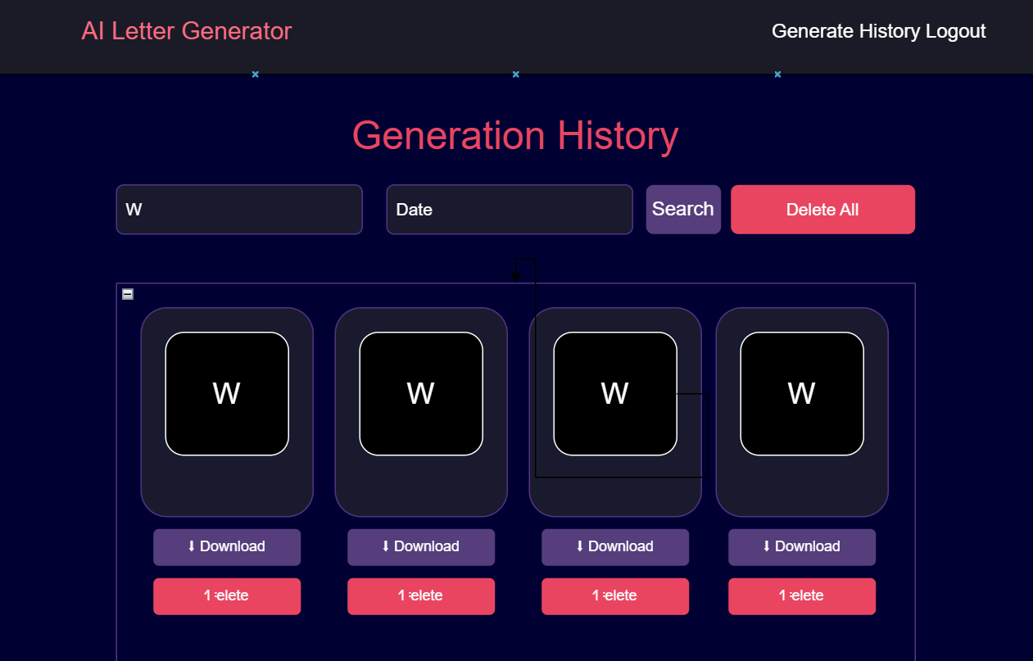
Wireframe Design

Slide 8
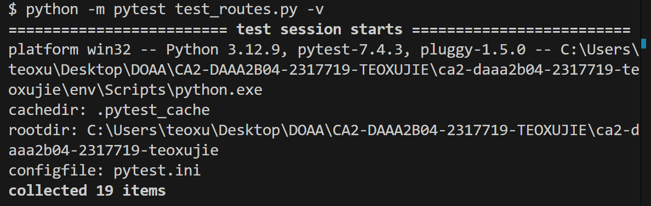
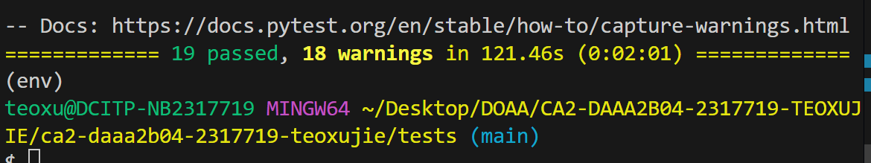
APIs Testing

Slide 9
APIs Testing
The application provides secure and reliable API interactions, covering user authentication, image generation, and history management. Each API is designed to handle both valid and invalid inputs, ensuring robust functionality.
My testing strategy includes validity, range, consistency, unexpected failure, and expected failure testing to validate inputs, maintain data integrity, and ensure smooth user experiences across all scenarios.
To ensure reliable AI-powered image generation, tests verify that each generated output is stored correctly, retrieved accurately, and meets user specifications under different conditions.
The system gracefully handles errors like malformed JSON, excessive inputs, or unauthorized access, providing clear feedback and maintaining stability, ensuring seamless performance even under edge cases.

Slide 10
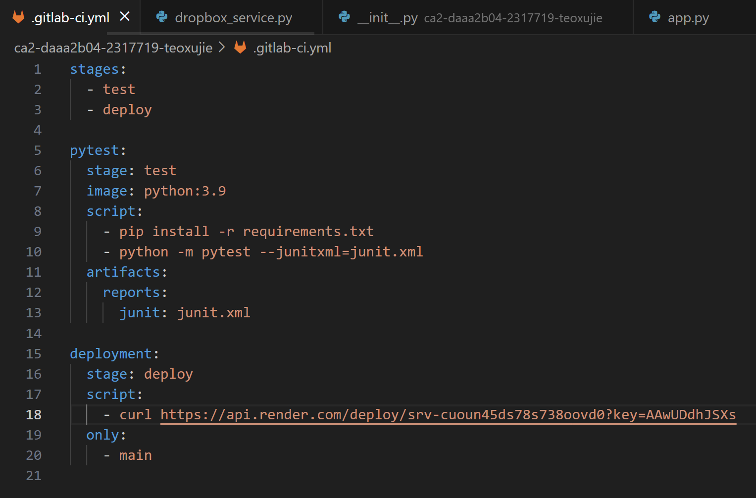
CI/CD
This GitLab CI/CD pipeline automates testing and deployment by running pytest for my unit tests in a Python 3.9 environment and saving test reports. If tests pass, it deploys the application to Render when changes are pushed to the main branch.

Slide 11
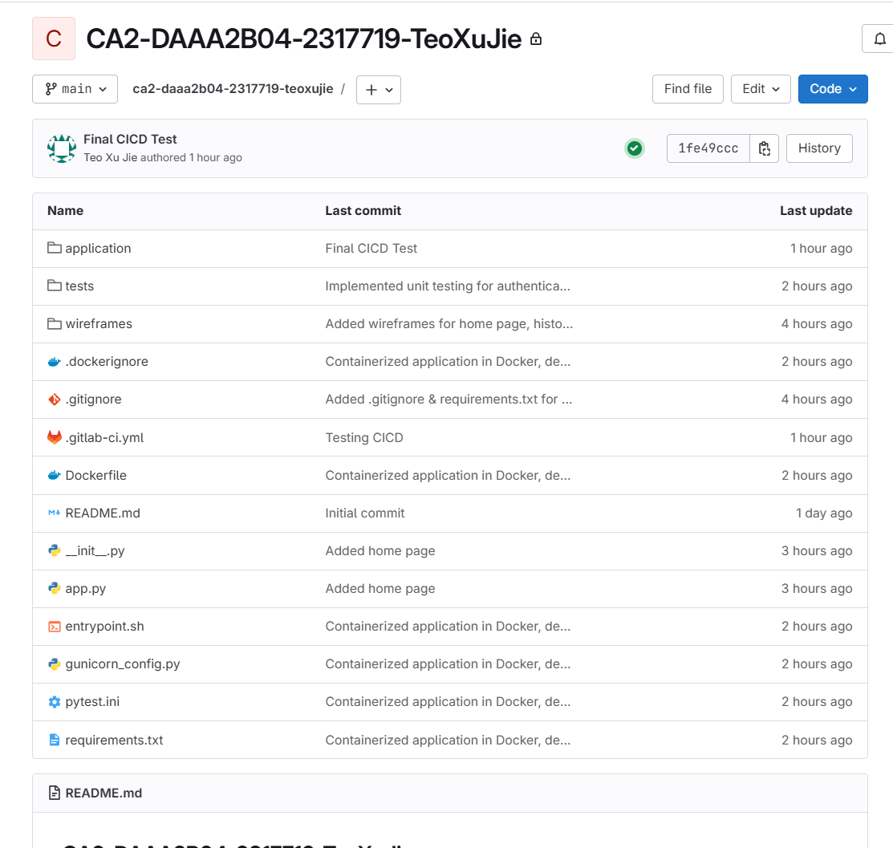
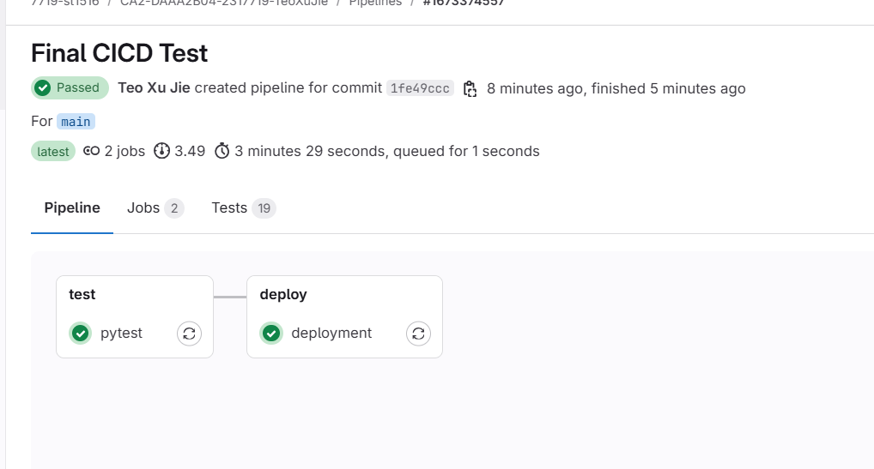
CI/CD
Here are the results:

Slide 12
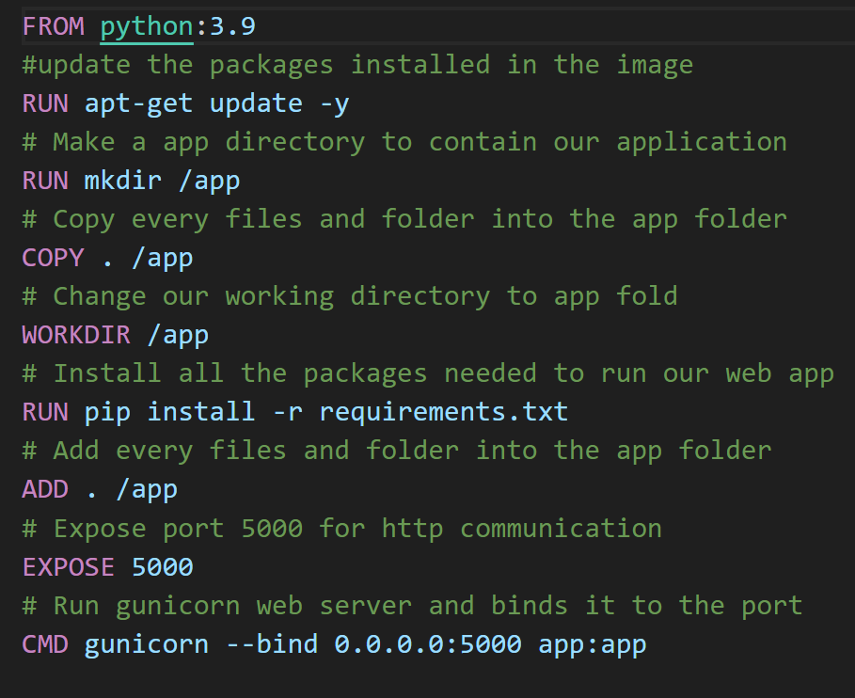
Docker & Deployment to Internet
This Docker file creates a containerized Python 3.9 environment for the web application by copying the app files, installing dependencies, and exposing port 5000 for communication. It runs the app using Guni corn, binding it to 0.0.0.0:5000, making it accessible for deployment on the internet.

Slide 13
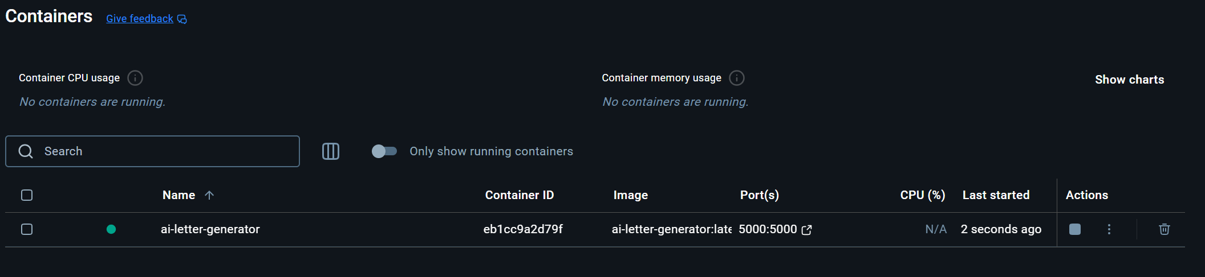
Docker & Deployment to Internet
I built a Docker image using docker build -t ai-letter-generator:latest ., which packaged my application and dependencies, then ran the container using docker run -d --name ai-letter-generator -p 5000:5000 -e FLASK_APP=run.py -e FLASK_ENV=development ai-letter-generator:latest, resulting in the running ai-letter-generator container as shown in the Docker dashboard.

Slide 14
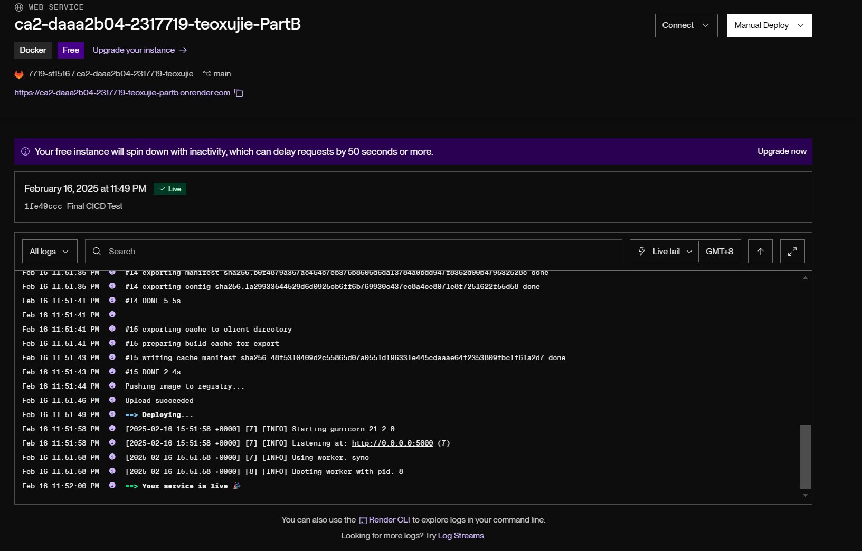
Docker & Deployment to Internet
I deployed the application to Render by pushing the Docker image to the registry via GitLab CI/CD, which automatically triggered a deployment using the Render API, starting the Guni corn server on port 5000, and confirming that the service is live.

Slide 15
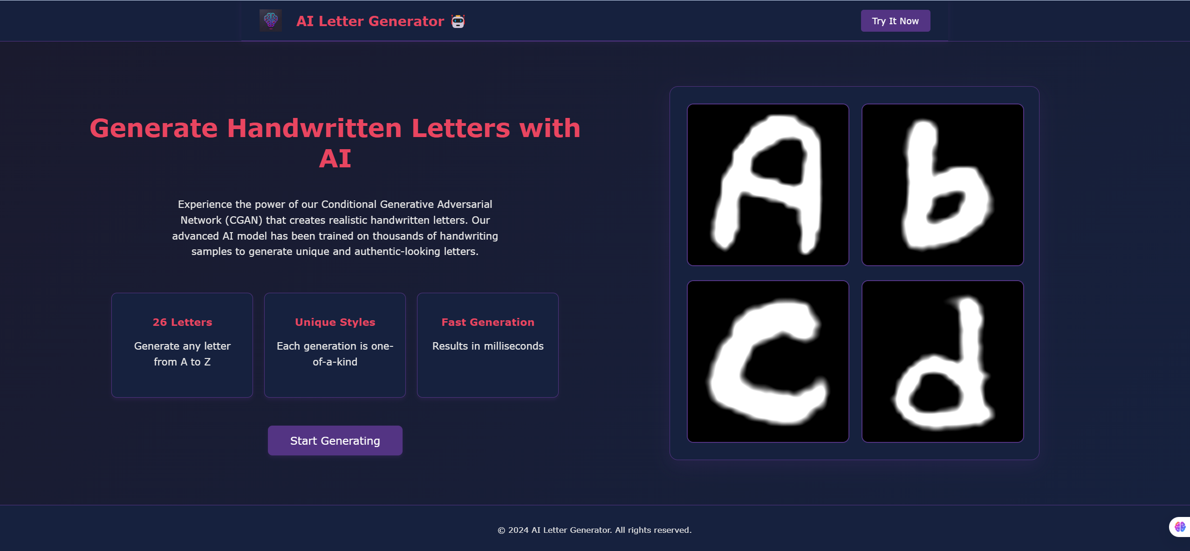
Click here to login

Slide 16
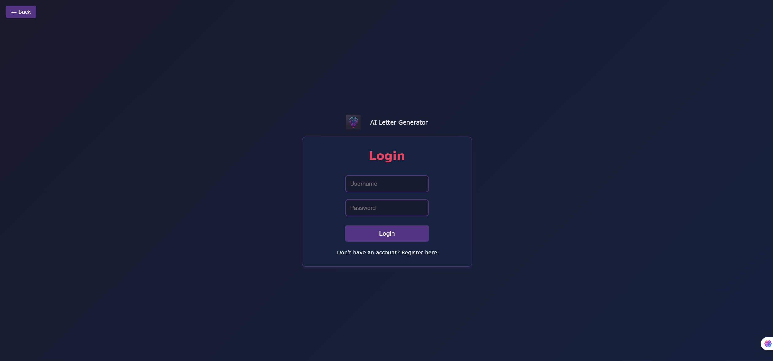
Click here to go back to home page
Key in username
Key in password
For new users, click here to register

Slide 17
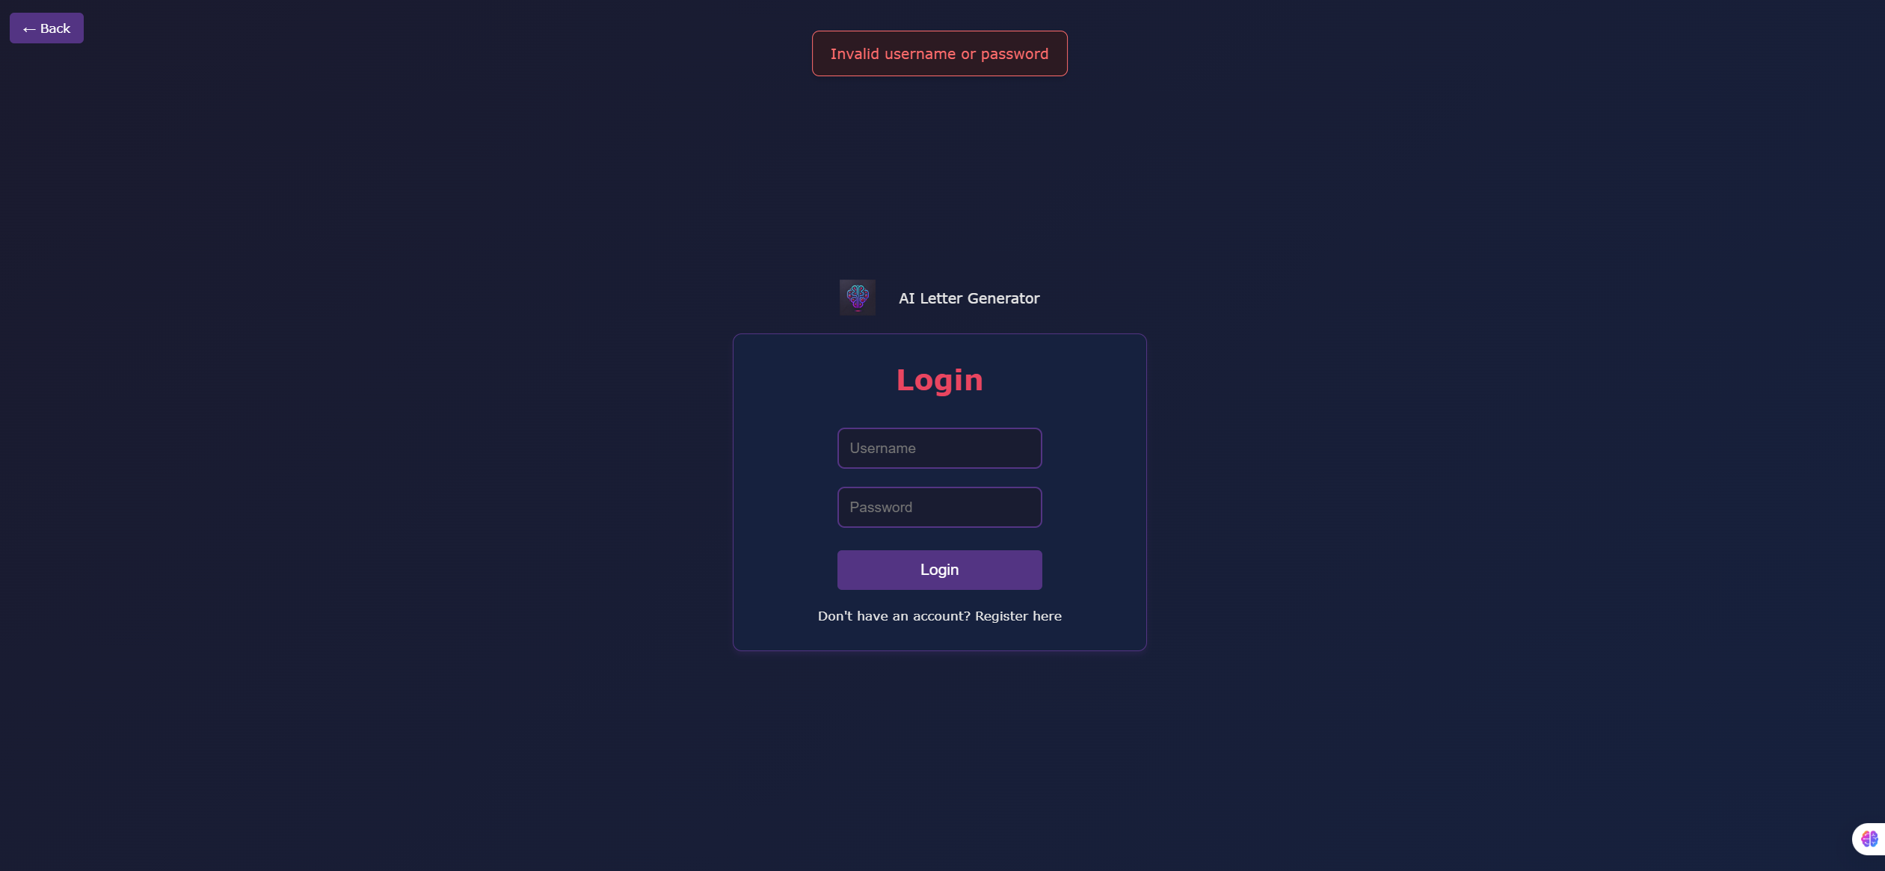
In the event where user has not registered

Slide 18
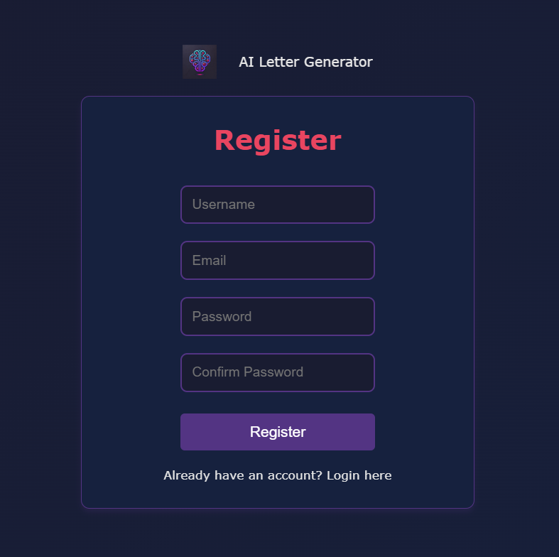
Key in username
Key in email
Confirm the same password
Click here to login if you already have an account

Slide 19
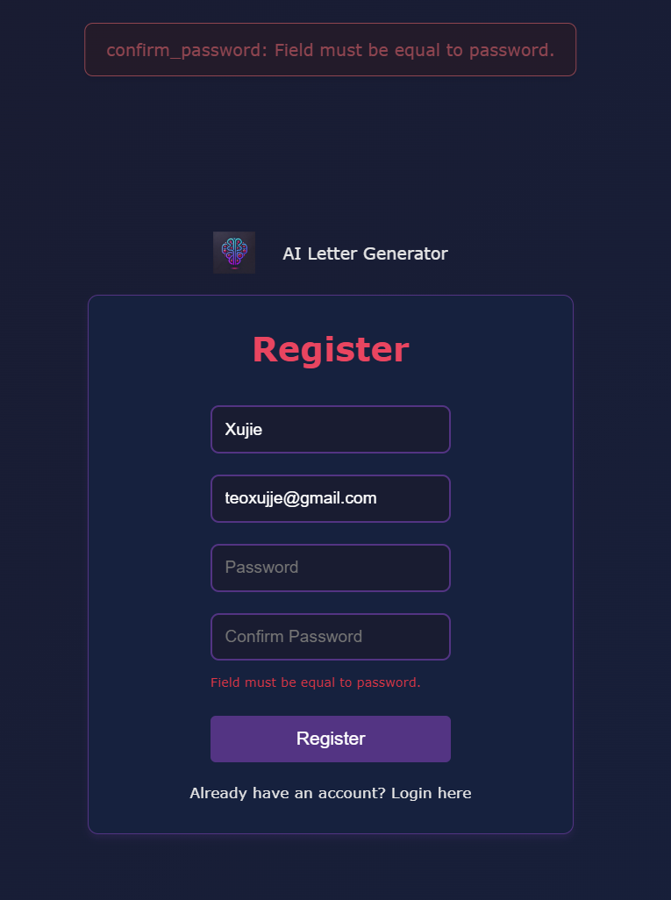
In the event where user does not key in matching passwords

Slide 20
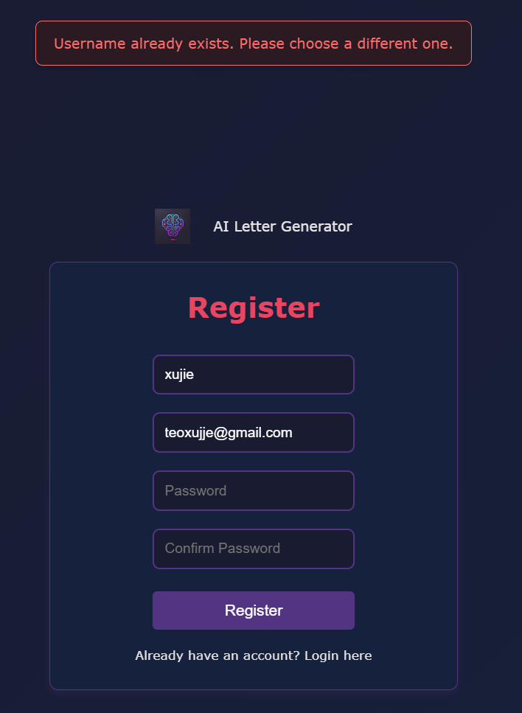
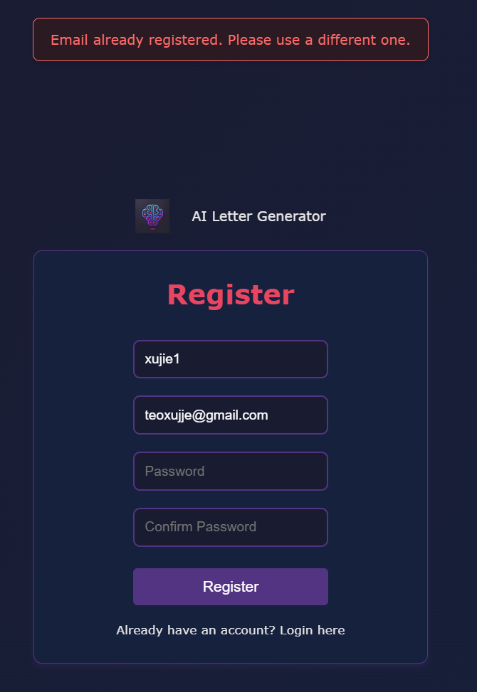
In the event where database already has that username/email

Slide 21
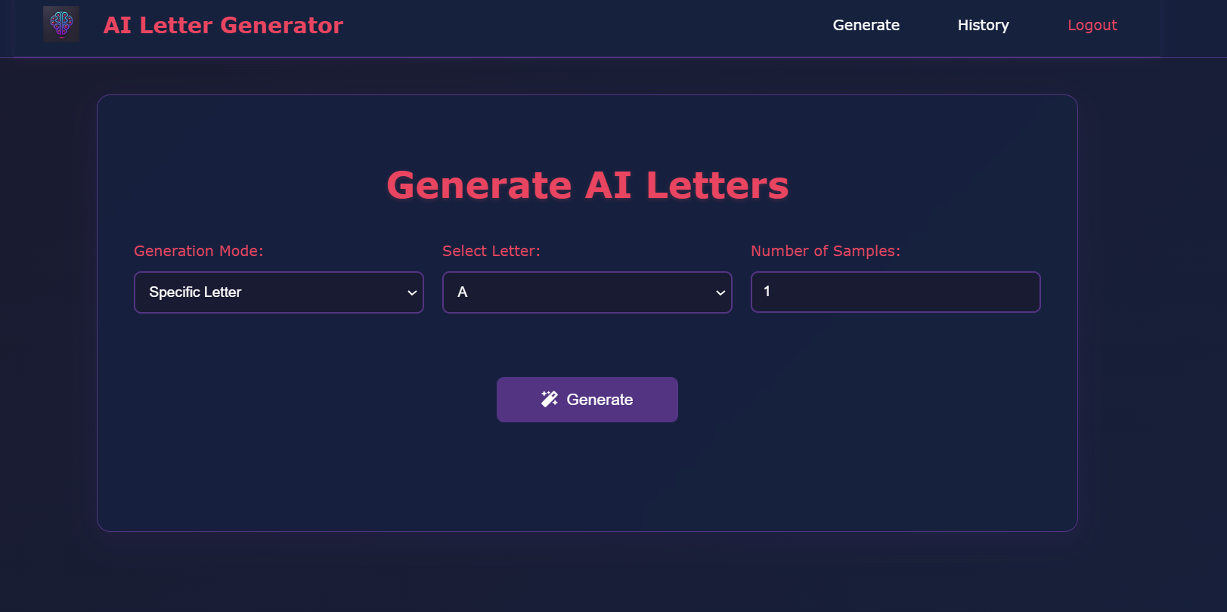
User has logged in!
Click here to log out

Slide 22
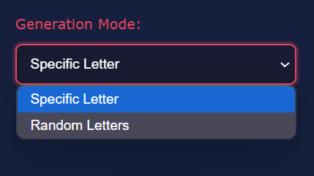
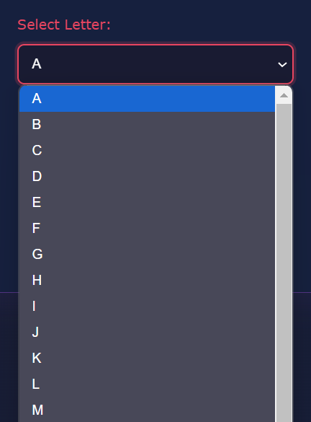
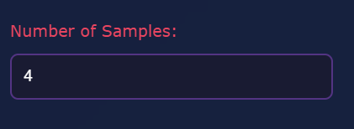
User can choose whether he wants the model to generate a specific letter or random images
User can choose the number of images generated

Slide 23
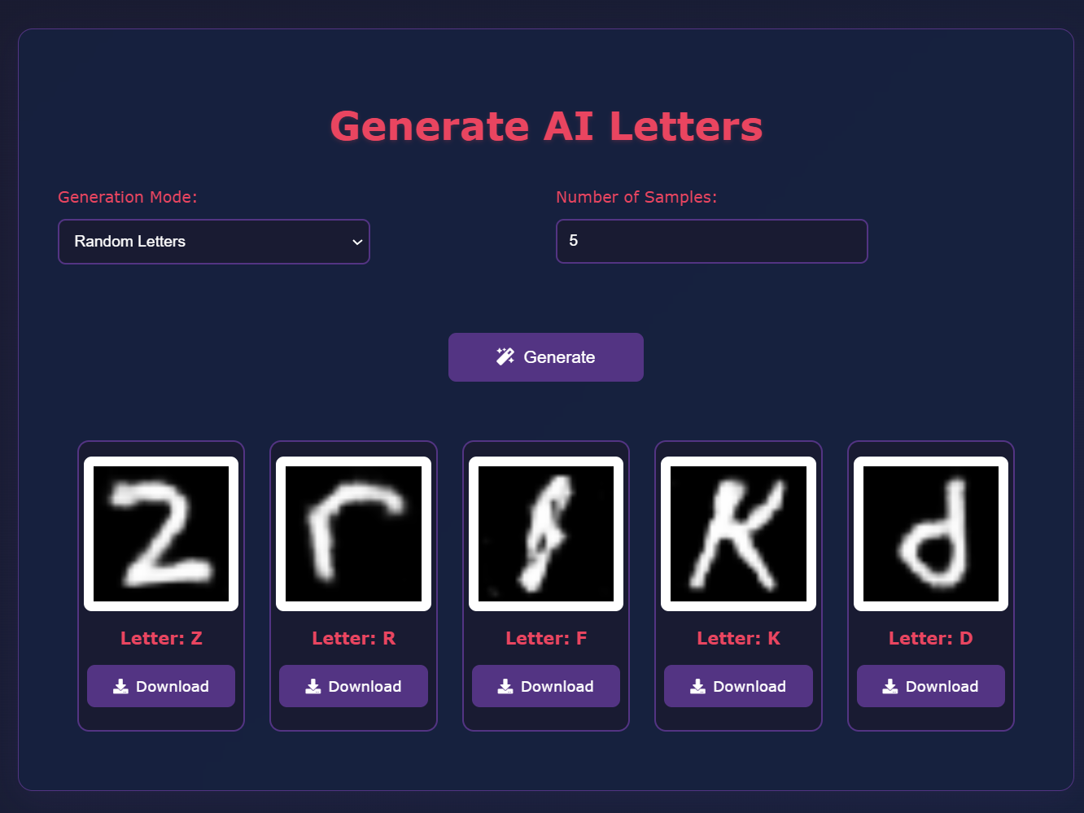
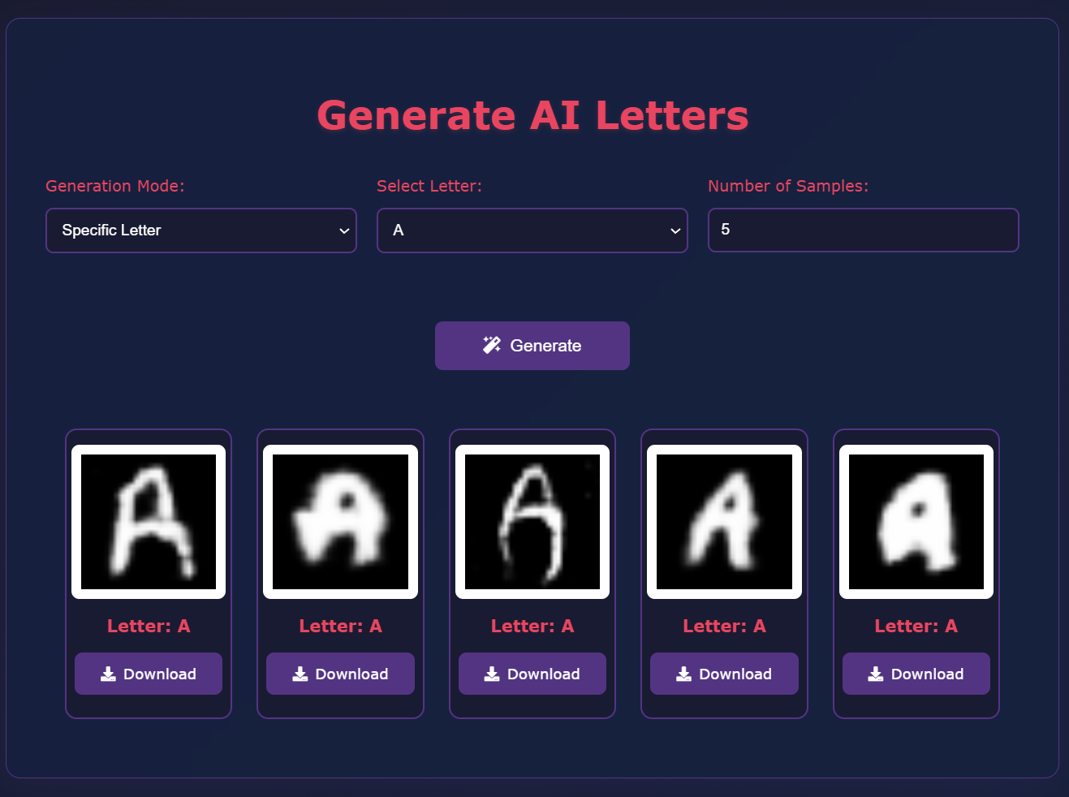

Slide 24
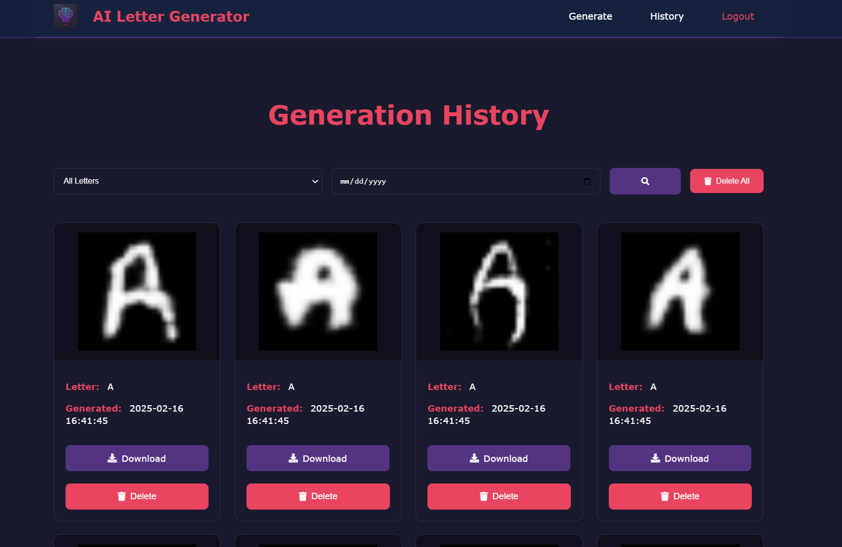
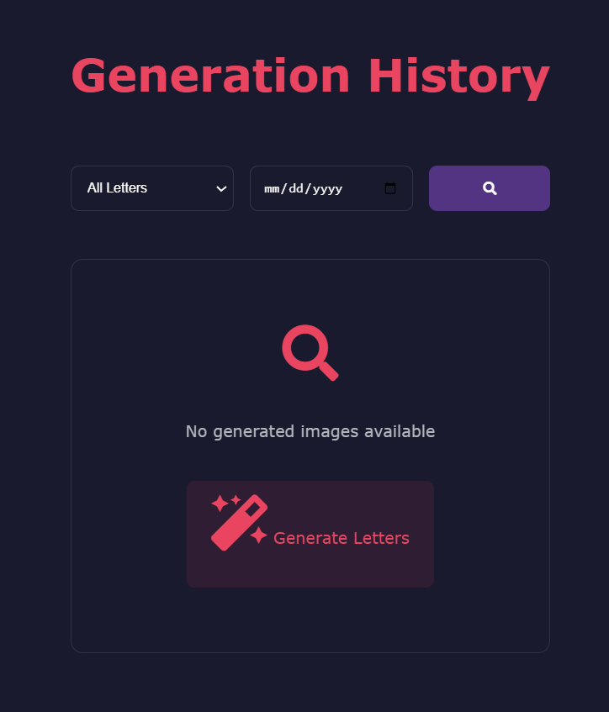
User can see past generated letters, download them, delete them and filter images by their letter, and the date in which they were created.
If there are no results searched using the filter ^

Slide 25
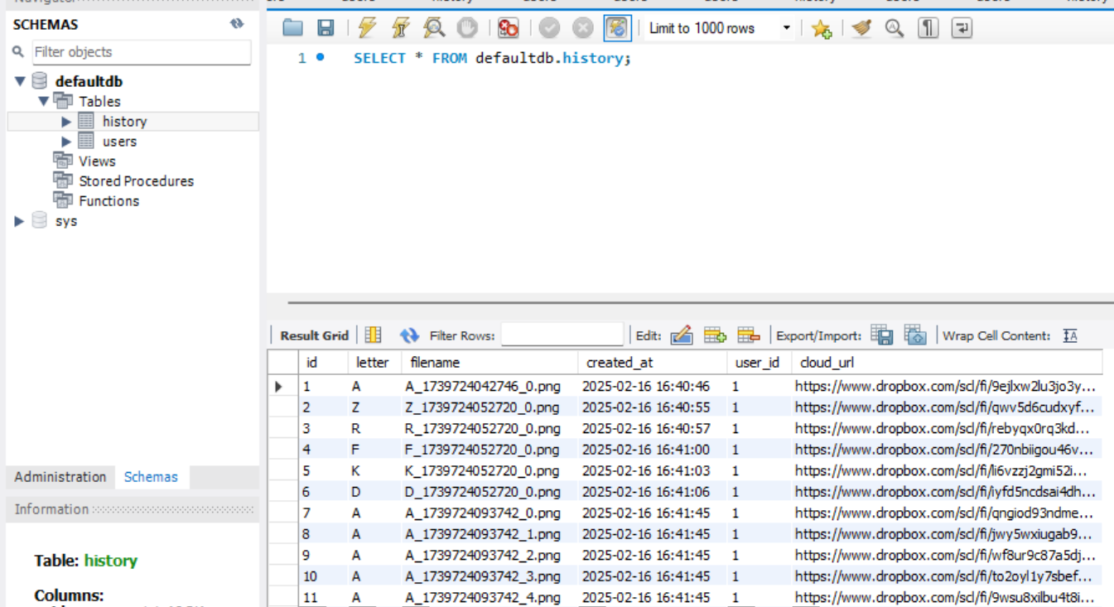
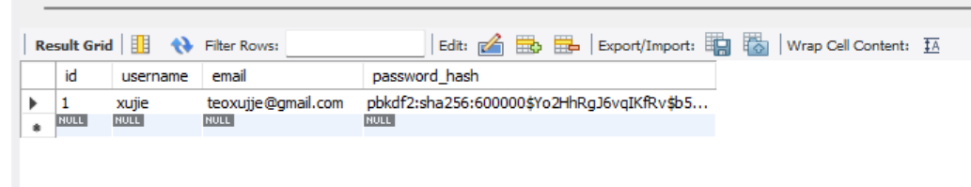
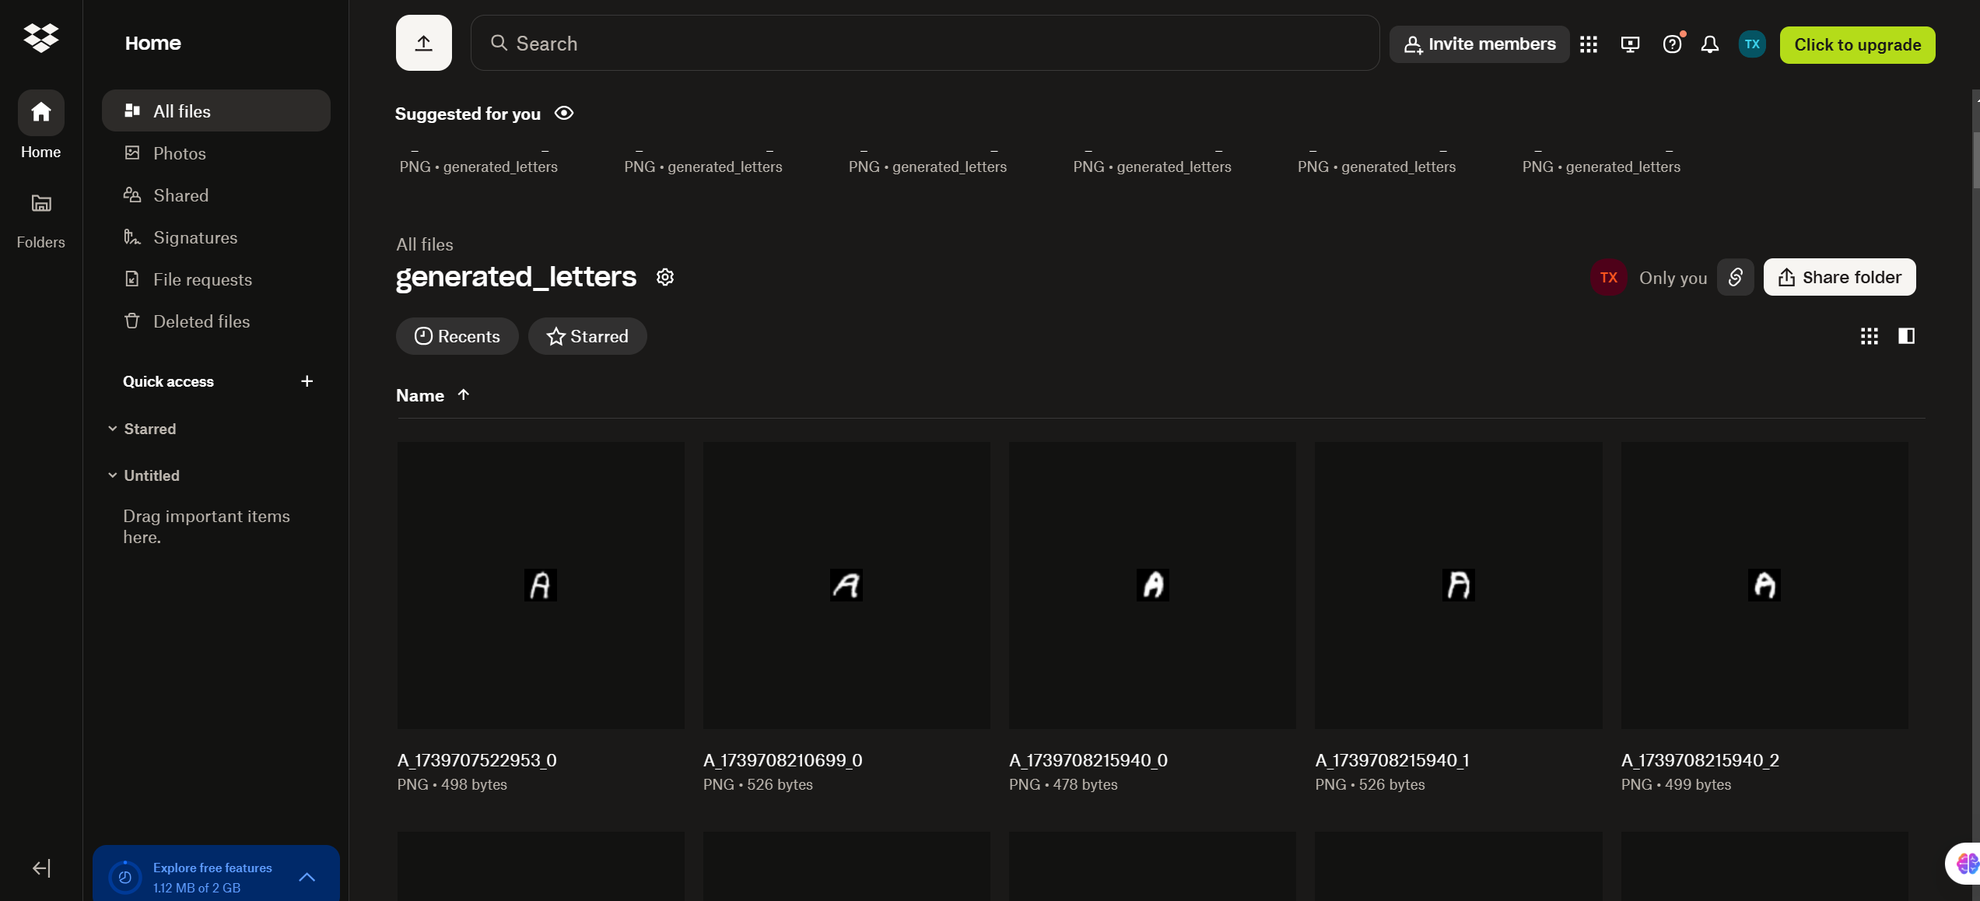
User table ^
History table ^
My database is hosted on Aiven. Image is stored as a Dropbox link that can be accessed. All images are stored on Dropbox in a generated letters folder.

