Slide 1


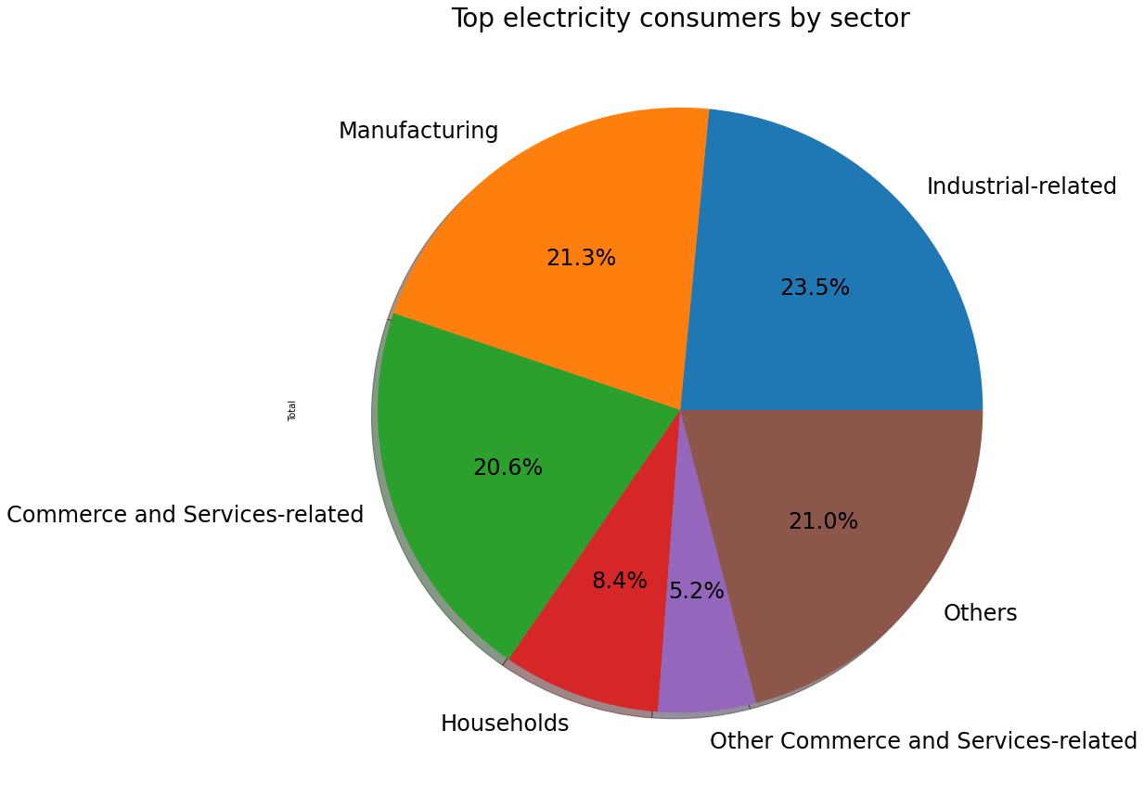
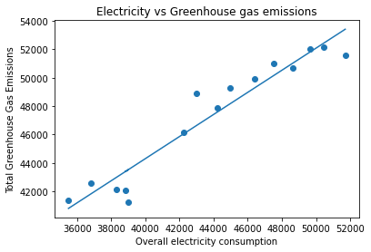
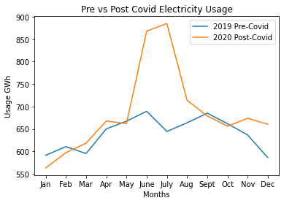
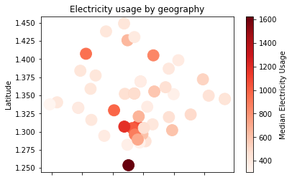
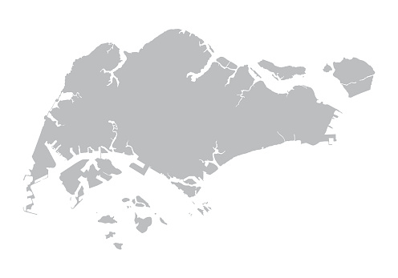
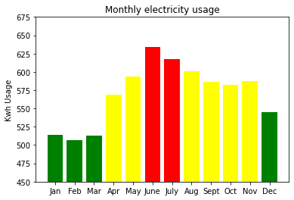
Should we be concerned with Singaporeans’ electricity consumption? How does it affect our environment and how should we address it?
Video Links (click on the name)
Chok Loong Kiat
Teo Yu Xuan
Chua Zhen Long
4. Sun Yanting
5. Sean Toh Shan Meng
Background
Correlation between electricity consumption and Greenhouse Gas Emissions
With the large amount of greenhouse gas emissions produced daily, it creates a drastic effect on our planet as our environment continues to worsen. Currently, climate change is an essential topic to address where it is imperative for everyone to play their part to save our environment.
Electricity production is the largest source of greenhouse gas emissions. From the chart on the right, we can observe that the total electricity consumption and total greenhouse emissions are highly correlated in Singapore. Yet, the use of electricity goes easily unnoticed – we do not give much thought into electricity usage when using appliances, as well as the long-term impact of these emissions. Thus, it is crucial to raise the awareness of electricity usage among Singaporeans, and to propose targeted solutions to tackle these issues.
As shown from the detailed breakdown of greenhouse gas emissions by industry, a concentration of efforts in reduction of electricity usage should be carried out in the Industrial-related sectors to achieve the biggest reduction in greenhouse gas emissions.
The industrial sector consists of Information Technology, Health Care and Communication services. Such sectors utilize large amounts of electricity in operation of servers and machinery. Hence, alternative sources can be advocated such as solar energy.
Due to the Covid-19 pandemic, many Singaporeans have resorted to working from home and led to a huge spike in electricity consumption in 2020. This is imperative where the consumption between June – Aug 2020 rose to a shocking overall consumption of 885GWh. Despite the lifting of Covid-19 measures from Sept 2020 onwards, the overall consumption is still higher as compared to before in 2019. As Covid-19 continues to remain prevalent in our lives, it is essential that we explore the trends and usage in Singapore to find targeted solutions and save our earth.
Recommendation 1: Targeted Marketing Strategy
According to data collected since 2005, the area with the highest electricity usage is Southern Island with a Median monthly usage of : 1625 Kwh. Other regions which have high usage of electricity includes Southern Singapore, Sungei Kadut, Punggol, Central Business District and Orchard.
Therefore, in order to streamline marketing efforts, these are the key areas that we should target in order to have properly high electricity users.
Since 2005, Singapore’s household electricity consumption greatly varies throughout the year. While the consumption between Jan – Mar falls within the healthy range, Singaporean households consume a much higher electricity usage for the rest of the year. A startling difference of approximately 127Kwh is present between June (highest) and February (lowest). Thus, greater initiatives and focus are needed between June and July to remind Singaporeans on the impact of electricity consumption on our mother Earth. This can be utilised through interactive social media engagement (e.g. Instagram stories) and increase awareness.

Slide 2
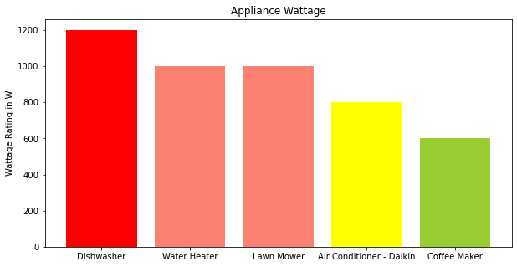
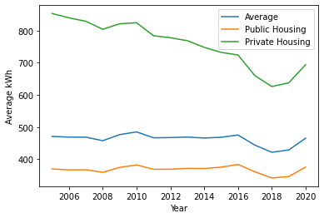
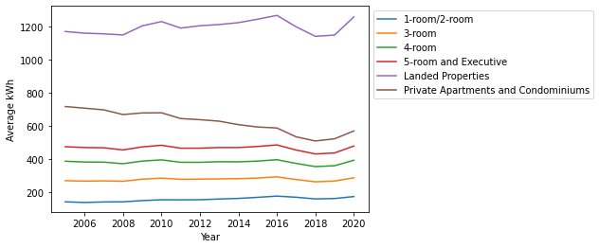
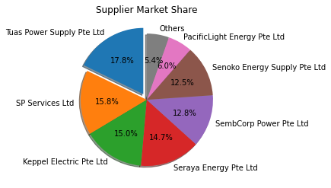
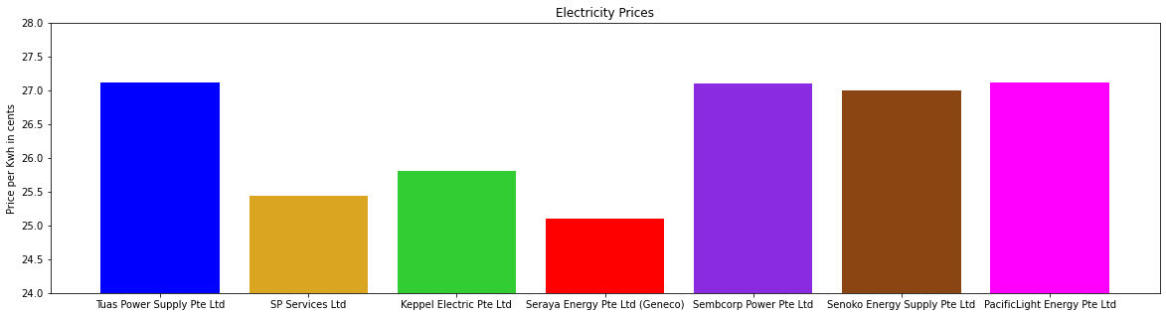
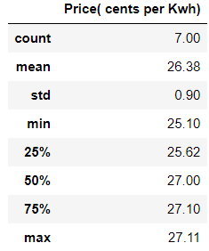
Across the appliances commonly owned in households, there’s a large variation in electricity consumption per appliances. As seen in the graph, the wattage used by dishwasher is approximately twice of coffee maker. While there’s a general marketing effort in encouraging consumers to reduce overall electricity consumption, it is far more effective to provide further suggestions in how consumers can play their part. Thus, marketing efforts can be employed to encourage consumers to take the first step by reducing usage for targeted appliances which utilises higher wattage, e.g. dishwasher. The targeted marketing campaign will create a much larger impact and is more effective in reducing overall electricity consumption. Marketing initiatives (e.g. #washyourownplates or #reduceby20%) can be implemented to create buzz and spread the word.
Proposed Solution: Overall Marketing Strategy
When are we promoting this marketing strategy?
Marketing should be conducted throughout the year, with added frequency during June and July.
Where would the marketing campaign be held?
We will be focusing on areas such as Sentosa, Central Business District, Orchard and Punggol, which are areas with high electricity usage.
Who is our target audience?
We plan to target Private Housing, particularly Landed Properties whom have shown to be the major contributor of electricity consumption in Housing
What are our objectives?
To focus on aspects including geographical components, monthly variances and appliances and spread awareness amongst consumers to reduce overall electrical consumptions accordingly.
Why the selection of this marketing strategy?
To customise our marketing initiative and produce targeted results
How are we planning to implement it?
Improving our marketing initiatives (E.g., #reduceby20%) and introducing alternative campaigns
Recommendation 2: Tiered Pricing Strategy
The total electricity consumption in private housing significantly exceeds that of public housing, despite having much lesser units. From the chart on the right, there is also a clear correlation between the size of the home and its electricity consumption. Thus, a targeted approach to reduce electricity consumption among those living in larger homes would be significantly reduce the overall nation’s electricity consumption. We believe that a tiered pricing strategy would be effective in achieving this objective. This is similar to the concept of a progressive tax rate, where the price of electricity increases with each tier of electricity consumed. We benchmark our pricing tiers through analysis of average of a 4-room household, private housing and condominium as a gauge. Through this tiered pricing strategy, this would incentivise residents in large homes to take greater initiatives in reducing electricity consumption.
Tuas Power Supply Pte Ltd has the highest market share amongst all the suppliers, with the top 4 market leaders owning more than 60% of market share. The oligopoly market structure introduces interdependence of firms and low pricing competitiveness across the firms. Thus, pricing strategies are often implemented throughout the market and companies follow suit. Therefore, it is definitely feasible to implement a tiered pricing strategy across the market to dissuade the households with high electricity usage.
Electricity prices implemented by the firms only vary within a small range from 25.10 cents/kwh to 27.11 cents/kwh, with a mere difference of 2.01 cents. This further supplements our analysis of the current market structure and its feasibility in implementing our tiered pricing strategies across the various firms.
Proposed Solution: Overall Pricing Strategy
What is our pricing strategy and how are we implementing it?
We will have a different and increasing electricity price for the first 350 kWh, the next 250 kWh, the next 250 kWh… and implement it across the market.
Who is our target audience?
This solution targets residents in larger homes (Private Housing, Landed Properties), incentivising them to reduce electricity consumption.
When are we implementing and where?
We propose implementing it across firms in the electricity consumption industry once firms tally the pricing strategy with their financials and budget planning.
Why the selection of this pricing strategy?
To utilise price discrimination to discourage residents from high electricity consumption while keeping it affordable for the general public.

