Slide 1
Voice messaging tool with speech-to-speech translation
Dmitry Lukyanov
Shivam Nahar
Anuja Patil

Slide 2
Team & Roles
Dmitry Lukyanov | Project & Engineering Manager
 | Solution Architect
 | DevOps Engineer
Shivam Nahar | Backend Engineer
 | QA Engineer
Anuja Patil | Frontend Engineer
 | Business Analyst

Slide 3
Big Bang
What
No structured process
No strict interdependencies between components development
System design is intermixed with implementation
Why
Short-term project
Requirements are clear and full from the beginning
No stable schedule
No stable engineering team that worked together before
Not enough time for all formal stages
Strict deadline

Slide 4
Purpose
A system that would allow people who do not speak the same language to communicate via voice messages.
Supports 15 languages.

Slide 5
Functionality (main)
Sign up / in
Onboarding
Name
Language
List of users
Conversations history
Record and send a voice message
Automatically translate a voice message to a voice message
Receive and listen to messages

Slide 6

Demo

Slide 7
Infrastructure
Main criteria - zero cost
AWS-heavy (free tier)
Serverless backend (Lambda) to not pay for k8s
PostgreSQL due to universality
S3 for media storage
Queues (SQS) for processes decoupling
Transcribe / Translate / Polly for translation
Amplify for CD and webhosting
CloudWatch for logs
Firebase for authentication (free under the limit)
Total cost - $2 for the domain

Slide 8
Architecture
Client
React + Redux
Backend
Serverless + Async + Decoupled
Client-agnostic API
Scalable
DB is a potential bottleneck
Testable
Separate pieces

Slide 9
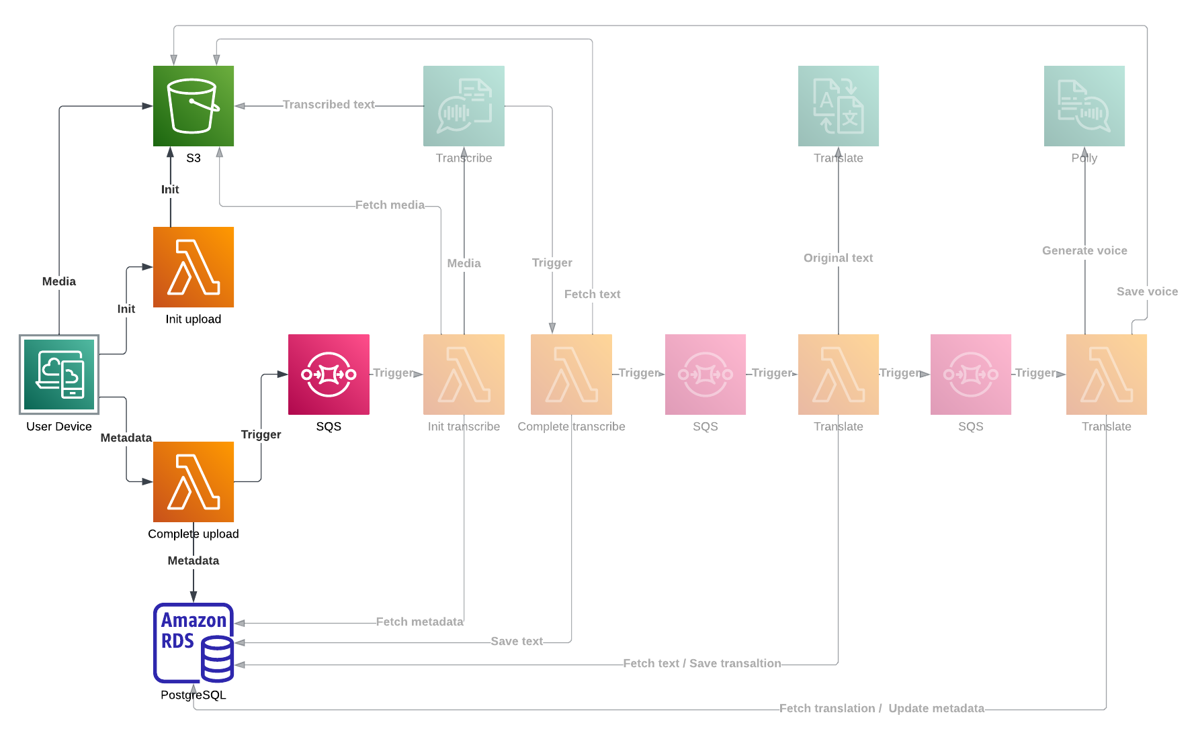
Architecture (main flow)

Slide 10
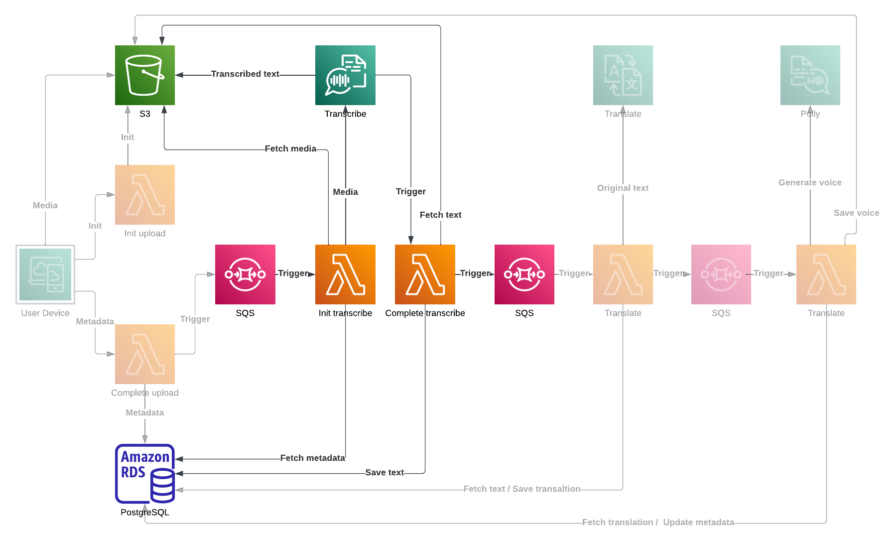
Architecture (main flow)

Slide 11
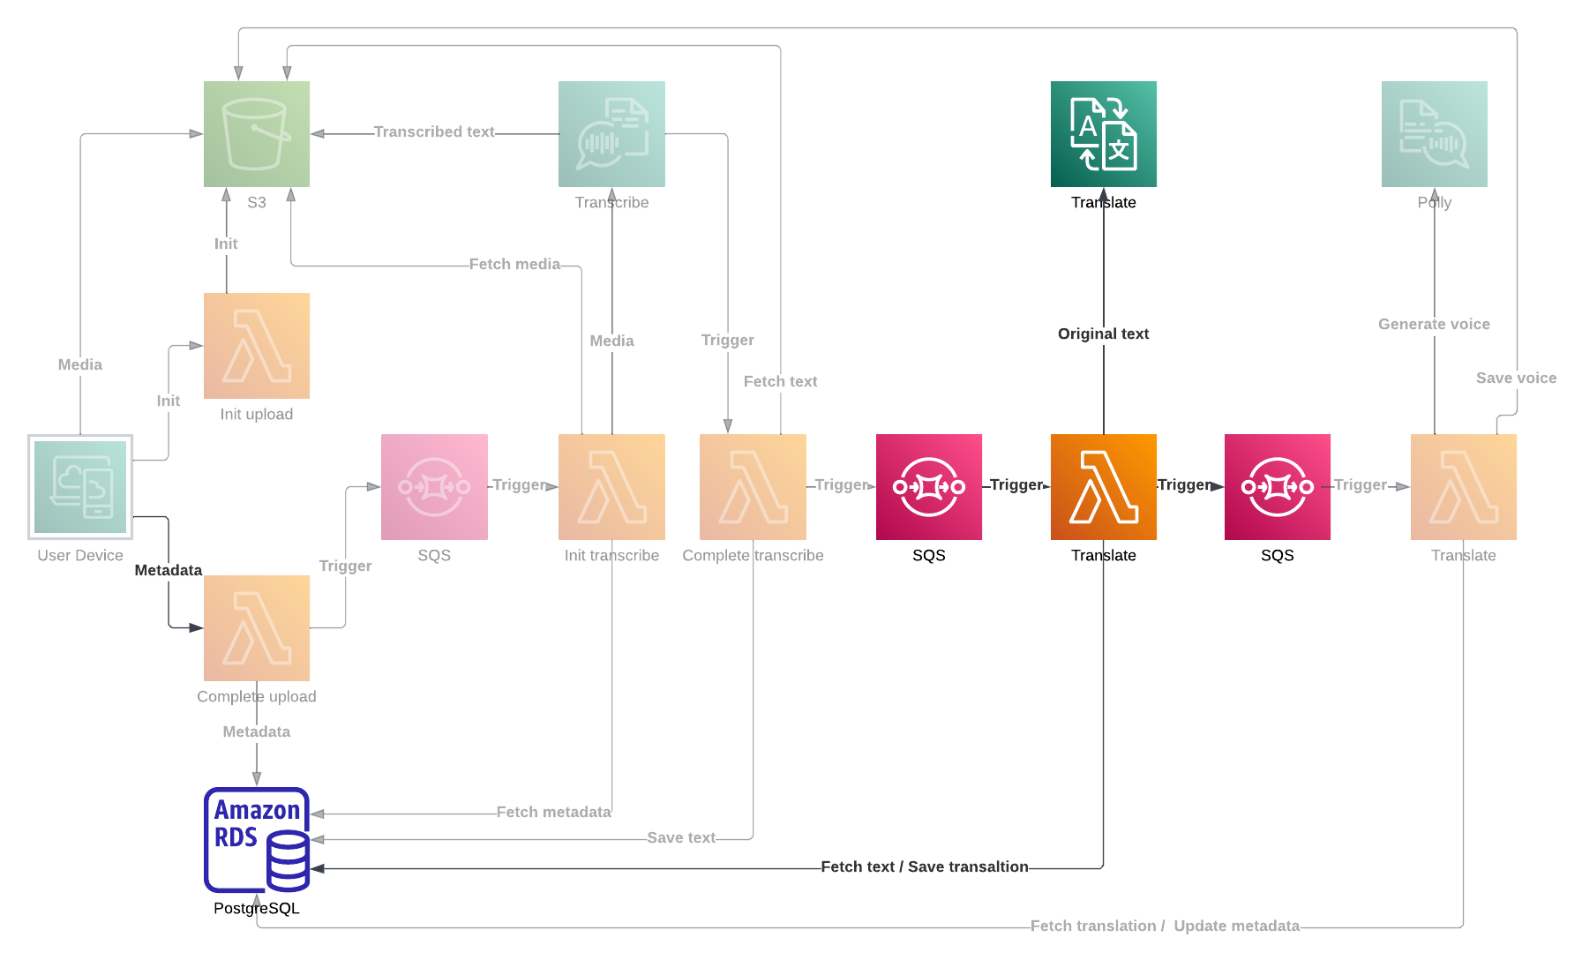
Architecture (main flow)

Slide 12
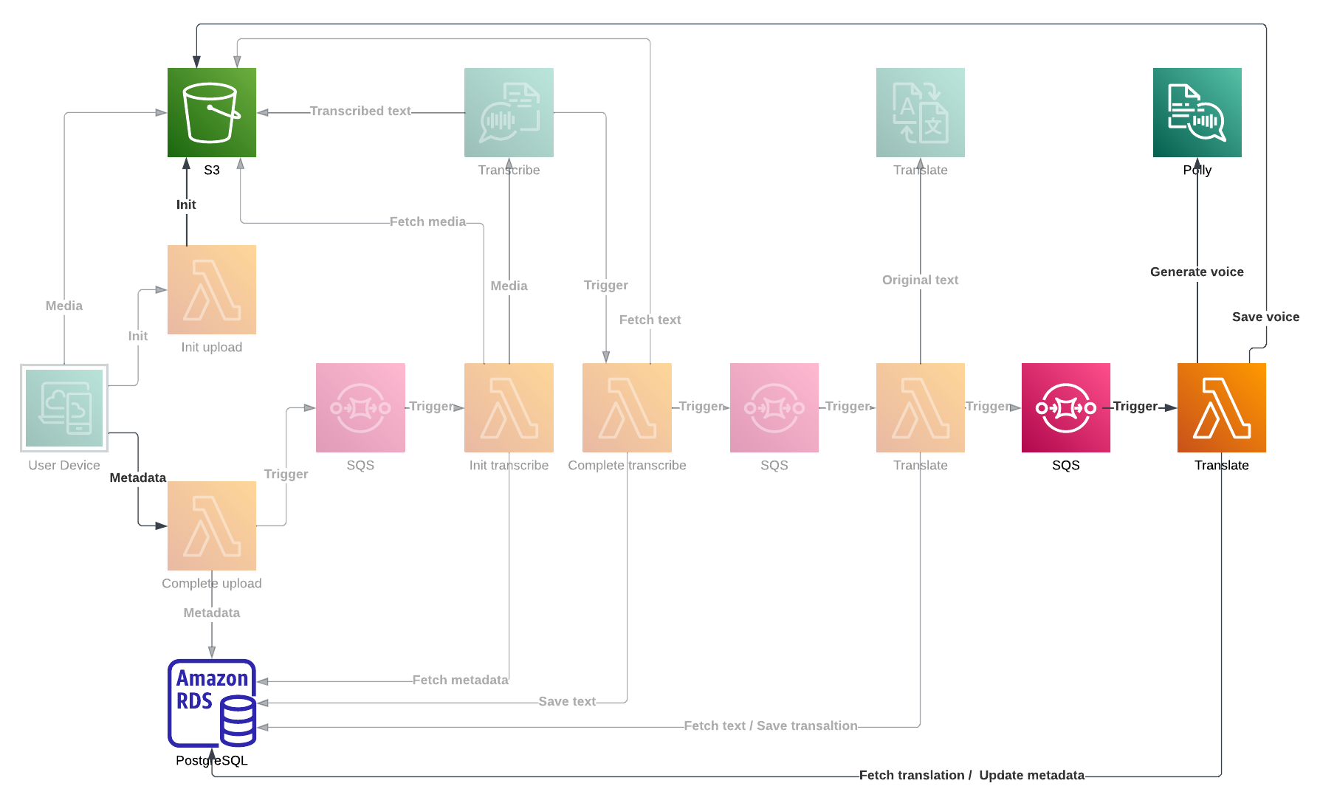
Architecture (main flow)

Slide 13
Takeaways
Played with AWS AI tools
Played with AWS Amplify
Mostly used TeamCity + k8s before
Played with AWS Lambda
Mostly used traditional microservices before
Obtained lingua.lol domain

Slide 14
Potential improvements
Architecture
Security is limited
Websockets with UI auto-updates for better UX
Recovery message processing in the case of failure
User stories
Listen to a message before sending
Group chats
Search within voice messages

Slide 15
Networking time
Feel free to connect on LinkedIn
Dmitry Lukyanov
Shivam Nahar
Anuja Patil

