Slide 1
Advanced Machine Learning
MLEARN 520 – Lesson 7

Slide 2
Motivation: Harnessing Big Text Data
Internet
News
Literature
Blogs Knowledge Many applications
Email
Twitter
Etc.
Gaining Intuition:
I’m given a task. What approach will work?

Slide 3
Main approaches in NLP
Rule-based methods
Regular expressions
Context free grammar
Probabilistic modelling and machine learning
Linear classifiers
Likelihood maximization
Deep Learning
CNN, RNN, LSTM, etc.

Slide 4
Examples (rule-based methods)
Semantic slot filling
Context free grammar
Parsing

Slide 5
Examples (traditional ML based methods)
Training corpus (with some markups)
Feature engineering
- Is the word capitalized?
- What are the previous words?
- etc…
Define a Probabilistic graphical model
Conditional Random Field: p(tags|words)

Slide 6
Text classification
Example: sentiment analysis
Input: text of review
Output: class of sentiment (e.g. positive vs negative)

Slide 7
Text preprocessing
What is text?
Sequence of words
What is a word?
A single distinct meaningful element of speech or writing, used with others (or sometimes alone) to form a sentence and typically shown with a space on either side when written or printed (Ref: Oxford dictionary).
Input: The dog ate the fish, then took a nap.
Output: The dog ate the fish then took a nap

Slide 8
Text preprocessing
German has some compound words which are written without space
rindfleischetikettierungsüberwachungsaufgabenübertragungsgesetz
that's 63 letters long meaning "the law for the delegation of monitoring beef labeling.”
In Chinese there are no spaces at all!
如果你能看懂这句话那么你的中文很厉害！

Slide 9
Tokenization
Process that split an input sequence into tokens
Tokens are useful unit for semantic processing (can be a word, sentence, paragraph, etc.)
Example:

Slide 10
Token normalization
Process of canonicalizing tokens so that matches occur despite superficial differences in the character sequences of the tokens
Dog, dogs dog
Wife, wives wife
Stemming
A process of removing and replacing suffixes to get to the root form of the word, called a stem
Lemmatization
return the base or dictionary form of a word, which is known as the lemma

Slide 11
Example (stemmer)
Rule Example
SSES → SS caresses → caress
IES → I ties → ti
SS → SS caress → caress
S → cats → cat
Problem: fails on irregular forms & produces non words
Notes:
Ref: https://www.nltk.org/_modules/nltk/stem/porter.html

Slide 12
Example (lemmatization)
WordNet lemmatizer
Uses the WordNet database to lookup lemmas
churches → church dogs → dog
Wolves → wolf maximum → maximum
Problem: not all words are reduced
Notes:
Takeaway: we need to try stemming or lemmatization and choose depending on use case.

Slide 13
Tokens to features
Most common ways to extract numerical features from text content
tokenizing strings and giving an integer id for each possible token, for instance by using white-spaces and punctuation as token separators.
counting the occurrences of tokens in each document.
normalizing and weighting with diminishing importance tokens that occur in the majority of samples / documents.
Ref: http://scikit-learn.org/stable/modules/feature_extraction.html

Slide 14
Tokens to features
Most common ways to extract numerical features from text content
tokenizing strings and giving an integer id for each possible token, for instance by using white-spaces and punctuation as token separators.
counting the occurrences of tokens in each document.
normalizing and weighting with diminishing importance tokens that occur in the majority of samples / documents.
In this scheme, features and samples are defined as follows:
each individual token occurrence frequency (normalized or not) is treated as a feature.
the vector of all the token frequencies for a given document is considered a multivariate sample.
A corpus of documents can thus be represented by a matrix with one row per document and one column per token (e.g. word) occurring in the corpus.
Ref: http://scikit-learn.org/stable/modules/feature_extraction.html

Slide 15
Tokens to features
Great instructor
Not a great instructor
Do not like
great | instructor | not | a | do | like
1 | 1 | 0 | 0 | 0 | 0
1 | 1 | 1 | 1 | 0 | 0
0 | 0 | 1 | 0 | 1 | 1
Limitations:
Word orders is lost hence BOW cannot capture phrases and multi-word expressions
BOW model doesn’t account for potential misspellings or word derivations.

Slide 16
Tokens to features
N-grams
Instead of building a simple collection of unigrams (n=1), one might prefer a collection of bigrams (n=2), where occurrences of pairs of consecutive words are counted.
Great instructor | instructor | Do not | a | Not like | …
1 | 1 | 0 | 0 | 0 | …
1 | 1 | 0 | 1 | 0 | …
0 | 0 | 1 | 0 | 1 | …
Great instructor
Not a great instructor
Do not like

Slide 17
Tokens to features
Reduce the number of features in n-grams
High frequency n-grams (e.g. stop words)
Low frequency n-grams (e.g. typos)
Medium frequency n-grams are usually good n-grams
Problem: If we were to feed the direct count data directly to a classifier very frequent terms would shadow the frequencies of rarer yet more interesting terms. Therefore we need to re-weight the count features into floating point values suitable for usage by a classifier

Slide 18

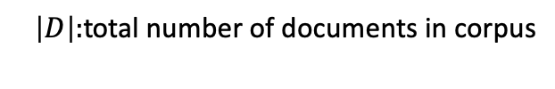
Tokens to features
TD-IDF term weighting
tf–idf stands for term-frequency inverse document-frequency
tf-idf(t,d) = tf(t,d) x idf(t)
tf(t,d): frequency for term (or n-gram) t in document d
idf(t,D)$=log⁡(|D|/|\left\{d∈D:t∈d\right\}|$
$\left|D\right|:$total number of documents in corpus
$|\left\{d∈D:t∈d\right\}|$ : number of documents where the term t appears

Slide 19
END

Slide 20
Language modeling
Assign a probability to a sentence
Why?
Machine translation (e.g. P(the average probability) > P(the mean probability))
Spell correction (e.g. P(I’m enjoying this class) > P(I’m enjoiing this class))
Speech recognition (e.g. P(I’m gonna take a walk)> P(am gonna take a wok)
Handwriting recognition
Etc.

Slide 21
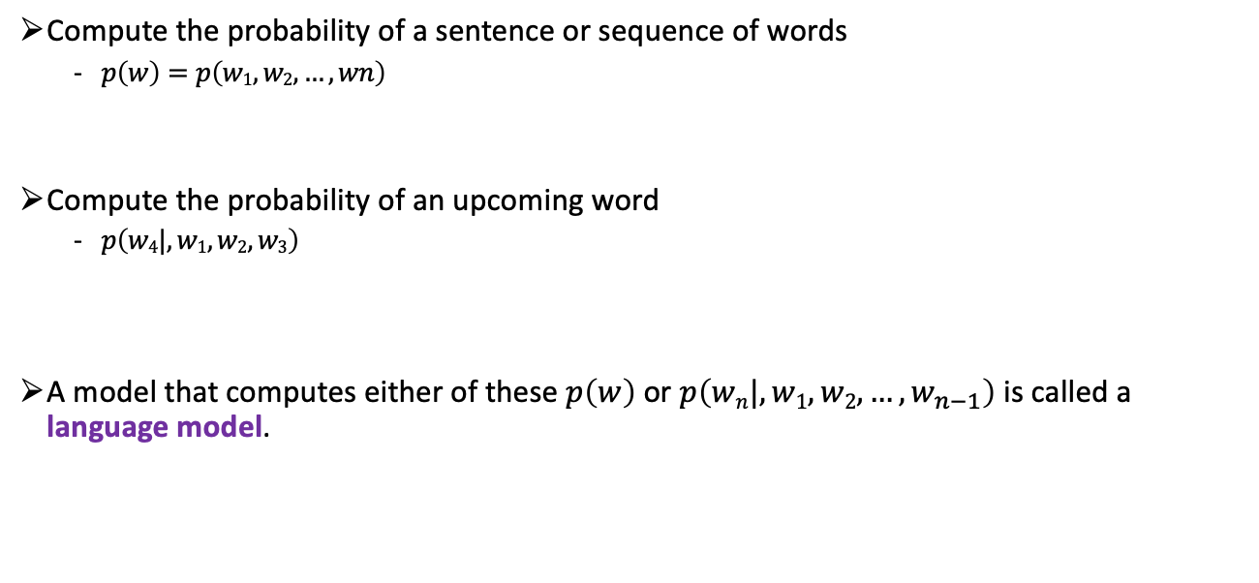
Language modeling
Compute the probability of a sentence or sequence of words
$p\left(w\right)=p\left(w1,w2,…,wn\right)$
Compute the probability of an upcoming word
$p\left(w4|,w1,w2,w3\right)$
A model that computes either of these $p\left(w\right)$ or $p\left(wn|,w1,w2,…,w_{n−1}\right)$ is called a language model.

Slide 22
Example
Toy corpus
This is the house that Jack built.
This is the malt
That lay in the house that Jack built.
This is the rat,
That ate the malt
That lay in the house that Jack built.
This is the cat,
That killed the rat,
That ate the malt
That lay in the house that Jack built.
What is P(house | this is the) ?

Slide 23

Example
$p\left(house | this is the\right)= \frac{c(this is the house)}{c(this is the …)}=\frac{1}{4}$
$p\left(Jack | that\right)= \frac{c(that Jack)}{c(that …)}=\frac{4}{10}$

Slide 24
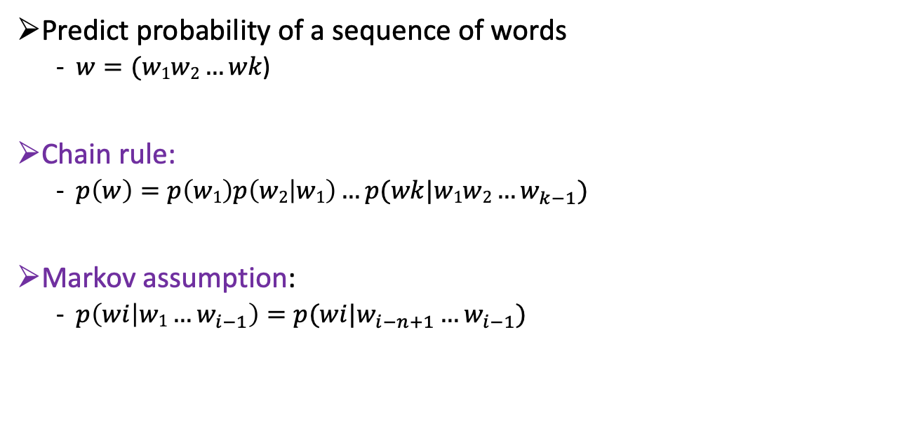
Language modeling intuition
Predict probability of a sequence of words
$w=(w1w2…wk$)
Chain rule:
$p\left(w\right)=p\left(w1\right)p\left(w2 | w1\right)…p(wk|{w1w2…w}_{k−1})$
Markov assumption:
$p\left(wi | w1…w_{i−1}\right)=p(wi|w_{i−n+1}…w_{i−1})$

Slide 25
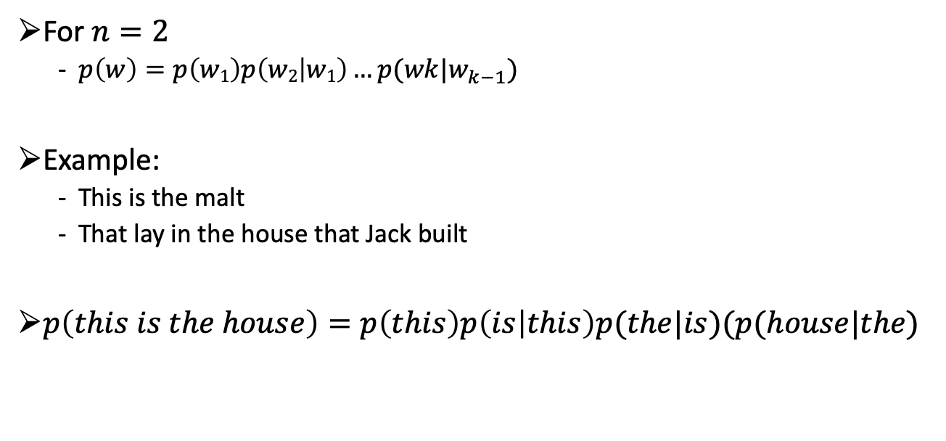
Bigram language model
For $n=2$
$p\left(w\right)=p\left(w1\right)p\left(w2 | w1\right)…p(wk|w_{k−1})$
Example:
This is the malt
That lay in the house that Jack built
$p\left(this is the house\right)=p\left(this\right)p\left(is | this\right)p(the|is)(p(house|the)$

Slide 26

Bigram language model summarized
Define the model
$p\left(w\right)=\prod_{i=1}^{k+1}{p(wi|w_{i−1}})$
Estimate the probabilities:
$p\left(w_{i} | w_{i−1}\right)=\frac{c(w_{i−1}w_{i})}{\sum_{wi}{c(w_{i−1}w_{i})}}=\frac{c(w_{i−1}w_{i})}{c(w_{i−1})}$

Slide 27
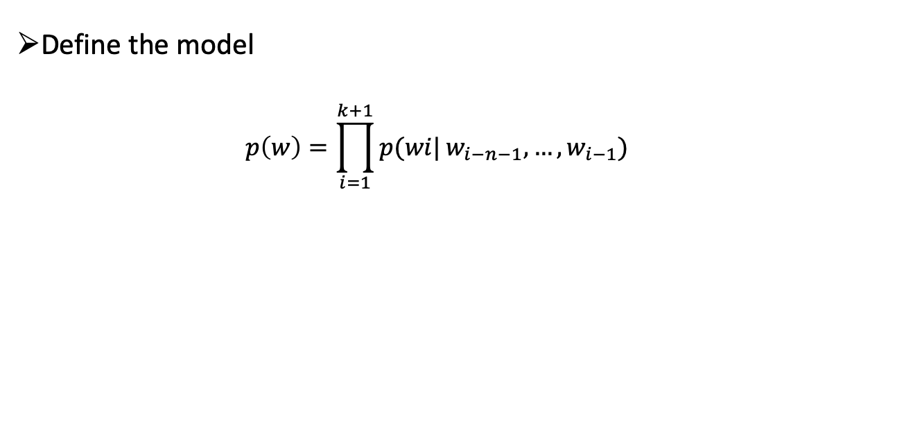
N-gram language model summarized
Define the model
$$p\left(w\right)=\prod_{i=1}^{k+1}{p(wi|}w_{i−n−1},…,w_{i−1})$$

Slide 28
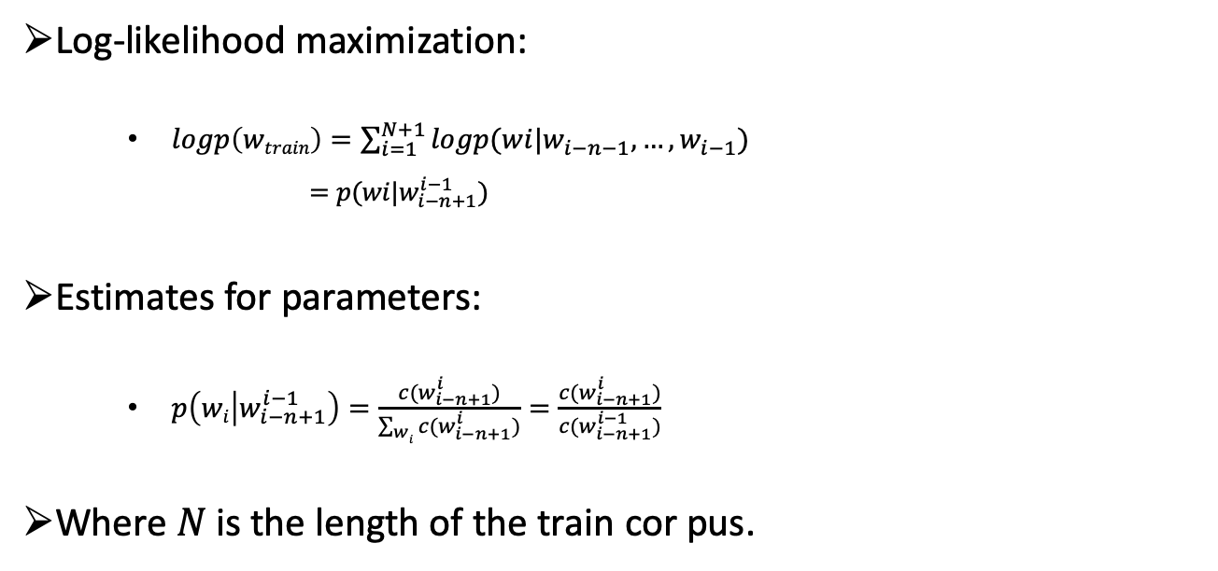
How to train n-gram models
Log-likelihood maximization:
$logp\left(wtrain\right)=\sum_{i=1}^{N+1}{logp(wi|w_{i−n−1},…,w_{i−1})}$
$=p(wi|w_{i−n+1}^{i−1})$
Estimates for parameters:
$p\left(wi | w_{i−n+1}^{i−1}\right)=\frac{c(w_{i−n+1}^{i})}{\sum_{wi}{{c(w}_{i−n+1}^{i})}}=\frac{c(w_{i−n+1}^{i})}{c(w_{i−n+1}^{i−1})}$
Where $N$is the length of the train cor pus.

Slide 29
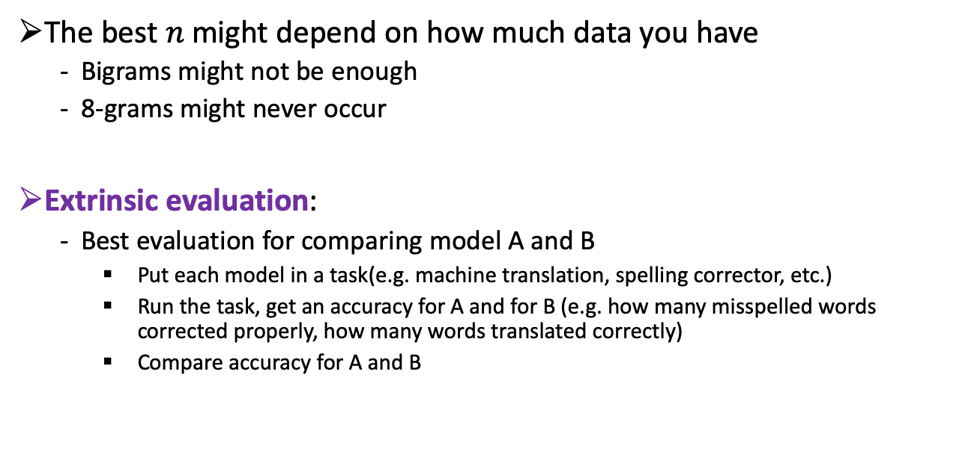
Evaluating Language Models
The best $n$ might depend on how much data you have
Bigrams might not be enough
8-grams might never occur
Extrinsic evaluation:
Best evaluation for comparing model A and B
Put each model in a task(e.g. machine translation, spelling corrector, etc.)
Run the task, get an accuracy for A and for B (e.g. how many misspelled words corrected properly, how many words translated correctly)
Compare accuracy for A and B

Slide 30
Evaluating Language Models
Extrinsic evaluation:
Time-consuming (can take days, weeks, etc.)
How to address that?
Use intrinsic evaluation: perplexity
Perplexity is the inverse of the probability of the test set (as assigned by the language model), normalized by the number of word tokens in the test set.

Slide 31
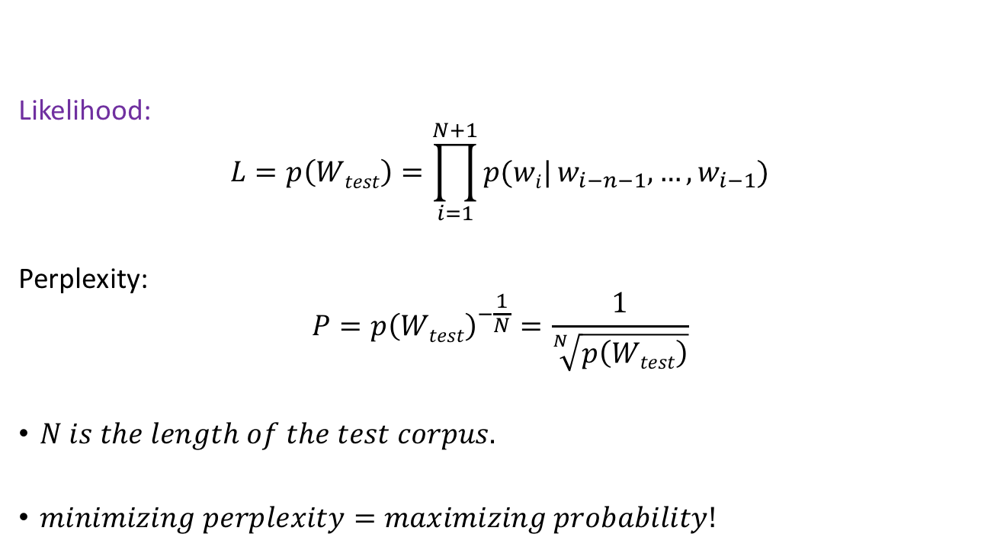
Evaluating Language Models
Likelihood:
$$L=p\left(Wtest\right)=\prod_{i=1}^{N+1}{p(wi|}w_{i−n−1},…,w_{i−1})$$
Perplexity:
$$P={p\left(Wtest\right)}^{−\frac{1}{N}}=\frac{1}{\sqrt[N]{p\left(Wtest\right)}}$$
$N is the length of the test corpus.$
$minimizing perplexity=maximizing probability!$

